Slide 1
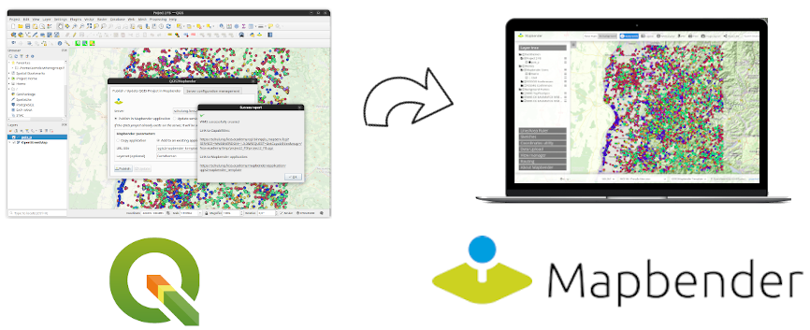
QGIS2Mapbender QGIS Plugin
Publish your QGIS Project directly in Mapbender
Astrid Emde WhereGroup | FOSS4G Europe 2025 | Mostar | Bosnia-Herzegovina
Slides https://github.com/astroidex/presentations/tree/master/FOSS4G-Europe-2025

Slide 2

Astrid Emde
GIS-Consultant
FOSS-Academy-Schulungen
Mapbender PSC
OSGeoLive PSC
QGIS-DE
OSGeo
FOSSGIS e.V.
astrid.emde@wheregroup.com
WhereGroup GmbH
Standort Bonn
Astrid Emde
GIS-Consultant
FOSS-Academy Trainings
Mapbender PSC & technical Lead
OSGeoLive PSC
QGIS-DE
OSGeo
FOSSGIS e.V.
astrid.emde@wheregroup.com
WhereGroup GmbH
Bonn

Slide 3
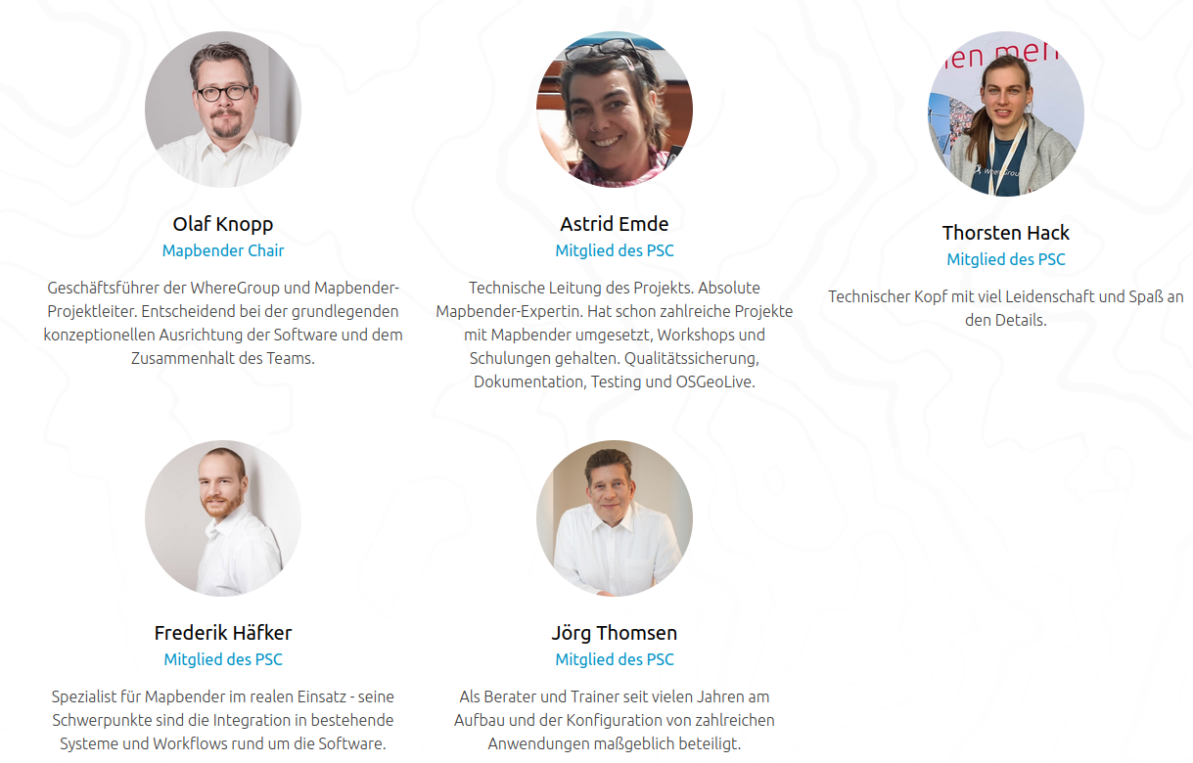

Mapbender PSC

Slide 4
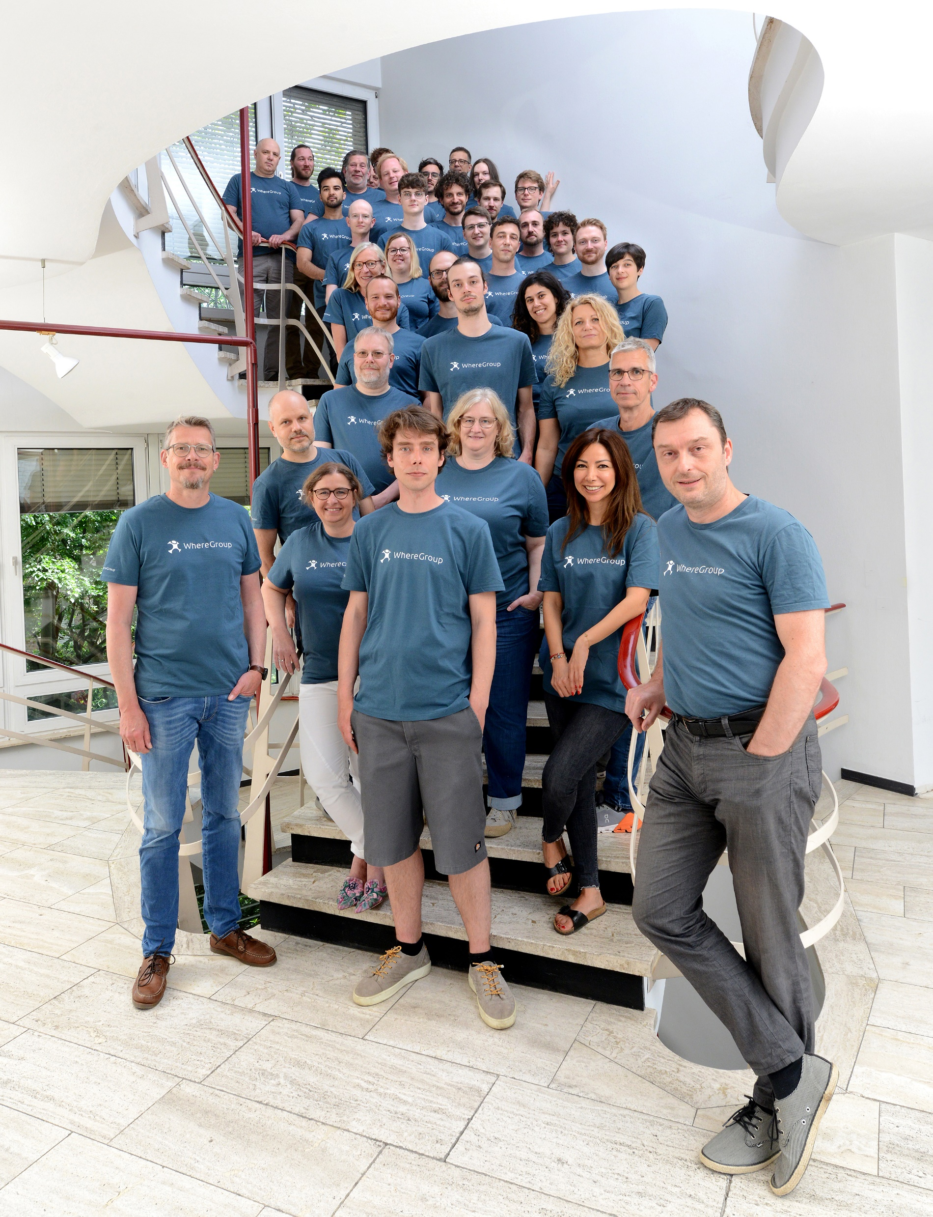
WhereGroup
50 employees - developers, consultants & geospatial experts
Working with & supporting Open Source Geospatial Software for more than 15 years
Berlin | Bonn | Freiburg | Hamburg
FOSSGIS e.V. member & OSGeo sponsor
Company behind Mapbender & MapComponents
Training Institute FOSS Academy

Slide 5
QGIS2Mapbender
Bridge between QGIS Desktop – QGIS Server – Mapbender
QGIS Plugin
Idea and developmet started in 2024
Uses Mapbender API, needs Mapbender >= 4.1.3

Slide 6
QGIS2Mapbender
QGIS-Project
Transfer via QGIS2Mapbender
QGIS Server WMS
Publish /
Update in Mapbender
Create your QGIS project
via Mapbender API
QGIS-Project & Data ready to use as QGIS Server Service
Use the WMS in Mapbender
Assign WMS to an application & layerset

Slide 7
QGIS2Mapbender Requirements
Needs Mapbender Version 4.1.3
Plugin needs link to QGIS Server and Mapbender
Needs Mapbender user with sufficiant rights
Plugin needs additional configuration for Mapbender and Apache
QGIS Server needs access to the Mapbender upload directory
https://github.com/WhereGroup/QGIS2Mapbender/blob/main/README.md
https://plugins.qgis.org/plugins/qgis2mapbender/

Slide 8
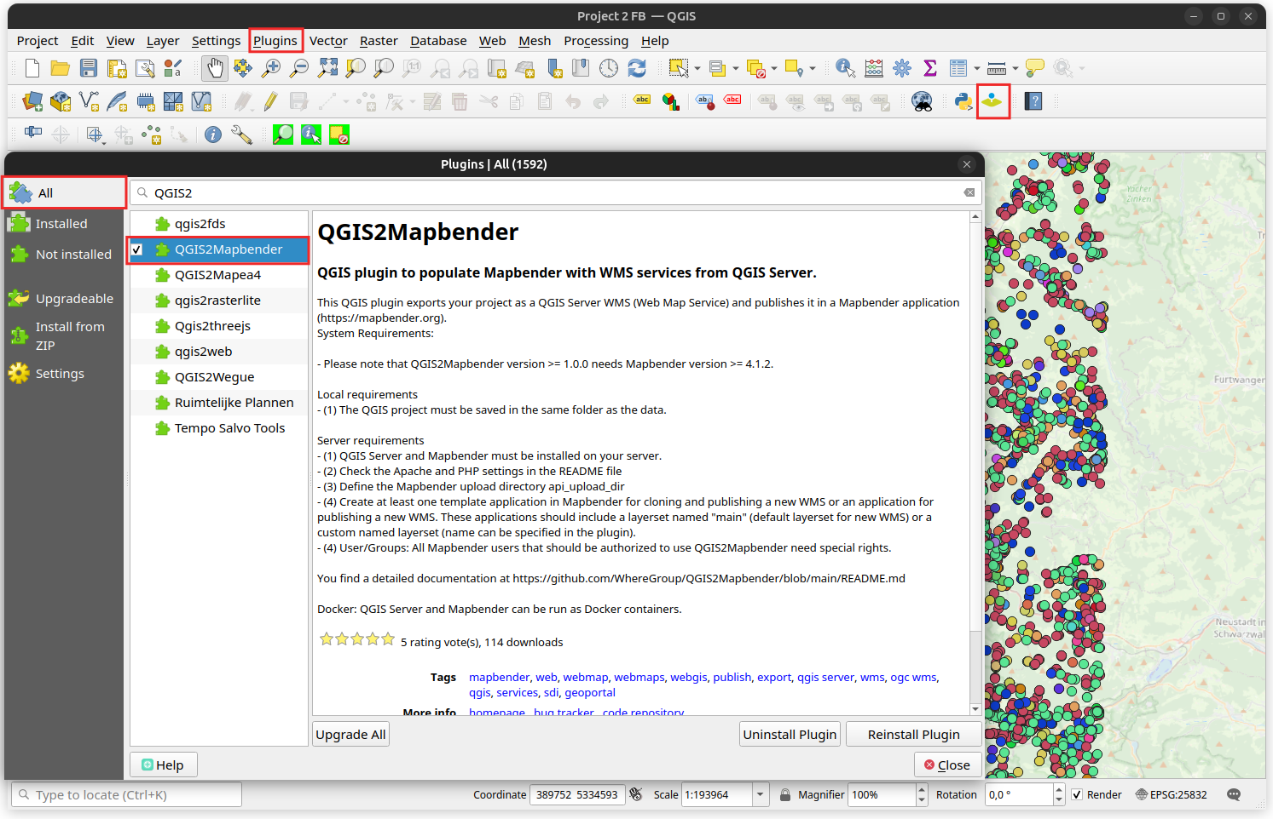


Notes:
2024 4.0
Juli 2023 3.3.5
May 2023 3.3.4
Dez 2022 3.3.2
Nov 2022 3.3.1
April 2022

Slide 9
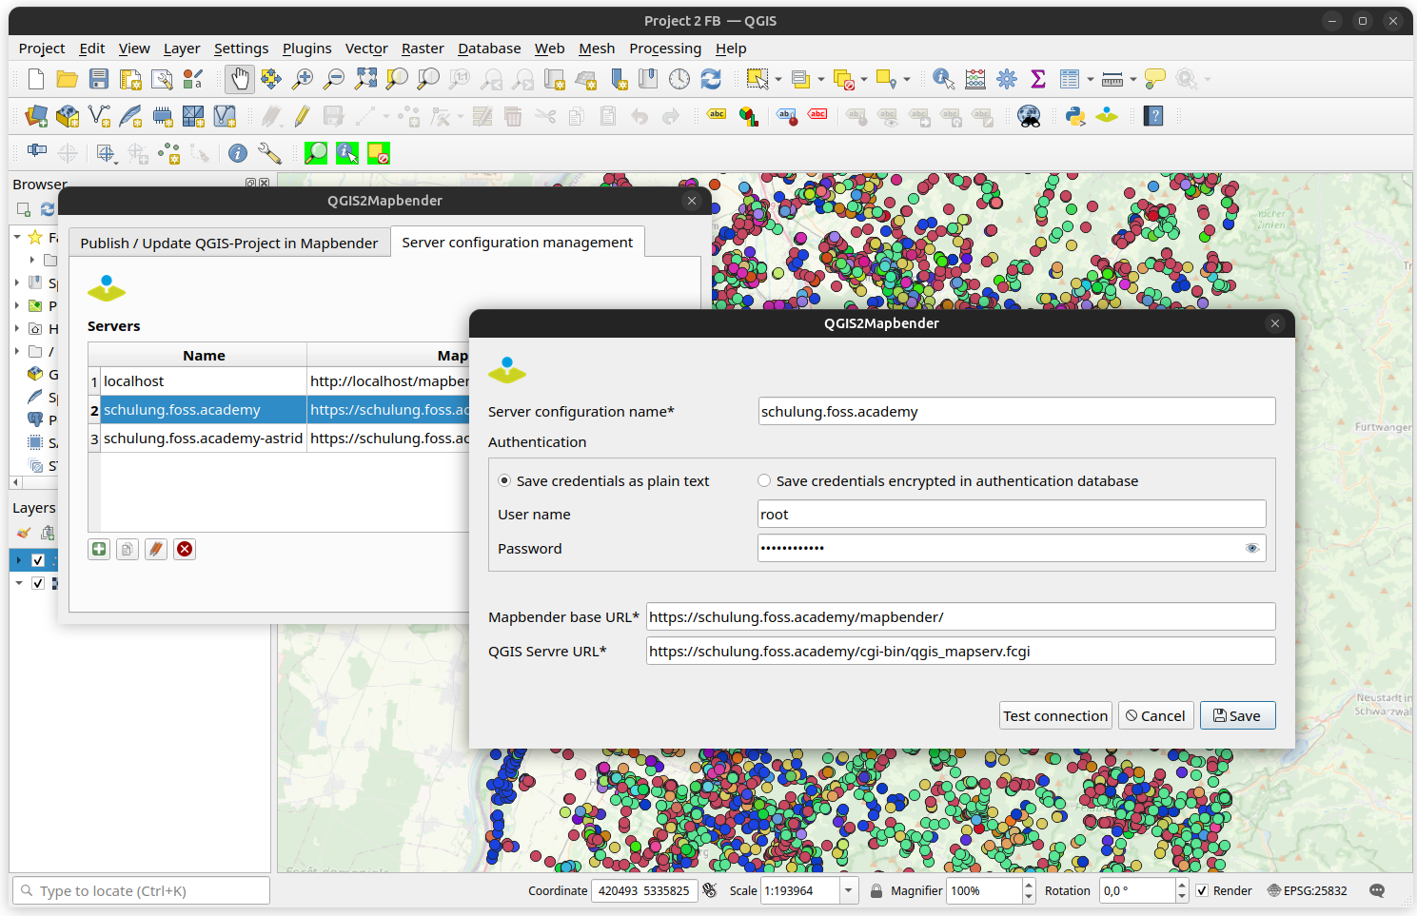
Notes:
2024 4.0
Juli 2023 3.3.5
May 2023 3.3.4
Dez 2022 3.3.2
Nov 2022 3.3.1
April 2022

Slide 10
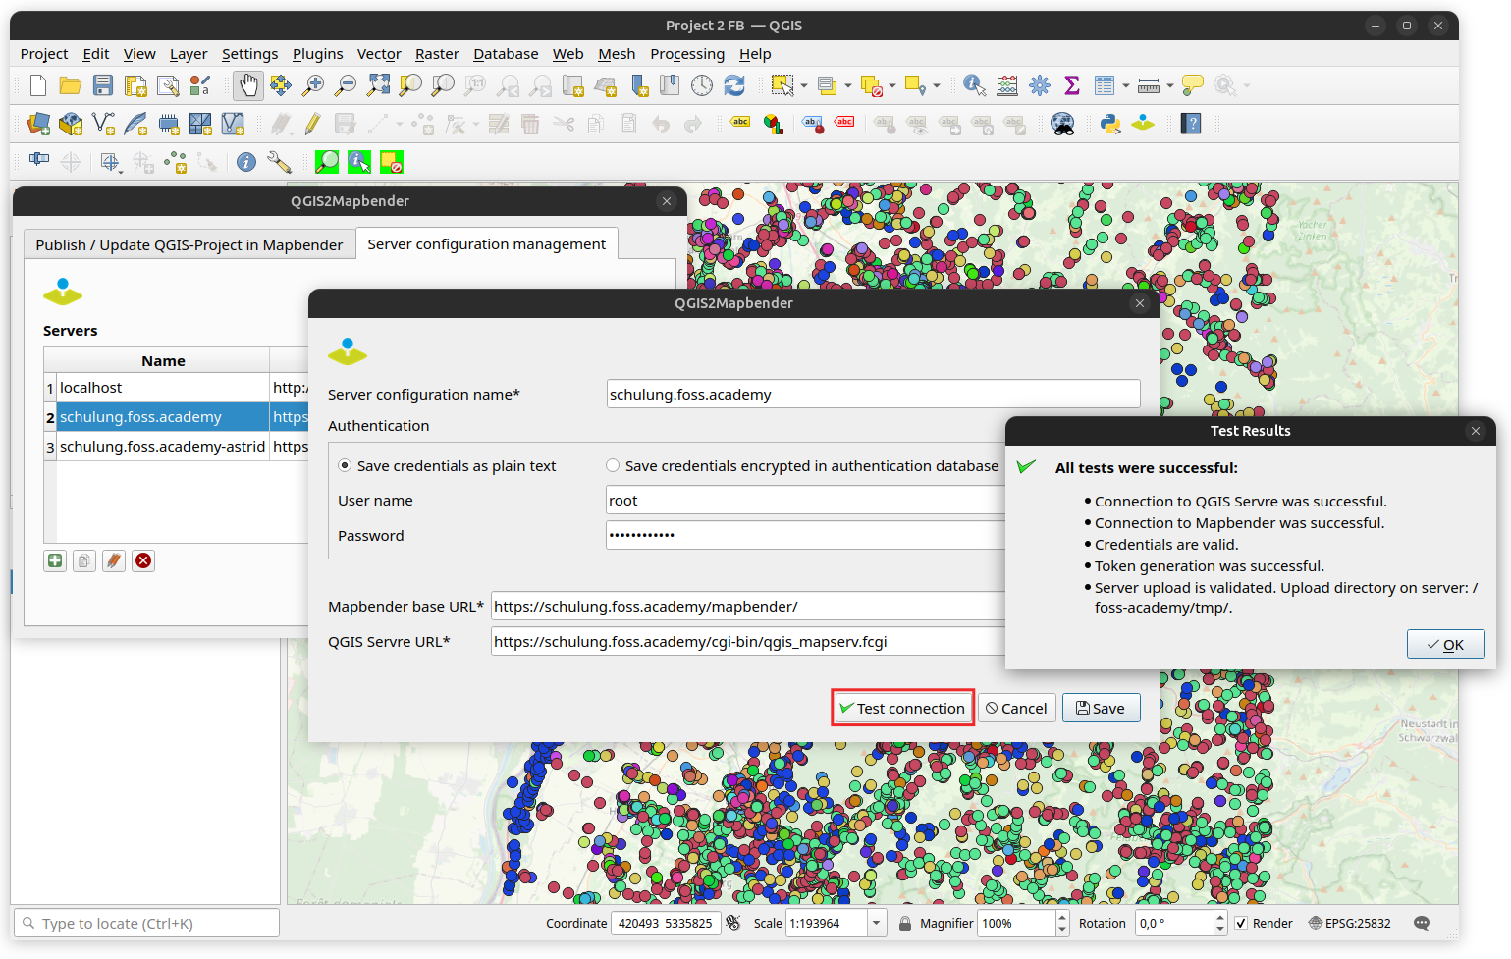
Notes:
2024 4.0
Juli 2023 3.3.5
May 2023 3.3.4
Dez 2022 3.3.2
Nov 2022 3.3.1
April 2022

Slide 11
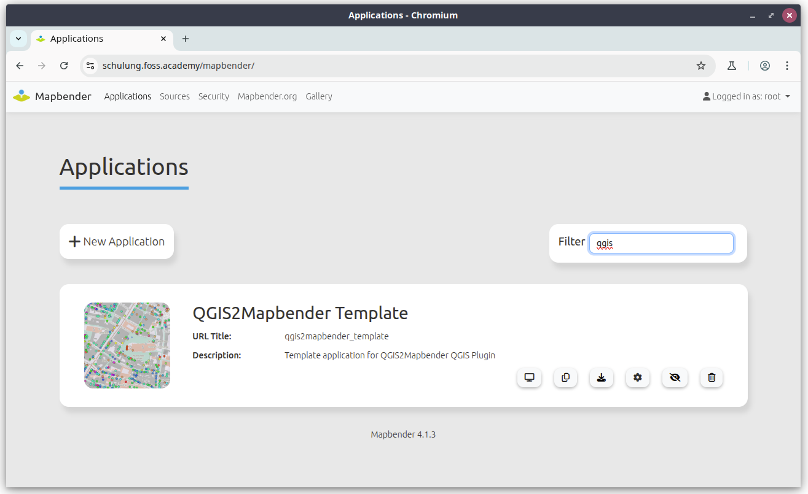
Notes:
2024 4.0
Juli 2023 3.3.5
May 2023 3.3.4
Dez 2022 3.3.2
Nov 2022 3.3.1
April 2022

Slide 12
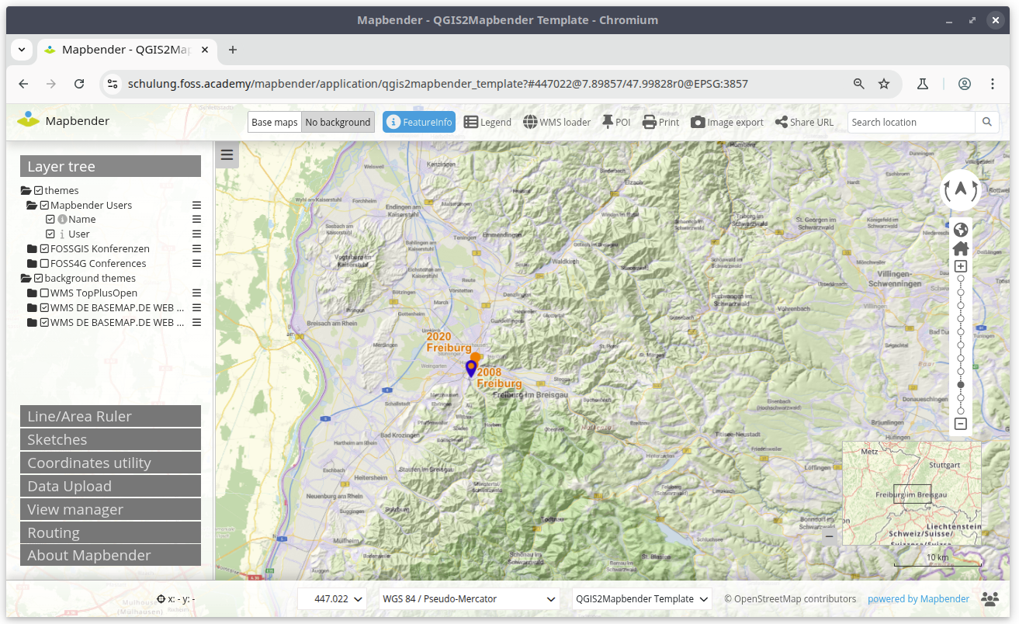
Notes:
2024 4.0
Juli 2023 3.3.5
May 2023 3.3.4
Dez 2022 3.3.2
Nov 2022 3.3.1
April 2022

Slide 13
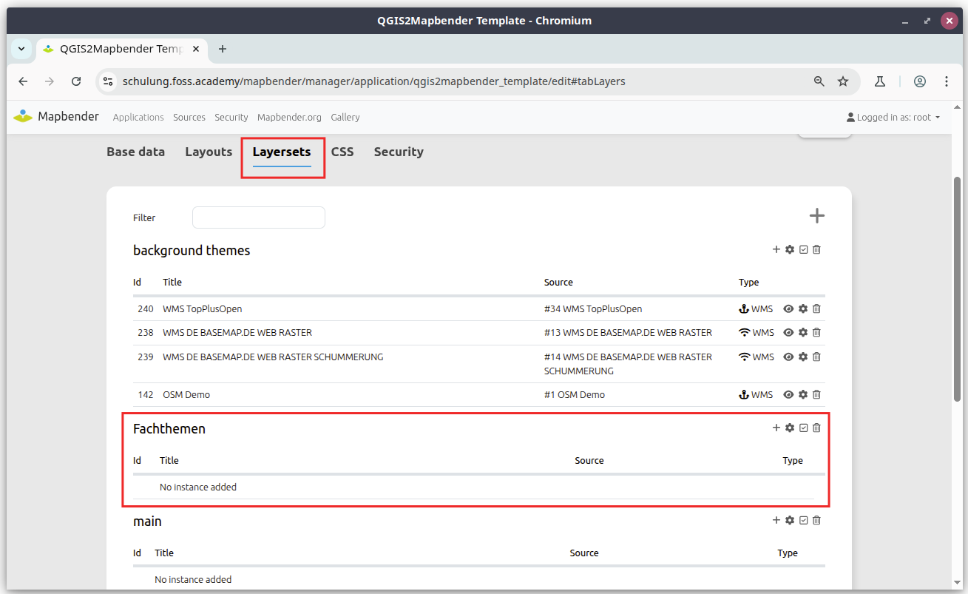
Notes:
2024 4.0
Juli 2023 3.3.5
May 2023 3.3.4
Dez 2022 3.3.2
Nov 2022 3.3.1
April 2022

Slide 14
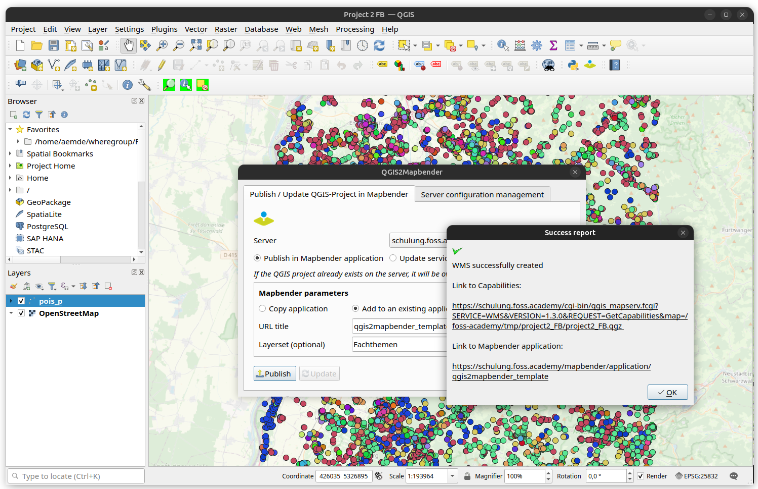
Notes:
2024 4.0
Juli 2023 3.3.5
May 2023 3.3.4
Dez 2022 3.3.2
Nov 2022 3.3.1
April 2022

Slide 15
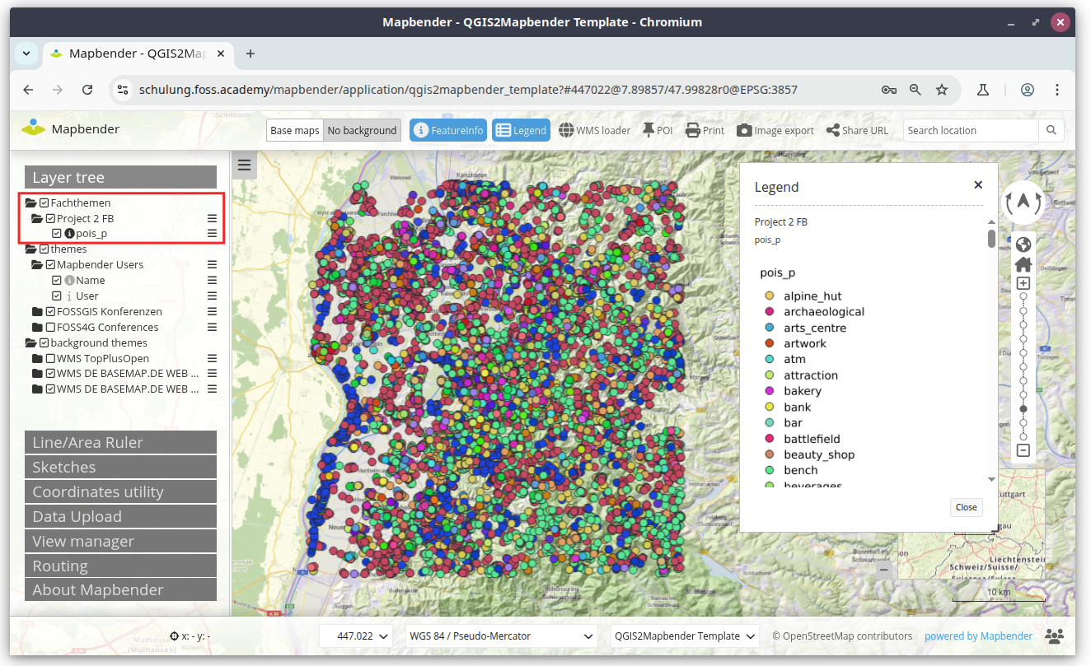
Notes:
2024 4.0
Juli 2023 3.3.5
May 2023 3.3.4
Dez 2022 3.3.2
Nov 2022 3.3.1
April 2022

Slide 16
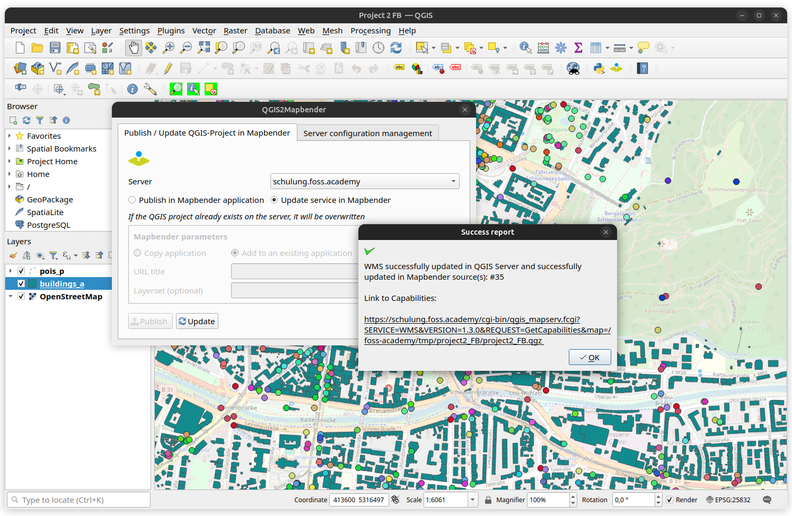


Notes:
2024 4.0
Juli 2023 3.3.5
May 2023 3.3.4
Dez 2022 3.3.2
Nov 2022 3.3.1
April 2022

Slide 17
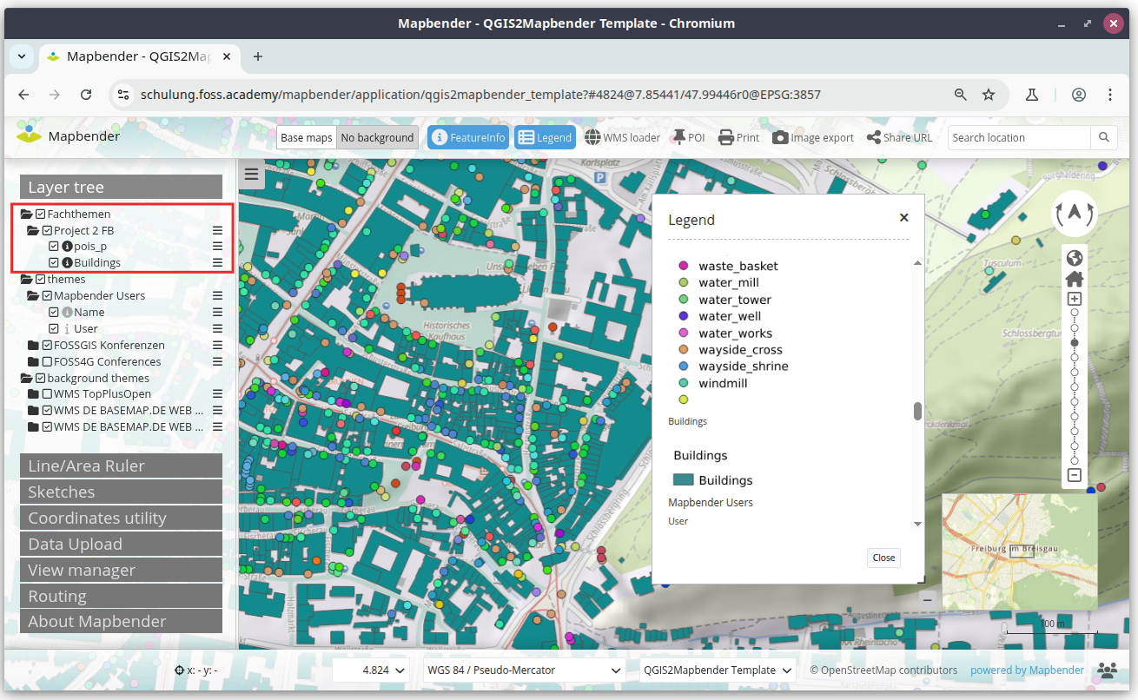
Notes:
2024 4.0
Juli 2023 3.3.5
May 2023 3.3.4
Dez 2022 3.3.2
Nov 2022 3.3.1
April 2022

Slide 18
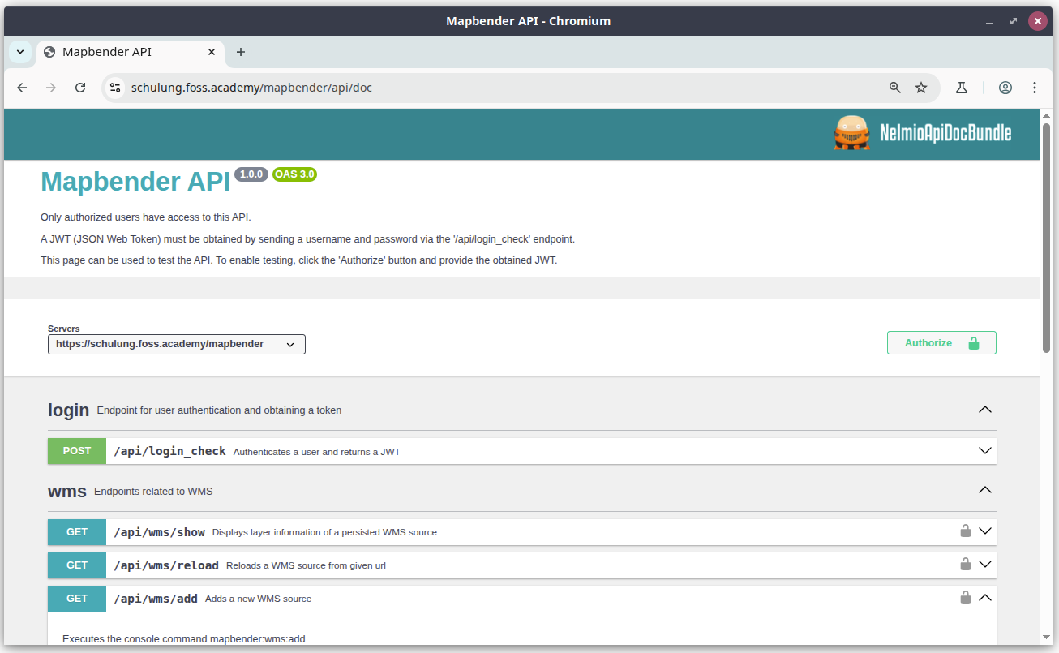
Notes:
2024 4.0
Juli 2023 3.3.5
May 2023 3.3.4
Dez 2022 3.3.2
Nov 2022 3.3.1
April 2022

Slide 19
QGIS2Mapbender – ideas & next steps
More options
Upload QGIS project without transfer of the data (only upload QGIS file)
Upload QGIS project without publishing in Mapbender
Support for QGIS projects saved in the PostgreSQL database
I18n – provide support for other languages (already in progress)
Mapbender options
Decide how to handle new layers on update
Additional Mapbender settings: activate proxy, convert to Shared Instance

Slide 20

Thanks a lot
for your attention
Slides
https://github.com/astroidex/presentations/tree/master/FOSS4G-Europe-2025

Slide 21

Feedback is welcome
Website
https://mapbender.org
Mailingliste
mapbender_users@lists.osgeo.org
E-Mail
astrid.emde@wheregroup.com
Adresse
Eifelstraße 7
53119 Bonn

