Slide 1

Create your own Spatial Data Infrastructure (SDI) with Open Source Software
Astrid Emde, WhereGroup
FOSS4G Europe 2018 Guimarães (Portugal)

Slide 2

Astrid Emde
Project management and development, trainings for MapServer, PostgreSQL/PostGIS, Mapbender, GeoServer, QGIS
Part of Mapbender Team & PSC, Concept, Testing, Documentation
OSGeoLive PSC since 2017
OSGeo Board since 2017
Local Chapter FOSSGIS e.V. & FOSSGIS Konferenz
Bonn

Slide 3

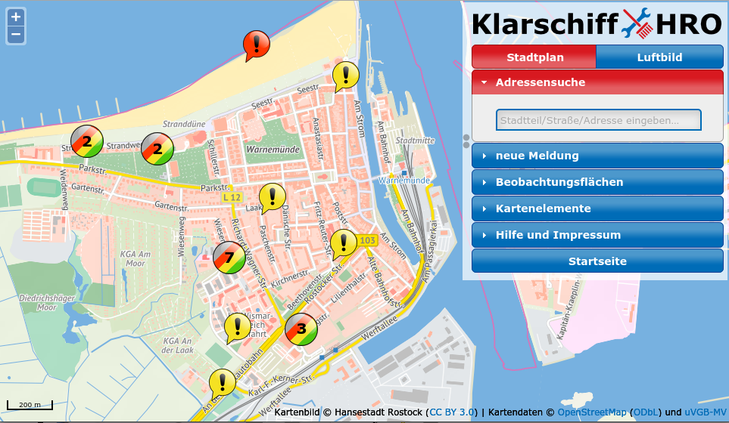


WhereGroup

Slide 4
WhereGroup
> 30 employees - developers, consultants & geospatial experts
Working with Open Source Software for more than 15 years
Company behind Mapbender, Metador & Mops
Bonn – Berlin - Freiburg
FOSSGIS e.V. member & OSGeo sponsor
We are hiring!

Slide 5
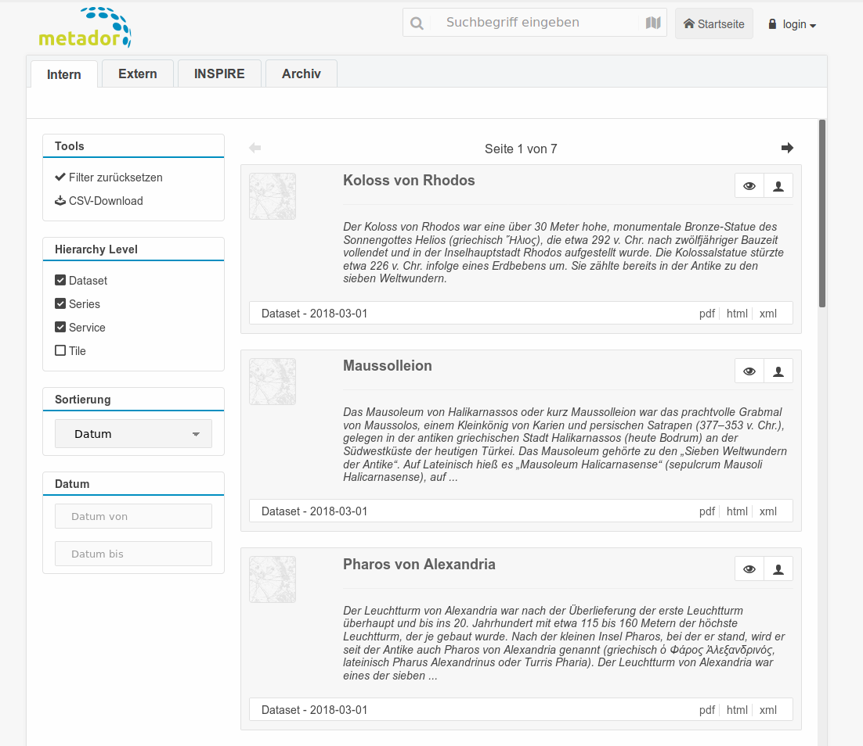
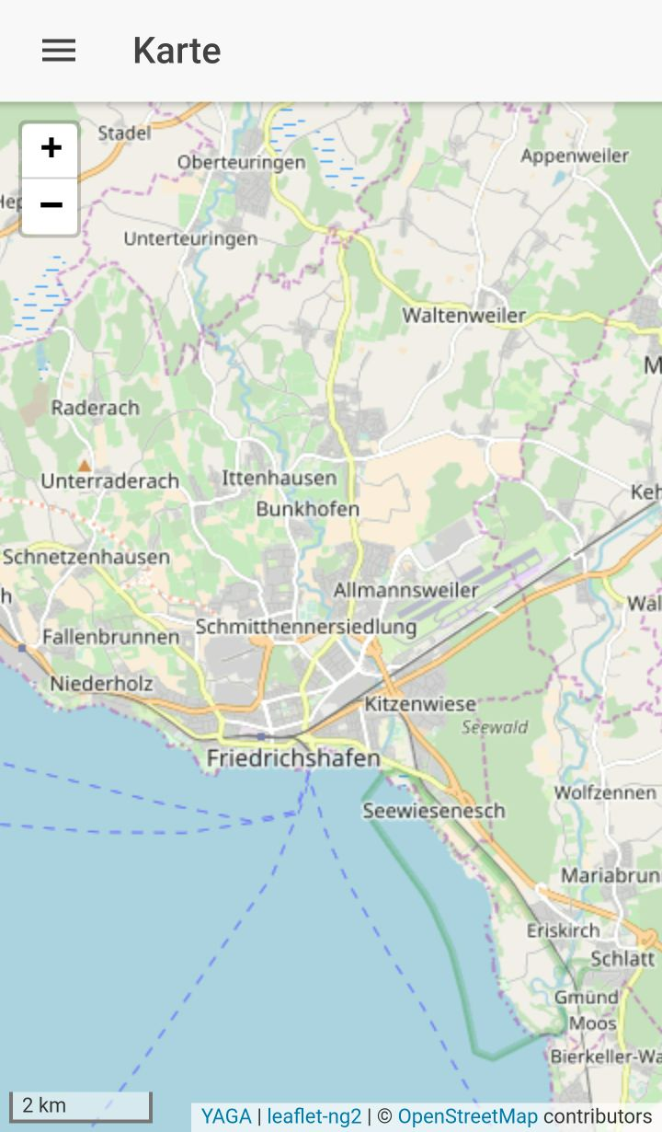

WhereGroup
Metador
Metadata editor
Offline Client using
Yaga, Leaflet, Angular
Consulting, Training & more

Slide 6
SDI Workshop
What is a Spatial Data Infrastructure (SDI)
Components of an SDI
Data
Services & OGC Standards
Clients
Metadata
Get to know OSGeo Software

Slide 7
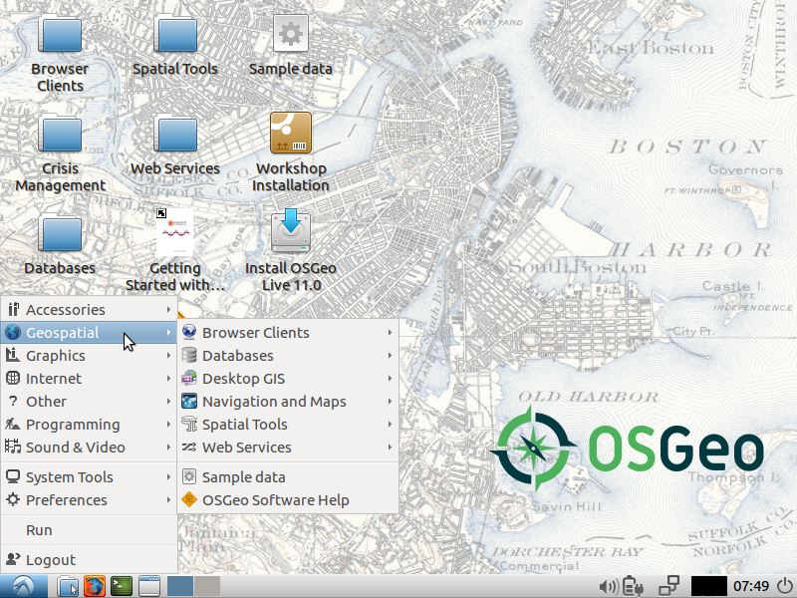
Workshop with OSGeoLive
OSGeoLive 11.0
(August 2017)
OSGeoLive
http://live.osgeo.org
Download Data & Presentation http://trac.osgeo.org/osgeo/wiki/Live_GIS_Workshop_Install

Slide 8
What is a SDI?

Slide 9

What is an SDI?
A spatial data infrastructure (SDI) is a data infrastructure implementing a framework of geographic data, metadata, users and tools that are interactively connected in order to use spatial data in an efficient and flexible way. Another definition is "the technology, policies, standards, human resources, and related activities necessary to acquire, process, distribute, use, maintain, and preserve spatial data".
Zitat: Wikipedia https://en.wikipedia.org/wiki/Spatial_data_infrastructure

Slide 10
SDI
Data infrastructure that provides geographic data and metadata
Data network to exchange data
Data producer and data user are connected via a physical network f.e internet / intranet
it is accessible for several users
Users can use different tools for different processes
It helps you to make data accessible, maintainable and findable throughout your organization
Increases efficiency and flexibility

Slide 11
Was ist eine GDI?
Als Geodateninfrastruktur (GDI) wird ein Netzwerk zum Austausch von Geodaten bezeichnet, in dem Geodaten-Produzenten, Dienstleister im Geo-Bereich sowie Geodatennutzer über ein physisches Datennetz, in der Regel das Internet, miteinander verknüpft sind.
Aufgrund der Bedeutung von raumbezogenen Informationen (=Geodaten) ist es das Ziel der GDI, diese Geodaten allen Nutzern zur Verfügung zu stellen. Dabei beinhaltet der Begriff „Nutzer“ sowohl die öffentliche Verwaltung als auch die Wirtschaft, die Wissenschaft und den Bürger. [...]
Zitat: Wikipedia https://de.wikipedia.org/wiki/Geodateninfrastruktur

Slide 12

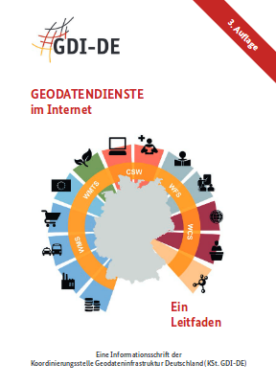
Was ist eine GDI?
Werden Geodatendienste und die dazugehörigen
Geodaten strukturiert und systematisch koordiniert
sowie verwaltungsebenen- und fachübergreifend
angeboten, wird dies als Geodateninfrastruktur
(GDI) bezeichnet. Eine GDI besteht im Kern aus
Geodaten einschließlich Metadaten zu deren Beschreibung, Geodatendiensten und Netzen.
Zitat: Geodatendienste im Internet (3. Auflage, KSt. GDI-DE)
http://www.geoportal.de/SharedDocs/Downloads/DE/GDI-DE/Flyer-Broschueren/Leitfaden-Geodienste-im%20Internet.pdf?__blob=publicationFile

Slide 13
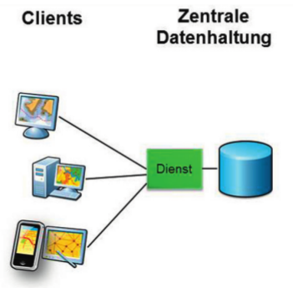

Abbildung: Geodatendienste im Internet (3. Auflage, KSt. GDI-DE)
http://www.geoportal.de/SharedDocs/Downloads/DE/GDI-DE/Flyer-Broschueren/Leitfaden-Geodienste-im%20Internet.pdf?__blob=publicationFile

Slide 14




Communication with the Clients
Clients
centralized
Data storage
Clients
Server
Service
From Geodatendienste im Internet (3. Auflage, KSt. GDI-DE)
http://www.geoportal.de/SharedDocs/Downloads/DE/GDI-DE/Flyer-Broschueren/Leitfaden-Geodienste-im%20Internet.pdf?__blob=publicationFile
Notes:
GDI als Netzwerk zum Austausch von Geodaten
* Verwaltungs- und Fachübergreifende Geodatenangebote
--> Verknüpfung von Geodaten-Produzenten, Dienstleistern und Geodatennutzer
--> Bereitstellung raumbezogener Informationen für alle Nutzer
* Systematische Strukturierung und Koordinierung von Geodaten
GDI-Elemente:
* Geodaten mit Metadaten (Beschreibung)
* Geodatendienste
* Datennetze

Slide 15
Data storage
file system
database
Spatial Services
View Data
Browser
Desktop GIS
Spatial Services
Provide data access
OGC Services
WMS Web Map Service
WFS Web Feature Service
WCS Web Coverage Service
WMC Web Map Context
WPS Web Processing Service
& more
Catalog & find Data
Metadata Catalog
CSW Catalog Service Web
Edit data
editors f.e. Desktop GIS
command line tools
scripts
Excercise 1: Please assign Open Source Software to the components of a SDI. See https://live.osgeo.org

Slide 16
Spatial Services
View Data
Browser: Mapbender,
OpenLayer,
Leaflet, Marble,
Cesium
DesktopGIS: QGIS,
GRASS GIS, Saga,
OpenJump
Data storage
file system
database
ESRI Shape
OGC GeoPackage
PostgreSQL/PostGIS...
Spatial Services
Provide data access
OGC Services
MapServer
GeoServer
deegree
QGIS Server
pyWPS
Catalog & find Data
Metadata Catalog
CSW Catalog Service Web
GeoNetwork
pyCSW
Edit data
editors f.e. Desktop GIS
QGIS, gvSIG, uDIG,
Saga, GRASS, OpenJump
command line tools
ogr2ogr gdal shp2pgsql
scripts f.e. python

Slide 17
Data - Status
Users work with different data
Different formats
Different tools to view and edit
Data can is spread and copied
Data can have different versions that are in use

Slide 18
Data
Goals
Central data storage
Editing does not have to take place always in the central data storage, but define how to exchange
Easy import & export of data
Flexible visualisation with different tools
Data storage with defined access
Data storage with authentification/authorisation and multi user access
Data history

Slide 19
Data
Goals
First Goal: centralized data storage

Slide 20

Database

Slide 21


PostgreSQL & PostGIS
<
https://live.osgeo.org/de/overview/overview.html

Slide 22
PostgreSQL
Supported by several other programms and programming languages
Fast, powerful, reliable, robust, easy to maintain
PostGIS is an extension for PostgreSQL
Let PostGIS do the work - not your Desktop GIS
Follows standard - OGC Simple Feature Spezification for SQL and OGC ISO SQL/MM Spezification
Provides many spatial functions
Control access to your data

Slide 23

Excercise 2: Create Database in PostgreSQL
Open Database Client pgAdmin III
Create database: context menu on database → new database → name foss4g
Load postgis Extension
  Context menu on database foss4g → new objekt → new extension → name: postgis
fourth

Slide 24
Data
Goals
First Goal: centralized data storage
Second Goal: Easy import & export of data
Third Goal: Flexible visualisation with different tools

Slide 25
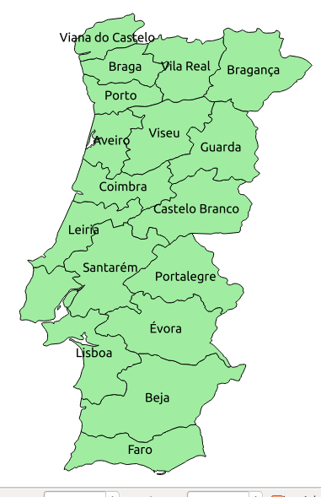
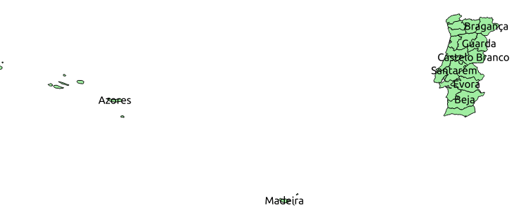

Excercise 3: Load Natrual Earth data (Shapes) in Desktop GIS QGIS
/home/user/data/natural_earth2/ne_10m_admin_1_states_provinces_shp.shp
Provinces of Portugal
Filter show only admin = 'Portugal'
Label mit [name]

Slide 26

Data import from QGIS to PostgreSQL
You can import Shape to PostgreSQL via
  QGIS DB Manager
  or
  shp2pgsql
  ogr2ogr
  python
  ...

Slide 27
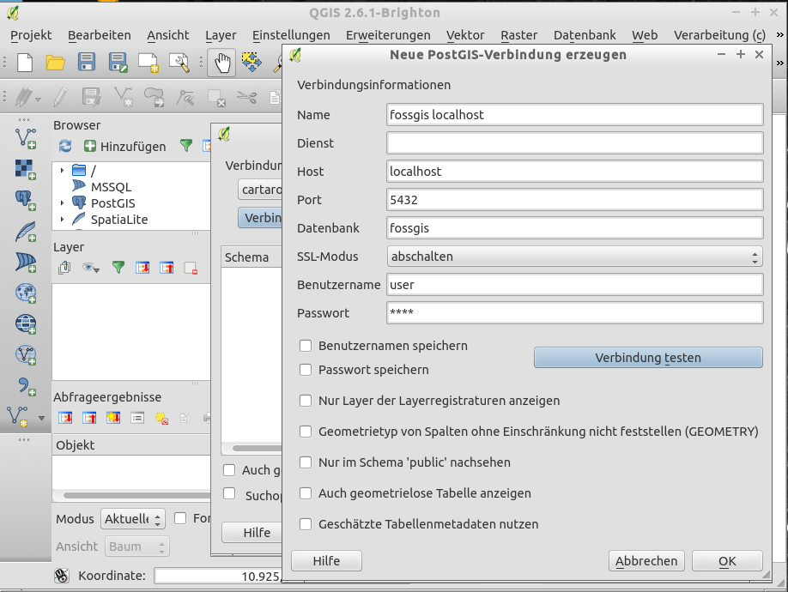
Create a new PostgreSQL Connection in QGIS

Slide 28
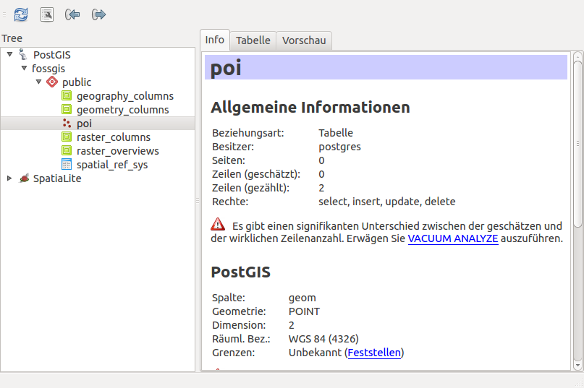
QGIS DB Manager
Easy Import / Export
Supports many data formats
Visualize your data
Show &
edit table structure
Create index
Vacuum / Analyze

Slide 29
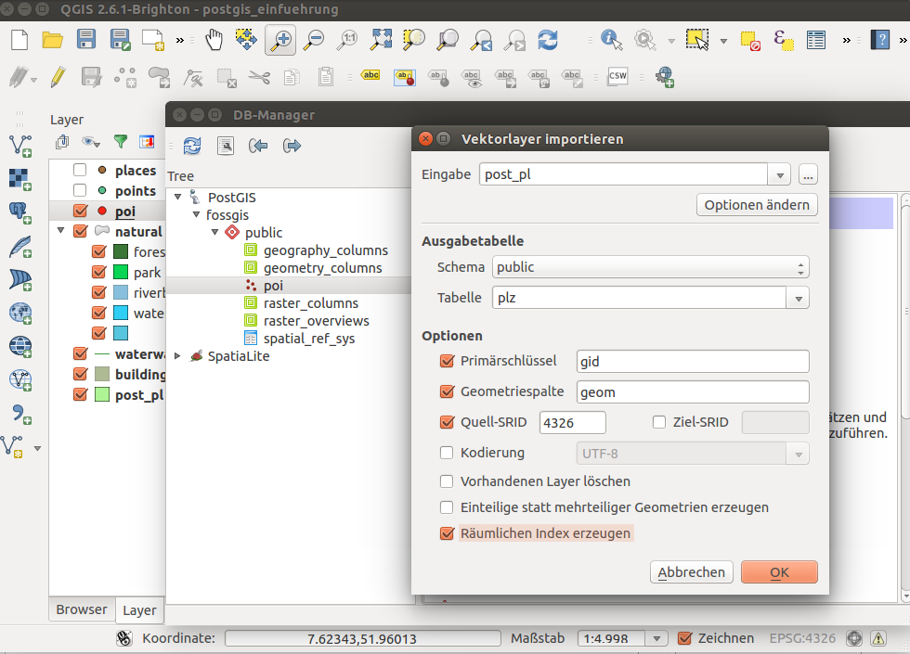
QGIS DB Manager Import

Slide 30
Exercise 3 Import & Export
Import provinces from Natural Earth data (only Portugal)
Import populated places from Natural Earth data (only Portugal)
Add the table from you database to your QGIS project (drag & drop)
Save populated places as geopackage via DB Manager or via QGIS save as...

Slide 31
Data
Goals
First Goal: centralized data storage
Second Goal: Easy import & export of data
Third Goal: Flexible visualisation with different tools
Fourth Goal: Defined access to data

Slide 32
PostgreSQL roles
PostgreSQL has roles
  groups
  User with login
You can give access to databases, schema, tables, views … to roles
Write or read access

Slide 33
Create roles in PostgreSQL
Create role, create login role
Give read access to table places
Give write access to table countries

Slide 34
Exercise 4 – control data access
Create a role workshop_read and workshop_writer
Create a login role robert with a password and add to workshop_reader
Create a new login role wilma and add wilma to the workshop_writer role
Grant read access to table places to your new role workshop_reader
Grant write access to table countries to your new role workshop_writer
Try to access and edit via QGIS

Slide 35
Excercise 4 - solution
CREATE ROLE workshop_reader;
CREATE ROLE workshop_writer;
CREATE ROLE robert WITH LOGIN PASSWORD 'foss4g';
GRANT workshop_reader TO robert;
CREATE ROLE wilma WITH LOGIN PASSWORD 'foss4g';
GRANT workshop_writer TO wilma;

Slide 36
Excercise 4 - solution
GRANT SELECT ON places to workshop_reader;
-- change to user robert
Select * from places;
GRANT ALL ON countries to workshop_writer;
GRANT USAGE ON SEQUENCE countries_gid_seq TO workshop_writer;
-- change to user wilma
Select * from countries;
Update countries set name = 'TEST' WHERE name = 'Porto';

Slide 37
Provide Data via OGC Services
Goals
Provide Data in the web - Intra- or Internet
Provide data via standards that many tools support
OGC WMS Web Map Service – show data and get information (advantage: styling is already defined)
OGC WFS Web Feature Service - download service, provide data, edit data
Provide INSPIRE conform Services in Europe
https://live.osgeo.org/de/standards/standards.html

Slide 38

OSGeo Software with OGC WMS Support
MapServer
GeoServer
QGIS Server
deegree
MapProxy
OGC WMS – map service, provide maps as raster, information as html, plain text, GML

Slide 39
OSGeo Software with OGC WFS Support
MapServer
GeoServer
QGIS Server
deegree
MapProxy
OGC WFS – feature service, data access f.e. via GML

Slide 40
Provide Data via OGC Services
Goals
First Goal: Provide Data in the web - Intra- or Internet
Provide data via standards that many tools support
OGC WMS Web Map Service – show data and get information (styling is already defined)

Slide 41
WMS example with QGIS Server
Publish your data via QGIS Server as WMS
Menu → Project → Project properties → OWS Server
Name and title, extent, layer access
(make sure you saved the password for your database access)
http://localhost/cgi-bin/qgis_mapserv?SERVICE=WMS&VERSION=1.3.0&REQUEST=GetCapabilities&map=/home/user/service_wms.qgs

Slide 42
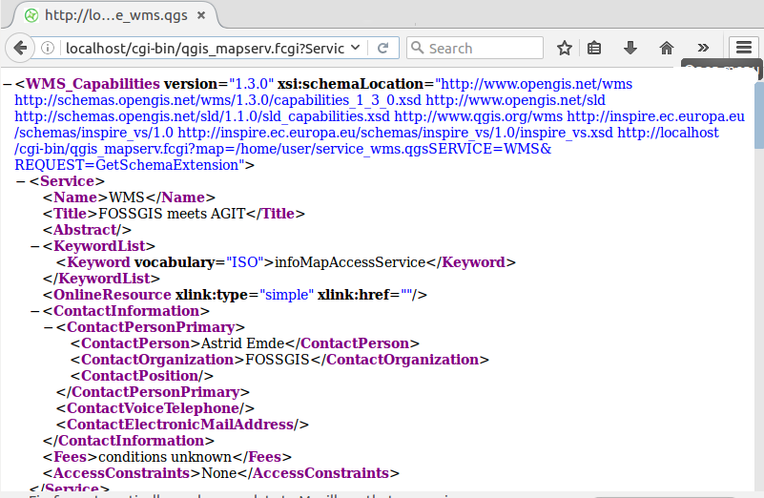
WMS Capabilities Document

Slide 43
Exercise 5: WMS example with QGIS Server
Publish your data via QGIS Server as WMS
Create a WMS with two layers countries and places – style them nicely with labeling
Save your project at: /home/user/service_wms.qgs
Load your WMS in an empty QGIS project

Slide 44
Exercise 5: Load external Services to QGIS
You find WMS all over the world
Add some services to your QGIS project
http://osm-demo.wheregroup.com/service?REQUEST=GetCapabilities&Service=WMS&Version=1.3.0
Portugal
http://mapas.dgterritorio.pt/geoportal/catalogo.html
http://snig.dgterritorio.pt/portal/index.php?option=com_wrapper&view=wrapper&Itemid=354&lang=pt
http://www.igeo.pt/dadosabertos/listagem.aspx

Slide 45
How to spread you service in the web?
Refer to your GetCapabilities-Urls
Add your GetCapabilities & Metadata in a Metadata catalog
Offer your WMS in WebGIS Client in a ready to use application f.e. OpenLayers, Leaflet, Mapbender, GeoMoose, MapStore, QGIS Map Client

Slide 46
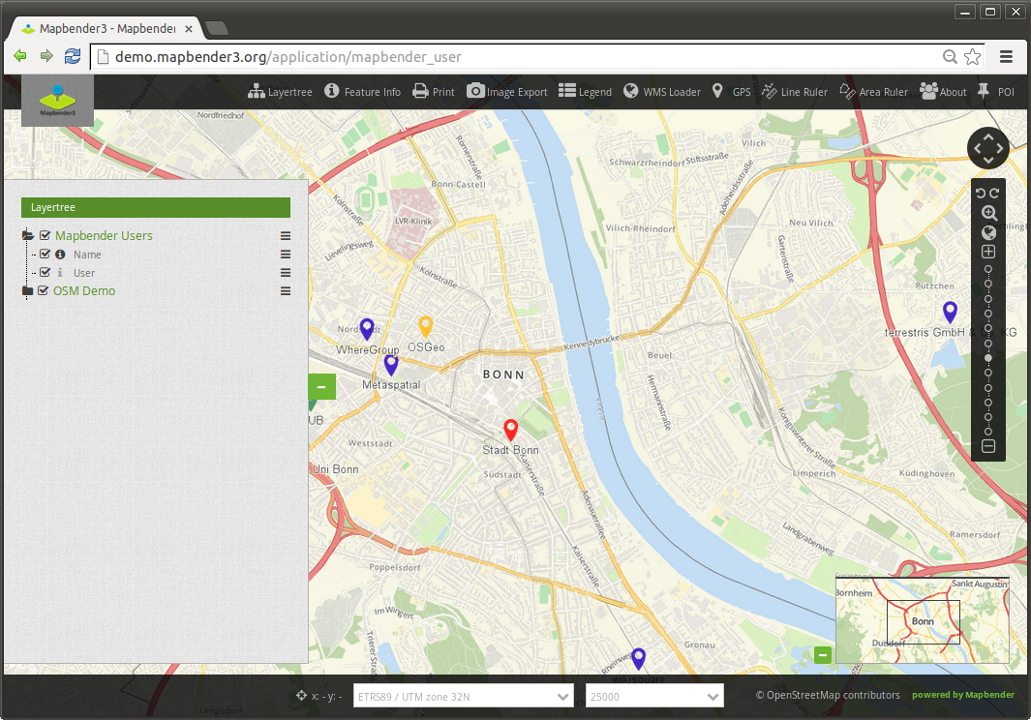
Provide services in a Geoportal f.e. Mapbender
http://localhost/mapbender3/
Login via: root / root
Provide Applications
for different needs

Slide 47
Publish WMS in Mapbender
Menu → New DataSource
Load GetCapabilities Url (do not check only valid)

Slide 48
Exersize 6: Load WMS in Mapbender
Load your QGIS WMS and some other WMS in Mapbender

Slide 49
Excersize 6: Create a new Application in Mapbender
Your application should start with the extent of Guimarães
Copy Application mapbender_user and rename it to FOSS4G
Switch to tab Layout and set SRS EPSG:4326
Modify MAX EXTENT to Portugal
lower left -12 36 – upper right -3 43
Modify Start Extent to Guimarães
lower left -8.32 41.42 upper right -8.28 41.46

Slide 50
Excersize 6: Add Services to your application
Your application should show your QGIS WMS and some other external WMS
Go to Tab Layerset
Add WMS via +

Slide 51
Metadata Catalog to find your data
Goals
Your user should find your data
Provide a catalog for you data

Slide 52
Provide Metadata for your data and Services
Metadata should be provides & has to be up-to-date
OGC Catalogue Service Web (CSW)
GeoNetwork, GeoNode, pycsw, Metador
f.e Germany: GDI-DE & 16 Catalogues for provinces
INSPIRE
  https://inspire.ec.europa.eu/INSPIRE-in-your-Country/DE
  https://inspire.ec.europa.eu/INSPIRE-in-your-Country/PT http://snig.dgterritorio.pt/portal/

Slide 53
Exercise 8: Search in the Portugal Metadata Catalog for a Service
http://www.igeo.pt

Slide 54
Exercise 9: Add your new QGIS WMS to GeoNetWork or GeoNode
Open GeoNetwork
Login: admin/admin
Add a new Metadata entry for you WMS
Follow the quickstart https://live.osgeo.org/en/quickstart/geonetwork_quickstart.html

Slide 55
Wrap things up
Central data storage in a database offers lot of advantages
Data Sharing via Services is easy and supported by many programs
Offering ready-to-use applications covers the needs of many not advanced users
Metadata helps you to find the data you need
Metadata should be up-to-date
A SDI is a profit for all involved parties

