Slide 1
Happy Birthday - 10 Jahre OSGeo!
Anita Graser OSGeo Board Member
Andreas Hocevar OSGeo Charter Member
Astrid Emde OSGeo Charter Member
einige Folien Markus Neteler OSGeo Charter Member

Slide 2
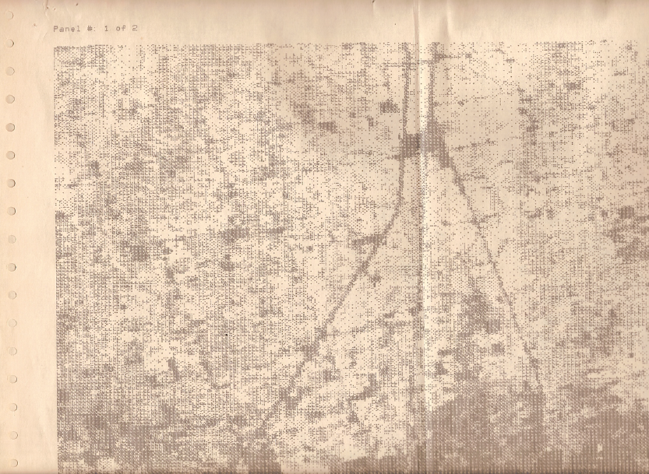
THE 80's … the beginning
Img. courtesy: J Westervelt 2006:
Early GRASS Community Views on FOSS

Slide 3
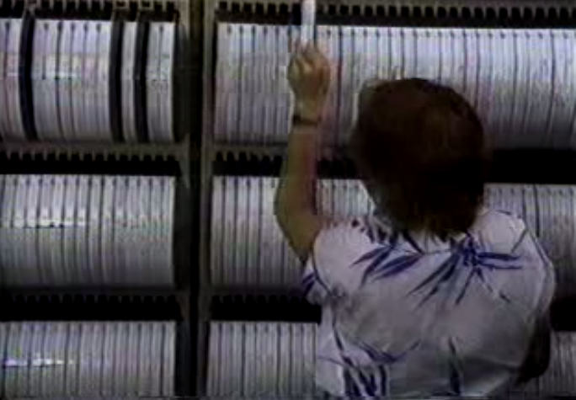

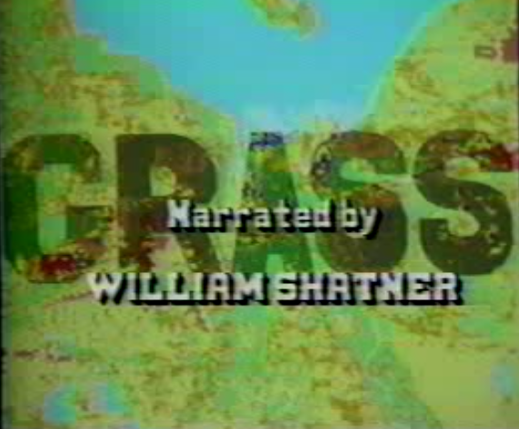
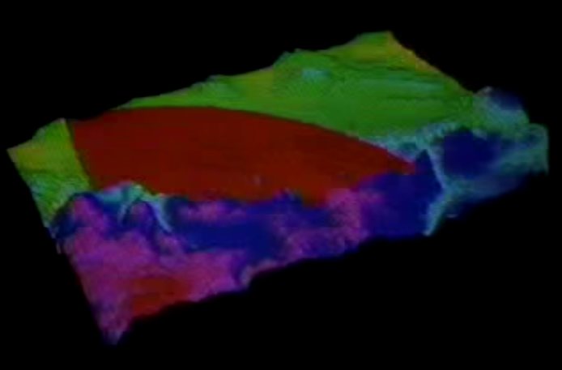
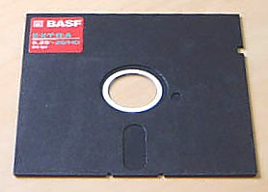
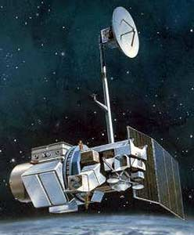
THE 80's ...
1984 – GRASS running on SUN-1 and Masscomp
1985 – GRASS 1.0, GRASSnet established
(pre-mailing list)
15 March 1985: first commercial Internet domain name registered
1985 – Richard Stallman publishes the GNU Manifesto
1987 – GRASS 2.0; first issue of GRASSClippings Newsletter
GRASS video narrated by William Shatner (Captain Kirk of Star Trek)
1988 – GRASS 3.0; Army R&D Achievement Award (Webster, Goran, Shapiro, Westervelt)

Slide 4
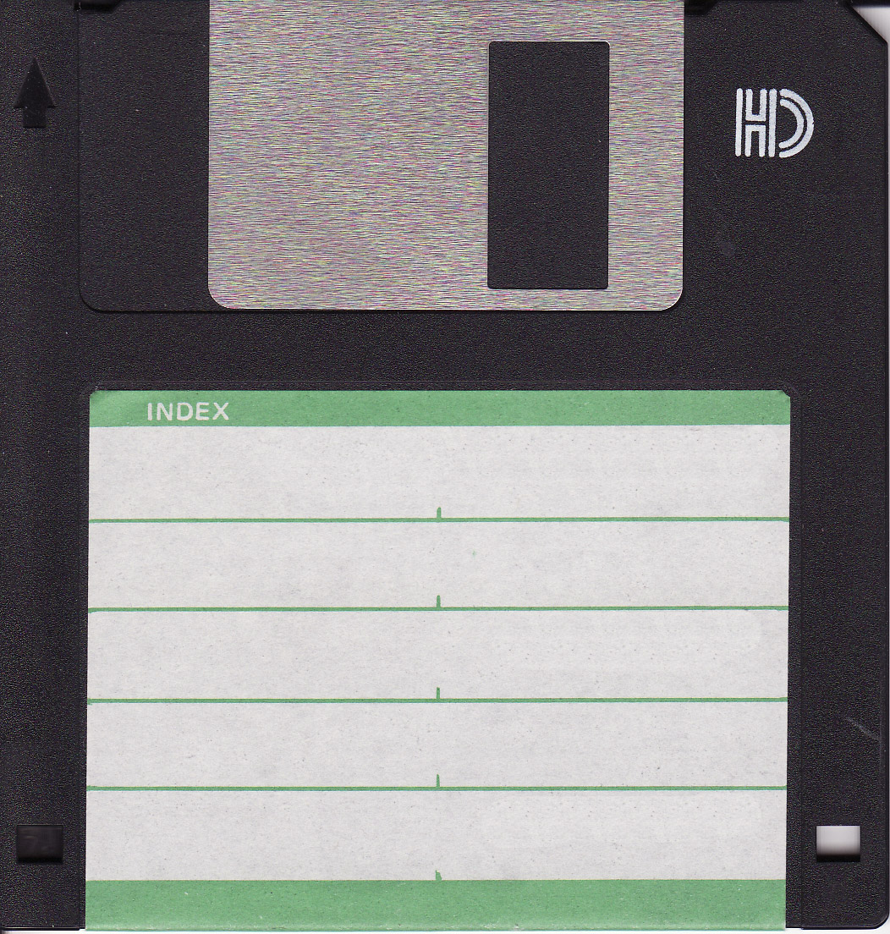
THE 80's ...
1989 – GRASS 3.1
First release available on Internet
(uxc.cso.uiuc.edu)
But how was software developed? Locally!
While Revision Control System (RCS) was available and
sometimes used, yet no server based system like “CVS“
(CVS 1.0 in 1990 – today: SVN, git, …)
TCP/IP goes global (1989–2010)
However:
By 1992, still less than 15,000 .com domains registered...
See also:
  http://grass.osgeo.org/home/history/
  http://wiki.osgeo.org/wiki/Open_Source_GIS_History
  http://grass.osgeo.org/uploads/grass/history_docs/westervelt2004_GRASS_roots.pdf

Slide 5
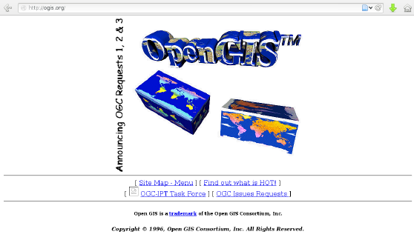
THE 90's ...
ORGANIZATIONS + WWW
1992
GRASS Inter-Agency Coordinating Committee
→ Open GRASS Foundation (OGF)
→ OpenGIS Consortium (OGC)
1994 – Tim Berners-Lee decided to constitute the
World Wide Web Consortium (W3C)
1994 – Open Geospatial Consortium
(OGC) founded
– MapServer (former UMN) started
OSGeo
1990
1992
1994
2004
2006
GRASS Interagency
Steering Commitee
Open GRASS
Foundation (OGF)
Open GIS Open Geospatial
Consortium (OGC) Consortium (OGC)

Slide 6
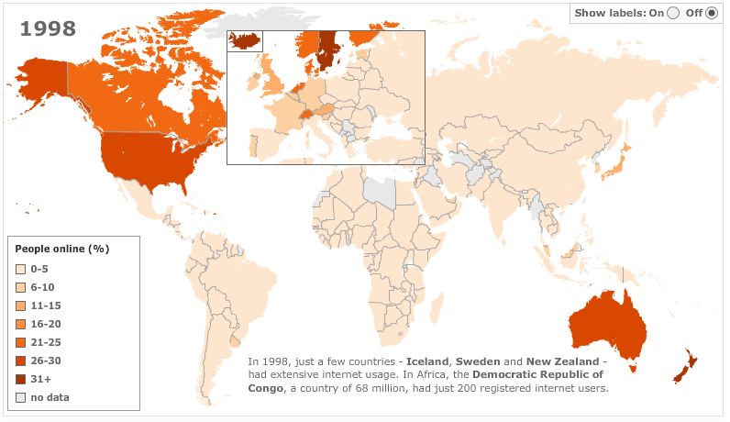
THE 90's …
Internet growth as a crucial
precursor to FOSS4G development
Source:http://news.bbc.co.uk/2/hi/technology/8552410.stm

Slide 7
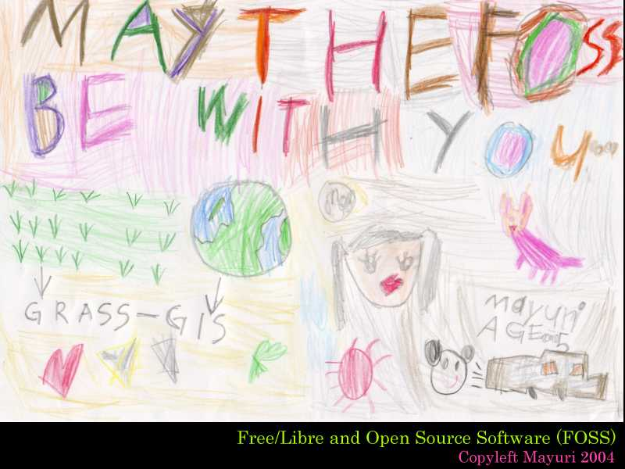
Since 2000...
May the FOSS be with you

Slide 8

Since 2000... growing communities
2001 – OSSIM initial revision in CVS
PostGIS started
GeoNetwork opensource started
GeoServer started
2002 – QGIS (former Quantum GIS) initial revision in CVS
GEOS initial revision in CVS
2003 – Community MapBuilder started. End of life in 2008
Release of Mapbender under the GNU GPL license
gvSIG was started
2004 – uDig was started
2005 – MapGuide Open Source
2006 – Mapbender gets first bits in CVS
OpenLayers Started
2007 – GeoMoose was open sourced (started 2005)
Thanks to CVS,
SVN and git
4. Februar 2006!
http://wiki.osgeo.org/wiki/Open_Source_GIS_History

Slide 9
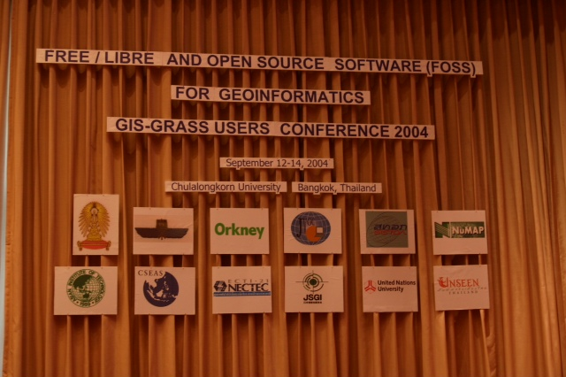
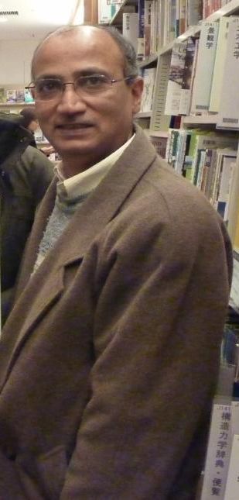
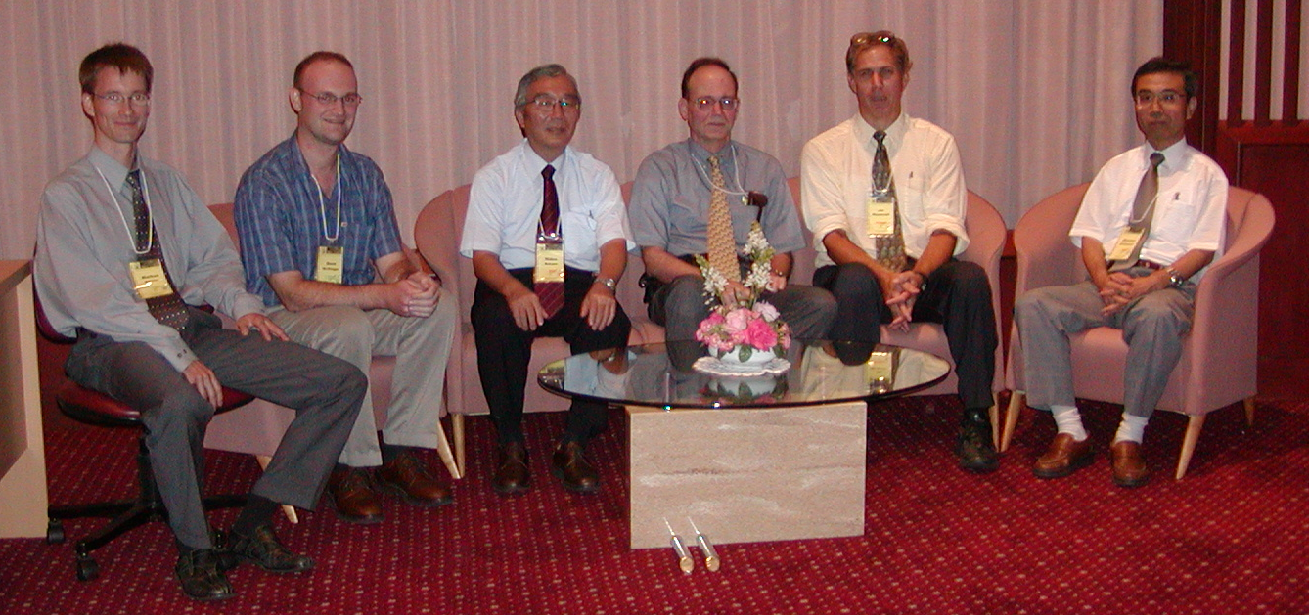
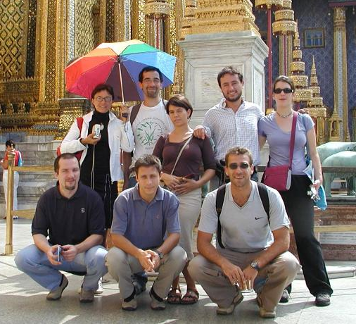
2004... a new name is coined
Chulalongkorn University,
Bangkok 2004:
“FOSS4G” is born!
Jim Westervelt
Original GRASS
GIS developer
Special thanks to
Venkatesh Raghavan,
Osaka City University

Slide 10
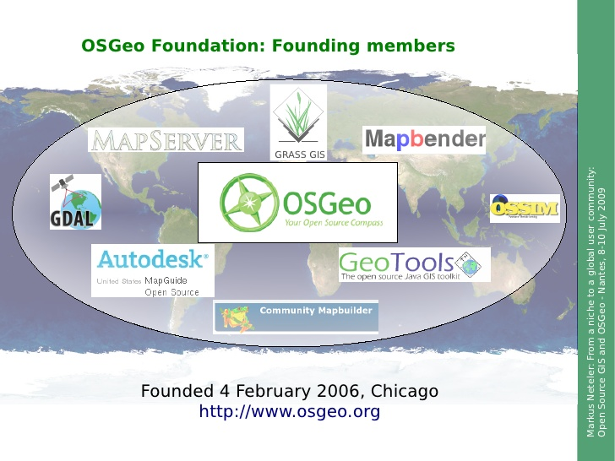
2006: OSGeo founded

Slide 11

OSGeo Structure
Charter Members vote
Board of 9 Directors
and President
Officers
Officers
Officers
represent
Committees
Committees
Committees
Committees
Committees
Committees
Local
Chapters
Local
Chapters
Local
Chapters
Foundation
Projects
Local
Chapters
Local
Chapters
elected by Membership
244 Charter Members
Sponsors
2013-02-20 | OSGeo 2013. All rights reserved

Slide 12
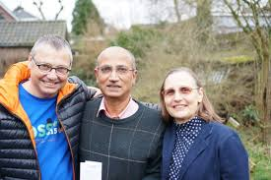
The OSGeo Presidents
Dirk Fringe Venkatesh Raghavan Helena Mitasova

Slide 13
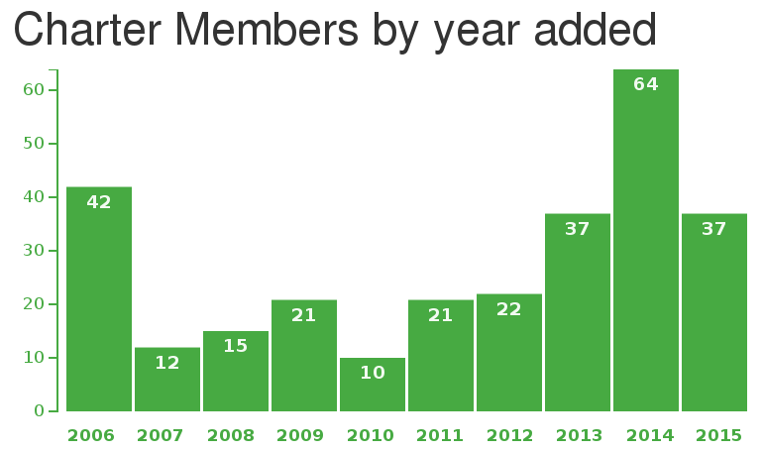
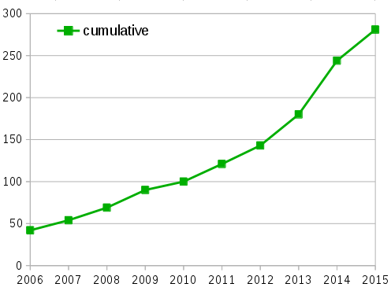
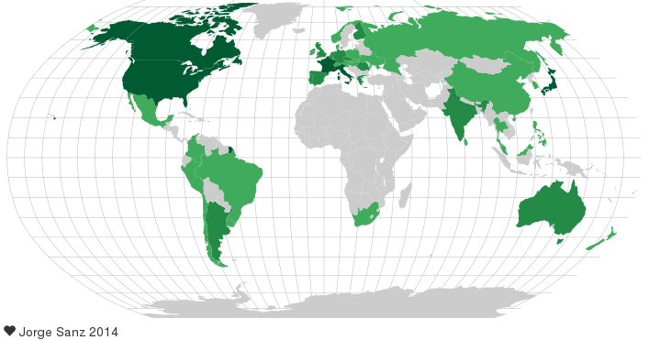
2015: OSGeo membership
http://www.osgeo.org/charter_members

Slide 14











Support through
Professional Service Providers
http://www.osgeo.org/search_profile
A few logos out of many....

Slide 15











FOSS4G

Slide 16
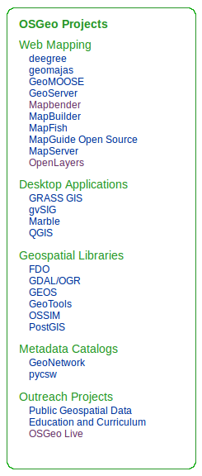
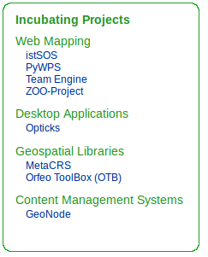

OSGeo Projects
22 OSGeo Projects
8 Projects in Incubation
Incubation Process

Slide 17
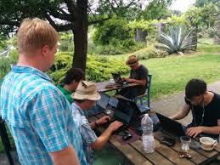
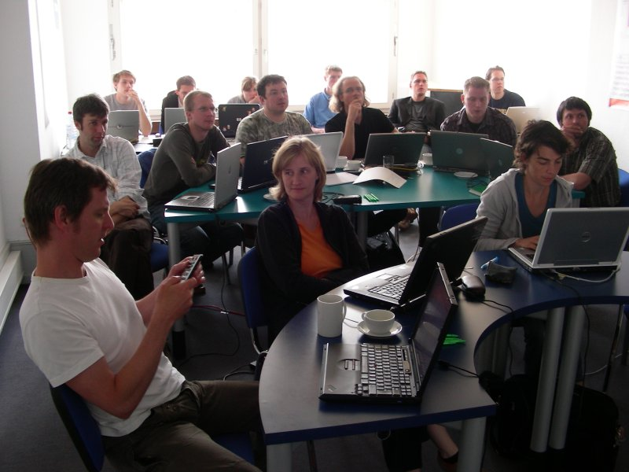
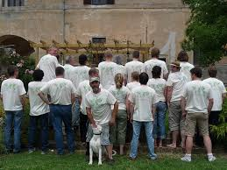
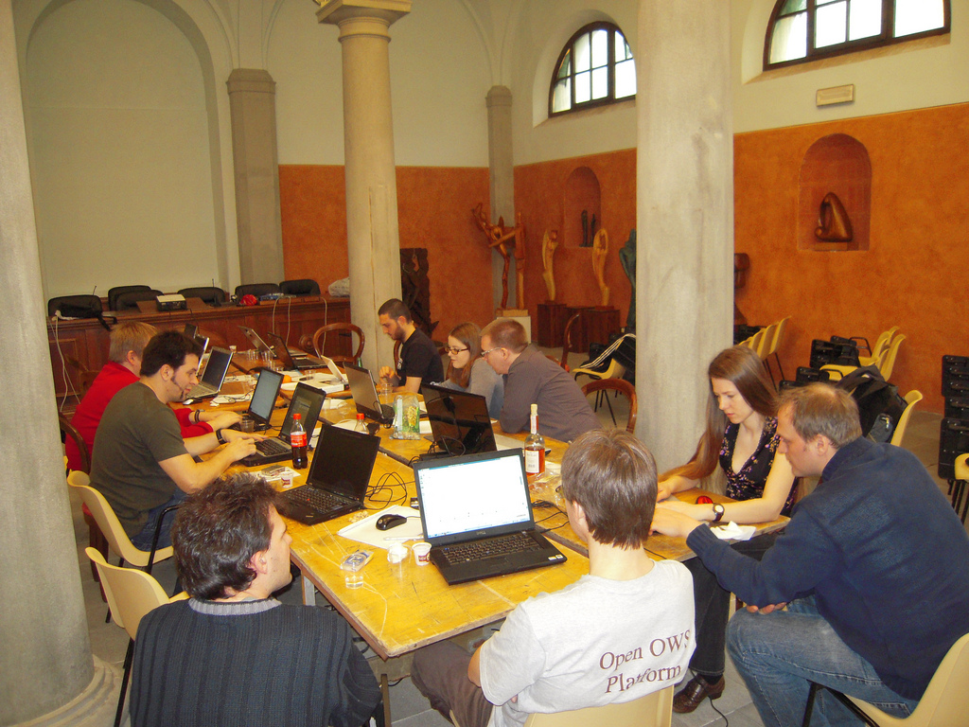
Community and code sprints!
Bolsena OSGeo
Code Sprint
Mapbender
code sprint 2007
QGIS Hackfest Pisa 2010

Slide 18

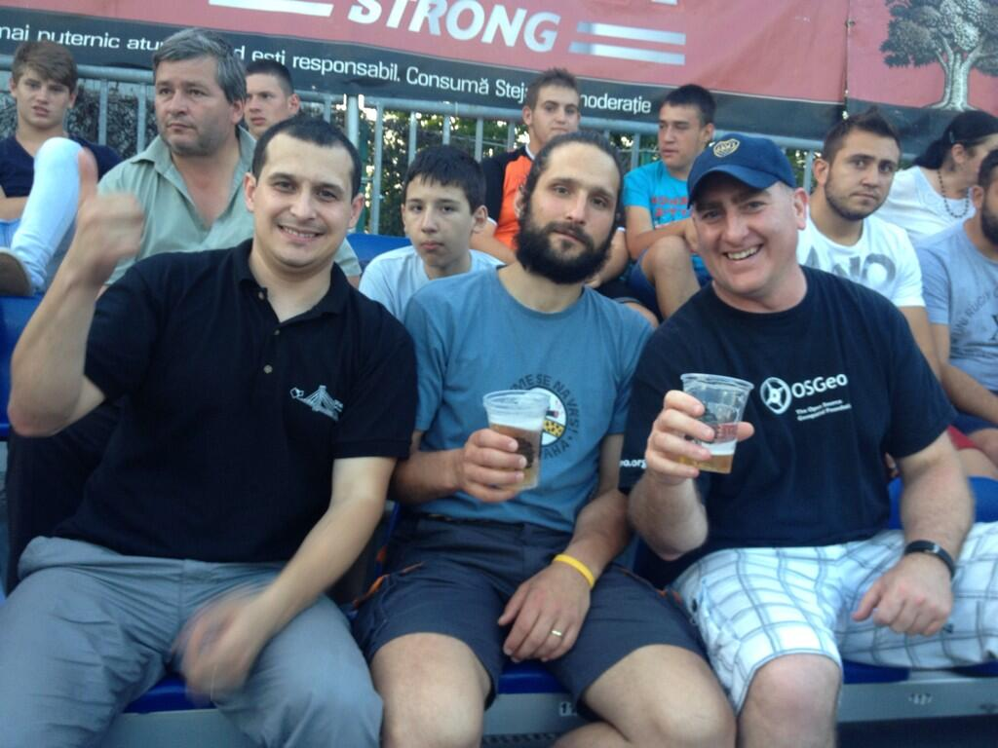


Conferences... e.g.
FOSS4G CEE 2012 Prague
FOSS4G CEE 2013
Bucharest
FOSS4G Europe
Bremen 2014
https://wiki.osgeo.org/wiki/Global_conferences_overview#Regional_Conferences:_Europe

Slide 19
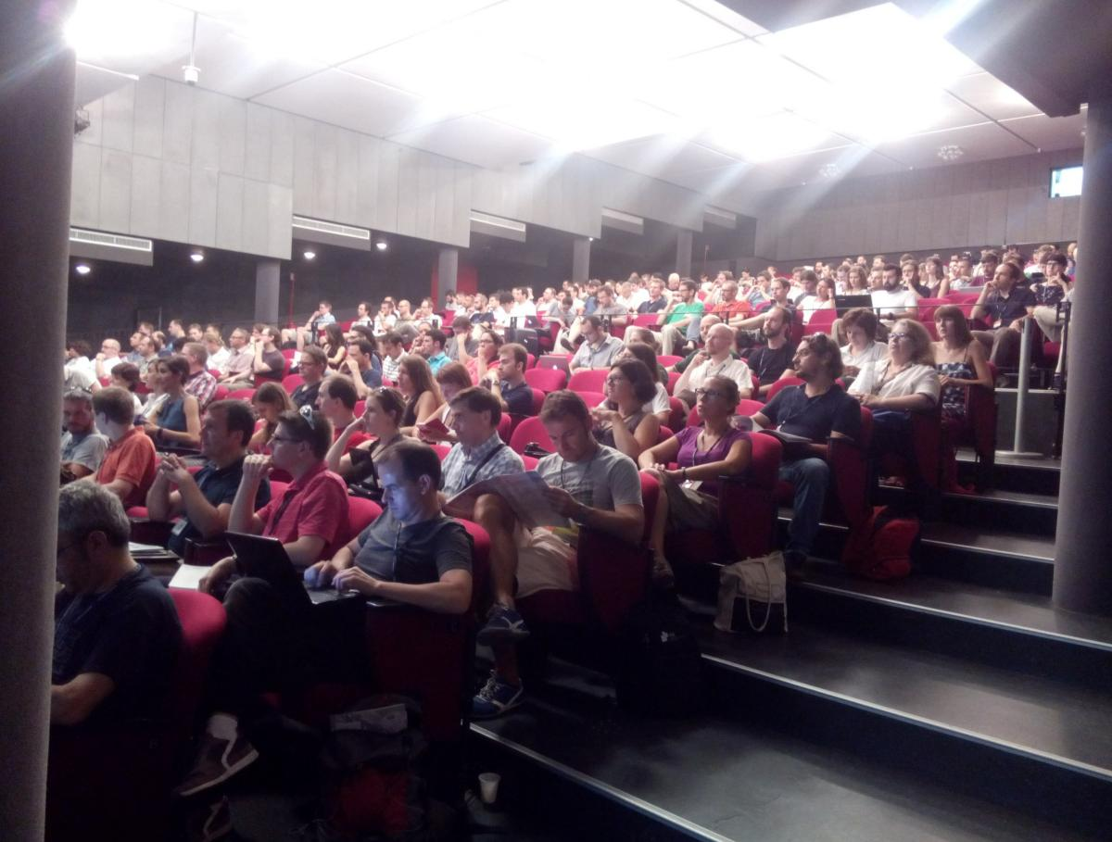

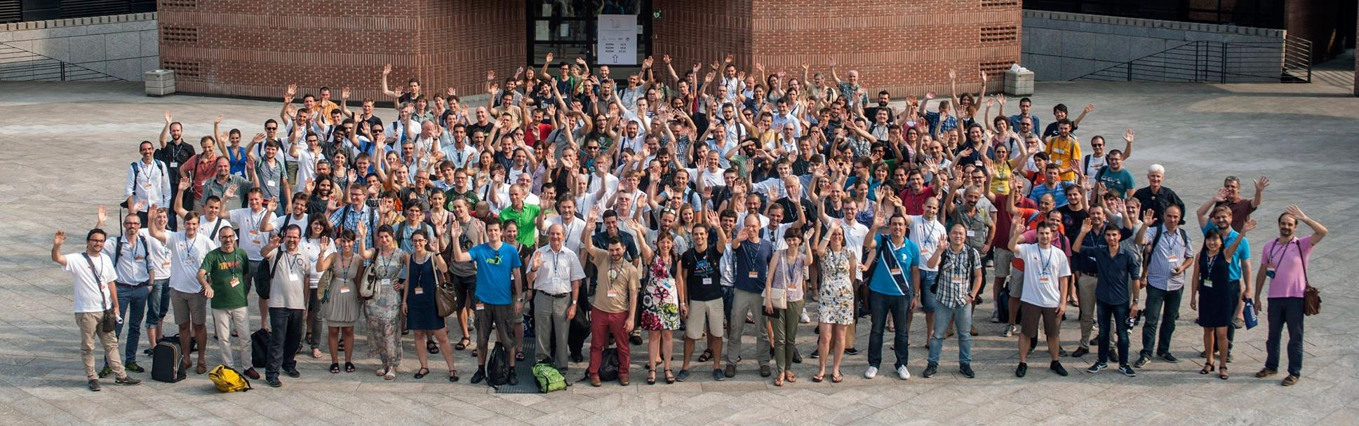
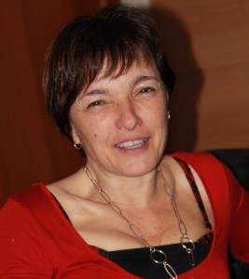
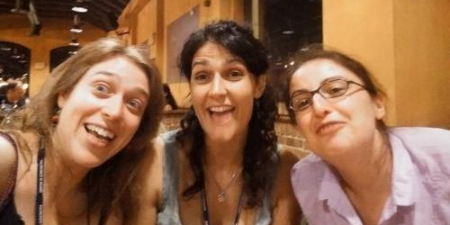
Conferences... e.g.
FOSS4G-Europe Como 2015

Slide 20
FOSS4G (Bonn, Germany) 2016
FOSS4G (Seoul, South Korea) 2015
FOSS4G (Portland, USA) 2014
FOSS4G (Nottingham, Great Britain) 2013
FOSS4G (Denver, USA) 2011
FOSS4G (Barcelona, Spain) 2010
FOSS4G (Sydney, Australia) 2009
FOSS4G (Cape Town, South Africa) 2008
FOSS4G (Victoria, Canada) 2007
FOSS4G (Lausanne, Switzerland) 2006
FOSS4G (Bangkok, Thailand) 2004
Open Source Free Software GIS -
GRASS users conference (Trento, Italy) 2002
FOSS4G NA 2016
FOSS4G NA 2015
FOSS4G NA 2013
FOSS4G NA 2012
FOSS4G-Asia 2014
FOSS4G EU 2015
FOSS4G EU 2014
FOSS4G CEE 2013
FOSS4G CEE 2012
FOSS4G Argentina 2016
FOSS4G Argentina 2015
FOSS4G Argentina 2013
FOSS4G-AU Unconference 2012
FOSS4G (Sydney, Australia) 2009
Conferences...
https://wiki.osgeo.org/wiki/Global_conferences_overview
XVII Italian GRASS GIS and GFOSS meetings (Parma) 2016
XVI Italian GRASS GIS and GFOSS meetings (Bologna) 2015
XV Italian GRASS GIS and GFOSS meetings (Palermo) 2014
XIV Italian GRASS GIS and GFOSS meetings (Genova) 2013
XIII Italian GRASS GIS and GFOSS meetings (Trieste) 2012
XII Italian GRASS GIS and GFOSS meetings (Trento) 2011
XI Italian GRASS GIS and GFOSS meetings (Lugano,CH) 2010
X Italian GRASS GIS users meeting (Cagliari) 2009
IX Italian GRASS GIS users meeting (Perugia) 2008
VIII Italian GRASS GIS users meeting (Palermo) 2007
VII Italian GRASS GIS users meeting (Genova) 2006
VI Italian GRASS GIS users meeting (Roma) 2005
V Italian GRASS GIS users meeting (Padova) 2004
IV Italian GRASS GIS users meeting (Firenze) 2003
III Italian GRASS GIS users meeting (Trieste) 2002
II Italian GRASS GIS users meeting (Trento) 2001
I Italian GRASS GIS users meeting (Como) 2000
GFOSS DAY 2015 2015
GFOSS DAY 2014 2014
GFOSS DAY 2013 2013
GFOSS DAY 2012 2012
GFOSS DAY 2011 2011
GFOSS DAY 2010 2010
GFOSS DAY 2009 2009
GFOSS DAY 2008 2008
OSGeo.nl Day 2015
OSGeo.nl Day 2014
OSGeo.nl Day 2013
OSGeo.nl Day 2012
SASIG 4 2011
SASIG 3 2010
SASIG 2 2009
SASIG 1 2008
FOSS4G India 2015
FOSS4G India 2012
FOSS4G Tokyo 2015
FOSS4G Osaka 2015
FOSS4G Hokkaido 2015
FOSS4G Hokkaido 2014
FOSS4G Korea 2015
FOSS4G Korea 2014
FOSS4G Korea 2013
FOSS4G Korea 2012
FOSS4G Korea 2011
OpenGIS Conference 2015
Jornadas SIG Libre 2015
Jornadas SIG Libre 2014
Jornadas SIG Libre 2013
Jornadas SIG Libre 2012
Jornadas SIG Libre 2011
Jornadas SIG Libre 2010
Jornadas SIG Libre 2009
Jornadas SIG Libre 2008
Jornadas SIG Libre 2007
OSGIS 2011
OSGIS 2010
OSGIS 2009

Slide 21
Mailing list subscribers
1 Feb 2016: 27,417
Top 10 number of unique registrants in OSGeo email lists
qgis-user 2984
foss4g2009-announce 1855
announce 1791
postgis-users 1722
gdal-dev 1721
openlayers-users 1422
mapserver-users 1377
discuss 1319
grass-user 1070
gdal-announce 934
How do we know? Monthly mailman cronjob run by MN

Slide 22

Support Education
OSGeo is mentor organization
13 students were accepted for 2015 GSoC summer
From Belgium, Canada, Czech Republic, India,
Italy, Luxemburg, Portugal, Spain and Sri Lanka
https://wiki.osgeo.org/wiki/Google_Summer_of_Code_Application_2016

Slide 23
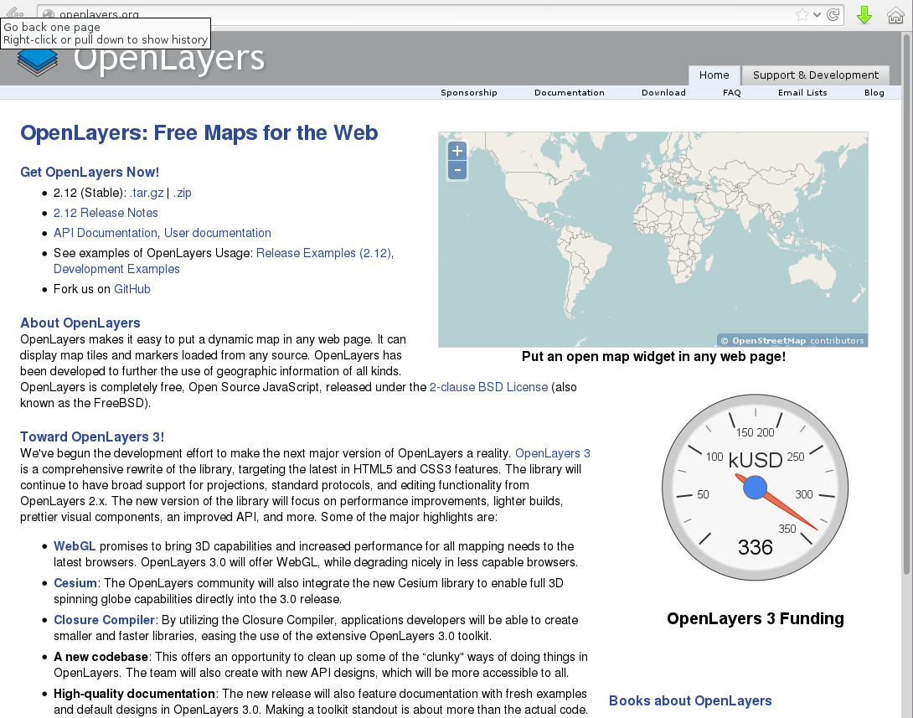
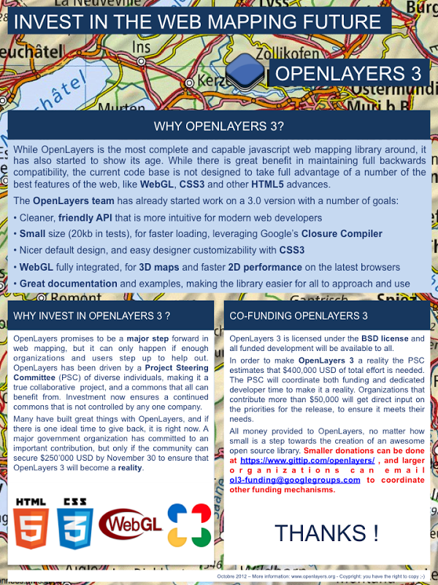
Crowdfunding of development, e.g. ...

Slide 24

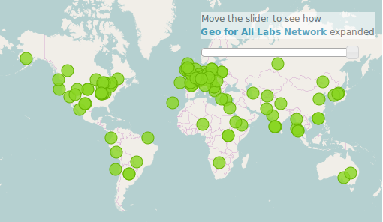
Geo4All
Mission - "Making geospatial education and opportunities accessible to all"
Educational material
Building up connection
http://www.geoforall.org/
110 Labs (7.7.2016)

Slide 25

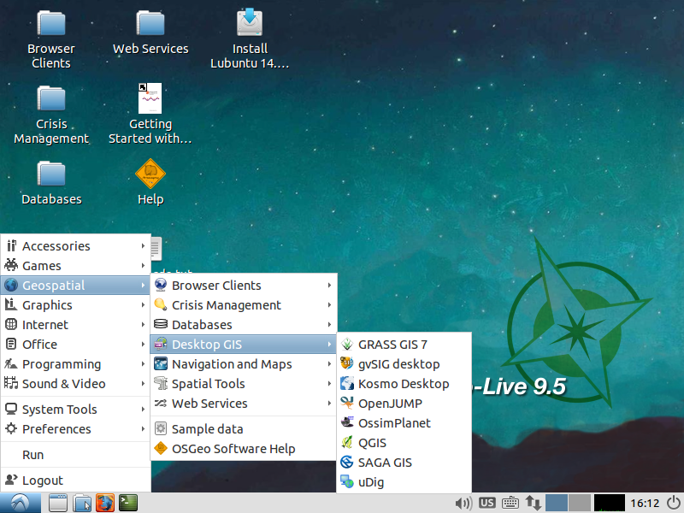
.
Version 10.0 ready for
FOSS4G
Based on Lubuntu
> 50 Software projects
Data OSM, Natural Earth…
Overview Documents &
Tutorial
In Action at FOSSGIS & AGIT & around the world
http://live.osgeo.org

Slide 26
FOSSGIS e.V.
April 2000 als GRASS-Anwender-Vereinigung (GAV) gegründet
September 2008 erfolgte die Umbenennung in FOSSGIS e. V.
200 Mitglieder
Jährliche Ausrichtung der FOSSGIS Konferenz
Local Chapter der OSGeo im deutschsprachigen Raum
Fördert Communitytreffen & Hacking Events

Slide 27
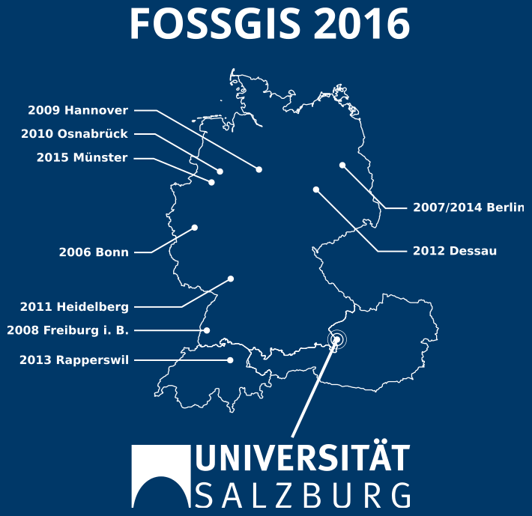

FOSSGIS Konferenz
1. FOSSGIS Konferenz
im März 2006 in Bonn
mit 350 Besuchern
2003-2005 MapServer Anwendertreffen

Slide 28

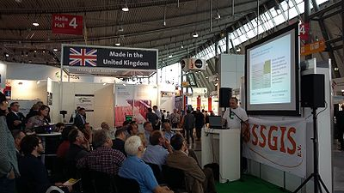
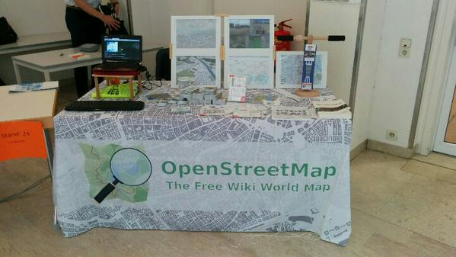
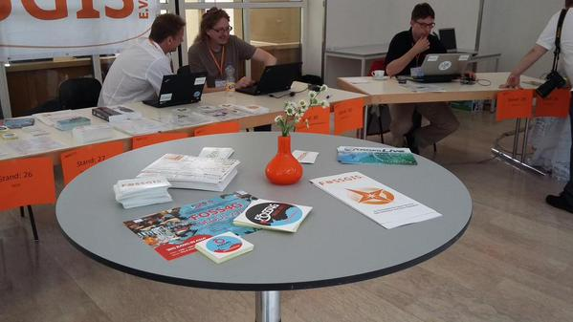
OSGeo Park INTERGEO / OSGeo Day AGIT

Slide 29

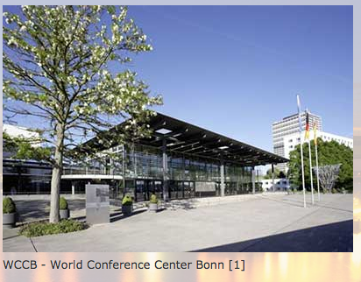
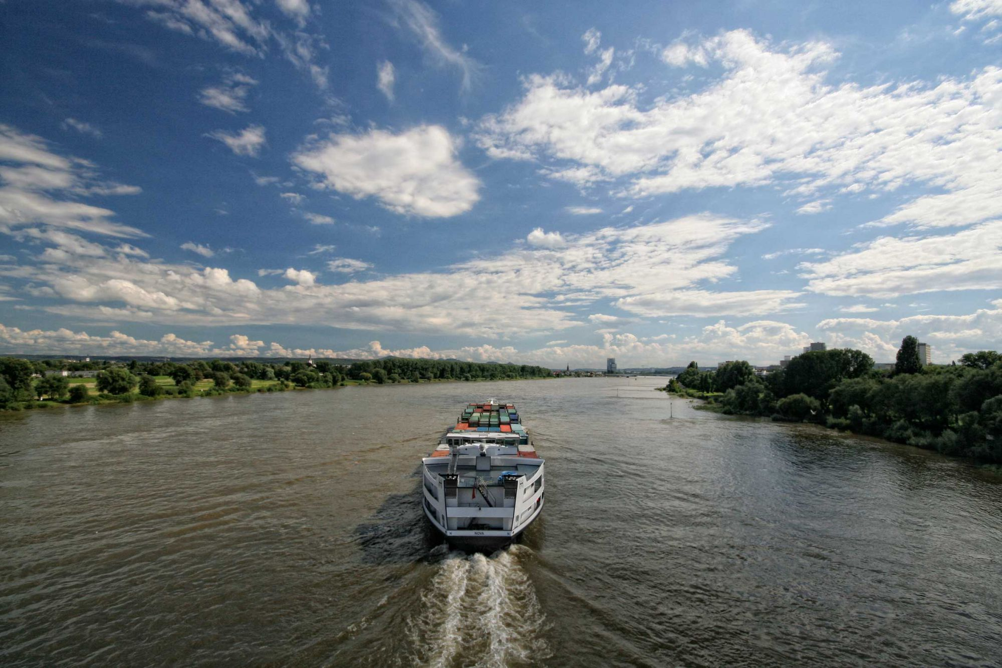
2016.foss4g.org

Slide 30
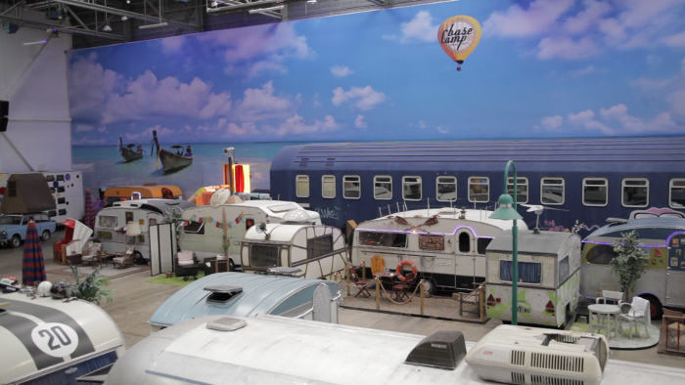



FOSS4G OSGeo Code Sprint Bonn
So 21.8. - Di 23.8
Sa 27.8. - So 28.8.
Weitere Informationen

Slide 31


Happy Birthday!

