Slide 1


Learn how to create
Web Applications with Mapbender
Astrid Emde
FOSS4G 2022 Firenze (Italy)
https://talks.osgeo.org/foss4g-2022-workshops/talk/PSVE7N/

Slide 2

Astrid Emde
Mapbende Developer Team since 2004
Mapbender PSC (Project Steering Committee)
Project management and development, implementations
Trainings for MapServer, PostgreSQL/PostGIS, Mapbender, GeoServer, QGIS
Concept, Testing, Documentation
OSGeoLive PSC since 2017
OSGeo Board 2017-2021
WhereGroup Bonn

Slide 3
WhereGroup
> 40 employees - developers, consultants & geospatial experts
Working with Open Source Software for more than 15 years
Support for WebGIS, SDI, Datenbases, QGIS, Consulting, Training
Company behind Mapbender, Metador & Mops
Bonn – Berlin - Freiburg - Hamburg
FOSSGIS e.V. member & OSGeo sponsor
We are hiring!

Slide 4
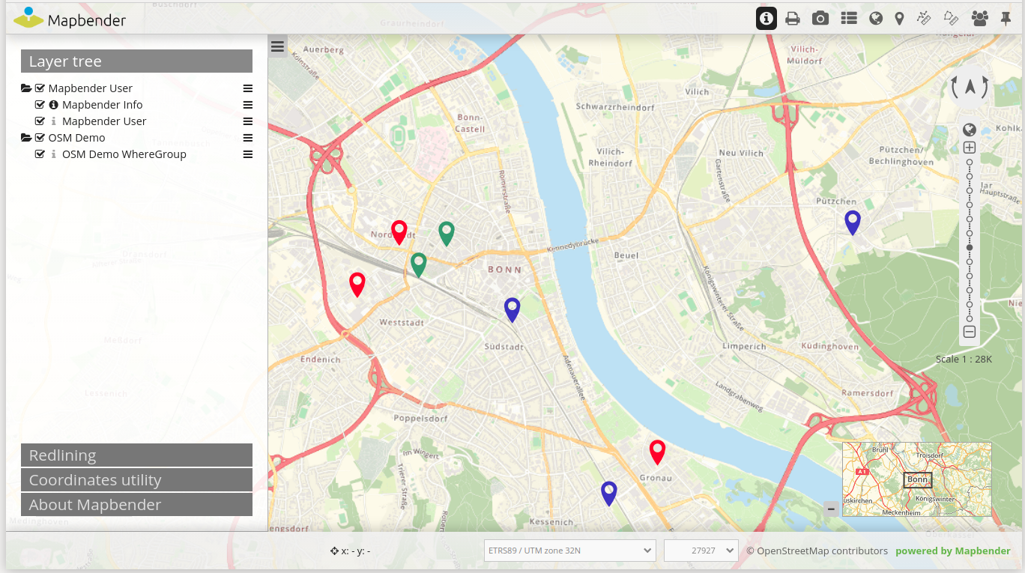
Mapbender-User Demo
Notes:
Basisdienste
Karte
Navigationsleiste (Drag & Drop)
Einfache Diensteübersicht

Slide 5
Workshop
What does Mapbender do?
Architecture and Installation
Register Services
Create your own application
User and group security management
Design adjustments, template printing
Search module and digitizer

Slide 6
Workshop
Mapbender Website https://mapbender.org
Mapbender Galerie https://mapbender.org/en/showcase/
Mapbender Functions https://mapbender.org/en/features/
Mapbender Documentation https://doc.mapbender.org
Mapbender on Github https://github.com/mapbender/
Mapbender Workshop-Package https://github.com/mapbender/mapbender-workshop/
OSGeoLive https://live.osgeo.org

Slide 7
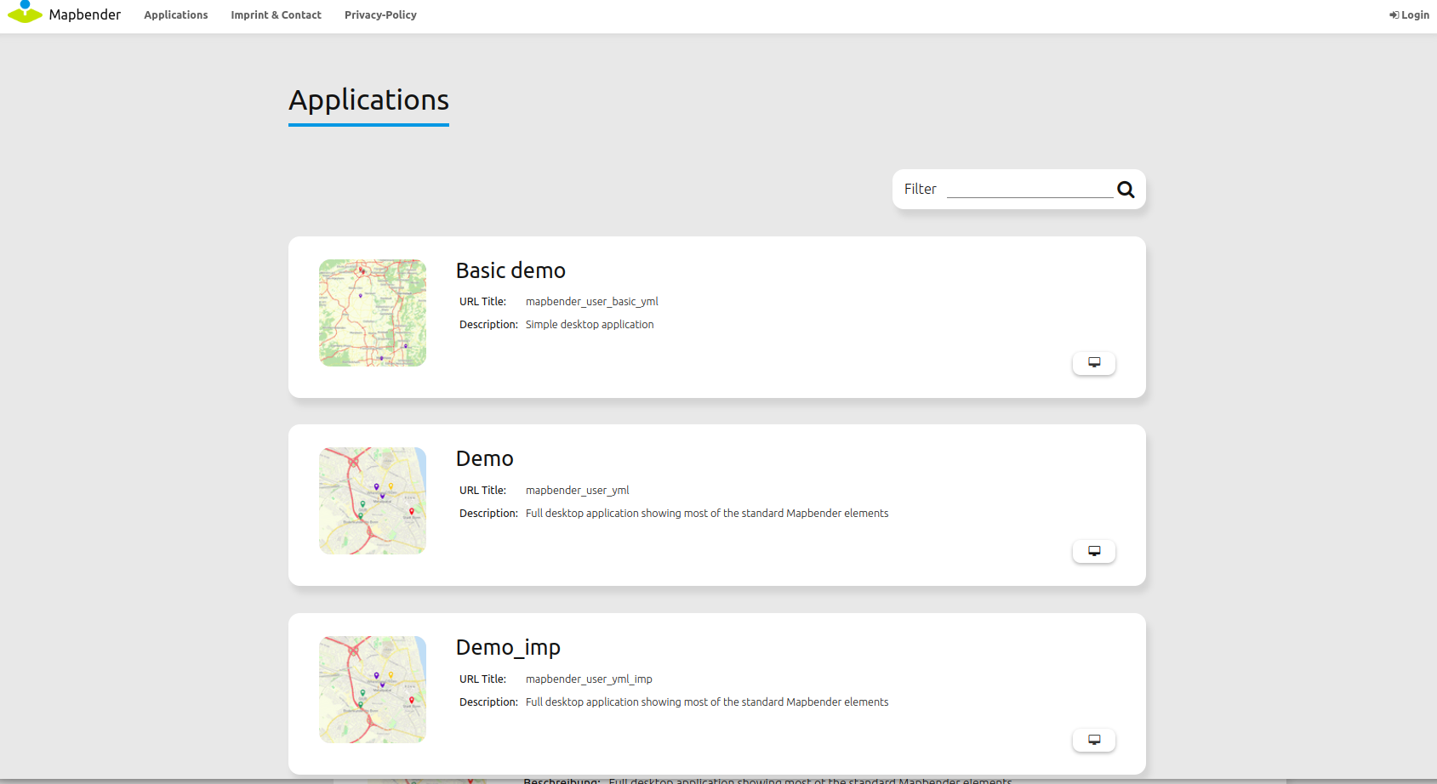
What does Mapbender do?

Slide 8
WebGIS Client Suite
with administration web interface

Slide 9
Create a geoportal without writing a single line of code!

Slide 10
Create and maintain an OWS repository

Slide 11
Distribute configured services among applications

Slide 12
Grant users and groups access to
applications and services

Slide 13

Mapbender Components
Symfony as PHP framework
  Doctrine, Twig, Monolog, Bootstrap...
  Bundles
OpenLayers6
jQuery
Administrative database: SQLite, PostgreSQL, MySQL, Oracle database

Slide 14
Installation
Read about Mapbender Installation
Download https://mapbender.org/en/download/
Or use the code from GitHubhttps://github.com/mapbender/mapbender-starter
Or docker image

Slide 15
Start Mapbender
Productive mode
http://localhost/mapbender/
Developer mode
http://localhost/mapbender/app_dev.php

Slide 16
Find Mapbender on OSGeoLive?
ALIAS mapbender refers to:
/var/www/html/mapbender/web/
app_dev.php → mapbender/web/app_dev.php

Slide 17
Enjoy YAML syntax!
Symfony configuration via YAML
Mapbender configure database, language, mailer & more
parameters.yml
config.yml
Mapbender application can be defined in YAML
  mapbender/app/config/applications/
  Define your application and services

Slide 18
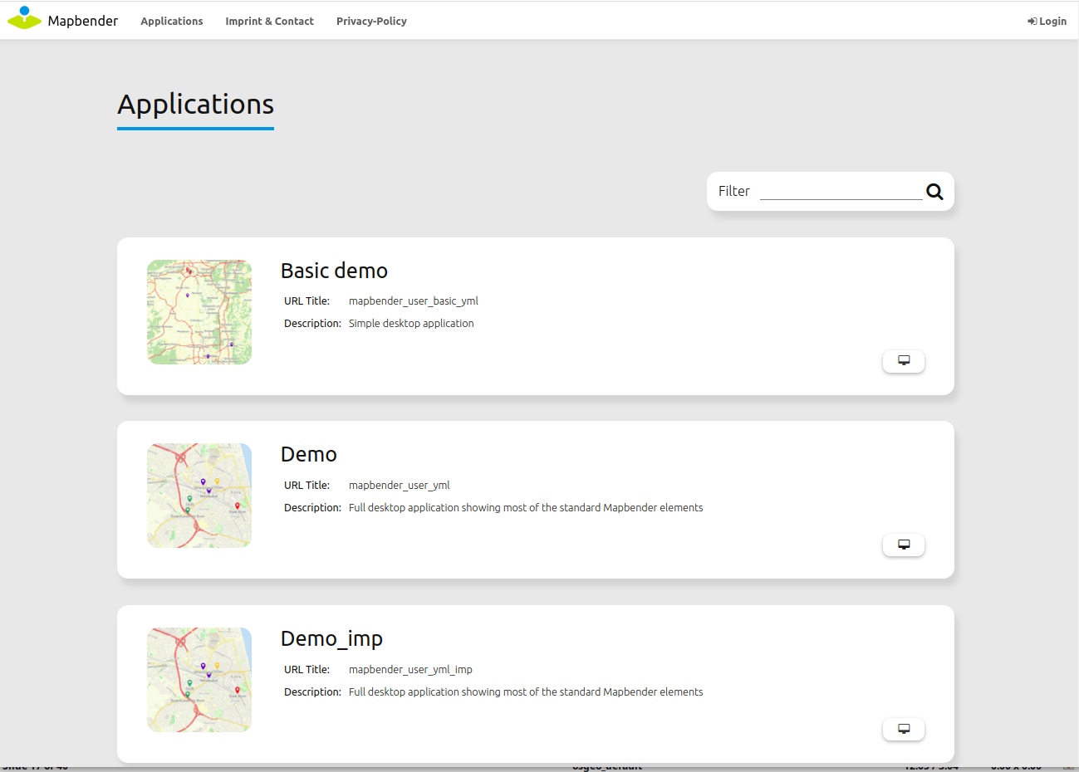
Application Overview
Lists of available
applications
Start Application
Login
Add Links

Slide 19
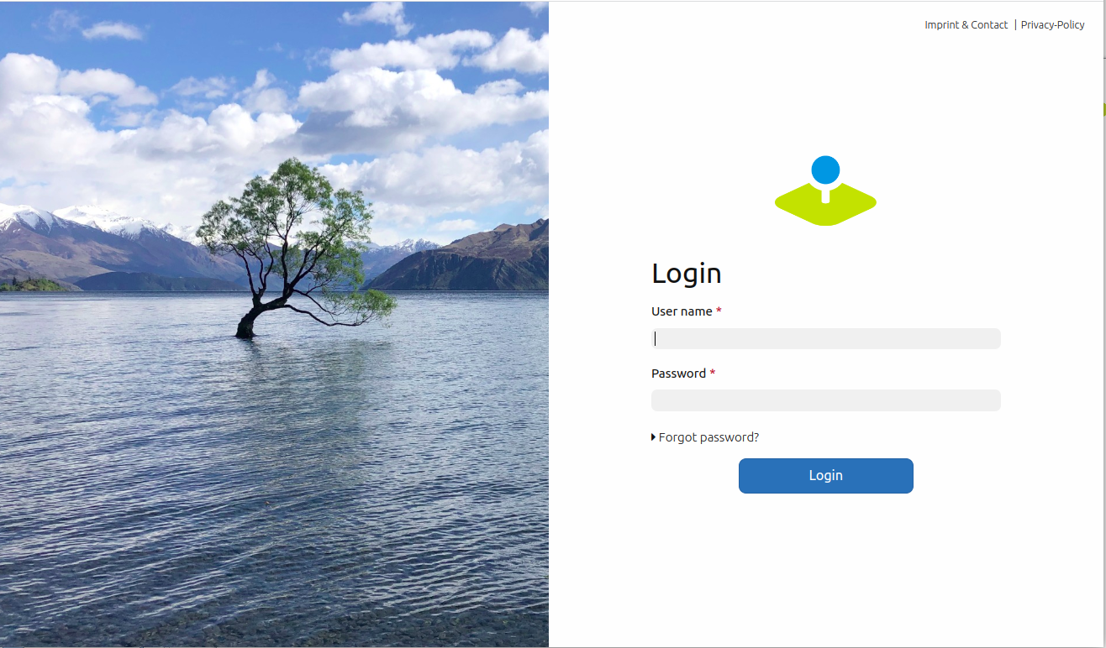
Login
root user is created on installation
You can provide Register and Forgot password functionality

Slide 20
Hands on

Slide 21
Hands on – Part I
Explore with Mapbender
Load OGC WMS
Create your own Application
Populate application with Services
Get elements for your application
Create user and groups
Assign application to user and groups
Assign element access to user and groups

Slide 22
Hands on – Part II
Print
Define an individual Design
Create your own bundle
Setup a Search module
Setup a Digitizer module

Slide 23
Mapbender Documentation
Mapbender Quickstart https://doc.mapbender.org/en/quickstart.html
Element documentation
https://doc.mapbender.org/en/functions.html

Slide 24
Load WMS
OSM WMS
https://osm-demo.wheregroup.com/service?REQUEST=GetCapabilities&Service=WMS&Version=1.3.0
http://localhost/cgi-bin/qgis_mapserv.fcgi?map=/usr/local/share/qgis/QGIS-NaturalEarth-Example.qgz&SERVICE=WMS&VERSION=1.3.0&REQUEST=GetCapabilities
https://sgx.geodatenzentrum.de/wms_topplus_open?request=GetCapabilities&service=wms
Find a WMS Server for you needs
https://inspire-geoportal.ec.europa.eu/
https://inspire-geoportal.ec.europa.eu/results.html?country=it

Slide 25
OGC WMS Italy
http://www.pcn.minambiente.it/mattm/en/view-service-wms/
http://wms.pcn.minambiente.it/ogc?map=/ms_ogc/WMS_v1.3/Vettoriali/Carta_geologica.map&service=wms&request=getCapabilities&version=1.3.0
http://wms.pcn.minambiente.it/ogc?map=/ms_ogc/WMS_v1.3/Vettoriali/Rete_ferroviaria.map&service=wms&request=getCapabilities&version=1.3.0
http://wms.pcn.minambiente.it/ogc?map=/ms_ogc/WMS_v1.3/raster/ortofoto_bn_94.map
http://wms.pcn.minambiente.it/ogc?map=/ms_ogc/WMS_v1.3/Vettoriali/ZPE.map&service=wms&request=getCapabilities&version=1.3.0
http://wms.pcn.minambiente.it/ogc?map=/ms_ogc/WMS_v1.3/servizi-LiDAR/LIDAR_TOSCANA.map&service=wms&request=getCapabilities&version=1.3.0

Slide 26
Load Services to the Mapbender Repository
Sources → Add Source
Load WMS https://osm-demo.wheregroup.com/service?REQUEST=GetCapabilities&Service=WMS&Version=1.3.0
https://sgx.geodatenzentrum.de/wms_topplus_open?request=GetCapabilities&service=wms
Load other Services from Italy

Slide 27
Easy way to create an application
Copy an existing application
Reorder elements and delete everything you do not need
Add your own services

Slide 28

Create your own Application
Create application FOSS4G (copy Demo)
Switch to tab Layout
Edit Map-Element (region content)
  SRS EPSG:4326
  MAX EXTENT Italy lower left 6.649 35.5 upper right 13.701 47.625
  Start Extent Firenze lower left 11.217 43.747
        upper right 11.296 43.801
  Add some more scales
  Add some EPSG Codes 3004, 32632, 3263
  https://epsg.io

Slide 29
Populate application with Services
Switch to tab Layersets
Create a layerset for the Orthophotos and a layerset for different topics like Geology or Infrastructure
Add WMS to your layersets
If necessary configure the services

Slide 30
Activate Layersets in Map-Element
Go back to layout to your map-Element
Choose the layerset/s you would like to display in the main map
Change the ordering for the layersets if needed
Go to the element Layertree activate Thematic Layer

Slide 31
Configure elements for your application
You find information about the elements in the documentation
https://doc.mapbender.org/en/functions.html
Try to integrate some more Elements
HTML – add a notice about FOSS4G
Share URL
View Manager
BaseSourceSwitcher
Application Switcher

Slide 32
Create user
Create user foss4g
User control → User → New User
Define user name, email and password

Slide 33
Assign application to user
Application → pen → Application Security
+ → Select user → Give permission view
Access Control List
Test the permission by registering as user foss4g
Note: You also can assign access to single elements

Slide 34
Create a group
Create a group called workshop
User control → Groups → New Group
Add your user foss4g to the group workshop
Assign an application to your group workshop

Slide 35
CSS Editor
Default style can be overwritten
Switch to tab css-Editor
Define a different button color
Examples:
https://doc.mapbender.org/en/customization/css.html

Slide 36
Try the workshop bundle
Find the workshop bundle at https://github.com/mapbender/mapbender-workshop
https://doc.mapbender.org/en/customization/templates.html

Slide 37
Search with SearchRouter (PostgreSQL)
Define search with SearchRouter
SQL Search using PostgreSQL
https://doc.mapbender.org/en/functions/search/search_router.html
Setup a database connection in parameters.yml and config.yml
Define the search form as YAML definition

Slide 38
Search with Element SimpleSearch
Solr, Nominatim, Photon, OGC API Features
https://doc.mapbender.org/en/functions/search/simplesearch.html

Slide 39
Digitizer
Define digitze functionality
Edit directly on a database table
https://doc.mapbender.org/en/functions/editing/digitizer.html

Slide 40
How can I participate?
Testing
Reporting Feedback and Bugs
Documentation
Programming
Mailing lists
Translation
Join us during the FOSS4G Community Sprint on Saturday!
FOSS4G 2022 Community Sprint

Slide 41

Thanks you for your attention!
Question? Please contact us
Astrid Emde astrid.emde@wheregroup.com
or
mapbender-users@list.osgeo.org
https://talks.osgeo.org/foss4g-2022-workshops/talk/PSVE7N/
With the kind support of
Creative Commons Share Alike License 4.0

