Slide 1


Fun with
Foreign Data Wrappers
Get access to other Sources via FDW
Astrid Emde, WhereGroup
FOSS4G 2019 Bucharest (Romania)

Slide 2

Astrid Emde
Mapbender Team & PSC member
Bonn (Germany)
Project management and less development, trainings for MapServer, PostgreSQL/PostGIS, Mapbender, GeoServer
Mapbender Concept, Testing, Documentation
OSGeoLive PSC since 2017
OSGeo Board since 2017
Notes:
Major Mapbender sponsor
Company in Bonn, Germany with 18 employees
Service provider with experience in all fields of spatial data management with free software: WebGIS, SDI, database, relevant standards, trainings, conferences
Open Source projects: Mapbender, PostNAS

Slide 3

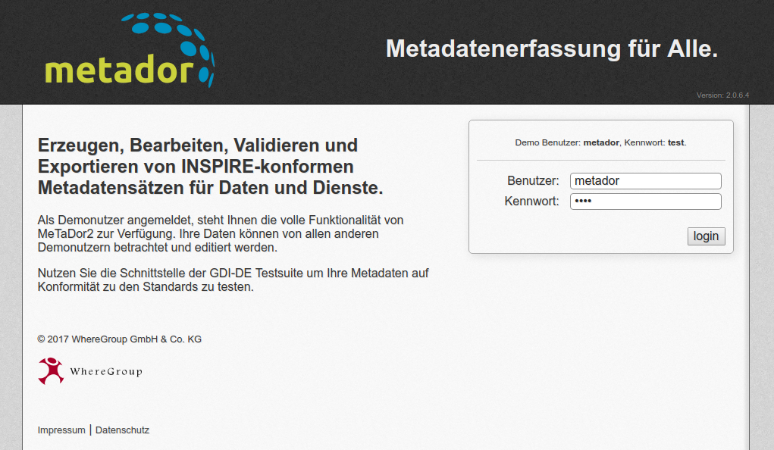

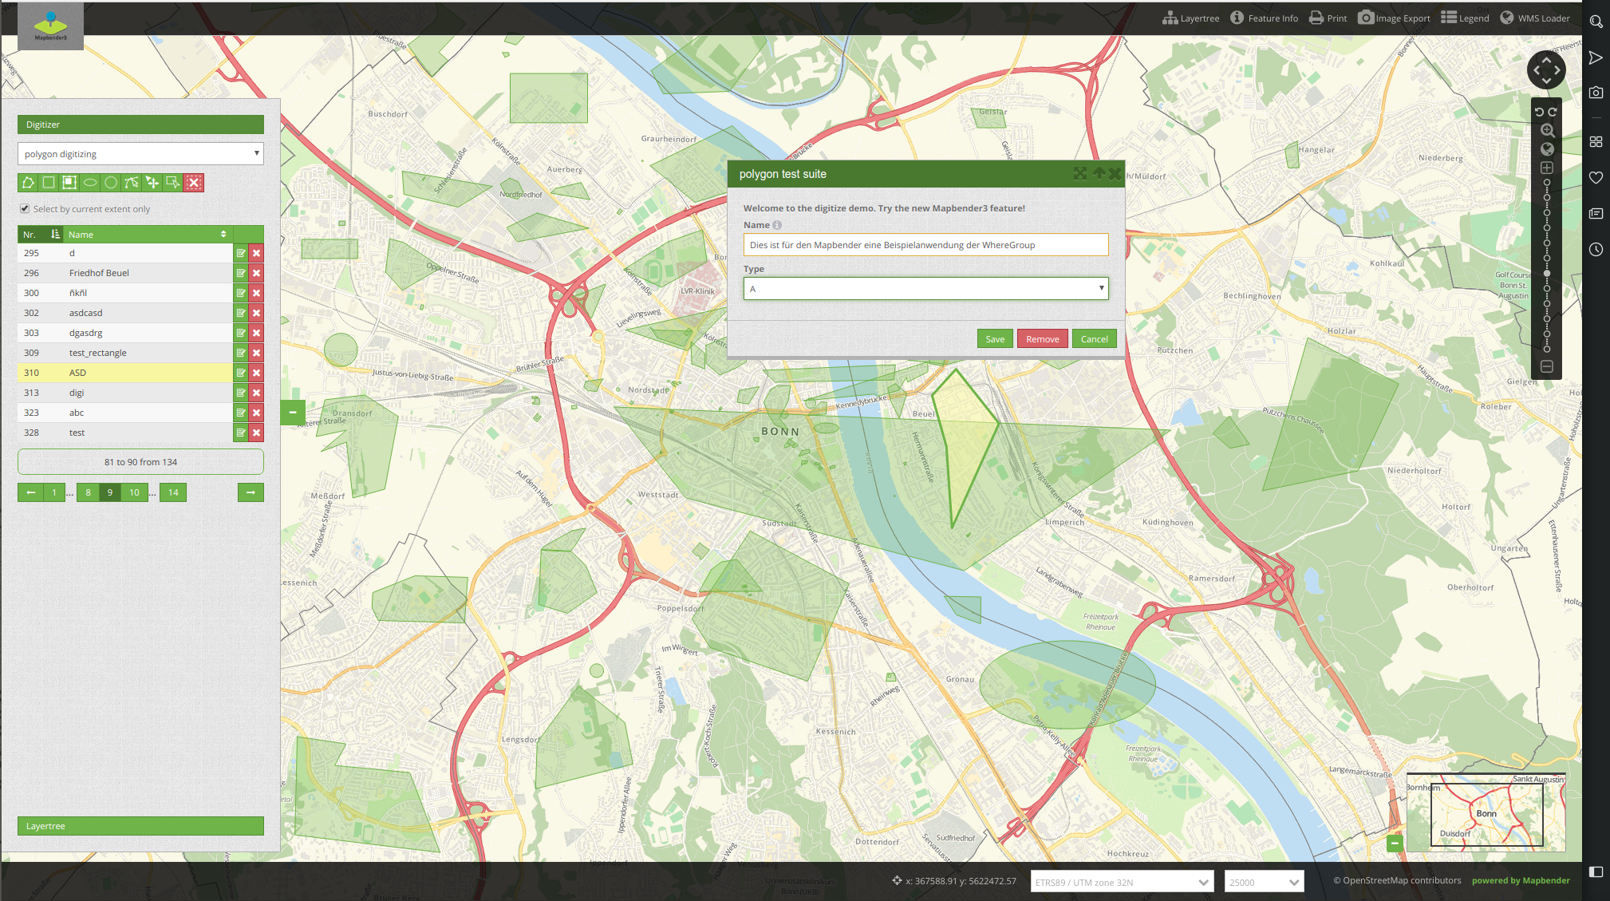

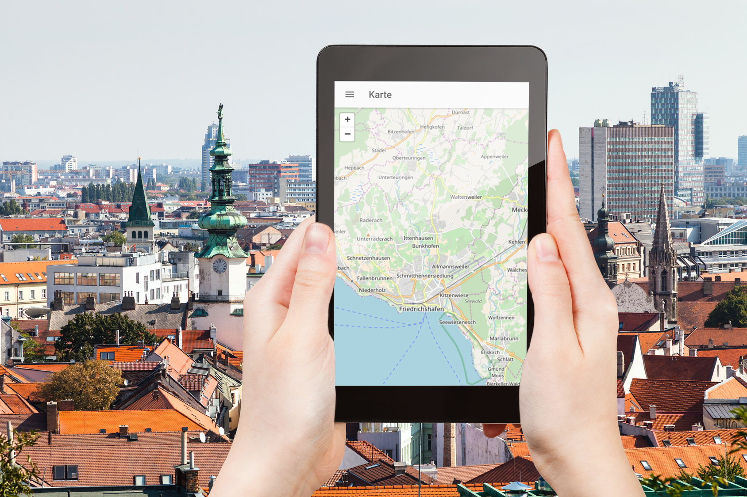
WhereGroup
Notes:
Major Mapbender sponsor
Company in Bonn, Germany with 18 employees
Service provider with experience in all fields of spatial data management with free software: WebGIS, SDI, database, relevant standards, trainings, conferences
Open Source projects: Mapbender, PostNAS

Slide 4
FOSS4G Community Sprint 2019
Don‘t miss it!
Saturday 31.8.2019
https://wiki.osgeo.org/wiki/FOSS4G_2019_Community_Sprint

Slide 5
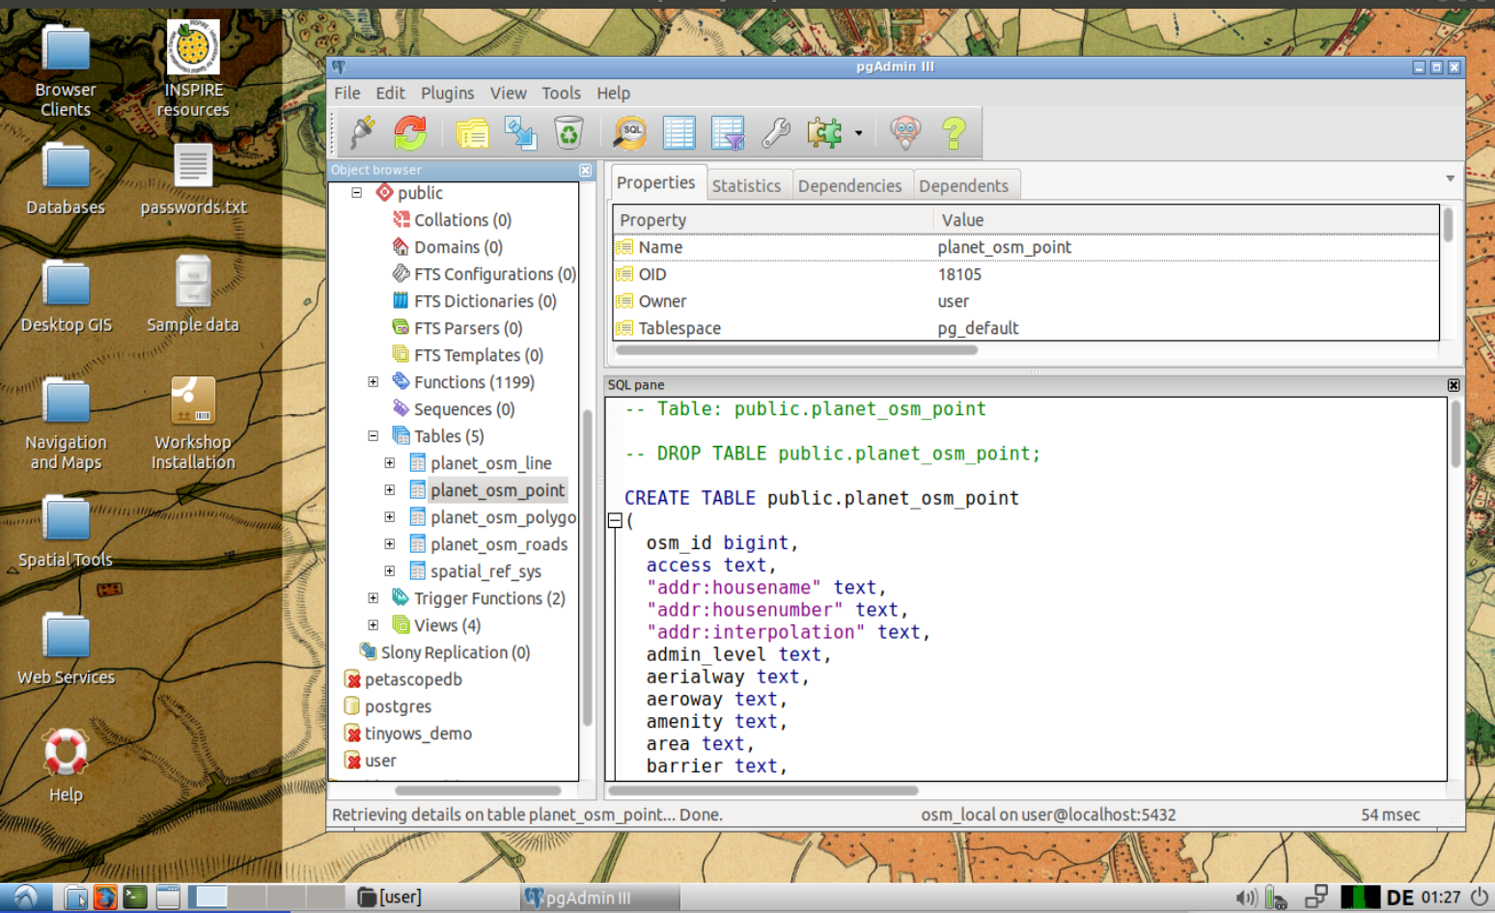
Try the presentation with OSGeoLive
Get pgAdmin 4
sudo apt-get install pgadmin4

Slide 6
What are Foreign Data Wrappers - FDW
& why is it fun to work with them?

Slide 7
Why FDW?
... but we already have dblink

Slide 8
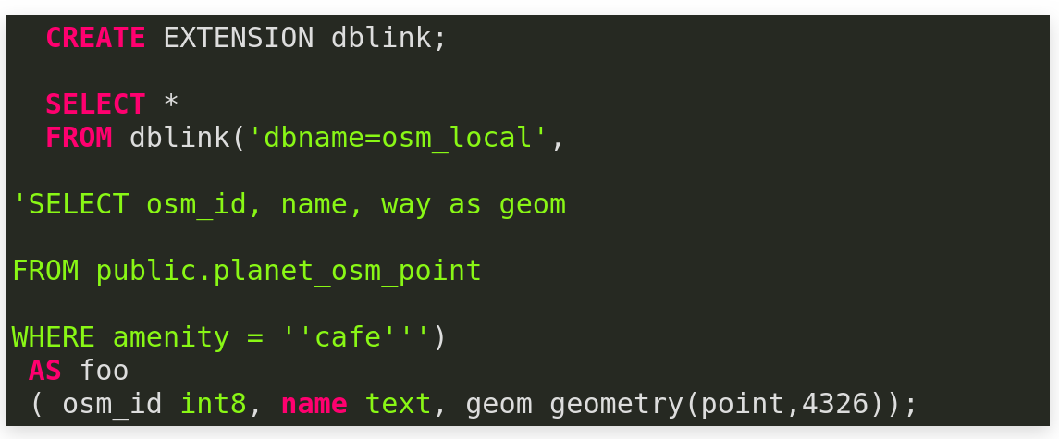
DBLINK
... but we already have dblink

Slide 9
SQL/MED Standard
Based on the SQL/MED Standard
SQL Management of External Data
SQL Standard from by ISO/IEC 9075-9:2008
Defines how a database can connect to external datasources
https://wiki.postgresql.org/wiki/SQL/MED

Slide 10
FDW in general
FDW in general
not many implementations
MariaDB CONNECT - but not following the standard
IBM/DB2

Slide 11
FDW in PostgreSQL
added in 2011 with read-only support (9.1)
2013 write support (9.3)

Slide 12
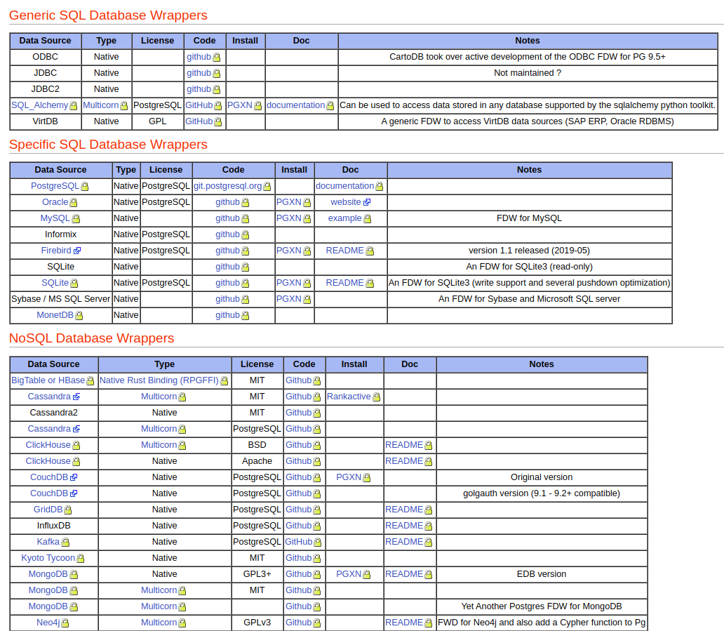
https://wiki.postgresql.org/wiki/Foreign_data_wrappers

Slide 13
PostgreSQL FDW
many other sources are supported
other SQL databases
flat files
geospatial data sources
Twitter
https://wiki.postgresql.org/wiki/Foreign_data_wrappers
Different installation, some with PGEX PostgreSQL Extension Network

Slide 14
Connect PostgreSQL to to PostgreSQL Database
Connect natural_earth2 with osm_local
Load Extension postgres_fdw
Create a foreign Server
Create a foreign User
Create a foreign Table
Have Fun!

Slide 15
Load Extension

Slide 16
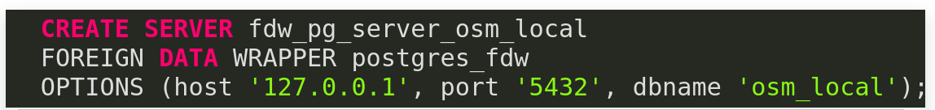
Foreign Server

Slide 17

User Mapping

Slide 18
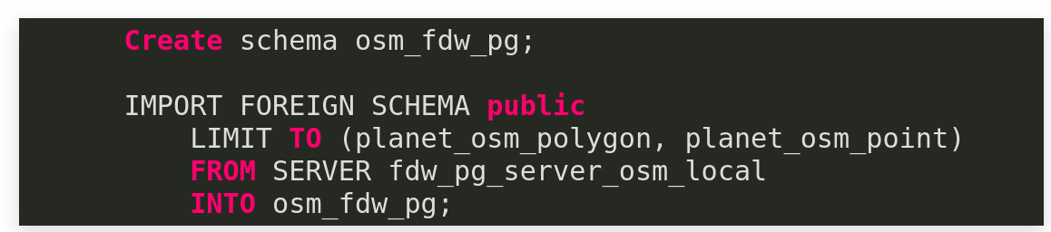
CREATE FOREIGN TABLE
LIMIT TO (tablename, tablename)
EXCEPT (tablename, tablename)

Slide 19
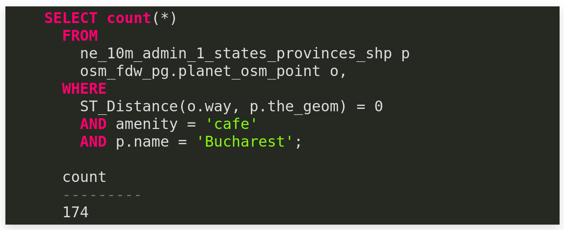
Combine tables as if there are in your database

Slide 20
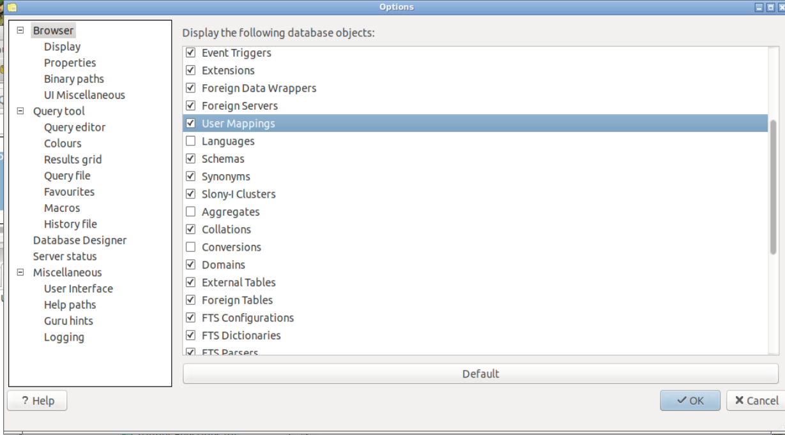

Slide 21
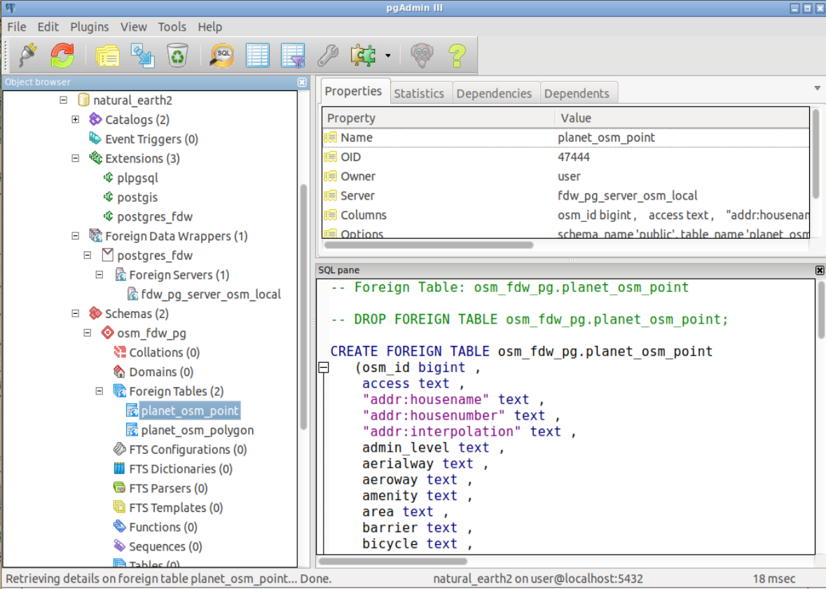

Slide 22
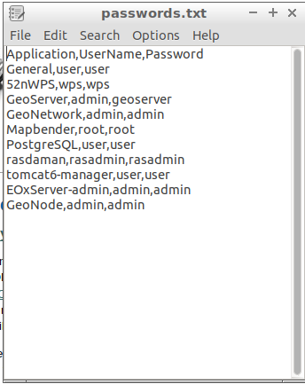
file_fdw
https://www.postgresql.org/docs/current/file-fdw.html
CREATE EXTENSION file_fdw;
/home/user/Desktop/passwords.txt
CREATE SERVER fdw_server_file
FOREIGN DATA WRAPPER file_fdw;

Slide 23
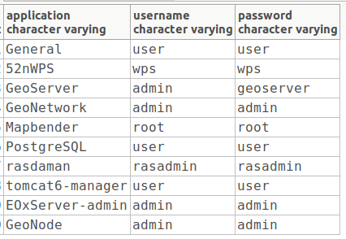
file_fdw
CREATE FOREIGN TABLE passwords (
application varchar,
username varchar,
password varchar
) SERVER fdw_server_file
OPTIONS (
filename '/home/user/Desktop/passwords.txt', format
'csv',
header 'true'
);
Select * from passwords;

Slide 24
Connect from PostgreSQL to
ORACLE Database
Load Extension oracle_fdw
Create a foreign Server
Create a foreign User
Create a foreign Table
Have Fun!

Slide 25
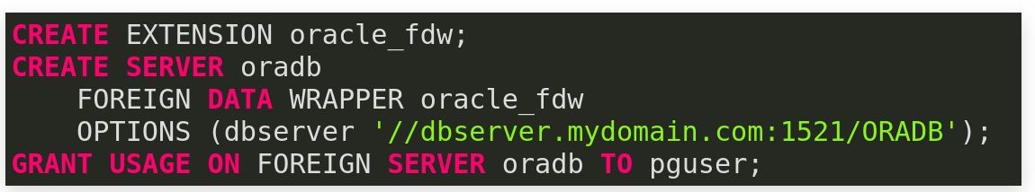
oracle_fdw
CREATE USER MAPPING FOR pguser SERVER oradb
OPTIONS (user 'orauser', password 'orapwd');
CREATE FOREIGN TABLE oratab (
id integer OPTIONS (key 'true') NOT NULL,
text character varying(30),
floating double precision NOT NULL
) SERVER oradb OPTIONS (schema 'ORAUSER', table 'ORATAB');

Slide 26
oracle_fdw
Combine tables as if there are in your database
Pushdown of WHERE Clause
Pushdown of requierd columns
EXPLAIN Support

Slide 27
OGR FDW
FDW by Paul Ramsey
Many formats like Geopackage, WFS, OSM, ESRI Shape, KML, …
Even WFS 3.0

Slide 28
How to install OGR FDW?
Download & compile ogr_fdw on yourself
or use OSGeoLive 13.0
packages available
https://packages.ubuntu.com/source/bionic/pgsql-ogr-fdw
https://packages.debian.org/sid/postgresql-10-ogr-fdw
sudo apt-get install postgresql-10-ogr-fdw

Slide 29
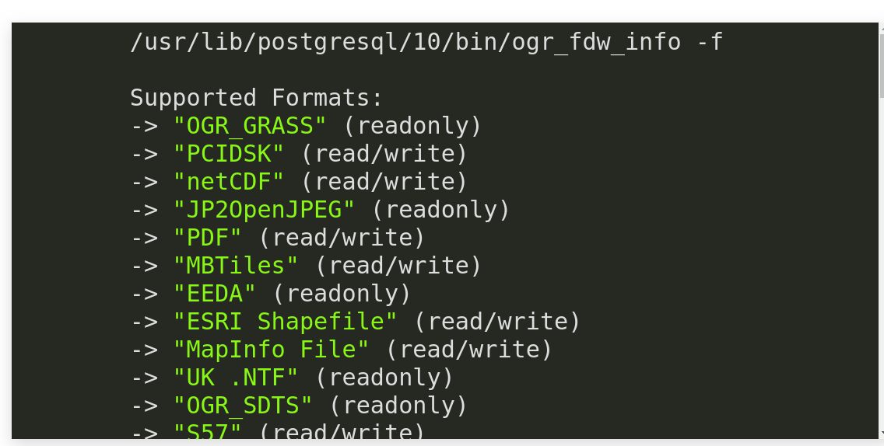
OGR FDW Formats
See availabe formats

Slide 30

OGR FDW and ESRI Shape
Connect natural_earth2 ESRI SHP
Load Extension ogr_fdw
Create a foreign Server
Create a foreign User
Create a foreign Table
Have Fun!

Slide 31
Load Extension
CREATE EXTENSION ogr_fdw;

Slide 32
Have a look at your data
cd /usr/lib/postgresql/10/bin/
./ogr_fdw_info -s /home/user/data/natural_earth2/
Layers:
ne_10m_geography_marine_polys
ne_10m_geography_regions_points
ne_10m_urban_areas
ne_10m_populated_places
ne_10m_admin_0_countries
ne_10m_geography_regions_polys
ne_10m_admin_1_states_provinces_shp
ne_10m_geography_regions_elevation_points
ne_10m_lakes
ne_10m_ocean
ne_10m_rivers_lake_centerlines
ne_10m_land

Slide 33
Create Foreign Server
CREATE SERVER myserver
FOREIGN DATA WRAPPER ogr_fdw
OPTIONS (
datasource '/home/user/data/natural_earth2/',
format 'ESRI Shapefile' );

Slide 34
Create Foreign Table
CREATE FOREIGN TABLE ne_10m_populated_places (
fid bigint,
geom Geometry(Point,4326),
scalerank integer,
natscale integer,
labelrank integer,
featurecla varchar,
name varchar,
namepar varchar,
namealt varchar,
diffascii integer,
…...
pop2010 real,
pop2015 real,
pop2020 real,
pop2025 real,
pop2050 real,
cityalt varchar
) SERVER myserver
OPTIONS (layer 'ne_10m_populated_places');

Slide 35
Encod?ng
'utf-8' codec can't decode byte 0xed in position 1: invalid continuation byte
CREATE SERVER myserver_latin1
FOREIGN DATA WRAPPER ogr_fdw
OPTIONS (
datasource '/home/user/data/natural_earth2/',
format 'ESRI Shapefile',
config_options 'SHAPE_ENCODING=LATIN1');
Set client_encoding to UNICODE;

Slide 36
OGR FDW und OSM
Examine your data
/usr/lib/postgresql/10/bin/ogr_fdw_info -s /home/user/feature_city.osm
Layers:
points
lines
multilinestrings
multipolygons
other_relations

Slide 37
ogr_fdw_info writes SQL for you
/usr/lib/postgresql/10/bin/ogr_fdw_info -s /home/user/feature_city.osm -l points
CREATE SERVER myserver_osm
FOREIGN DATA WRAPPER ogr_fdw
OPTIONS (
datasource '/home/user/feature_city.osm',
format 'OSM' );
CREATE FOREIGN TABLE points (
fid bigint,
geom Geometry(Point,4326),
osm_id varchar, name varchar,
barrier varchar, highway varchar,
ref varchar, address varchar,
is_in varchar, place varchar,
man_made varchar,
other_tags varchar
) SERVER myserver_osm
OPTIONS (layer 'points');

Slide 38
ogr_fdw_info writes SQL for you
/usr/lib/postgresql/10/bin/ogr_fdw_info -s /home/user/feature_city.osm -l points
CREATE SERVER myserver_osm
FOREIGN DATA WRAPPER ogr_fdw
OPTIONS (
datasource '/home/user/feature_city.osm',
format 'OSM' );
CREATE FOREIGN TABLE points (
fid bigint,
geom Geometry(Point,4326),
osm_id varchar, name varchar,
barrier varchar, highway varchar,
ref varchar, address varchar,
is_in varchar, place varchar,
man_made varchar,
other_tags varchar
) SERVER myserver_osm
OPTIONS (layer 'points');

Slide 39
FDW and EXPLAIN ANALYZE
Total points: 77003
Select count(*) from points where highway = 'traffic_signals';
-------
600
EXPLAIN ANALYZE
Select count(*) from points where highway = 'traffic_signals';
"Aggregate (cost=1027.50..1027.51 rows=1 width=8) (actual time=2586.355..2586.355 rows=1 loops=1)"
" -> Foreign Scan on points (cost=25.00..1025.00 rows=1000 width=0) (actual time=3.047..2586.076 rows=600 loops=1)"
" Filter: ((highway)::text = 'traffic_signals'::text)"
"Planning time: 34.801 ms"
"Execution time: 2637.603 ms"

Slide 40
OGR FDW netCDF Support
/usr/lib/postgresql/10/bin/ogr_fdw_info -s /home/user/data/netcdf/rx5dayETCCDI_yr_MIROC5_historical_r2i1p1_1850-2012.nc
Layers:
rx5dayETCCDI_yr_MIROC5_historical_r2i1p1_1850-2012
CREATE SERVER myserver_netcdf
FOREIGN DATA WRAPPER ogr_fdw
OPTIONS (
datasource '/home/user/data/netcdf/rx5dayETCCDI_yr_MIROC5_historical_r2i1p1_1850-2012.nc',
format 'netCDF' );
CREATE FOREIGN TABLE rx5dayetccdi_yr_miroc5_historical_r2i1p1_1850_2012 (
fid bigint,
time real
) SERVER myserver_netcdf
OPTIONS (layer 'rx5dayETCCDI_yr_MIROC5_historical_r2i1p1_1850-2012');
Select * from rx5dayetccdi_yr_miroc5_historical_r2i1p1_1850_2012;

Slide 41
OGR FDW and WFS Support
WFS is supported
Readonly
CREATE SERVER myserver_wfs_qgis_server
FOREIGN DATA WRAPPER ogr_fdw
OPTIONS (
datasource 'WFS:http://localhost/cgi-bin/qgis_mapserv.fcgi?map=/home/user/world.qgz',
format 'WFS',
config_options 'CPL_DEBUG=ON');

Slide 42
OGR FDW and WFS
Create schema fdw_wfs_qgis_server;
IMPORT FOREIGN SCHEMA ogr_all
FROM server myserver_wfs_qgis_server
INTO fdw_wfs_qgis_server;
Show client_min_messages;
SET client_min_messages=debug2;
Select * from fdw_wfs_qgis_server.ne_10m_admin_0_countries;

Slide 43
Thank you
Astrid Emde
WhereGroup GmbH
https://wheregroup.com
astrid.emde@wheregroup.com

