Slide 1
Sextractor & Spark
https://www.astromatic.net/software/sextractor
Installed in the Spark cluster @LAL (all workers) (+ lapack, atlas, fftw)
Principle to install sextractor into a Spark pipeline:
Sextractor is a standalone application to be applied onto one single FITS image
By default a set of parameters are provided in the sextractor package (=> default algorithms)
Extract objects from the image into a catalog (=> a table of object characteristics [float])
Object characteristics must be selected from a fixed list of ~300 predefined keys => flot values
=> we parallelize N runs from N images
Output of a run is sent to the Spark data flow as one combined dataframe
Can select values extracted from the FITS header file
Send all selected catalog columns
Then the assembled dataframe may be used to perform combined analyses

Slide 2
Sextractor & Spark
To submit one sextractor run, we define one UDF
Input:
The FITS file name
List of FITS keys to be extracted from the FITS header: List[any]
list of selected keys to the catalog production : List[float]
Operation:
read the FITS header
Build the param.default file to be given to sextractor
Run sextractor and format catalog from stdout
Ouput: (the selected header values + the produced catalog) : List[any]
def run_sextractor(fitskeys: List[str], keys: List[str], image_file: str) -> List[str]: outfits = run_fits(fitskeys, image_file)
with open("default.param", "w") as f: for k in keys: f.write(k + "\n")
conf = "-c /usr/local/share/sextractor/default.sex" filter = "-FILTER_NAME /usr/local/share/sextractor/default.conv" params = "-PARAMETERS_NAME default.param" sex = "/usr/local/bin/sex {} {} {} -CATALOG_NAME STDOUT".format(conf, params, filter) command = "{} {}".format(sex, image_file)
rawout = subprocess.run(command.split(), stdout=subprocess.PIPE, stderr=subprocess.PIPE).stdout.decode('utf-8').split("\n")
out = [outfits + list(map(lambda x: float(x), re.sub("[ \t]+", ";", i).split(";")[1:])) for i in rawout if len(i) > 0 and i[0] != "#"]
return out
aa

Slide 3
Sextractor & Spark
The Spark pipeline
fitskeys = ["RA_DEG", "DEC_DEG", "FILTER", "RUNID"]
keys = ["NUMBER", "EXT_NUMBER", "FLUX_ISO", "MAG_ISO", "ALPHA_SKY", "DELTA_SKY", "FLUXERR_ISO", "MAGERR_ISO"]
images_for_CFHT_dataset = "/lsst/data/CFHT/rawDownload/*/*.fits"
files = random.sample(glob.glob(images_for_CFHT_dataset), N)
rdd = spark.sparkContext.parallelize(files, len(files)).flatMap( lambda x : run_sextractor(fitskeys, keys, x))
df = rdd.toDF(fitskeys + keys).cache()
data = df.sample(False, 0.1).select("ALPHA_SKY", "DELTA_SKY").toPandas().get_values().transpose()
x = data[0].astype(float)
y = data[1].astype(float)
plt.scatter(x, y, marker='.')
plt.show()

Slide 4
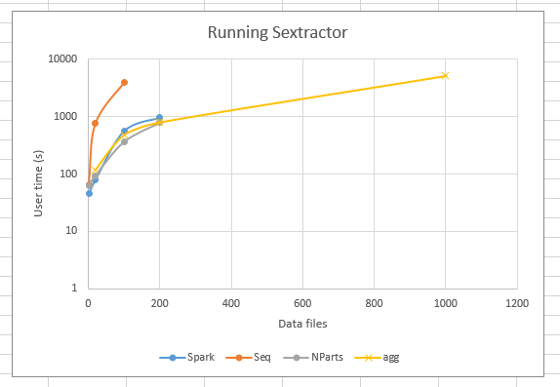
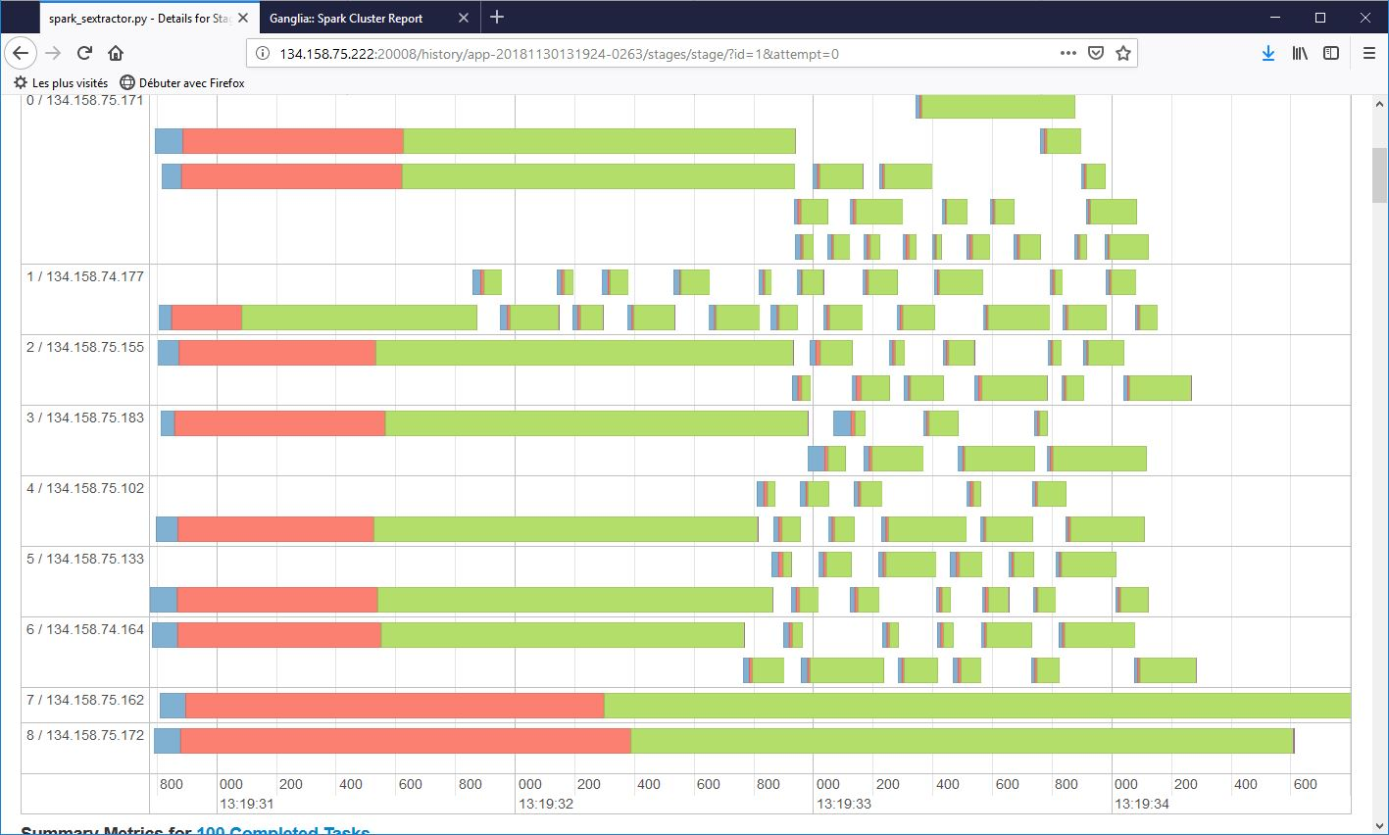
Sextractor plain bash without Spark
Spark with 10 partitions
Spark with increasing partitions
Aggregate FITS header + all catalogs N partitions
SparkUI:
Homogeneous repartitions
Of resource usage
(9 workers, 100 files)
Time for 9 workers is ~1/10 the
time for raw execution without Spark:
sextractor runs with same execution mode
In both cases (multithreading)

