Slide 1
Least-privileged principals of container security

Slide 2
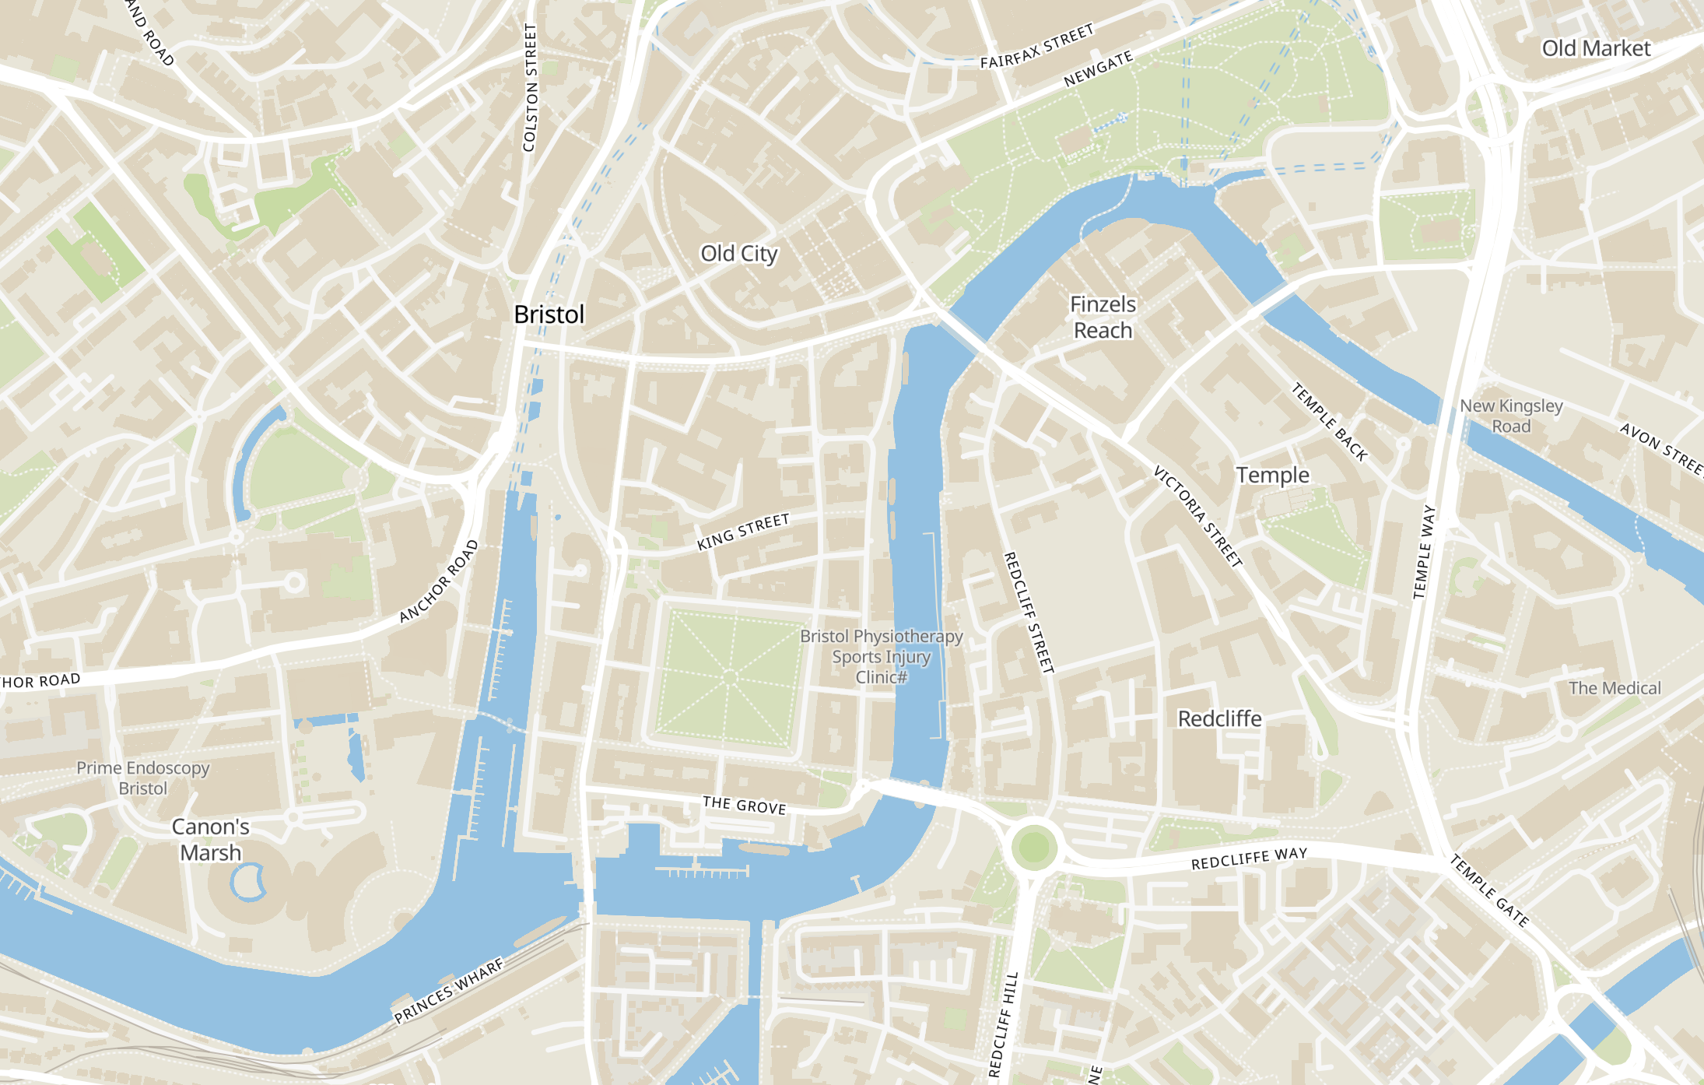
Who am I?
Ben (he/him)
Distributed systems dev at Oracle’s Bristol office
Security interests
Cryptographic systems
Process isolation
etc..
Currently building “serverless” systems like Functions, API Gateways, Kubernetes, etc..

Slide 3
I’m here to talk about Kontainers containers,

Slide 4
And a bit about designing security into distributed systems*
* I’m not an expert

Slide 5
Hopefully you’ll all learn something,

Slide 6
Or at least be intrigued.

Slide 7
Why my team cares about this stuff?
There are in fact, lots of servers in ”serverless” systems
They’re just shared a lot.. (multi-tenant)
HTTP(S) and customer-specific logic the norm
Separation between customers is:
Thin
Fast and cheap
Full of tradeoffs
We’re learning a lot, we’re only human, we make mistakes, and so we try to design systems that are impervious by design rather than by checkbox.

Slide 8
A quick intro, Securing a system by modelling information and control flow

Slide 9
Control and decision making should always flow in one direction
A
X
X should not be able to dictate the actions of A (ideally)

Slide 10
Observations of state can flow back up, but not the state itself
A
X

Slide 11
Any state that does go up, should be from a bounded set
A
X
“Whats your name?”
“My name is Max”
Hmm, I’m going to assume their name is really Unknown since I only know {Alice, Bob, Charlie}..

Slide 12
These kinds of systems are often separated into ”Control” and “Data” planes
A
X
Control plane
Data plane
Customers
Customer’s customers
Slow lifecycles
Rapid, short-lived lifecycles
Initialize, setup, connect, design
Throughput, Availability, Redundant

Slide 13




A quick example distributed system (TODO servers?)
😇
Control plane
Data plane
👹
😇
👹
⛔️
⛔️
⛔️
”Create me a TODO server pls”
“Create a TODO pls”

Slide 14
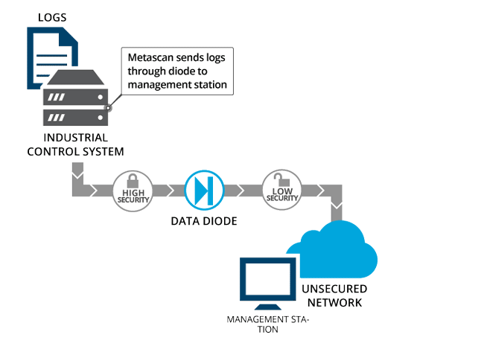
Random Aside: Data Diodes?
One way data transfer
Literally an air gap
You don’t get ACKs
You might get a success/fail
Between networks/buildings/companies (not usually individual machines)

Slide 15
So you might be thinking: “What does this have to do with containers?”

Slide 16
Well, lets zoom in..

Slide 17
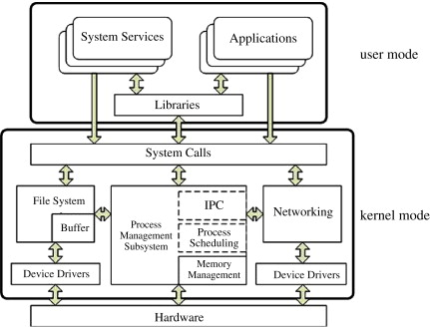
One of our data-plane instances is almost a distributed system on its own
Control surface?
REST API exposed to external network
State storage?
Virtual Filesystem
Ram
Etc.
Message passing?
IPC, signals
Sockets
Operational plane?
Docker Daemon
Dataplane?
Network stack listening externally
Firewalls?
Namespaces
Resource and bandwidth limits?
Cgroups etc?

Slide 18
Looks fairly similar right?! Does that mean we can try follow the same control/state flows as before and hope for the best?

Slide 19
Unfortunately, it’s a bit harder.. We no longer have physical separation*.
* Did we ever have physical separation in the same hypervisor/rack/AD/country?

Slide 20
How does this break our security models?
From the previous talk we know vulnerabilities in HTTP services can be used to execute or access arbitrary files.
“Vulnerabilities are possible” ∴ “We have unknown vulnerabilities” ∴ “Someone is exploiting our unknown vulnerabilities”.
Similar to “Hardware can fail” ∴ ”Hardware will fail” ∴ “Hardware is failing in some way right now”.
This is a good assumption to make even if it it isn’t realistic. It informs our architecture and design.

Slide 21
Assign the smallest available set of functionality to each component of the system. Reduce the set of possible vulnerabilities from <almost certain> to <very unlikely>.

Slide 22
This is what we’re calling “least privileged” in this talk

Slide 23
So how do we achieve this in Linux systems? Containers! 🎉

Slide 24
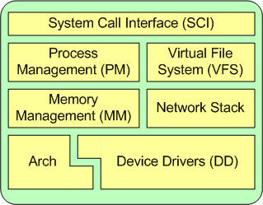
Want to do anything on the machine?
You’ll probably need a system call (syscall).
A switch from user-mode to kernel-mode, executing a task, and then switching back
Eg:
Opening things
Writing things
Reading things
Signaling things
Spawning things
Etc.. x436
Linux “containers” change the view of a process by defining “namespaces” which change the objects that the syscalls from a process can interact with.

Slide 25
Basic attributes of namespaces
Types of namespaces:
cgroups, IPC, Network, Mount, PID, User, UTS
Anchored to the lifespan of a process
Processes can clone and switch namespaces (if allowed)
Multiple processes can be in one namespace at a time
http://man7.org/linux/man-pages/man7/namespaces.7.html

Slide 26
Basic example of a mount namespace
Example mount namespace:
Mount file system A at path /
Mount file system B at path /foo/
Mount file system C at path /bar/
= Virtual File System Tree
If a process wants to open a file /foo/hello.txt I might execute a open(/foo/hello.txt, ..) call.
A process in another mount namespace, might have a totally different arrangement.
http://man7.org/linux/man-pages/man7/namespaces.7.html

Slide 27
This is where Docker images and bind mounts operate!
Docker images are made of layers
Assemble the layers of my docker image into a copy-on-write filesystem mounted at /
Create a procfs and mount it at /proc
Create a tmpfs and mount it at /tmp
Bind mount an inode from a host file system onto /foo/bar

Slide 28
So what’s the best we can do for the least privileges in our mount namespace?

Slide 29
1. Restrict what files can be read in the namespace
Tend towards smaller base images
Ubuntu -> *-slim → Alpine → busybox | <Smith-ified image>
Ideal target here is that your image contains only the binary you wish to run + its runtime.
Don’t blindly mount host file systems
https://github.com/oracle/smith

Slide 30
2. Restrict what files can be written in the namespace
Goal: read only root filesystem
--read-only root file system
Goal: read only bind mounts
--mount type=bind,..,readonly
Goal: if you need writeable space, use a tmpfs
--tmpfs rw,size=xxx,…

Slide 31
3. Restrict what files can be executed in the namespace
Goal: always use noexec and nosetuid with –tmpfs

Slide 32
4. Constrain file ownership
In your image build:
USER: 99
RUN: chown –R 99:99
(erase setuid bits)
In your tmpfs:
..,uid=99,gid=99,..
http://man7.org/linux/man-pages/man5/tmpfs.5.html

Slide 33
5. Constrain file limits
(Really resource related, but goes well with this topic)
With –tmpfs:
..,inodes=100
On Docker launch:
--ulimits nofile=1024:1024

Slide 34
😃 Awesome, so my container is secure now?

Slide 35
Well that was only one type of namespace, and only a handful of the hundreds of available syscalls in total

Slide 36
Sidebar: root and capabilities
The root user with uid=0 still exists inside Docker containers
And it has some non-trivial capabilities by default:
CHOWN
NET_RAW
KILL
SETUID
NET_BIND_SERVICE
Etc.
So please use –cap-drop=all!
Add explicit –cap-add=X if absolutely required (NET_RAW)
Do not use –privileged 😳
http://man7.org/linux/man-pages/man7/capabilities.7.html

Slide 37
User namespaces
If a container wants to run as root with certain capabilities, you can still remap the user so that it isn’t == root on the host.
This is called userns remapping:
Map uid/gid X in the container to Y on the host
So even if the process does break out of some container namespaces, its uid/gid are still in the user namespace

Slide 38
Network Namespaces

Slide 39
Isolate everything to do with the network stack:
Devices
IP stacks
Socket numbers
Iptables
Routing rules
Etc

Slide 40
This is what Docker uses for each container
Creates a new network namespace with the container anchor process
Creates a virtual-eth interface on the bridge network
Creates a veth interface in the container network namespace and links them
Configures veth interface in container for ip address, mac address, routing rules
There are many different ways of doing container networking.

Slide 41
Can we go further? Yes!

Slide 42
Namespacing physical interfaces
You can move physical network devices into a containers network namespace!
Set up your own network namespace just like Kubernetes:
--net=none
Manually setup network namespace
Move physical interface into network namespace
Listen on physical interface
Ensures that a process in the network namespace cannot communicate over the other interfaces (even for local ports)

Slide 43
Can we go further? Yes!

Slide 44
🔥SELINUX🔥

Slide 45
Turn it on from day 0. Keep it on. Enforcing+Targeted

Slide 46
Fastest explanation?
Everything can be labelled with an “selinux context”
Selinux policies enforce the operations a labelled process can do against a labelled or unlabelled resource
For example, even if the file ownership says the process could have read access to a file, Selinux kernel modules could identify that the process is not in the right selinux context and will refuse the operation.

Slide 47
Combined with containers this means:
Each container can have its own unique selinux context
Even if processes break out of the container namespaces, they are still present in the Selinux context and cannot interact with the bind mounts, devices, network interfaces, or files of other contexts unless the policy files allow it.

Slide 48
Can we go even further? Yes!

Slide 49
🤯Seccomp Filters

Slide 50
Fastest explanation?
The seccomp module in the kernel can filter syscalls attempted by a userland process using a small BPF (Berkley Packet Filter) program
You can run an analysis round to determine which syscalls your application uses in a nominal flow, and then restrict it to only those syscalls in production.
Want to stop a container ever being able to execute another process? Drop fork() and exec(), etc.

Slide 51
Wrapping Up

Slide 52
Use the techniques as defaults across your organisation
Set all containers to least privileged by default:
Use minimal base images or run Smith to compact them
Read only root file system
Limited write file system on a tmpfs or separate block device
Run as random non-root user
Use user-ns remapping
Drop all capabilities
Turn on selinux
Teams should follow a documented process to get an exception to any of these
You can also do most of these things in Kubernetes! (If you control the cluster)

Slide 53
The future better solutions?
Don’t share a kernel!
Firecracker! / Microvm’s
Micro-kernels
But those are topics for another time!

Slide 54
Thanks!

