Slide 1
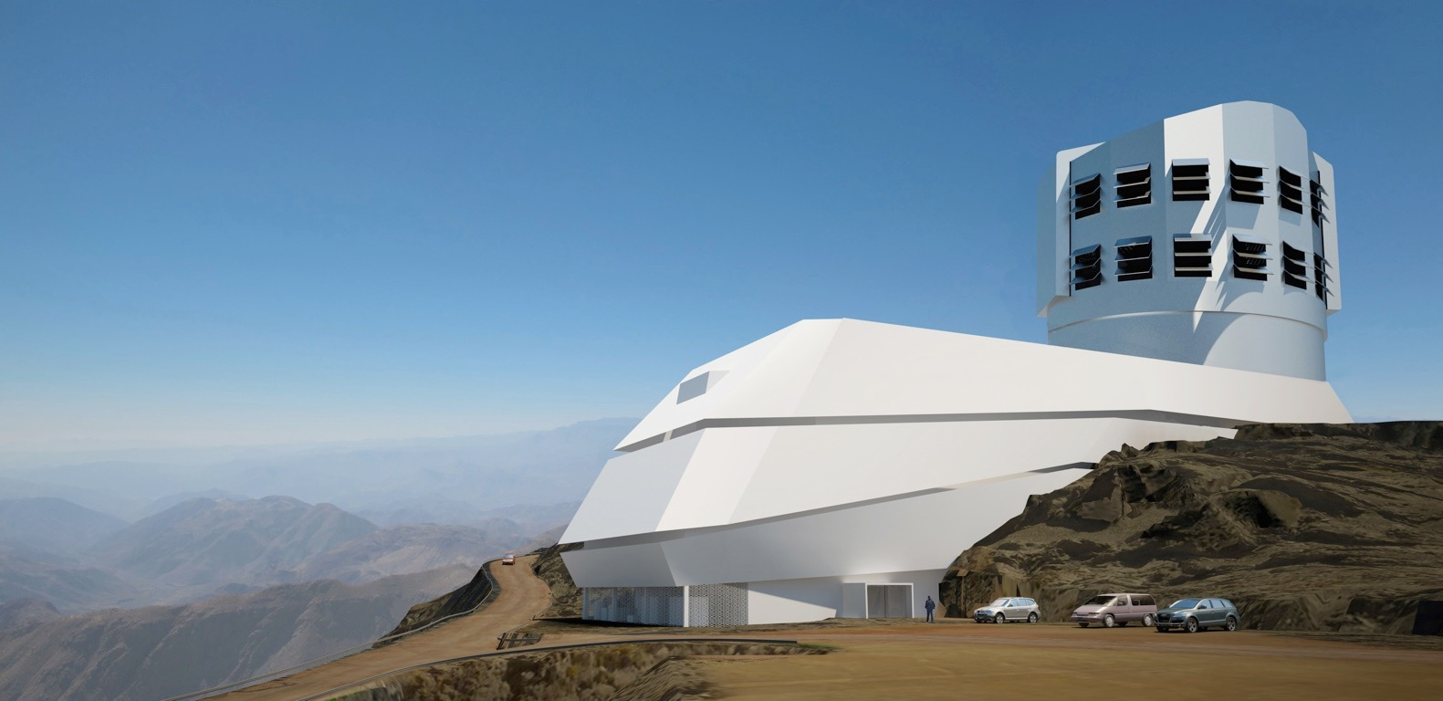
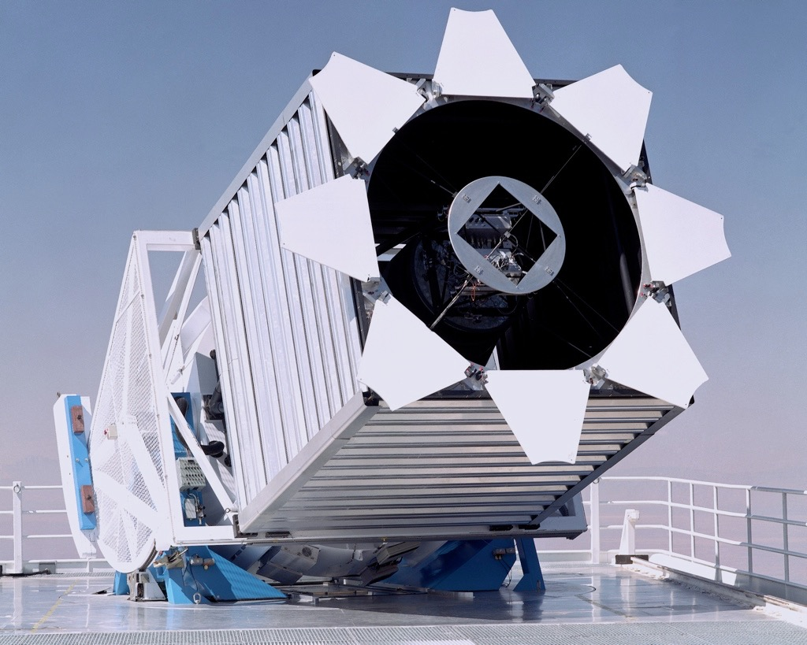
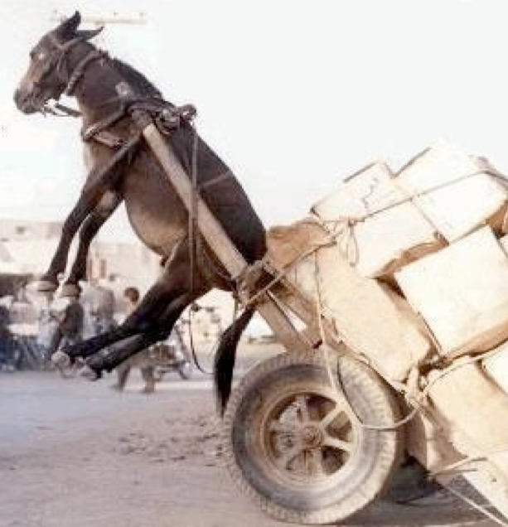
Week 1: Introduction and warm-up with astroML
LSST
SDSS
Astroinformatics, Fall 2018
Astronomical Observatory Belgrade

Slide 2
Outline
Syllabus, etc
Motivation for astrostatistics and this class – ever increasing data volume and complexity – sophisticated analysis, need for reproducibility – open-source approach – generally useful tools
astroML - what is it? - what can you do with it?

Slide 3
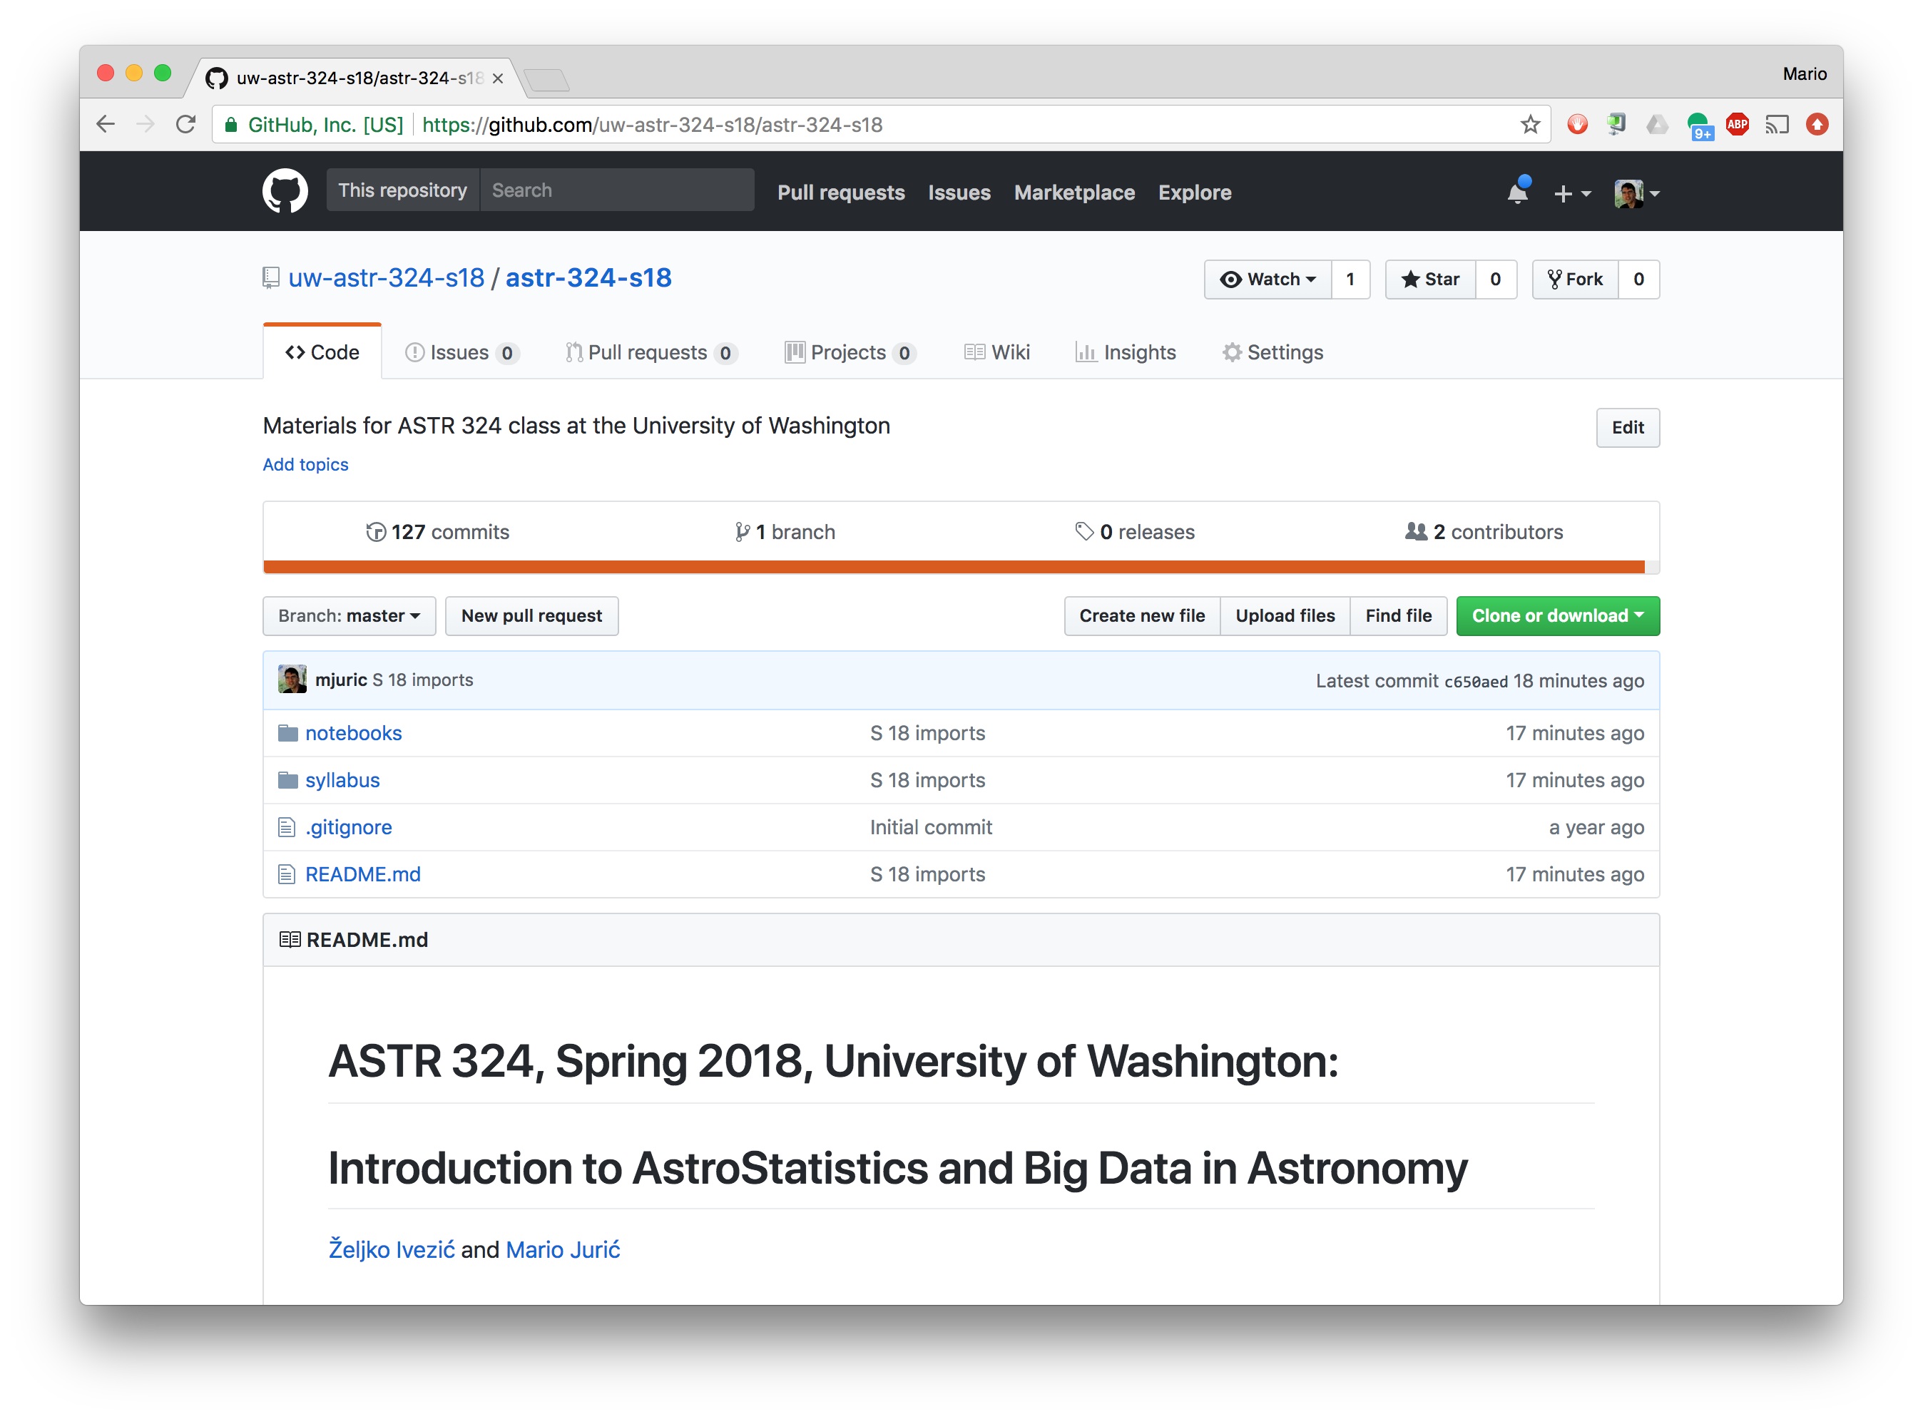
Everything is on GitHub: https://github.com/uw-astr-324-s18/astr-324-s18
Syllabus and all that

Slide 4
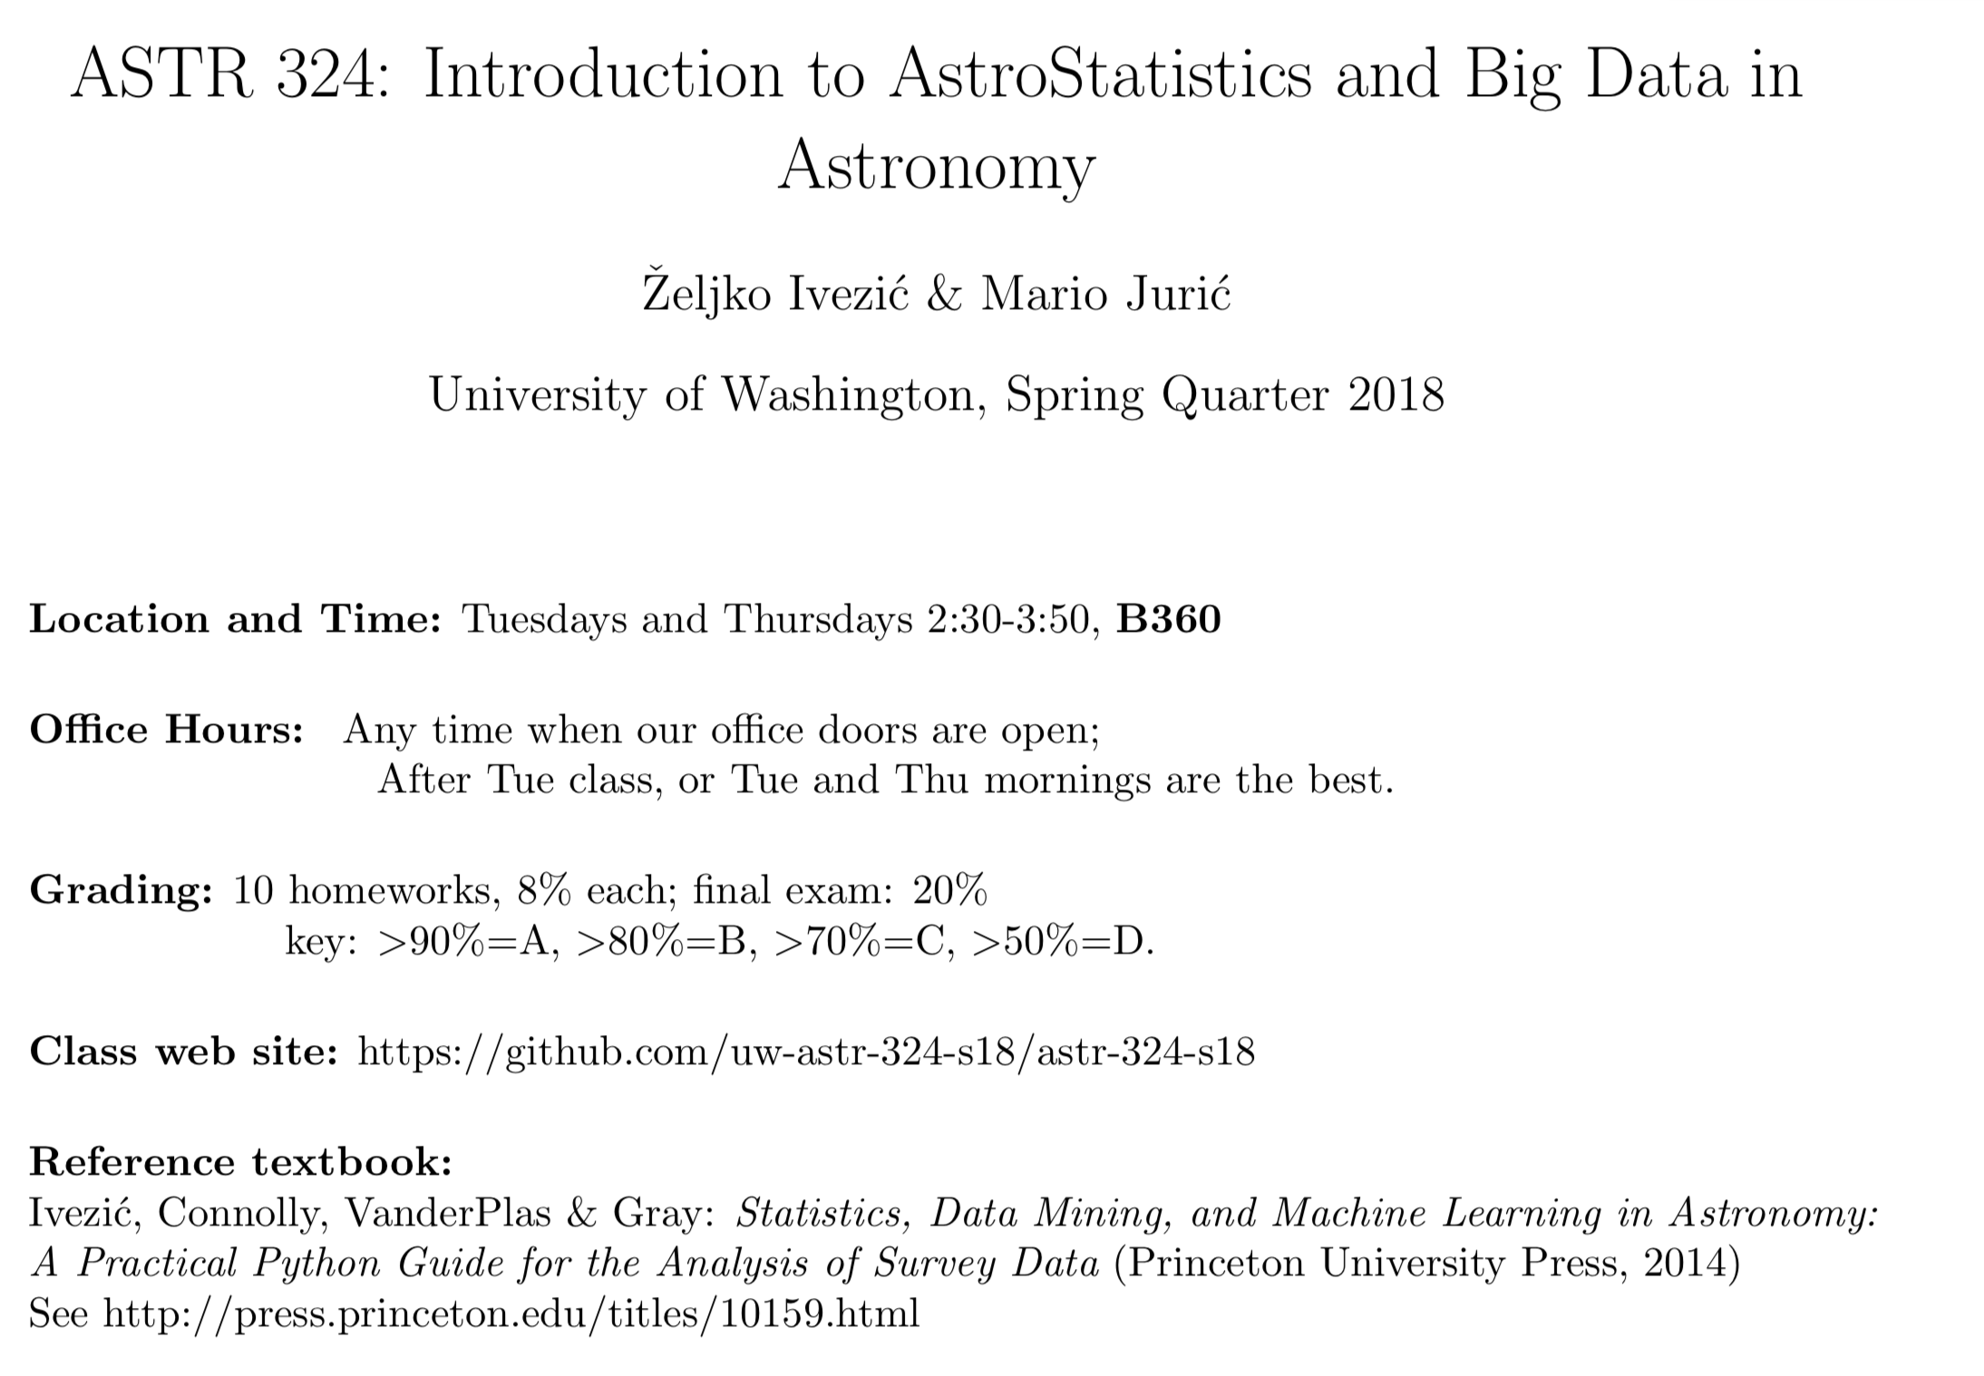

Slide 5
More (free!) resources:
Concise “handbook”: Notes on statistics for physicists by Orear, http://www.astro.washington.edu/users/ivezic/Teaching/Astr507/orear.pdf
A great book: Probability Theory: The Logic of Science by Jaynes, http://bayes.wustl.edu/etj/prob/book.pdf
A book about python and data science by Jake VanderPlas: https://github.com/jakevdp/PythonDataScienceHandbook
An intro class by Gordon Richards (Drexel University): https://github.com/gtrichards/PHYS_T480
An advanced class by Phil Marshall (Stanford University): https://github.com/KIPAC/StatisticalMethods
LSST Data Science Fellowship Program: https://github.com/LSSTC-DSFP/LSSTC-DSFP-Sessions
TED talk “The best stats you’ve ever seen” by Hans Rosling: http://ls.st/0dt

Slide 6
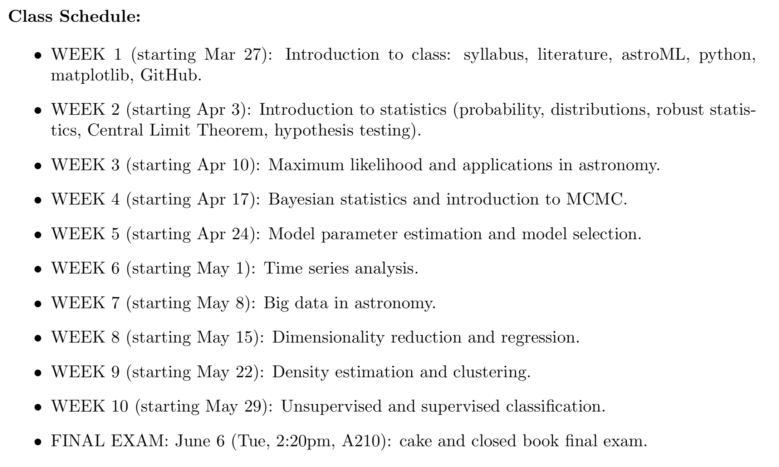

Slide 7
Python & Computers
We will be using Python 3 in this class. Python has become a de-facto standard for data analysis in astronomy (and beyond)
It’s best if you had Anaconda Python installed on your laptops when following along the examples in class.
  Will be faster than the desktops
  You can take them home to work on homeworks.
Macs and Linux will work, Windows should work with some additional setup. Bring your laptops along next time, we’ll make sure you have everything installed.

Slide 8
Recordings
We’ll do our best to record (screen capture) these lectures, and upload them to an unlisted channel on YouTube.
This should make it easier for you to review what we discussed in class (and others to audit the class).

Slide 9
Why Astrostatistics?

Slide 10
More data, but mostly…
More need, and the ability, to properly analyze data

Slide 11
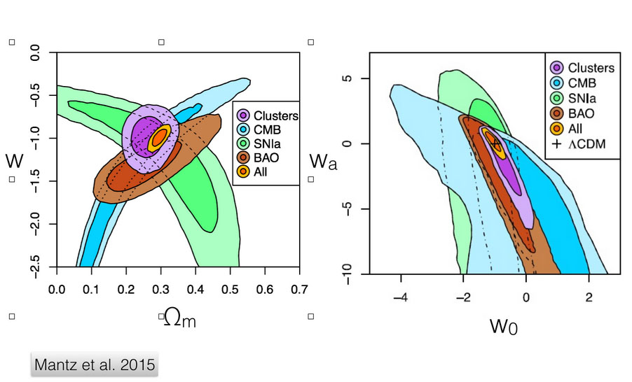
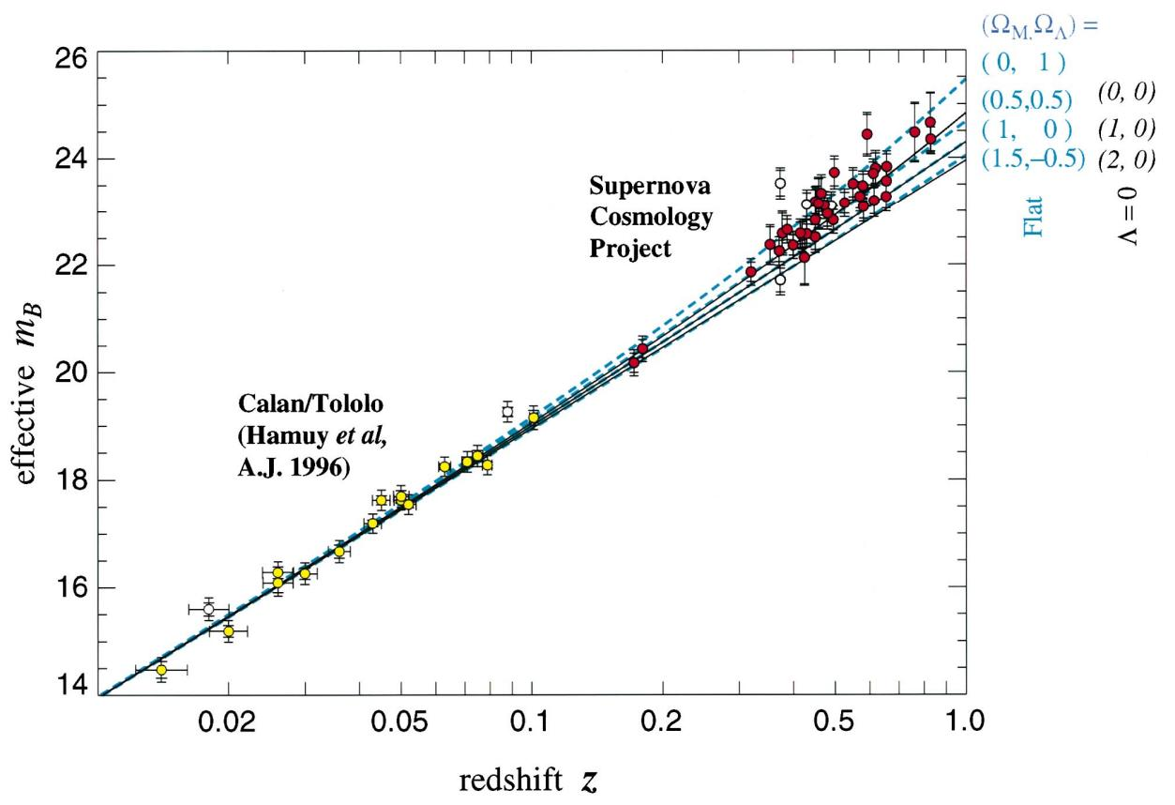
Rules of thumb and approximate statistics are often insufficient…
The signals being measured today are typically weak; careful statistical analyses are required to detect and measure them.
Because we became more sophisticated in our data analysis, today we routinely perform measurements which would’ve been unthinkable 20 years ago.
Understanding the nature of Dark Energy ⤴
Discovery of Dark Energy ——>
Also, they used to be too (computationally) expensive, but not any more!

Slide 12
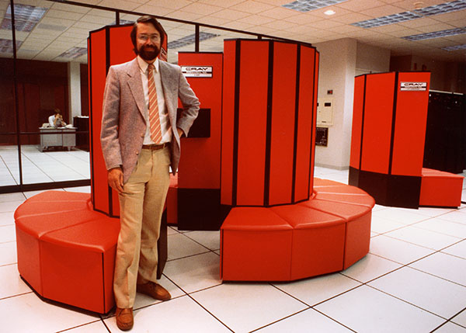

The first Cray supercomputer at NCSA ⤴
(National Center for Supercomputing Applications)
My cell phone ⤴

Slide 13

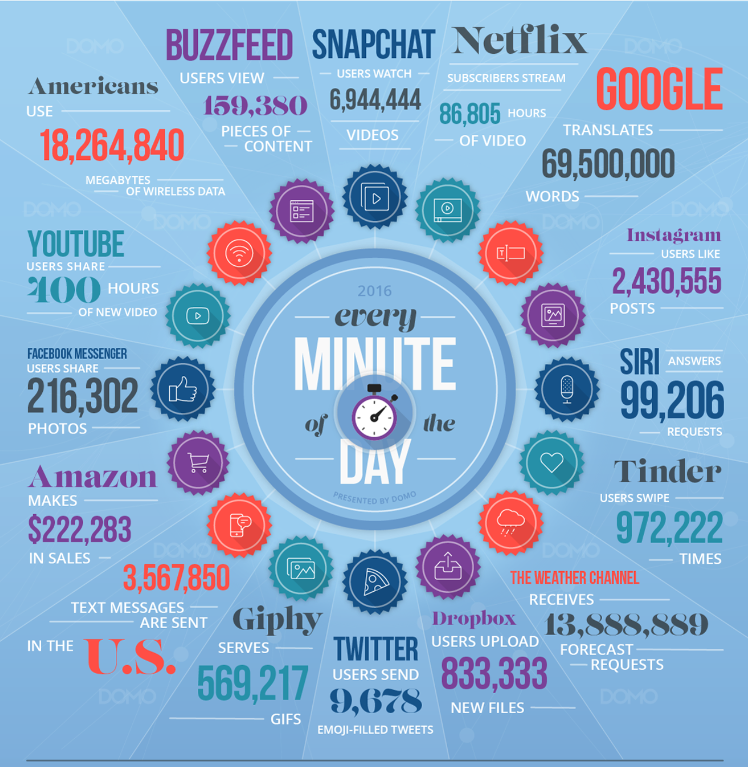
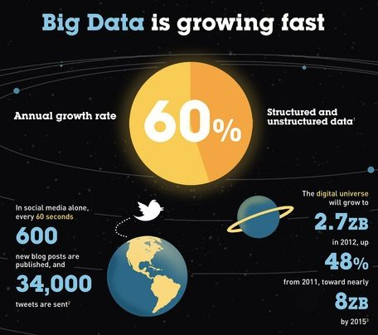
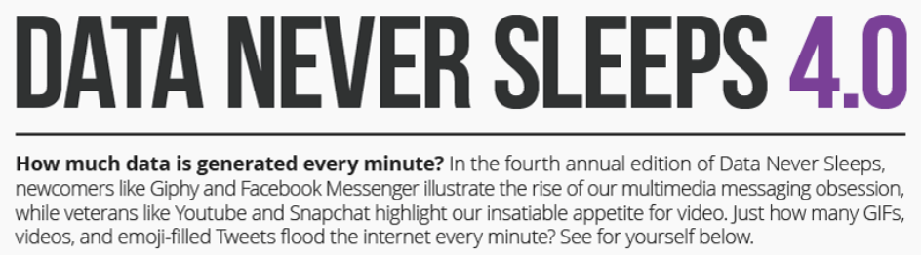
Big Data

Slide 14
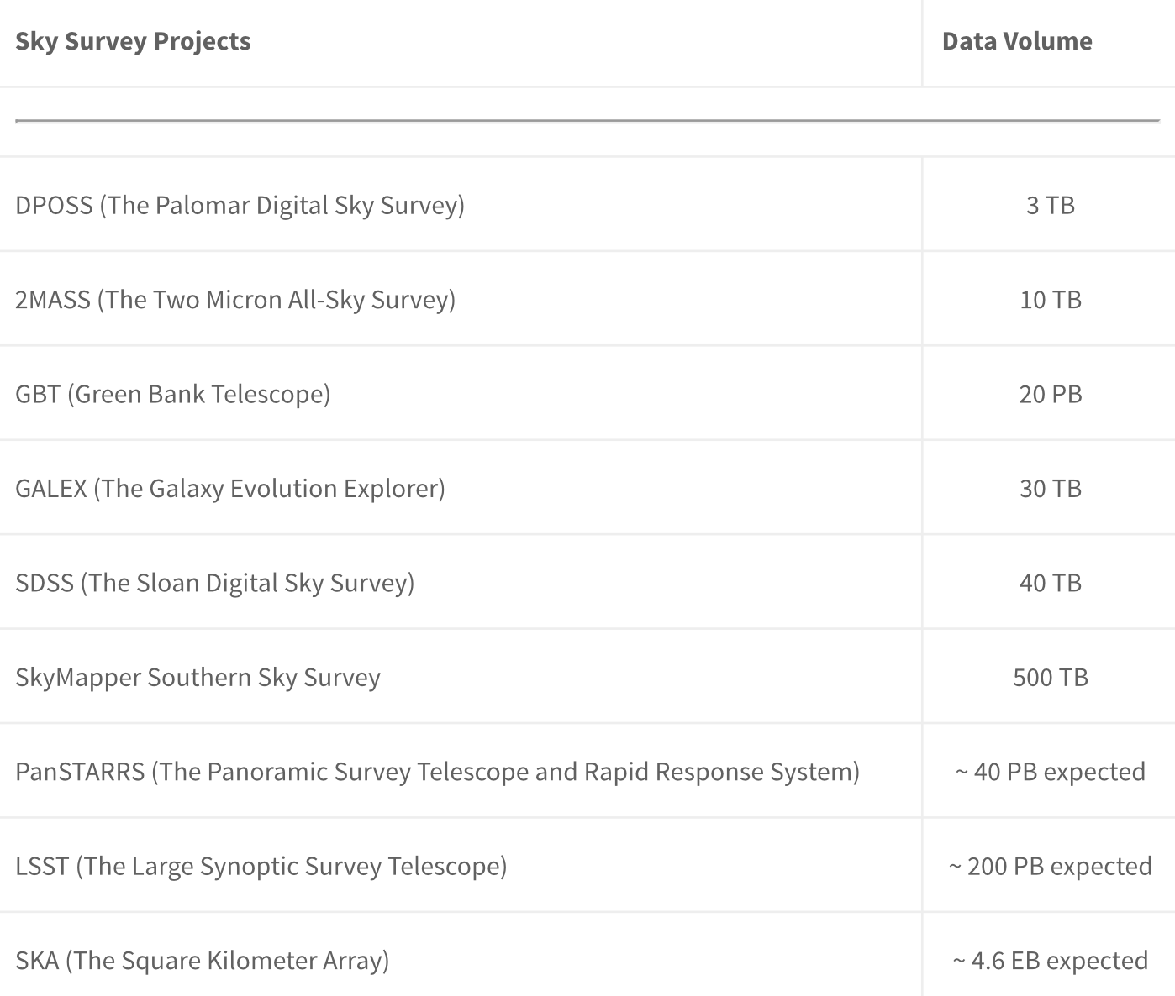
Zhang & Zhao (2015): http://datascience.codata.org/articles/10.5334/dsj-2015-011/

Slide 15
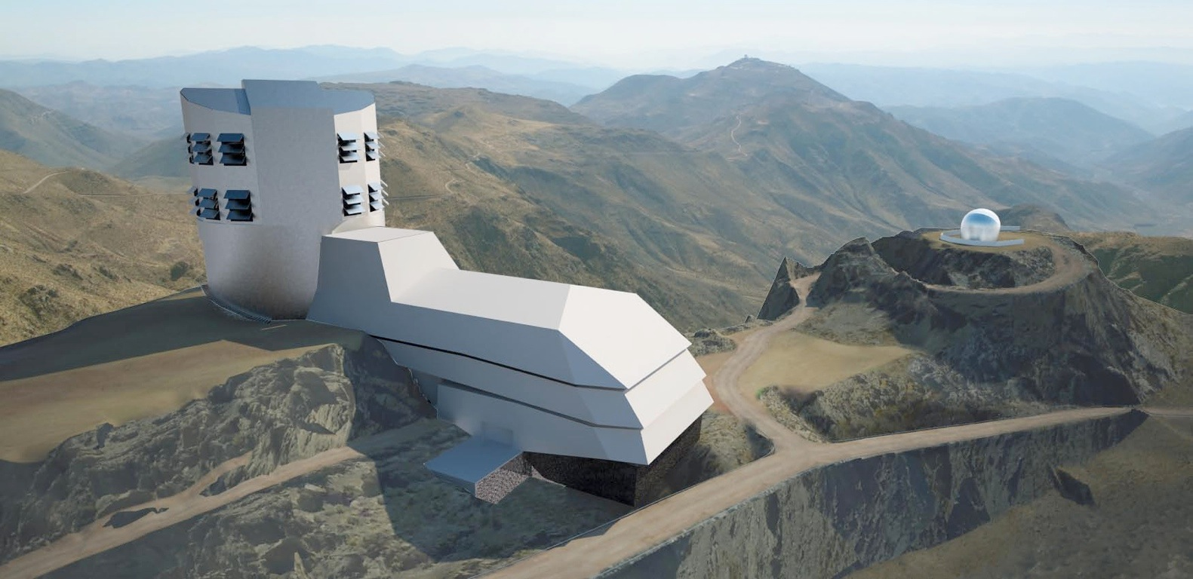
LSST: a digital color movie of the Universe...
3.6x10⁻³¹ erg/s/cm²/Hz
LSST in one sentence:
An optical/near-IR survey of half the sky in ugrizy bands to r~27.5 based on ~800 visits over a 10-year period:
More information at www.lsst.org
and arXiv:0805.2366
A catalog of 20 billion stars and 20 billion galaxies with exquisite photometry, astrometry and image quality!

Slide 16
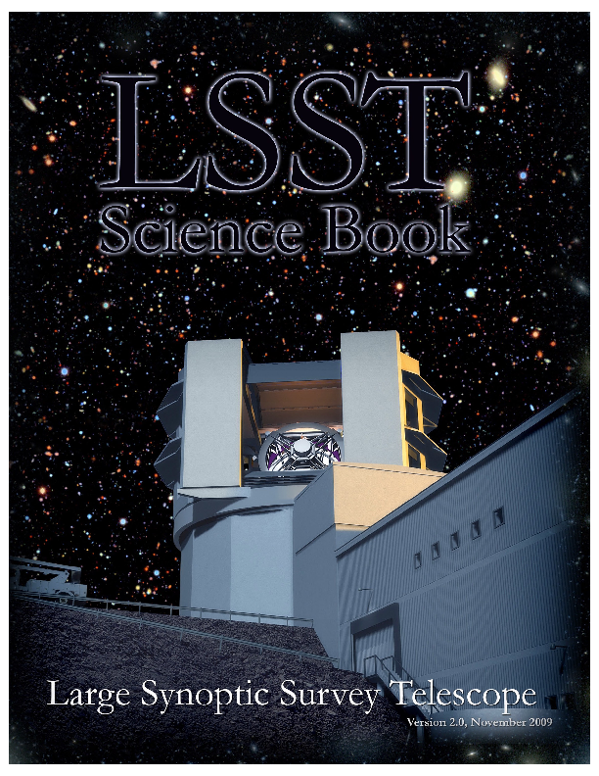
LSST Science Themes
Dark matter, dark energy, cosmology (spatial distribution of galaxies, gravitational lensing, supernovae, quasars)
Time domain (cosmic explosions, variable stars)
The Solar System structure (asteroids)
The Milky Way structure (stars)
LSST Science Book: arXiv:0912.0201
Summarizes LSST hardware, software, and observing plans, science enabled by LSST, and educational and outreach opportunities
245 authors, 15 chapters, 600 pages

Slide 17
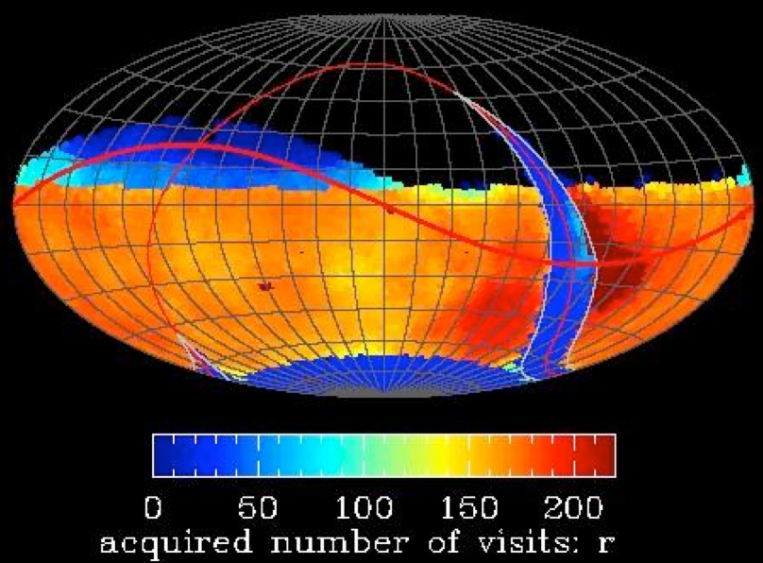
Basic idea behind LSST: a uniform sky survey
90% of time will be spent on a uniform survey: every 3-4 nights, the whole observable sky will be scanned twice per night
after 10 years, half of the sky will be imaged about 1000 times (in 6 bandpasses, ugrizy): a digital color movie of the sky
~100 PB of data: about a billion 16 Mpix images, enabling measurements for 40 billion objects!
LSST in one sentence:
An optical/near-IR survey of half the sky in ugrizy bands to r~27.5 (36 nJy) based on 825 visits over a 10-year period: deep wide fast.
Left: a 10-year simulation of LSST survey: the number of visits in the r band (Aitoff projection of eq. coordinates)

Slide 18
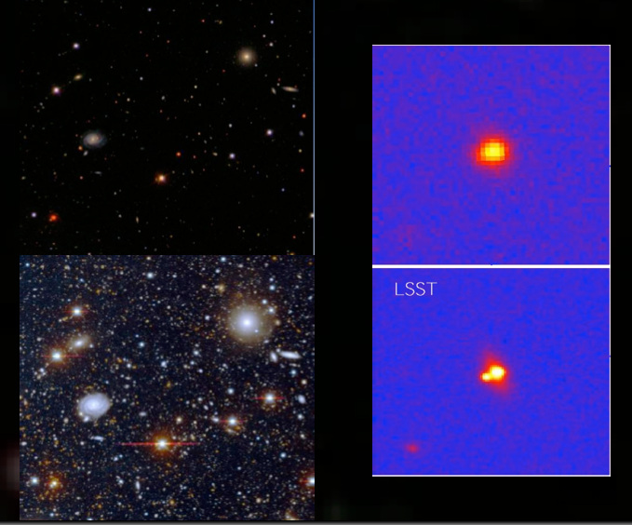
SDSS vs. LSST comparison: LSST=d(SDSS)/dt, LSST=SuperSDSS
3x3 arcmin, gri
3 arcmin is 1/10 of the full Moon’s diameter
20x20 arcsec; lensed SDSS quasar (SDSS J1332+0347, Morokuma et al. 2007)
20x20 arcsec
SDSS
SDSS, seeing 1.5 arcsec
(almost) like LSST depth (but tiny area)
Subaru, seeing 0.8 arcsec
Deep Lens Survey (r~26)

Slide 19
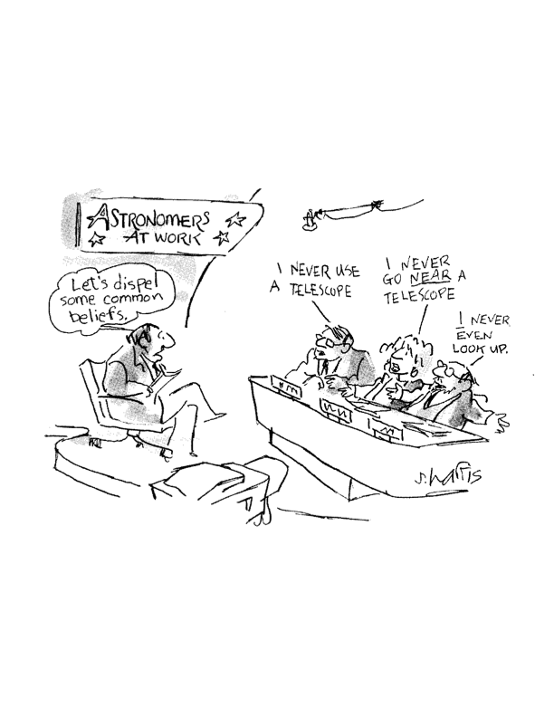
The era of surveys...
    Standard: “What data do I have to collect to (dis)prove a hypothesis”?
    Data-driven: “What theories can I test given the data I already have?”

Slide 20
Data analysis challenges in the era of Big Data
The bottleneck is not any more data availability but instead our ability to extract useful and reliable information from data.
1) Large data volume (petabytes)
2) Large numbers of objects (billions)
3) Highly multi-dimensional spaces (thousands)
4) Unknown statistical distributions
5) Time-series data (irregular sampling)
6) Heteroscedastic errors, truncated, censored and missing data
7) Unreliable quantities (e.g. unknown systematics and random errors)

Slide 21
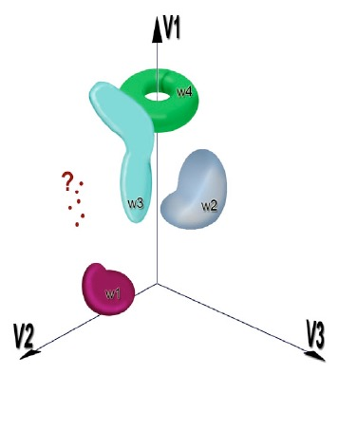
Characterize the known clustering)
Assign the new (classification)
Discover the unknown (outlier detection)
Benefits of very large data sets:
    best statistical analysis of “typical” events
    automated search for “rare” events
Tom Vestrand
In this class, you will learn how to do all that.
Btw, it need not be an astronomical application!

Slide 22
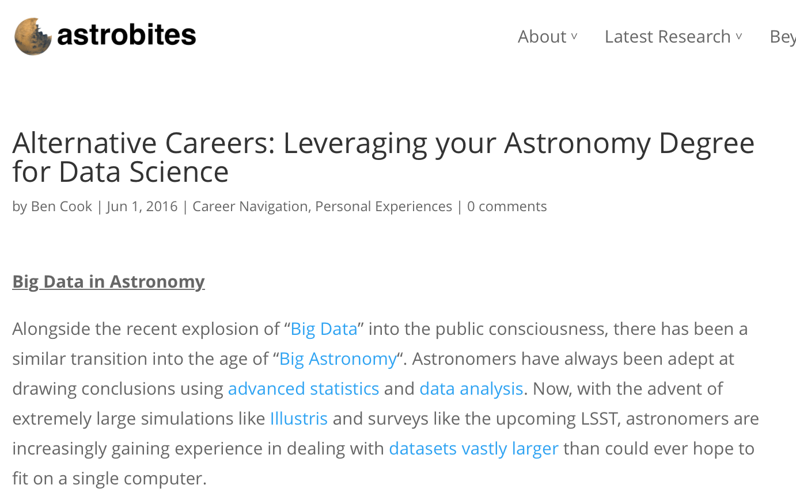
https://astrobites.org/2016/06/01/alternative-careers-leveraging-your-astronomy-degree-for-data-science/

Slide 23
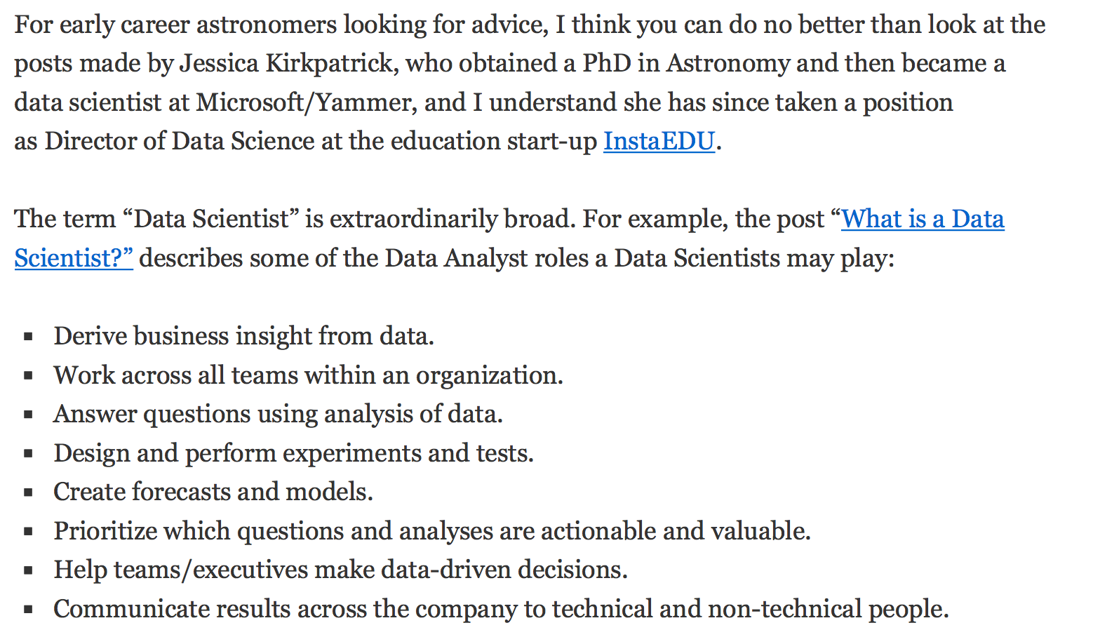
https://astrocompute.wordpress.com/2016/01/29/how-does-an-astronomer-become-a-data-scientist/

Slide 24
What to expect from this class
This class is not a computer science class
This class is not a statistics class
This class is not an astronomy class
The main purpose of this class is to expose you to a combination of concepts and tools from the above fields so that you can “handle” your “data” (as in data & noise & models & understanding etc.). We want to demystify statistical methods and give you the practical tools to apply them.
“Your data” can be big and small, astronomical or not, but most basic concepts and tools will have a general utility (e.g. histograms - which will be much more fun than you think!)

Slide 25
AstroML (and Visualization)

Slide 26
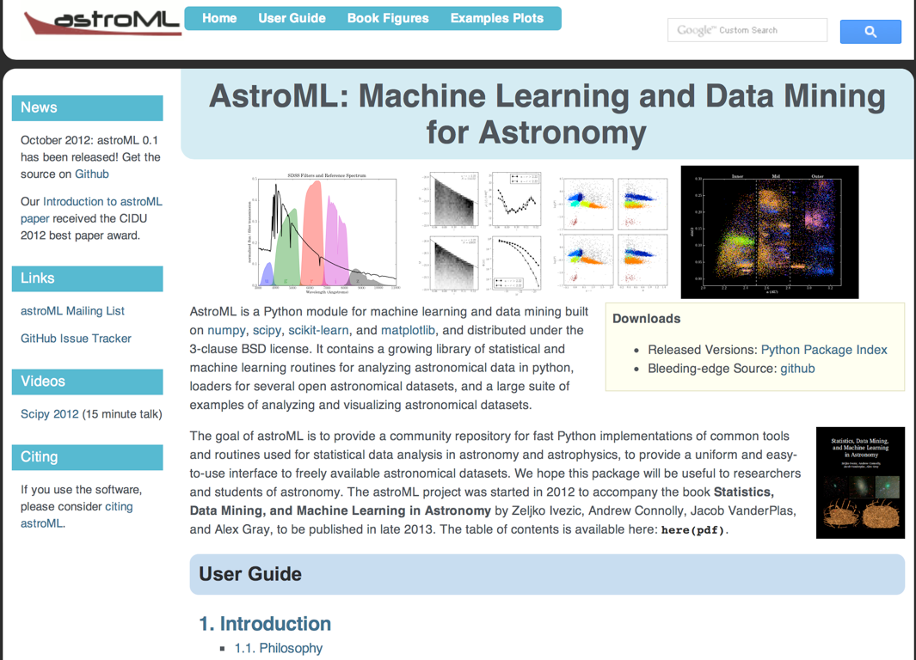
Open source!
www.astroML.org
Open source!
www.astroML.org

Slide 27
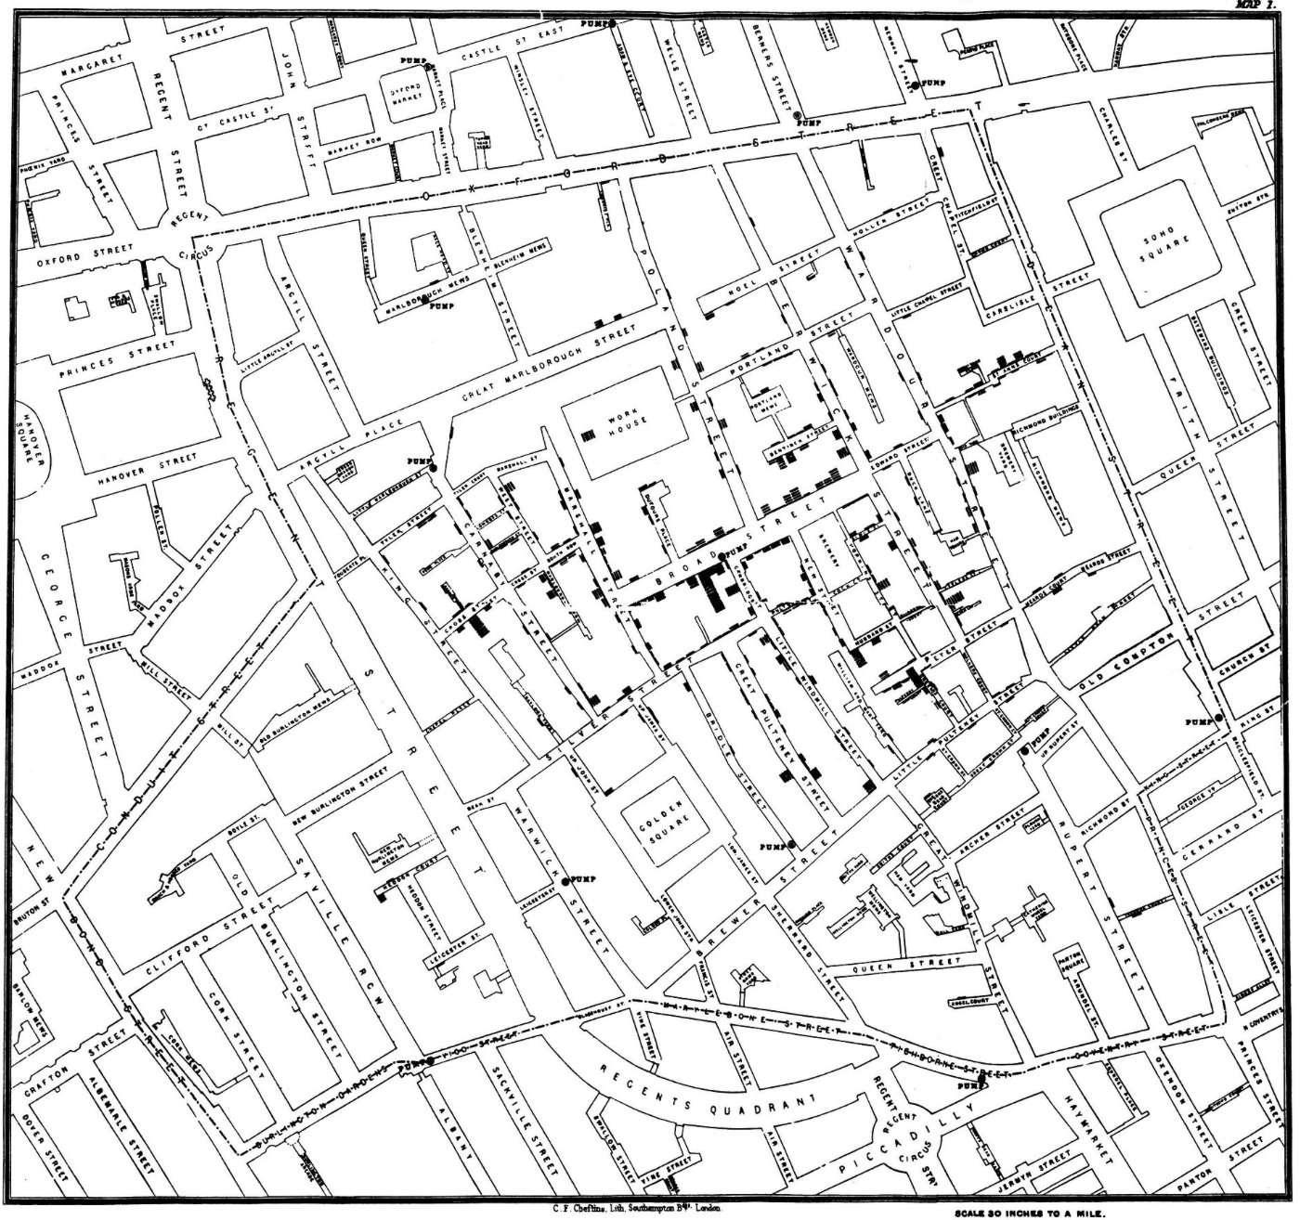
Visualization of multi-dimensional correlations and
search for patterns
“The greatest value of a picture is when it forces us to notice what we never expected to see.” (John Tukey, 1977)
John Snow plotted the number of cholera deaths (black marks) in London in 1854 outbreak and realized that the deaths are clustered around the Broad Street pump: the cholera is spread by water!
https://en.wikipedia.org/wiki/1854_Broad_Street_cholera_outbreak
The Broad Street pump

Slide 28
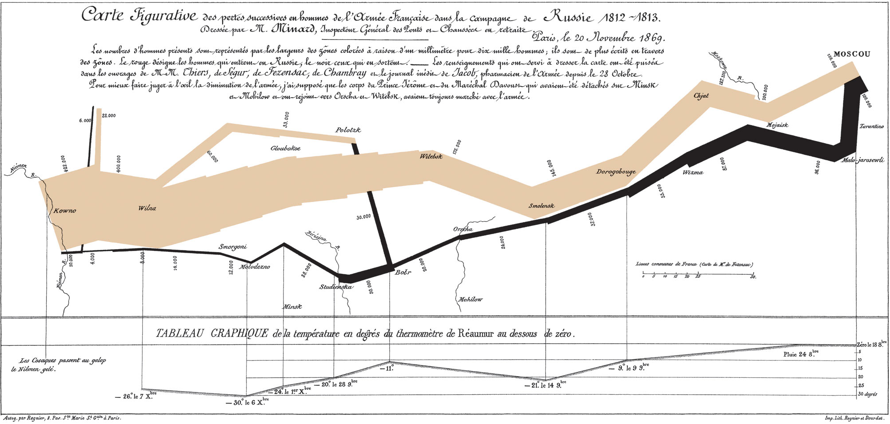
Visualization of multi-dimensional correlations
and search for patterns
Napoleon’s march on Moscow: 4-D data (2 positions, time, army size; also temperature and some other “metadata”)
98% of soldiers perished… (visualization by Charles Minard)
https://upload.wikimedia.org/wikipedia/commons/2/29/Minard.png

Slide 29
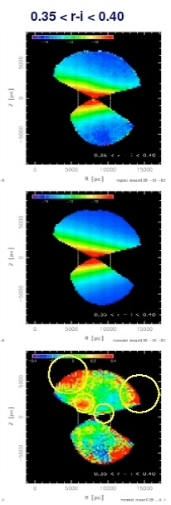
An example from Jurić et al. (2008): our Galaxy grew by cannibalizing nearby smaller neighbors
Four-dimensional data: stellar color, apparent magnitude, position on the sky (RA, Dec)
Step 1: derive three dimensional positions and bin the data in cylindrical coordinates
Step 2: fit a (relatively complicated) model
Step 3: subtract the best-fit model from data
We will learn about all these steps in this class.
Visualization of multi-dimensional correlations and search for patterns
“The greatest value of a picture is when it forces us to notice what we never expected to see.” (John Tukey, 1977)

Slide 30
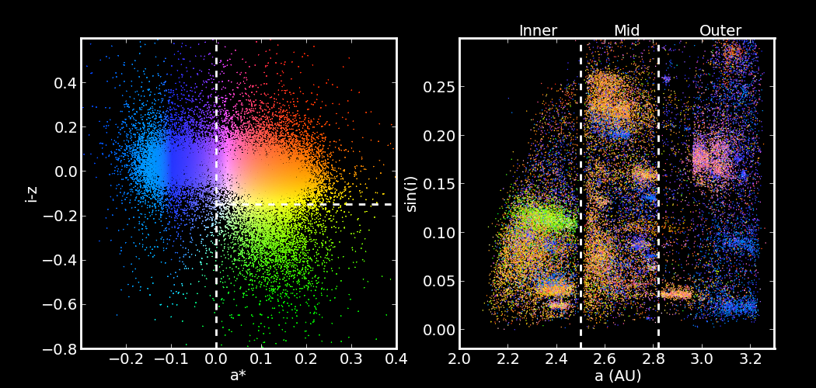
You will be able to make this plot yourself!
Ivezic et al. (2002)
Visualization of 4-dimensional correlations
Homework #1 is based on this example

Slide 31
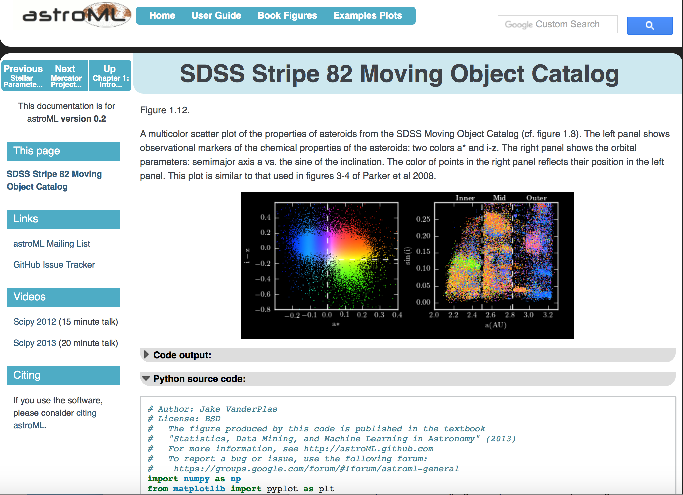
http://www.astroml.org/book_figures/chapter1/fig_moving_objects_multicolor.html

Slide 32
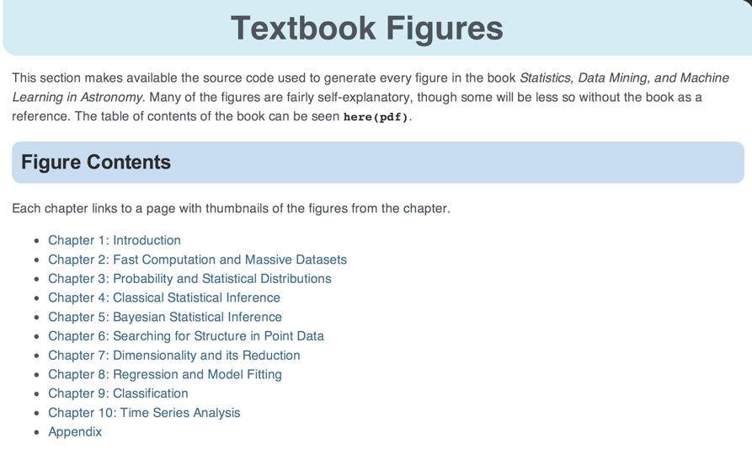
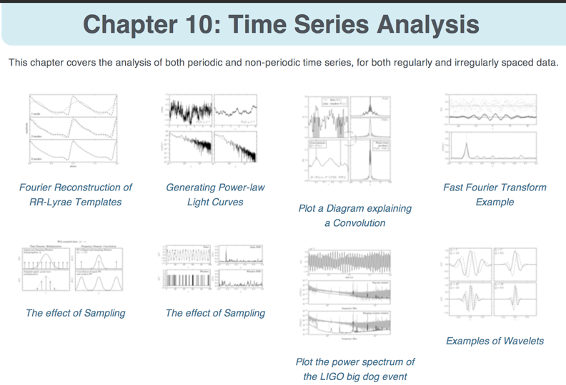

Slide 33
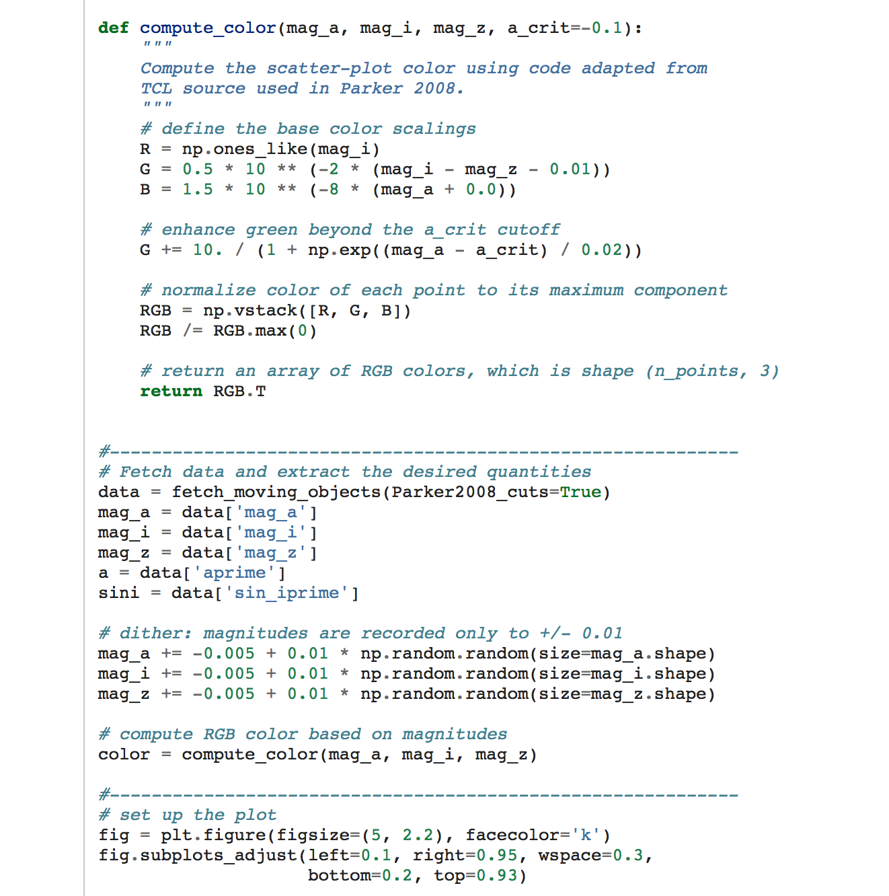
  https://github.com/astroML/astroML_figures
  $BOOK/book_figures/chapter1/fig_moving_objects_multicolor.py

Slide 34
A simple example of astroML use: a Hess diagram coded by a third quantity
Hess diagram is astronomical term for pixelated color-magnitude diagram, where each pixel is coded to display the number of objects in it (also known as “two-dimensional histogram”)

Slide 35
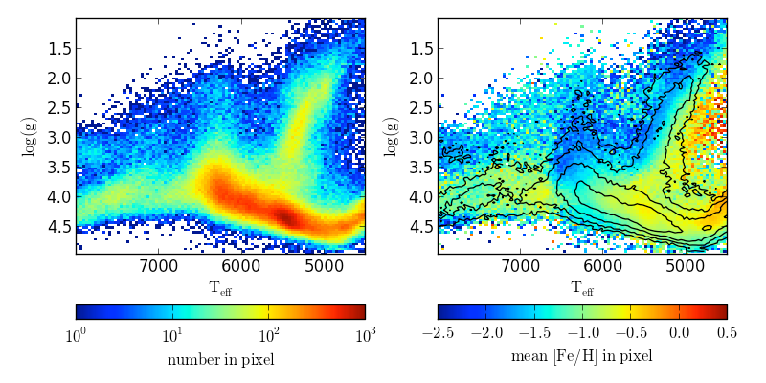
A Hess diagram coded by a third quantity
Here we plot a measure of the star’s surface gravity strength vs. effective temperature (both estimated from a spectrum obtained by SDSS); the left panel shows the count of stars in each pixel

Slide 36
Of course, the pixels don’t have to be coded by the number of objects in it - we can use instead any other statistic (the mean, median, scatter, etc): the right panel shows the mean metallicity [Fe/H] by color and the same counts as in the left panel, but now using contours

Slide 37
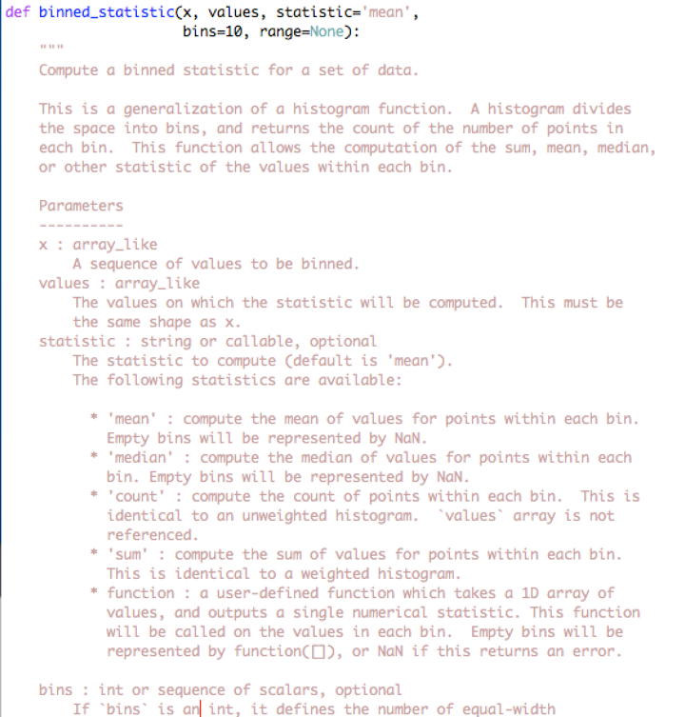
  $astroMLdir/astroML/stats/_binned_statistic.py

Slide 38
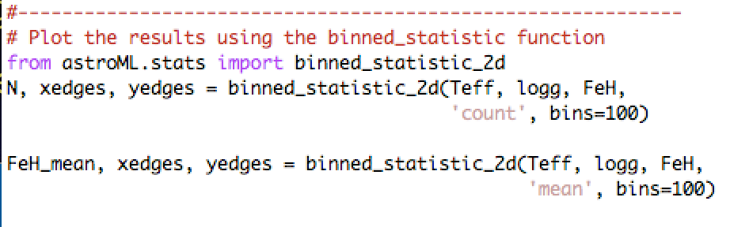
  $astroMLdir/astroML/stats/_binned_statistic.py
  $astroMLdir/astroML/stats/_binned_statistic.py

Slide 39
make this plot by running %run $astroMLdir/examples/datasets/plot_SDSS_SSPP.py
now, let’s look at the code and change something, for example, let’s only select stars with 15 < rpsf < 16 find line 23: data = data[(rpsf > 15) & (rpsf < 19)] and change 19 to 16, save and then rerun…

Slide 40
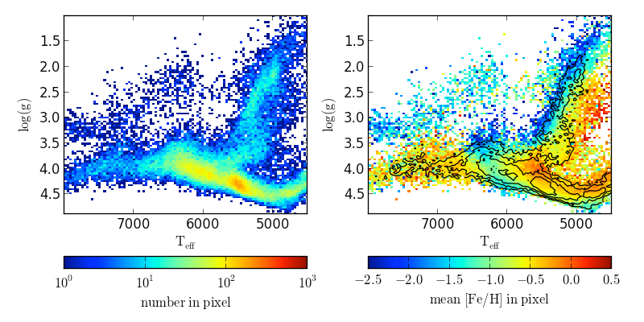
make this plot by running %run $astroMLdir/examples/datasets/plot_SDSS_SSPP.py
now, let’s look at the code and change something, for example, let’s only select stars with 15 < rpsf < 16 find line 23: data = data[(rpsf > 15) & (rpsf < 19)] and change 19 to 16, save and then rerun…

