Slide 1

Credit Score Classification
455 894

Slide 2
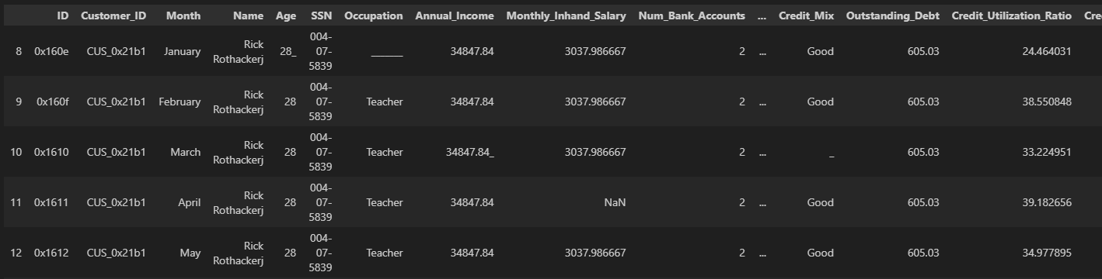
Data overview
Dataset had 100.000 rows x 28 columns and included customers with multiple loans.
Dataset quality wasn’t very good. (too many typos, placeholders, missing entries)
However, well-explained features.

Slide 3
Data overview
In our dataframe, customers with multiple loans. Which will help us filling the missing. Using FillMissingWithGroupMode.
Name 9,985
Occupation 7,062
Monthly_Inhand_Salary 15,002
Type_of_Loan 11,408
Num_of_Delayed_Payment 7,002
Monthly_Balance 1,209
Num_Credit_Inquiries 1,965
Credit_Mix 20,195
Credit_History_Age 9,030
Amount_invested_monthly 8,784
Payment_Behaviour 7,600

Slide 4
Basic Information about our features
ID: Represents a unique identification of an entry.
Customer_ID: Represents a unique identification of a person.
Month: Represents the month of the year.
Name: Represents the name of a person.
Age: Represents the age of the person.
SSN: Represents the social security number of a person.
Occupation: Represents the occupation of the person.
Annual_Income: Represents the annual income of the person.
Monthly_Inhand_Salary: Represents the monthly base salary of a person.
Num_Bank_Accounts: Represents the number of bank accounts a person holds.
Num_Credit_Card: Represents the number of other credit cards held by a person.
Interest_Rate: Represents the interest rate on a credit card.
Num_of_Loan: Represents the number of loans taken.
Type_of_Loan: Represents the types of loans taken by a person.
Delay_from_due_date: Represents the average number of days delayed from the payment date.
Payment_Behaviour: Represents the payment behavior of the customer (in USD).
Monthly_Balance: Represents the monthly balance amount of the customer (in USD).
Num_of_Delayed_Payment: Represents the average number of payments delayed by a person.
Changed_Credit_Limit: Represents the percentage change in credit card limit.
Num_Credit_Inquiries: Represents the number of credit card inquiries.
Credit_Mix: Represents the classification of the mix of credits.
Outstanding_Debt: Represents the remaining debt to be paid (in USD).
Credit_Utilization_Ratio: Represents the utilization ratio of a credit card.
Credit_History_Age: Represents the age of the credit history of the person.
Payment_of_Min_Amount: Represents whether only the minimum amount was paid by the person.
Total_EMI_per_month: Monthly EMI payments (in USD).
Amount_invested_monthly: Represents the monthly amount invested by the customer (in USD).
Credit_Score: Represents the bracket of credit score (Poor, Standard, Good). d
Data Size: 100000 rows x 28 columns

Slide 5
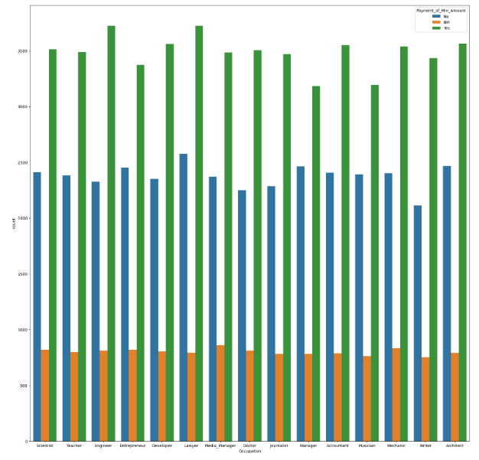
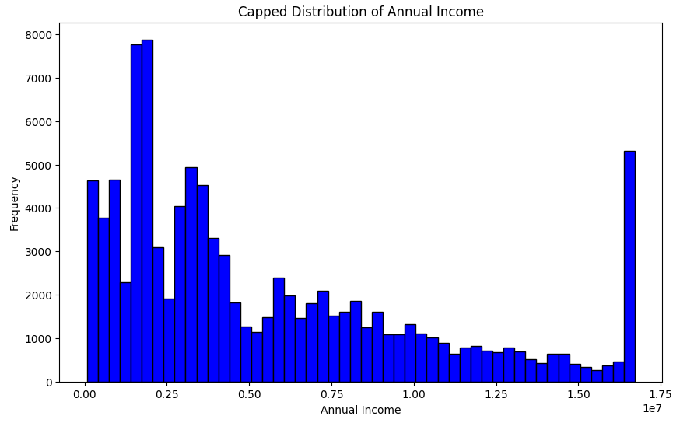
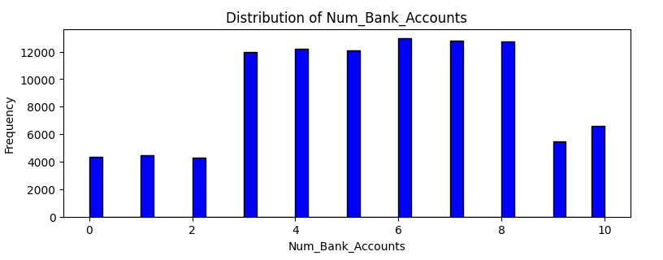
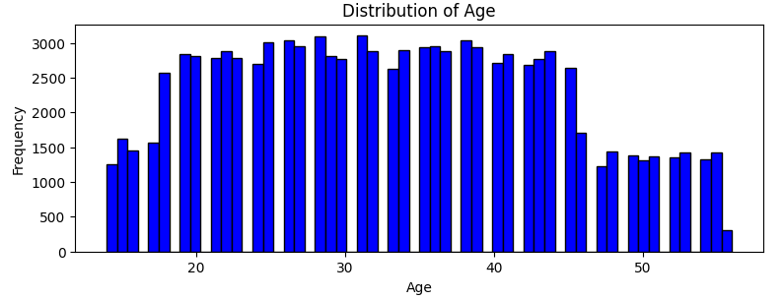
EDA and Data Preprocessing.

Slide 6
EDA and Data Preprocessing.
Used detect_outliers function. Utilize 0.05 and 0.95 quantiles. Identify outliers beyond 1.5x IQR.
Also used similar function to identify inconsistencies. Such as, different occupation, Annual Income for same customer.
Cleaning DataFrame from illogical values. Such as, negative ages or +100, negative number of bank accounts and etc.
Use one-hot encoding for 'Occupation', 'Credit_Mix', 'Payment_of_Min_Amount', 'Payment_Behaviour'.
And MultiLabelBinarizer ‘Type_of_Loan’.
Example for ‘Type_of_Loan’: 'Type_of_Loan for Customer_ID CUS_0x2dbc: Auto Loan, Auto Loan, Personal Loan and Not Specified'
Used credit_utilization_category function to separate the values into Low, Medium, High and one-hot encode them.
And lastly, since have over 50 columns explaining the target variable well, given the computational cost constraint, I only engineered 3 most used ratios. 'Debt_Income_Ratio', 'Balance_Salary_Ratio', 'EMI_Salary_Ratio'.

Slide 7
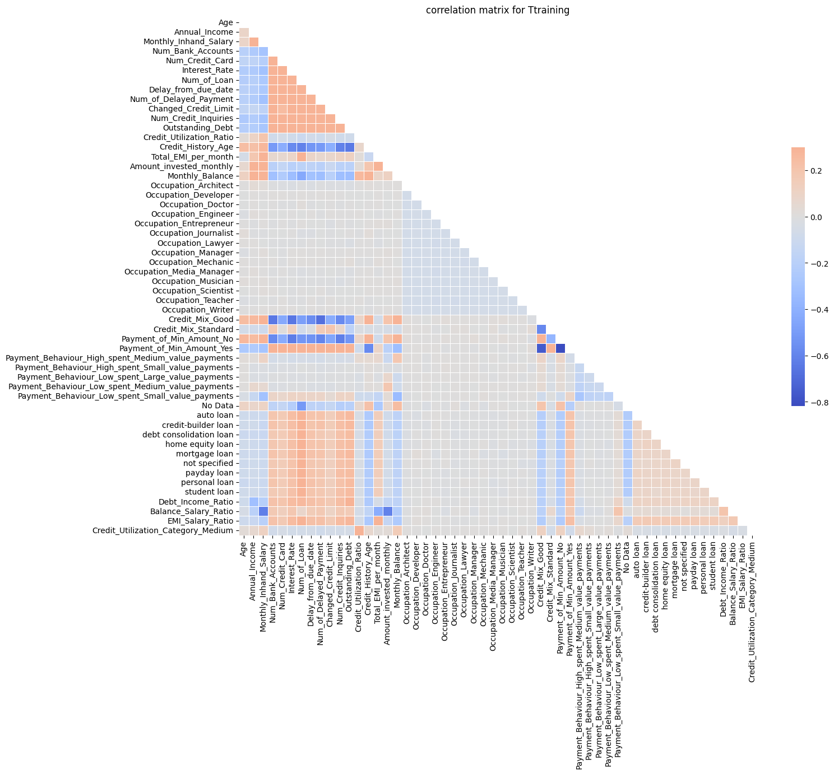
Feature selection: Basic Correlation
highly correlated variables: ['Age', 'Annual_Income', 'Monthly_Inhand_Salary', 'Num_Bank_Accounts', 'Num_Credit_Card', 'Interest_Rate', 'Num_of_Loan', 'Delay_from_due_date', 'Num_of_Delayed_Payment', 'Changed_Credit_Limit', 'Num_Credit_Inquiries', 'Outstanding_Debt', 'Credit_Utilization_Ratio', 'Credit_History_Age', 'Total_EMI_per_month', 'Amount_invested_monthly', 'Monthly_Balance', 'Occupation_Architect', 'Occupation_Developer', 'Occupation_Doctor', 'Occupation_Engineer', 'Occupation_Entrepreneur', 'Occupation_Journalist', 'Occupation_Lawyer', 'Occupation_Manager', 'Occupation_Mechanic', 'Occupation_Media_Manager', 'Occupation_Musician', 'Occupation_Scientist', 'Occupation_Teacher', 'Occupation_Writer', 'Credit_Mix_Good', 'Credit_Mix_Standard', 'Payment_of_Min_Amount_No', 'Payment_of_Min_Amount_Yes', 'Payment_Behaviour_High_spent_Medium_value_payments', 'Payment_Behaviour_High_spent_Small_value_payments', 'Payment_Behaviour_Low_spent_Large_value_payments', 'Payment_Behaviour_Low_spent_Medium_value_payments', 'Payment_Behaviour_Low_spent_Small_value_payments', 'No Data', 'auto loan', 'credit-builder loan', 'debt consolidation loan', 'home equity loan', 'mortgage loan', 'not specified', 'payday loan', 'personal loan', 'student loan', 'Debt_Income_Ratio', 'Balance_Salary_Ratio', 'EMI_Salary_Ratio', 'Credit_Utilization_Category_Medium']

Slide 8
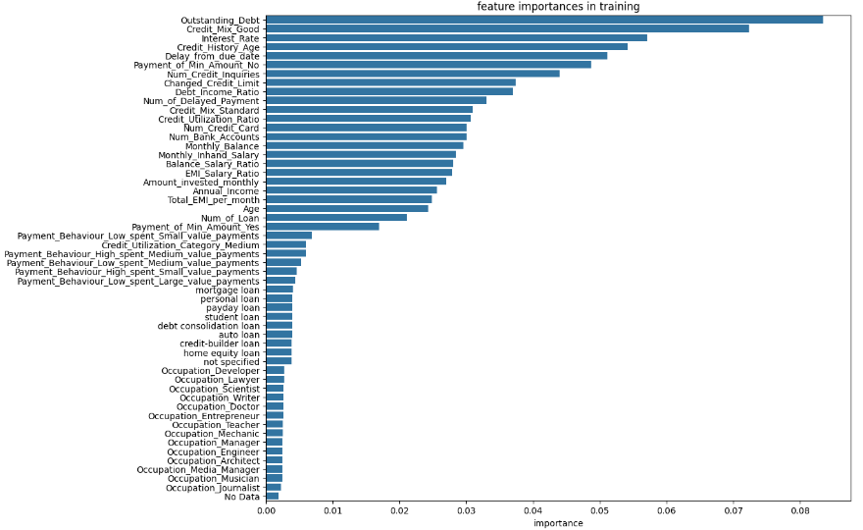
Feature selection: Feature Importance with Random Forest

Slide 9
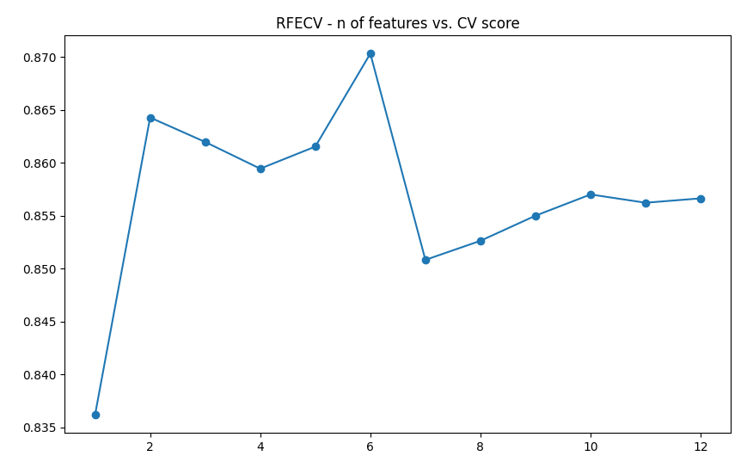
Feature selection: RFE CV(5)
'Age', 'Annual_Income', 'Monthly_Inhand_Salary', ‘Num_Bank_Accounts', 'Num_Credit_Card', 'Interest_Rate', 'Num_of_Loan', 'Delay_from_due_date', ‘Num_of_Delayed_Payment', 'Changed_Credit_Limit', 'Num_Credit_Inquiries', 'Outstanding_Debt', 'Credit_Utilization_Ratio', 'Credit_History_Age', ‘Total_EMI_per_month', 'Amount_invested_monthly', 'Monthly_Balance', 'Credit_Mix_Good', 'Credit_Mix_Standard', 'Payment_of_Min_Amount_No', ‘Payment_of_Min_Amount_Yes', 'Debt_Income_Ratio', 'Balance_Salary_Ratio', 'EMI_Salary_Ratio'

Slide 10
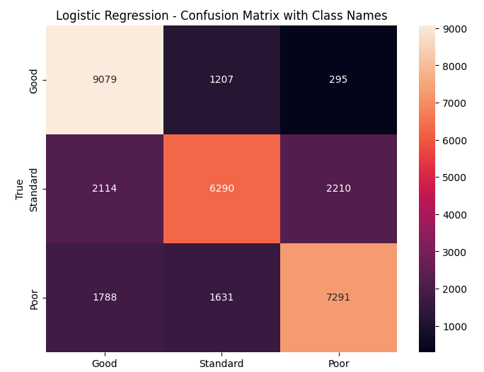
Model Building and Tuning: Logistic Regression (baseline model)
Training Accuracy: 71.47%
Validation Accuracy: 71.02% #best tradeoff
Precision, Recall, F1-Score for each class:
Good: Precision - 70%, Recall - 86%, F1-Score - 77%
Standard: Precision - 74%, Recall - 68%, F1-Score - 71%
Poor: Precision - 69%, Recall - 59%, F1-Score - 64%
≈20s to train
Note: No parameters, tuning and etc.

Slide 11
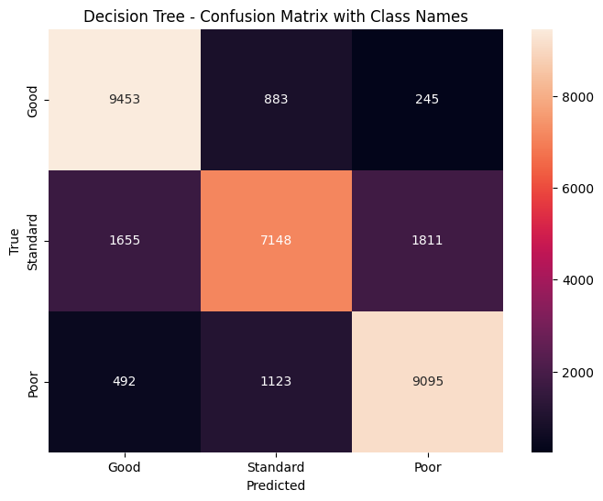
Model Building and Tuning: Decision Trees
Training Accuracy: 88.09%
Validation Accuracy: 80.54% #worst trade-off
Precision, Recall, F1-Score for each class:
Good: Precision - 81%, Recall - 89%, F1-Score - 85%
Standard: Precision - 82%, Recall - 85%, F1-Score - 83%
Poor: Precision - 77%, Recall - 66%, F1-Score - 71%
≈15 minutes to train
param_grid_dt = {
'criterion': ['gini', 'entropy'],
'max_depth': [10, 15, 20], #<--- depth reduced to avoid overfitting
'min_samples_split': [4, 10, 20], #<--- (see: previous commit)
'min_samples_leaf': [4, 6, 8] #<--- same
}
Best parameters found: {'criterion': 'entropy', 'max_depth': 20, 'min_samples_leaf': 4, 'min_samples_split': 10}

Slide 12
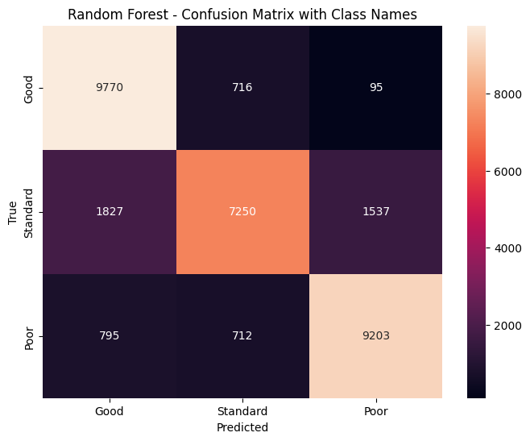
Model Building and Tuning: Random Forest
Training Accuracy: 87.16%
Validation Accuracy: 82.19% #better trade off
Precision, Recall, F1-Score for each class:
Good: Precision - 79%, Recall - 92%, F1-Score - 85%
Standard: Precision - 85%, Recall - 86%, F1-Score - 85%
Poor: Precision - 84%, Recall - 68%, F1-Score - 75%
≈2.5 hours to train
param_grid = {
'n_estimators': [100, 150, 200],
'max_depth': [10, 15, 20],
'min_samples_split': [10, 15, 20],
'min_samples_leaf': [4, 6, 8],
'max_features': ['sqrt', 'log2'], #tuned to reduce overfitting
}
Best parameters: {'max_depth': 20, 'max_features': 'sqrt', 'min_samples_leaf': 4, 'min_samples_split': 10, 'n_estimators': 200}

Slide 13
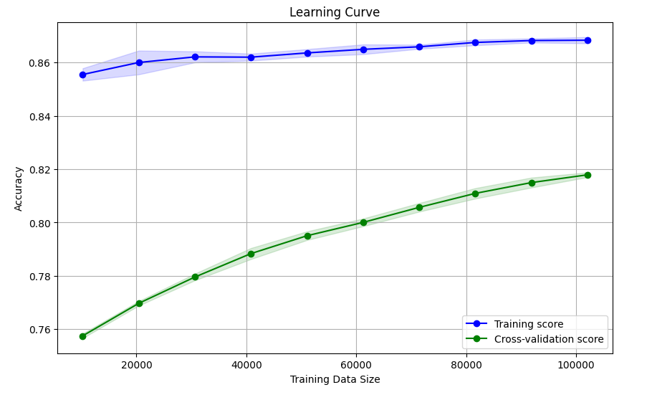
Model Building and Tuning: Random Forest 2 - Learning Curve

Slide 14
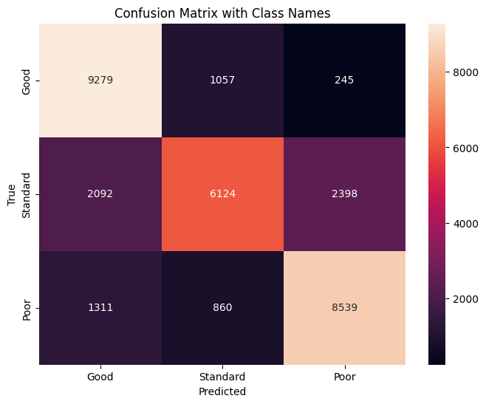
Model Building and Tuning: LightGBM
Training Accuracy: 75.38%
Validation Accuracy: 75.04%
Precision, Recall, F1-Score for each class:
Good: Precision - 73%, Recall - 88%, F1-Score - 80%
Standard: Precision - 76%, Recall - 79%, F1-Score - 78%
Poor: Precision - 76%, Recall - 58%, F1-Score - 66%
≈45 minutes to train
param_grid = {
'learning_rate': [0.005, 0.01],
'n_estimators': [50, 150, 200],
'num_leaves': [6, 16, 24, 31],
'boosting_type': ['gbdt'],
'objective': ['multiclass'],
'colsample_bytree': [0.65, 0.75],
'subsample': [0.7, 0.75],
'reg_alpha': [1, 1.2],
'reg_lambda': [1, 1.2, 1.4],
}
Best parameters: {'boosting_type': 'gbdt', 'colsample_bytree': 0.75, 'learning_rate': 0.01, 'n_estimators': 200, 'num_leaves': 31, 'objective': 'multiclass', 'reg_alpha': 1, 'reg_lambda': 1, 'subsample': 0.7}

Slide 15
Summary
Considering the context of our application:
If we would consider solely the metrics, the Random Forest Classifier emerges as the most performing model. It has superior balance in precision, recall, and F1-scores across all classes, coupled with the highest validation accuracy, makes it the most reliable choice for this specific dataset and task. But it has small overfitting issue.
If we consider the metrics and computational costs equally important, then LightGBM show the best results. It could be improved even further with further feature engineering. It is also important that overfitting was significantly lower than others.
If interpretability is important for the given task, Logistic Regression might be preferred despite its lower performance.
Suggestions: ADASYN for class imbalance, bigger GridSearch pool, more feature engineering.

