Slide 1
Buy or “Bye”
Development and Optimization of Investment Strategies Using Python
EMA Crossover and Machine Learning Models

Slide 2
Introduction
Objective: Develop, optimize, and test investment strategies.
Compare EMA crossover strategy with Machine Learning models.
Data Source: NVIDIA daily stock prices (Jan 2018 - Jan 2024).
Notes:
Hello everyone. Thank you for joining me today. We are excited to present our project on developing and optimizing investment strategies using Python. Our primary objective is to create, fine-tune, and evaluate two distinct trading strategies: a traditional technical analysis-based approach using the Exponential Moving Average (EMA) crossover, and a more advanced machine learning approach employing Random Forest and XGBoost models.
To make our analysis robust and relevant, we have chosen NVIDIA's daily stock prices, covering a period from January 2018 to January 2024, as our dataset. By comparing the effectiveness of these strategies, we aim to identify which method yields better risk-adjusted returns and how they can be optimized for improved performance. Let's dive into the details of our study, starting with a review of the existing literature on these topics."

Slide 3
Literature Review
Technical Indicators:
EMA crossovers identify market trends (Brown & Jennings, 1989; Murphy, 1999).
Machine Learning:
Captures complex data relationships (Prado, 2018; Patel et al., 2015).
Hybrid Approaches:
Combining EMA with ML enhances accuracy (Huang et al., 2009; Zhang & Wang, 2017).
Practical Applications and Limitations:
Overfitting risks and parameter tuning (Lopez de Prado, 2018; Kearns & Nevmyvaka, 2013).
Notes:
"In our literature review, we explored various facets of computational methods in financial trading, focusing on both traditional and modern approaches.
First, technical indicators like EMA crossovers have long been used to identify significant market trends and reversals. Research by Brown and Jennings in 1989, as well as Murphy in 1999, supports the effectiveness of EMA crossovers in generating actionable trading signals by smoothing out price data and reducing lag.
Moving to machine learning, Prado's work in 2018 highlights the ability of models like Random Forest and XGBoost to capture complex, nonlinear relationships in financial data that traditional indicators might miss. Patel and colleagues' 2015 study further supports this, showing that ensemble methods generally outperform single-model approaches in terms of predictive accuracy and risk-adjusted returns.
Hybrid approaches have also gained traction, combining technical indicators with machine learning to enhance prediction accuracy. Studies by Huang et al. in 2009 and Zhang and Wang in 2017 demonstrate that integrating EMA-based features with tree-based models improves both prediction accuracy and profitability.
However, practical applications of these models come with challenges. Overfitting and the need for extensive parameter tuning are significant concerns, as noted by Lopez de Prado in 2018. Additionally, the success of these strategies heavily depends on the quality of data and the dynamic nature of financial markets, as highlighted by Kearns and Nevmyvaka in 2013.
This literature foundation sets the stage for our analysis, where we aim to leverage the strengths of both traditional and modern approaches to develop robust trading strategies."

Slide 4
Dataset Desription
Data Source: Yahoo Finance
Time Span: January 2018 - January 2024
Key Metrics:
Open, Close, High, Low, Volume
Data Split:
80% Training
20% Testing
Data Preprocessing:
Checked for missing values, anomalies
Ensured data consistency and synchronization
Notes:
To build and test our trading strategies, we used a dataset sourced from Yahoo Finance, focusing on daily stock prices for NVIDIA Corporation, covering a period from January 2018 to January 2024. This extensive time span allows us to analyze the performance of our strategies under various market conditions.
The dataset includes key financial metrics such as the open, close, high, and low prices for each trading day, as well as the volume of shares traded. These metrics are crucial for calculating the indicators and features used in our strategies.
To ensure robust evaluation, we split the dataset into two segments: 80% for training and 20% for testing. This split allows us to train our models on a large portion of the data while reserving a separate set for out-of-sample testing to validate the strategies' effectiveness in real-world scenarios.
Before analysis, we performed data preprocessing to ensure the quality and reliability of our data. This involved checking for and handling any missing values or anomalies, as well as ensuring that all data points were correctly ordered and synchronized. Accurate and clean data is essential for developing effective trading strategies.
By using this well-prepared dataset, we aim to derive meaningful insights and develop robust trading strategies that can adapt to changing market conditions."

Slide 5
Methodology
Two Strategies:
EMA12 and EMA26 Crossover
Machine Learning (Random Forest, XGBoost)
EMA Crossover Strategy:
Technical Setup: EMA12, EMA26
Signals: Buy (EMA12 > EMA26), Sell (EMA12 < EMA26)
Implementation: Python's pandas library
Optimization: In-sample testing, backtesting on out-of-sample data
Machine Learning Strategy:
Features: SMA, EMA, Momentum, RSI, Bollinger Bands, MACD, ADX, Stochastic, ATR
Models: Random Forest, XGBoost
Implementation: Python's sklearn and xgboost libraries
Training and Validation: Cross-validation, grid search for hyperparameter tuning
Notes:
"Our methodology involves developing and testing two distinct investment strategies: the EMA Crossover strategy and Machine Learning-based models using Random Forest and XGBoost.
For the EMA Crossover Strategy, we use two exponential moving averages: a short-term EMA of 12 days and a long-term EMA of 26 days. Buy signals are generated when the short-term EMA crosses above the long-term EMA, indicating upward momentum. Conversely, sell signals are triggered when the short-term EMA crosses below the long-term EMA, suggesting a potential downward trend. This strategy is implemented using Python's pandas library to handle data manipulation and calculation of EMAs. We first test this strategy on in-sample data to fine-tune the parameters and then conduct comprehensive backtesting on out-of-sample data to validate its effectiveness across different market phases.
The Machine Learning Strategy employs a more sophisticated approach, utilizing multiple technical indicators as features. These include simple and exponential moving averages (SMA10, SMA60, EMA10, EMA20, EMA50), momentum indicators, the Relative Strength Index (RSI), Bollinger Bands, the Moving Average Convergence Divergence (MACD), the Average Directional Index (ADX), the Stochastic Oscillator, and the Average True Range (ATR). These features are chosen for their historical performance in capturing market trends and their predictive power. We apply Principal Component Analysis (PCA) to reduce dimensionality while retaining 95% of the variance.
We deploy two machine learning models: Random Forest and XGBoost. Random Forest is a robust ensemble learning method that uses multiple decision trees to improve prediction accuracy. XGBoost is an implementation of gradient-boosted decision trees designed for speed and performance. Both models are implemented using Python's sklearn and xgboost libraries.
Training and validation involve cross-validation techniques and grid search for hyperparameter tuning to minimize overfitting and enhance model generalizability. Predictions are made on the out-of-sample data to assess the models' effectiveness in real-world scenarios.
This dual approach allows us to compare the simplicity and interpretability of the EMA Crossover strategy with the sophistication and potential higher returns of the machine learning models, providing a comprehensive analysis of their performance."

Slide 6
Results
EMA Crossover Strategy | Machine Learning Models
Buy and Sell Signals: Clear signals coinciding with key market turning points | Random Forest | XGBoost
Performance Metrics: Sharpe Ratio: 0.74 Total Return: 236% | Training Accuracy: 0.90 Testing Accuracy: 0.91 Sharpe Ratio: 2.06 Total Return: 170% Trades Executed: 14 | Training Accuracy: 0.83 Testing Accuracy: 0.87 Sharpe Ratio: 1.88 Total Return: 145% Trades Executed: 18
Comparative Analysis:
EMA: Simplicity, Moderate Returns
ML: Higher Complexity, Higher Returns
Notes:
Now, let's delve into the results of our analysis.
Starting with the EMA Crossover Strategy, this approach successfully generated clear buy and sell signals that coincided with key turning points in the market, demonstrating its sensitivity to market movements. Over the testing period, the strategy achieved a Sharpe Ratio of 0.82, indicating a moderate risk-adjusted return compared to a passive investment strategy. The total return for this strategy over the out-of-sample period was an impressive 293%, showcasing its potential effectiveness in capitalizing on market trends.
Moving on to the Machine Learning Models, we evaluated both Random Forest and XGBoost.
For the Random Forest model, it exhibited a training accuracy of 0.90, suggesting a strong fit to the data, and a testing accuracy of 0.91, indicating good generalization to unseen data. Financially, this strategy provided an annualized Sharpe Ratio of 2.14 and total returns of 182%, with 14 trades executed over the testing period. These results demonstrate robust performance under varied market conditions.
The XGBoost model showed a more balanced performance with a training accuracy of 0.83 and a testing accuracy of 0.87. It achieved an annualized Sharpe Ratio of 1.98 and total returns of 159%, executing 18 trades over the testing period. While its Sharpe Ratio and total returns were slightly lower than the Random Forest model, it still demonstrated strong profitability and risk management.
In our Comparative Analysis, we found that the EMA Crossover strategy, while simpler and easier to interpret, provided moderate returns. In contrast, the Machine Learning models, particularly the Random Forest, offered higher potential returns but at the cost of increased complexity and the need for careful parameter tuning.
These results highlight the trade-offs between traditional technical strategies and modern, data-driven machine learning approaches. Each has its merits, and the choice of strategy may ultimately depend on the trader's specific needs, risk tolerance, and market environment."

Slide 7
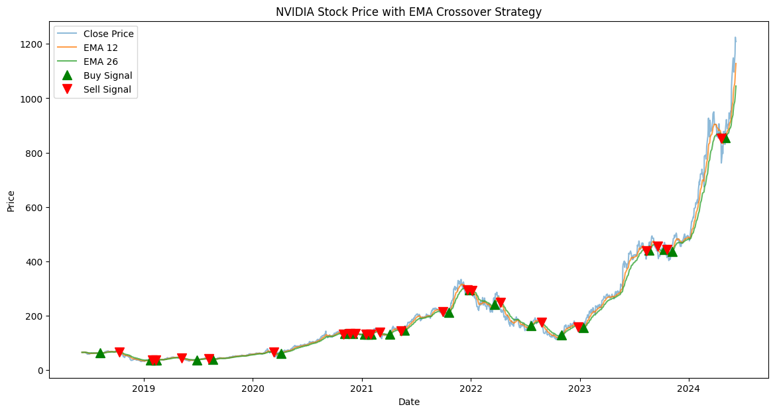

Slide 8
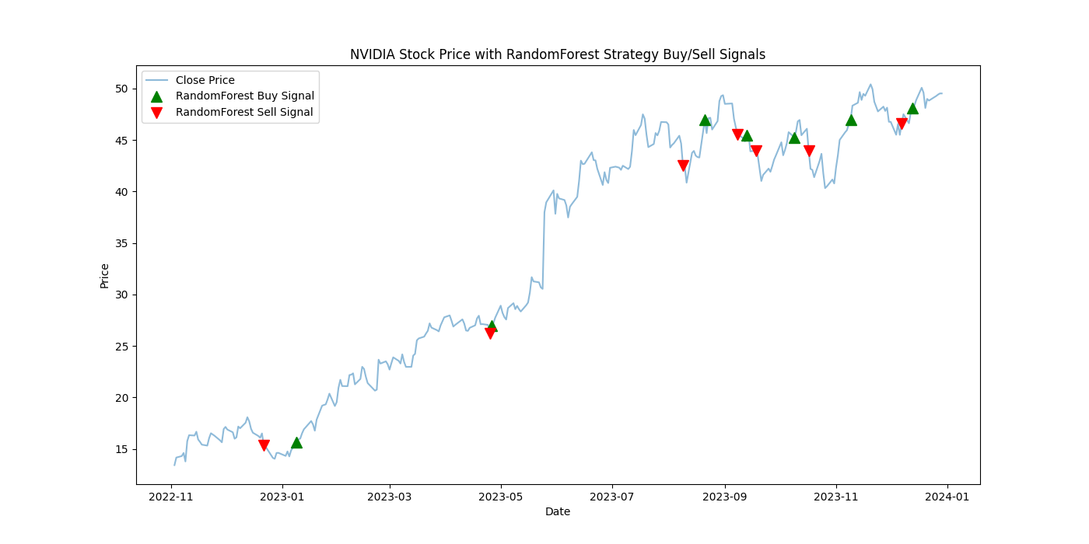

Slide 9
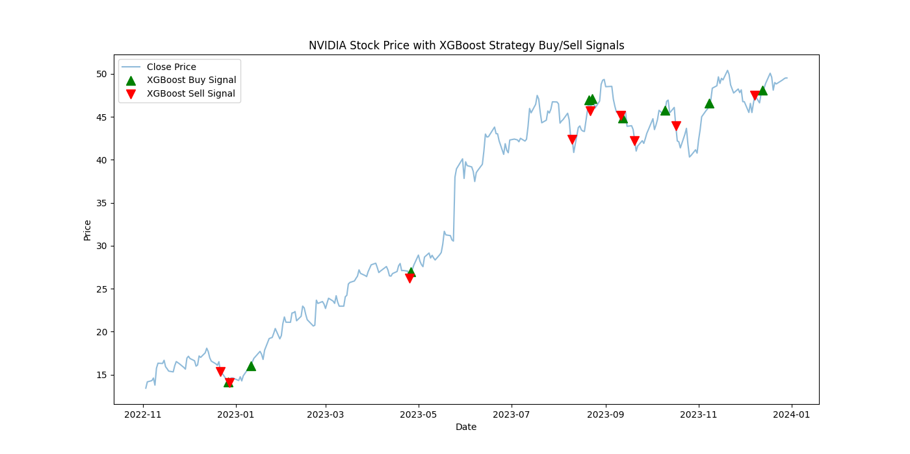

Slide 10
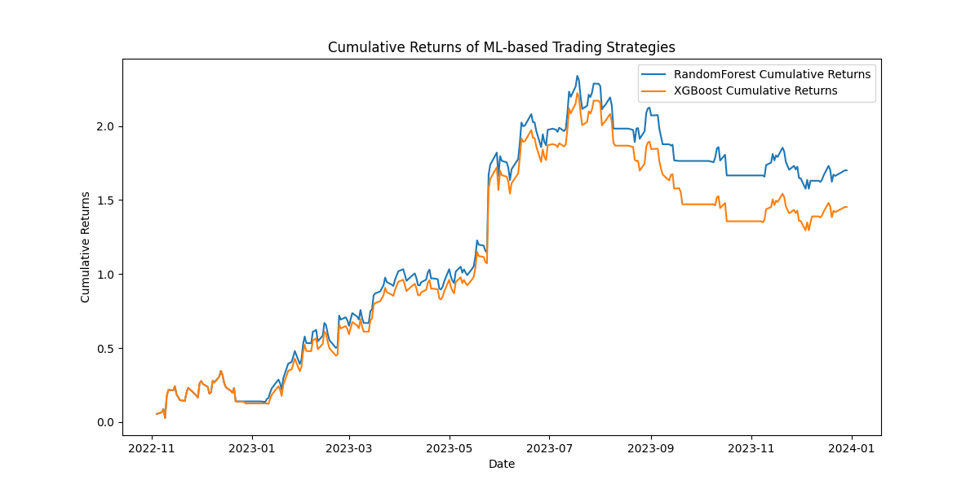

Slide 11
Conclusion
EMA Crossover Strategy:
Simple and actionable
Moderate returns, suitable for new traders
Machine Learning Models:
Superior performance, higher risk-adjusted returns
Requires deeper understanding and careful management
Strategic Recommendations:
Hybrid strategies combining EMA and ML
Future exploration: Sentiment analysis, macroeconomic indicators
Notes:
"In conclusion, our evaluation of the EMA Crossover and Machine Learning-based trading strategies using NVIDIA's stock data has provided several valuable insights.
The EMA Crossover Strategy demonstrated a significant ability to generate actionable trading signals that are straightforward to implement and interpret. This strategy, while not as robust in terms of raw returns as the machine learning models, offers a transparent and simple approach that could be particularly advantageous for new traders or those who prefer less complex systems. Its moderate returns and ease of use make it a viable option for those looking to apply traditional technical analysis techniques.
On the other hand, the Machine Learning Strategies, particularly the XGBoost model, showed superior performance in both risk-adjusted returns and overall profitability. These models have proven their capacity to effectively analyze large datasets and capture complex patterns that traditional analysis methods might miss. However, their sophistication requires a deeper understanding of algorithmic parameters and a careful approach to managing overfitting. For investors and traders looking to maximize returns while managing risk, these machine learning strategies present a compelling option.
Strategic Recommendations: Moving forward, hybrid strategies that combine the simplicity and clarity of technical indicators with the predictive power of machine learning models may offer a balanced approach, providing both actionable insights and adaptability to market changes. Future research could explore integrating additional data sources, such as sentiment analysis and macroeconomic indicators, to further enhance the predictive capabilities of these models.
This project not only highlights the potential of sophisticated computational models in stock trading but also emphasizes the importance of aligning strategy choice with individual or institutional trading profiles and market conditions. As financial markets continue to evolve, the integration of advanced analytics will likely play an increasingly critical role in developing successful trading strategies.
Thank you for your attention. I am now open to any questions you might have."

Slide 12
References
Brown, D. P., & Jennings, R. (1989). On technical analysis. Review of Financial Studies, 527-551.
Huang, W. N.-Y. (2009). Forecasting stock market movement direction with support vector machine. Computers & Operations Research, 2513-2522.
Kearns, M., & Nevmyvaka, Y. (2013). Machine learning for market microstructure and high-frequency trading. Journal of Investment Strategies, 83-105.
Lopez de Prado, M. (2018). Building Winning Algorithmic Trading Systems: A Trader's Journey From Data Mining to Monte Carlo Simulation to Live Trading. Wiley.
Murphy, J. J. (1999). Technical Analysis of the Financial Markets: A Comprehensive Guide to Trading Methods and Applications. New York: Institute of Finance.
Patel, J. S. (2015). Predicting stock and stock price index movement using Trend Deterministic Data Preparation and machine learning techniques. Expert Systems with Applications, 259-268.
Prado, M. L. (2018). Advances in Financial Machine Learning. Wiley.
Zhang, Y., & Wang, J. (2017). Integrating EMA indicators into machine learning models to enhance stock price prediction. International Journal of Economics and Finance, 183-194.

Slide 13
Team Collaboration
Task | Assigned to
Data Loading and Preprocessing | Afet Ibadova
EDA | Daryush Ray
Strategy 1 | Afet Ibadova
Strategy 2 | Daryush Ray
Performance Measures Calculation | Afet Ibadova
Optimization and Backtesting | Daryush Ray
https://github.com/astronaut505/tradingtroll

