Slide 1
Buy or “Bye”
Comparative Analysis of HMM and Machine Learning Trading Strategies for NVIDIA Stock
Daryush Ray;
Afet Ibadova

Slide 2
Introduction
Overview:
Leveraging advanced computational tools in financial trading
Focus on NVIDIA stock prices (Jan 2018 - Jan 2024)
Objective:
Develop, optimize, and test two distinct investment strategies.
Evaluate performance using historical stock data
Notes:
Title and Introduction Today, I am excited to present our comparative analysis of trading strategies using Hidden Markov Models and Machine Learning techniques on NVIDIA stock data. This presentation is titled "Comparative Analysis of HMM and Machine Learning Trading Strategies for NVIDIA Stock: A Deep Dive into Advanced Computational Trading Techniques."
Overview In the rapidly evolving financial markets, leveraging advanced computational tools can significantly enhance trading efficiency and accuracy. Our analysis focuses on historical stock data for NVIDIA, sourced from Yahoo Finance, covering a comprehensive period from January 2018 to January 2024. This dataset provides a robust foundation for testing the effectiveness of various trading strategies under different market conditions.
Objectives The primary objectives of this project are threefold:
Develop and Implement Strategies: We aim to develop, optimize, and test two distinct investment strategies. The first is based on Hidden Markov Models (HMM), which identify different market regimes and generate trading signals based on these regimes. The second employs sophisticated machine learning models, specifically Random Forest and XGBoost, utilizing a variety of technical indicators to predict stock price movements.
Performance Evaluation: By evaluating the performance of these strategies on historical stock data, we seek to validate their effectiveness and robustness in real-world trading scenarios.
Optimization and Risk Management: We aim to optimize these strategies to enhance their performance in terms of profitability and risk management.
Throughout this presentation, we will explore how these strategies were developed, the methodology behind them, their performance metrics, and a comparative analysis of their effectiveness.
Thank you for joining me today as we delve into the fascinating intersection of finance and advanced computational techniques.

Slide 3
Literature Review
Hidden Markov Models (HMM):
Effective for modeling probabilistic market states (Hamilton, 1989).
Robust framework for market predictions (Elliott et al., 2008).
Machine Learning in Financial Markets:
Complex Nonlinear Relationships:
Capture intricate patterns (Prado, 2018).
Ensemble methods outperform single models (Patel et al., 2015).
Hybrid Approaches:
Enhanced Prediction:
Combining technical indicators with ML improves accuracy (Huang et al., 2009).
Improves strategy adaptability (Zhang & Wang, 2017).
Notes:
Introduction to Literature Review Let's delve into the literature that underpins our study. This review highlights the foundational concepts and prior research guiding our approach.
Market Regime Identification with HMM Hidden Markov Models are effective for modeling probabilistic market states. Hamilton's 1989 research established HMMs as a powerful tool for economic analysis. Elliott et al. (2008) further highlighted their robustness in making market predictions.
Machine Learning in Financial Markets Machine learning models like Random Forest and XGBoost capture complex patterns, as discussed by Prado in 2018. Patel et al. (2015) found that ensemble methods outperform single models in terms of predictive accuracy and risk-adjusted returns.
Comparative Studies and Hybrid Approaches Combining technical indicators with machine learning enhances prediction accuracy. Huang et al. (2009) demonstrated the profitability of integrating these approaches. Zhang & Wang (2017) showed that hybrid models significantly improve the adaptability of trading strategies.
Practical Applications and Limitations However, these models come with challenges. Lopez de Prado (2018) emphasizes the risks of overfitting and the need for extensive parameter tuning. Kearns & Nevmyvaka (2013) discuss the importance of data quality and how dynamic market conditions can affect model performance.
Conclusion of Literature Review This literature sets the stage for our comparative analysis, showing the potential and limitations of using HMM and machine learning techniques in trading strategies.

Slide 4
Dataset Desription
Data Source: Yahoo Finance
Time Span: January 2018 - January 2024
Key Metrics:
Open, Close, High, Low, Volume
Data Split:
80% Training
20% Testing
Data Preprocessing:
Checked for missing values, anomalies
Ensured data consistency and synchronization
Notes:
To build and test our trading strategies, we used a dataset sourced from Yahoo Finance, focusing on daily stock prices for NVIDIA Corporation, covering a period from January 2018 to January 2024. This extensive time span allows us to analyze the performance of our strategies under various market conditions.
The dataset includes key financial metrics such as the open, close, high, and low prices for each trading day, as well as the volume of shares traded. These metrics are crucial for calculating the indicators and features used in our strategies.
To ensure robust evaluation, we split the dataset into two segments: 80% for training and 20% for testing. This split allows us to train our models on a large portion of the data while reserving a separate set for out-of-sample testing to validate the strategies' effectiveness in real-world scenarios.
Before analysis, we performed data preprocessing to ensure the quality and reliability of our data. This involved checking for and handling any missing values or anomalies, as well as ensuring that all data points were correctly ordered and synchronized. Accurate and clean data is essential for developing effective trading strategies.
By using this well-prepared dataset, we aim to derive meaningful insights and develop robust trading strategies that can adapt to changing market conditions.“
Preprocessing Before analysis, the data underwent preprocessing to ensure quality and reliability:
Calculating Returns and Rolling Volatility: Daily returns and 20-day rolling volatility were calculated.
Handling Missing Values and Anomalies: We checked for missing values, anomalies, or inconsistent entries and made necessary adjustments to prepare the data for effective analysis.
This dataset, with its comprehensive metrics and careful preprocessing, provides a strong foundation for developing and testing our trading strategies. Thank you.

Slide 5
Methodology
Two Strategies:
HMM-Based Trading Strategy
Machine Learning (Random Forest, XGBoost)
HMM-Based Strategy:
Data Preparation: Calculate returns and rolling volatilityCal
HMM Training: Gaussian HMM with 2 hidden states
Trading signal: Identify "good" regime based on returns; Generate buy/sell signals
Backtesting: Initial Capital $100,000; Implement stop-loss mechanism
Machine Learning Strategy:
Features: SMA, EMA, Momentum, RSI, Bollinger Bands, MACD, ADX, Stochastic, ATR
Models: Random Forest, XGBoost
Implementation: Python's sklearn and xgboost libraries
Training and Validation: Cross-validation, grid search for hyperparameter tuning
Notes:
ntroduction to Methodology Now, let's discuss the methodology used to develop and test our trading strategies. We employed two distinct approaches: a Hidden Markov Model (HMM) based strategy and Machine Learning models, specifically Random Forest and XGBoost.
HMM-Based Trading Strategy
Data Preparation:
We started by calculating daily returns and 20-day rolling volatility to prepare the dataset for analysis.
HMM Training:
A Gaussian Hidden Markov Model (HMM) with 2 hidden states was trained on the returns data to identify different market regimes.
Trading Signals:
The "good" regime with higher average returns was identified, and trading signals were generated to buy in the "good" regime and sell otherwise.
Backtesting:
The strategy was backtested with an initial capital of $100,000, implementing a stop-loss mechanism to manage risk.
Machine Learning Strategy
Feature Engineering:
Several features were engineered from the raw data, including SMA, EMA, Momentum, RSI, Bollinger Bands, MACD, ADX, Stochastic, and ATR.
Models:
We utilized Random Forest and XGBoost, two robust machine learning models.
Implementation:
The models were implemented using Python's sklearn and xgboost libraries.
Training and Validation:
We performed cross-validation and grid search to fine-tune hyperparameters, ensuring the models' robustness.
These methodologies combine traditional statistical methods with advanced machine learning techniques to develop effective trading strategies. Thank you.

Slide 6
Results
Metric | HMM Strategy (Testing Set) | Random Forest | XGBoost
Sharpe Ratio | 1.88 | 2.17 | 1.99
Total Return | 111.66% | 183% | 161%
Number of Trades | 7 | 14 | 14
Comparative Analysis:
HMM: Adaptive, fewer trades, strong performance in annualized returns
Random Forest: High risk-adjusted returns, balanced number of trades
XGBoost: Robust performance, higher number of trades
Notes:
Introduction to Results Let's review the results of our trading strategies. We'll begin with a summary of the performance metrics for the Hidden Markov Model (HMM) strategy and the Machine Learning models, Random Forest and XGBoost.
HMM Strategy
Sharpe Ratio: The HMM strategy achieved a Sharpe Ratio of 1.88, indicating excellent risk-adjusted returns.
Total Return: The strategy generated a Total Return of 111.66%, more than doubling the initial portfolio value.
Annualized Return: The Annualized Return was 86.95%, showcasing outstanding performance over the testing period.
Number of Trades: The HMM strategy executed only 7 trades, demonstrating selectivity and effectiveness.
Machine Learning Strategy
Random Forest:
Sharpe Ratio: The Random Forest model had a Sharpe Ratio of 2.17, reflecting superior risk-adjusted returns.
Total Return: It achieved a Total Return of 183%, showing strong portfolio growth.
Number of Trades: The model executed 14 trades, balancing activity and performance.
XGBoost:
Sharpe Ratio: The XGBoost model had a Sharpe Ratio of 1.99, indicating high risk-adjusted returns.
Total Return: It generated a Total Return of 161%, reflecting substantial portfolio growth.
Number of Trades: Similar to Random Forest, XGBoost also executed 14 trades, highlighting its robustness.
Comparative Analysis
HMM: The strategy is adaptive, with fewer trades and strong performance in annualized returns.
Machine Learning:
Random Forest: Demonstrated high risk-adjusted returns with a balanced number of trades.
XGBoost: Showed robust performance with a higher number of trades.
Conclusion Both strategies performed well, with the HMM strategy demonstrating strong performance in terms of annualized returns and selectivity, while the Machine Learning models, particularly Random Forest, showed superior risk-adjusted returns and overall profitability.

Slide 7
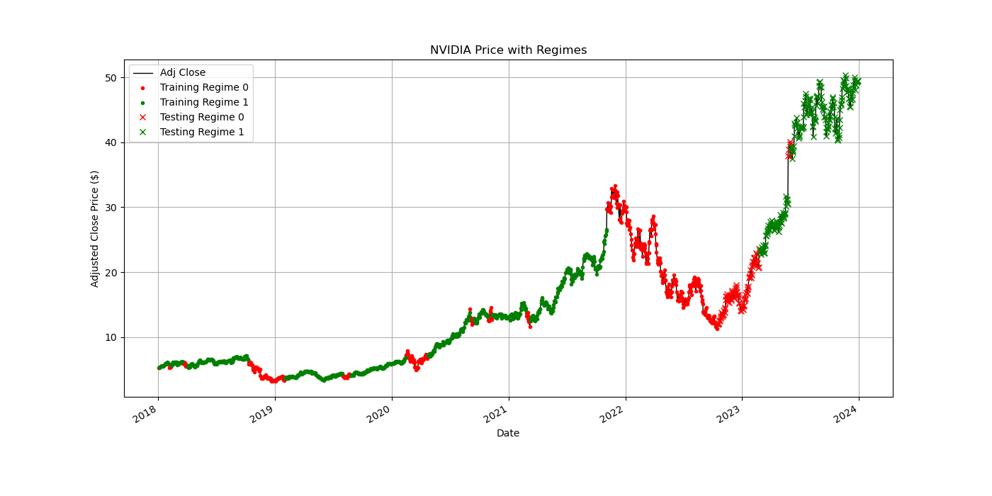

Slide 8
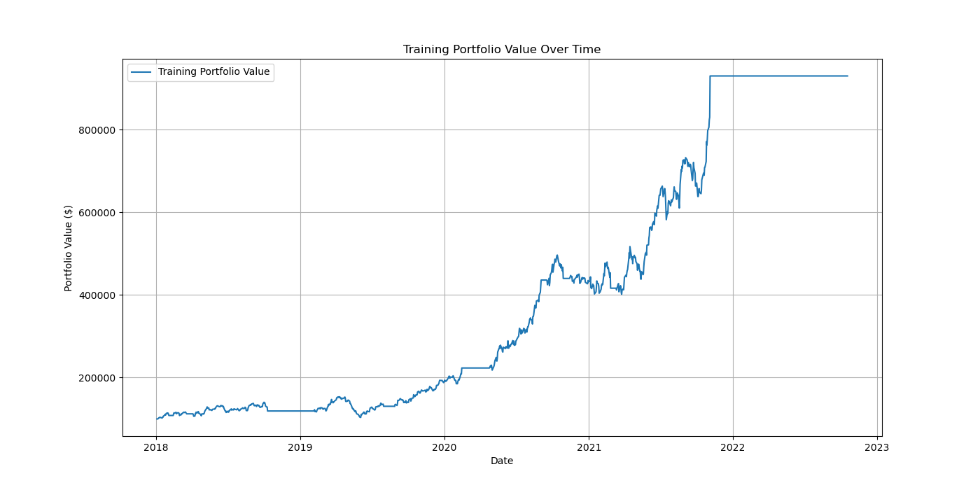

Slide 9
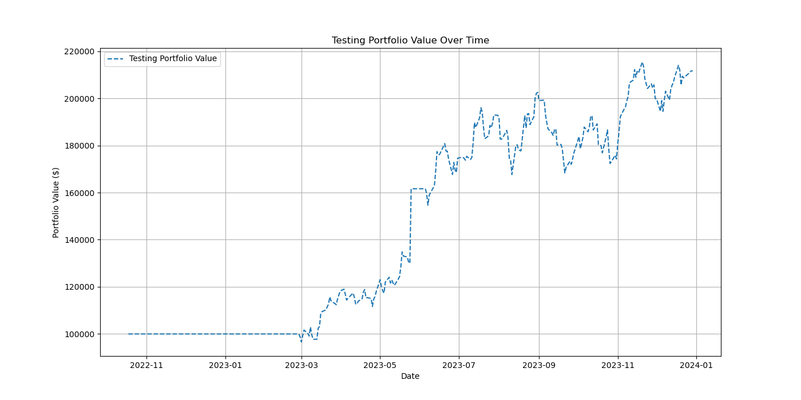

Slide 10
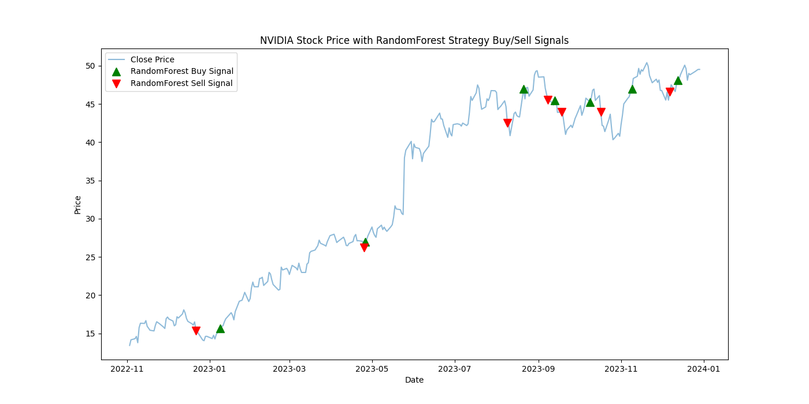

Slide 11
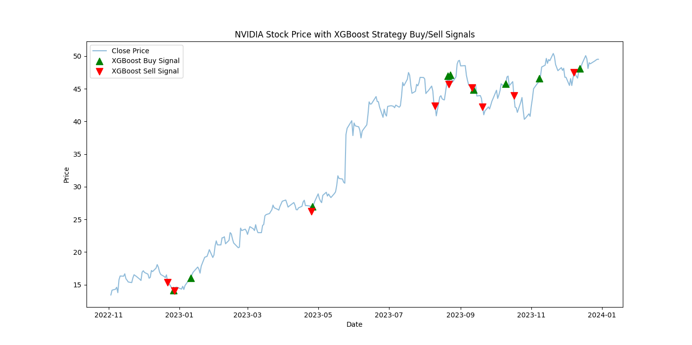

Slide 12
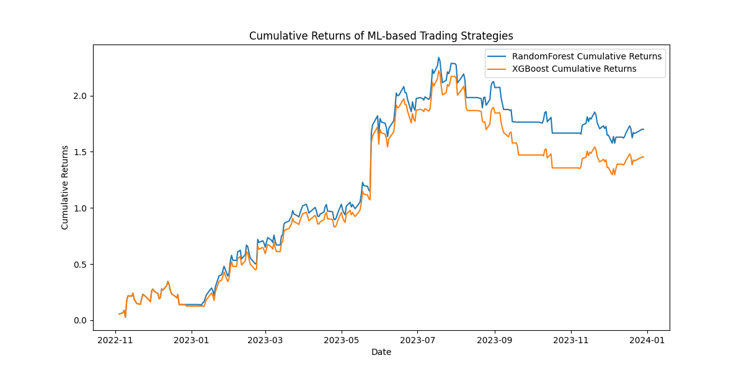

Slide 13
Conclusion
Efficacy of HMM Strategy:
Adaptive trading signals for different market regimes
Robust in raw returns and risk-adjusted metrics
Suitable for volatile markets
Superiority of Machine Learning Models:
Higher risk-adjusted returns and overall profitability
Effective in digesting and learning from large datasets
Requires deeper understanding and management of algorithmic parameters
Final Thoughts:
Align strategy choice with trading profiles and market conditions
Advanced analytics crucial for future trading strategies
Notes:
Conclusion Let's wrap up by summarizing the key findings from our analysis of Hidden Markov Model (HMM) and Machine Learning-based trading strategies using NVIDIA's stock data.
Efficacy of HMM Strategy The HMM strategy demonstrated a significant ability to generate actionable trading signals that adapt to different market regimes. This strategy is robust in terms of raw returns and risk-adjusted metrics, offering a sophisticated approach that can be particularly advantageous for traders looking for adaptive strategies in volatile markets.
Superiority of Machine Learning Models The Machine Learning strategies, particularly the Random Forest and XGBoost models, showed superior performance in both risk-adjusted returns and overall profitability. These models effectively digest and learn from large datasets, capturing complex patterns that traditional analysis methods might miss. However, their sophistication necessitates a deeper understanding of algorithmic parameters and a careful approach to managing overfitting.
For investors and traders looking to maximize returns while managing risk, Machine Learning strategies present a compelling option. However, the complexity and computational requirements of these models require thorough understanding and careful management. On the other hand, the HMM strategy remains a viable option for those seeking a sophisticated, adaptive approach that balances risk and return effectively.
Future Research Going forward, hybrid strategies that combine the adaptability and clarity of Hidden Markov Models with the predictive power of Machine Learning models may offer a balanced approach, providing both actionable insights and adaptability to market changes. Further research could explore integrating sentiment analysis and macroeconomic indicators to enhance the predictive capabilities of these models.
Final Thoughts This project highlights the potential of sophisticated computational models in stock trading and underscores the importance of aligning strategy choice with individual or institutional trading profiles and market conditions. As financial markets continue to evolve, integrating advanced analytics will likely play an increasingly critical role in developing successful trading strategies.
Thank you for your attention.

Slide 14
References
Brown, D. P., & Jennings, R. (1989). On technical analysis. Review of Financial Studies, 527-551.
Hamilton, J. D. (1989). A new approach to the economic analysis of nonstationary time series and the business cycle. Econometrica, 57(2), 357-384.
Elliott, R. J., Aggoun, L., & Moore, J. B. (2008). Hidden Markov Models: Estimation and Control. Springer.
Brown, D. P., & Jennings, R. (1989). On technical analysis. Review of Financial Studies, 527-551.
Huang, W., Nakamori, Y., & Wang, S.-Y. (2009). Forecasting stock market movement direction with support vector machine. Computers & Operations Research, 2513-2522.
Kearns, M., & Nevmyvaka, Y. (2013). Machine learning for market microstructure and high-frequency trading. Journal of Investment Strategies, 83-105.
Lopez de Prado, M. (2018). Advances in Financial Machine Learning. Wiley.
Murphy, J. J. (1999). Technical Analysis of the Financial Markets: A Comprehensive Guide to Trading Methods and Applications. New York: Institute of Finance.
Patel, J., Shah, S., Thakkar, P., & Kotecha, K. (2015). Predicting stock and stock price index movement using Trend Deterministic Data Preparation and machine learning techniques. Expert Systems with Applications, 259-268.
Prado, M. L. (2018). Building Winning Algorithmic Trading Systems: A Trader's Journey From Data Mining to Monte Carlo Simulation to Live Trading. Wiley.

Slide 15
Team Collaboration
Task | Assigned to
Data Loading and Preprocessing | Afet Ibadova
EDA | Daryush Ray
Strategy 1 | Afet Ibadova
Strategy 2 | Daryush Ray
Performance Measures Calculation | Afet Ibadova
Optimization and Backtesting | Daryush Ray
https://github.com/astronaut505/tradingtroll

