Slide 1
VaxLivestock
Smart Livestock Vaccination Monitoring & Fraud Detection Platform
Securing livestock health through intelligent digital monitoring
Karnataka Department of Animal Husbandry & Veterinary Services
Team Members: Nishant Yadawad.
USN: 2GI25CS116
Guide: Prof. Vivek Tiwari

Slide 2
The Problem
India: 535+ million livestock (20th Livestock Census, 2019). Endemic diseases — FMD, Brucellosis, HS, BQ, PPR — cause crippling economic losses (> ₹20,000 crore/year). Current program gaps enable large-scale fraud and operational blind spots.
Key Challenges
Ghost vaccinations and fabricated field records go undetected
No GPS verification to confirm officer visits
Repeated proof images across records; no deduplication
Expired vaccine vials administered; no automatic expiry checks
No real-time dashboard — manual Excel aggregation at district level
Paper and unstructured Excel records provide zero auditability

Slide 3
Our Solution & Tech Stack
VaxLivestock is a zero-infrastructure, browser-based platform that converts raw Excel/CSV vaccination records into actionable intelligence — all client-side. No data leaves the user's browser; privacy and cost are preserved.
Core Capabilities
Tech Stack
Client-side parsing with SheetJS (xlsx.js) — offline-first
Weighted fraud-signal scoring engine with 4 detection rules
Interactive multi-view dashboard: maps, stats, activity feed
Single static HTML file: zero server, zero DB, zero licensing
HTML5, CSS3, JavaScript (ES6+), TailwindCSS (Material Design 3 tokens), SheetJS, Google Fonts (Hanken Grotesk, Inter, JetBrains Mono), Google Material Symbols

Slide 4
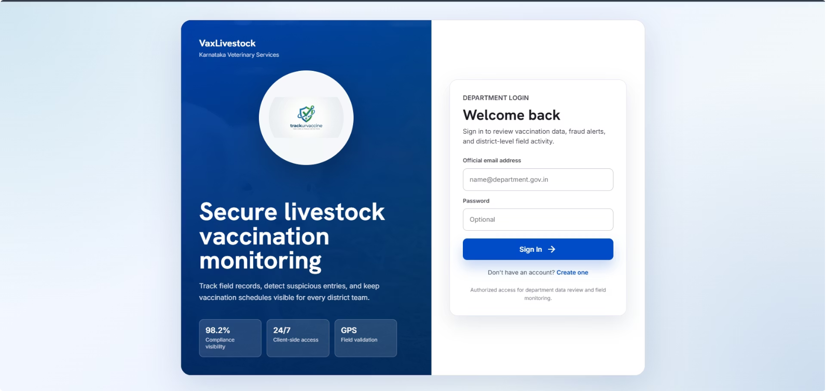
Login & Home Dashboard
Secure, lightweight access — department users sign into a browser-first dashboard that provides real-time compliance and anomaly visibility.
Login Highlights
Dashboard Snapshot
District Map & Panels
Branded split-panel, department login card, 98.2% compliance visibility, 24/7 client-side access, GPS field validation
Hero banner: "Govt. of Karnataka Veterinary Dept." • Stats: 14,208 Records Verified Today • 98.2% Compliance • 241 Anomalies Flagged
District compliance grid (Bengaluru Rural 99% green, Hassan 82% amber, Belagavi 41 flags red). Side panels: FMD coverage 86%, GPS match 92%, Recent Activity feed

Slide 5
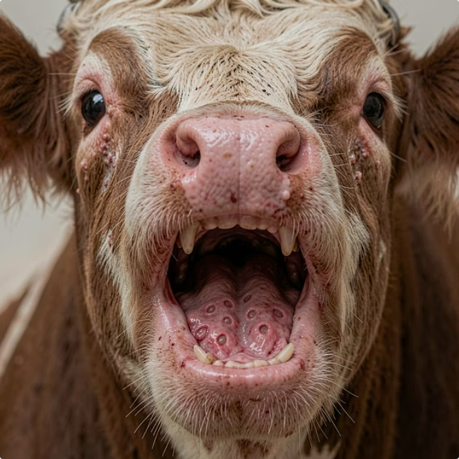

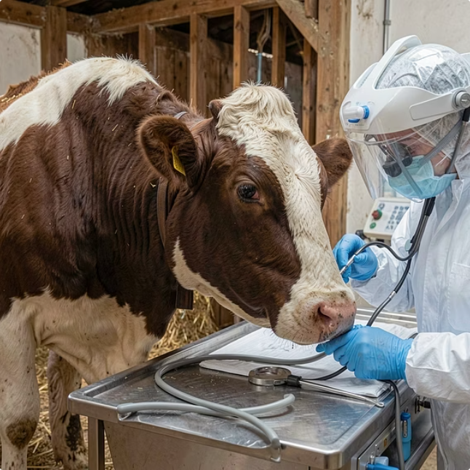
Disease Directory
Comprehensive reference for field officers: clinical signs, prevention steps, and vaccination protocols — coupled with emergency protocols and quick-action links.
Brucellosis
Foot and Mouth Disease (FMD)
Anthrax
Zoonotic • Species: Bovine, Ovine
High Risk • Species: Bovine, Porcine
High Risk • All species

Slide 6
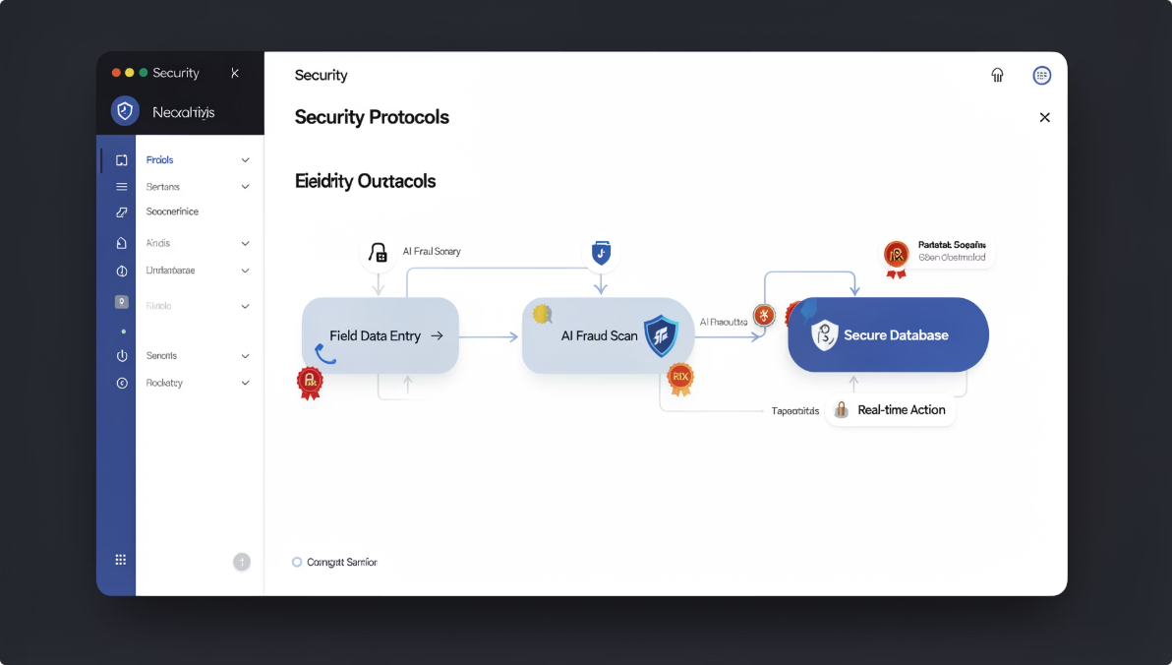
Fraud Detection Engine
The core innovation is a weighted, multi-signal fraud scoring engine that surfaces high-risk records for immediate review and action.
4 Detection Rules & Weights
Risk Badges
Security Health
GPS Mismatch — +40 weight: Assigned village ≠ GPS village → Officer review
Impossible Speed — +20 weight: 15 vaccinations logged in 1 minute → Audit trail
Duplicate Image — +30 weight: Same proof image reused across animals → Flag record
Expired Vaccine — +50 weight: Vaccination date after vial expiry → Escalate immediately
0 = Safe (green) • 1–39 = Warning (amber) • 40+ = High Risk (red)
Offline signing, sync tokens, image hash checks, manual override audit — immutable event log per district

Slide 7
Manage Field Data Tool
Operational hub for validating, normalizing, and exporting vaccination records. Designed for rapid ingestion and immediate fraud analysis.
Operational Metrics
Expected Upload Columns
Pipeline & Preview
Minimum schema: 8 columns
4 fraud scans enabled
7-day due-week alert window
2 export outputs (district report, state summary)
Animal_ID, Assigned_Village / GPS_Village, Proof_Image_Name, Last_Vaccination_Date, Vaccine_Expiry_Date — each with purpose and validation rules enforced before processing
Read spreadsheet → Normalize fields → Detect anomalies → Export reports. Sample records: KA-HAS-00491 (Valid, green); KA-BGM-01882 (GPS review, amber); KA-BLR-00217 (Overdue, red)

Slide 8
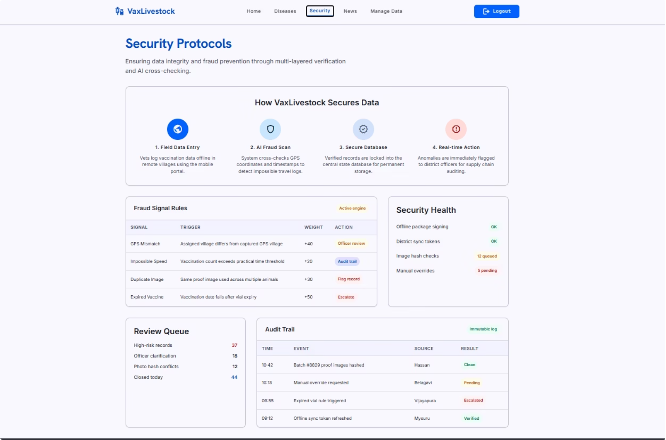

Security & Audit Trail
A compact, verifiable four-step security pipeline ensures records are auditable and tamper-resistant.
Field Data Entry — vets log data (offline-capable)
AI Fraud Scan — GPS, timestamps, image-hash checks
Secure Database — verified records locked (client-side immutability patterns)
Real-time Action — anomalies pushed to district officers instantly
Security Health: offline package signing OK; district sync tokens OK; image hash checks 12 queued; manual overrides 5 pending.
Immutable Audit Trail: logs every event with timestamp, source district, and result — suitable for state audit cell reviews and forensic analysis.

Slide 9
User Testing & Impact
Field-tested with 3 veterinary officers and 2 district administrators using anonymized real data. Results show fast processing and reliable fraud detection.
Key Findings
Upload-to-results: ~45 seconds
Fraud engine detected 100% of planted anomalies (3/3)
Feedback implemented: side-by-side GPS comparison, color legend, mobile-responsive grid, WCAG AA accessibility
Operational Impact
Field officers receive automated scheduling alerts; district admins gain real-time compliance visibility; State Audit Cell moves from weeks-long manual audits to instant detection.
Cost & Governance
Zero infrastructure cost — 100% open-source, runs entirely in the browser. Simplifies procurement and ensures rapid, low-risk deployment.

Slide 10
Future Scope & Thank You
Planned extensions to strengthen surveillance, usability, and analytics across Karnataka.
Short & Medium Term
Communications & AI
Contact & Acknowledgements
Companion Android app with mandatory GPS & camera proof
IoT cold-chain sensors (ESP32) for automated temperature monitoring
Backend option (Firebase / Supabase) for persistent trends and state-level analytics
SMS / WhatsApp alerts for high-risk records
Kannada localization for field users
AI-powered outbreak prediction using historical data
"Securing Karnataka's livestock, one vaccination at a time."
Team: [Names] • Guide: [Faculty name] • Contact: [Email]

