Slide 1
gender in #AAS223 talks
Jim Davenport
Katja Poppenhaeger
Alex Hagen
Adam Burgasser
Erin Grand
Laura Watkins
…
+ many others!

Slide 2
fundamental questions
do MEN and WOMEN ask the same number of questions in talks?
do MEN and WOMEN get asked the same number of questions in talks?
etc

Slide 3
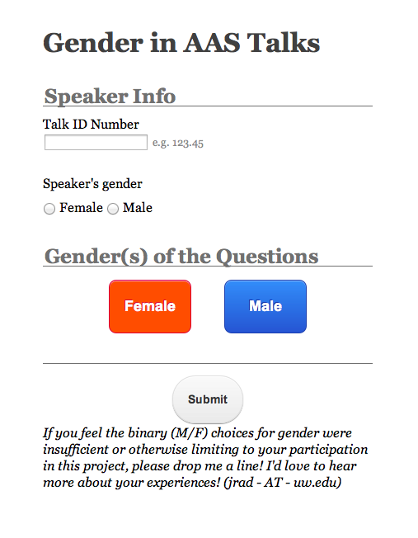

Slide 4
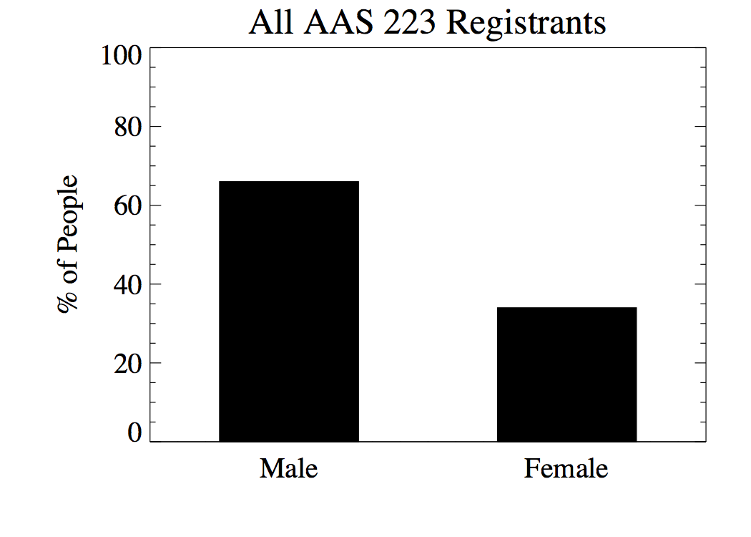

Slide 5


Slide 6
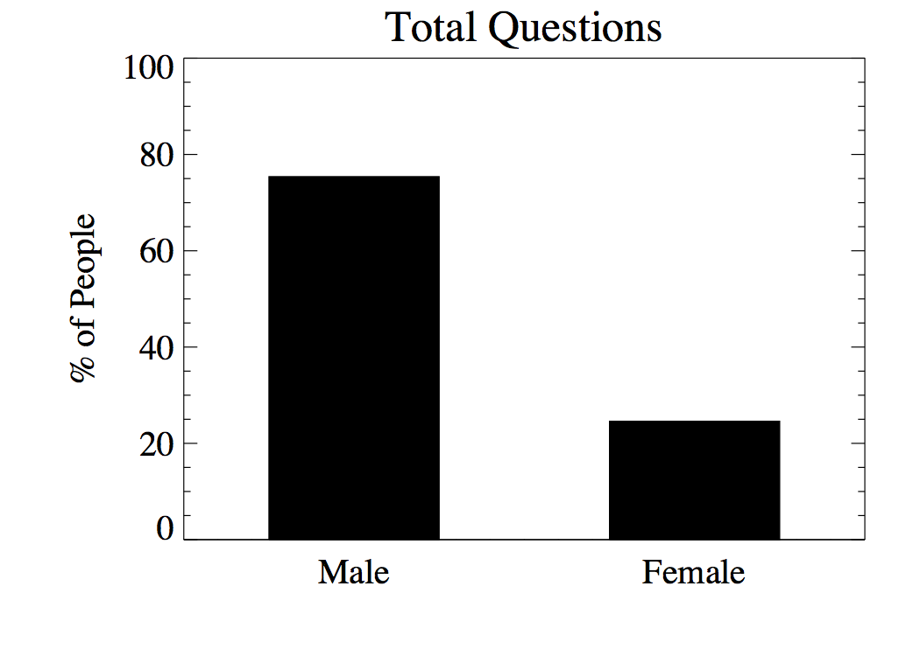

Slide 7


Slide 8


Slide 9
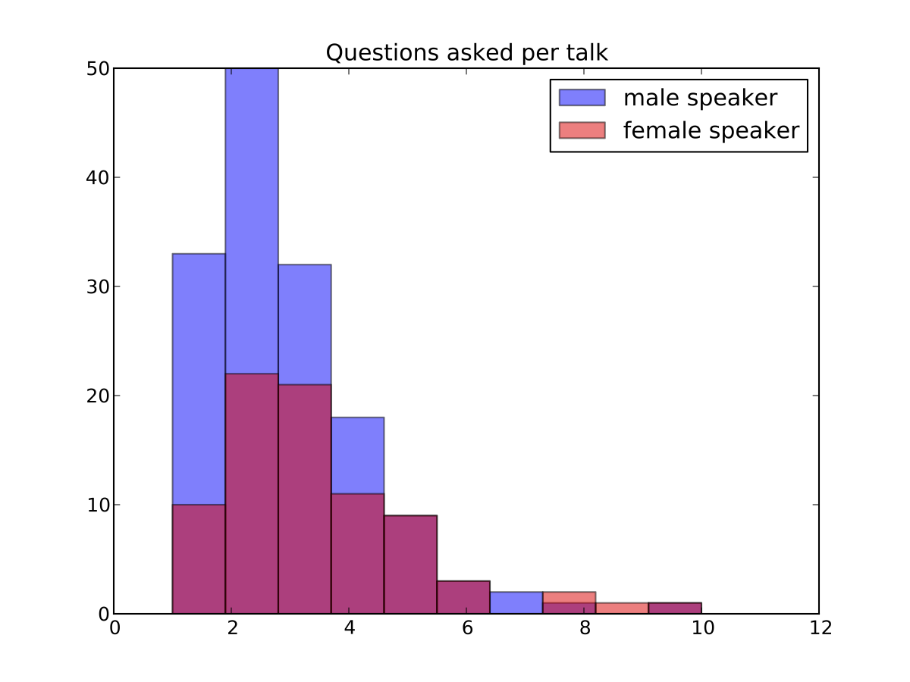

Slide 10
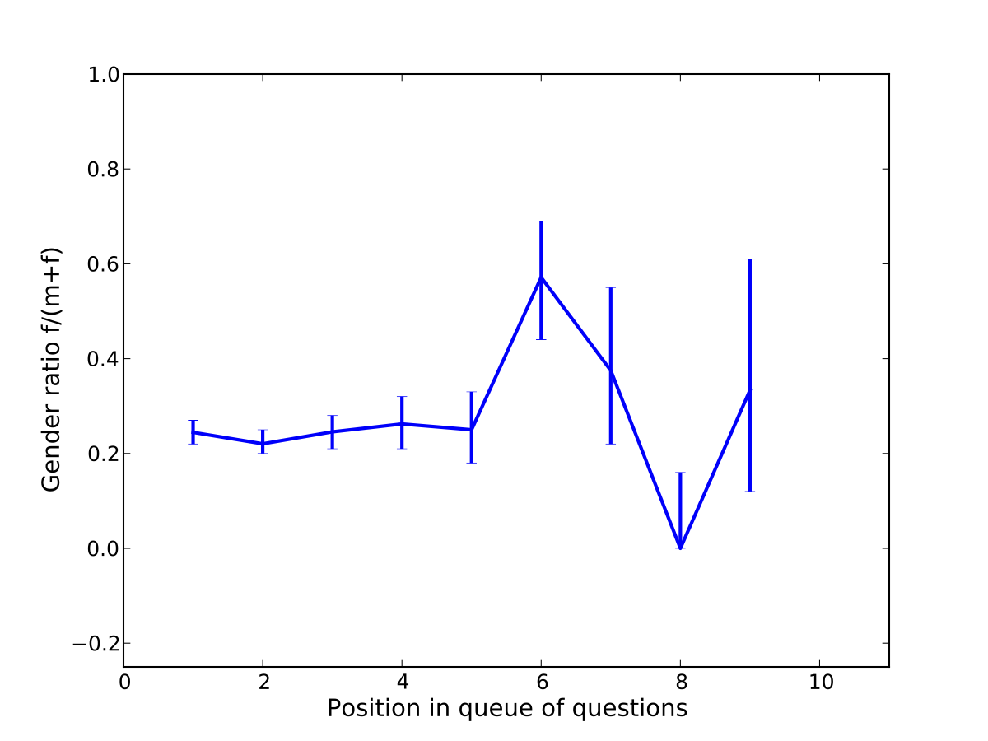
women ask questions later?

Slide 11
