Slide 1

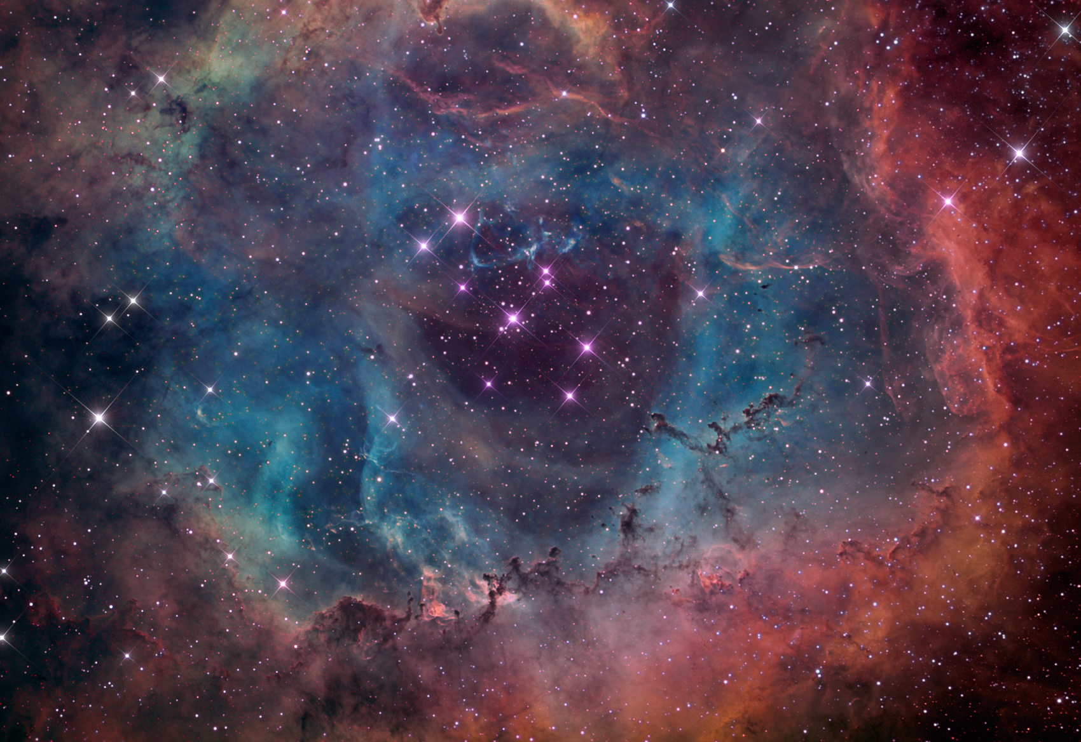
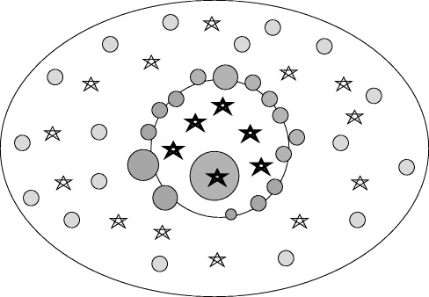
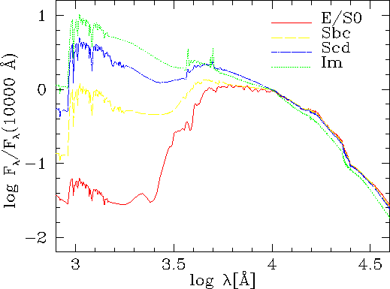
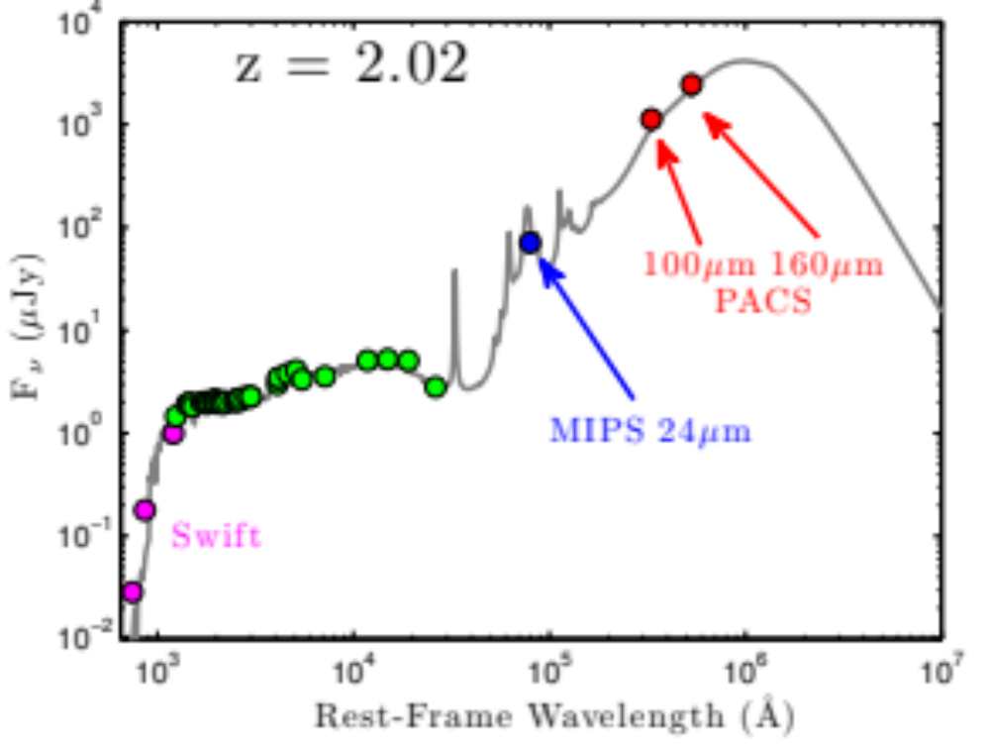
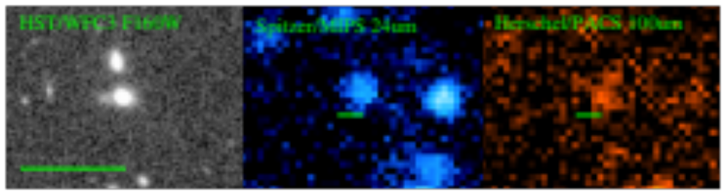
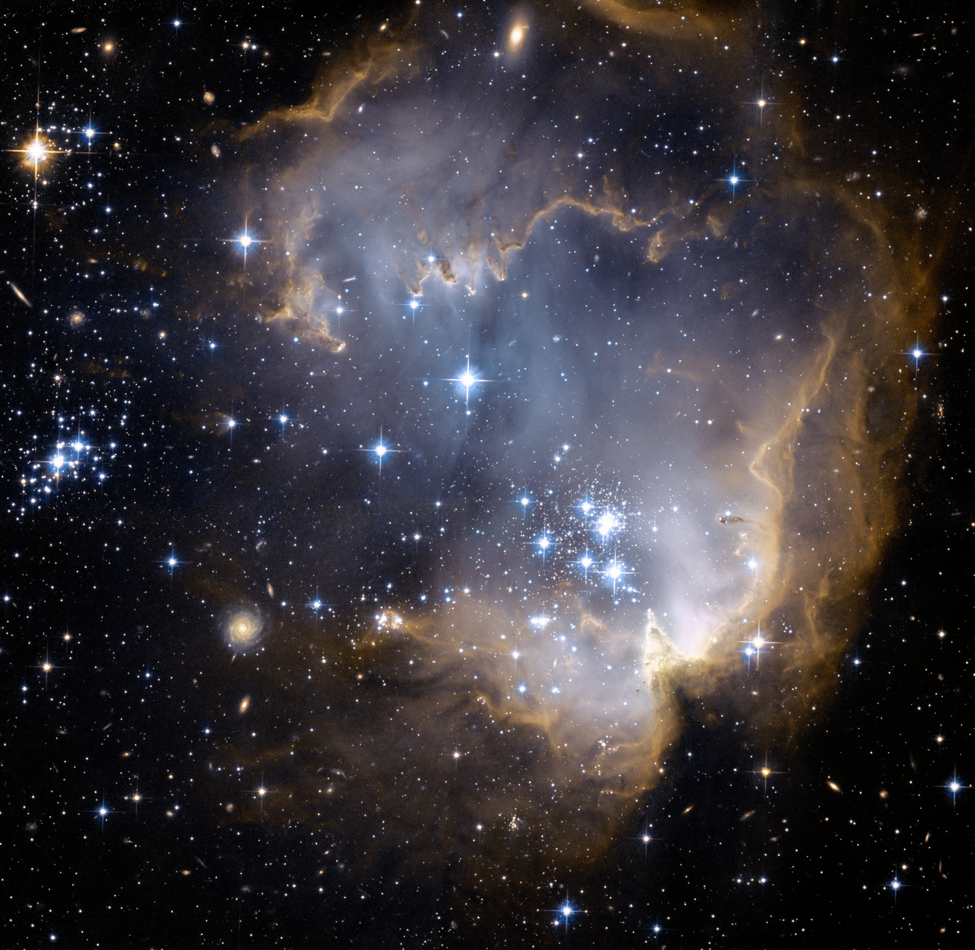
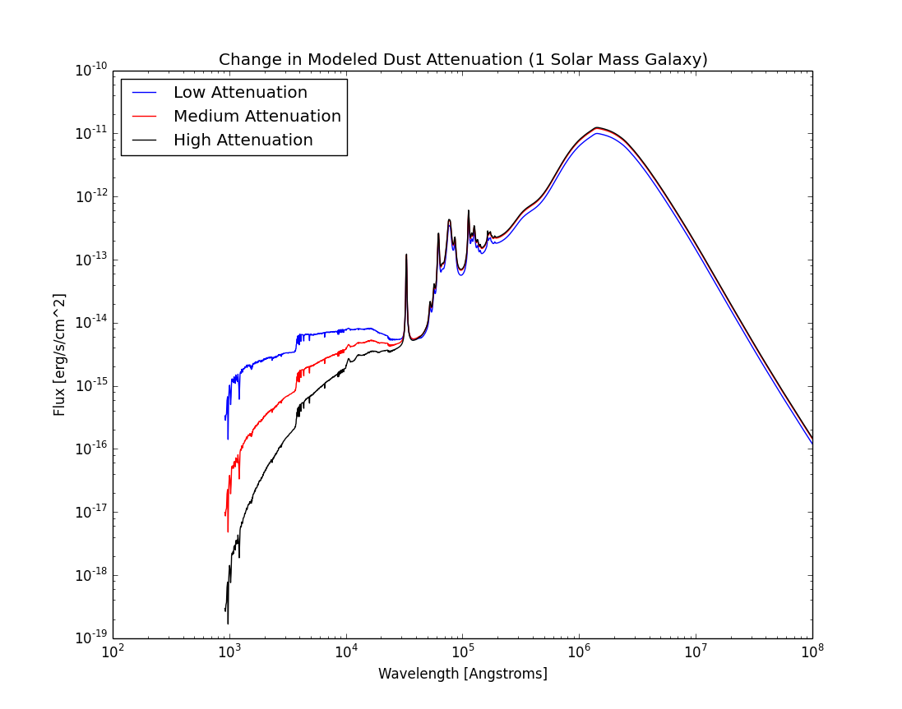
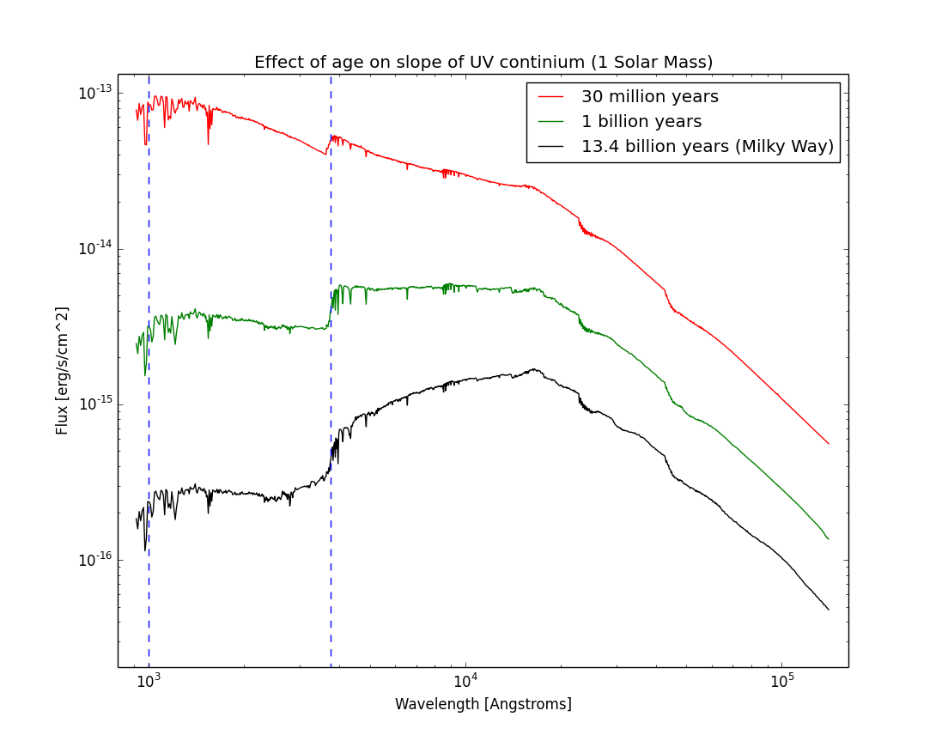
Hubble Space Telescope Emission Line Galaxies: The Dust Law
Hunter Brooks, Gregory R. Zeimann, Robin Ciardullo, Caryl Gronwall, Henry
Gebhardt, Donald P. Schneider, Alex Hagen
The young stars in the center of the nebula have cleared the gas and dust but the larger dust cloud still surrounds them.
Summary: Why are we doing this?
In star forming galaxies, the space between stars is composed of dust and gas. Gravity accumulates this material into clumps, eventually forming stars. At the end of their life cycles, stars eject their material, effectively recycling it back into the interstellar medium via supernova, or explosions of dead stars, and from expulsion off the surface of dying red dwarf stars. We are interested in learning about the early universe by studying the effects of dust on young galaxies. The epoch of the universe we investigate is 10 billion years old. For reference, the universe is only 13 billion years old. We attempt to deduce characteristics of these galaxies, accounting for the complicated effects of dust.
Dust affects the light we see from a galaxy in two ways: absorption of light (attenuation) and its reemission. In general, dust particles capture light in the Ultraviolet and reemit it in the Inferred part of the electromagnetic spectrum. In the Ultraviolet, dust is often modeled by two clouds. One is optically dense but short lived. This is the smaller cloud in the figure to the right. The other is larger, affects older stars, but is more transparent. In the Inferred, the emission of light is model dependent; we use a fractional organic particle method that requires three parameters. We model the light spectrum, or the amount of energy per wavelength, of a hypothetical galaxy by inputting possible values for five important parameters into a code. Then we compare this calculated model to what we actually observe in effort to get a close match. Once we have a close match, we can deduce values for our five parameters and thus calculate characteristics for that galaxy. This technique allows us to study the galaxies of the universe as it was 10 billion years ago.
SFR and Reddening
Age
Stellar Mass
Left: A depiction of the model used for dust attenuation. The smaller birth cloud shrouds the majority of stars for a short time while the less dense larger cloud affects the each star within it.
Right: How do we learn about a galaxy from only a plot of energy vs. wavelength? Different parts of the plot tell us different things!
Source: http://apod.nasa.gov/apod/ap110214.html
Why study dust?
Dust is an important part of Cosmology, or the study of the creation of the universe, because the night sky is a time machine. When we look up at night, we are seeing light that left source galaxies many years ago. As a result, we can see and learn about the universe at a young age.
Our sample consists of young galaxies riddled with large clouds of free roaming particles. These dust clouds modify the appearance of the light produced by stars within these star forming clouds. The effect varies along the electromagnetic spectrum, removing light in a certain shape at some wavelengths and reemitting it at others. The specifics of this modification can tell us information about the early universe. The opacity of dust, its composition, and the shape and strength of its emission curve dictate its effects. For example, up to 30% of a galaxies combined luminosity could come from dust emission. It is also one of the most prominent sources of uncertainty when making calculations about the early universe. Most importantly, it has a profound effect on the formation of stars, the fluid dynamics of the interstellar medium, and the thermodynamics and chemistry of gas. Today, the interactions between dust, gas, and the radiation field of the local universe have been thoroughly studied. However, studies on the time evolution of these properties are less common. What is the dust of the past made of? How much is there? To answer these questions we must go further back in our time machine.
The grey line to the right is the computer calculated model of the spectral energy distribution. The colored circles represent observations. Notice how the blue and red points are necessary to constrain the grey model at higher wavelengths. With out them, the models result would vary wildlyng.
Generating galaxy models and matching them to observation
We used a program called Flexible Stellar Population Synthesis code to simultaneously model the stellar emission, dust attenuation, and dust emission of our sample. The code calculates an energy distribution using variable numerical inputs. As we change these inputs, the shape of the output, an energy vs. wavelength plot, is modified. It’s this output plot we compare to observation. We explore five parameters: the age of the stellar population, the strength of the dust attenuation curve, and three parameters governing the dust emission. However, nature creates galaxies with a whole slew of parameter combinations. To account for this, we fix nearly every parameter governing the intensity of light we would observe from a galaxy, except our five. For example, because our sample galaxies contain stars much younger than todays, the metallicity of the stellar population was fixed at 20% that of our sun. Another simplification is to only study dust properties of galaxies at a specific epoch. This is why it is important to use redshift confirmed galaxies emission line such as the ones from our Hubble Space Telescope sample.
Still, the five free parameters cover a vast volume of phase space. To fit observations to models, we create a five dimensional grid and use a sophisticated exploration method to identify best-fit models as well as degenerate solutions. To accomplish this, we use emcee, a Metropolis Hastings Markov Chain Monte Carlo simulator. The code uses a set of ”walkers” functioning as an ensemble to explore the multidimensional parameter space, eventually converging on an estimation for each parameter. In the end, we maximize a Chi-Squared probability to different degrees of efficiency and accuracy based on computer run-time.
Source: https://www.astro.virginia.edu/class/clark107images/image_12.jpg
Above is a plot of our dust attenuation model at different strengths. The blue galaxy has a slightly attenuating dust cloud while black galaxy has strong attenuation effects. Varying a parameter changes the opacity of the birth cloud in our model thus changing the shape of the expected light distribution.
What have we found?
At this point, we are exploring the distribution of our five different parameters in the sample. Dust attenuation appears to require a “bump” in the power law and we hope to explore the characteristics of this bump. As for emission, the fraction of carbonaceous dust particles has a steep effect on the pattern of emission. We need to make our model more complex in order to obtain a better match to our observational data and find out how the model changes with characteristics of different galaxies. Efficiently and run-time are paramount in any data sciences project and this must be considered along with the accuracy of alternative models.
Acknowledgements
This work was supported via NSF through grant AST 09-26641. The Institute for Gravitation and the Cosmos is supported by the Eberly College of Science and the Office of the Senior Vice President for Research at the Pennsylvania State University. STScI declined to support this use of the 3D-HST Treasury Program data. Generous help from Robin Ciardullo, Greg Zeimann, and Alex Hagen was much appreciated!
As a galaxy ages, we see the general slope of the UV band (dotted window) changes. Why is this? What can we learn from this?

