Slide 1
MCSED Overview
Generates SEDs with Charlie Conroy’s Flexible Stellar Population Synthesis (FSPS) Fortran 90 code
Uses a fast Monte Carlo simulator called emcee to conduct a random walk, arriving at estimations for SED parameters
Relies on Python-FSPS, written by Dan Foreman-Mackey, to keep everything in Python

Slide 2
Why FSPS?
Created 100,000 SEDs in 15 minutes on LAE
Dust Emission
AGB Model from Villaume et al. (2014)
Draine & Li (2007)
Dust Attenuation
Simple power law
Calzetti curve
Milky Way Extinction Law
Several IMFs
Salpeter, Chabrier, Kroupa, van Dokkum, Dave

Slide 3
About the Random Walk
3 emcee variables, “tunable knobs”
Number of Walkers
Steps per walker
Number burn-in steps
No One-Size-Fits-All
Walkers need to check likelihood of position after each step, use linear interpolation of parameter space grid to get SED to do Chi^2 with
Run time scales linearly with nWalkers + nSteps

Slide 4
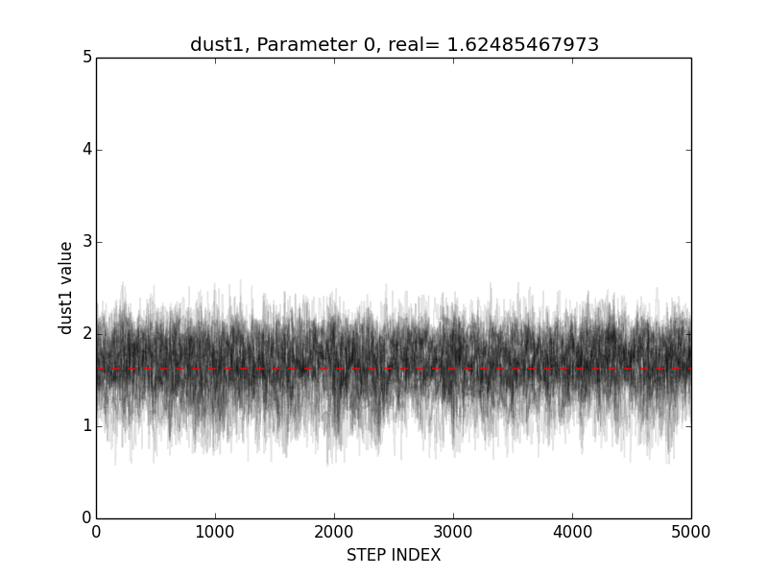

Slide 5
Download and install
Customize Software Package
Edit handful of project specific, well documented, variables
Write 1 line of code/parameter under investigation
Test Accuracy of MCSED
Copy/Paste Filter Transmission Curves
Average Fluxes for each object
Create pseudo-data from with random values for parameters under investigation
Run a script to create parameter space grid
Single command (ideally) to install FSPS, emcee, Python-FSPS
Run random walk on pseudo-data
Adjust random walk parameters, repeat until desired accuracy
Run and Export Results
Load Inputs
Redshifts for each object

Slide 6
Accuracy Testing
(Randomly) Pick parameter values to create SED from
Run MCSED on pseudo-data
Interpret and Plot results (Does MCSED recover your initial parameters?)
Change nWalkers, nSteps, nBurnSteps, log(parameters)
Add random Gaussian noise (sigma = 0.1)

Slide 7
MCSED: GOODS-South Object
~60% of runs result in multimodal distributions
Always at least 2 parameters are multimodal
Addition of MIPS 24, PACS 100, PACS 160 allows q_PAH to be constrained

Slide 8
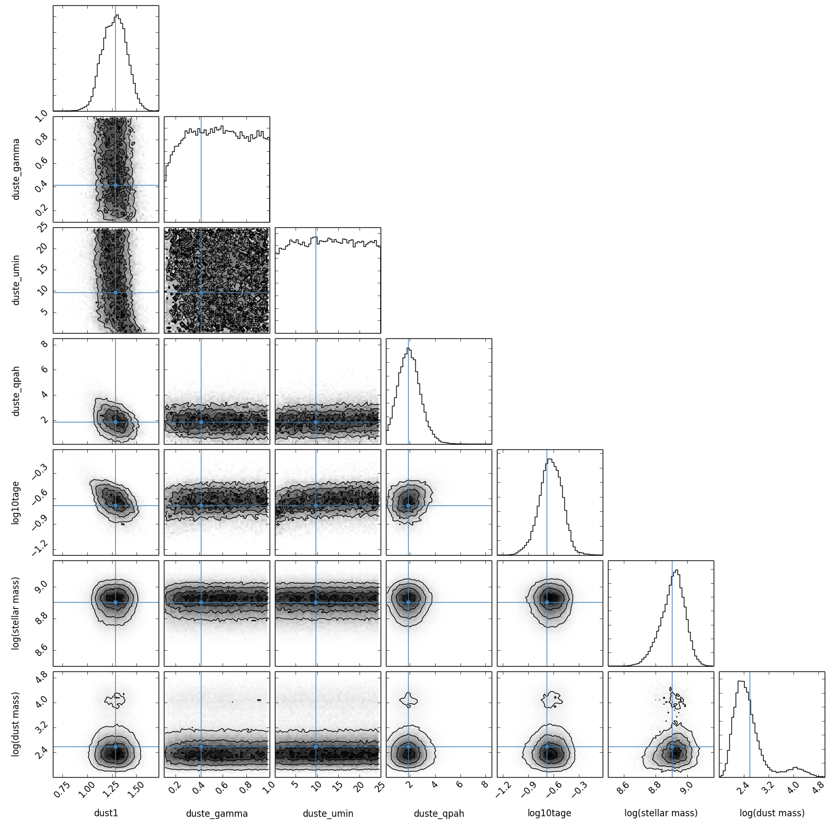

Slide 9
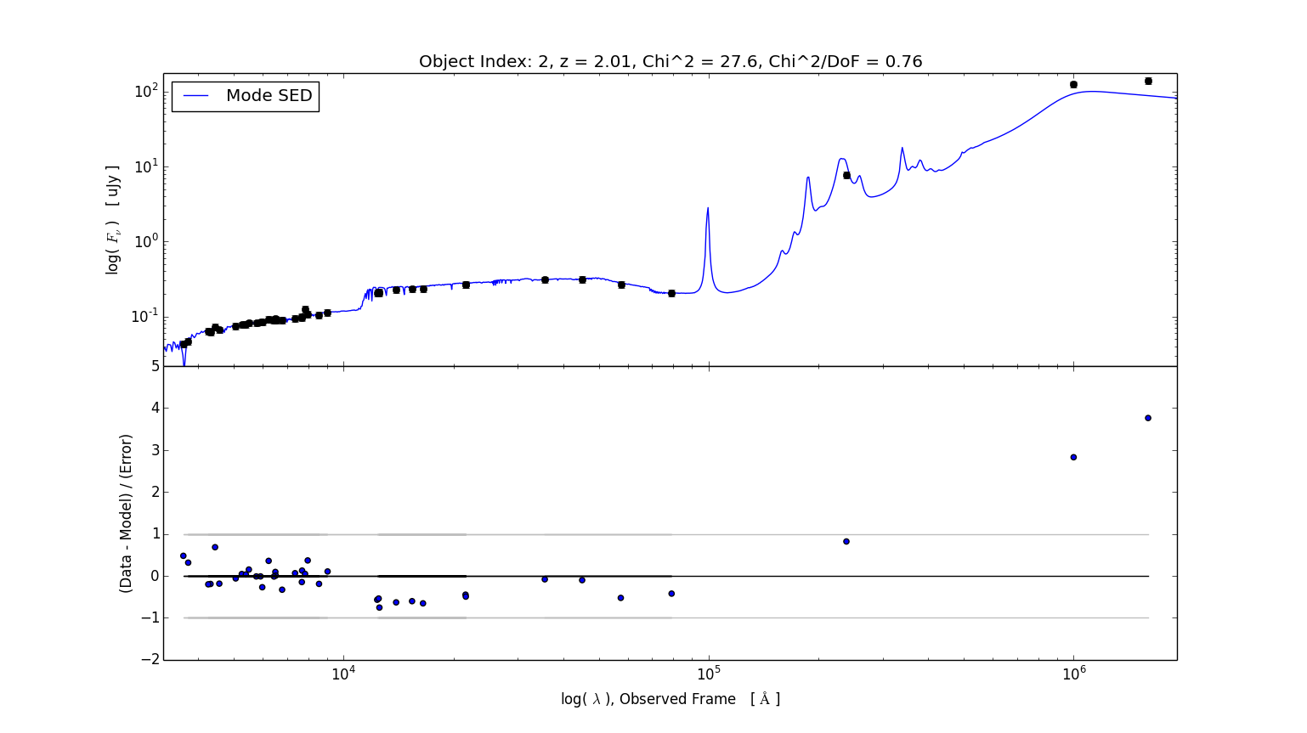

Slide 10
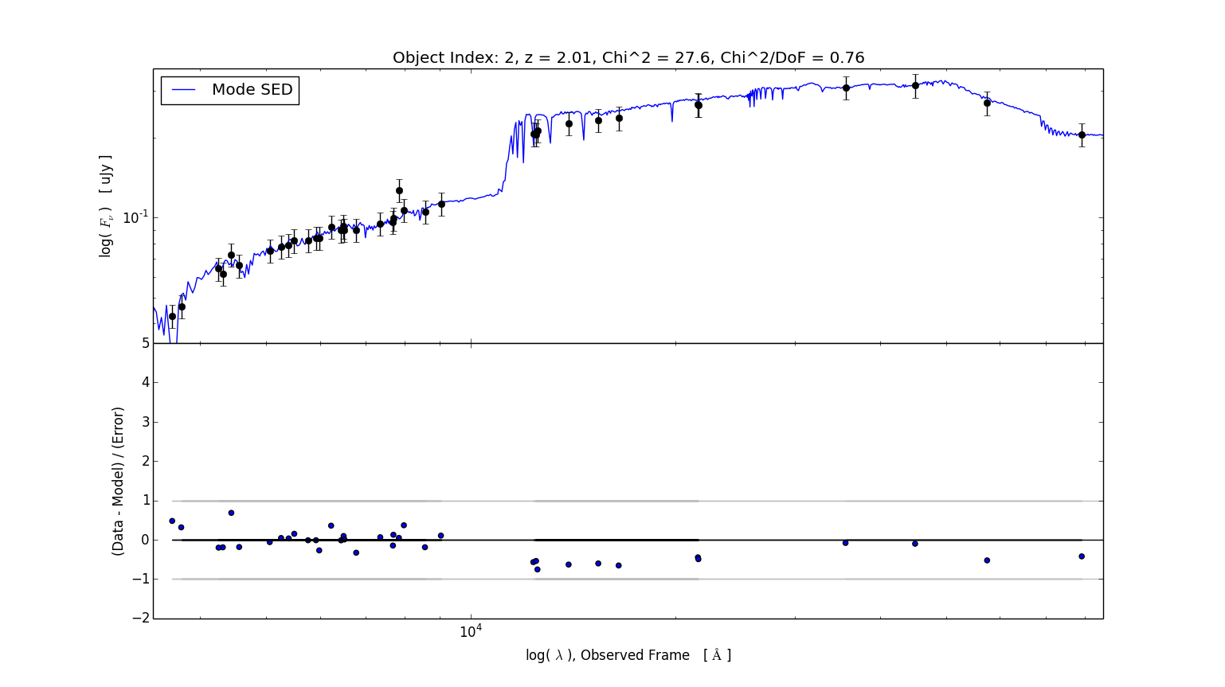
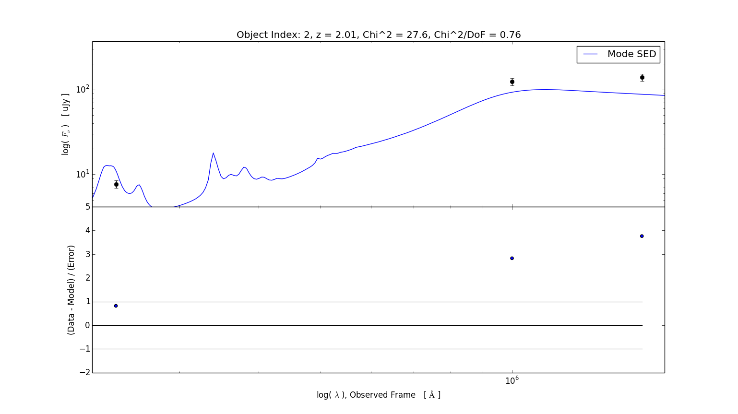

Slide 11
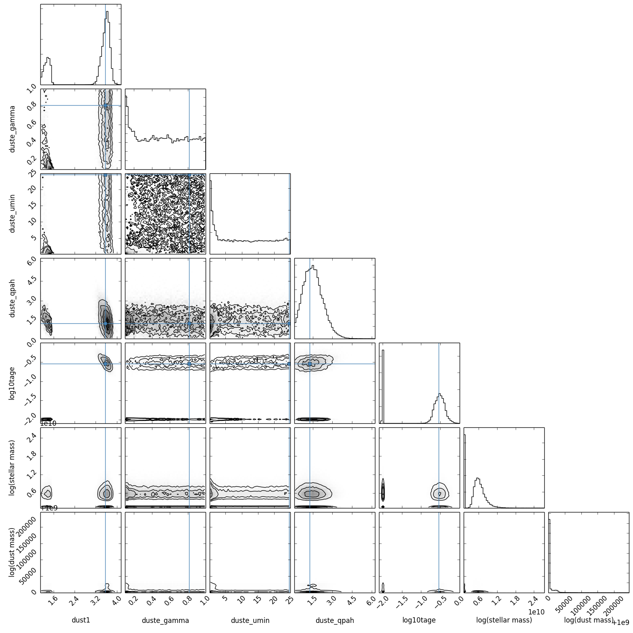

Slide 12
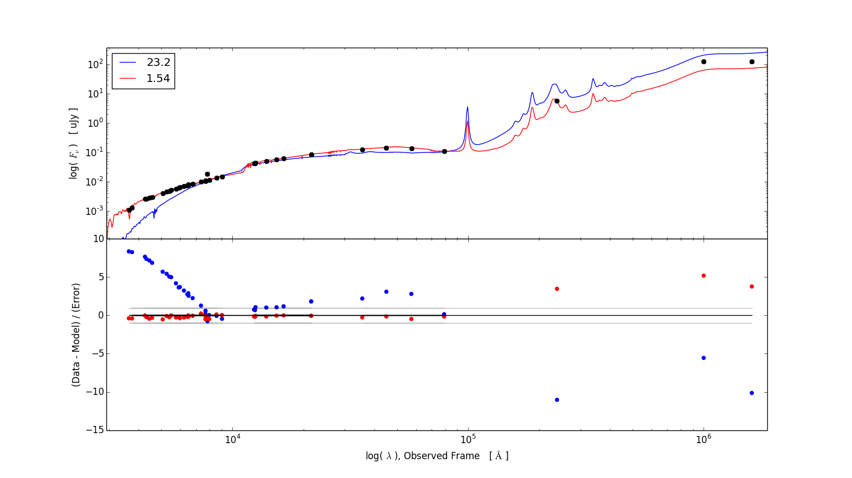

Slide 13
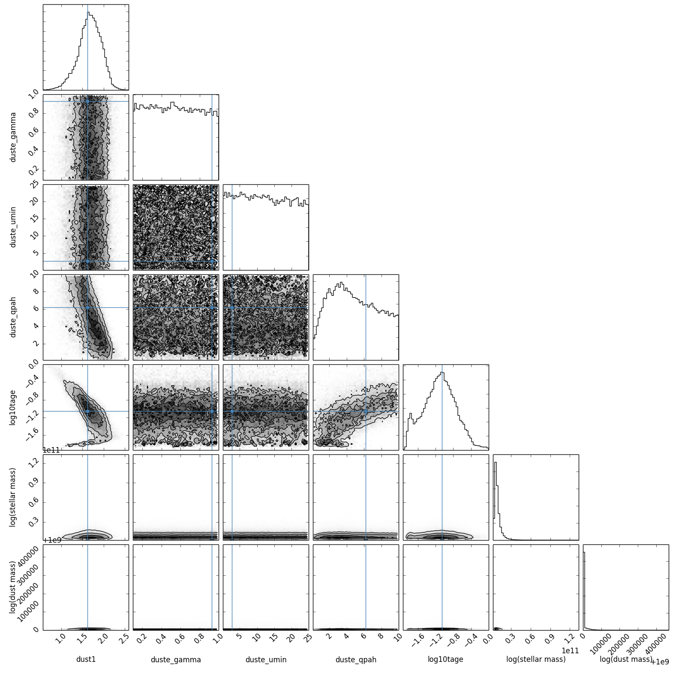
Pseudo-data results for a simulated GOODS-South Object
without MIPS24um, PACS100, 160um

