Slide 1
GitHub Flow Brett Andrews 3.27.2018

Slide 2
Bad things happen.
Sometimes the Universe is conspiring against you.
Sometimes your collaborators are conspiring against you.
Most likely, you're conspiring against you.

Slide 3
Protect your work from yourself.
Turn a project (in a local directory) into a git repository (repo):
git init
Add files and commit:
git add main.py
git commit -m "Fixes critical bug"

Slide 4
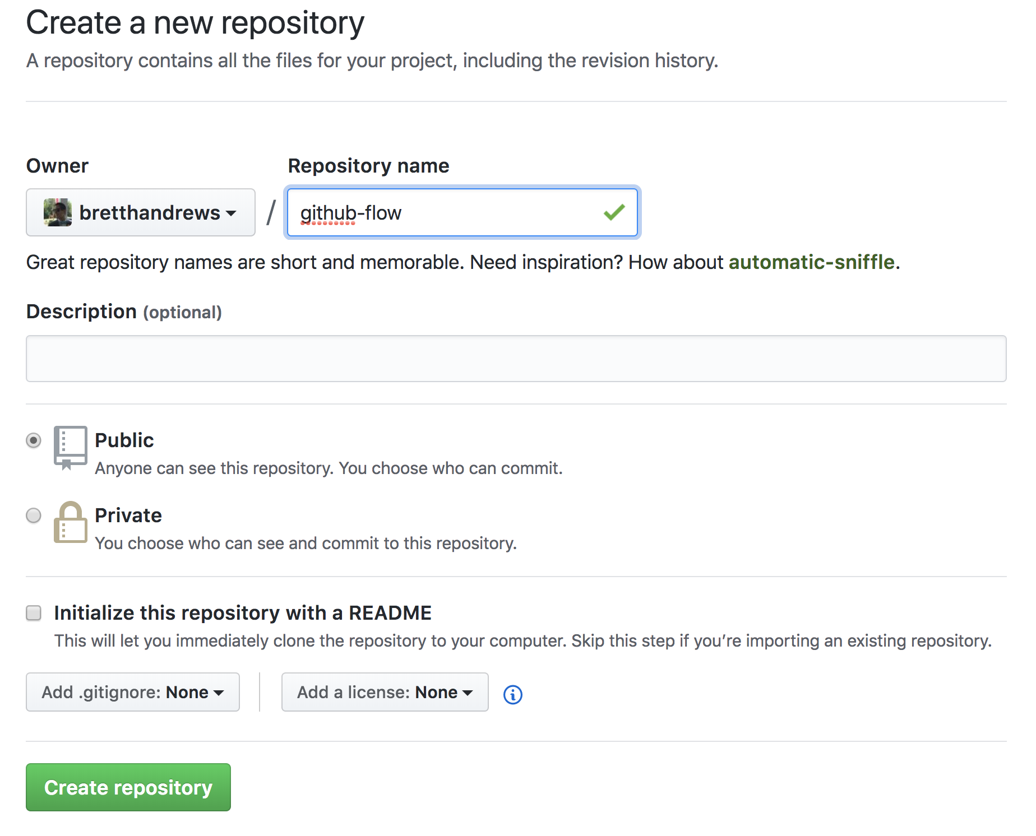
Protect your work from "water" spills.
Setup remote repo on GitHub:

Slide 5
Protect your work from "water" spills.
Connect local and remote repos:
git remote add origin <server>
for me: <server> = git@github.com:bretthandrews/github-flow.git
Push to remote repo:
git push –u origin master

Slide 6
Protect your work from collaborators*
*including past-you and future-you.
Work in branches
Submit Pull Requests
Merge branch into the master branch

Slide 7
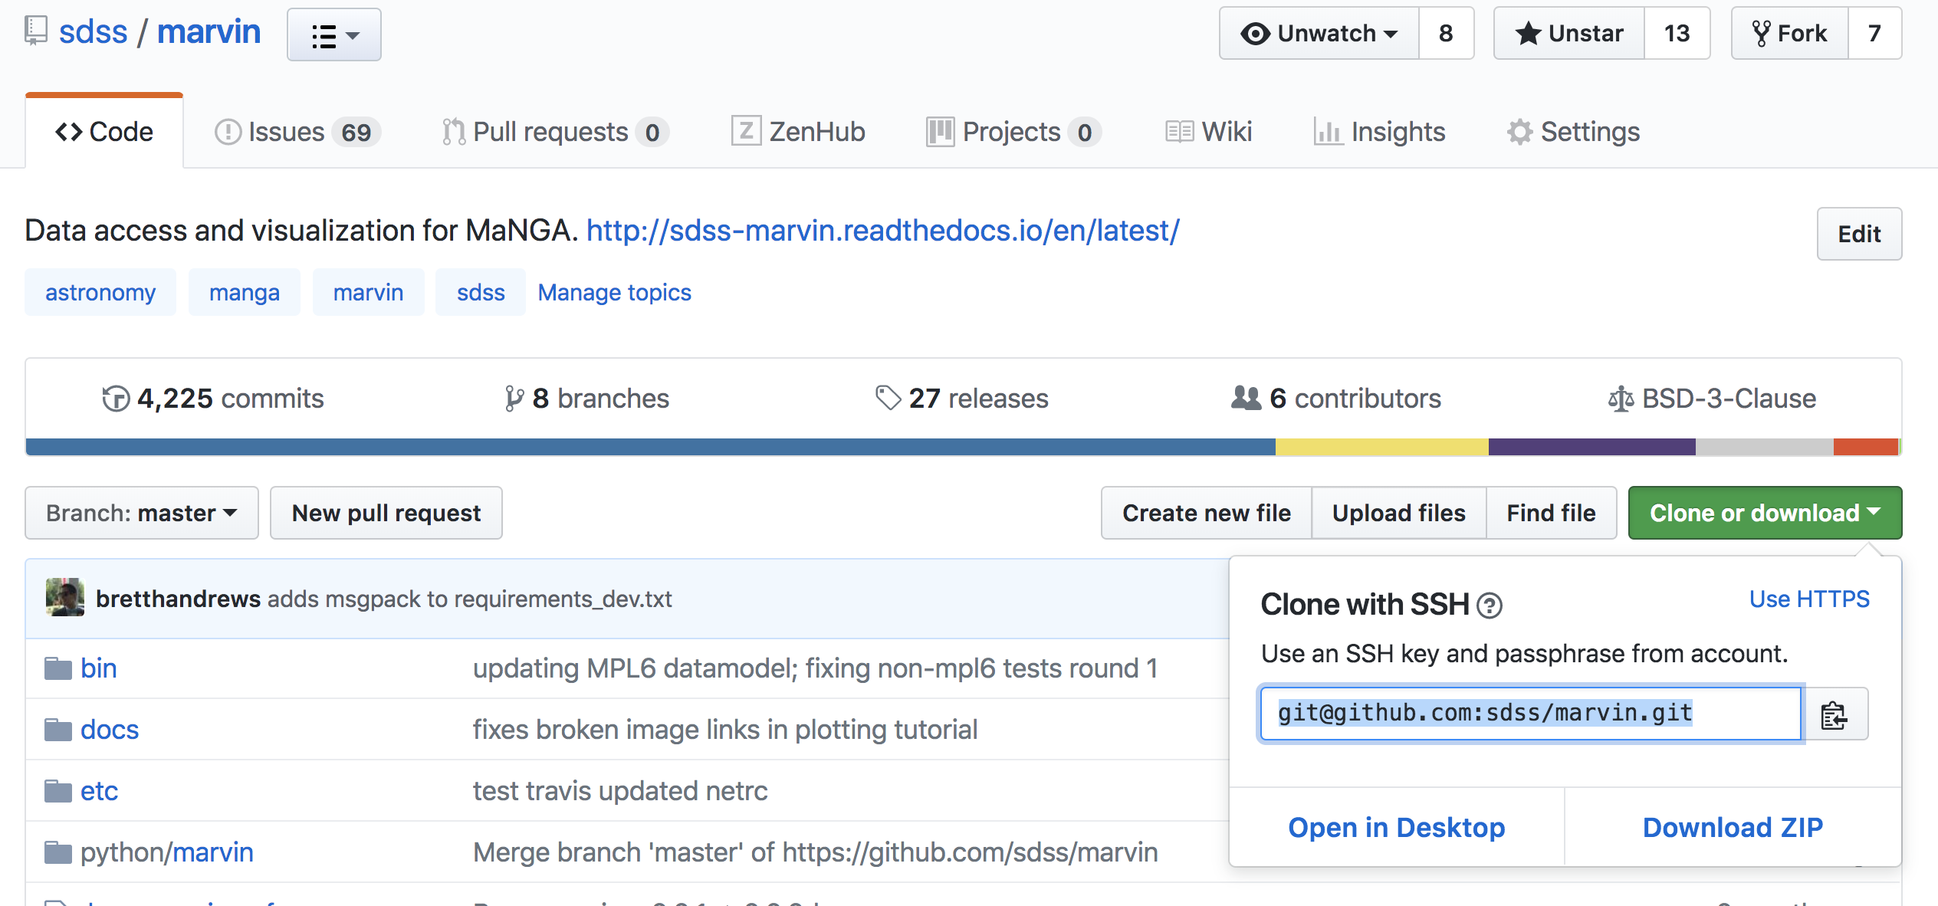
Protect your work from collaborators
For now, let's assume that you are a collaborator on the project (i.e., have push-access).
git clone git@github.com:sdss/marvin.git

Slide 8
GitHub Flow by Scott Chacon
The master branch always works.
Create a descriptively-named branch for each new feature.
Commit locally and regularly push to the same named branch on GitHub.
Submit Pull Requests for feedback, help, and merging.
Only merge into master after someone signs off on your changes.

Slide 9
master Always Works
Imperative if you are actively serving a web site.
Even if not, always want a stable version of code.
Start new branches from master.
You need to run the last working version of the code.
Bottom line: don't actively develop in master.

Slide 10
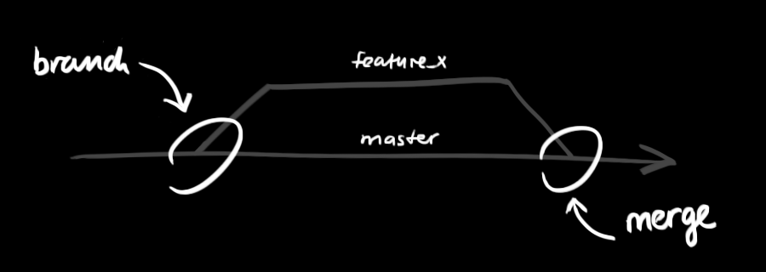
New Feature New Branch
One new feature per branch.
Use descriptive names (future-you will thank you).
Create a new local branch:
git checkout –b github-flow
Image credit: http://rogerdudler.github.io/git-guide/

Slide 11
New Feature New Branch
Sync w/remote branch of same name.
git push origin github-flow
Nomenclature note:
origin = my remote GitHub repo
upstream = shared remote GitHub repo.

Slide 12
Commit and Push Frequently
Make frequent commits.
One idea or complete change per commit.
Regularly push to remote branch (but pull first to incorporate changes):
git pull origin feature-x
git push origin feature-x

Slide 13
Pull Requests: Code Review
When you're done or stuck, submit a Pull Request to your collaborators.
Opportunity for you to review and communicate the changes that you made.
Receive feedback and help from collaborators.
Incorporate feedback.
After the Pull Request gets approved, then merge your branch into master.

Slide 14
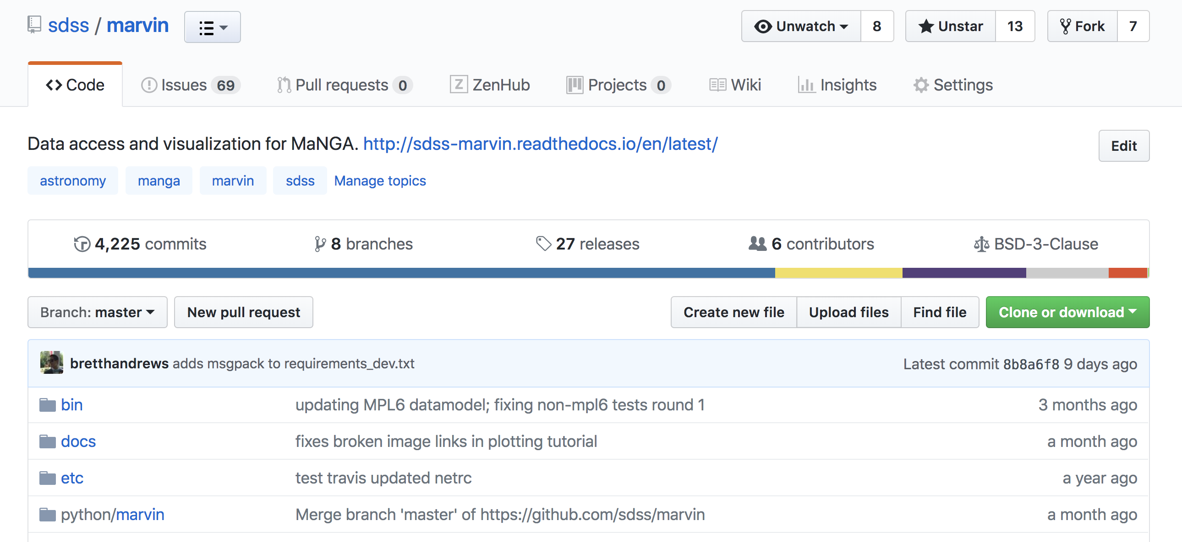
Create a Pull Request

Slide 15
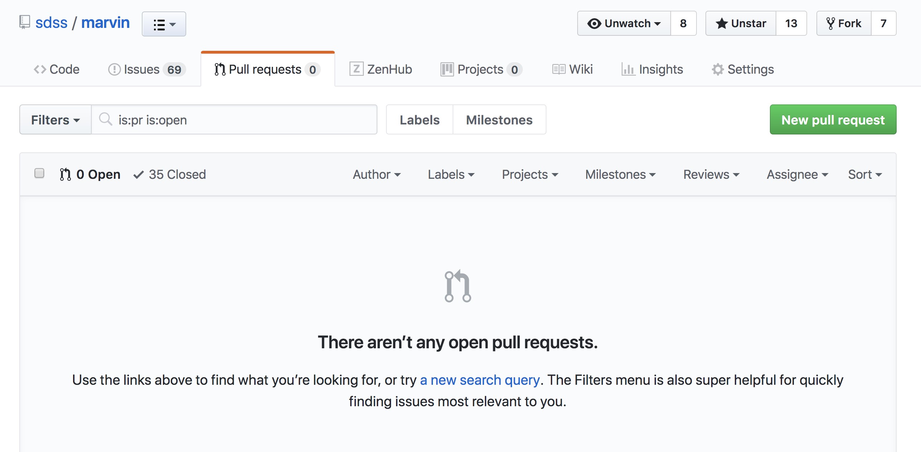
Create a Pull Request

Slide 16
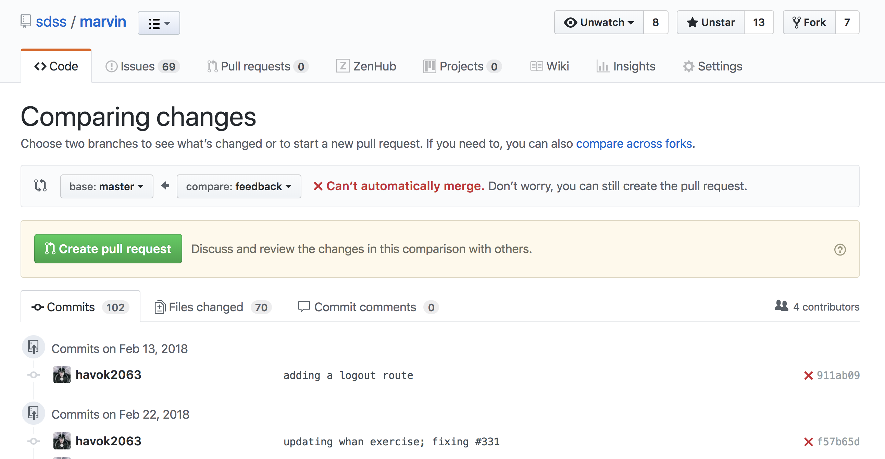
Pull Requests: Commit Log
Still need to merge master into feedback

Slide 17
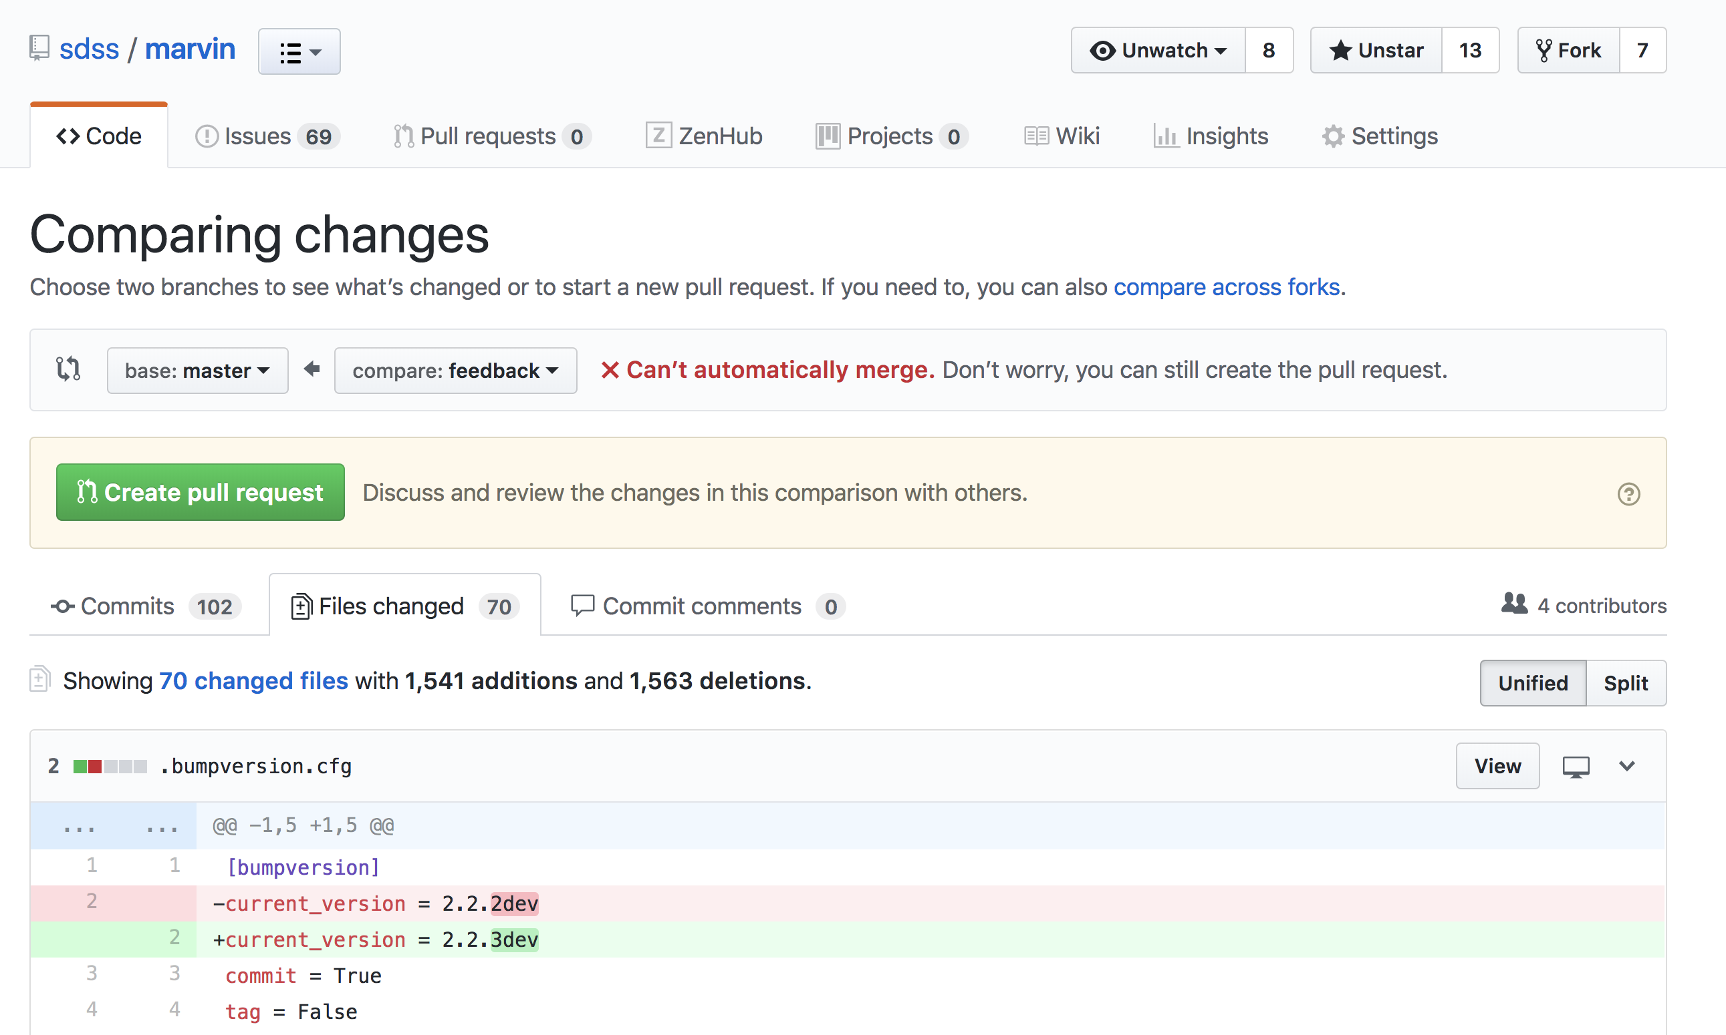
Pull Requests: Code Changes

Slide 18
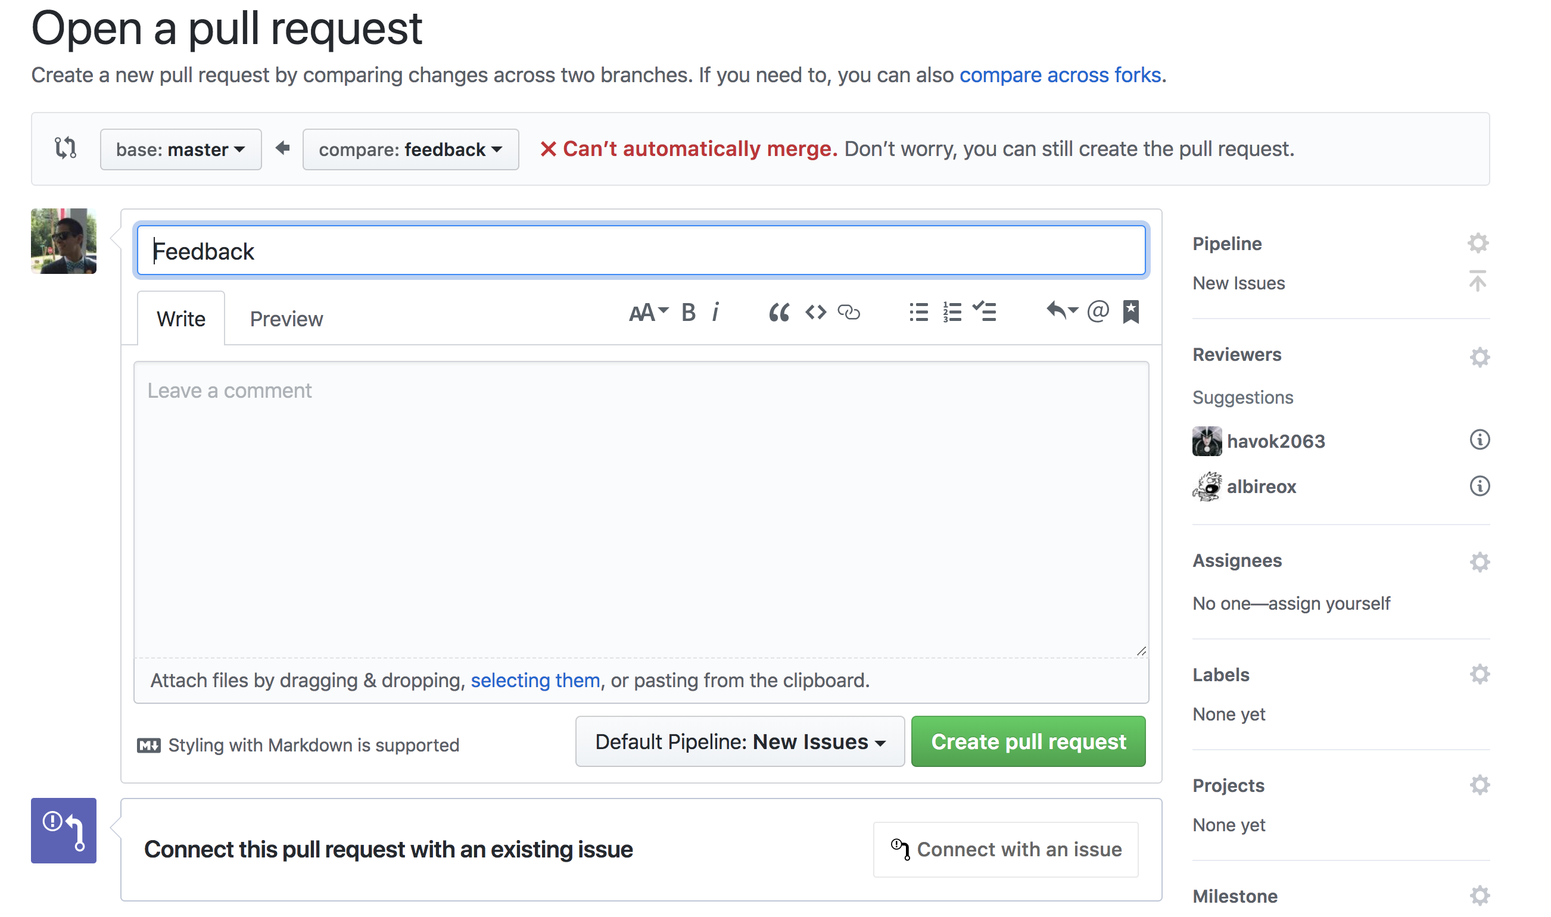
Pull Requests: Communication
Describe your changes

Slide 19
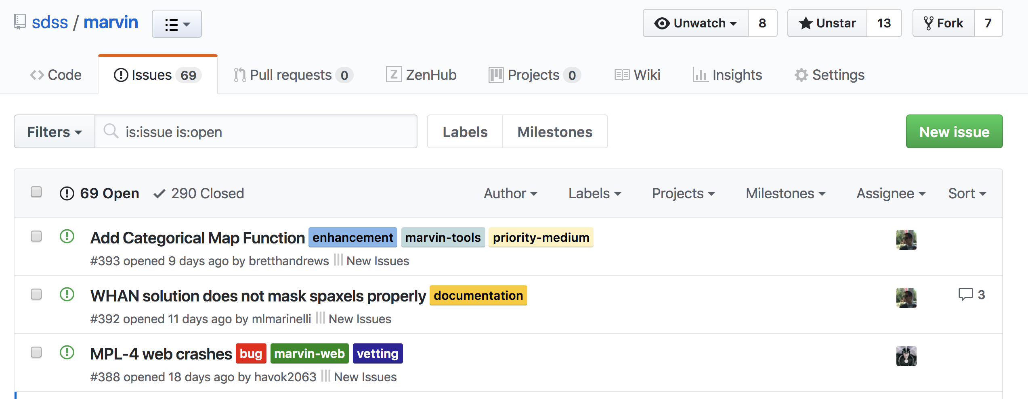
GitHub Issues
Communicate ideas (including to future-you)
Assign tasks
Prioritize

Slide 20
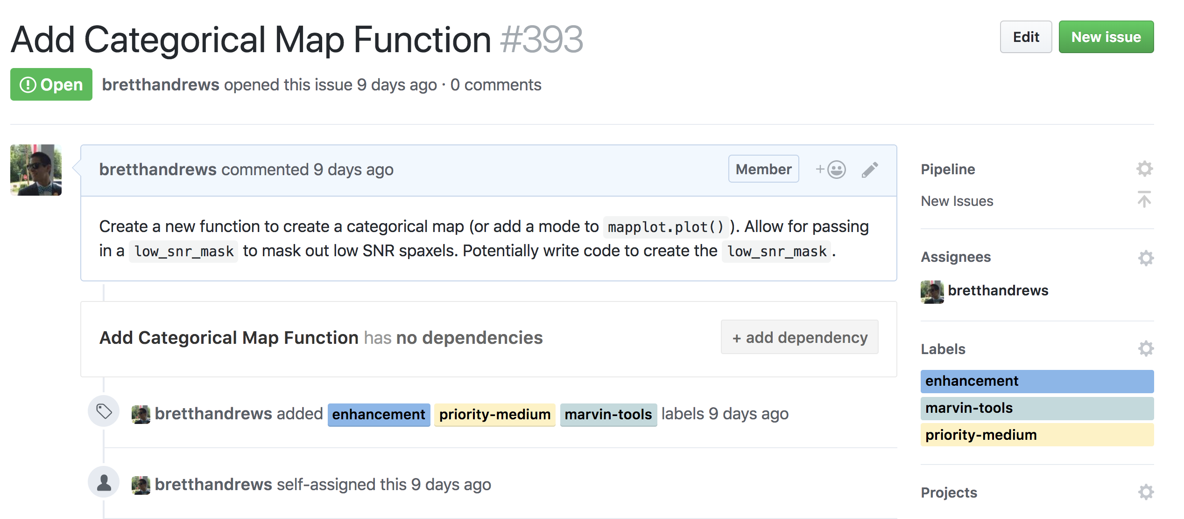
GitHub Issues

Slide 21
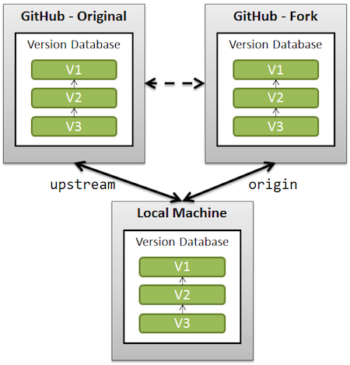
Forking: Concept
You want to contribute to a project...but you aren't a collaborator, so you can't push to it.
fork
clone
add remote
Image credit: https://stackoverflow.com/questions/3611256/forking-vs-branching-in-github

Slide 22
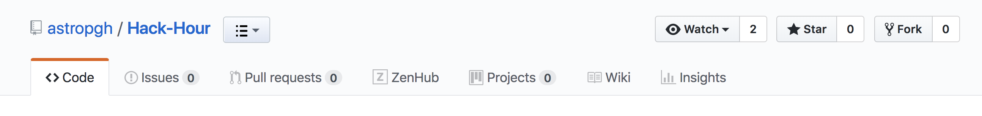
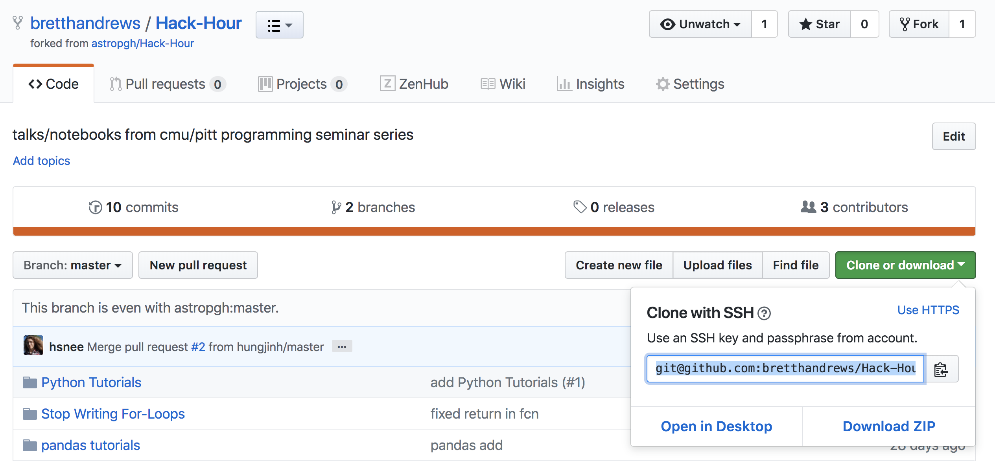
Forking: How To
git clone git@github.com:bretthandrews/Hack-Hour.git
git remote add upstream git@github.com:astropgh/Hack-Hour.git

Slide 23
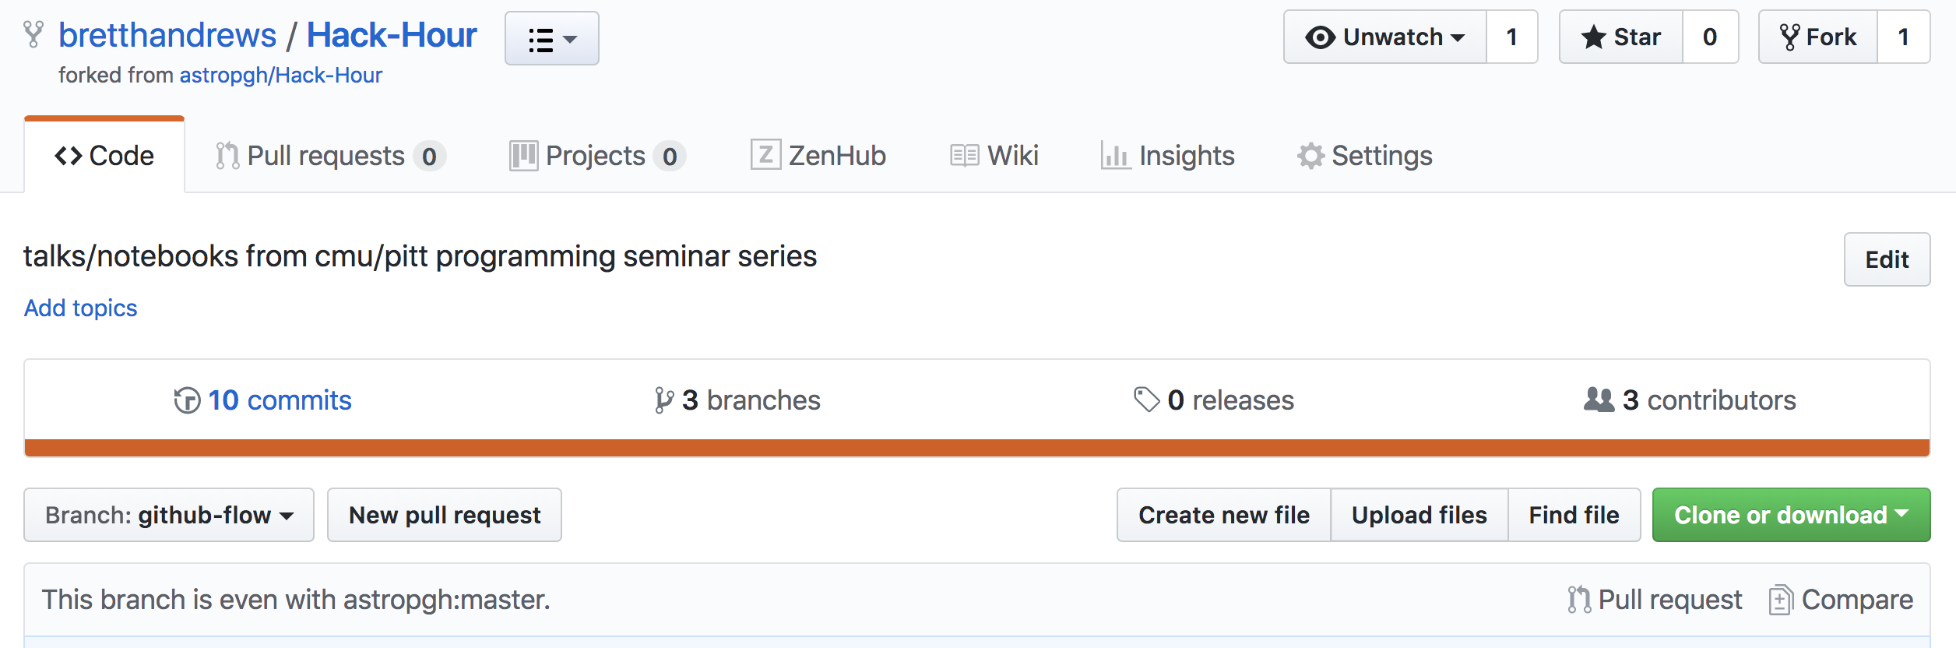
Forking: Contributing
Pull from the original repo (upstream) and merge any changes.
git pull upstream github-flow
Submit a Pull Request
The owner of the upstream repo will review and possibly merge in your contributions.

Slide 24
Summary
Don't actively develop on master.
Make changes to master by merging approved Pull Requests.
Make Pull Requests to ask for feedback on or review of a branch.
Each branch corresponds to one new feature.
Each commit corresponds to one complete change.

