Slide 1
RIVET for Heavy Ions (21-24 Aug)

Slide 2
RIVET, what is?
Framework for preserving experimental data + analyses.
Experimental analyses posted along with data, all written in C++.
Also invaluable for MC authors.
Covers pp well, heavy ion… not so much

Slide 3
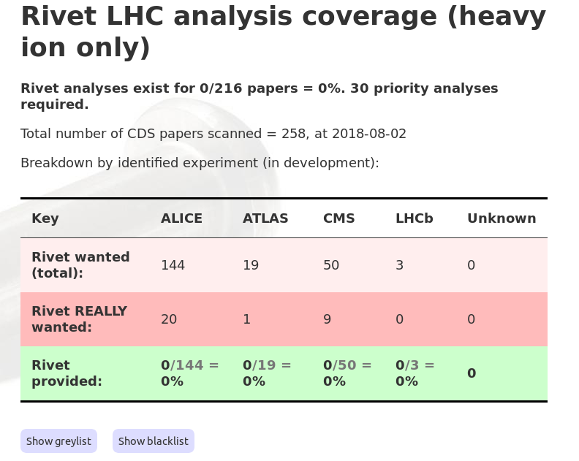
http://rivet.hepforge.org/rivet-coverage-heavyiononly

Slide 4
Why so poor coverage?
Tools have been missing from RIVET – largely solved.
Cultural barrier.
Lack of communication and man-power.
Lack of push from MC authors.

Slide 5

Providing the PoP
Next week:
Pick the low hanging fruits!
Goal: As many analyses as
possible.
Obtaining critical mass is
crucial for further success.

Slide 6
Who are we?
15-20 mixed MC people and experimentalists.
Each with their own favorite analysis.
Some have lots of RIVET experience and no HI experience.
Some the other way around.
Use the expertise of each other!

Slide 7
The program
Mornings: A common talk/discussion
Bulk: Implement alone or in groups.
Afternoons: Progress reports.
Also:
- Lay ground for a release note (sharing credit, good for students/post docs).
- Attending Katarina’s defense.

Slide 8

...but what can I do?
Active participation (writing code)
is key!
Take charge, and start implementing
your own analysis, or join a small
group.
Be friendly with our guests, we
will be sharing office space.

