Slide 1
Constraining Milky Way models with action clustering
Robyn Sanderson
Kapteyn Institute, Groningen

Slide 2
Tidal streams: keys to the dark Milky Way
Martinez-Delgado et al. 2010

Slide 3
Tidal streams in AA space

Slide 4
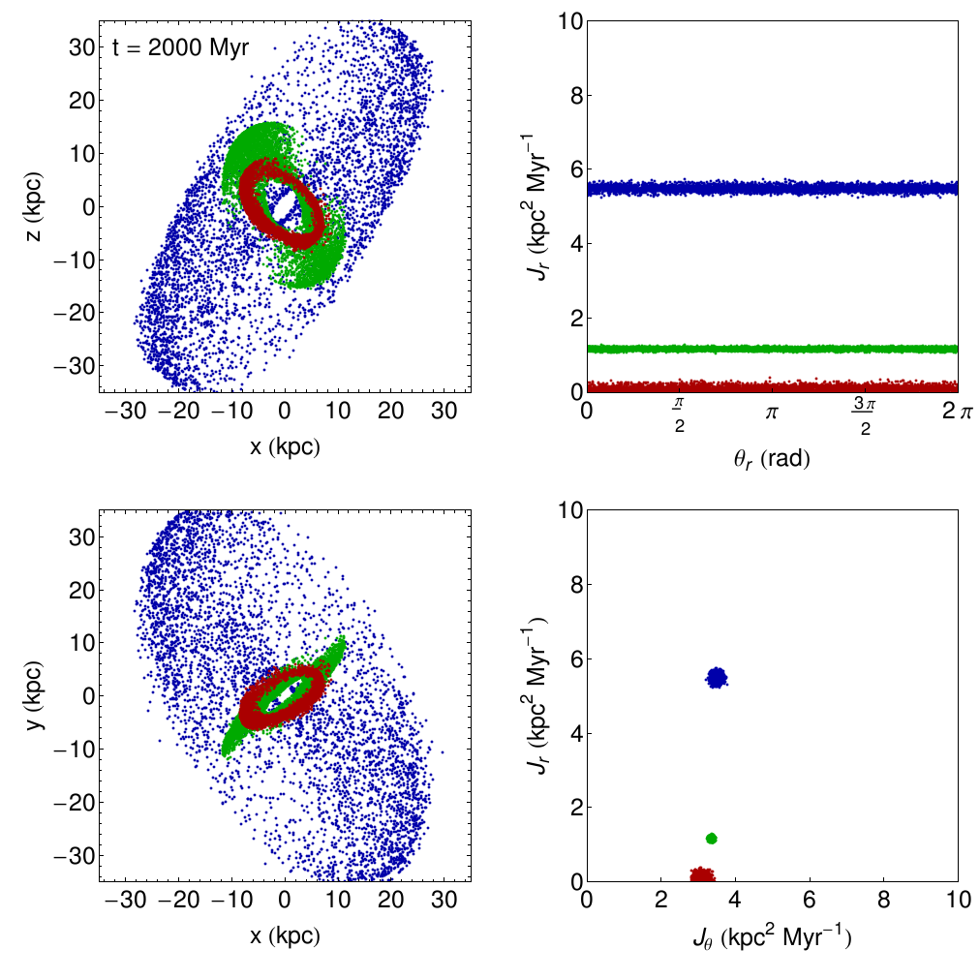
Tidal streams in AA space

Slide 5

Actions are most clustered in the correct potential
Potential parameters
Observations
Both

Slide 6
Actions are most clustered in the correct potential
Potential parameters
Observations
Both

Slide 7
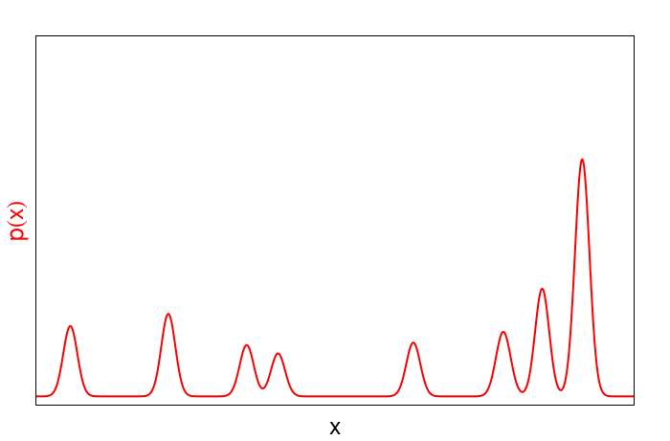
Clustering measurements: the Kullback-Liebler divergence

Slide 8
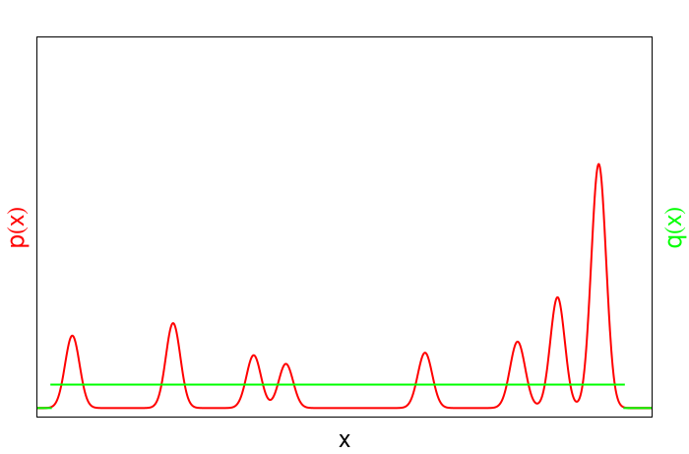
Clustering measurements: the Kullback-Liebler divergence

Slide 9
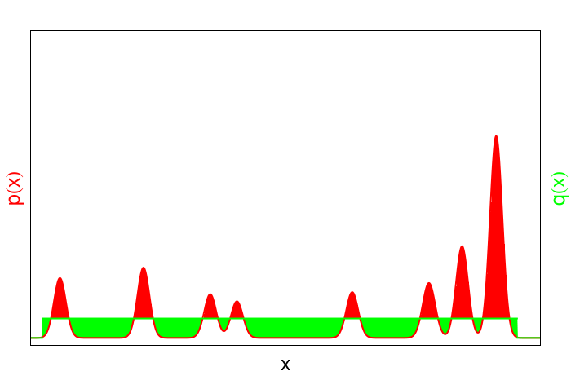

Clustering measurements: the Kullback-Liebler divergence

Slide 10
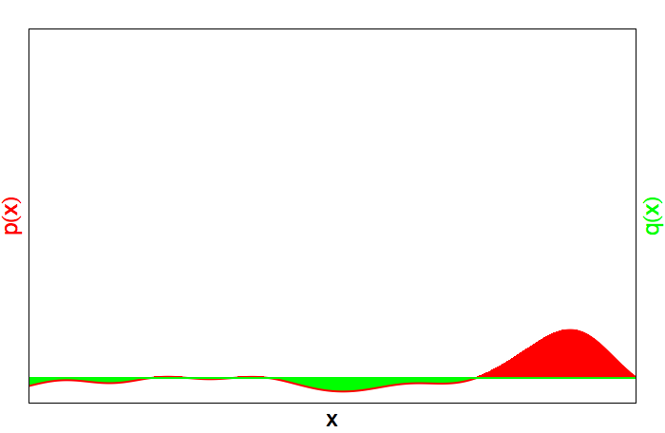
Clustering measurements: the Kullback-Liebler divergence
Clumpier Distribution → higher D_{KL}
D_{KL} = 1.1
Smoother Distribution → lower D_{KL}
D_{KL} = 0.4

Slide 11
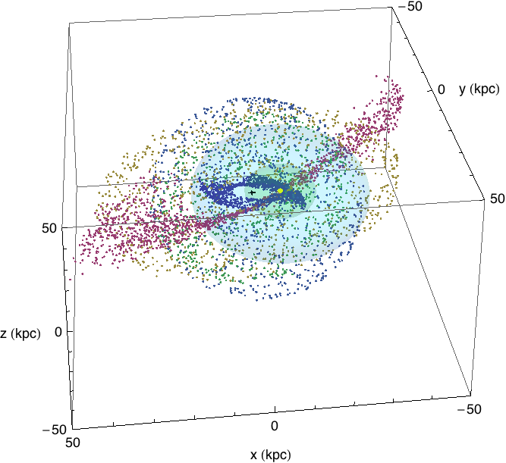
Performance with perfect measurements
Initial “satellites”:
σ_{r} : 0.5-4.5 kpc
σ_{v} : 10-40 km/s
Orbital pds: 20-70 Myr
Stream ages: 500-5000 Myr
Sun
GC
10 kpc from Sun
25 kpc from Sun

Slide 12
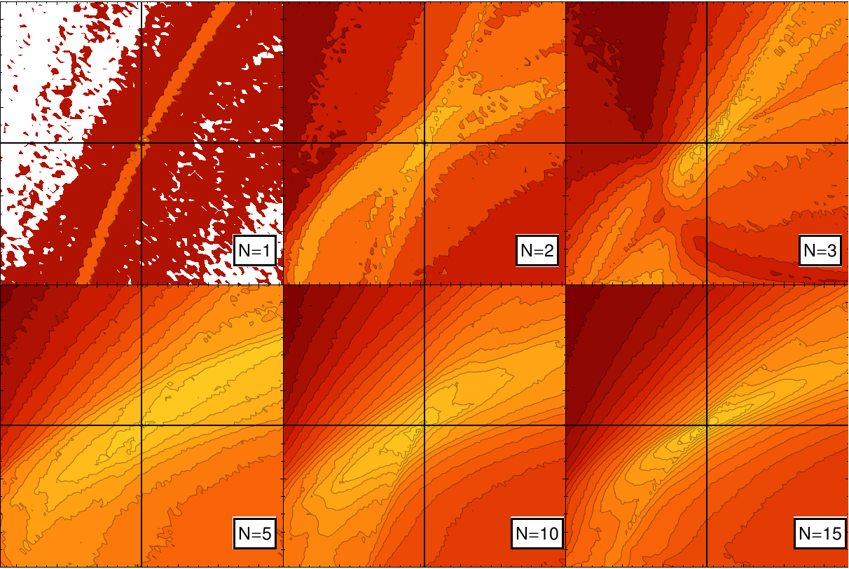
Effect of adding more streams (avg. 1000 stars each)
16
Scale radius (kpc)
0
1.15
M (10¹² solar masses)
4.25

Slide 13
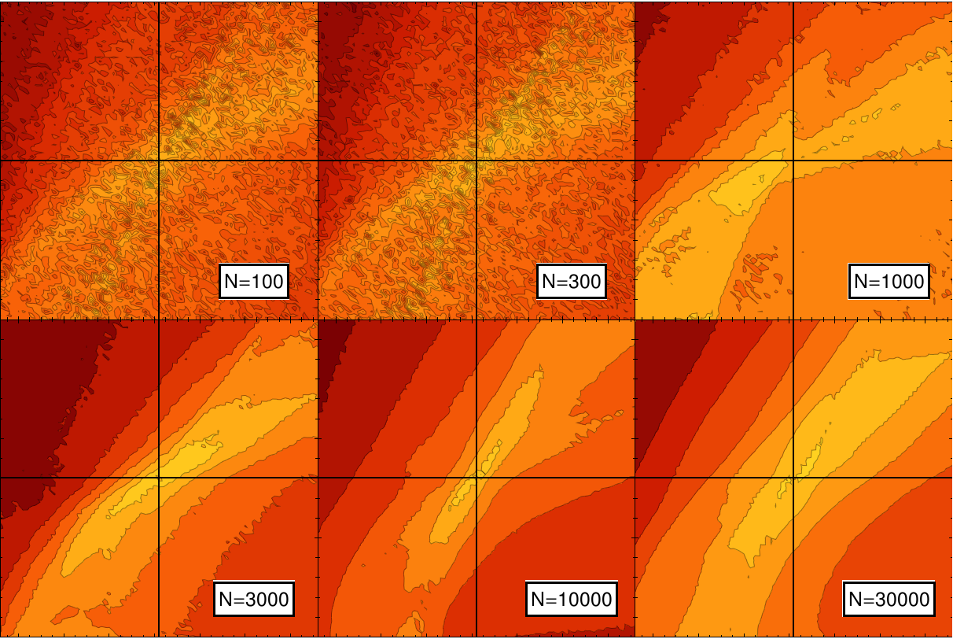
Effect of adding more stars (5 streams)
16
Scale radius (kpc)
0
1.15
M (10¹² solar masses)
4.25

Slide 14
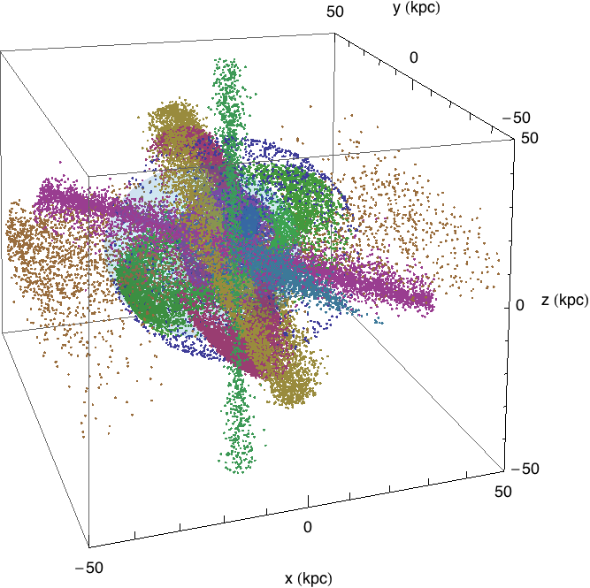
Including observational errors
Ten “satellites”
Avg. 5000 stars each
Randomly chosen orbits & ages
Isochrone potential
Convolved with Gaia/4MOST error models
Includes Gaia photo parallaxes
No RA/Dec cuts

Slide 15
The effect of improved RVs
% of stars with σ_{π}/π < 0.2
that also have σ_{RV} < 10 km/s
Stellar mag | Gaia only | Gaia + 4MOST
“Red giants” (M_{V} = 1) | 60% | 100%
“MSTO” (M_{V} = 4.5) | 2% | 100%

Slide 16
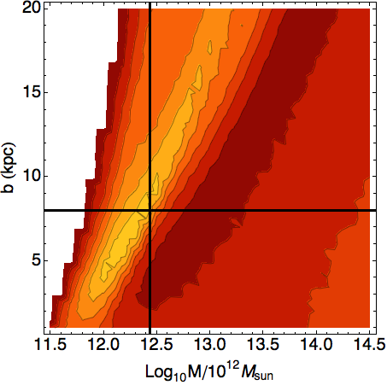
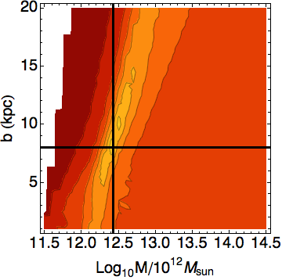
The effect of improved RVs
For RED GIANTS (M_{V} = 1)
Gaia only
With 4MOST RVs

Slide 17
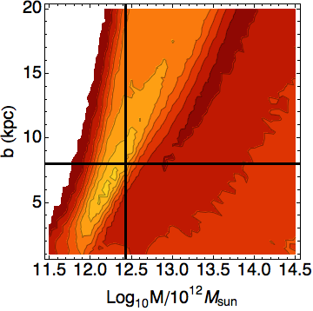
The effect of improved RVs
For MSTO (M_{V} = 4.5)
Not enough stars left!
Gaia only
With 4MOST RVs

Slide 18
Conclusions
Action clustering can be used to constrain the mass and shape of a potential
number of streams > number of stars per stream
  Resolve degeneracies between parameters
  Clumpier underlying distribution provides more contrast
Gaia photo parallax errors may be sufficient
Existence of 4MOST RVs >> accuracy (dist error dominates)
  sky coverage >> spectral resolution
More stars = better constraints:
  Find more streams
  Larger distances = better total mass measurement
  Pick best data in each stream

Slide 20





Review of action-angle coordinates
Canonical transformation for bound orbits
Angles increase linearly with time
Actions are
  Constants of motion
  Adiabatic invariants
  Potential-dependent

Slide 21
Outline
Review of action-angle variables
Tidal streams in action space
How to measure clustering
Proof of principle
Effect of Gaia proper-motion errors
Impact of 4MOST improved RVs

