Slide 1
Sky Chart
for Part 1: Naked-Eye Competition

Slide 2

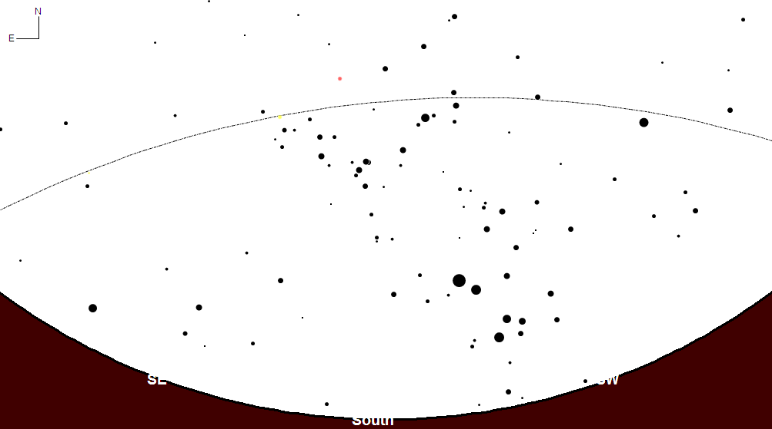
PART I: Naked Eye
Sky chart at 19.00 on August 21, 2008
Figure 1
Country and Student Code: …………………………….
Antares
Ecliptic
Acrux
SE
SW
South

Slide 3
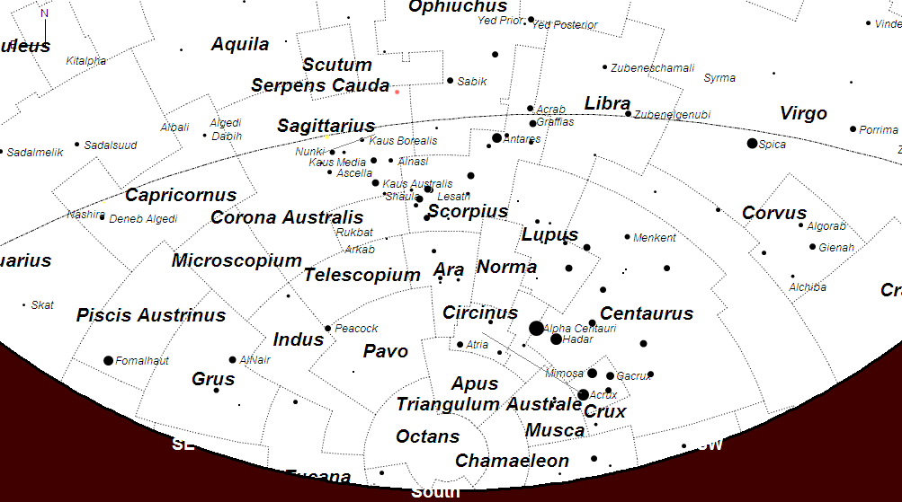
Solution of PART I: Naked Eye
Sky chart at 19.00 on 21 August 2008
Figure 1
13
2
16
7
29
11
28
20
Antares
21
8
26
23
34
Acrux

