Slide 1
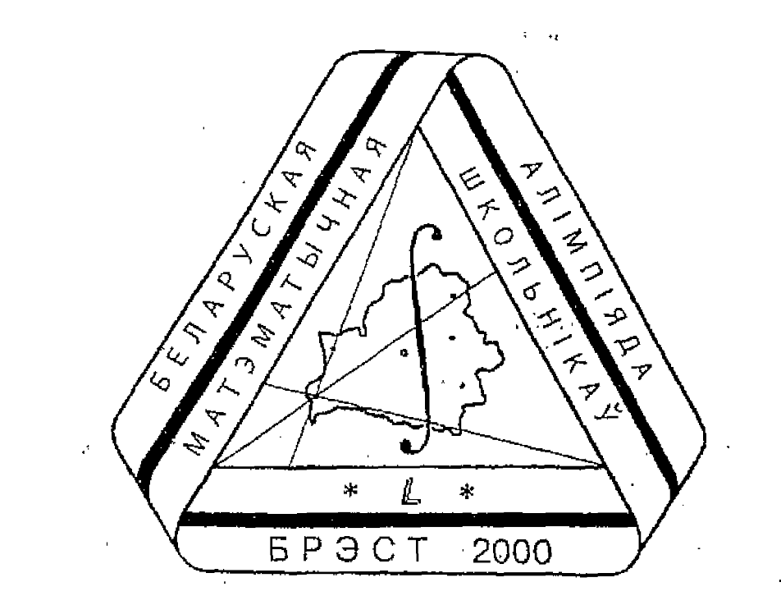
Belarusian
Mathematics
Olympiad
Schoolchildren
BELARUS
2026

