Slide 1
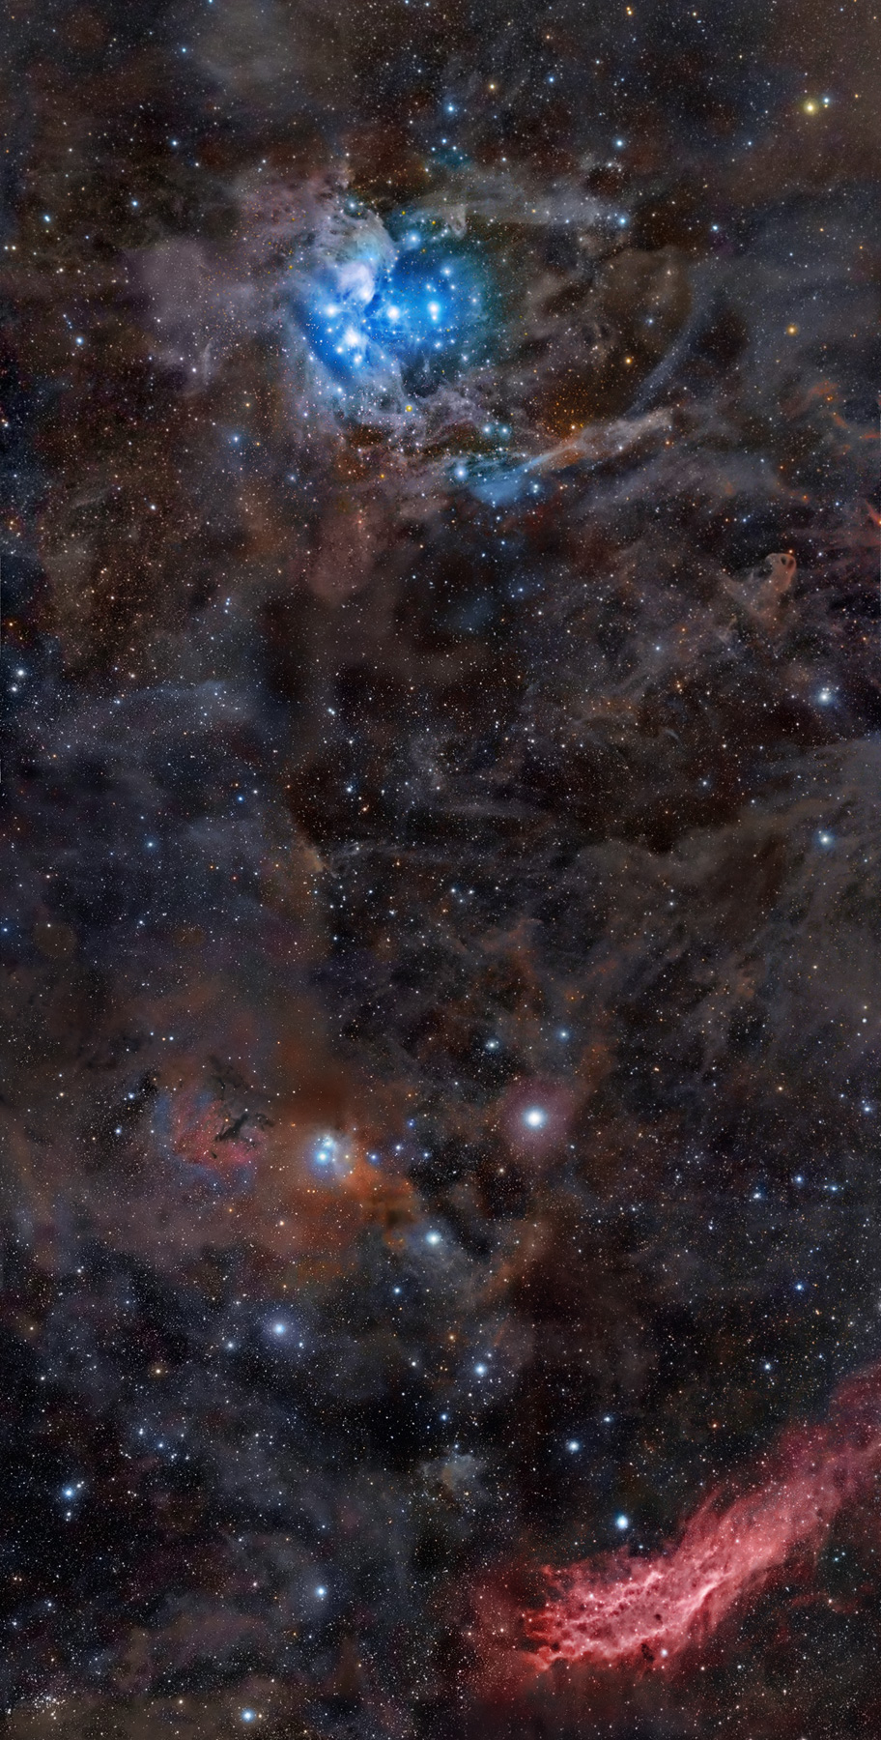


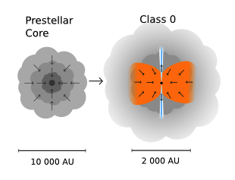
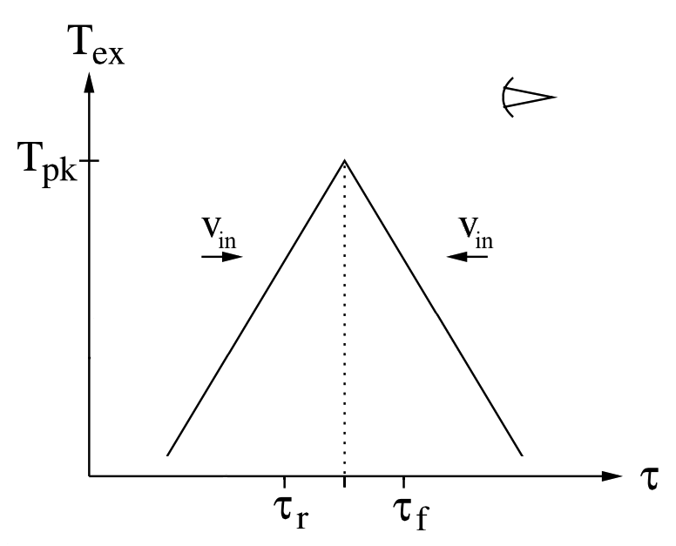
Infall Signatures of Dense Cores in the Perseus Molecular Cloud
Jessica Campbell (Department of Astronomy & Astrophysics)
R. K. Friesen¹, P. G. Martin², P. Caselli³, J. Kauffmann⁴, J. E. Pineda³
¹Dunlap Institute for Astronomy & Astrophysics, ²Canadian Institute for Theoretical Astrophysics, ³Max-Planck-Institut für extraterrestrische Physik, ⁴Max-Planck-Institut für Radioastronomie
Abstract: Molecules that trace high density gas (~10⁴ cm⁻³) are useful probes of dense core kinematics where star formation takes place. Blue (red) asymmetries in optically-thick emission profiles are commonly used indicators of core collapse (expansion). We analyze observations of HCO⁺ (3-2) and N₂D⁺ (3-2) rotational transitions toward 91 dense cores in the Perseus molecular cloud using the James Clerk Maxwell Telescope. While N₂D+ is optically-thin and traces the systemic velocity of the cores, HCO⁺ is often optically-thick and probes core kinematics. We detect significant HCO⁺ line asymmetries toward 20 cores using a dimensionless asymmetry parameter (δ_{v}) and detect contraction (expansion) speeds (V_{in}) toward 22 cores using HILL5, an analytic infall model. Comparing the tracers of core infall, we find that line asymmetries are a good tracer of core infall when the optically-thin emission is aligned with the model-derived systemic velocity, or the line profile center.
HCO⁺ (3-2) and N₂D⁺ (3-2) Observations
The 91 dense cores in the Perseus molecular cloud observed in the HCO⁺ (3-2) and N₂D⁺ (3-2) rotational transitions are predominantly located in clustered regions, seen in the 1.1 mm continuum images in Figure 1 (Enoch et al. 2006).
Line Asymmetries and the Analytic Infall Model
Isolated spherical cores undergoing collapse
produce red-shifted self-absorption
results in classic blue asymmetries
is caused by the combination of radial motion
and high optical depth. (Leung & Brown 1977)
We used a dimensionless asymmetry parameter,
δ_{v} = V_{thick} – V_{thin} , (1)
Δv_{thin}
defined by Mardones et al. (1997) to quantify
HCO⁺ asymmetries toward 20 cores
δ_{v} < 0 indicates collapse
δ_{v} > 0 indicates expansion/outflow
The analytic HILL5 model of a collapsing core used to model infall velocities (V_{in}) toward 22 cores assumes:
two slabs of gas moving toward or away from each other at a constant speed
the excitation temperature follows a linear relationship with optical depth
Figure 2. A cartoon representation of a prestellar core (left) collapsing to form a Class 0 protostar with its signature outflows shown (right). Adapted from Persson (2013).
Dec (J2000)
Figure 3. Left: An HCO+ profile (top) toward core B87 overlaid with the HILL5 model (red) and the resulting residuals shown below. Right: A Graphical representation of the HILL5 model. Adapted from De Vries et al. (2005).
RA (J2000)
Figure 1. 1.1 mm continuum images of well known sub-regions within the Perseus molecular cloud taken with Bolocam on the Caltech Submillimeter Observatory 10 m telescope (Enoch et al. 2006). Overlaid are circles (blue) and triangles (red) that indicate core pointings toward starless and protostellar dense cores, respectively.
Comparison of Infall Tracers
Detection Rates and Core Infall Velocities
Protostellar cores:
had a higher HCO⁺ detection rate
41/43 (95%) protostellar cores
31/48 (65%) starless cores,
were more likely to exhibit asymmetries
12/20 (60%) protostellar cores
8/20 (40%) starless cores,
and were more likely to be fit with HILL5
15/22 (68%) protostellar
7/22 (32%) starless
Infall speeds:
ranged from subsonic (0.03 kms⁻¹) to
supersonic (0.4 kms⁻¹) where supersonic infall
likely traces global rather than core infall
were often much less than their free-fall
speeds
Figure 5. Left: Modeled infall velocities (V_{in}) versus the asymmetry parameter (δ_{v}). The Pearson correlation coefficient between these two parameters is -0.59. In both plots, starless and protostellar cores are indicated with circles (blue) and triangles (red), respectively. Right: Modeled infall velocities (V_{in}) versus the modified asymmetry parameter (δ_{v}*) where V_{thin} in Equation (1) is replaced by the model-derived systemic velocity. The Pearson correlation coefficient between these two parameters is -0.69.
Figure 4. Histograms of V_{in} values of the dense cores modeled with the analytic HILL5 model. Note that V_{in} < 0 implies outward motion. The dashed lines indicate the approximate sound speed of the molecular gas assuming a gas kinetic temperature of 11 K (Rosolowsky et al. 2008).
References:
Campbell et al. 2016, in press • De Vries et al. 2005, ApJ, 620, 800 • Enoch et al. 2006, ApJ, 638, 293 • Leung & Brown 1977, ApJ, 214, L73 • Mardones et al. 1997, ApJ, 489, 719 • Persson 2013 • Rosolowsky et al. 2008 ApJS, 175, 509

