Slide 1
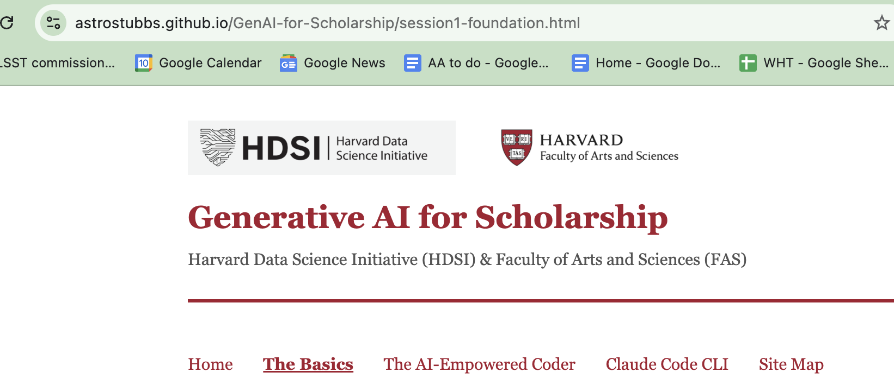
Welcome!

Slide 2
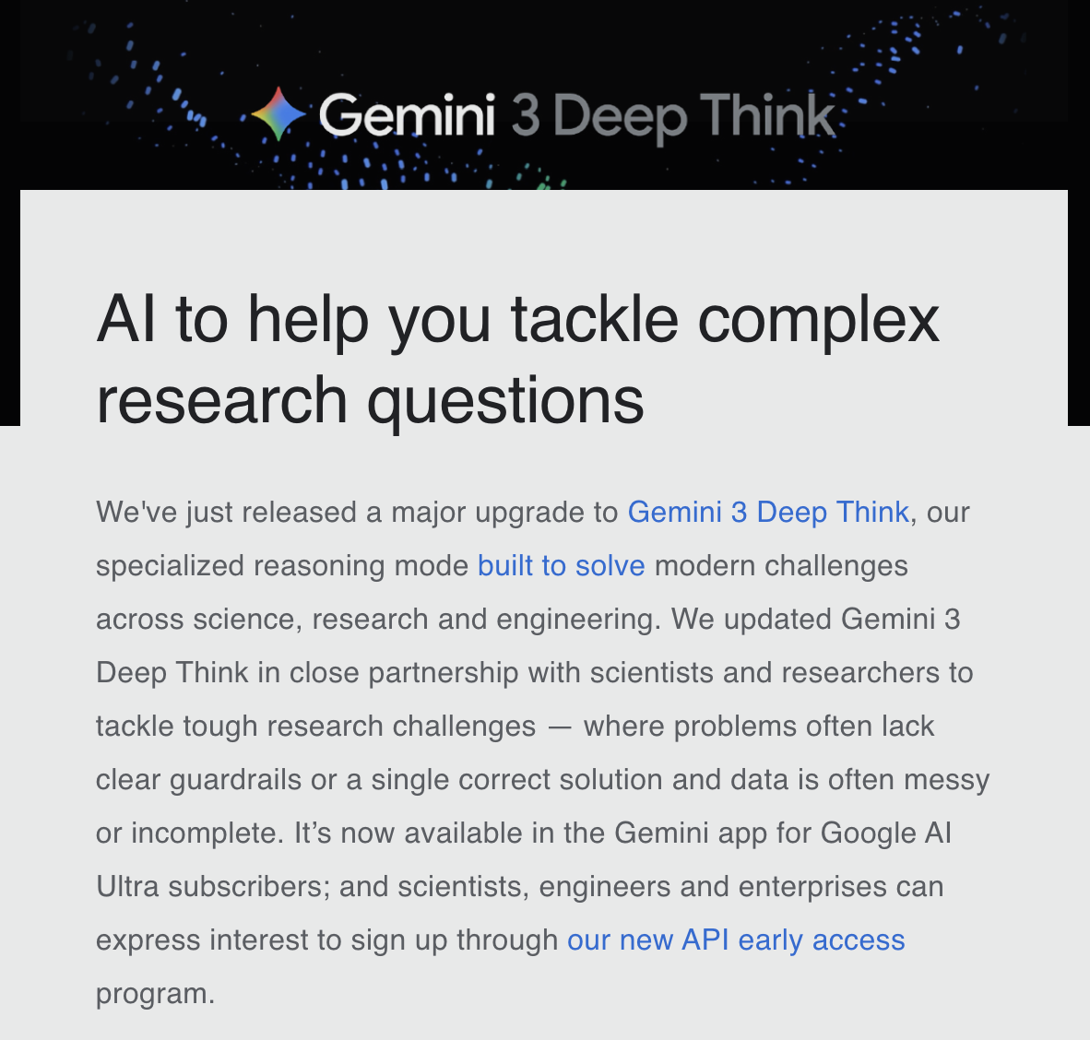
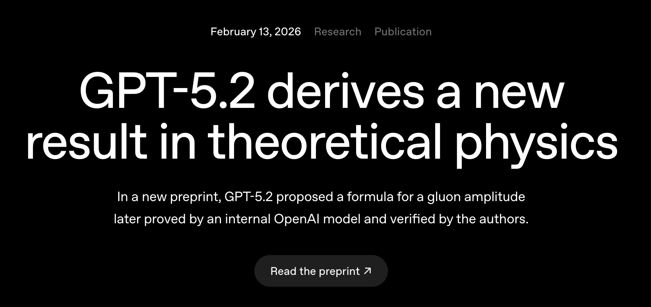
AI is changing how we do research
Feb 14, 2026

Slide 3
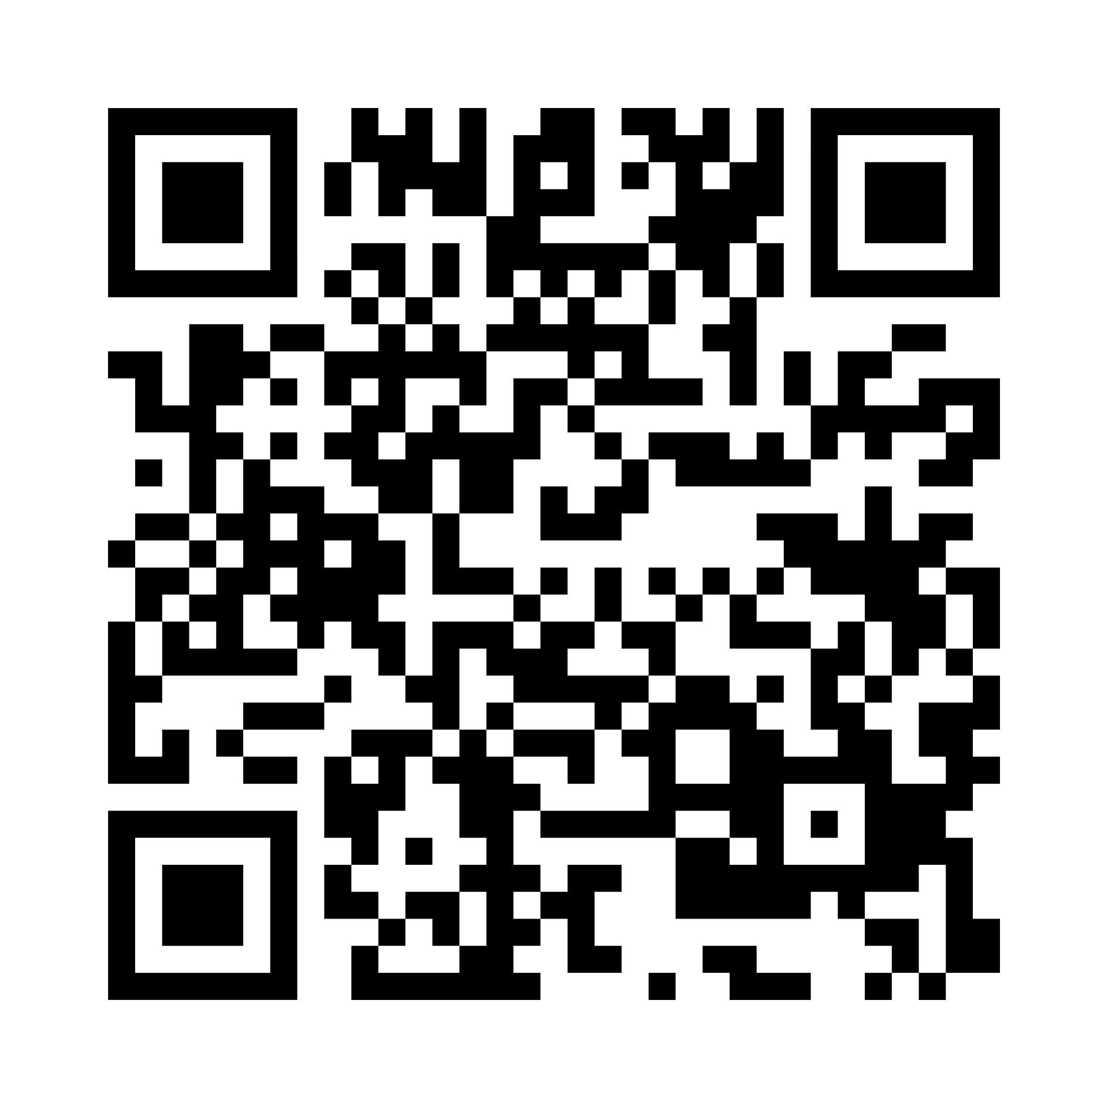
Three initial sessions, five more after Spring Break
Session 1, Today: Google toolkit: Gemini, NotebookLM & Custom Gems
Session 2, Friday Feb 27: Integration of AI with Python notebooks
Session 3, Friday March 6: Claude Code command line interface.
Link for home page:
https://bit.ly/3ZxtPw8

Slide 4
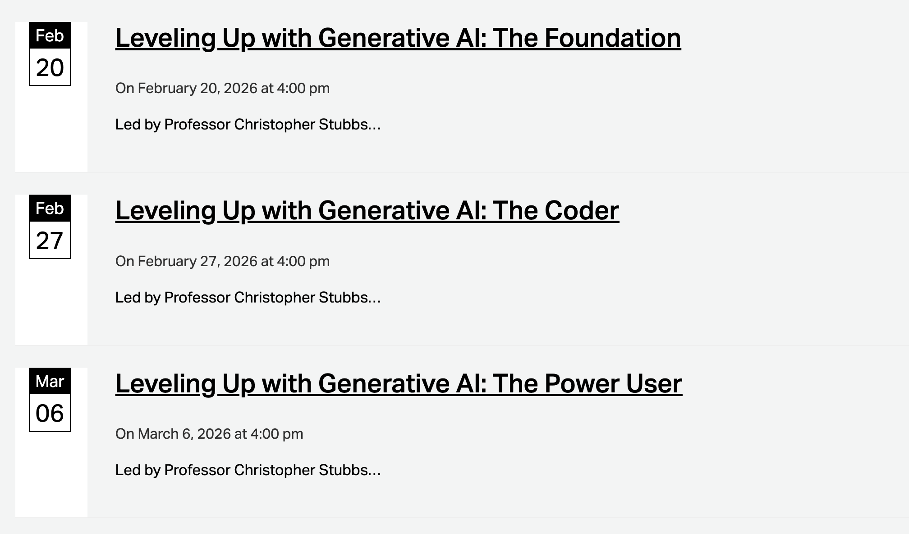

Slide 5
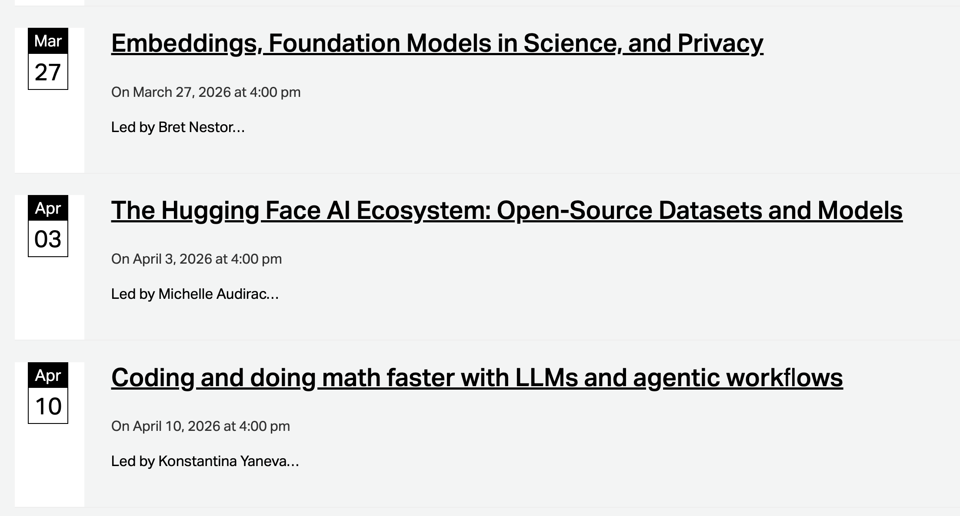

Slide 6
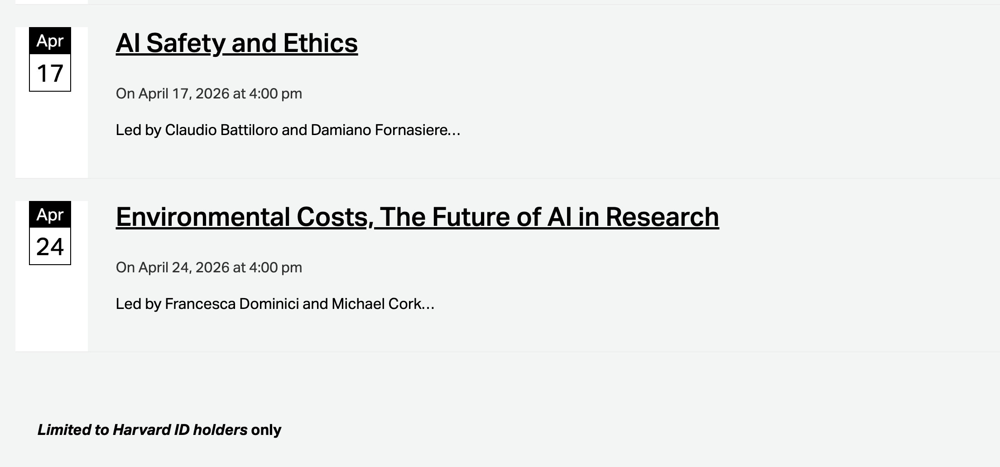

Slide 7
Quadrants of competencies
GIA proficiency
amateur scientists
&
Some undergraduates
A handful of individuals
high
low
high
Domain
expertise
Other undergraduates
low
me, 3 years ago

Slide 8
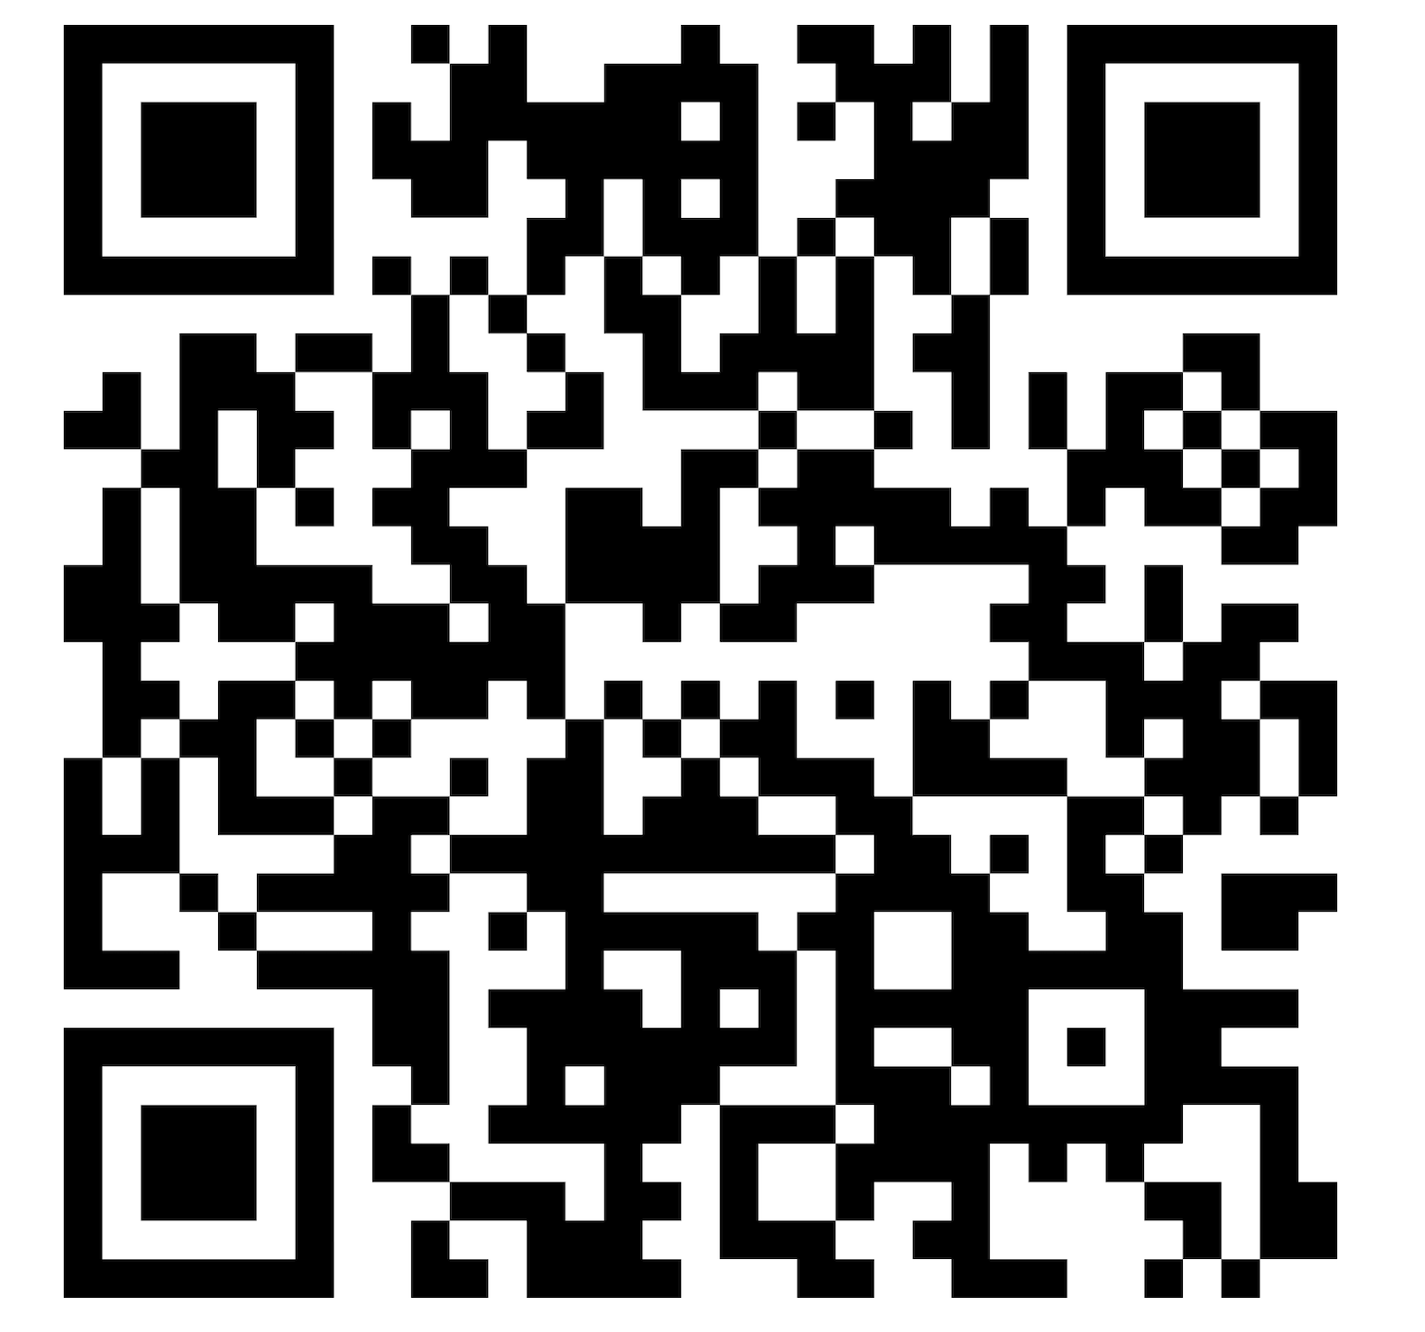
QR code for all 8 sessions
Sign up!

Slide 9
Tool | Primary Function | Context (base level) | Privacy | Illustrative Use
Gemini | Chat | 32K ~50 pages | Private, one user | Multimodal AI tool, image generation, tutor, general queries.
NotebookLM | Querying and summarizing documents | 50 sources < 200MB per file | Private by default, sharable | Gives links to locations in docs as part of response. Private resource library
Gemini Gems | Customizable! | 32K | Private to user, sharable | Anything with a persistent, customized prompt- exam prep, policy checks….
GAI in IDE: Cursor, Windsurf, VScode | Software development | NA | Live-share options exist. | Programming
Colab Python notebook + AI | Python development, data analysis | 32K | Notebook sharing | Data analysis Data browsing & visualization Code generation and debugging
Claude Code Command Line interface | Agentic Workflow on your laptop | 200K tokens | Local execution | Problem solving! Run on local data OS execution

Slide 10
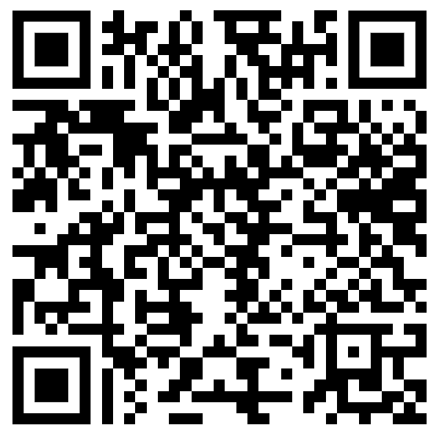
Tell us how we did!
https://bit.ly/4rlIBCt

