Slide 1
Astro Team
SDD Presentation

Slide 2
Scenario View
Logical View
Process View
CONTENTS
Physical View
Architecture style Selection

Slide 3
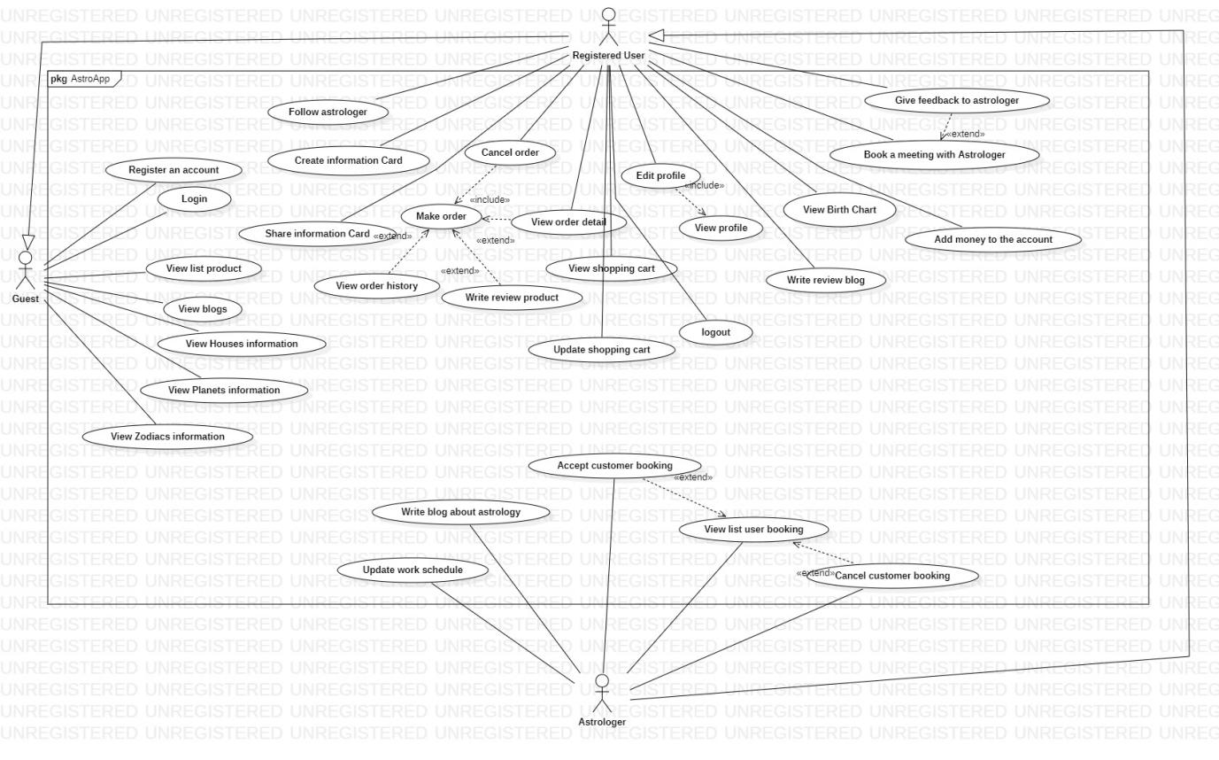
Scenario view

Slide 4
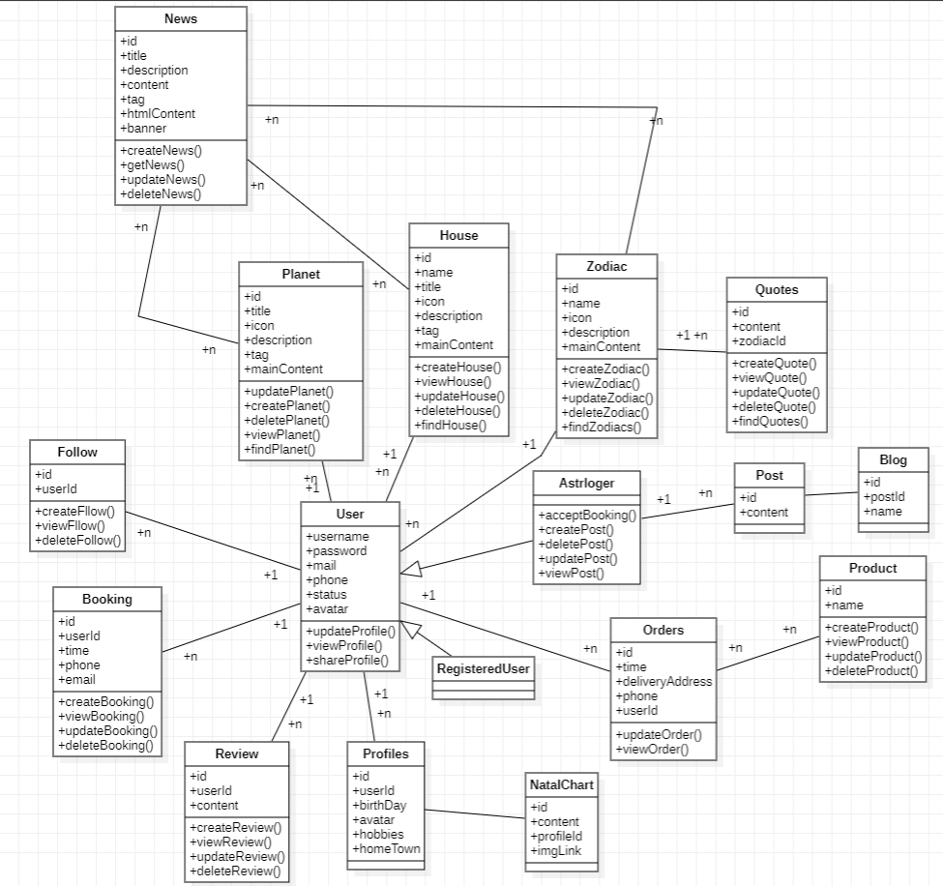
Logical view

Slide 5
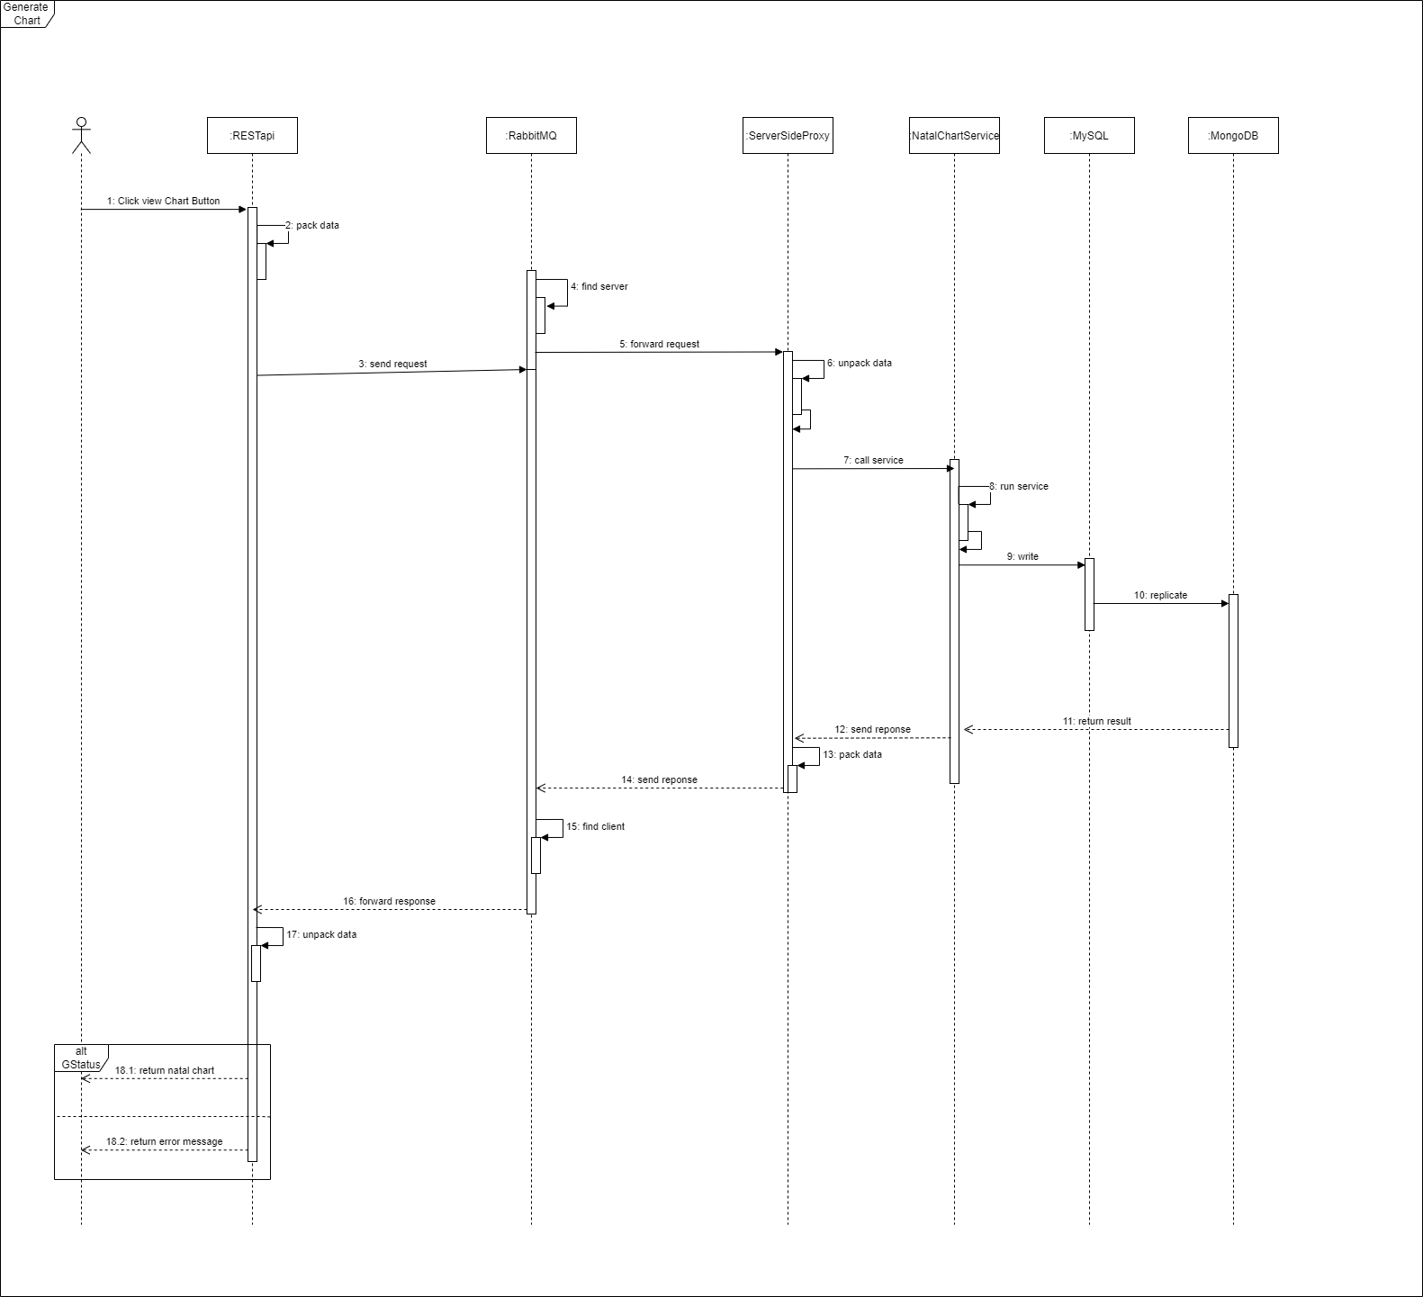
Process
view
Generate NatalChart (Master slave, message broker)

Slide 6
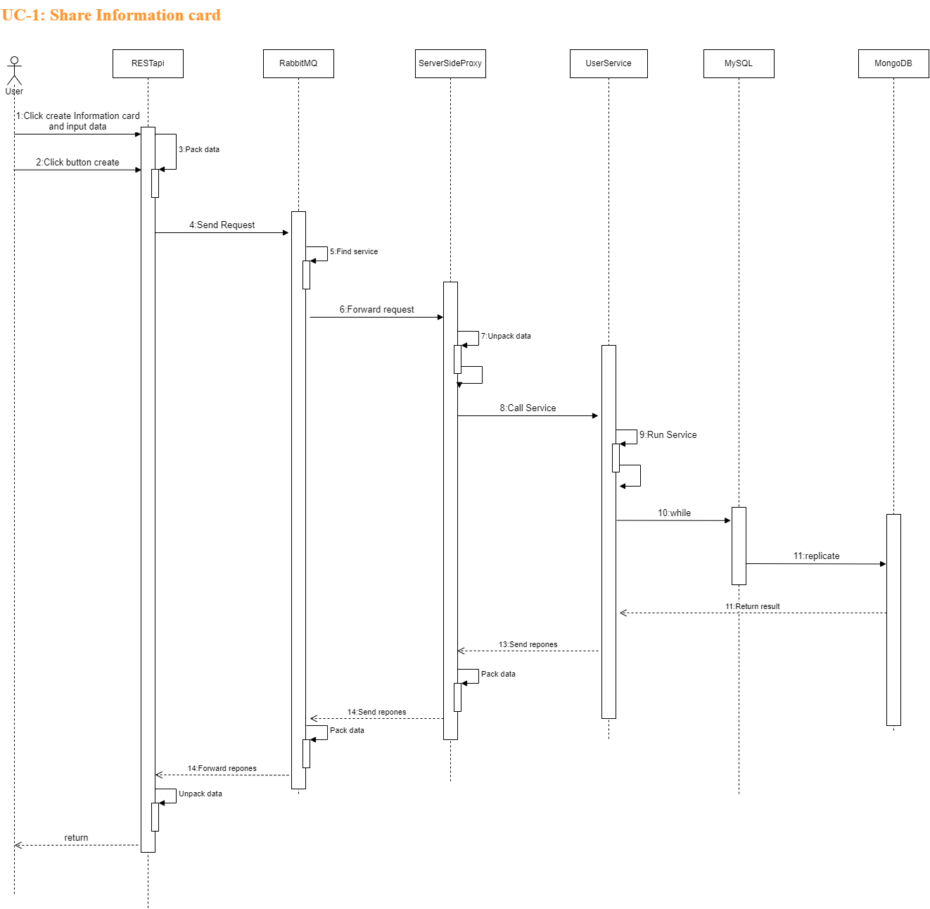

Slide 7
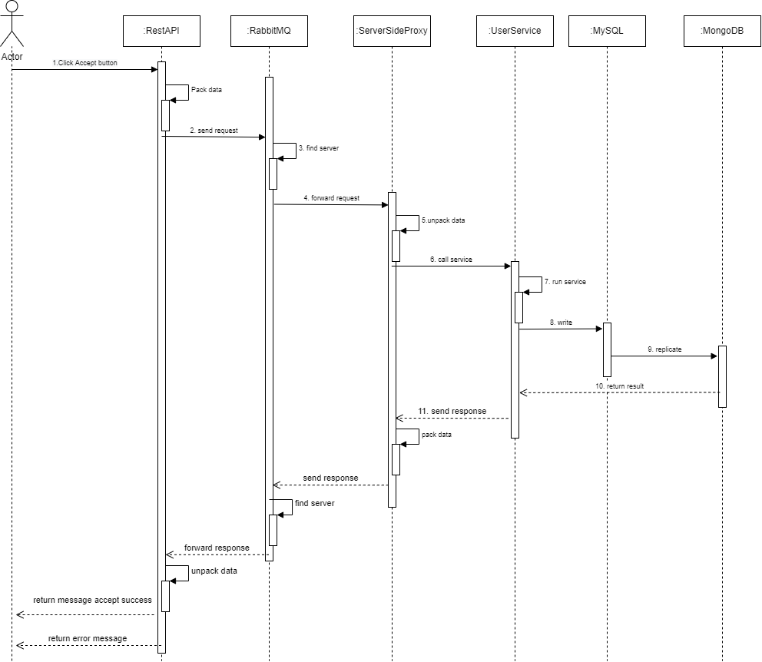

Slide 8
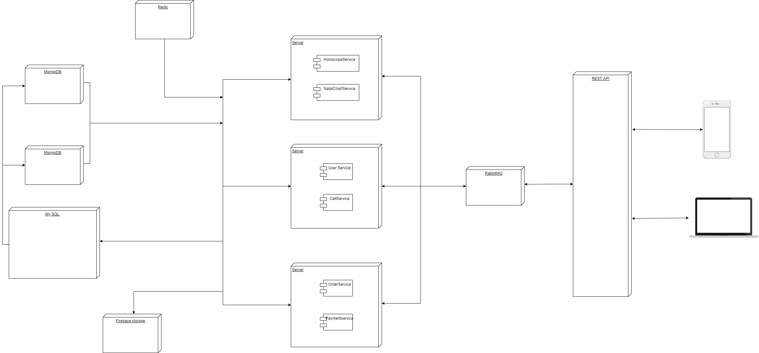
Physical View

Slide 9
Architecture Style Selection
Master - Slave
Repository
Message Broker

Slide 10
THANKS

