Slide 1
atroloZ

Slide 2
Team members
Cao Hoàng Phát Lộc
Huỳnh Anh Vũ
Cao Hoàng Quy
Nguyễn Văn Hiếu
Nguyễn Thanh Hoàng
Phạm Thanh Tùng

Slide 3
Table of content
Context
Who will use this app?
Problems
Why do you need to use this app?
Solution
What benefits does this app bring to you?
Actor’s functions

Slide 4
Context
1

Slide 5
Who will use this app?
The oriented users of this app is gen Z in Viet Nam

Slide 6
Problems
2

Slide 7
Why do you need to use this app?
Language barriers
Changing your negative to positive life
Understand more about themselves(personalities )
Having a positive life
Opportunity to make friend

Slide 8
Solution
3
What benefits does this app bring to you?

Slide 9
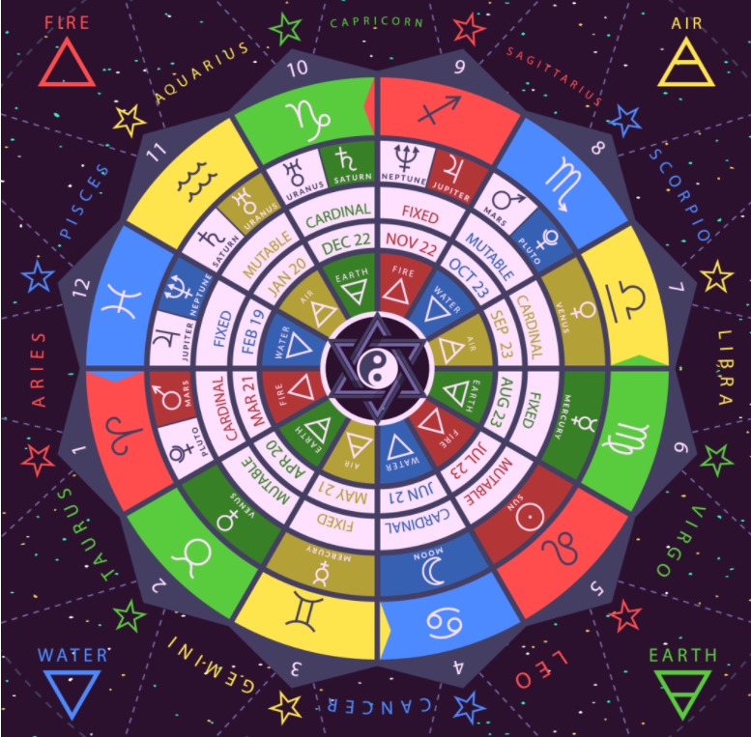
Discover your horoscope, planet, zodiac, houses and others' Zodiac's characteristic and personalities

Slide 10

Compatibility of friendship

Slide 11
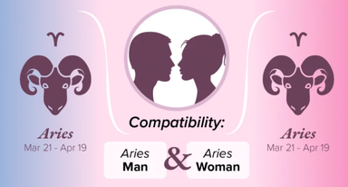
Compatibility of love

Slide 12
Actor’s functions
4

Slide 13
