Slide 1
James Lim
Job Application: Big Data analysis Engineer
15 SEP 2025
Notes:
Good afternoon, everyone.
My name is James Lim.
Today, I would like to share about my background details in pursuant to my application for Big Data Analysis Engineer.

Slide 2
Agenda
Personal Background
Project Achievement: Time-Series Predictive Maintenance
Research Work: “SubLIME: Less is More for LLM Evaluation”
Notes:
In order to better introduce myself, I have prepared a slide deck that consolidates details about my background, project achievement, and overview of research work.
Under background, I will lightly touch upon the overview of my work experience, education, and career aspirations.
Under project achievement, I will elaborate in details on a successful end-to-end project that I spearheaded during one of my internships.
Under overview of research work, I will also elaborate in details on 1 research publication which I personally feel to be most rewarding as well as most relevant to the role am applying now.

Slide 3
Background
Personal Background:
Name: James Lim
Country of Origin: Indonesia
Obtained Singapore PR in 2025
Hobby: Stargazing
Professional Experience:
2017 Jul – 2023 Jan: Micron Technology (Lead Data Scientist & Algorithm Engineer)
2023 Aug – 2024 Jan: Robert Bosch (AI Research Intern, GenAI –Predictive Maintenance)
Detailed project covered in Slide 4
2024 Jan – 2024 Jul: Hewlett Packard Enterprise (AI Researh Intern, NLP)
Detailed project covered in Slide 8
2024 Oct – Present: Amgen (Specialist Data Scientist)
Educational Journey:
2013-2017: NTU (BEng. EEE, 1st class)
2022-2024: NUS (MSc. DSML)
Key Skills & Expertise:
Data Science, Data Eng., Data Viz.
Big Data, AI/ML, DevOps, MLOps
Agile Project Management
Future Career Goals:
Big Data Engineer
Data Scientist
AI/ML Engineer
Notes:
Introduction (1 minute):
I'm excited to share a bit about myself today.
I'll be covering my personal background, educational journey, professional experience, key skills, notable projects, and my future goals.
Personal Background (1 minute):
I was born and raised in Indonesia.
After high school, I moved to Singapore in 2013 to pursue my Bachelor Study at NTU and have been living here for more than 12 years.
A couple of months ago, I was granted Singapore PR status, back in May 2025, which am very happy about.
From a young age, I was fascinated by how things work, which naturally led me to pursue a career in engineering and technology.
Outside of work, I have a keen interest in astronomy which I picked up naturally during my study as I previously served as the Chairperson of the NTU Astronomy Society
I enjoyed observing the moon, stars, and galaxies through telescopes.
Educational Journey (2 minutes):
For my educational journey, I earned a Bachelor's degree in Electrical and Electronic Engineering with First Class Honours from NTU back in 2017.
In 2024, I earned a Master's degree in Data Science and Machine Learning from NUS.
During this period, I delved deep into various aspects of machine learning, big data technologies, and natural language processing.
My academic experiences not only enriched my technical knowledge but also honed my research skills, where I co-authored an award-winning paper at 2024 ACM WWW conference
I will cover in more in-depth about this research work in subsequent slides.
Professional Experience (3 minutes):
I have accumulated diverse professional experience across several esteemed organizations.
As a Lead Data Scientist and Algorithm Engineer at Micron Technology, I led a team to develop product quality test programs and develop ML models to improve quality and save costs.
At Hewlett Packard Enterprise, as an AI Research Intern focusing on NLP and Large Language Models, I co-authored a research paper and developed innovative Python pipelines integrating various NLP libraries to evaluate top LLMs.
During my internship at Robert Bosch, I spearheaded the development of a time-series Generative AI model for predictive maintenance, which drastically reduced machine downtime and maintenance costs.
Am currently attached to Amgen (a pharma company) as a Specialist Data Scientist where I was hired to establish Data Science function from 0 to 1.
Within the span of 1 year since I joined Amgen, I had personally delivered more than 20 Data Analytics/AI solutions, established data governance framework, and conducted monthly Data Analytics technical sharing sessions to all staffs as part of Digital Upskilling program that I proposed to my Director.
As a team, my Data Science team had delivered close to 90 Data Analytics/AI solutions within the same span since I joined the company.
***
I’ve really enjoyed my time at Amgen, where I led several impactful analytics projects, but I’d now like to take on new challenges in a different industry.
Huawei offers the opportunity to work with massive telecom datasets, build service growth models, and contribute to an ecosystem that operates at global scale.
I see this as a chance to expand my expertise, take on more complex data problems, and grow in a dynamic environment.
***
Key Skills and Expertise (1 minute):
My technical skill set includes proficiency in programming languages such as Python, and C++; and expertise in data science techniques like A/B testing, anomaly detection, data engineering, and statistics.
I have a strong command of big data technologies, including Spark and Databricks.
I'm well-versed in DevOps and MLOps tools, such as AWS, TensorFlow, and PyTorch.
I also have capabilities on Data Visualization using tools like PowerBI, Tableau, SmartSheet, and SpotFire.
Last but not least, I always successfully manage the workload of my Data Science team using Agile approach where there is clear mention about project planning, assignment, complexity level assessment, and timeline communication to stakeholders.
Future Goals (1 minute):
My long-term career goal is to grow into a versatile professional across Big Data Analytics, Data Science, and AI/ML, where I can design scalable systems and extract insights that drive real business impact.
I see Huawei as the ideal place to advance this path, given its global scale, complex data ecosystems, and focus on innovation.
Conclusion (1 minute):
In conclusion, my journey so far has been driven by a passion for technology and innovation.
I am eager to leverage my skills and experiences to contribute to exciting projects and continue growing in my career.
Before I move on to explain about my project achievements and research work, do you have any question for me?

Slide 4
GenAI Project Achievement
Project Background
Experience: Robert Bosch (AI Research Intern)
Title: DGAN-based Predictive Maintenance on Time-Series Machine Sensory Data
Background:
Bosch plant in Singapore imported same CNC machines that are used in Bosch plant in China.
Many False Positive on maintenance with fixed schedule => Costly + Reactive Effort
Legal regulation on massive cross-border data transfer from Bosch plant in China
Objective:
To learn latent failure characteristic on minimal machine failure data from Bosch plant in China and generate synthetic time-series data.
To implement predictive maintenance before actual machine breakdown.
Notes:
Next, for my project achievement, I will be discussing my generative AI experience at Robert Bosch, that specifically focuses on the implementation and training of the DoppelGANger model for generating synthetic data.
Let’s understand about the project background first.
So, the situation at the time was that Bosch plant in Singapore bought CNC machines which are exactly the same as those used in Bosch plant in China.
And CNC machines are machines for drilling and grinding materials like steel.
For the maintenance, fixed schedule was implemented where we invited external vendor to come down to our manufacturing floor to check if there is any machine breakdown.
Most often than not, the machines are okay so it means there are many false positives.
On the flip side, when the machine actually breaks down, it will take some time to get these external vendors to fix the issue, and therefore costing huge machine down time and cost.
This is the first pain point.
The second pain point is that there was a tight legal regulation regarding massive cross-border data transfer from Bosch plant in China to anywhere outside China.
Therefore, we did not have sufficient machine failure data to train on.
That’s why the objective of the project is to learn latent failure characteristic on minimal machine failure data from Bosch plant in China and generate synthetic time-series data using GenAI model.
Second objective is to implement predictive maintenance before actual machine breakdown.

Slide 5
GENAI Project Achievement
Overview of Data Processing and Model Training
Data Preparation:
Data Cleaning & Normalization: Aggregated and standardized data from various sources.
Data imputation: Ensured consistent sequence lengths using replication.
Model Configuration:
Parameter Settings: Configured key parameters like sample length, batch size, epochs, and network layers for both discriminator and generator.
Feature Scaling: Applied feature scaling and normalization.
Training the DoppelGANger Model:
Training Process: Utilized GPU for efficient model training
Loss Functions: Implemented KL divergence and spectral loss for improved accuracy.
Optimization Techniques: Used Adam optimizer and sinusoidal-decaying learning rates for stable training.
Generating Synthetic Data:
Data Generation: Created synthetic data matching the statistical properties of real data.
Evaluation Metrics: Assessed quality using various statistical metrics and visual comparisons
Notes:
We started with data preparation, involving cleaning and normalizing the vibration dataset to ensure consistency.
This step was crucial to remove any noise and inconsistencies that could affect the model's performance.
Data imputation was applied to maintain uniform sequence lengths across all samples, ensuring that each data point had the same sequence length of time series data.
Next, we configured the model parameters.
This involved setting key parameters like the sample length, batch size, epochs, and the number of hidden layers and hidden units in both the generator and discriminator networks.
Proper configuration of these parameters is essential for balancing the model's performance and training time.
During the training phase, we leveraged GPU capabilities to speed up the process significantly.
The training was performed using custom loss functions.
So on top of usual loss functions for GAN, I added KL divergence and spectral loss.
These loss functions were crucial in ensuring that the generated data not only looked realistic but also preserved the statistical properties of the original dataset.
For optimization, we used the Adam optimizer, known for its efficiency and adaptability.
We also implemented sinusoidal-decaying learning rates to prevent the model from getting stuck in local minima and to ensure stable training throughout the epochs.
After training, the DoppelGANger model was used to generate synthetic data.
This synthetic data was evaluated using various statistical metrics to ensure it closely matched the properties of the real data.
Visual comparisons, such as histograms and KDE plots, were also used to verify the quality of the generated data.

Slide 6
GENAI Project Achievement
Detailed Implementation of DoppelGANger
Model Structure:
GAN Framework: Comprised of a generator and discriminator network.
Custom Loss Functions: Incorporate KL divergence and spectral loss.
Training Procedure:
Data Loading; Prepared data in batches and used DataLoader for efficient processing.
Gradient Penalty: Applied gradient penalty to enhance discriminator performance.
Loss Calculation: Computer and logged generator and discriminator losses using TensorBoard
Checkpointing and Best Model Saving:
Checkpointing: Saved model states at regular intervals.
Best Model: Identified and saved the best model on lose metrics.
Synthetic Data Generation:
Noise Functions: Generated synthetic data using noise vectors for attributes and features.
Evaluation Metrics: Converted internal representations back to the original data format.
Notes:
The DoppelGANger model is structured as a GAN, with a generator and discriminator network.
The generator creates synthetic data, while the discriminator evaluates the authenticity of the data.
By training these networks together, the generator improves its ability to produce realistic data over time.
We incorporated custom loss functions to improve performance.
The KL divergence loss was used to measure the difference between the distributions of real and synthetic data.
Additionally, spectral loss was used to ensure the generated data maintained the frequency characteristics of the original data.
During training, we prepared data in batches using DataLoader, which is efficient for handling large datasets.
Gradient penalty was applied to enhance the discriminator's performance by ensuring it learned a smooth decision boundary.
We logged generator and discriminator losses using TensorBoard, which provided real-time insights into the training process.
This allowed us to monitor the model's performance and make adjustments as needed.
We implemented checkpointing to save model states at regular intervals.
This was important for ensuring we could resume training in case of interruptions.
We also identified and saved the best model based on loss metrics, ensuring we had the most accurate model available.
For synthetic data generation, we used noise vectors to generate new data points.
These noise vectors were transformed into synthetic data that closely matched the properties of the original dataset.
Post-processing was then performed to convert the internal representations back to the original data format, making the synthetic data ready for use.
Upon going through numerous iterations of hyper parameter tuning, I saved the model parameters and construct Docker file with all libraries involved along with algorithm to load trained model parameters, performing inference, and similarity computation against real-time machine sensory data in manufacturing line.
Whenever any machine starts to exhibit similar characteristics of machine failure, we would trigger external vendor to perform maintenance immediately to prolong operational time of the machine.
I created web application using Dash and plotly package in python to provide visualization GUI to users for monitoring purpose.
The outcome of this project was that the predictive maintenance model was able to save about 48-hour downtime and SGD 10,000 cost per machine.

Slide 7
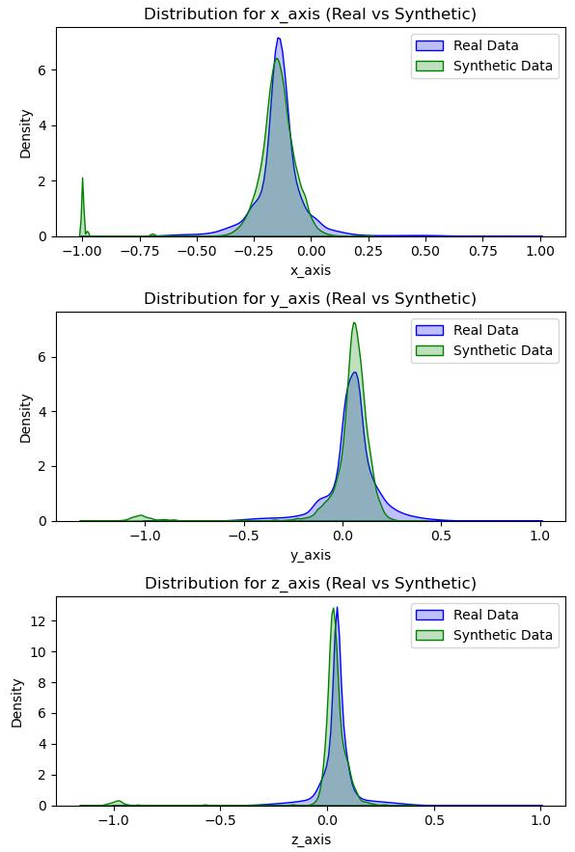
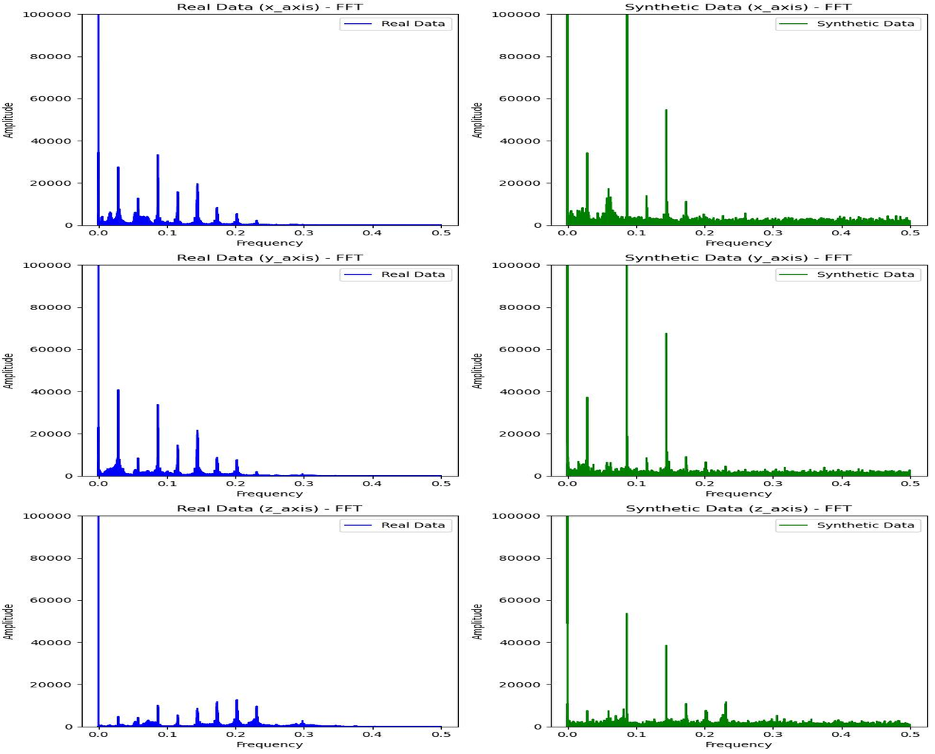
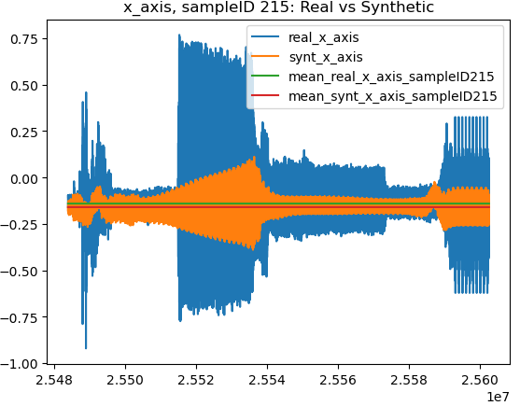
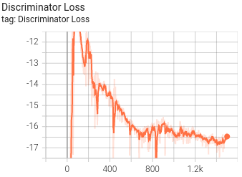
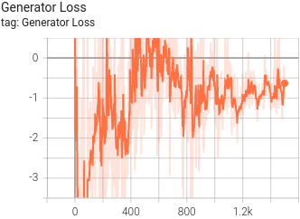
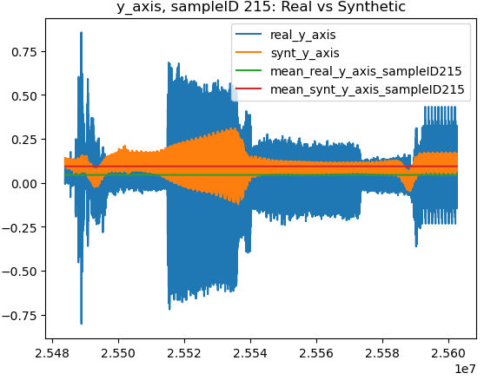
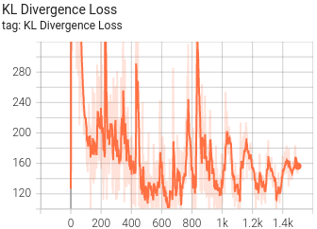
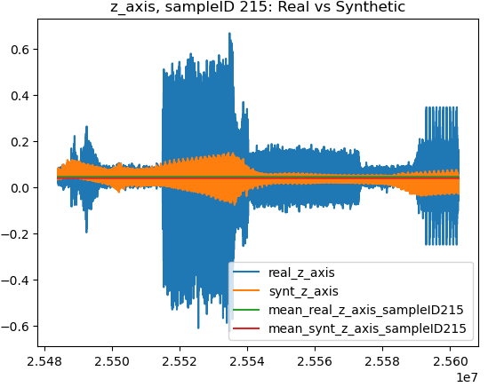
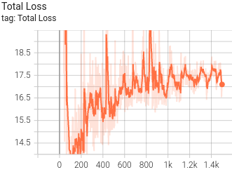
GENAI Project Achievement
Result Example
KDE Distribution
Frequency-domain data
Time-domain data
X Axis
Y Axis
Z Axis
Notes:
[Impromptu]

Slide 8
LLM Research Work
Introduction & Key Contributions
Title: “SubLIME: Less is More for LLM Evaluation” [2024 ACM WWW Best Research Paper Award]
Background:
Rapid growth of LLMs (over 400,000 models on HuggingFace, 3,000 on Open LLM Leaderboard)
Need for efficient evaluation due to high computational and financial costs
Challenges:
Expensive and time-consuming evaluations
Need for standardized benchmarks
Quality-Based Sampling:
Strong correlations (0.85 to 0.95) with full datasets at a 10% sampling rate
Clustering Methods:
Effective in specific benchmarks
Adaptive Sampling Framework:
Dynamically selects optimal technique per benchmark
Significant cost reduction while preserving ranking integrity
Notes:
I will present our research on SubLIME, an adaptive sampling strategy for efficient LLM evaluation.
With the rapid growth of large language models, we now have over 400,000 models on platforms like HuggingFace and about 3,000 models on the Open LLM Leaderboard.
Evaluating these models is both computationally expensive and time-consuming.
The financial burden is significant, from the HELM project done by Stanford, which spent around $50,000 on evaluating just 30 models.
Our solution, SubLIME, addresses this challenge by introducing an adaptive sampling strategy that significantly reduces evaluation costs while maintaining the integrity of model rankings.
Our research makes several key contributions.
First, we found that quality-based sampling consistently yields strong correlations in preserving LLM ranking, between 0.85 to 0.95, with the full datasets even at a 10% sampling rate.
This means we can evaluate models with a fraction of the data without losing accuracy.
Second, clustering methods, though not universally best, they excel in specific benchmarks, making them valuable tools in certain contexts.
Lastly, our adaptive sampling framework dynamically selects the optimal technique for each benchmark, to ensure statistically aligned LLM ranks with significantly reduced costs.
This adaptability is crucial for handling the diverse and evolving landscape of LLMs.

Slide 9
LLM Research Work
Sampling Strategy & Experimental Setup
Random Sampling:
Baseline, used for fair comparison
Clustering-Based Sampling:
Techniques: LDA, NMF, K-means, Spectral Clustering
Example: Spectral Clustering with BERT embeddings
Quality-Based Sampling:
Metrics: Word length, diversity, repetitiveness
Example: Compound Probability Distribution (CPD)
Benchmarks:
TruthfulQA, ARC, Winogrande, GSM8k, MMLU, Hellaswag
LLMs:
Top 50 models from Open LLM Leaderboard
Metrics:
Rank preservation, score distribution
Sampling Rates:
1% to 100% at 1% increments
Notes:
We employed various sampling strategies in our research.
Random sampling served as our baseline, providing a simple yet effective comparison point.
For clustering-based sampling, we used methods like LDA, NMF, K-means, and Spectral Clustering.
For instance, Spectral Clustering with BERT embeddings proved effective in certain datasets, revealing hidden patterns and groupings.
Quality-based sampling evaluated metrics such as word length, diversity, and repetitiveness.
The Compound Probability Distribution (CPD) method, which integrates multiple quality metrics, was particularly effective in selecting high-quality subsets of data.
Our experiments included benchmarks such as TruthfulQA, ARC, Winogrande, GSM8k, MMLU, and Hellaswag.
We selected these benchmarks to cover a wide range of evaluation scenarios, from factual correctness to complex mathematical and logical reasoning.
We evaluated the top 50 models from the Open LLM Leaderboard, focusing on metrics like rank preservation and score distribution.
Sampling rates ranged from 1% to 100% at 1% increments, allowing us to thoroughly assess the impact of different sampling strategies.

Slide 10
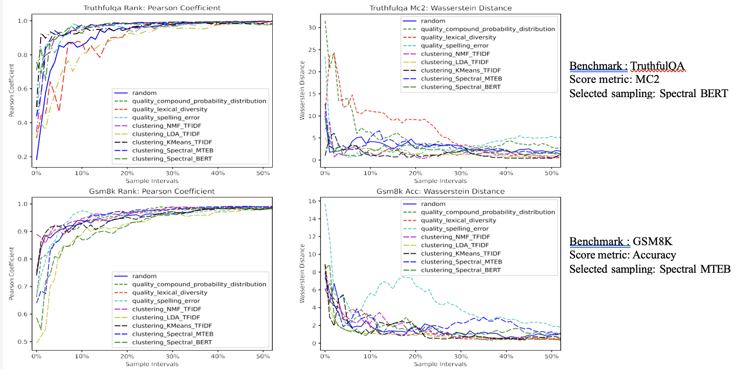
LLM Research Work
Result of Individual Sampling Strategy
Notes:
[Impromptu]

Slide 11
LLM Research Work
Analysis Result & Adaptive Sampling Framework
Quality-Based Sampling:
High performance with CPD and spelling error metrics
Clustering Methods:
Spectral Clustering with MTEB and BERT embeddings
Adaptive Sampling:
Effective in maintaining rank and score distribution
Reduced evaluation time by up to 99% for benchmarks like MMLU
Dynamic Selection:
Adapts to benchmark characteristics
Uses statistical measures (e.g., Pearson correlation)
Use Cases:
Efficient evaluation with consistent rank preservation
Enhanced score distribution with difficulty-based sampling
Notes:
Quality-based sampling methods, particularly those using CPD and spelling error metrics, performed exceptionally well.
These methods maintained high fidelity to the original data even with significant reductions in sample size.
Clustering methods like Spectral Clustering with MTEB and BERT embeddings also showed strong performance, particularly in benchmarks that require nuanced understanding.
Our adaptive sampling approach was highly effective, maintaining rank and score distributions while reducing evaluation times by up to 99% for benchmarks like MMLU.
Our adaptive sampling framework dynamically selects the best sampling technique based on the characteristics of each benchmark.
This approach uses statistical measures like the Pearson correlation to ensure that model rankings remain aligned between the sampled subset and the full dataset.
We applied this framework in scenarios requiring efficient evaluation and in enhancing score distributions with difficulty-based sampling.
By adapting to the specific needs of each benchmark, our framework ensures optimal performance across a variety of tasks.

Slide 12
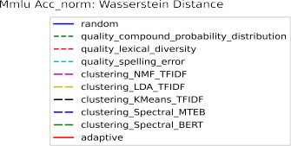

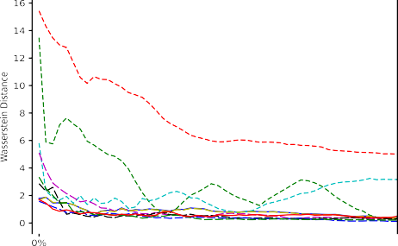
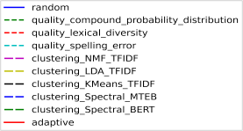
LLM Research Work
Result of Adaptive Sampling Framework on MMLU
Notes:
[Impromptu]

Slide 13
LLM Research Work
Difficulty Sampling and Experimental Results
Goal:
Focus on challenging segments to enhance model differentiation
Techniques:
Readability indices (Dale Chall, Flesch, Gunning Fog)
Example: Selecting complex queries in TruthfulQA
Rank Preservation:
High Pearson correlation coefficients (e.g., 0.98 for MMLU)
Score Distribution:
Low Wasserstein Distance, indicating well-preserved score distributions
Adaptive Sampling Performance:
Consistent results across diverse benchmarks
Notes:
Difficulty sampling focuses on selecting the most challenging segments of benchmarks to enhance model differentiation.
We used readability indices such as the Dale Chall, Flesch, and Gunning Fog scores to identify and select complex queries.
For example, in TruthfulQA, we selected questions with higher difficulty scores to create a more discriminative evaluation.
This approach ensures that we can effectively differentiate between models based on their ability to handle difficult and complex queries, providing deeper insights into their capabilities.
In our experiments, rank preservation was measured using Pearson correlation coefficients, which were consistently high, exceeding 0.98 for benchmarks like MMLU.
This indicates that our sampling methods effectively maintained the relative rankings of models.
Score distribution was assessed using the Wasserstein Distance, which indicated well-preserved distributions.
Adaptive sampling consistently delivered strong performance across various benchmarks, demonstrating its robustness and reliability in maintaining evaluation integrity.

Slide 14
LLM Research Work
Broader Application & Conclusion
Unbalanced Benchmarks:
Balanced sampling approach to capture wider array of tasks
Benchmark Fairness:
Mitigating biases for fairer model comparisons
Future Research:
Exploring more adaptive and dynamic evaluation strategies
Summary:
SubLIME offers a data-efficient, adaptive sampling strategy
Significant reduction in evaluation costs
Maintains high fidelity in rank and score preservation
Impact:
Paves the way for sustainable LLM evaluation methodologies
Notes:
Our adaptive sampling strategy also addresses issues of unbalanced benchmarks by employing a balanced sampling approach to capture a wider array of tasks.
Additionally, it mitigates biases inherent in benchmarks, promoting fairer model comparisons.
For example, in coding benchmarks where Python dominates, our method ensures a more balanced representation across different programming languages.
This methodology opens new opportunities for sustainable and efficient LLM evaluations, providing a versatile tool for researchers and practitioners.
In conclusion, SubLIME presents a data-efficient and adaptive sampling strategy that significantly reduces evaluation costs while maintaining high fidelity in rank and score preservation.
This research paves the way for more sustainable methodologies in LLM evaluation and offers a framework for future research to explore adaptive and dynamic evaluation strategies further.
By reducing the computational and financial burden of LLM evaluation, SubLIME enables more frequent and comprehensive assessments of model performance.
Thank you for your attention.
I'm happy to answer any questions you may have.

