Slide 1
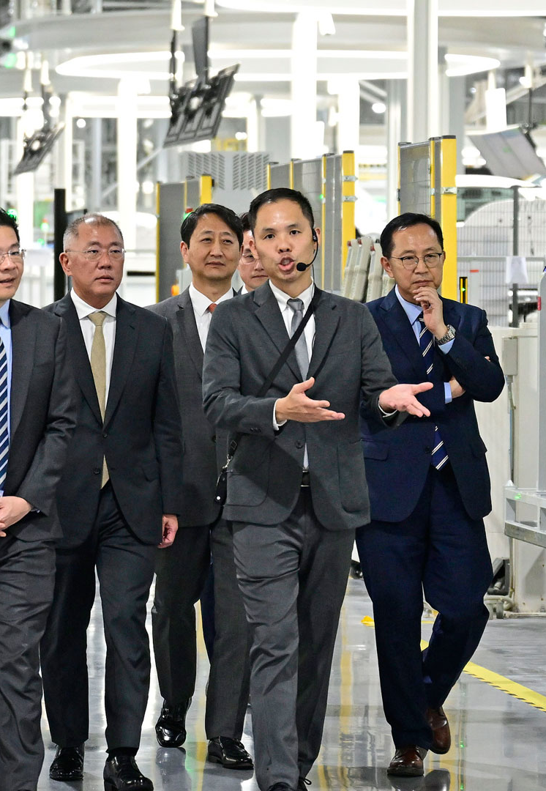

Data Science
Project Portfolio
James Lim
Data Scientist candidate | Hyundai Singapore onsite interview
Industrial AI • LLM evaluation research • Enterprise GenAI systems
Selected projects, sanitized for confidentiality
Notes:
[Sources] - Hyundai watermark emblem: https://www.freepnglogos.com/uploads/hyundai-logo-0.png - Title slide image from Hyundai Motor Group official news (HMGICS Singapore): https://www.hyundaimotorgroup.com/en/news/CONT0000000000123640

Slide 2
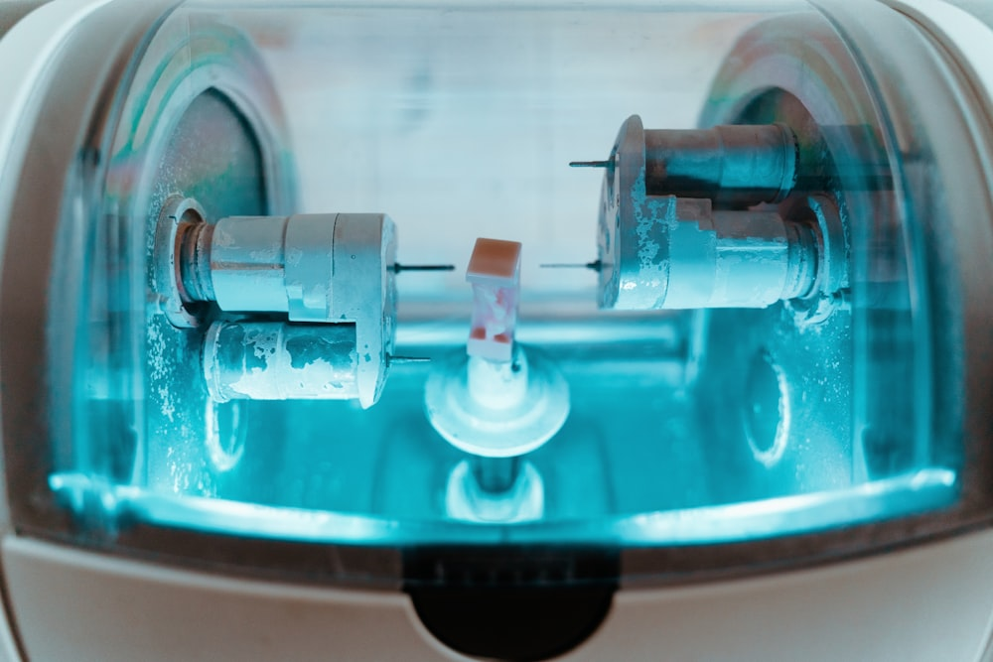
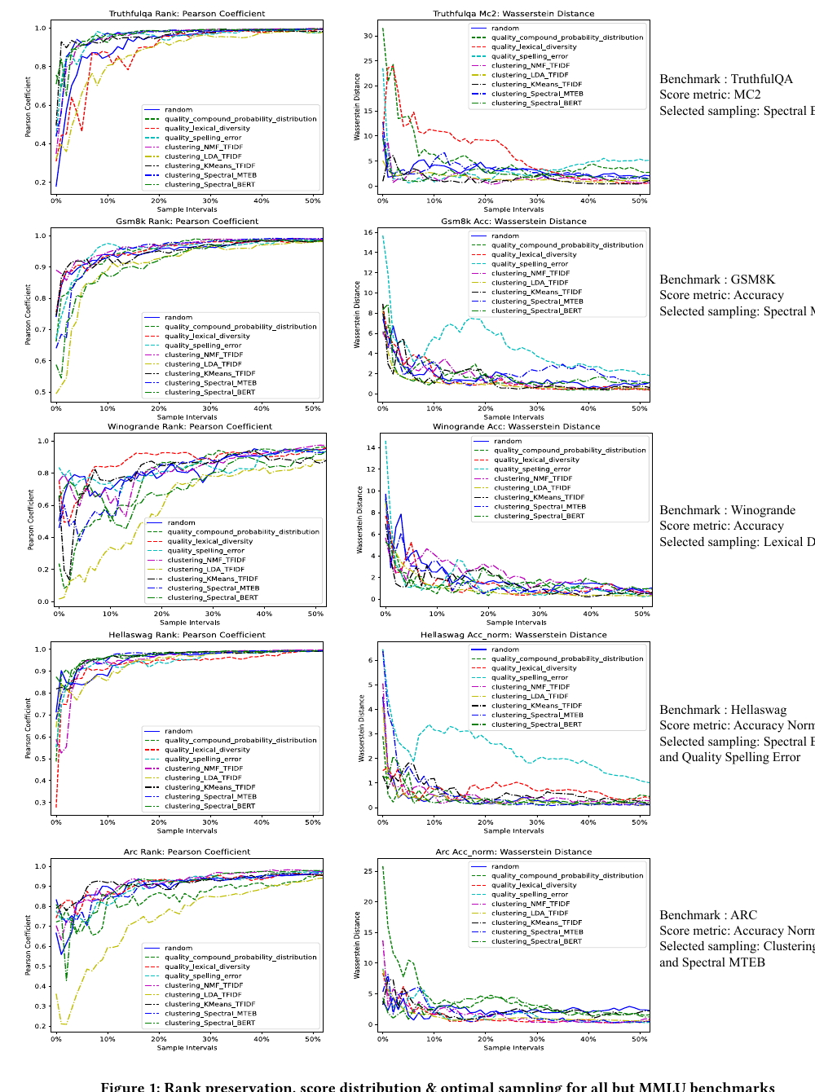
PORTFOLIO
2/13
Three projects, one consistent pattern
I like to frame ambiguous operational problems clearly, design an evaluation strategy I can trust, and then build toward deployment.
Upload
Embed
Ask
1 Industrial AI under data scarcity
2 Research rigor for LLM benchmarking
3 Deployable GenAI for enterprise search
• Synthesized rare failure patterns from limited machine breakdown data.
• Moved maintenance closer to need, not fixed calendar checks.
• Tested random, quality, clustering and adaptive sampling strategies.
• Preserved model ranking with far less evaluation data.
• Reduced friction in both knowledge capture and knowledge retrieval.
• Designed a path from local PoC to M365-connected deployment.
GitHub → astrozoid2604/CNC_Vibration
GitHub → astrozoid2604/LLM_Leaderboard_Crawler
GitHub → astrozoid2604/ai_km_poc
Notes:
[Sources] - Machine image: https://images.unsplash.com/photo-1555085575-47bd89db1be4?ixid=MnwxMjA3fDB8MHxzZWFyY2h8MTF8fG1pbGxpbmd8ZW58MHx8MHx8&ixlib=rb-4.0.3&q=80&w=1000 - SubLIME paper PDF (The Web Conference, DCAI Workshop, 2024): https://dcai-workshop.github.io/assets/pdf/accepted_papers/106.pdf - Scale/cost and sampling-performance claims on LLM counts, leaderboard counts, HELM spend, 0.85–0.95 Pearson at 10% sampling, and 1% MMLU sampling are cited from the SubLIME paper PDF above.

Slide 3
PROJECT 1
3/13
DGAN-based predictive maintenance on CNC vibration data
Bosch Singapore needed earlier maintenance signals, but the richest failure cases lived elsewhere and could not be transferred freely at scale.
Background
• Singapore and China plants used the same CNC machine family, but detailed breakdown data was concentrated in China.
• Fixed-schedule vendor visits created many false positives and still reacted too late to real machine issues.
Objective
• Learn latent failure signatures from minimal abnormal data and generate synthetic multivariate time-series samples.
• Use those patterns to trigger maintenance before breakdown rather than on a fixed schedule.
My role
• Built the data pipeline, modified DoppelGANger losses, tuned hyperparameters, containerized inference, and created a Dash / Plotly monitoring UI.
Representative machine / process image
GitHub → astrozoid2604/CNC_Vibration
Notes:
[Sources] - Machine image: https://images.unsplash.com/photo-1555085575-47bd89db1be4?ixid=MnwxMjA3fDB8MHxzZWFyY2h8MTF8fG1pbGxpbmd8ZW58MHx8MHx8&ixlib=rb-4.0.3&q=80&w=1000

Slide 4
PROJECT 1
4/13
From limited failure records to a deployable maintenance workflow
The technical challenge was not just generating realistic time-series — it was making the result stable enough to support an operational maintenance decision.
Vibration streams
x / y / z axes
Cleaning +
normalization +
sequence imputation
Modified DGAN
KL divergence
spectral loss
sinusoidal LR
Synthetic failure
trajectories
Live similarity scoring
+ dashboard
Operationalization
Saved model parameters, packaged a Docker-based inference pipeline, computed similarity against real-time sensory data, and triggered vendor maintenance when live patterns approached known failure characteristics.
Python • Gretel DGAN • PyTorch • GPU • TensorBoard • Docker • Dash / Plotly
Maintenance action happens when the signal looks like failure — not when the calendar says so.
GitHub → astrozoid2604/CNC_Vibration

Slide 5
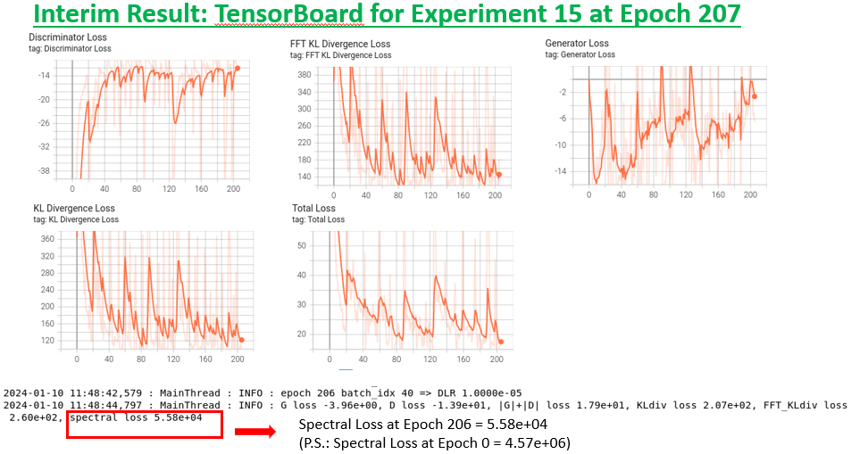
PROJECT 1
5/13
Operational impact and what I learned
~48 hours
~SGD 10,000
downtime saved
saved per machine
Why it mattered
• Reduced waste from fixed-schedule maintenance checks.
• Created a practical path around extreme failure-data scarcity.
Discussion
• Synthetic data quality still depends on the quality of rare seed failures.
• Next step: richer sensor fusion, online drift monitoring, and closed-loop retraining.
GitHub → astrozoid2604/CNC_Vibration
Training diagnostics from a tuned DoppelGANger experiment
Notes:
[Sources] - TensorBoard training figure from project repository: https://github.com/astrozoid2604/CNC_Vibration/blob/main/experiments/results/Exp15_interim_result.PNG

Slide 6
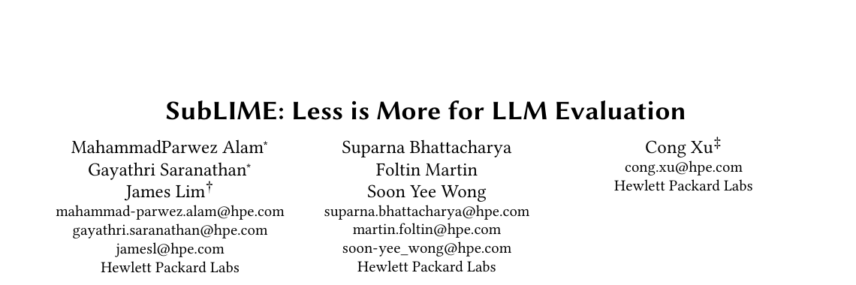
PROJECT 2
6/13
SubLIME: less data, still trustworthy LLM evaluation
[2024 ACM WWW Best Research Paper Award]
The question behind the paper was simple: if leaderboard evaluation is expensive, can we preserve model ranking with only a carefully chosen subset of benchmark items?
• Evaluating fast-growing LLM ecosystems is computationally and financially expensive.
• We compared random, quality-based, clustering-based and difficulty-based sampling approaches.
• I contributed to the benchmarking pipeline, sampling analysis and paper presentation.
400k+
3k+
~US$50k
open-source models mentioned in the paper context
models on the Open LLM Leaderboard
HELM spend for a 30-model evaluation cited in the paper
Conference paper header
GitHub → astrozoid2604/LLM_Leaderboard_Crawler
Notes:
[Sources] - SubLIME paper PDF (The Web Conference, DCAI Workshop, 2024): https://dcai-workshop.github.io/assets/pdf/accepted_papers/106.pdf - Scale/cost and sampling-performance claims on LLM counts, leaderboard counts, HELM spend, 0.85–0.95 Pearson at 10% sampling, and 1% MMLU sampling are cited from the SubLIME paper PDF above.

Slide 7
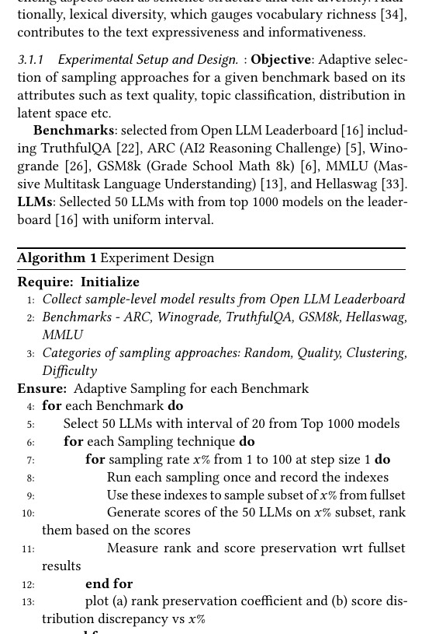
PROJECT 2
7/13
Adaptive sampling framework
Sampling families I explored
Random
Quality
Clustering
Difficulty
Benchmark
subset generation
Subset evaluation
for 50 models
Statistical
alignment check
Evaluation design
• 50 top models × 6 benchmarks × 1–100% sampling rates.
• Metrics: Pearson rank correlation, Wasserstein distance, KL divergence and KS test.
• Quality metrics included CPD, lexical diversity and spelling error; clustering used TF-IDF, BERT and MTEB-based variants.
Paper excerpt: experimental design and algorithm sketch
GitHub → astrozoid2604/LLM_Leaderboard_Crawler
Notes:
[Sources] - SubLIME paper PDF (The Web Conference, DCAI Workshop, 2024): https://dcai-workshop.github.io/assets/pdf/accepted_papers/106.pdf - Scale/cost and sampling-performance claims on LLM counts, leaderboard counts, HELM spend, 0.85–0.95 Pearson at 10% sampling, and 1% MMLU sampling are cited from the SubLIME paper PDF above.

Slide 8
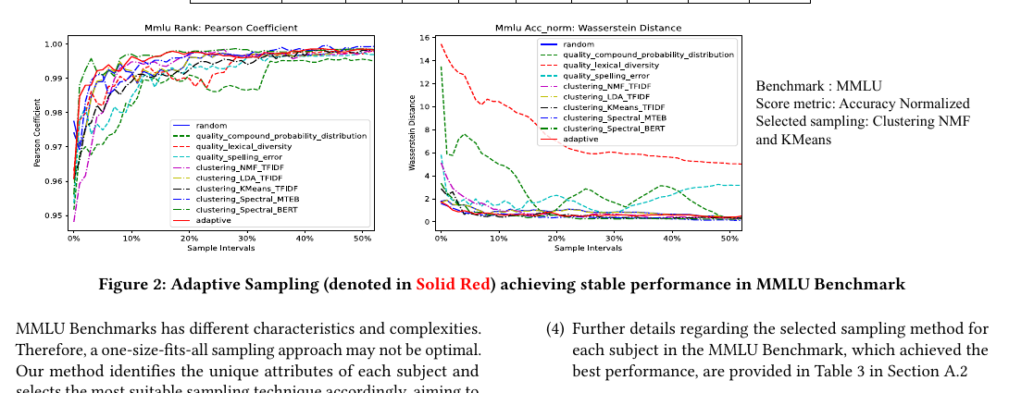
PROJECT 2
8/13
Key findings: preserve ranking, cut evaluation cost
1 Strong rank preservation
Quality-based sampling maintained Pearson correlations around 0.85–0.95 with the full datasets at 10% sampling in the paper’s experiments.
2 Benchmark-specific selection mattered
No single sampling family dominated every benchmark; adaptive selection improved robustness by choosing the right subset strategy for the task.
3 Large efficiency gains
Adaptive sampling reduced MMLU evaluation time by up to 99% while keeping ranks and score distributions statistically aligned; the paper also highlights effective behavior even at very small sample rates.
What I liked about this work: it forced me to think about evaluation as a product, not just as an experiment.
Paper figure excerpt: adaptive sampling behavior on MMLU
GitHub → astrozoid2604/LLM_Leaderboard_Crawler
Notes:
[Sources]
- SubLIME paper PDF (The Web Conference, DCAI Workshop, 2024): https://dcai-workshop.github.io/assets/pdf/accepted_papers/106.pdf - Scale/cost and sampling-performance claims on LLM counts, leaderboard counts, HELM spend, 0.85–0.95 Pearson at 10% sampling, and 1% MMLU sampling are cited from the SubLIME paper PDF above.

Slide 9
PROJECT 3
9/13
Enterprise knowledge search: friction in both ingestion and retrieval
The starting point was a simple question: if employees struggle to submit knowledge and the chatbot misses relevant results, can one system improve both capture and discovery?
Current practice
Target experience
Power Apps form
N fields to fill
Teams / WebApp /
Copilot trigger
SharePoint list
metadata storage
LLM extraction +
semantic indexing
proposed
shift
Separate WebApp
chatbot
Unified chatbot for
ingestion + search
• Users had to remember a specific link.
• Filling many fields created capture friction.
• Search startup was slow and relevant entries were often missed.
• Lower-friction capture through drag-and-drop or chat trigger.
• Embedding-based retrieval instead of brittle keyword-only search.
• One place to both submit and discover knowledge.
Same knowledge base, much less user friction.
GitHub → astrozoid2604/ai_km_poc

Slide 10
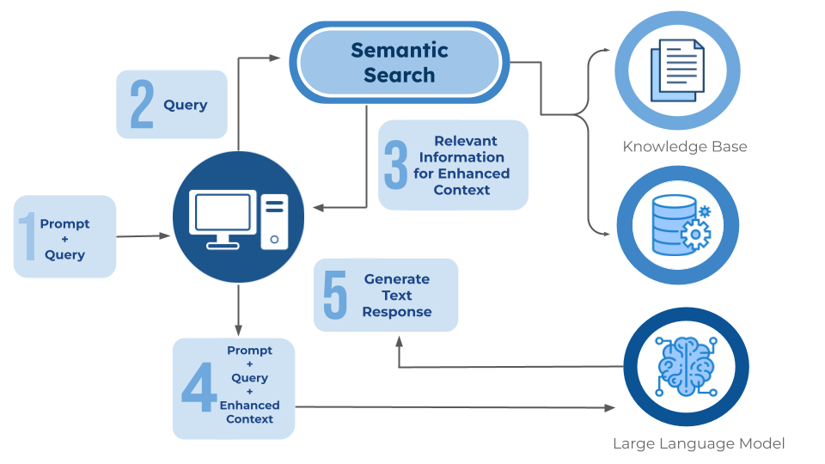
PROJECT 3
10/13
Architecture: one asset, one embedding, top-k retrieval
System flow
1
Upload files or ask via chat
2
Extract Title / Summary / Benefits / owner metadata
3
Store metadata in SharePoint and one embedding in Chroma
4
Encode query and retrieve top-k by cosine similarity
5
Return grounded answer + inline table + Excel export
1 asset ↔ 1 vector mapping kept search results traceable to a unique RecordId.
Semantic retrieval reference diagram
GitHub → astrozoid2604/ai_km_poc
Notes:
[Sources] - Semantic search diagram image: https://images.squarespace-cdn.com/content/v1/588a02f11b10e3d4643f5c35/0e4f0947-5cd2-40d6-86d8-5a2f43f7cdd4/Semantic%2BSearch%2BDiagram.png

Slide 11
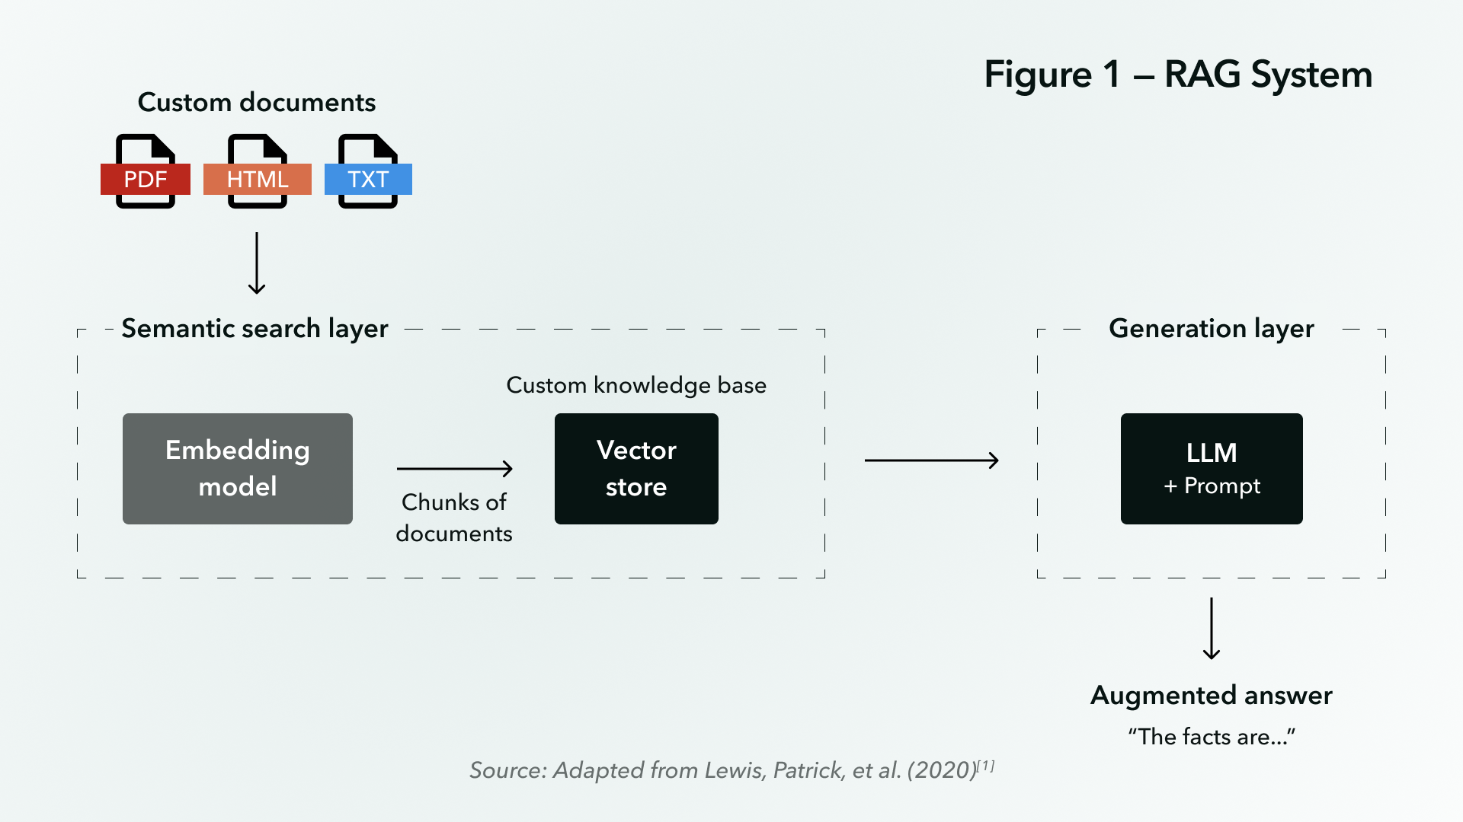
PROJECT 3
11/13
PoC decisions that made the system practical
Reliability
SharePoint integration toggled by environment variables; local CSV fallback for metadata; validation for email, site code and function fields.
Usability
Multi-file ingestion across PDF / DOCX / XLSX / TXT / PPTX; confirmation loops; downloadable Excel results for search matches.
Deployment path
Local PoC today, with a clear route to Teams message extension or Copilot experience in an enterprise M365 tenant.
Reference RAG diagram
Only sanitized PoC details are shown here; no confidential enterprise data is included.
GitHub → astrozoid2604/ai_km_poc
Notes:
[Sources] - RAG system diagram image: https://assets-global.website-files.com/61082de7b224bb1768edad68/65985ca13ca681c1ee34c710_RAG-system-simplified-breakdown.webp

Slide 12
FIT
12/13
What I would bring to Hyundai Singapore
These three projects represent the way I like to work as a data scientist: start from an operational pain point, make the evaluation rigorous, and keep the end deployment in view.
1
Manufacturing-first mindset
Time-series modeling, anomaly and failure-pattern learning, and an instinct to translate model output into downtime or cost impact.
2
Research discipline
Benchmark design, ablations, metric selection, and the habit of validating whether a faster method is still trustworthy.
3
Deployment mindset
Docker, dashboards, vector search, retrieval pipelines, and enough product thinking to design beyond the notebook.
That combination is the value I would want to bring into Hyundai Singapore’s data science work.

Slide 13
Thank you
Happy to discuss model design choices, validation trade-offs, or code walkthroughs.
Repositories shared for interview discussion
Project 1 → astrozoid2604/CNC_Vibration
Project 2 → astrozoid2604/LLM_Leaderboard_Crawler
Project 3 → astrozoid2604/ai_km_poc
Industrial AI • LLM research • Enterprise GenAI
All material in this deck has been kept high level and sanitized to avoid confidential or sensitive information.

