Slide 1
Gen-AI Evaluation Metrics for time-series data
James Lim
10/16/2023

Slide 2
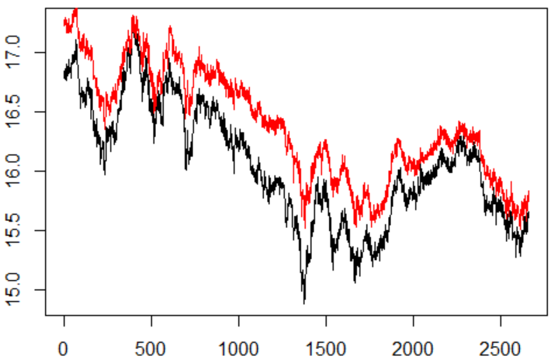


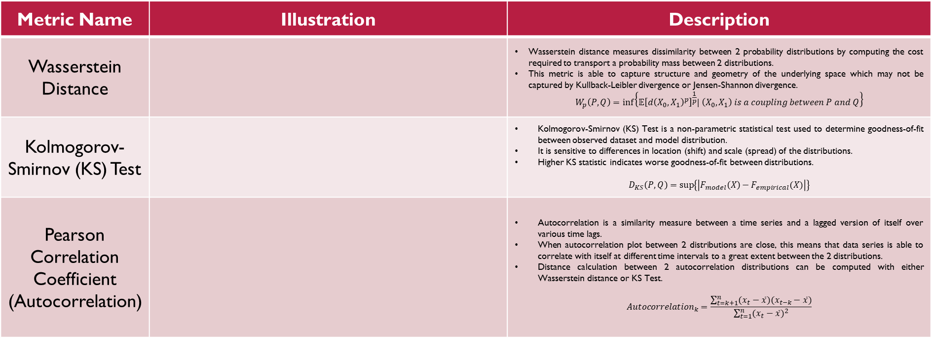




Gen-AI Evaluation Metrics
Prevalent Time-Series Metrics
Metric Name | Illustration | Description
Wasserstein Distance |  | Wasserstein distance measures dissimilarity between 2 probability distributions by computing the cost required to transport a probability mass between 2 distributions. This metric is able to capture structure and geometry of the underlying space which may not be captured by Kullback-Leibler divergence or Jensen-Shannon divergence. $$W_{p}\left(P, Q\right)=\inf\left\{𝔼{\left[d{\left(X_{0}, X_{1}\right)}^{p}\right]}^{\frac{1}{p}}| \left(X_{0}, X_{1}\right) is a coupling between P and Q\right\}$$
Kolmogorov-Smirnov (KS) Test |  | Kolmogorov-Smirnov (KS) Test is a non-parametric statistical test used to determine goodness-of-fit between observed dataset and model distribution. It is sensitive to differences in location (shift) and scale (spread) of the distributions. Higher KS statistic indicates worse goodness-of-fit between distributions. $$D_{KS}\left(P, Q\right)=\sup\left\{\left|F_{model}\left(X\right)−F_{empirical}(X)\right|\right\}$$
Pearson Correlation Coefficient (Autocorrelation) |  | Autocorrelation is a similarity measure between a time series and a lagged version of itself over various time lags. When autocorrelation plot between 2 distributions are close, this means that data series is able to correlate with itself at different time intervals to a great extent between the 2 distributions. Distance calculation between 2 autocorrelation distributions can be computed with either Wasserstein distance or KS Test. $$Autocorrelation_{k}=\frac{\sum_{t=k+1}^{n}{(x_{t}−\overline{x})(x_{t−k}−\overline{x})}}{\sum_{t=1}^{n}{{(x_{t}−\overline{x})}^{2}}}$$
$$P$$
$$Q$$
CDF
$$Model CDF$$
$$Empirical CDF$$
$$Autocorrelation$$
$$of Distribution X$$
Autocorrelation
$$Autocorrelation$$
$$of Distribution Y$$
Time Lag

