Slide 1
DSA5208 Project 1: MPI Pipeline for Kernel Ridge Regression (KRR)
Bryan Wong Hong Liang | bryanwong@u.nus.edu | A0215114X
James Lim | e0950510@u.nus.edu | A0251506M

Slide 2
Introduction
Objective:
Implement and evaluate kernel ridge regression (KRR) with different kernels for predicting house price at California
Dataset: California Housing Dataset

Slide 3
Data Preprocessing
Standardized input features:
Ensured input features follow a normal distribution N(μ=0, σ=1) for faster convergence
Input features includes all columns except the target feature (`medianHouseValue`), and unique identifiers (`latitude`, `longitude`).
Norminal feature (`oceanProximity`) also belongs to input features but it’s not standardized
One-hot encoded the nominal feature (`oceanProximity`):
Converted `oceanProximity` to numerical values using one-hot encoding.
Split data into training and testing sets (70:30 ratio):
Used random state 42 to split 70:30 between training and testing sets

Slide 4
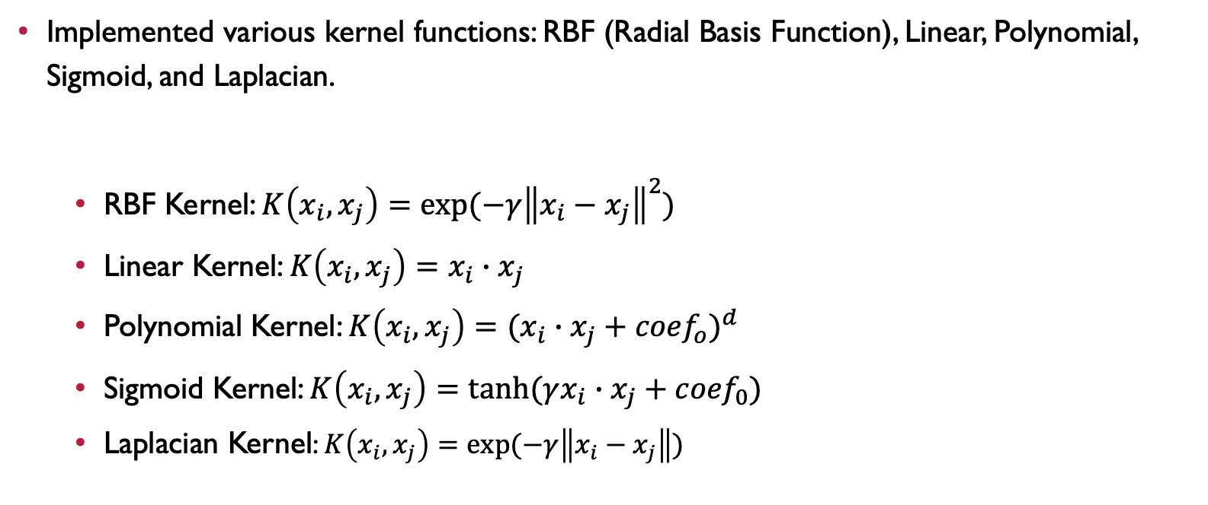
KERNEL FUnctions
Implemented various kernel functions: RBF (Radial Basis Function), Linear, Polynomial, Sigmoid, and Laplacian.
RBF Kernel: $K\left(x_{i}, x_{j}\right)=exp⁡(−γ{\left\|x_{i}−x_{j}\right\|}^{2})$
Linear Kernel: $K\left(x_{i}, x_{j}\right)=x_{i}∙x_{j}$
Polynomial Kernel: $K\left(x_{i}, x_{j}\right)={(x_{i}∙x_{j}+{coef}_{o})}^{d}$
Sigmoid Kernel: $K\left(x_{i}, x_{j}\right)=tanh⁡(γx_{i}∙x_{j}+{coef}_{0})$
Laplacian Kernel: $K\left(x_{i}, x_{j}\right)=exp⁡(−γ\left\|x_{i}−x_{j}\right\|)$

Slide 5
Parallel kernel matrix computation
MPI: A standardized and portable message-parsing system designed to function on parallel computing architectures.
Purpose: Enables efficient communication between multiple processes running on different nodes of a cluster.
Steps in parallel kernel matrix computation:
Initialization
MPI Communicator: `comm = MPI.COMM_WORLD`
Rank: `rank = comm.Get_rank()` # identifies the process ID
Size: `size = comm.Get_size()` # number of processes
Data Distribution
Training Data: Split data evenly across all processes.
Local Data: Each process works on a subset of the data (`local_X`)

Slide 6
Parallel kernel matrix computation
Steps in parallel kernel matrix computation:
Kernel Matrix Calculation
Local Computation:
Each process computes its portion of the kernel matrix for its local data.
Example: `local_K = kernel_base(local_X, local_X, **kwargs)`
Inter-Process Communication
Processes exchange local data segments with each other.
Use of non-blocking sends (`comm.Issend`) and receives (`comm.Recv`) to share data efficiently.

Slide 7
Parallel kernel matrix computation
Steps in parallel kernel matrix computation:
Combining Results
Local Results Aggregation:
Each process computes kernel values for its data against data received from other processes.
Global Kernel Matrix:
Root process (`rank == 0`) gathers all local kernel matrices into the global kernel matrix (`comm.Gather`)
Synchronization
Barrier: `comm.Barrier()` ensures all processes complete their tasks before proceeding.
Final Kernel Matrix: Constructed on the root process, combining results form all processes.

Slide 8
Hyperparameter tuning
Base Kernel Name | Hyperparameter Tuning Range
RBF Kernel | Gamma (Coarse): [1e-6, 1e-5, 1e-4, 1e-3, 0.01, 0.1]
 | Alpha (Coarse): [1e-5, 1e-4, 1e-3, 0.01 0.1, 1, 10, 100]
 | Gamma (Fine): [0.01, 0.02, 0.03, … , 0.08, 0.09, 0.1]
 | Alpha (Fine): [5e-3, 6e-3, 7e-3, … , 0.013, 0.014, 0.015]
Laplacian Kernel | Gamma (Coarse: [1e-6, 1e-5, 1e-4, 1e-3, 0.01, 0.1]
 | Alpha (Coarse): [1e-5, 1e-4, 1e-3, 0.01, 0.1, 1, 10, 100]
 | Gamma (Fine): [0.03, 0.04, 0.05, … , 0.11, 0.12, 0.13]
 | Alpha (Fine): [0.11, 0.12, 0.13, … , 0.19, 0.20, 0.21]
Linear Kernel | Alpha: [1e-5, 1e-4, 1e-3, 1e-2, 1e-1, 1, 10, 100]
Polynomial Kernel | Degree: [2, 3, 4, 5, 6]
 | Coef0: [0.2, 0.4, 0.6, 0.8, 1.0]
 | Alpha: [1e-5, 1e-4, 1e-3, 0.01, 0.1, 1, 10, 100]
Sigmoid Kernel | Gamma: [1e-6, 1e-5, 1e-4, 1e-3, 1e-2, 1e-1]
 | Coef0: [0.2, 0.4, 0.6, 0.8, 1.0]
 | Alpha: [1e-5, 1e-4, 1e-3, 1e-2, 1e-1, 1, 1e+1, 1e+2]
Optimizations: Iterated through combinations of hyperparameters and selected parameters with the lowest RMSE.
Note: Only RBF Kernel and Laplacian Kernel underwent fine-grained tuning range while others stopped at coarse-grained tuning range as said 2 Kernels have similar best results from coarse-grained tuning range.

Slide 9
Result
Base Kernel Name | Best RMSE Train | Best RMSE Test | Best Hyperparameters
RBF Kernel | 55805.7675 | 58494.1907 | Gamma=0.08, Alpha=0.014
Laplacian Kernel | 50237.9459 | 59528.4724 | Gamma=0.12, Alpha=0.2
Linear Kernel | 70083.2613 | 69158.2979 | Alpha=0.1
Polynomial Kernel | 60335.0835 | 61793.2234 | Degree=3, Coef0=1, Alpha=100
Sigmoid Kernel | 62934.3743 | 63104.2365 | Gamma=0.001, Coef0=0.8, Alpha=1e-5

Slide 10
conclusion
Summary:
Successfully implemented and evaluated various kernel ridge regression models.
Best Performance:
RBF Kernel with Gamma=0.08 and Alpha=0.014 attained lowest RMSE_train=55805.7675 and RMSE_test=58494.1907
This makes sense as RBF Kernel implicitly maps the input data to infinite-dimensional feature space and therefore it has the best expressive power to model very complex relationship in the data among other Kernels.
Future Work:
Explore additional kernels and further optimize hyperparameters.

