Slide 1
DSA5208 Project 2: Apache Spark + Mllib Regression
James Lim

Slide 2
Project overview
Title: Air pressure Prediction Using Machine Learning in Distributed Computing Settings
Objective: Build a machine learning model to predict air pressure using geographical and weather data.
Data Source:
Dataset: NOAA Global Hourly Data 2023
Documentation: NOAA Global Hourly Documentation
Tasks:
Download and preprocess the datset.
Build ML models to predict the column `ATMOSPHERIC_PRESSURE_OBSERVATION`
Train and test the models using a 7:3 data split
Evaluate and compare model performance

Slide 3
Data Preprocessing
Data Cleaning
Initial Steps:
Check for Preprocessed Data:
If the preprocessed data file exists, read it directly.
If not, proceed to read and preprocess raw data files.
Reading and Filtering Data:
Read Raw CSV Files:
Utilize PySpark to read multiple CSV files from the specified directory.
Enable header and schema inference.
Select Relevant Columns:
Keep columns: `LATITUDE`, `LONGITUDE`, `ELEVATION`, `WND`, `CIG`, `VIS`, `TMP`, `DEW`, `SLP`

Slide 4
Data Preprocessing
Data Transformation
Handle Missing Data:
Filtering Conditions:
`WND`: Discards rows where the first 3 characters are `999` or characters 6-9 are `9999`.
`CIG`: Discard rows where the first 5 characters are `99999`.
`VIS`: Discard rows where the first 6 characters are `999999`.
`TMP`, `DEW`: Discard rows where the first 5 characters are `+9999`.
`SLP`: Discard rows where the first 5 characters are `99999`.
Transform Columns:
Column Transformation:
Extract relevant parts of each column and cast to appropriate data types.
Rename columns for consistency.

Slide 5
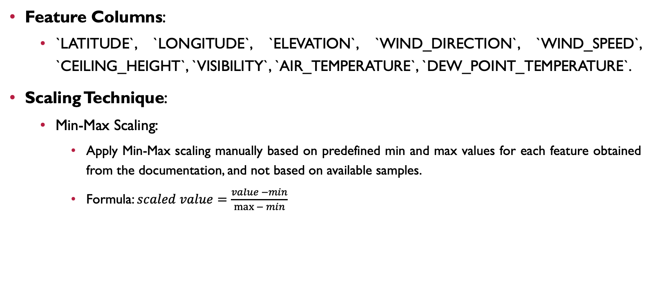
MIN-MAX Scaling
Feature Columns:
`LATITUDE`, `LONGITUDE`, `ELEVATION`, `WIND_DIRECTION`, `WIND_SPEED`, `CEILING_HEIGHT`, `VISIBILITY`, `AIR_TEMPERATURE`, `DEW_POINT_TEMPERATURE`.
Scaling Technique:
Min-Max Scaling:
Apply Min-Max scaling manually based on predefined min and max values for each feature obtained from the documentation, and not based on available samples.
Formula: $scaled value=\frac{value −min}{\max{− min}}$

Slide 6
MIN-MAX Scaling
Predefined Min-Max Values:
`LATITUDE`: [-90000, 90000]
`LONGITUDE`: [-179999, 180000]
`ELEVATION`: [-400, 8850]
`WIND_DIRECTION`: [1, 360]
`WIND_SPEED`: [0, 900]
`CEILING_HEIGHT`: [0, 22000]
`VISIBILITY`: [0, 160000]
`AIR_TEMPERATURE`: [-932, 618]
`DEW_POINT_TEMPERATURE`: [-982, 368]

Slide 7
Train-TEST SPLIT
Data Split:
Training Set: 70% of the data.
Test Set: 30% of the data.
Purpose: Ensure that the model is evaluated on unseen data to assess its performance.
Implementation:
Utilize `randomSplit` method in PySpark to split the dataset.
Set a random seed for reproducibility.

Slide 8
MODEL PIPELINE
Feature Engineering:
Vector Assembler:
Combine features into a single vector.
Model Selection:
Ridge Regression:
Using Linear Regression with `elasticNetParam=0.0` to simulate Ridge Regression.
Gradient-Boosted Tree Regression (GBT):
Employ `GBTRegressor` for capturing non-linear relationship.
Random Forest Regression:
Utilize `RandomForestRegressor` for ensemble learning.

Slide 9
MODEL PIPELINE
Hyperparameter Tuning:
Ridge Regression:
`regParam`: [0.01, 0.1, 1.0]
GBT:
`maxDepth`: [5, 7, 9]
`maxIter`: [20, 30, 40]
Random Forest:
`numTrees`: [20, 30, 40]
`maxDepth`: [5, 7, 9]
Cross-Validation:
Utilize `CrossValidator` for each model to perform 3-fold cross-validation.

Slide 10
MODEL EVALUATION
EvaluationMetrics:
Root Mean Squared Error (RMSE):
Measure the average magnitude of the error.
Evaluation Process:
Training:
Fit models using training data.
Predict and evaluate on training set.
Testing:
Predict and evaluate on test set.
Evaluator:
Use `RegressionEvaluator` with `rmse` metric for evaluation.

Slide 11
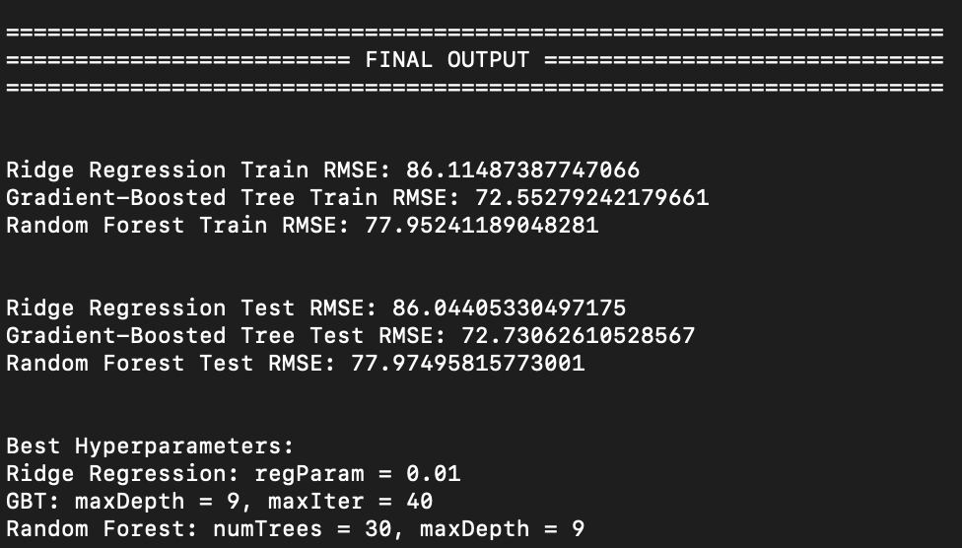
Results
Time taken to complete the run: 01 hour 15 minutes (with 8 cores of Mac M1 Silicon Chip)

Slide 12
conclusion
Summary:
Successfully built and evaluated 3 regression models under Spark MLlib.
Ridge Regression, Gradient-Boosted Tree, and Random Forest models were compared.
Model performance evaluated using RMSE on both training and test sets.
Best Performance:
Gradient-Boosted Tree with train RMSE = 72.55 and test RMSE = 72.73 with best hyperparameters maxDepth=9 and maxIter=40
Future Work:
Further optimization and feature engineering.
Exploring additional models and techniques.

