Slide 1
Project Arkanoid
By Josh Weaver & Steve Ham

Slide 2
Project Goal
Originally: to create/modify an open-source 2D side-scrolling platform game, using C++
Later revised to: modified/extended version of an Arkanoid clone (still in C++)
Goal changed due to issues with building & compilation of a specific open-source game we found

Slide 3
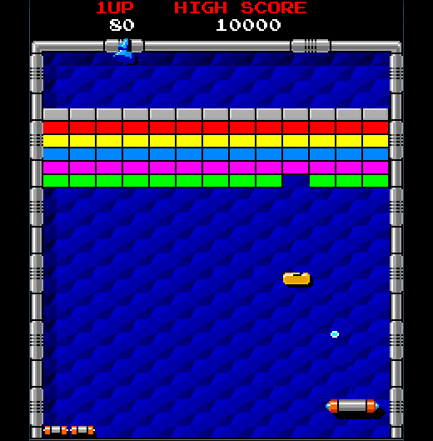
What is Arkanoid?
Game Objective: Use a ball & paddle to “destroy” all the bricks on the screen
(Note: screenshot not from our game implementation)

Slide 4
Modifications & Additions
Converted C++ structs to classes for a proper Object-Oriented design
Fixed various gameplay issues (like preventing the ball from bouncing off the bottom of the window and making it “fall off” instead, etc)
Added various elements: scoring, pausing, a “bad ball”, game-over states (winning & losing), main menu, etc
Refactoring for general code clean-up & design patterns

Slide 5
Design Patterns
Facade - created a GameEngine class to access the complex system of related classes and methods
Additional patterns that could have been used:
Prototype - to create more balls (as game power-ups)
Observer - for the paddle and ball objects
Singleton - for at most 1 instance of the GameEngine

Slide 6
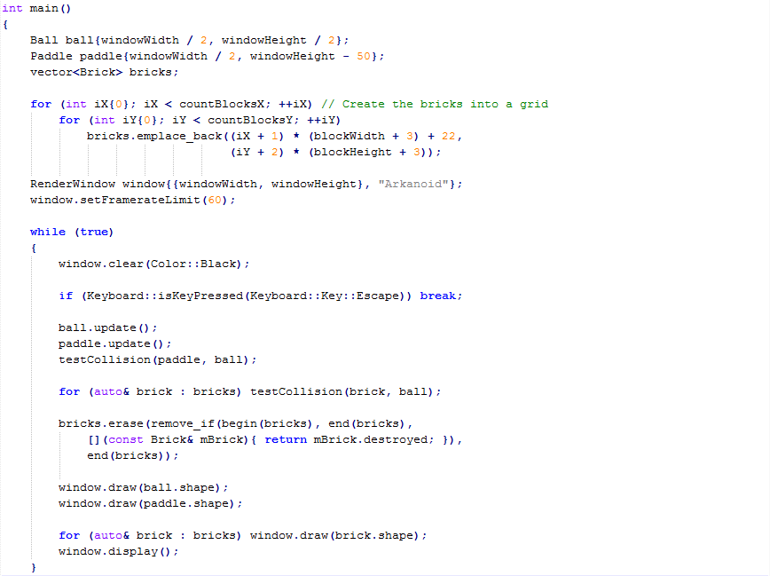
Before Facade

Slide 7
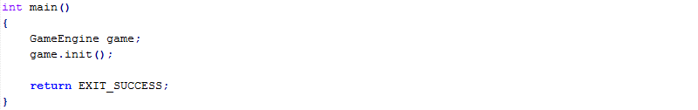
After Facade

Slide 8
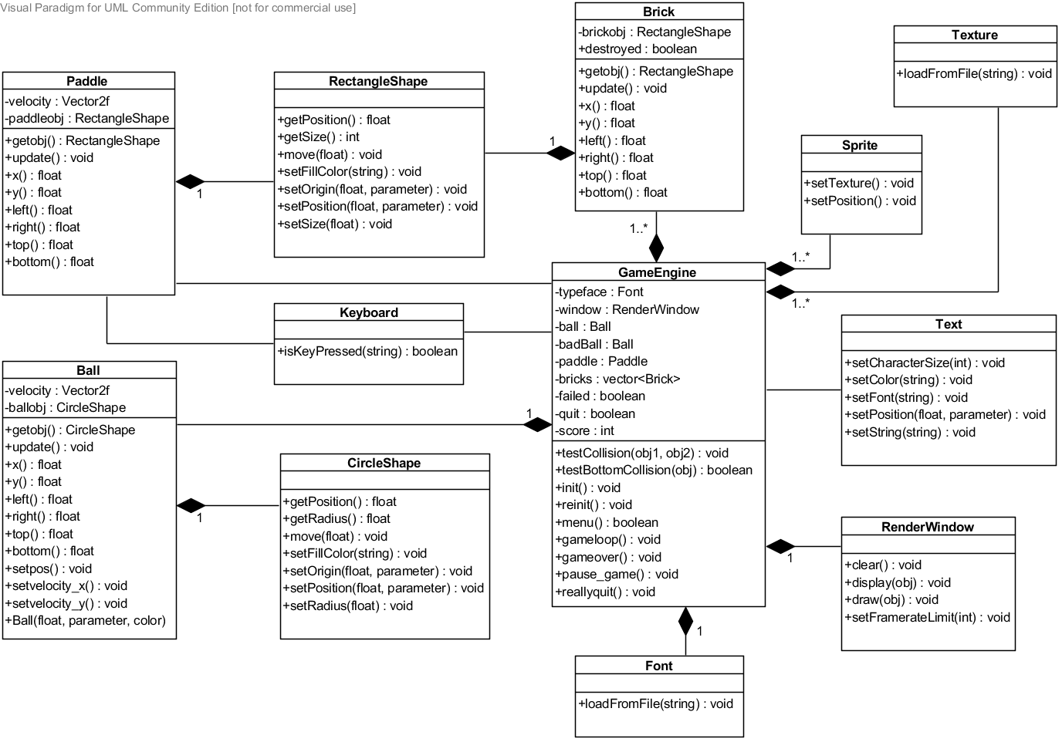
Class Diagram

Slide 9
Lessons Learned
Time would’ve been saved if we had searched for an open-source game using a specific multimedia API (like SFML, in our case) due to the variety of APIs available
Takes too much time to try to analyze & re-work open-source code that lacks proper OO coupling & cohesion
Activity & use case diagrams were helpful to verify correctness and functionality of our game (Activity especially to verify the game loop, which is important)

