Slide 1
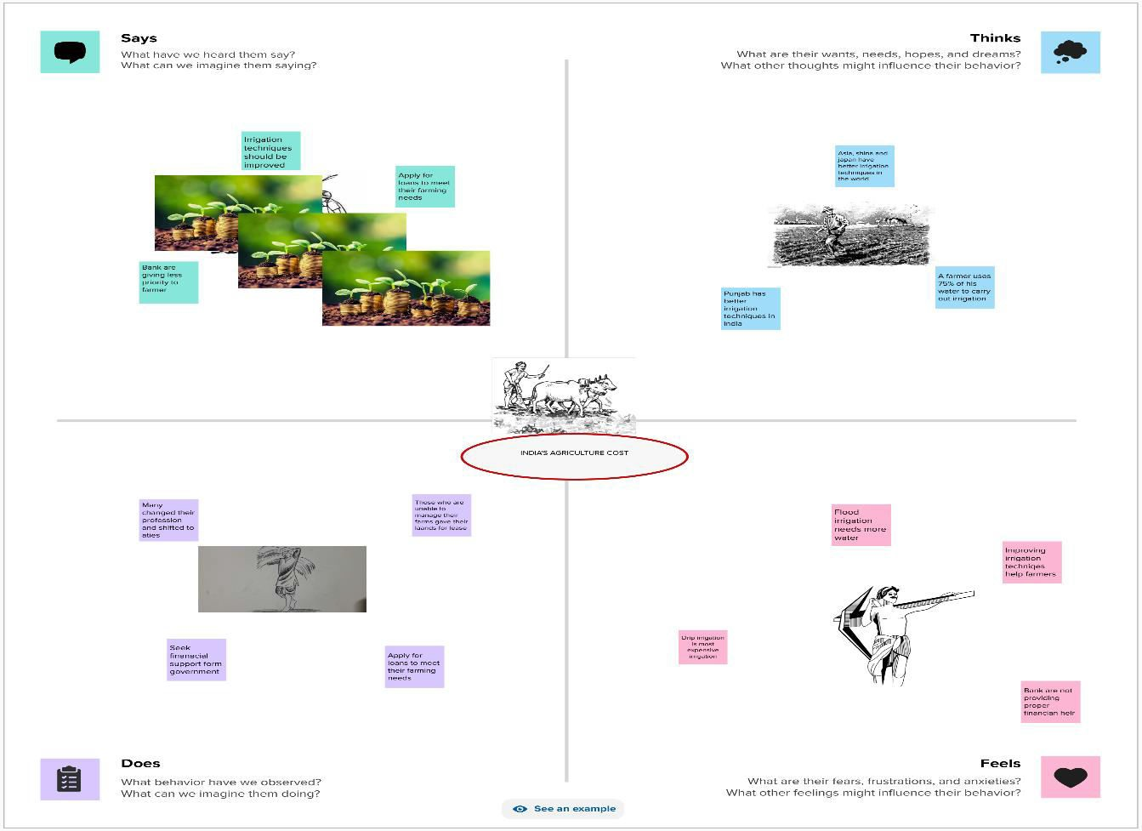
INTRODUCTION
  OVERVIEW
India is the second largest producer of wheat and rice, the world's major food staples. India is currently the world's second largest producer of several dry fruits, agriculture-based textile raw materials, roots and tuber crops, pulses, farmed fish, eggs, coconut, sugarcane and numerous vegetables.
  PURPOSE
India ranks first in the world with highest net cropped area followed by US and China. The economic contribution of agriculture to India's GDP is steadily ...
PROBIEM DEFINITION & DESIGN THINKING
  EMPATHY M

Slide 2

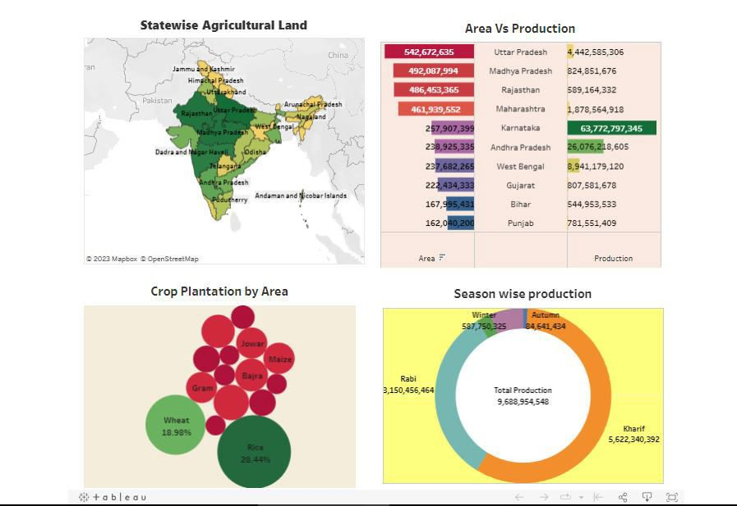
2.2 IDEATION & BRAINSTORMING MAP
3 RESULT

Slide 3
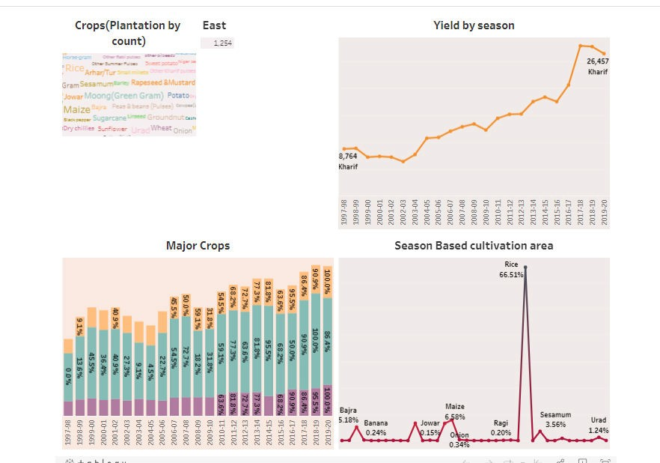
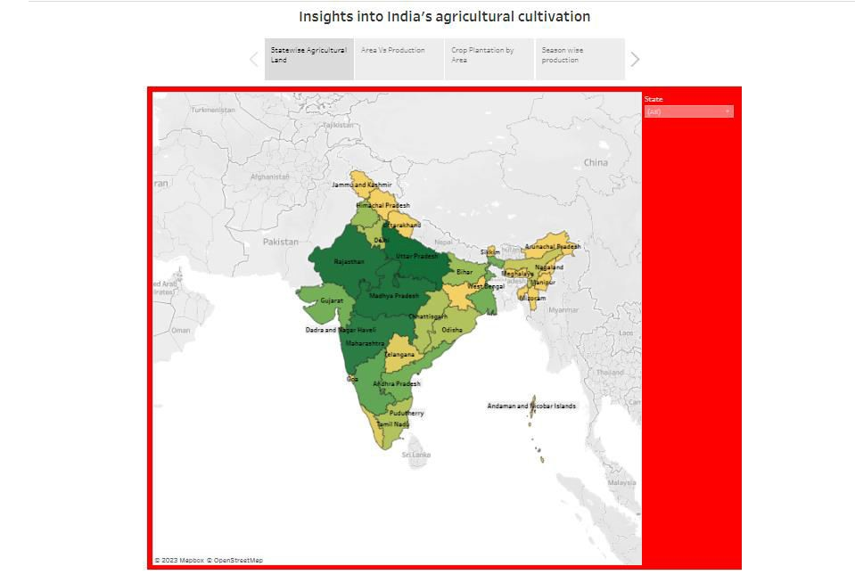

Slide 4
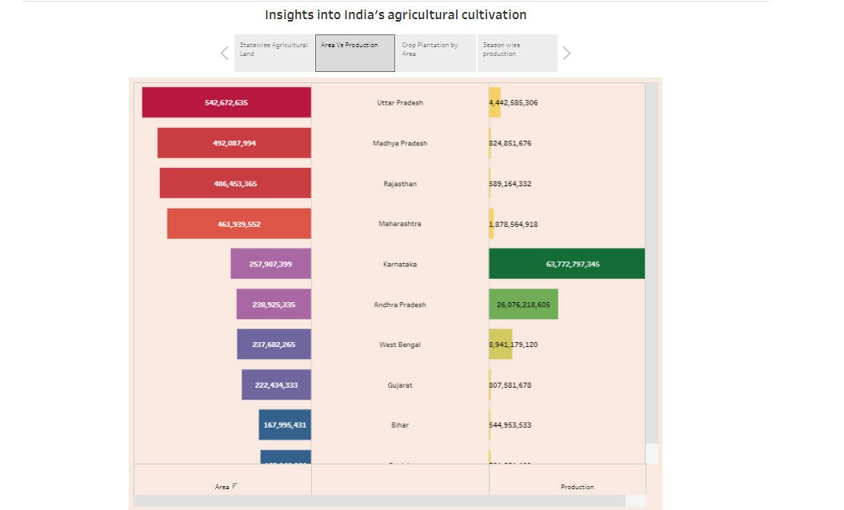
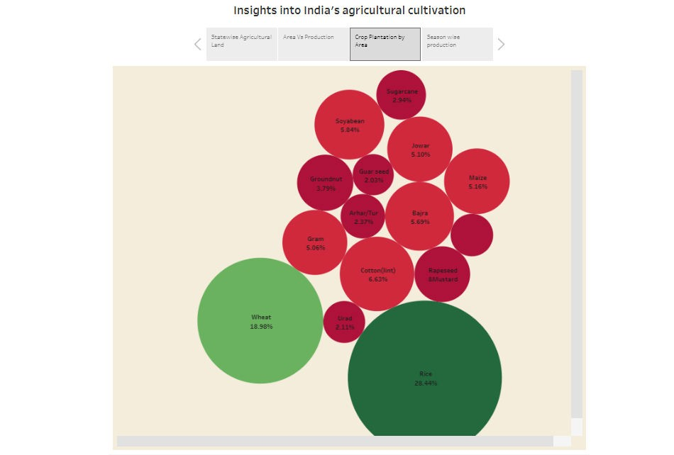
h

Slide 5
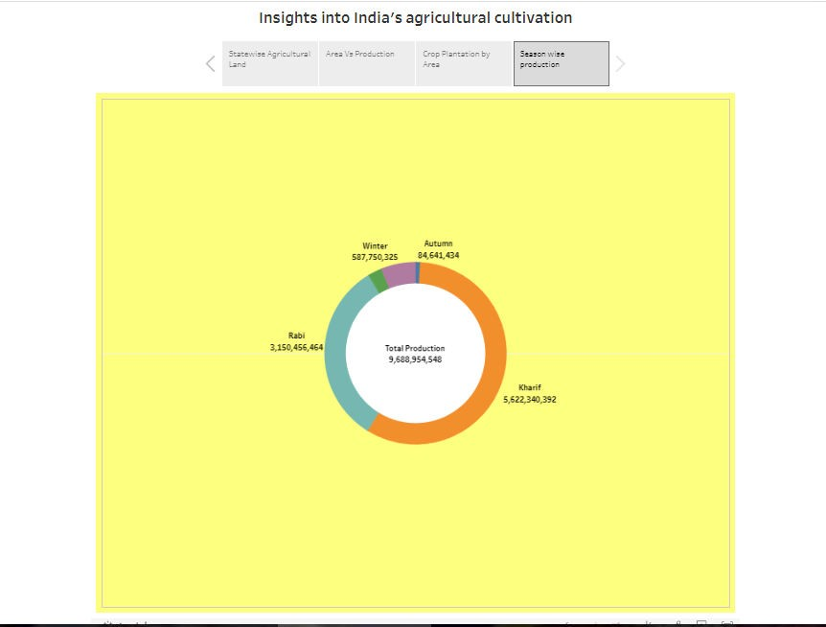
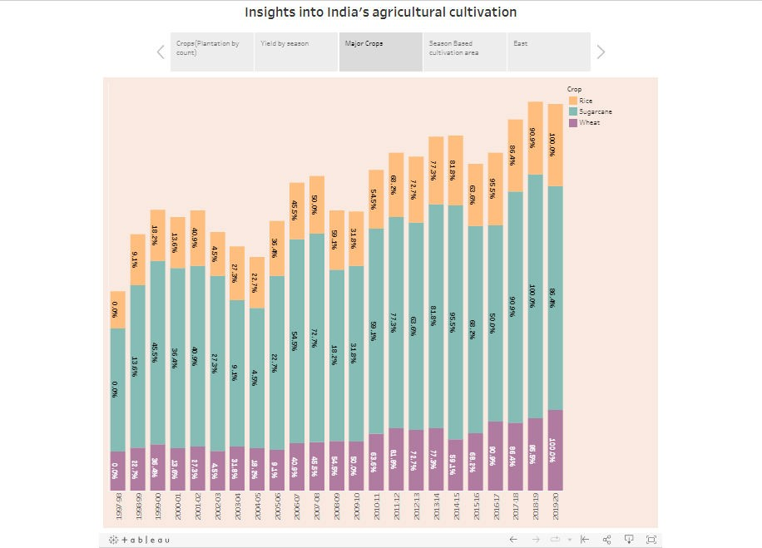

Slide 6
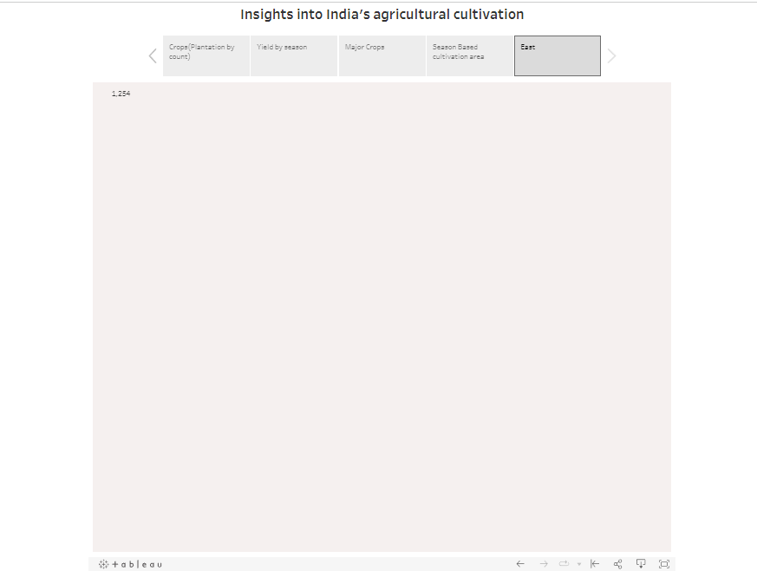
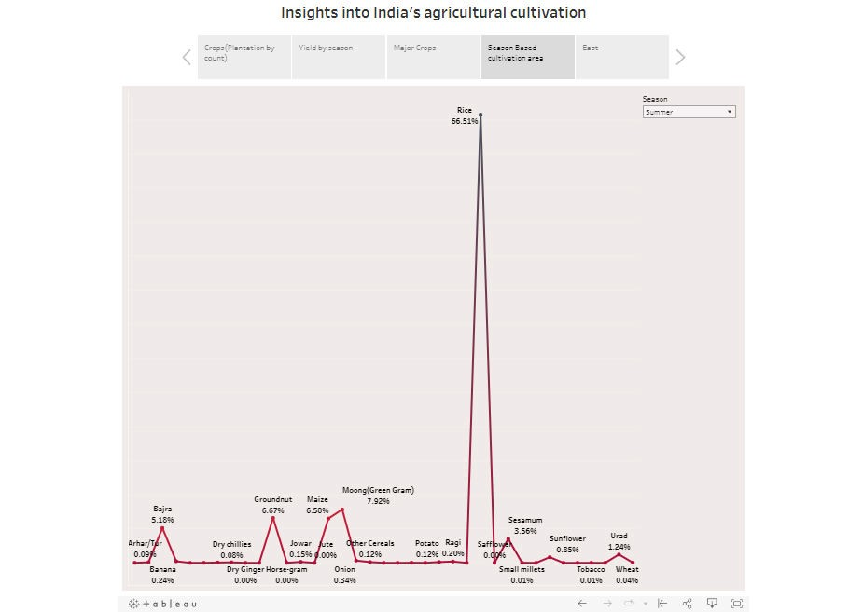
4
ADVANTAGES & DISADVANTAGES

Slide 7
1. Advantages
Natural Environment
Organic farming usually goes down in a natural environment. Unnecessary enclosures are not used for the crops or plants. This way the productivity is increased and is way better compared to closed spaces. An open and natural area for growing the crops would give them wild and instinctive growing nature. This is ideal for the crops and is one of the factors that leads to the plants being organic.
No Chemicals
Unlike other forms of farming, organic farming does not involve any artificial sources like chemicals to drive away pests or to speed up the process of farming. These chemicals are often used in commercial and industrial farming methods. However, organic farming stays true to its title. Its method is true to its natural core and does not use anything that may be of harm to its consumers. Any type of chemical is not entertained in the organic farming industry.

Slide 8
Eye On You
Unlike any other procedure, organic farming has a very strict supervision schedule. The reason for this extreme regulation is because of the importance to keep the label organic. It is very difficult to do so as most brands use artificial aspects in their farming. There are various methods of organic farming and its standards must be maintained in order to remain organic. This ensures that customers buying the end product receive what they’re truly looking for.
Environmentally Friendly
Among the advantages of organic farming, this one stands out the most. Today, almost the entire sector of industrial farming consists of chemicals that ruin the environment. However, when you have something like organic farming to replace it, a
huge benefit is received. Organic farming does not use any form of chemical nor does any form of pollution happen because of it. This makes it way better than regular farming. The whole world suffers because of the ignorant methods of regular farming including animals. Organic farming is definitely the way to go.
Healthier And Tastier
Since non-organic farming produces results that are way too suspicious when eaten, it is obvious that it isn’t good for health

Slide 9
either. Organic farming in kerala for example are known to keep the crops growing properly. They are given time and care unlike non-organic sectors that pump the results with chemicals in order for it to grow faster. These type of sectors are only commercial-minded and are least bothered about the satisfaction and health of the consumer. Since the fruits and vegetables grown organically are given longer time to flourish, they automatically are way better in terms of nutrition and taste.
2.Disadvantages
Expensive Products
One of the major problems of organic farming methods is that sometimes it can get a bit costly. Some products related to organic farming are too expensive, leading to some common people to not be able to afford it. In a country like India where most of its livelihood are farmers, organic farming brings a huge problem to it. However, organic farming in Tamil Nadu have had some success stories.
More Labor
Organic farming is a sector that requires a lot of patience. This is because pests and others obstacles must be tackled manually.

Slide 10
Unlike in non-organic farming, the use of pesticides and other chemicals are not permitted. This makes the work of the farmer harder as constant attention and care is needed. Due to the constant attention, a lot of time is consumed. Organic farming has to be executed well which needs a lot of time and not to forget weed-prevention.
High MRP
It is almost obvious that due to the extreme care taken to go along with organic farming, the results would be kept at a high price. Once sold to the market, most of the place is devoted to the sale of these organic fruits and vegetables. Most people do that approve of organic products because of this. The items sold in the market are half the price of non-organic products. So, we can say that organic items are expensive and not every consumer is willing to pay the price for it.
Cross Breeding Problem
The seeds of GMO plants once planted, create GMO crops. These crops then produce seeds and the pattern continues. This makes it very difficult to tell from the organic and GMO crops.
This has become a huge problem in the organic farming sector. This could ruin the future of organic planting as a whole.

Slide 11
5. Labor Charges
Labor charges refer to the amount payable to someone who has been involved in the building ot working of something. Like we said earlier, in organic farming ventures, the amount of labor is high and it takes a lot of time and patience to the get work done. If one is not able to do it by oneself, a lot of labor would be hired which increases the payment that those laborers deserve.
However, people are starting to prefer organic farming and are performing such practises like – mushroom cultivation, aloe vera farming, spirulina cultivation, sugarcane cultivation, banana cultivation, pomegranate cultivation etc. in various parts of our country.
5
APPLICATIONS
latest Indian agricultural commodities Mandi prices from different states and districts MNCFC .
6 CONCLUSION
The agricultural sector is of vital importance for the region. It is undergoing a process of transition to a market economy, with substantial changes in the social, legal, structural, productive and supply

Slide 12
set-ups, as is the case with all other sectors of the economy. These changes have been accompanied by a decline in agricultural production for most countries, and have affected also the national seed supply sectors of the region. The region has had to face problems of food insecurity and some countries have needed food aid for IDPs and refugees .
7
FUTURE SCOPE
The agriculture industry in India size reached INR 80,550 Billion
in 2022. Looking forward, IMARC Group expects the market to reach INR 158,991 Billion by 2028, exhibiting a growth rate (CAGR) of 12.2% during 2023-2028.

