Slide 1
Digital Portfolio
STUDENT NAME: KEERTHIKA.L
REGISTER NO AND NMID: 20324u18033 AND 315501E795C4DE2A0EB4B9B4DE78050
DEPARTMENT: BSC(computer science)
COLLEGE: COLLEGE/ UNIVERSITY:Dr.M.G.R. chockalingam Arts College& THIRUVALLUR UNIVERSITY

Slide 2
PROJECT TITLE
Future innovation-ideas you want to develop

Slide 3


AGENDA
Problem Statement
Project Overview
End Users
Tools and Technologies
Portfolio design and Layout
Features and Functionality
Results and Screenshots
Conclusion
Github Link
3/21/2024 Annual Review

Slide 4

PROBLEM STATEMENT
Personal AI Life Assistant – A fully integrated AI that manages daily tasks, health, finances, and learning.
Emotion-Sensing Devices – Wearables that can detect stress, anxiety, or happiness and suggest actions in real time.
AI-Powered Education Platform – Adaptive learning systems that customize lessons based on individual student progress.

Slide 5
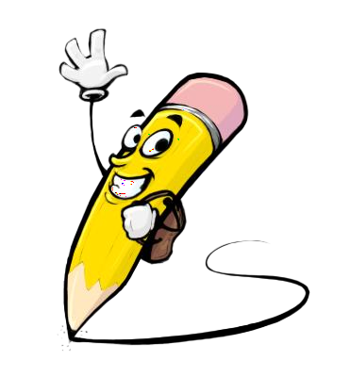
PROJECT OVERVIEW
The project focuses on developing innovative solutions for future challenges by integrating advanced technology, sustainability, and human-centered design. The aim is to create smart systems and applications that improve quality of life, support the environment, and transform industries.
This project explores emerging technologies such as Artificial Intelligence, Internet of Things (IoT), Biotechnology, Renewable Energy, and Smart Infrastructure to design future-ready solutions. By identifying current global issues—such as climate change, healthcare gaps, education access, and urban development—the project proposes

Slide 6

WHO ARE THE END USERS?
In the context of future innovations, end users are the individuals, groups, or organizations who will directly benefit from and interact with the product, service, or system. Identifying them is essential to design meaningful, user-centric innovations.
1. Students & Learners
End users of educational innovations such as digital portfolios, AI tutors, AR/VR classrooms, and skill-based platforms.
Future innovation focuses on personalized learning experiences and adaptive technologies.

Slide 7

TOOLS AND TECHNIQUES
Future innovations will be driven by advanced tools and modern techniques that make processes smarter, faster, and more user-friendly. These tools are not just digital aids but enablers of creativity, efficiency, and problem-solving.
1. Artificial Intelligence (AI) & Machine Learning (ML)
Tools for predictive analytics, automation, and personalization.
Techniques like natural language processing, deep learning, and recommendation systems will revolutionize industries.

Slide 8
POTFOLIO DESIGN AND LAYOUT
Portfolio design and layout are no longer just about presenting work — they are evolving into interactive, intelligent, and personalized experiences. Future innovations will focus on making portfolios more dynamic, user-centric, and immersive.
1. Interactive & Immersive Layouts
Use of 3D design, AR/VR integration, and motion graphics to create engaging experiences.
Visitors can explore a portfolio like a virtual gallery rather than static pages.
8

Slide 9
FEATURES AND FUNCTIONALITY
The features and functionality of future innovations will be designed to go beyond basic usability, focusing on intelligence, interactivity, adaptability, and inclusivity. These advancements will ensure that digital platforms and portfolios are not just tools, but smart ecosystems.
1. AI-Driven Features
Smart Recommendations: AI suggests learning paths, projects, or skills based on user interests.
Chatbots & Virtual Assistants: Real-time guidance, feedback, and support.

Slide 10
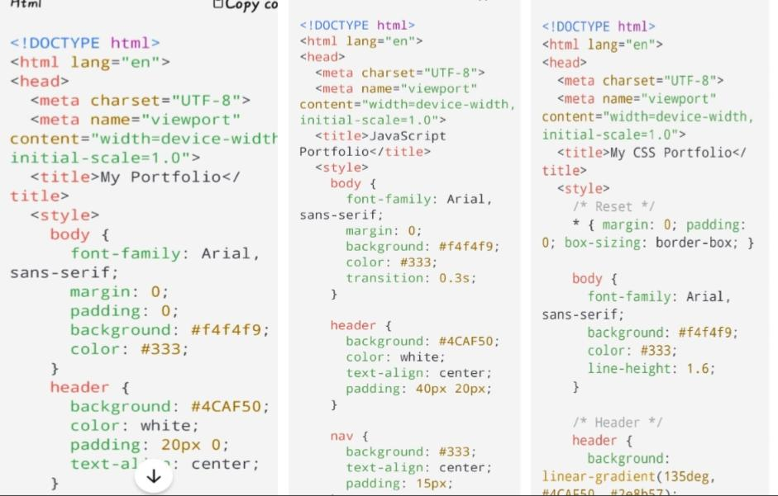
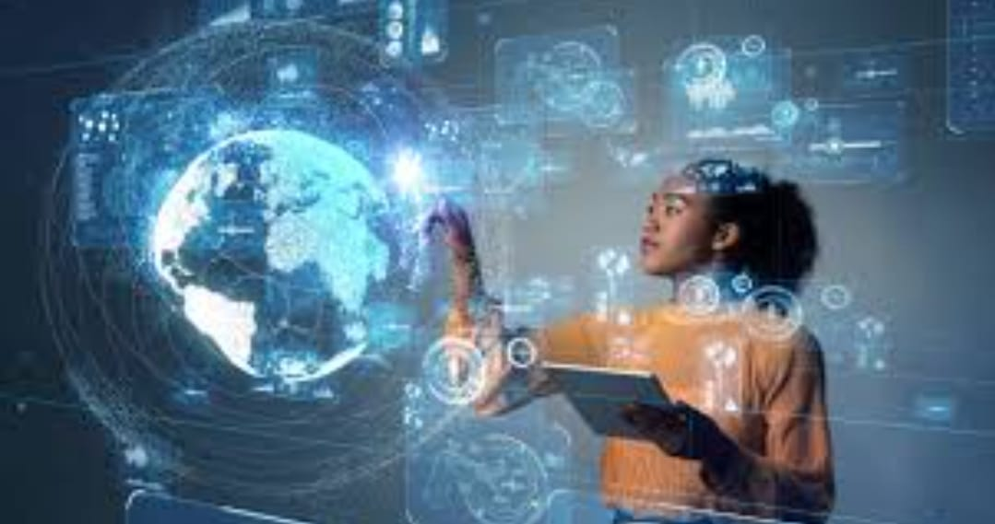

RESULTS AND SCREENSHOTS
3/21/2024 Annual Review
10

Slide 11
CONCLUSION
Future innovation is not just about new technologies but about creating human-centered, sustainable, and intelligent solutions that adapt to changing needs. By integrating AI, AR/VR, blockchain, cloud computing, and data-driven systems, the future will redefine how we learn, work, and interact.
Key takeaways include:
End Users will experience more personalized and inclusive solutions.
Tools & Techniques will focus on automation, immersive design, and sustainability.
Design & Layout will evolve into interactive, adaptive, and data-driven showcase
11

Slide 12
GITHUB LINK
https://github.com/astvu20324u18033/Keerthika.L.git

