Slide 1


















Digital Portfolio
STUDENT NAME:
REGISTER NO AND NMID:
DEPARTMENT:
2ndBCA
COLLEGE: COLLEGE/ UNIVERSITY
MMES ARTS AND SCIENCE
1

Slide 2



PROJECT TITLE
Digital
Portfolio
2

Slide 3





AGEND
A
1. Problem Statement
2. Project Overview
3. End Users
4. Tools and Technologies
5. Portfolio design and Layout
6. Features and Functionality
7. Results and Screenshots
8. Conclusion
9. Github Link
3/21/2024AnnualReview
3

Slide 4
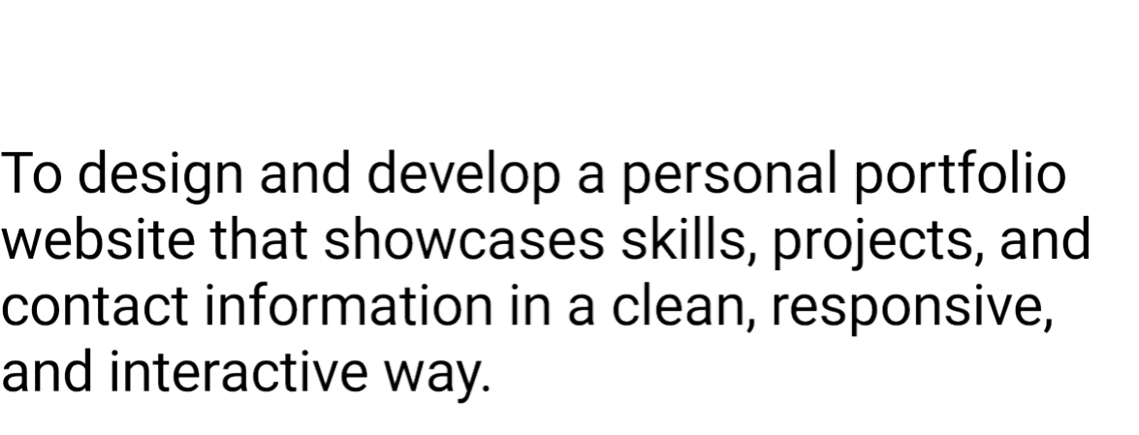

PROBLEM
STATEMENT
4

Slide 5
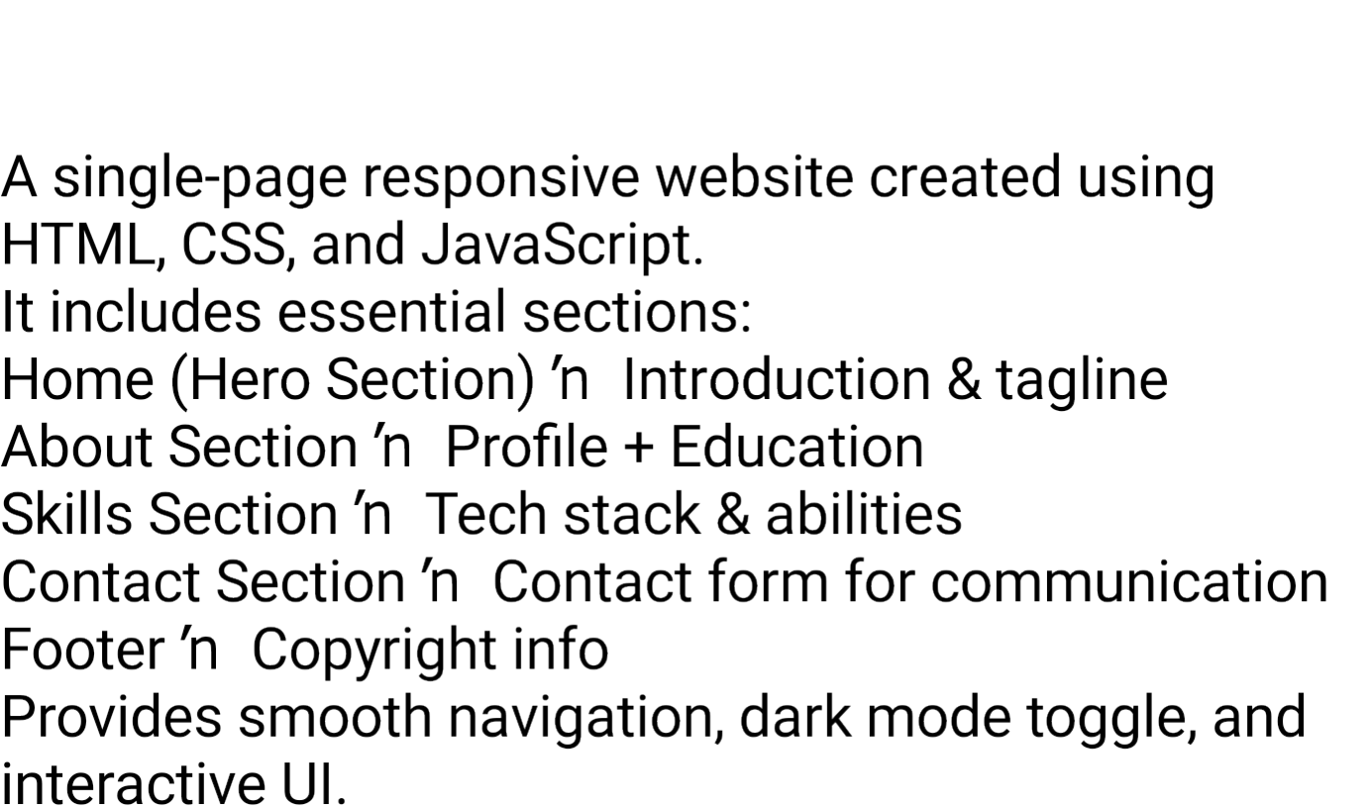

PROJECT OVERVIEW
5

Slide 6
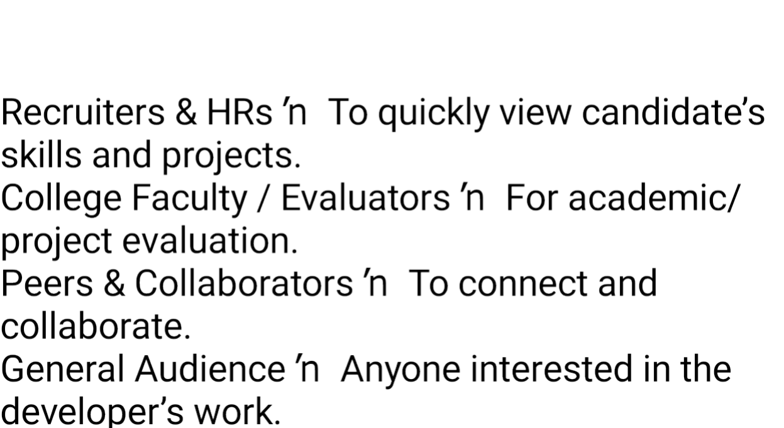

WHO ARE THE END USERS?
6

Slide 7
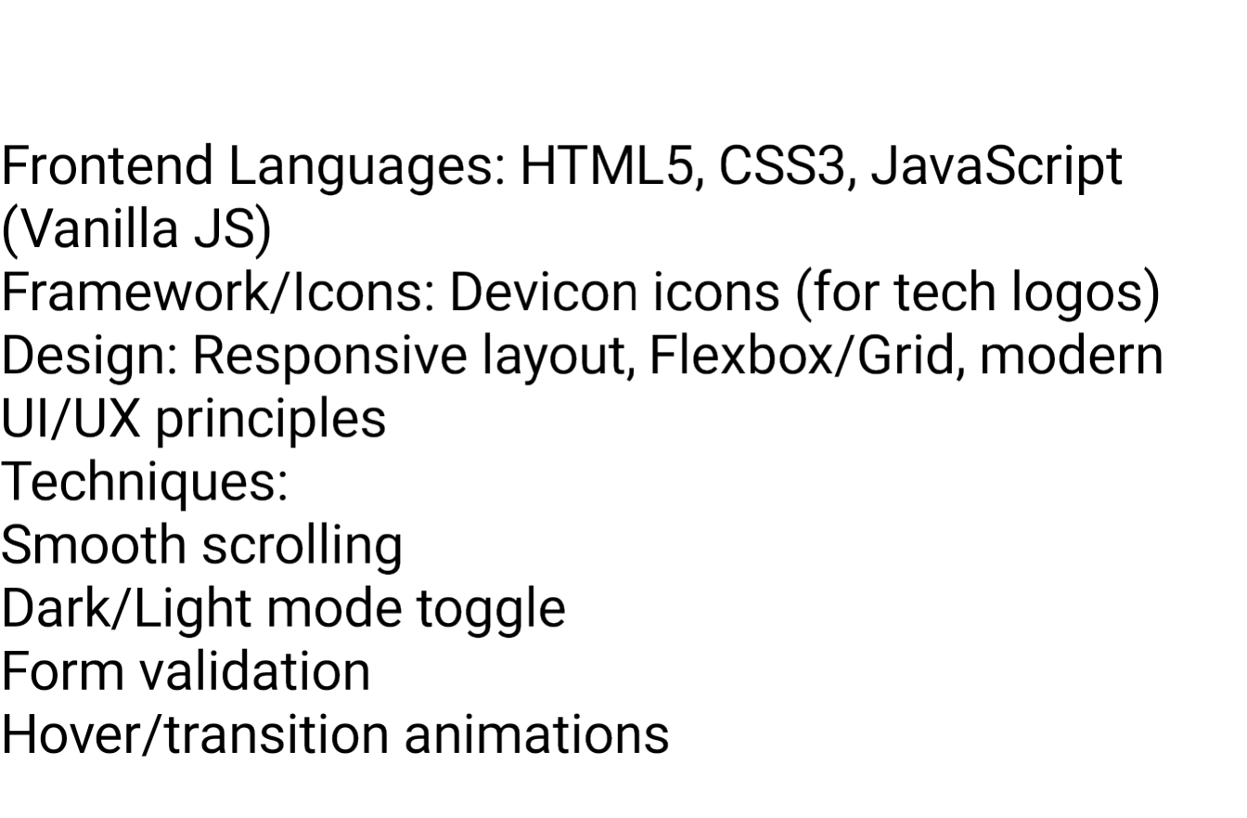

TOOLS AND TECHNIQUES
7

Slide 8
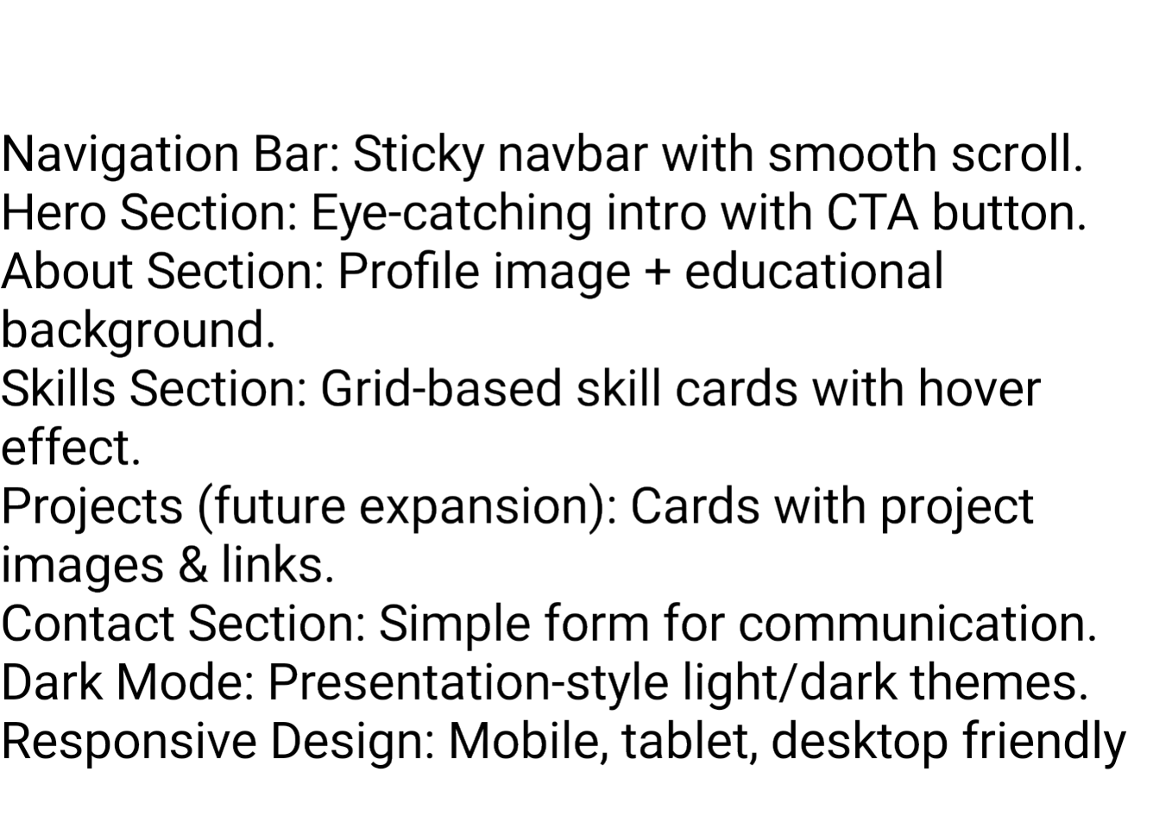
POTFOLIO DESIGN AND LAYOUT
8

Slide 9
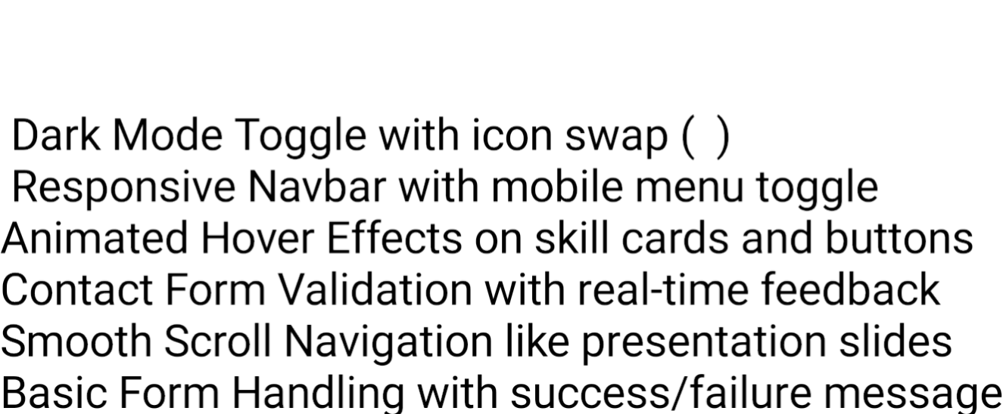
FEATURES AND FUNCTIONALITY

Slide 10

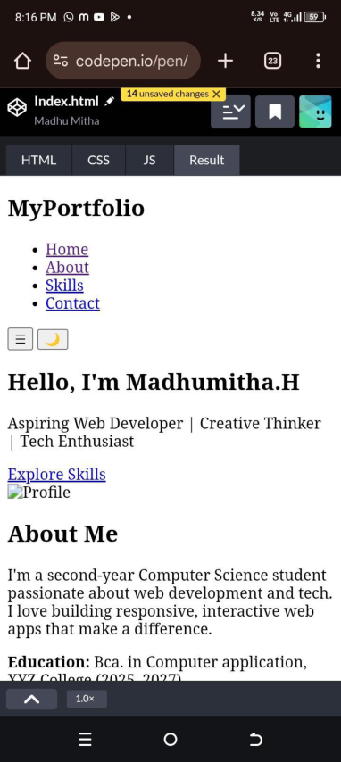
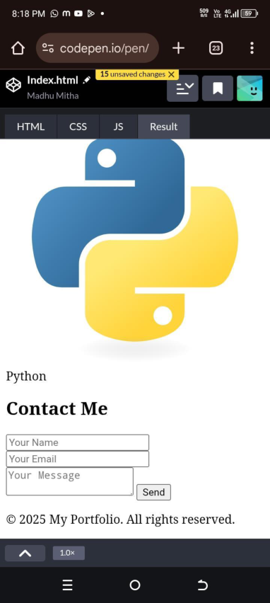
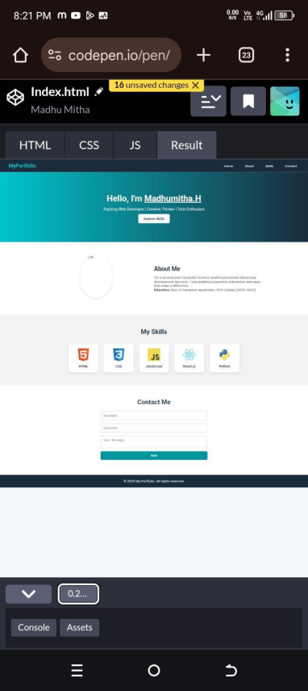


RESULTS AND SCREENSHOTS
3/21/2024AnnualReview
10

Slide 11
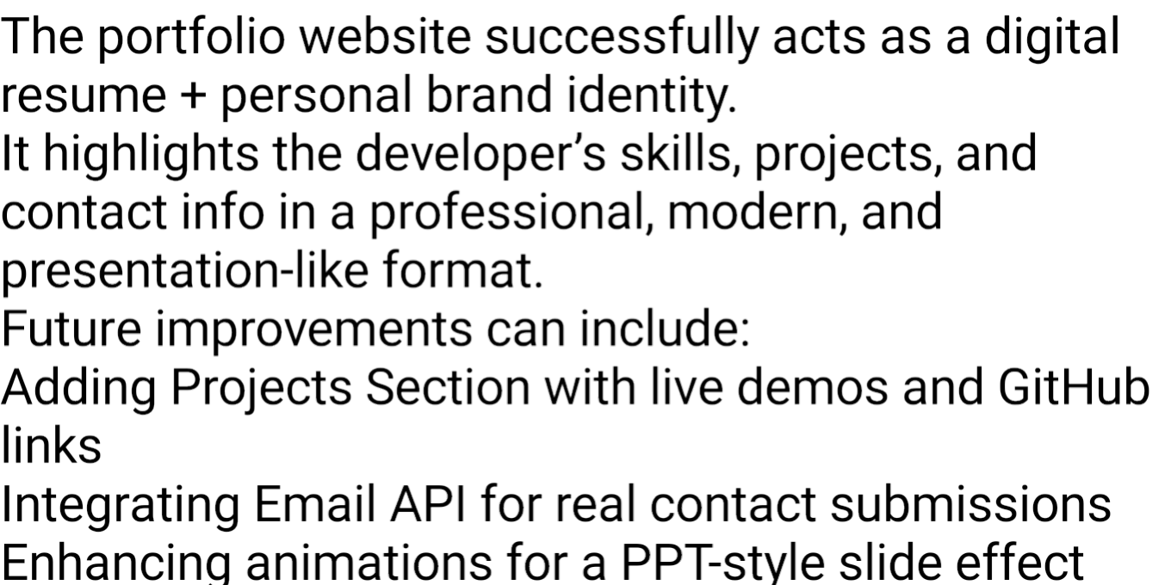
CONCLUSION
11

Slide 12
GitHub link
https://github.com/astvu346m24331/Madhumitha.git

