Slide 1

A Referral Program: Give $10, Get $10.

Slide 2
Buybackboss.com is a recommerce website for used and damaged iPhones.
Owner, Jack Wight, is a recent Marketing graduate from the W. P. Carey School of Business. In 2014, Wight was named one of Arizona’s “Top 35 Entrepreneurs Under 35,” by Arizona Economy.
Currently, Buyback Boss is competing with other popular recommerce sites such as:
Gazelle
iCracked
uSell
And more!
These popular recommerce sites are all competing for site traffic using pay-per-click marketing, search engine optimization, and incentive-based referral programs.
Notes:
Kyle S.

Slide 3
Many off-the-shelf referral programs, such as FriendBuy or Get Ambassador, require the user to log in and save information.
Buyback Boss is built to offer a fast and easy recommerce solution – requiring the users to log in would be detrimental to the business as most competitors do not require any login information.
Our team will create a comprehensive referral program to increase site traffic through the use of customer-to-customer marketing. The referral program will also give the business a personal touch by persuading customers who may be skeptical about selling their phone online with their own friends’ testimonials.
Notes:
Mahan S.

Slide 4
The client’s needs:
A functional referral system that does not require a user login.
A means for customers to share each purchase on Facebook, Twitter, and other social media outlets.
Branding that is consistent with the current website.
The client’s wants:
An automatic email sent to customers when their referral code is used.
A clickable link which points to his site with the referral code already attached to the order form.
An option for customers to become “ambassadors” for the company (i.e., “We will send you referral cards to give to your friends!”)
Bulk payment processing for referral cash
A back-end solution to analyze the ROI for the referral program (i.e., what percent of customers refer? On average how many customers does each person refer?)
Notes:
Jon N.

Slide 5
High-Level Tasks:
Examine existing application infrastructure.
Design optimal referral program from customer’s point-of-view.
Integrate optimal referral program with current infrastructure.
During phone sale to Buyback Boss:
Read and validate an inputted referral code.
NOTE: A valid referral code is one that exists in the database and is not the customer’s own referral code.
Allocate $10 to each order with a valid referral code.
Allocate $10 to the referrer’s account.
Contact referrer to have them validate form of payment and address.
Disburse payment to referrer after confirmation of information.
NOTE: Possible development for bulk payments, i.e., allow users to collect multiple payments and choose when to redeem rather than disburse $10 each time.
After a phone sale to Buyback Boss:
Check to see if customer has a referral link.
Read or generate referral link for customer.
Display order confirmation screen.
Display pop-up explaining referral program and asking user to share referral link with friends.
Depending on user-input, automatically share to Facebook, Twitter, Email, or other social media.
Notes:
Josh M.

Slide 6
Design Mockups
Notes:
Carrie D.

Slide 7
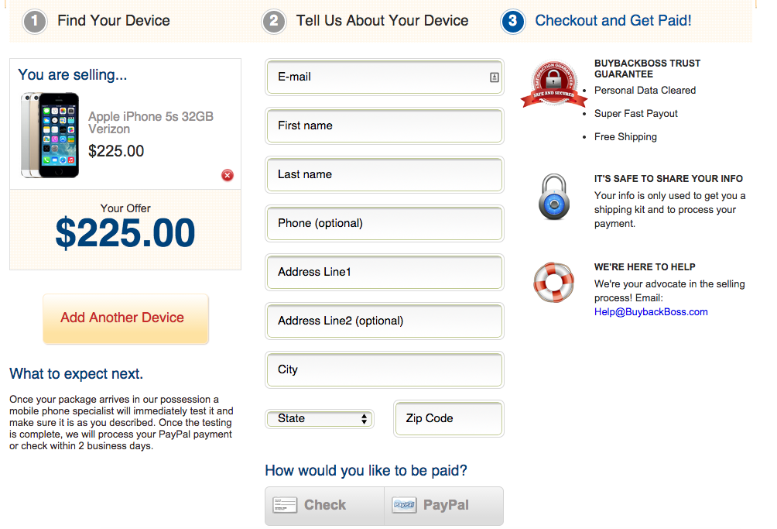
Notes:
Original Order Form
Carrie D.

Slide 8
Enter your referral code here!
No referral code? – Learn more about the program
after checkout! Earn cash for referring your friends!
Referral Code
Notes:
New Order Form

Slide 9
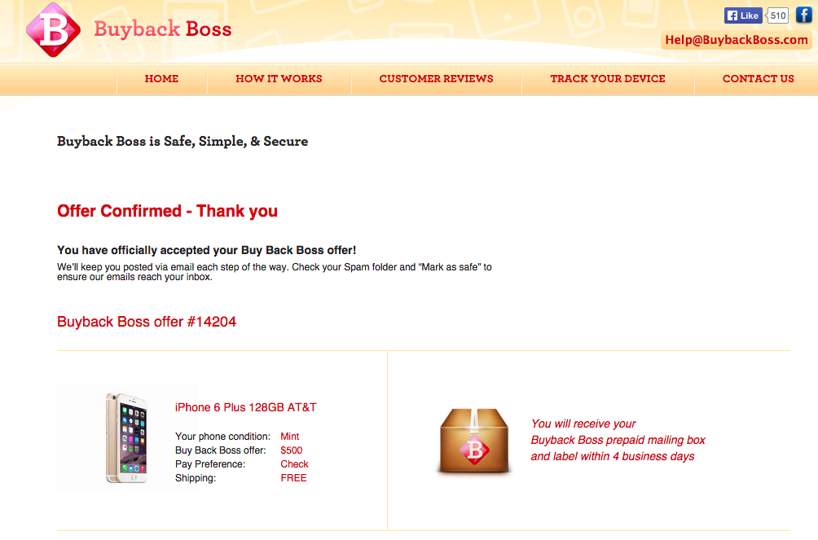
Notes:
Original Order Confirmation

Slide 10
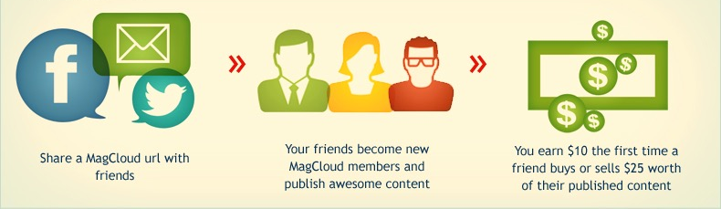

A Referral Program: Give $10, Get $10.
Share your personalized referral code with friends
Your friends sell their devices to Buyback Boss
Your friends get $10 toward their device sale, and we will send you an email with a link to claim your $10 cash!
Add a message….
Just sold my iPhone to Buyback Boss!
www.buybackboss.com
Sold my phone to Buyback Boss and got an awesome price for it! You can go on their site and get an instant free quote to sell yours. Use my code bbb10923 and get $10 extra toward your phone sale!
OR USE THIS CODE WITH FRIENDS:
bbb10293
Notes:
Updated Order Confirmation
Carrie D.

