Slide 1
Codename: Unstoppable T-Rex Initial Application Mock-up
Bryan Wegener, Chris Slater, Matt Babasick,
Ryan McGinn, & Bryan Fletcher

Slide 2
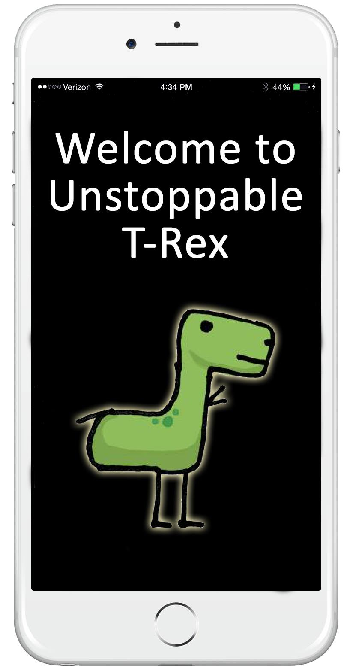
Welcome Screen

Slide 3
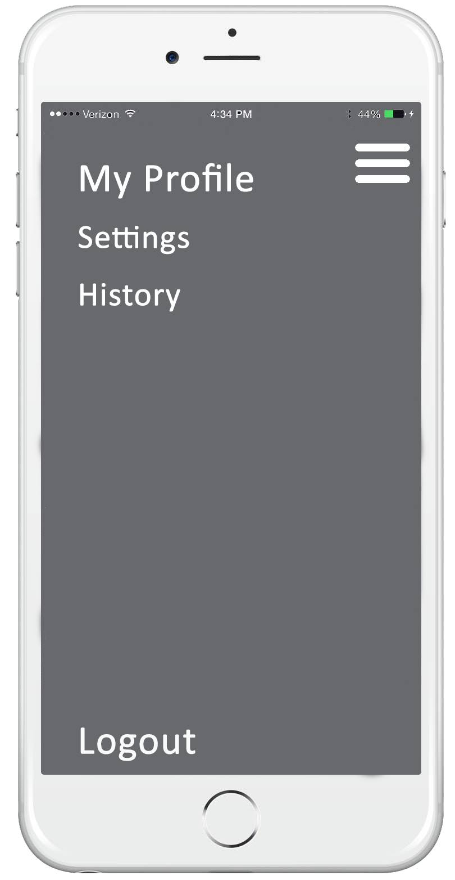
Menu

Slide 4
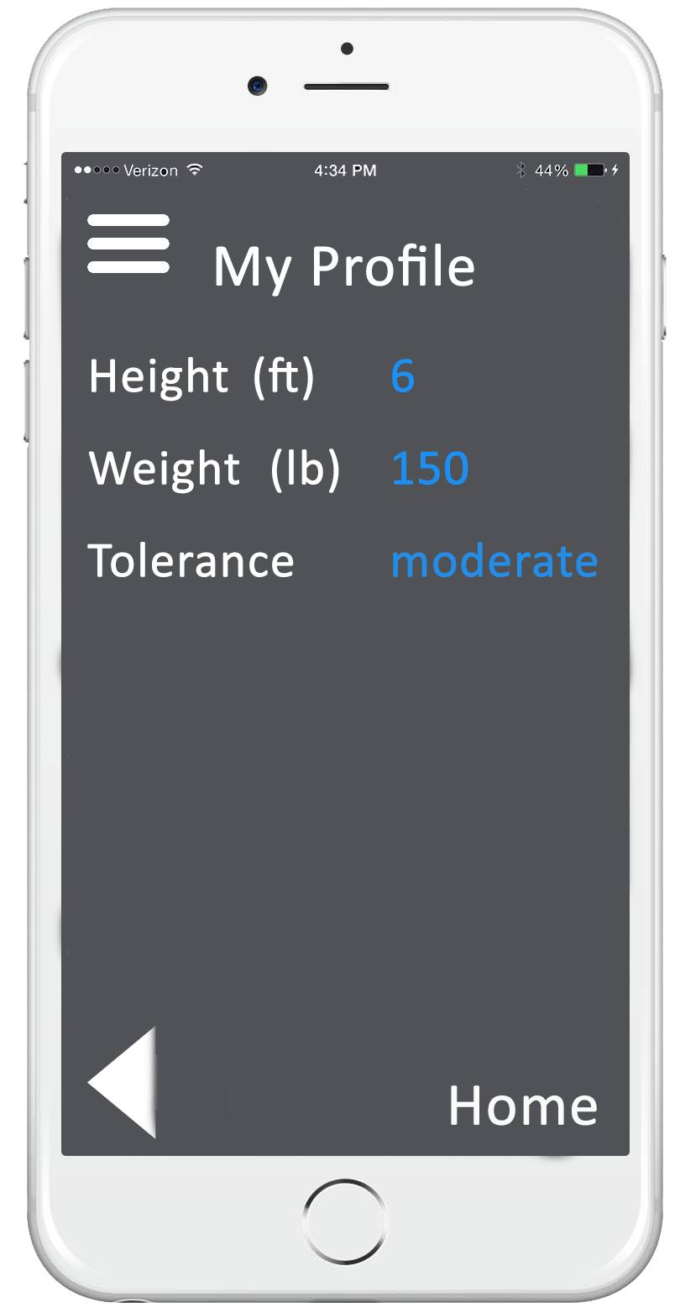
My Profile

Slide 5
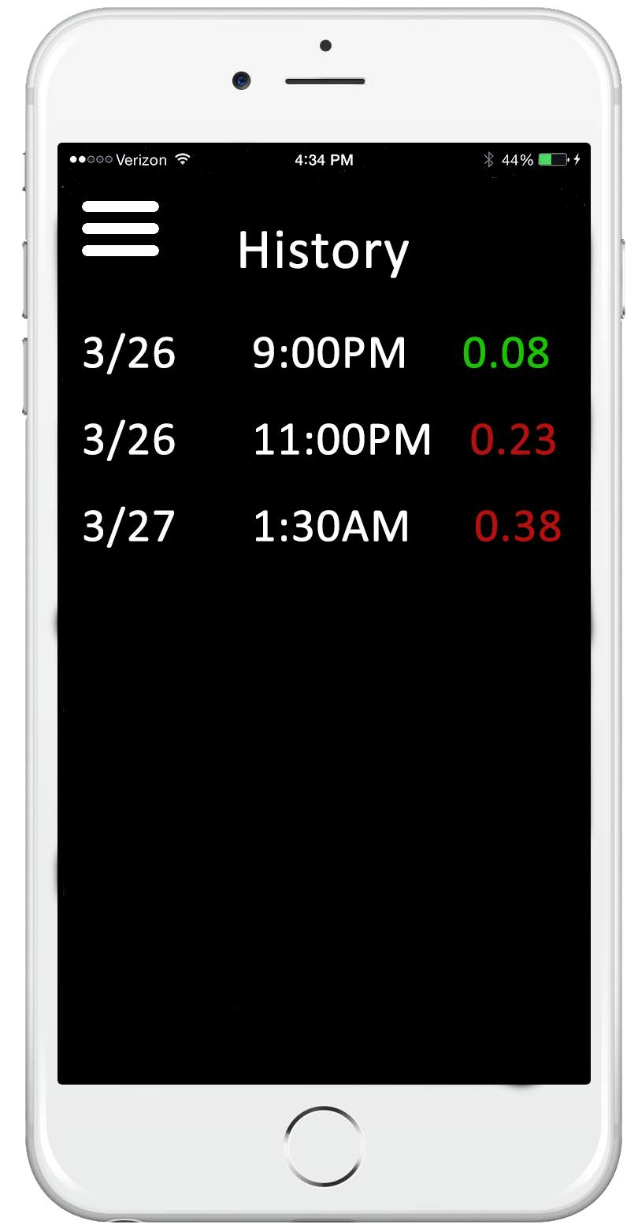
History

Slide 6
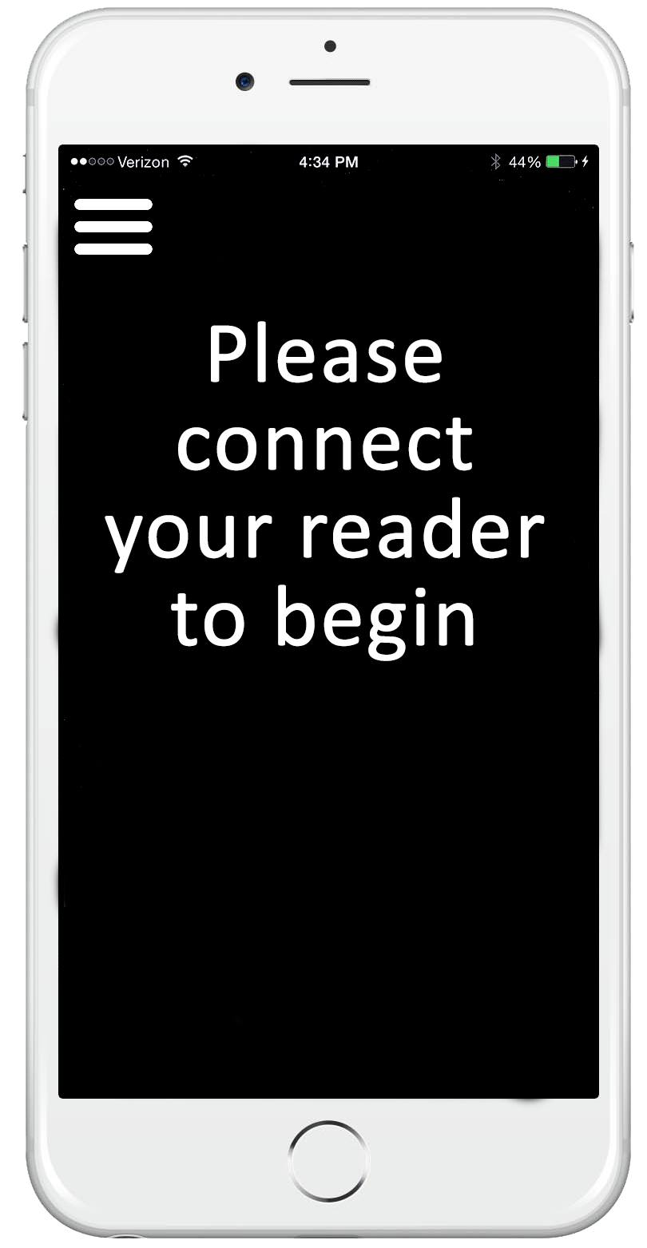
Connect BAC Reader

Slide 7
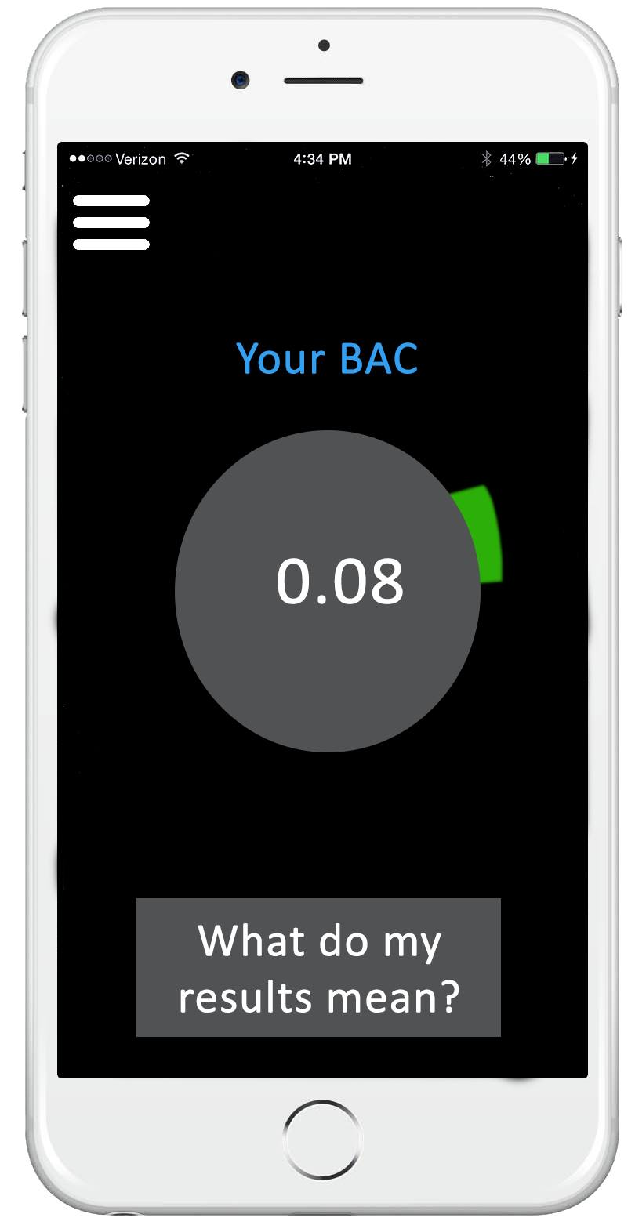
Legal BAC Level

Slide 8
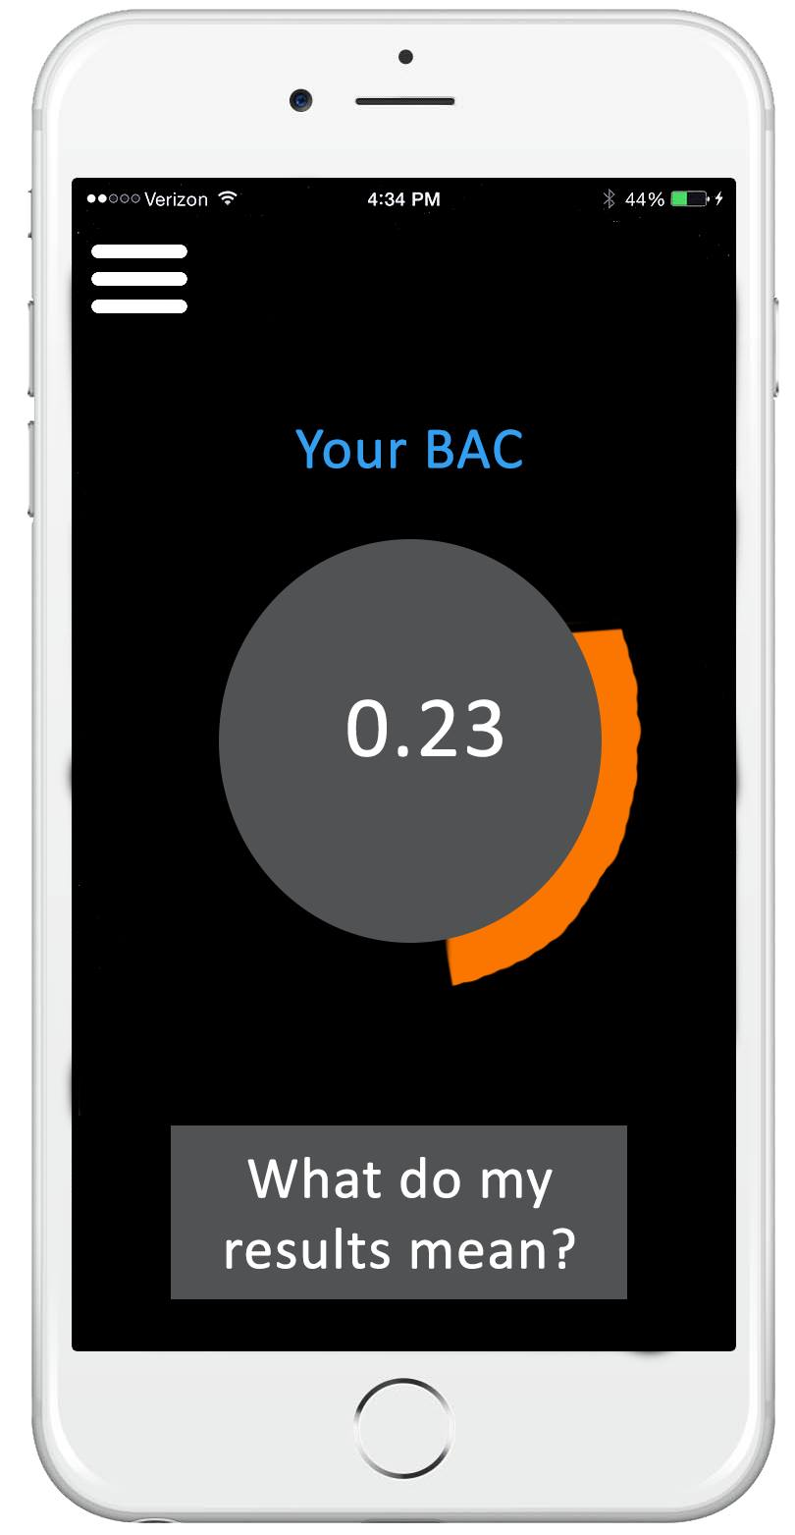
Over-the-limit BAC Level

Slide 9
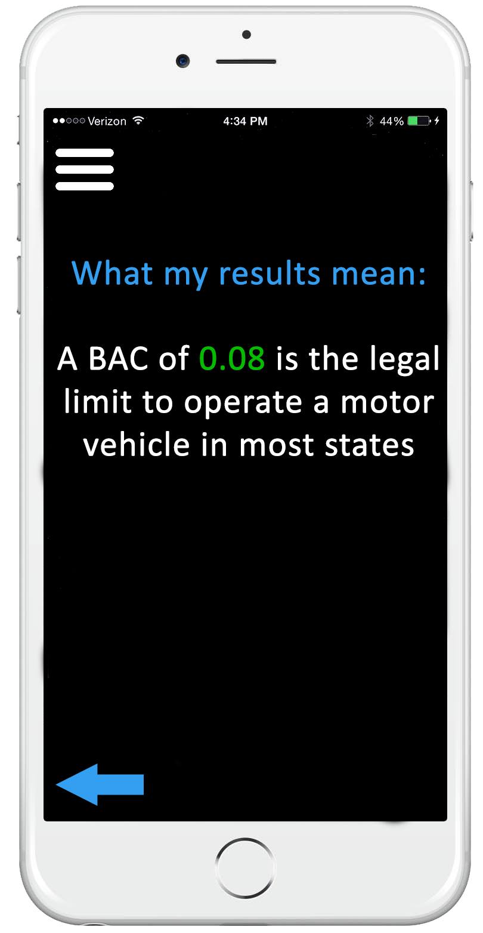
Results Explanation

