Slide 1
Codename: Unstoppable T-Rex Initial Survey Results
Bryan Wegener, chris slater, matt babasick, ryan mcginn, & bryan fletcher

Slide 2
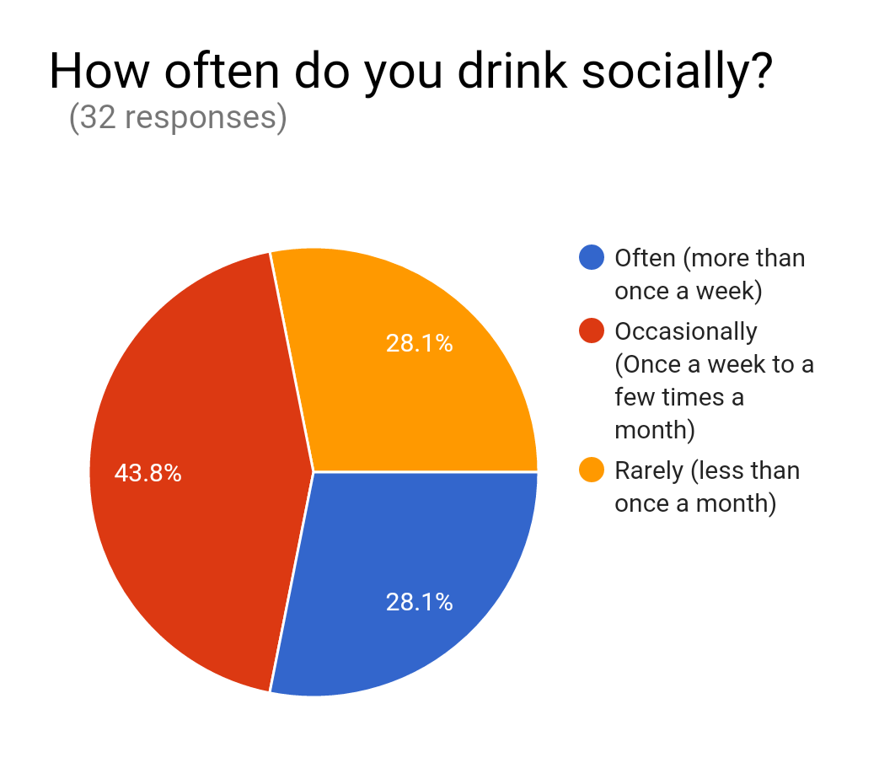
Customer Background

Slide 3
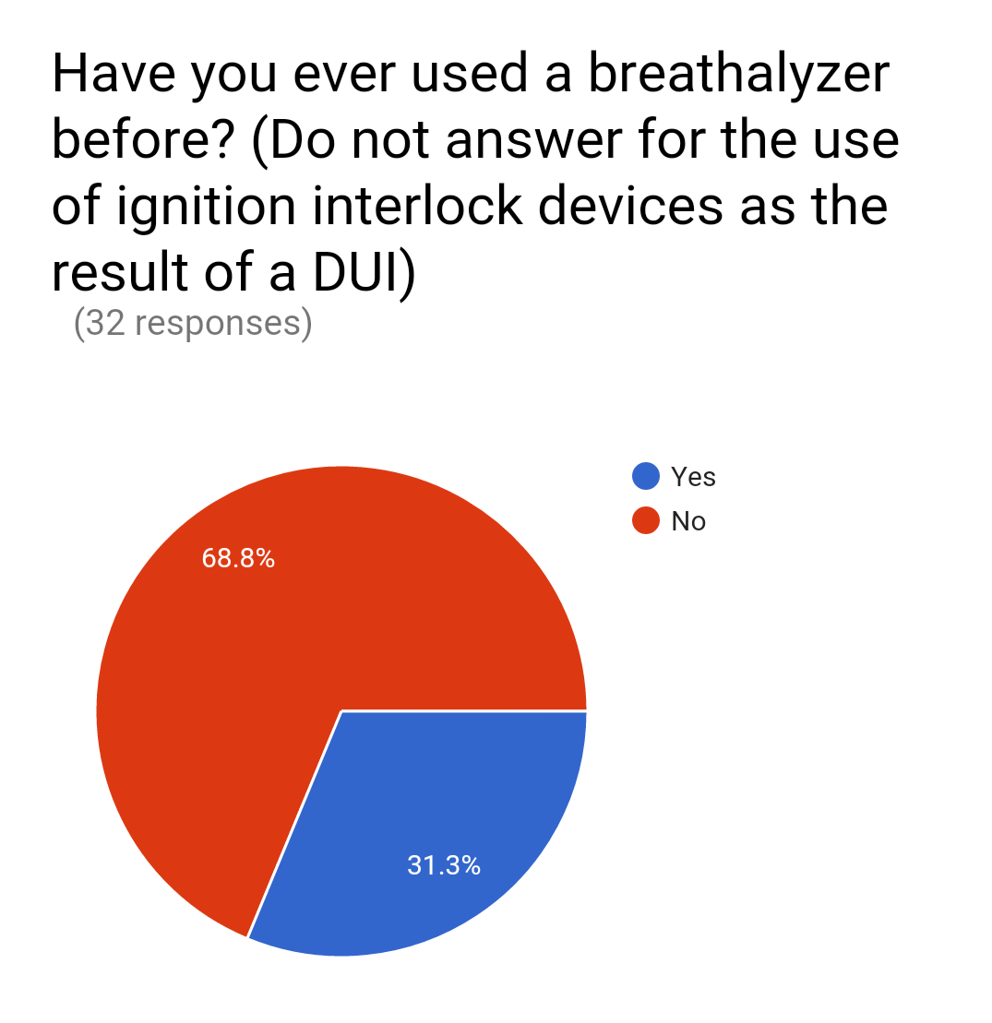
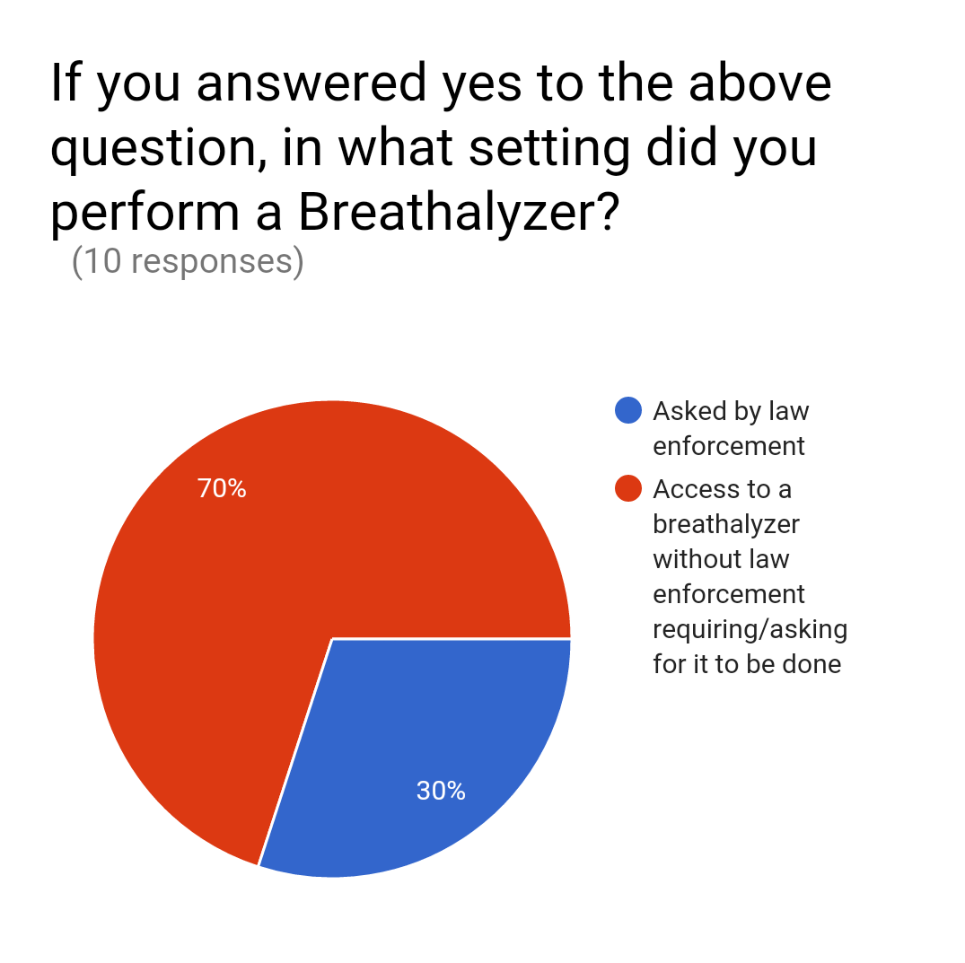
Previous Breathalyzer Use

Slide 4
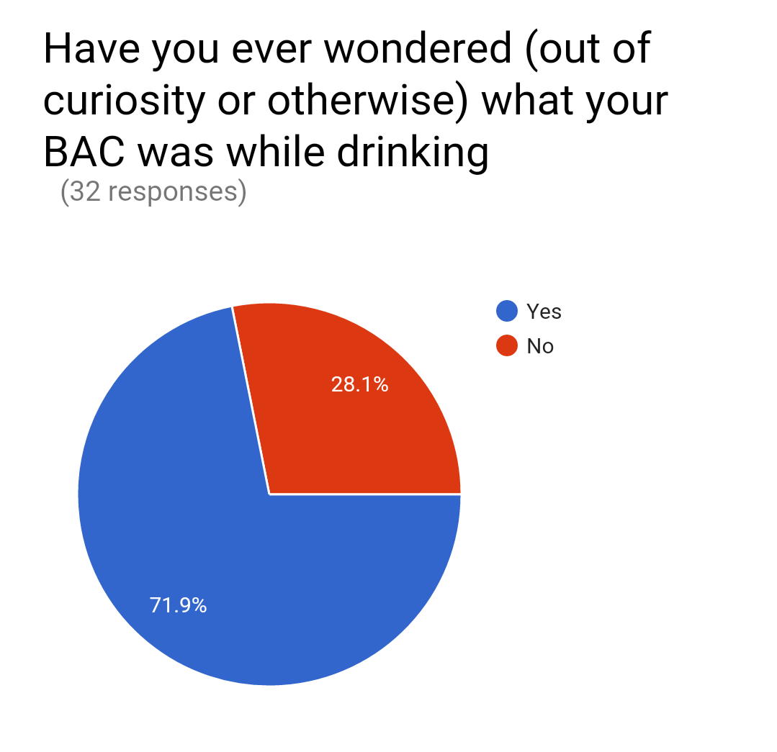
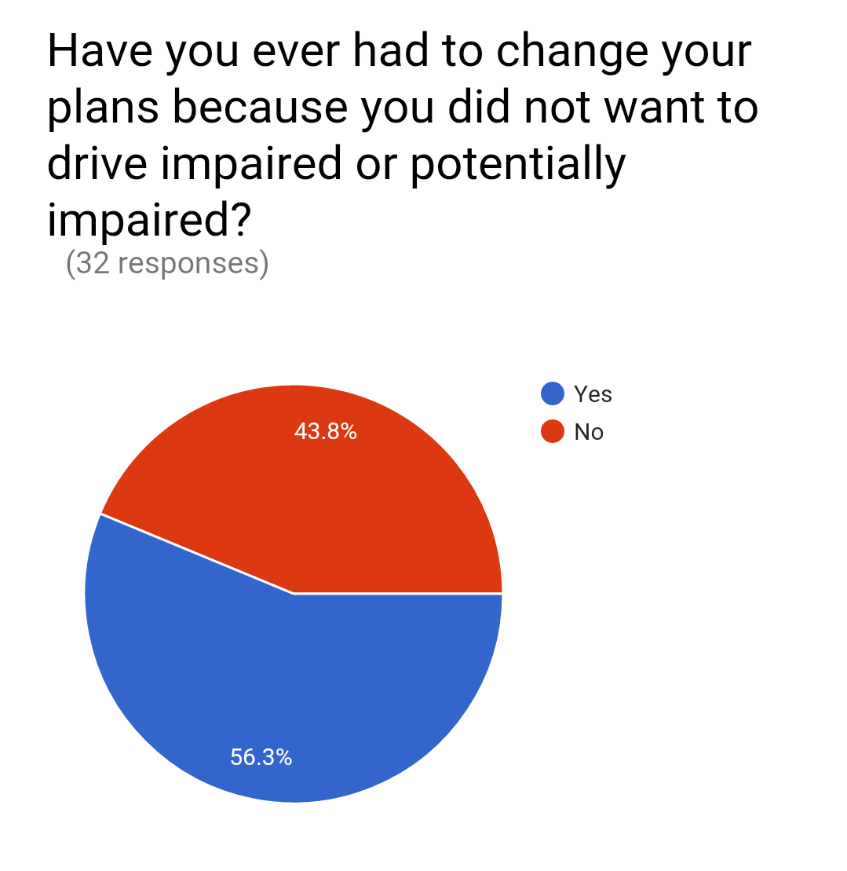
Customer Story

Slide 5
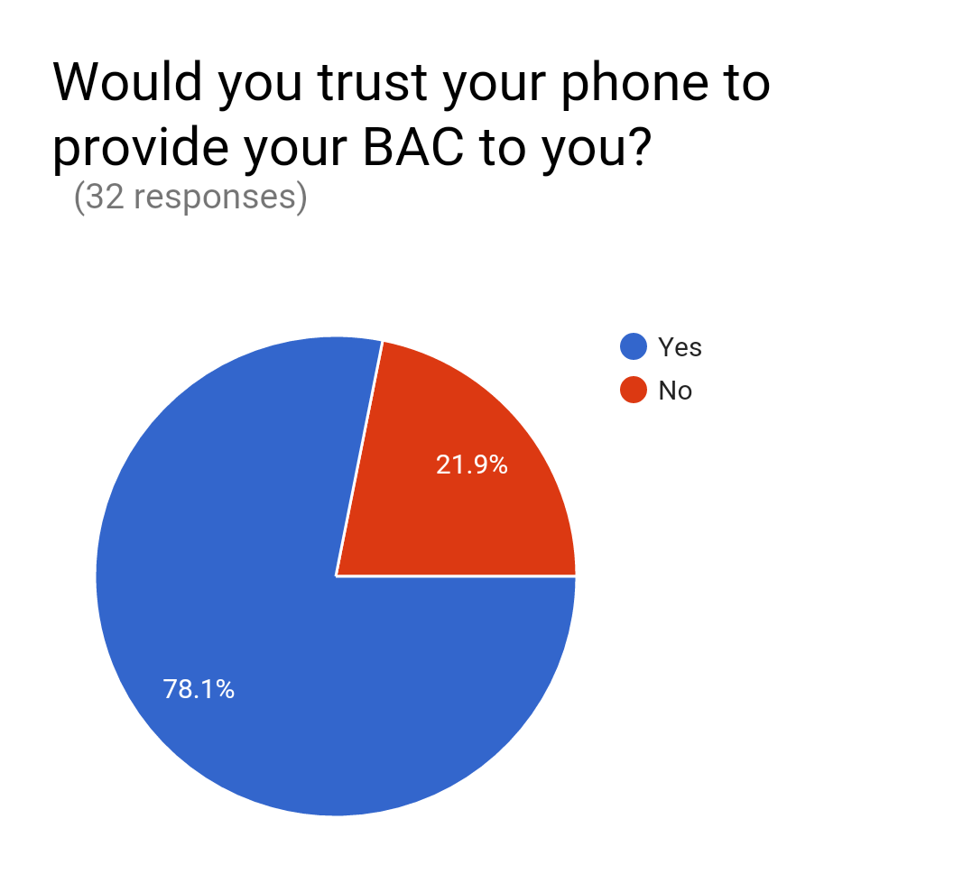
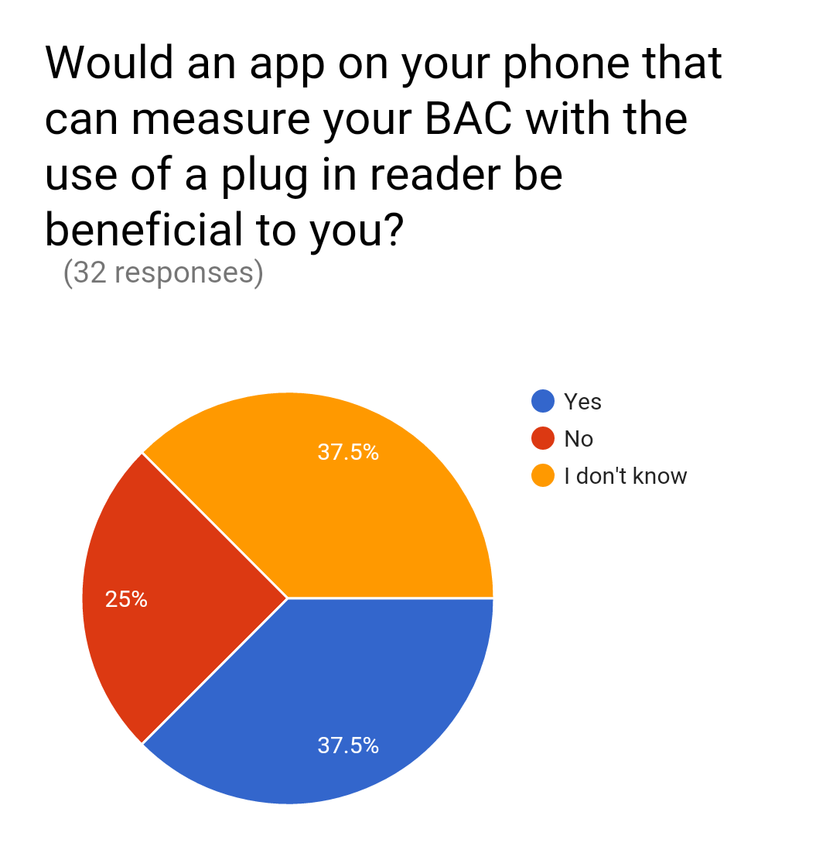
Likelihood to Use our Application

