Slide 1
FriendZone

Slide 2
FriendZone What we offer
While attending college, it can be difficult to find friends with similar interest. With the busy day-to-day of classes, homework, meetings, and work the FriendZone application can bring people together. FriendZone is a mobile application that will help ASU students find people with similar interests and create friendships through social activities

Slide 3
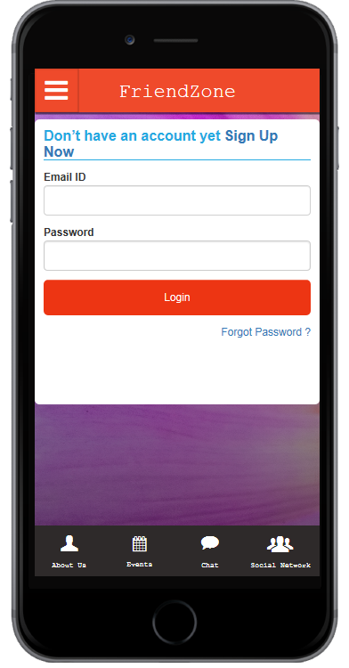
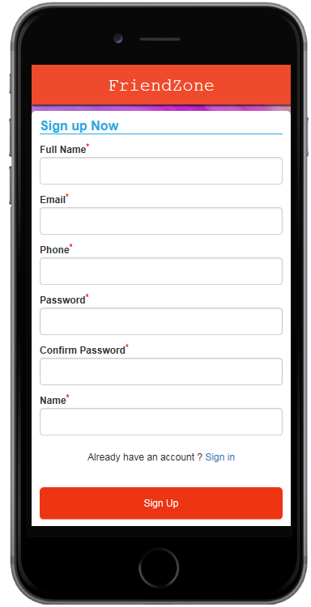

Slide 4
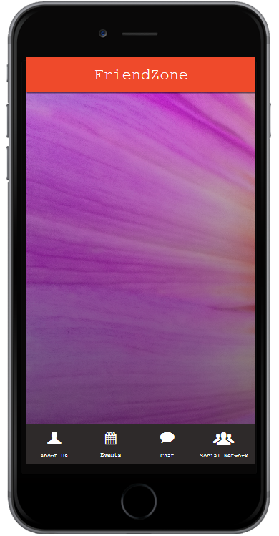

Activities
Bowling
Bowling
Sudoku
Create An Event
Join An Event
Coloring
Whittling

Slide 5
Metrics
We will use 2 metrics:
The % of surveyed users who sign up for our service.
The % of people who found an activity in our current list of activities that they would choose to join.
March 31, 2016, Baseline Measurement:
The % of survey users who signed up for our service = 0%.
The % of people who found an activity = N/A
April 7, 2016, Measurement:
The % of survey users who signed up for our service = 20%.
The % of people who found an activity = N/A

