Slide 1
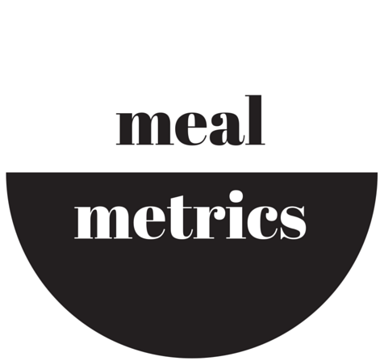
mealmetrics
…Helping you find a perfect meal solution fast!
Rozaliya Everstova Michael Denis Joel Sands Natalie Lowell

Slide 2
What is it?
Look up meals in restaurants nearby based on nutritional values
Compare nutrition of selected meals
Stay on track of set nutritional targets
Quick, easy way to decide what restaurant and meal to choose!

Slide 3
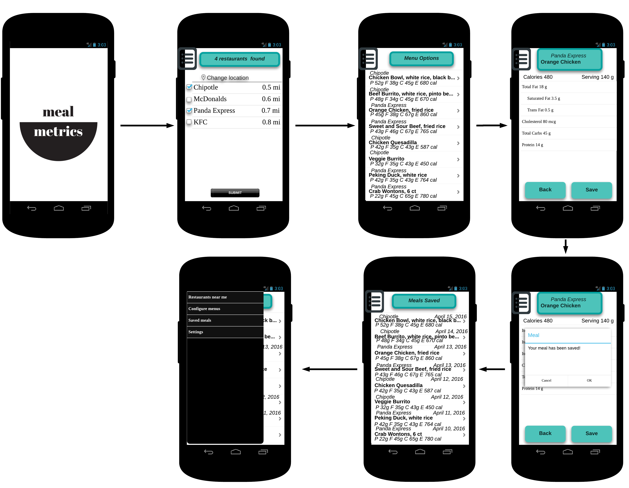
Mock Ups
New name, new logo
Created digital mock-ups,
using LucidChart
Mobile prototype on Pop for demonstration

Slide 4
Improved website
Changed website to contain new logo and new name
Added new mock-up screen
Added a note to address email privacy issues

Slide 5
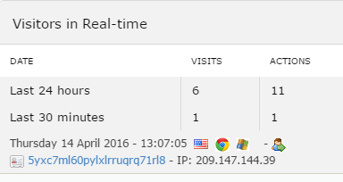
Results
2 new users
1 user shared using the links

Slide 6
Plans to improve
Improve prototype based on user feedback

