Slide 1

menumetrics
Rozalya
Michael
Joel
Natalie

Slide 2
What is it?
Look up quick food facts based on restaurants in your location
Test with Chipotle
Quick, easy!

Slide 3
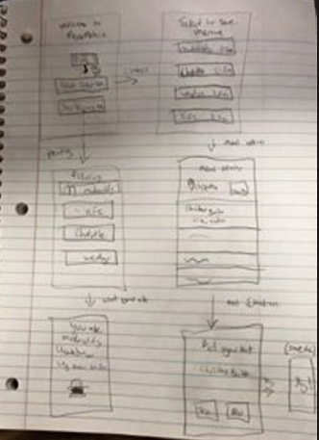
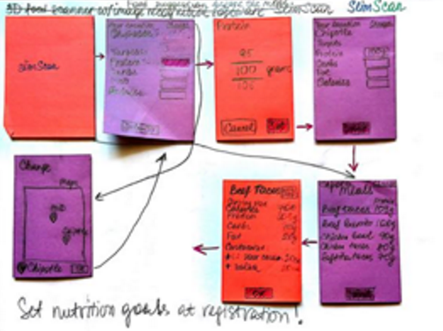
Mock Ups

Slide 4
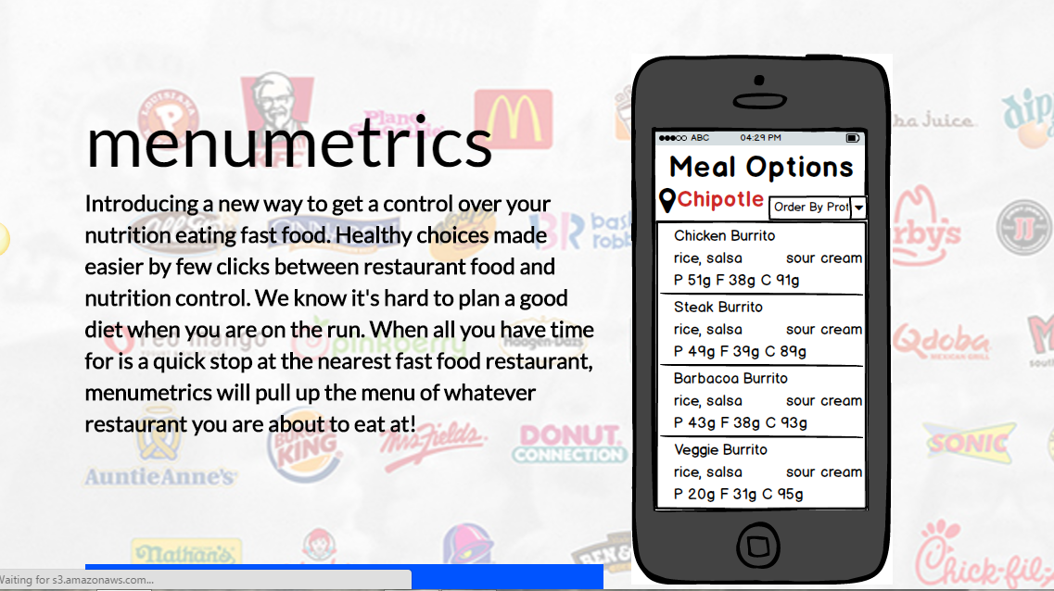
Webpage
Email Sign-up
Share on social media
http://menumetrics.launchrock.com

Slide 6
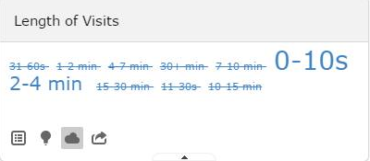
Results
Website Visits- 30%
Website Shares-0%

Slide 7

Facebook
Logo
(under construction)

Slide 8
Plans to Improve
Starting Feedback for webpage(readability, completeness, clarity, availability to smart phones)
Facebook (link to webpage, updates)
Create mobile phone friendly webpage

