Slide 1
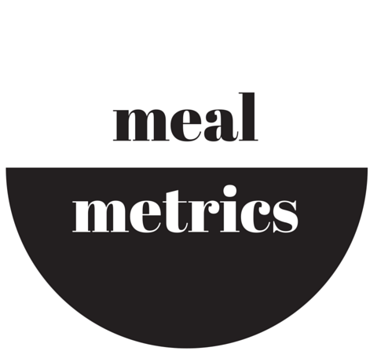
mealmetrics
…Helping you find a perfect meal solution fast!
Rozaliya Everstova Michael Denis Joel Sands Natalie Lowell

Slide 2
What is it?
Look up meals in restaurants nearby based on nutritional values
Compare nutrition of selected meals
Stay on track of set nutritional targets
Quick, easy way to decide what restaurant and meal to choose!

Slide 3
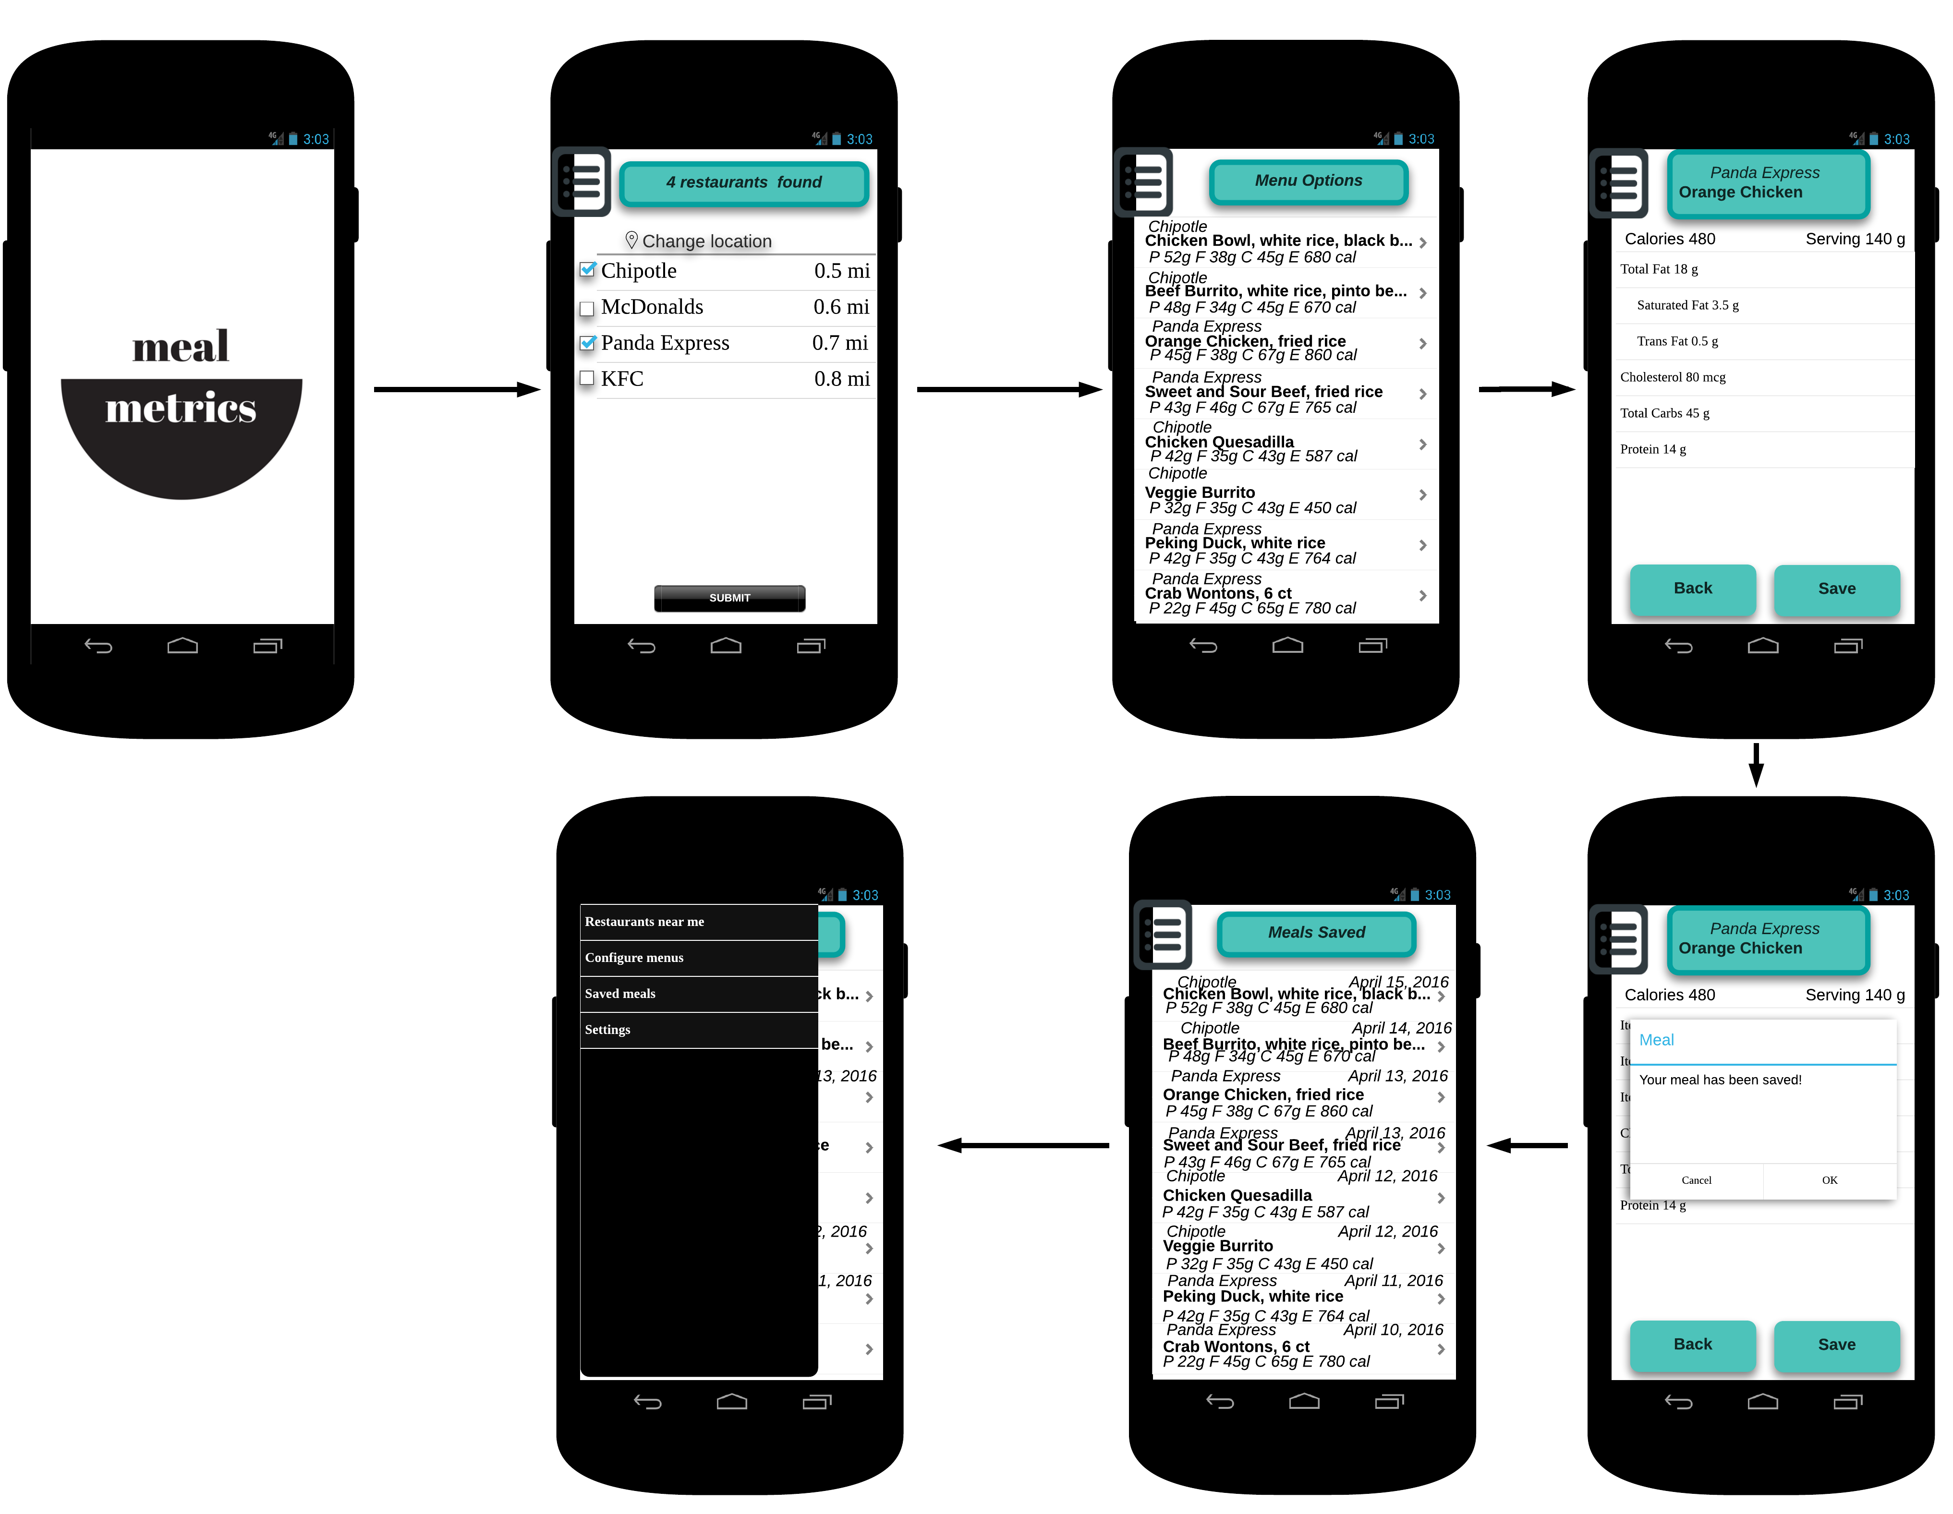
Mock-ups
New name, new logo
Created digital mock-ups,
using LucidChart
Mobile prototype on Pop for demonstration

Slide 4
Improved website
Changed website to contain new logo and new name
Added new mock-up screen
Added a note to address email privacy issues

Slide 5
User feedback
40 in-person interviews
40% are interested to use the app
5% are slightly interested
17 unique visitors
7 signups = 41% of visitors
0 user shared using the links
Add option to sort meals by sugar, price
Add option to sort restaurants by what is open
Add report where nutrition data is analyzed, calories eaten as % of target
Add option to add friend
Make logo more colorful

Slide 6
Plans to improve
Improve prototype based on user feedback
Make logo more colorful
Add sorting options
Add a page to analyze nutrition data
Add a friend

