Slide 1

CIS 440 Capstone Project
Circle K Stores Inc.
Presented by: The Notifier Team
(Daniel, Frank, Haley, Henry, Jesus )
POC: Kevin Reed: Senior Systems Analyst

Slide 2
The Notifier!
Primary Features:
Change Control
View Tickets
Approve/Disapprove tickets
Ease of Access

Slide 3
How to receive Notifier on your phone?
Download the app titled “Intel App Preview” from respective marketplace for Android, IOS, etc.
Login with the following credentials after installation is complete: username: haley0808 password: cis440_ck
Click on server apps, then click on CircleK.
Congratulations! You have arrived at the login screen. Login with your CircleK credentials.
Access Change control, ticket history, and many other features. Incident reporting is a feature we plan on adding in the near future!

Slide 4
Method 2 for Accessing the Application
Contact one of the following people for a secure email download link:
2. Enable installation from unknown sources temporarily for your phone, then proceed to install onto your phone.
3. Enjoy change control from your mobile device after logging in with company credentials.
**This method is a work in progress with some minor bugs. The latter will be fixed in an upcoming patch to our application.
Huong Hong (hmhong@asu.edu) --Frank fan (ffan2@asu.edu) --Henry Yee (hyee1@asu.edu) --Daniel Mercer (dtmercer@asu.edu) --Jesus Carrillo (jesusjv641@gmail.com)

Slide 5
Current Work in Progress
https://api.circlek.com?pending and https://api.circlek.com?fetch
Kevin is working on giving us the API’s and other necessary credentials for accessing company databases.
Incident Reporting is another feature we are planning to add in a future patch.

Slide 6
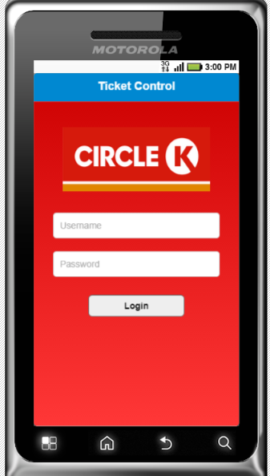
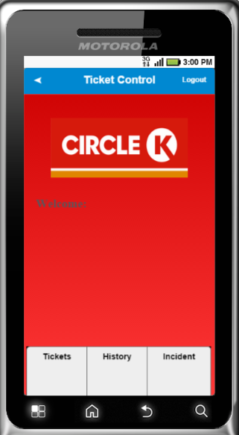
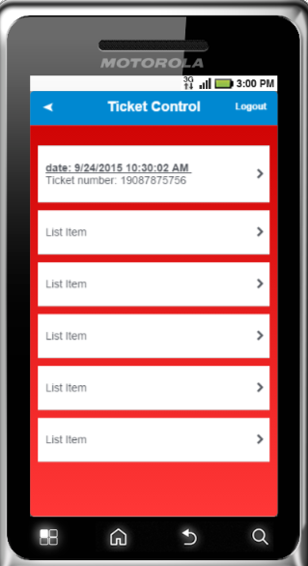
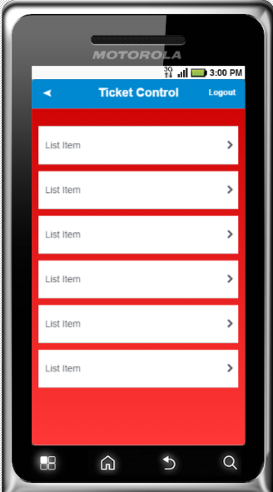
The Demo!

Slide 7

Questions?

Slide 8

Thank You!

