Slide 1

Sphere

Slide 2
The Team
Han Kim
❍
Catherine Phan
❍
Don Reese
❍
Michael Spitzkoff
Sphere

Slide 3
The Project
Create a new website for ASU’s DISC that is accessible, extensible and more easily maintainable

Slide 4
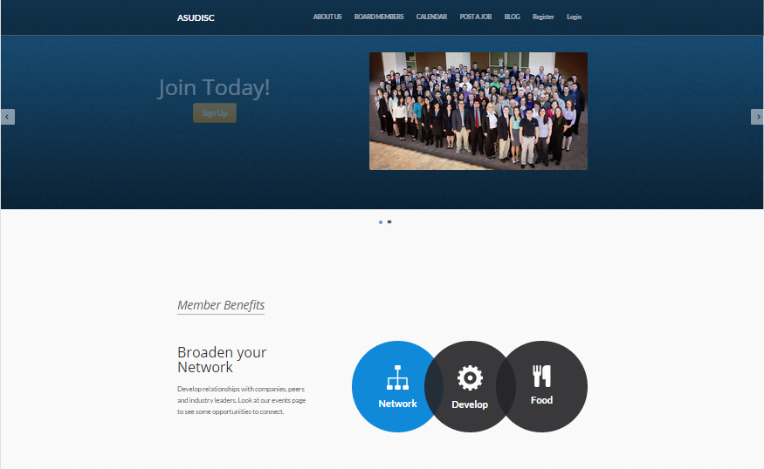
The Project – Old
Created by alumni member and based on Ruby on Rails:
Not easily maintainable.
Not easily extensible.
Not very accessible.

Slide 5
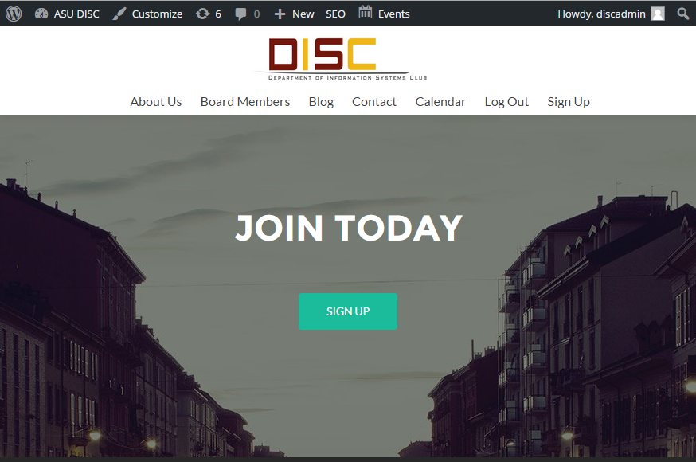
The Project – New
Based on WordPress:
Industry-Standard PHP, MySQL, HTML, CSS
Easy to Maintain!
Easy to Extend!
Very Accessible!

Slide 6
WordPress Requirements - 1
How to get WordPress
Hosted by WordPress.com:
No muss, no fuss, with limitations
Hosted by an ISP:
No muss, no fuss, some limitations
Self-install on an ISP:
Some muss, some fuss, less imitations
Self-install on private server:
Some muss, some fuss, no limitations

Slide 7
WordPress Requirements - 2
WordPress’ Famous 5-minute Install
Download and unzip WordPress
Create a MySQL database
Upload WordPress Files
Run WordPress Install Script

Slide 8
WordPress Requirements - 3
The ‘Tech Stack’:
PHP version 5.6 or greater
MySQL version 5.5 or greater
Web server (Apache, Nginx, IIS)
That’s it!

Slide 9
Project Requirements
Member Registration/Login
Member/Event Database/Reports
Event Calendar/Attendance
Blog Roll/Social Media Connectivity
Photo Gallery
Future Resume/Job links and ???

Slide 10
Plugins Required:
SEO/Anti-BlogSPAM
Database Extension
Photo Gallery
Event Calendar
Facebook Connector
Cool Parallax-scrolling Theme!
(OK, this isn’t really a plugin, but it is cool!)

Slide 11
Backup / DR
Export function ➔XML File
Posts, Pages, Comments, Custom Fields, Terms, navigation Menus, Custom Posts
FTP/Zip Files
This gets all of the Plugins, Pictures, etc.
SQLDump the Database
Mostly covered in the XML Export, but handy to have

Slide 12
What’s Next?
Add New Functionality via more Plugins!
Resume/Job database
Alumni Networking/marketing
Change Themes!
Super Customizable
Sell Stuff!
Add a StoreFront/Cart
Almost Unlimited Potential!

Slide 13
Project
What’s Next?
WP Reqs
Sphere
Backup/DR
Project Reqs
Plugins

Slide 14
Thank You!
Sphere

