Slide 1
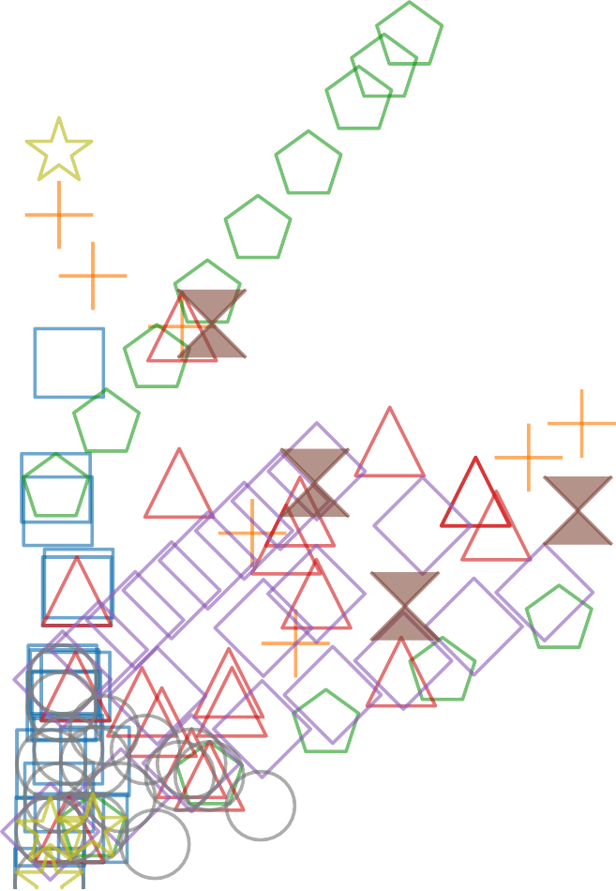
Proposed Approach
Simulated Annealing (DESTION'23) Bayesian Optimization (DESTION'23)
Random Search (DESTION'22) Genetic Algorithm (DESTION'22)
PG-DSE (ASP-DAC'23)
Discrete Search (DESTION'22) Lengler (DESTION'22) Portfolio (DESTION'22) Budget
Farm Size
120.0K
100.0K
80.0K
60.0K
40.0K
  (i)Insufficient Area Coverage
(ii) Sufficient Area Coverage
Total Cost in Thousands ($)
20.0K
Cluster
Cluster
0
300
600
900
0
3000 6000
9000
Payload(Kg)
Area coverage (m²)
(a)
(b)

