Slide 1
Open-Source Grid2Demand:
A tool for generating zone-to-zone travel demand based on grid zones
Mini-lessions through teaching dialog
Sevgi Erdogan,
Anjun Li,
Taehooie Kim,
Xuesong (Simon) Zhou

Slide 2


Inclusive Excellence
https://inclusion.asu.edu/

Slide 3
Part 1 Introduction to DTALite/NeXTA
1.1 Project Objective and Motivations
1.2 What NeXTA/DTALite Can Do
1.3 Open-source Free Software Package

Slide 4
Motivations
Adopting open network standard of GMNS
General Travel Network Format Specification is a product of Zephyr Foundation, which aims to advance the field through flexible and efficient support, education, guidance, encouragement, and incubation. Further details can be found in https://zephyrtransport.org/projects/2-network-standard-and-tools/
Integrated graphic user interface and analysis package
(1) Provide an open-source code base to enable transportation researchers and software developers to expand its range of capabilities to various traffic management application.
(2) Present results to other users by visualizing time-varying traffic flow dynamics and traveler route choice behavior in an integrated environment.
(3) Provide a free, educational tool for students to understand the complex decision-making process in transportation planning and optimization processes.

Slide 5
Motivations (II)
Our goals
Simplified data input from static traffic assignment
Use parallel computing capability, simplified routing and simulation
Open-source
Existing technical barriers: (based on DTA user survey, TRB network modeling committee, 2009)
Require too many input data: 47%
Take too long to run: 35%
Model is unclear: 35%
Visualization: Seeing is believing
Excel Tools: Start from basics

Slide 6
What DTALite/NeXTA Can Do
Open-source traffic simulation/modeling Data Hub
Integrated simulated and measured data management tools
Connection with Travel demand model, signal optimization tool (Synchro)
Large-scale dynamic traffic assignment
Typical network size: 2K~5K zones, 20K~50K links, 2~4 Million vehicles
Network scenario analysis
Rich outputs: various operational performance measures
Road pricing application: Consider time-dependent toll, Heterogeneous Value of times

Slide 7
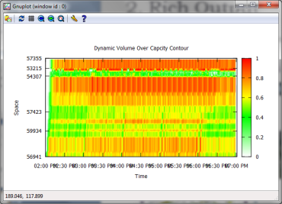
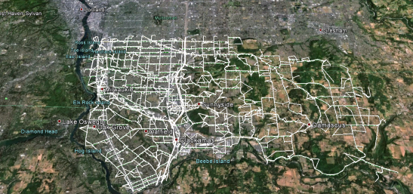
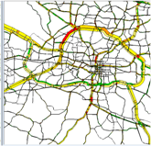
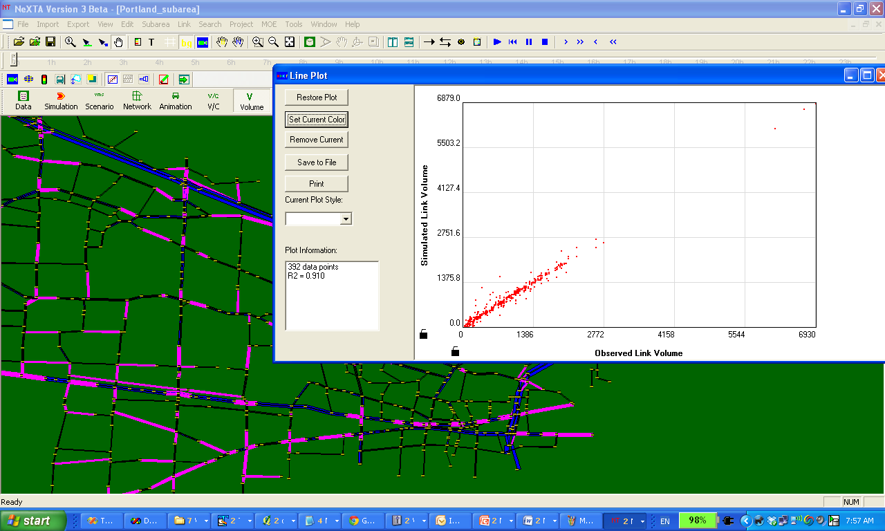

What NeXTA/DTALite Can Do
Rich Output
Other Visualization
Corridor-level VOC contour
Simulation vs. Observation Comparison
Q-GIS/OSM Maps
NeXTA
Large-scale Dynamic Traffic Assignment & Simulator

Slide 8
What NeXTA/DTALite Can Do
Integrated Modeling Practice
Current Practice Ad Hoc
With NeXTA Data Hub Systematic
Field Data
Land Use, Safety & Emissions Models
HCM & Signal Timing Models
Micro-simulation Models
Dynamic Traffic Assignment Models
Travel Demand Forecasting Models
Data Hub
Field Data
Land Use, Safety & Emissions Models
HCM & Signal Timing Models
Micro-simulation Models
Dynamic Traffic Assignment Models
Travel Demand Forecasting Models
NeXTA Data Hub

Slide 9
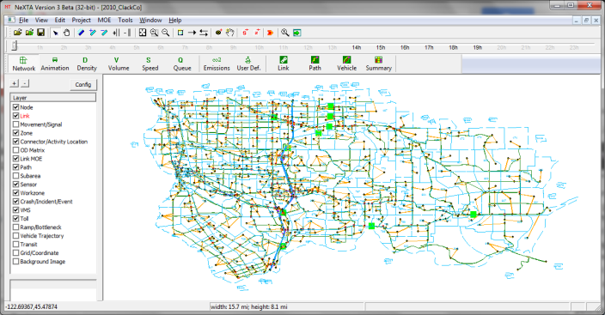
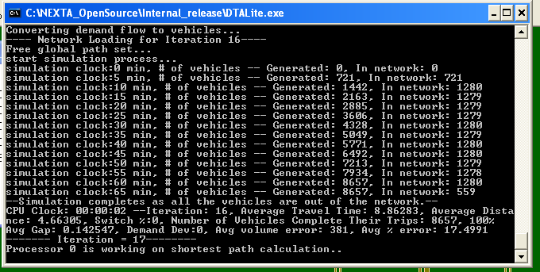
Open-source Free Software Package
NEXTA: front-end GUI (C++)
Version 0.5: GUI for TRANSIMS and DYNASMART
Version 0.9: GNU Open-source data hub
Import
Other regional planning models (TransCAD, VISSUM, Cube)
GIS shape files
Traffic volume, speed, GPS data, Google Public Transit Feed
Export
QQ-GIS
Prepare network and signal data
DTALite: Open-source computational engine (C++)
Light-weight and agent-based DTA
Built-in OD demand matrix estimation (ODME) program

Slide 10
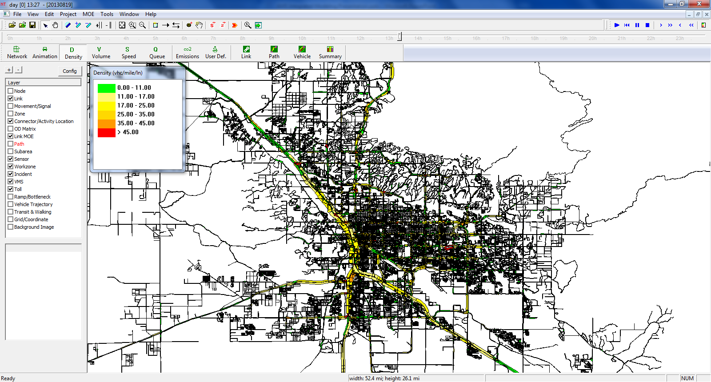
AMS Data Hub Software Prototype: NeXTA
Start with GIS with multiple transportation layers
1. node,
2. link,
3. agent,
4. trajectory,
5. signal timing.
Focus on data processing and visualization

Slide 11
Useful Materials
DTALite Software Release
https://github.com/xzhou99/dtalite_software_release
DTALite White paper
DTALite: A queue-based mesoscopic traffic simulator for fast model evaluation and calibration, by Zhou and Taylor, 2014
https://www.tandfonline.com/doi/full/10.1080/23311916.2014.961345
DTALite Source Codes
Python: https://github.com/asu-trans-ai-lab/DTALite
C++: https://github.com/xzhou99/dtalite_beta_test

Slide 12
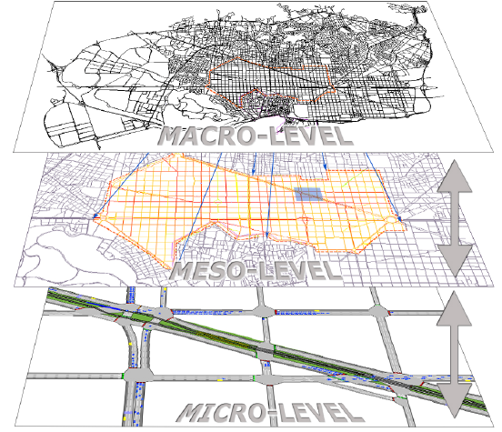
Mesoscopic Traffic Simulation

Slide 13
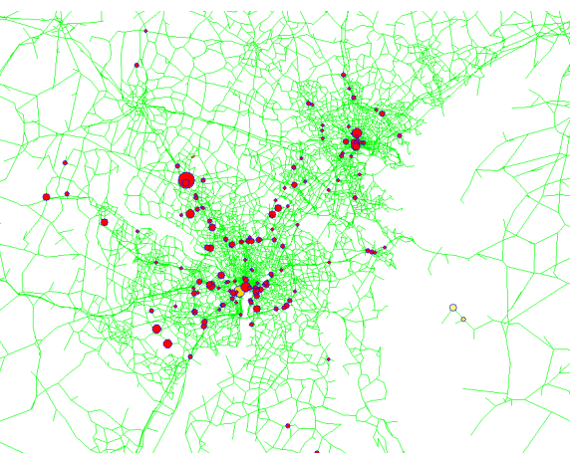
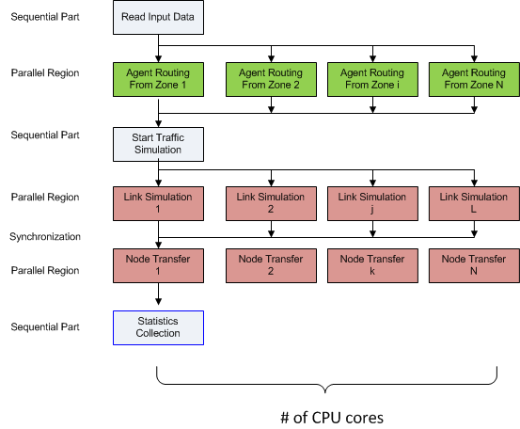
Computational Challenges
Shared memory-based parallel computing for agent-based path finding and mesoscopic traffic simulation (based on OpenMP)
Maryland State-wide model:
20 K nodes, 47K links, 3,000 zones, 18 M agents
CPU time: 30 min per UE iteration on a 20-core workstation with 194 GB RAM

Slide 14
Traffic Flow Theoretical Foundation: LWR Equations
Hyperbolic system of conservation laws
where q, k are flow and density, respectively, and g(·) is the net vehicle generation rate.
Traffic flow model
Speed (or flow) of traffic is a function of density only
E.g. Greenshields model: V = V_{free} (1 – k/K_{jam})

Slide 15
Numerical Calculation Scheme Based on Link Flow/Density (Used in CTM)
Notation
Δt = length of simulation interval (e.g. 1 sec, 6 sec)
Δx = cell length (e.g. 0.5 mile)
k_{i,t} , v_{i,t} =the prevailing density and mean speed in cell i during the t^{th} time step
q_{i,t} = transfer flow rate from section i to cell i+1 during the t^{th} time interval [t, t+Δt].
Computation Procedure
Step 1: Calculate prevailing speed v_{i,t} according to a traffic flow model
Step 2: Calculate flow ready to move from cell i-1 to section i: v_{i,t}×k_{i,t}
Step 3: Calculate transfer flow from section i to cell i+1
q_{i,t} = Min { v_{i,t} × k_{i,t} , q_{max i+1,t} }
Step 4: Update prevailing density at cell i
k_{i,t+1} = k_{i,t} + (q_{i-1,t} – q_{i,t}) × Δt /Δ x
Issue: transfer flow q_{i,t} is an explicit function of the occupancy at the current cell, other than the downstream capacity
Transferred flow exceeds the spatial storage capacity at the next cell

Slide 16
Newell’s N-Curve Approach (Used in DTALite)
N_{i} (t): cumulative flow counts at location i at time t
q=[N_{i}(t+1)-N_{i}(t)]/Δt
K=[N_{i+1}(t)-N_{i}(t)]/ΔX
Focus on N-curve at transfer points
N=Min {N_{upstream}, N_{downstream}}
Focus on change of N along a characteristic line (wave) at sections
dN = (∂N/∂x)dx + (∂D/∂t)dt = - kdx + qdt =
(-k+ q × wave)dx
if wave=v_{free}, dN=( -k + k) dx=0
if wave=w, dN=-(k+qw)dx= -k_{jam}dx

Slide 17
Illustration of N-Curve Computation For Tracking Queue Spillback

Slide 18
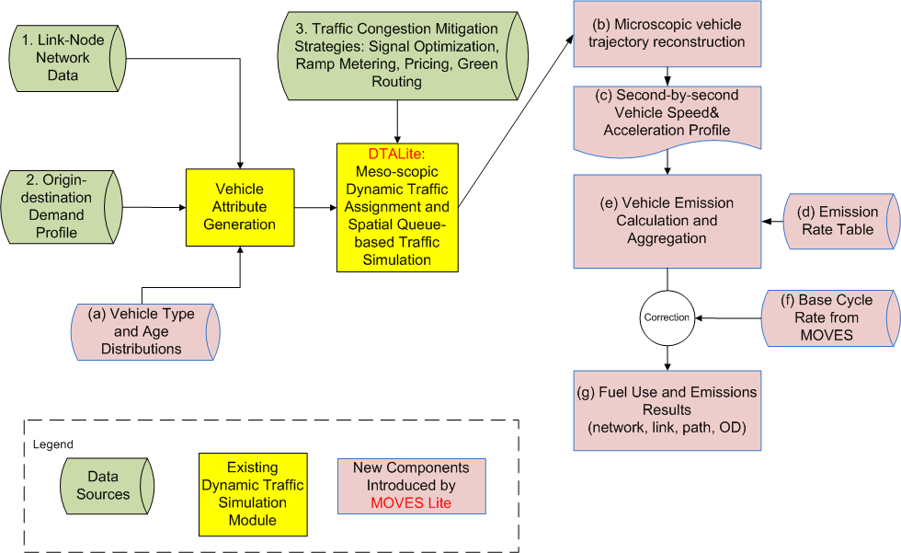
System Architecture and Data Flow
Data or progress | Corresponding functions or class
Link-Node Network Data | Class :Node(),Link() Functions: g_read_input_data()
Origin-destination Demand Profile | Class :Agent() Functions: g_read_input_data()
DTALite:Meso-scopic Dynamic Traffic Assignment and Spatial Queue-based Traffic Simulation | Class :Network() Functions: g_traffic_assignment() g_traffic_simulation()

Slide 19
Simulation Logic as Simple Queue
Can be viewed as pseudo event-based simulation and we do not simulate how a vehicle moves inside the link
Vehicle is moved into an in-flow queue at time t_{a}
Calculate time entering the out-flow queue as t_{a}+FFTT (free-flow travel time)
If the current simulation time t equals to or is later than t_{a}+FFTT, if the link out capacity is still available, move this vehicle to the next link, otherwise stay in the out-flow queue
Item | Corresponding variables
FFTT | link.free_flow_travel_time_in_min
In-flow queue | link.entrance_queue
Out-flow queue | link.exit_queue
Out –flow
Queue
Available capacity
at every simulation interval
In-flow Queue
Notes:
How to Determine Link-In Capacity at Each Simulation Interval
Free-flow or partially congested → use pre-specified reduced capacity
Fully congested according to N-Curve formula
--> Link-out flow rate from the previous simulation interval
How to Determine Link-Out Capacity at Each Simulation Interval
Minimal of the following elements
Pre-specified Average Capacity
If a link is fully congested, its link-in capacity will be distributed to incoming links as function of lanes

Slide 20
Part 2 Introduction to DTA modelling principles
2.1 Dynamic Traffic Assignment Modelling Framework
2.2 Agent-based Routing
2.3 VOT Distribution
2.4 Multiple Traffic Simulation Models

Slide 21
2.1 DTA Modelling Framework
Item | Corresponding functions or steps
Link Traversal | step 2.3 in g_traffic_simulation()
Node Transfer | step 2.4 in g_traffic_simulation()
Path processing | Network.optimal_label_correcting( )
User decision | Network. find_path_for_agents()
Notes:
In general, the traffic simulation assigns vehicles to different paths based upon link travel time. The physical process of moving vehicles works in a two-step process. First, a vehicle is moved across a link during the link pass, and then moved between links at the node during the node pass. Link travel times from the traffic simulator are fed to the shortest path model for path selection. The new paths are then fed back into the traffic simulator in the next iteration.

Slide 22
2.4 Multiple Traffic Simulation Models
Newell’s simplified kinematic wave model
Item | Corresponding variables
Outflow capacity | Link.td_link_outflow_capacity[]
Entrance List | Link. entrance_queue
Exit Queue | Link. exit_queue
Outflow capacity
Inflow capacity
Storage capacity
Exit Queue
Entrance List
Inflow Capacity
Outflow Capacity
Storage Capacity

Slide 23
2.4 MultipleTraffic Simulation Models
Item | Corresponding variables
Outflow capacity | Link.td_link_outflow_capacity[]
Entrance List | Link. entrance_queue
Exit Queue | Link. exit_queue
Queue propagation
Inflow capacity = outflow capacity
Inflow Capacity
Outflow Capacity

Slide 24
2.4 Multiple Traffic Simulation Models
Item | Corresponding variables or functions
Outflow capacity | Link.td_link_outflow_capacity[]
Node transfer | step 2.4 in g_traffic_simulation()
Entrance List | Link. entrance_queue
Exit Queue | Link. exit_queue
Node transfer
Node Transfer
Node
Check Outflow Capacity
Check Inflow Capacity
Check Storage Capacity
Notes:
Going into more specifics, let’s take a closer look at the link pass and node pass. The capacity constraints are enforced at both ends of each link. At the beginning of the link, the entrance list keeps track of vehicles entering the link, enforcing the inflow capacity constraint. During the link pass, the vehicles are moved between the entrance list and the exit queue. The exit queue keeps track of vehicles waiting to leave the link, enforcing the outflow capacity constraint. Vehicles are then moved between the exit queue and the entrance list of the next link during the node.

Slide 25
2.4 Multiple Traffic Simulation Models
Merge Models
Distribute inflow capacity to upstream links
Lane & demand-based methods
80%
Node
Available Inflow Capacity
20%

Slide 26
2.4 Multiple Traffic Simulation Models
Diverge Models
Different conditions by lane
First-In-First-Out (FIFO) constraint
Relaxation to prevent extreme bottlenecks
Node

Slide 27
2.4 Multiple Traffic Simulation Models
Signalized Intersections
Effective green time, saturation flow rate, movement-based capacity
Relaxed inflow constraints

Slide 28
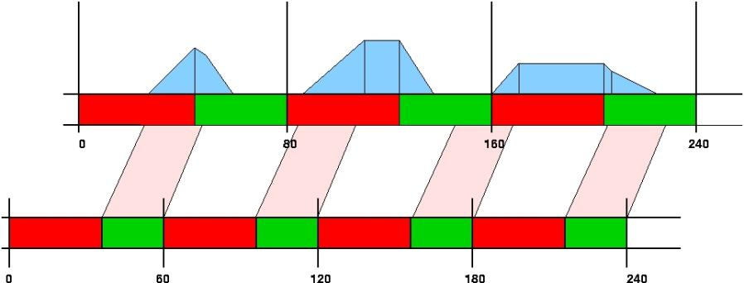
2.4 Multiple Traffic Simulation Models
Signal Timing & Hourly Capacity
Input: Average hourly capacity, cycle time, offset at node
Output: Effective green time per cycle(capacity/saturation flow rates)

