Slide 1
How to Guide: Use NeXTA Visualization Features

Slide 2
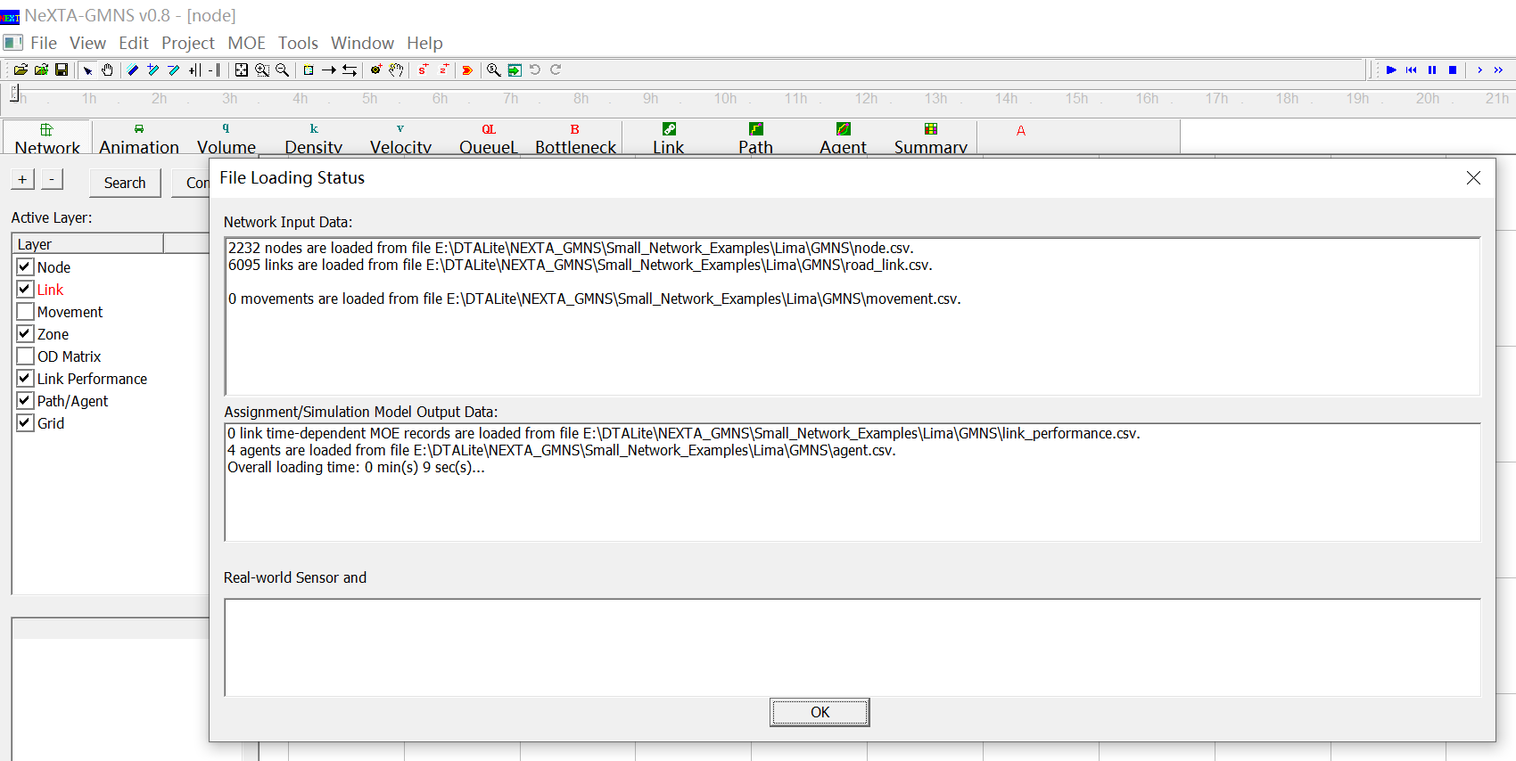
How to open a data set?
1
Notes:
3. NeXTA will open the network, and display the File Loading Status window.

Slide 3
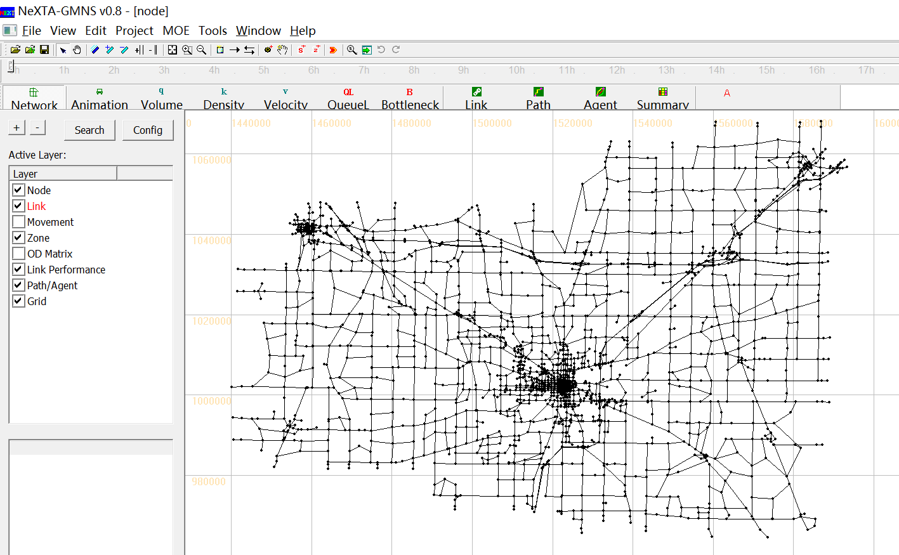
How to open a data set?

Slide 4
Outline
1. Network-related Display
2. Time-dependent Simulation Result Display
3. Advanced Analysis Features
4. Changing Network Data

Slide 5
Network-related Display

Slide 6
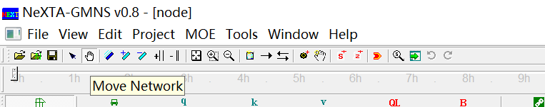
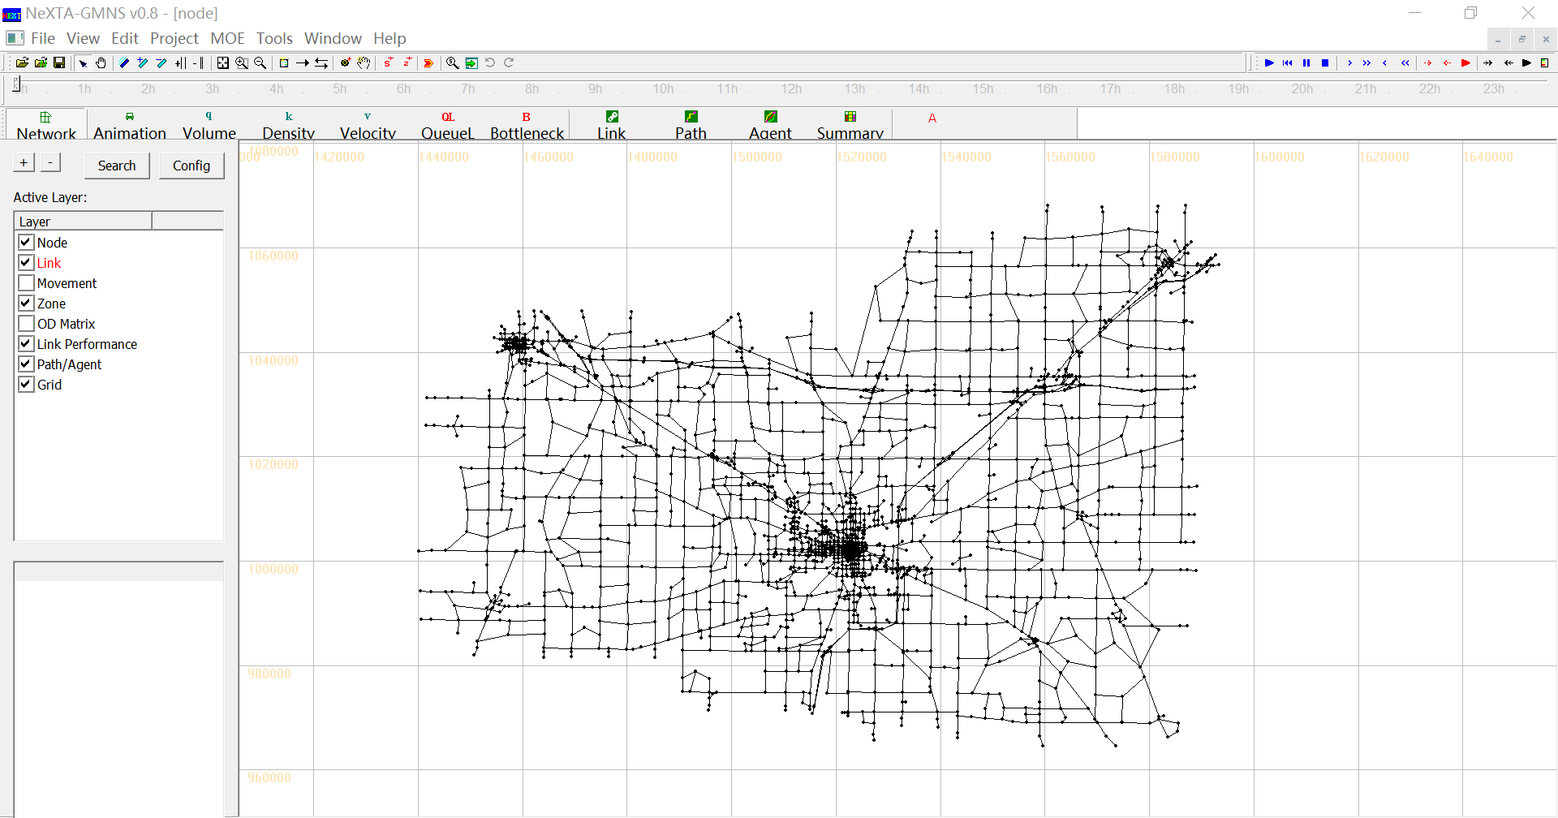
How to move a network?
Notes:
Click on the “Move Network” toolbar button.

Slide 7
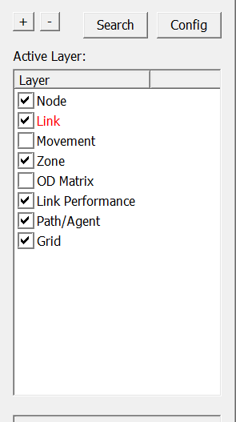
How to use GIS layer panel?
Link layer is selected.
Notes:
GIS layer panel, on the left of the display view, enable users to switch between different layers and show/ hide each layer.
Click one layer on the GIS layer panel , the corresponding layer becomes red when this layer is selected.
Check or uncheck this layer to show the corresponding data items on the display view.

Slide 8
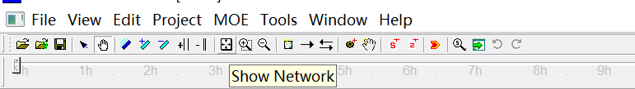
How to reset the network display?
Notes:
Click on the “Show Network” toolbar button.

Slide 9
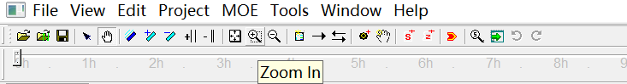
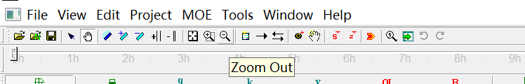
How to zoom in and zoom out?
Notes:
Click on the “Zoom in”/“Zoom Out” toolbar button.
You can also roll the mouse wheel to zoom in and out on the display view.

Slide 10
How to increase/decrease the size of node?
Notes:
Click on the “+”/“-” button in GIS layer panel.

Slide 11
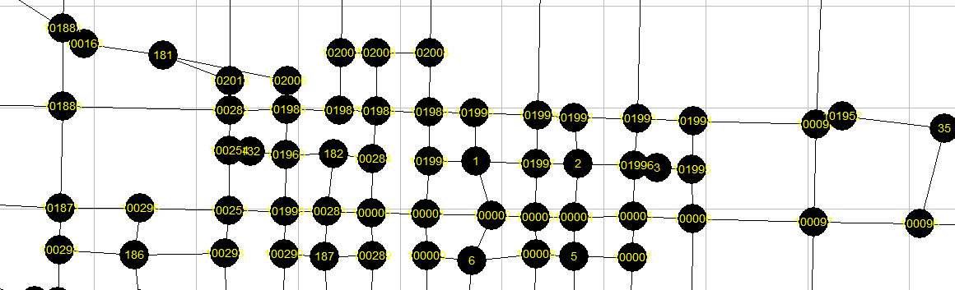
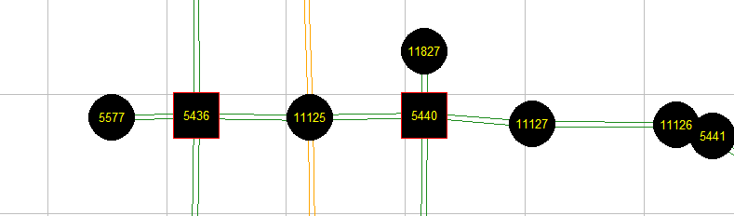
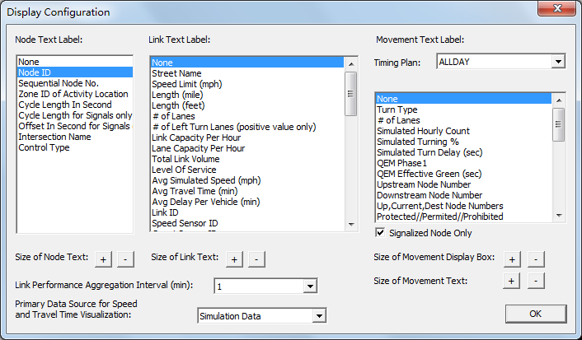
How to show node label?
1
2
Notes:
Click on the "Config" button in GIS layer panel to display the “Display Configuration” dialog;
Choose the text you want to show on the nodes and click “OK”.

Slide 12
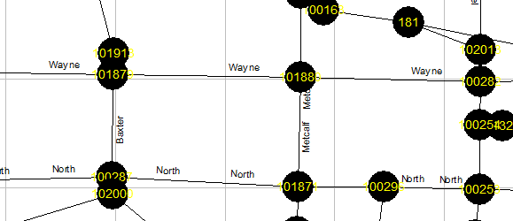
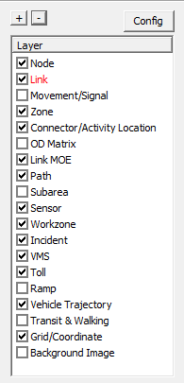
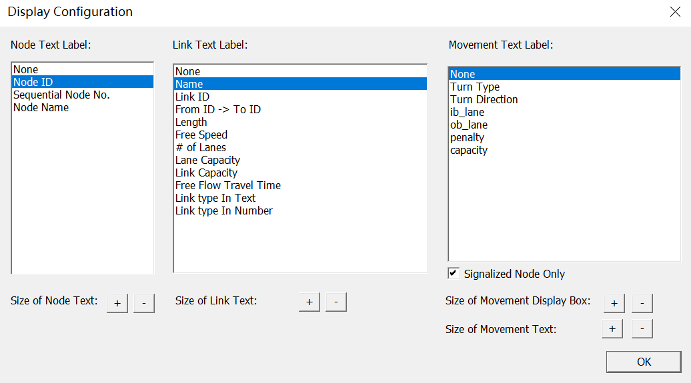
How to show link label?
1
2
Notes:
Click on the "Config" button in GIS layer panel to display the “Display Configuration” dialog;
Choose the text you want to show on the links and click “OK”.

Slide 13


How to increase/decrease offset between links?

Slide 14

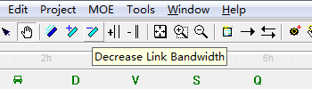
How to increase the bandwidth of a link?

Slide 15
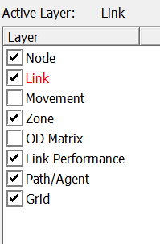
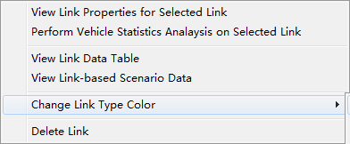
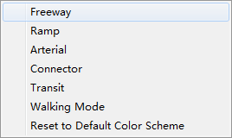
How to change link color?
1
2
3
Notes:
Choose Link layer in GIS layer panel;
Right-click on the display view and choose “Change Link Type Color” in the pop-up menu;
Select the type of link you want to change color of.

Slide 16
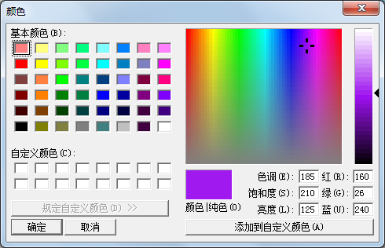
How to change link color?
4
Notes:
4. Choose the color you want to set to the link type.

Slide 17
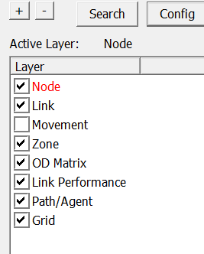
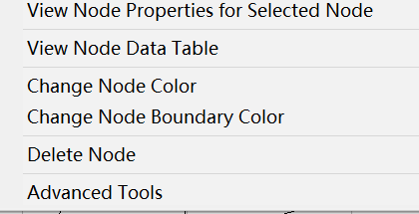
How to change node color?
1
2
3
Notes:
Choose Node layer in GIS layer panel;
Right-click on the display view and choose “Change Node Color” in the pop-up menu;
Choose the color you want to set to the nodes.

Slide 18
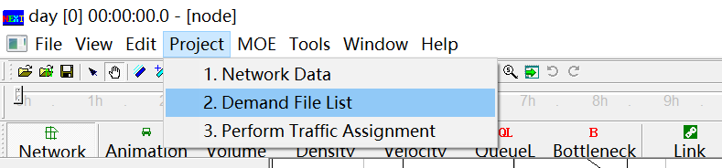
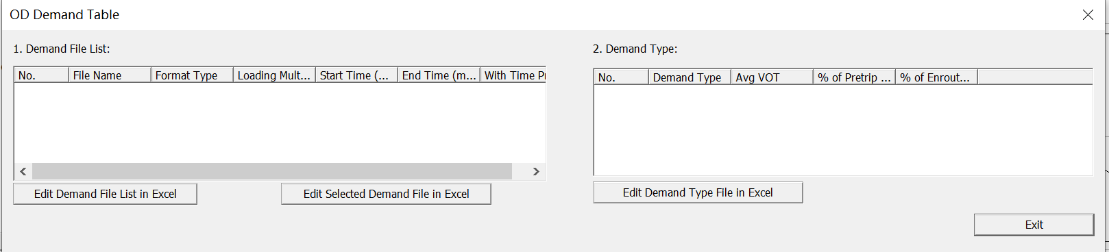
How to show OD matrix?
1
2
Notes:
Go to Project -> 2. Demand Meta Database;
In OD Demand Table, choose the demand find in Demand File List.

Slide 19
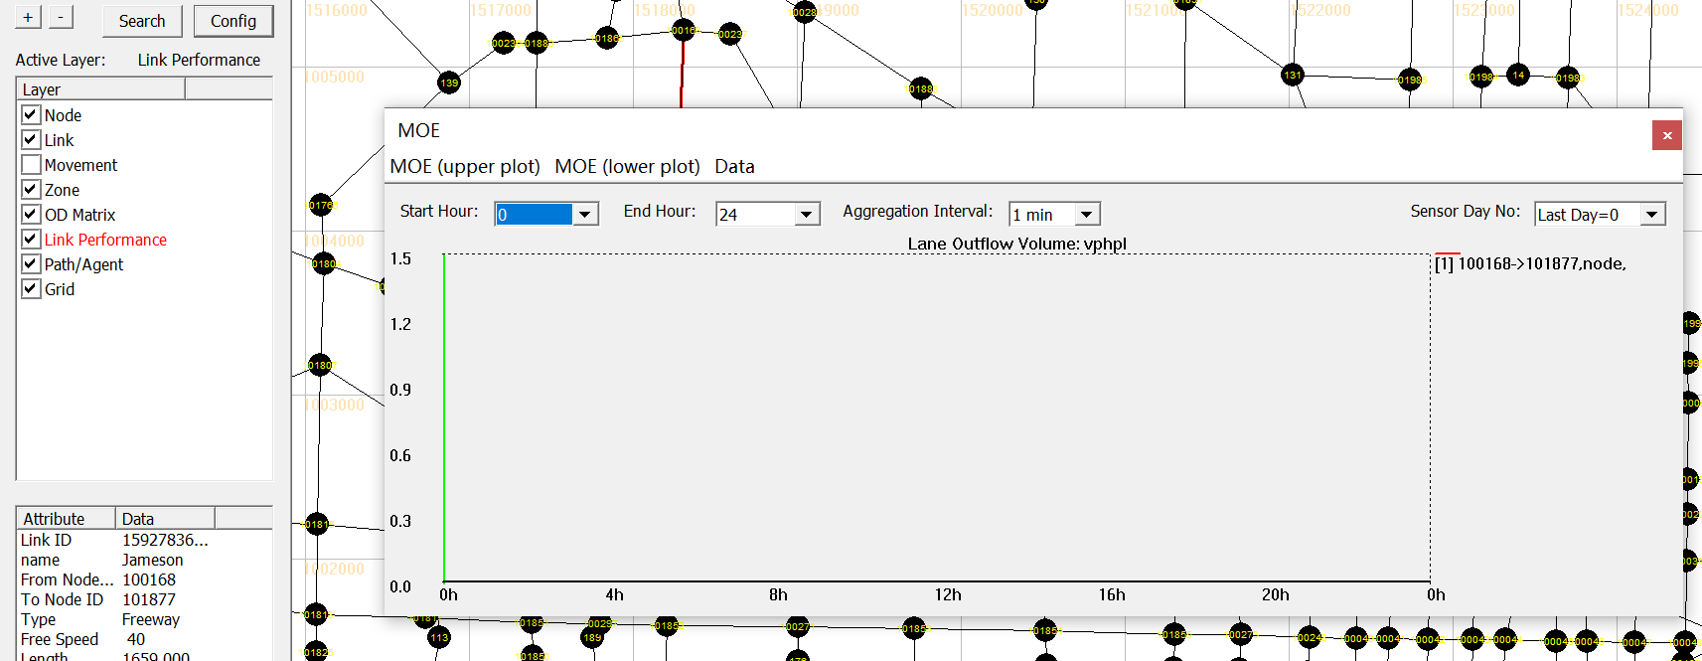
How to show link MOE?
1
2
Notes:
Choose Link MOE layer in GIS layer panel;
Choose a link on the display view.

Slide 20
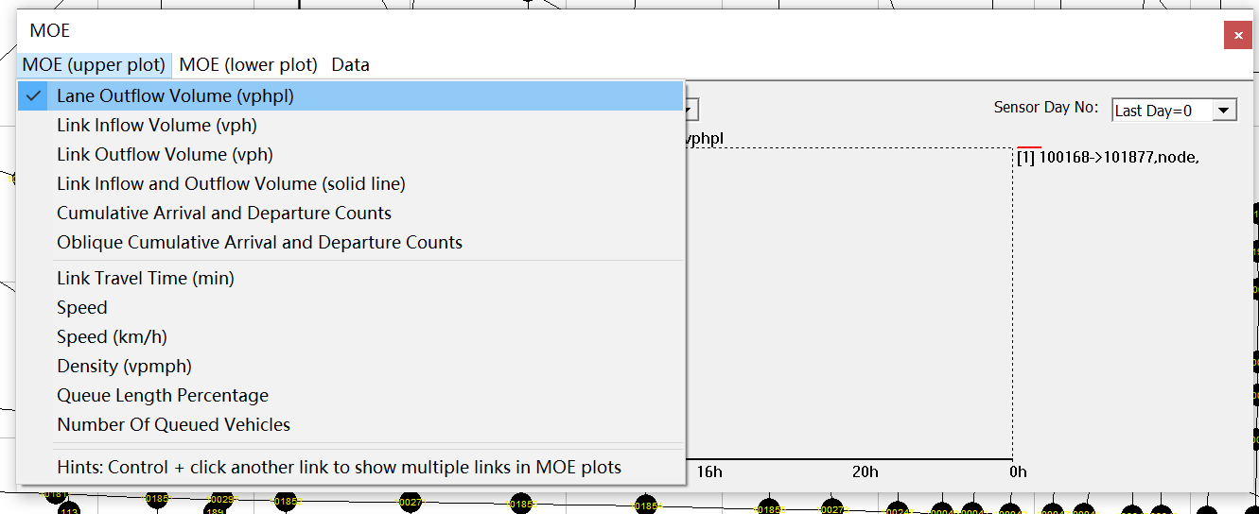
How to show link MOE?
Notes:
You can choose different MOEs from drop-down menu.

Slide 21
How to show two MOEs simultaneously?
1
2
Notes:
Choose Link MOE layer in GIS layer panel;
Choose a link on the display view;

Slide 22
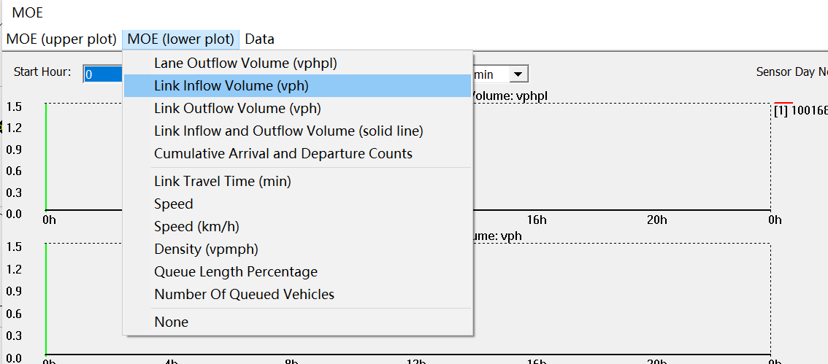
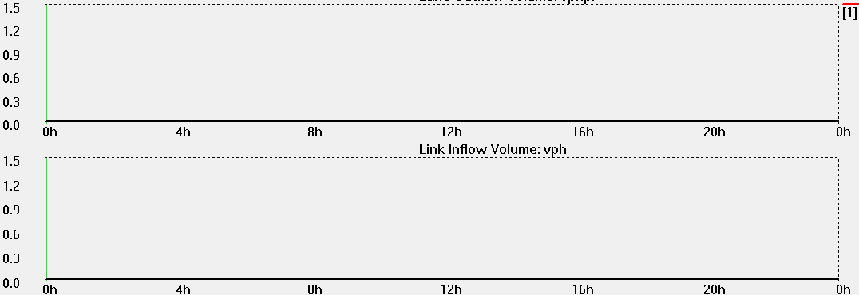
How to show two MOEs simultaneously?
3
Notes:
3. Click “MOE (lower plot)”menu in MOE window and choose an MOE to output.

Slide 23
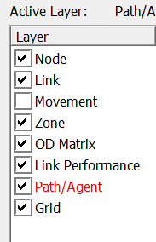
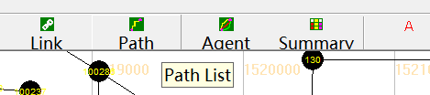
How to select a path?
1
2
Notes:
Check the check box of “Path” in GIS layer panel;
Click on the “Path List” button in the toolbar to open “Path List Dialog” window;

Slide 24
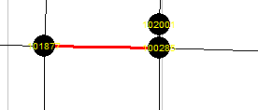
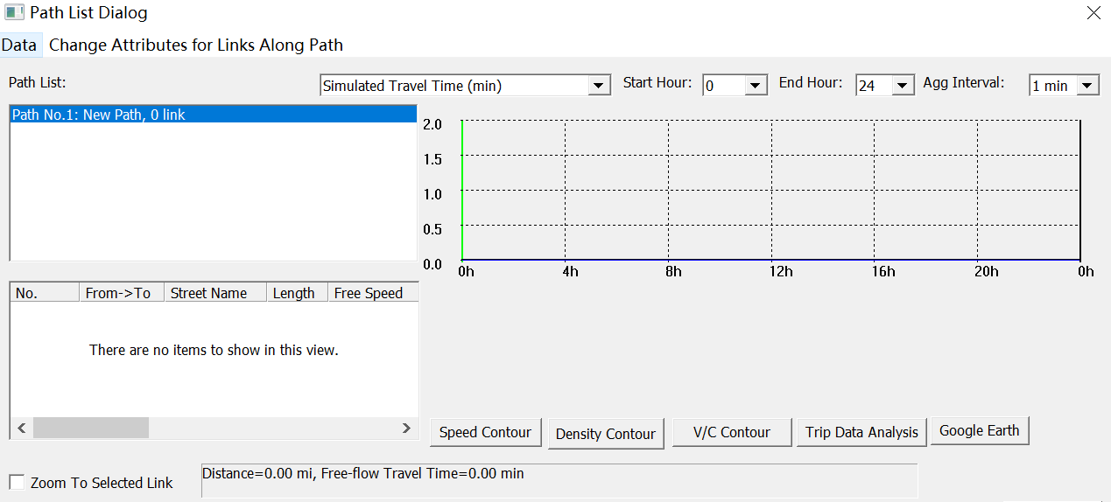
How to select a path?
3
Notes:
3. Click on the path in the “Path List” box in the “Path List Dialog” window, and the corresponding path is selected in the display view.

Slide 25
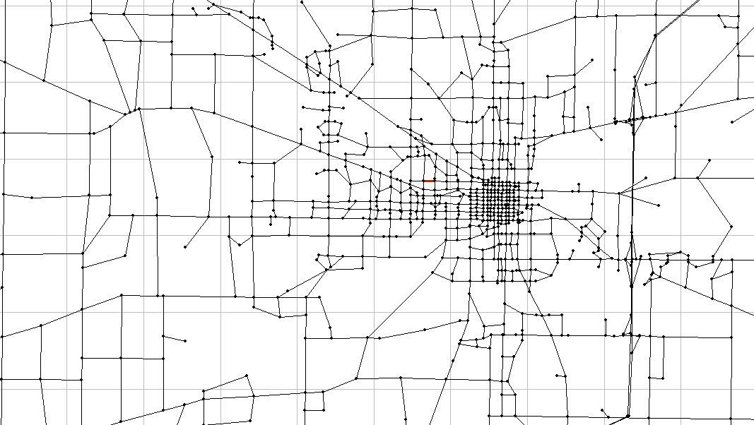
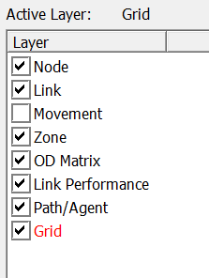
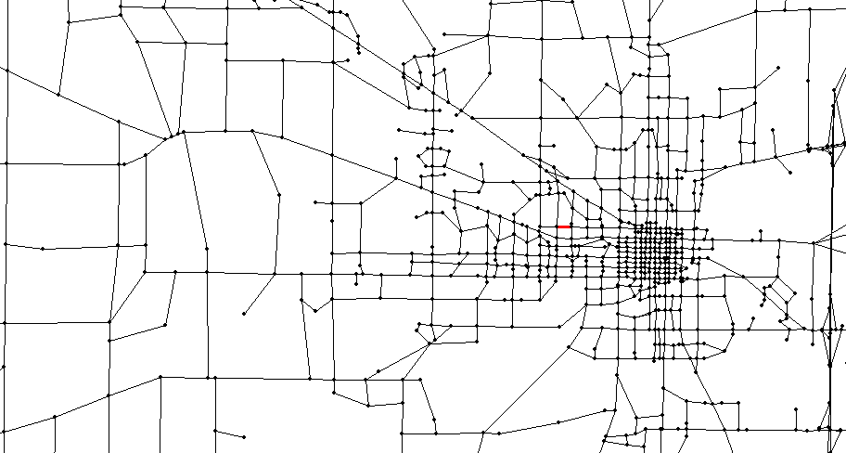
How to show/hide grid?
Notes:
Check/uncheck the check box of “Grid/Coordinate” in GIS layer panel.

Slide 26
Time-dependent AMS Result Display

Slide 27

How to display time-dependent simulation result?(Animation)
1
2
Notes:
Click on the “Animation with Vehicles” button in the toolbar;
Use the slider in the toolbar to adapt time stamp.

Slide 28

How to display time-dependent simulation result?(Volume)
1
2
Notes:
Click on the “Link Volume” button in the toolbar to show link volume;
Use the slider in the toolbar to adapt time stamp.

Slide 29

How to display time-dependent simulation result?(Density)
1
2
Notes:
Click on the “Link Density” button in the toolbar to show link density;
Use the slider in the toolbar to adapt time stamp.

Slide 30

How to display time-dependent simulation result?(Speed)
1
2
Notes:
Click on the “Speed” button in the toolbar to show speed on each link;
Use the slider in the toolbar to adapt time stamp.

Slide 31

How to display time-dependent simulation result?(Queue)
1
2
Notes:
Click on the “Queue Length” button in the toolbar to show queue length;
Use the slider in the toolbar to adapt time stamp.

Slide 32

How to display time-dependent simulation result?(Bottleneck)
1
2
Notes:
Click on the “Bottleneck” button in the toolbar to show bottleneck in the network;
Use the slider in the toolbar to adapt time stamp.

Slide 33
Advanced Analysis Features

Slide 34
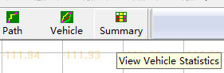
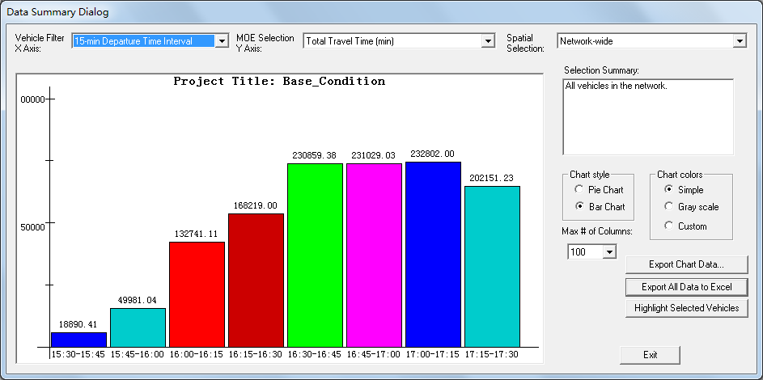
How to do overall network statistics?
1
2
Notes:
Click on the “Summary” button in the toolbar to open “Data Summary Dialog”;
Choose x and y axis to plot various summary chart.

Slide 35
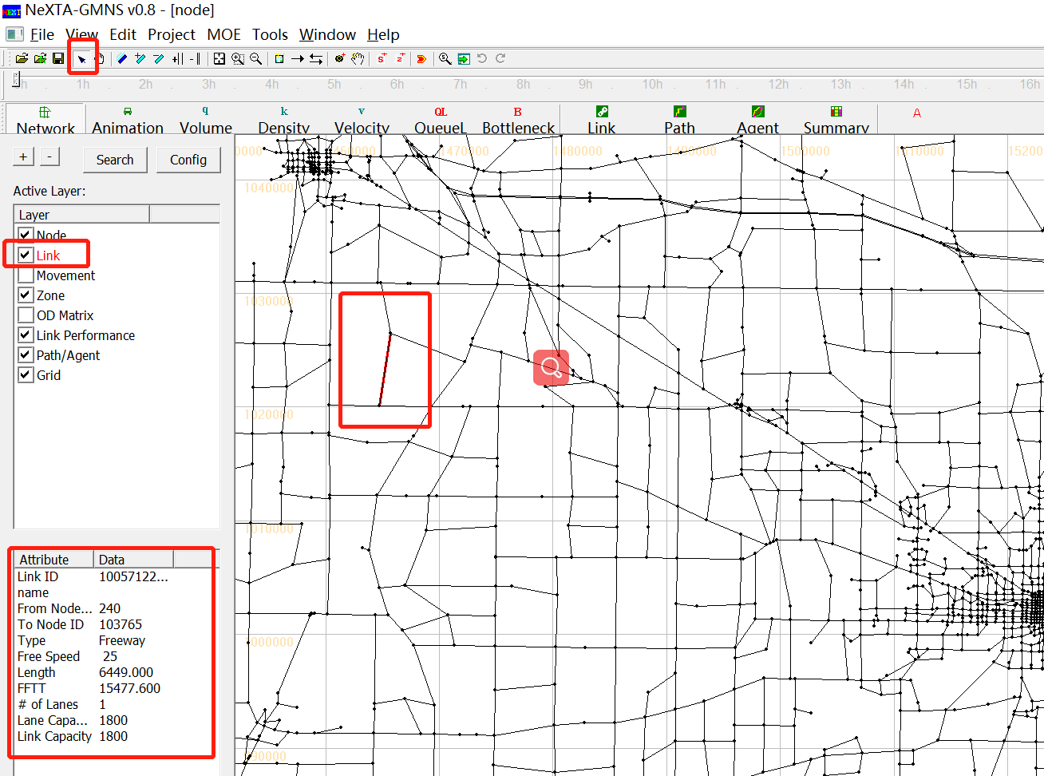
How to select link analysis?
1
2
Notes:
Choose Link layer in GIS layer panel;
Choose “Select Object” button in the toolbar;

Slide 36
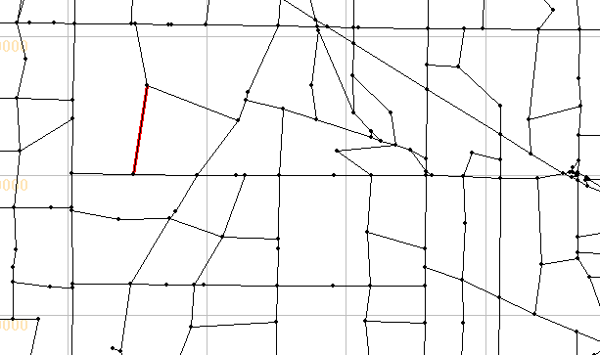
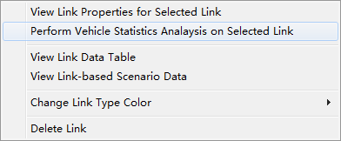
How to select link analysis?
3
4
Notes:
3. Select the link you want to analyze;
4. Right-click on the display view and click “Perform Vehicle Statistic Analysis on Selected Link”;

Slide 37
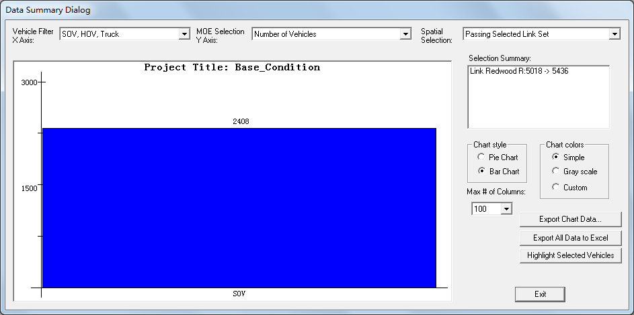
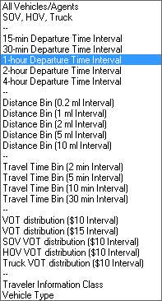
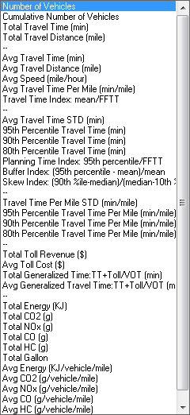
How to select link analysis?
5
Notes:
5. Choose the data for x axis and y axis from the drop-down list.

Slide 38
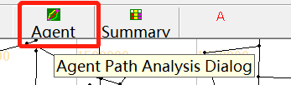
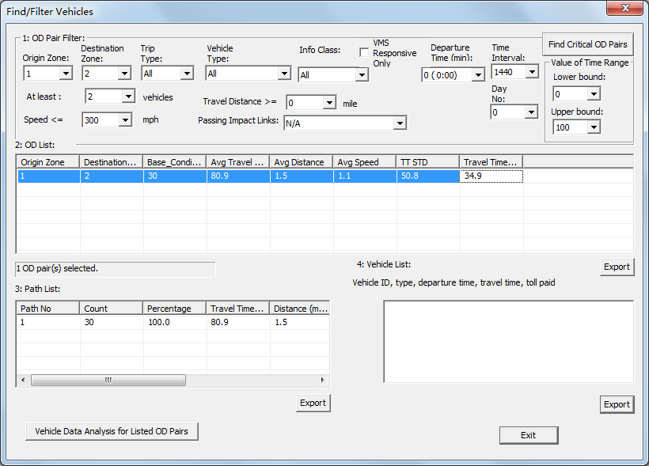
How to select OD analysis?
1
2
Notes:
Click on the “Vehicle” button in the toolbar;
In the “Find/Filter” window, choose the OD information in “1: OD Pair Filter”, click the OD record in the “2: OD List” and click on “Vehicle Data Analysis for Listed OD Pairs”;

Slide 39
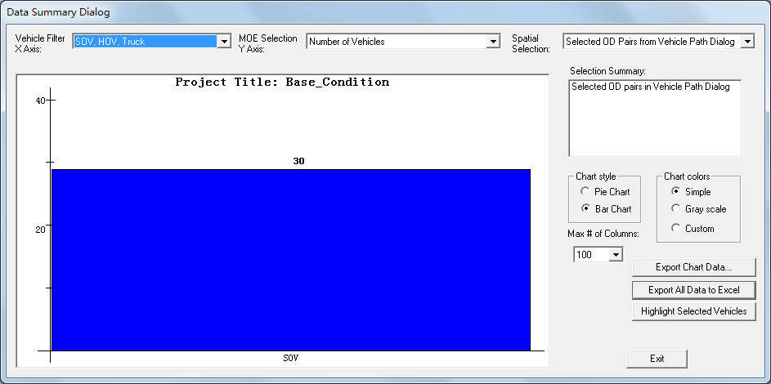
How to select link analysis?
3
Notes:
3. Choose the data for x axis and y axis from the drop-down list.

Slide 40
How to define vehicle selection categories?
Trips Passing Selected Path
Partial Trips Passing Selected Path
Notes:
Trips Passing Selected Path: The origin-to-destination trip travel time is used for a vehicle passing through path from A to B.
Partial Trips Passing Selected Path: When a path from A to B is defined, the path travel time from A to B is used for a vehicle passing through path A to B.

Slide 41
How to define vehicle selection categories?
Originating from Subarea
Notes:
3. Originating from Subarea: A vehicle has its first link in the subarea area, while their trips might end inside or outside of the subarea.

Slide 42
How to define vehicle selection categories?
Traversing through Subarea
Notes:
4. Traversing through Subarea: A vehicle starts outside of the subarea, and then enters the susarea and finally leave the subarea.

Slide 43
How to define vehicle selection categories?
Subarea Internal-to-External Trips
Notes:
5. Subarea Internal-to-External Trips: A vehicle starts inside the subarea and ends its trip outside of the subarea.

Slide 44
How to define vehicle selection categories?
Subarea External-to-Internal Trips
Notes:
6. Subarea External-to-Internal Trips: A vehicle starts outside of the subarea and ends its trip inside the subarea.

Slide 45
How to define vehicle selection categories?
Subarea Internal-to-Internal Trips
Notes:
7. Subarea Internal-to-Internal Trips: A vehicle’s entire trip is inside the subarea.

Slide 46
How to define vehicle selection categories?
Complete and Partial Trips inside Subarea
Notes:
8. Complete and Partial Trips inside Subarea: A vehicle starts from the subarea, while its trip might end inside the subarea (defined as a complete trip) or outside of the subarea (defined as a partial trip). When collecting travel time statistics, we use the travel time from point A (i.e. origin node) to point B (i.e. boundary node) for a partial trip, and the trip travel time from point A to point C (i.e. destination node) is used for a complete trip.

Slide 47
How to define vehicle selection categories?
Subarea Boundary-to-Boundary Trips
Notes:
9. Subarea Boundary-to-Boundary Trips: A vehicle starts outside the subarea, passes through the subarea and then ends its trip outside of the subarea. When collecting travel time statistics, we use the travel time from point A (boundary node) to the point B (boundary node).

Slide 48
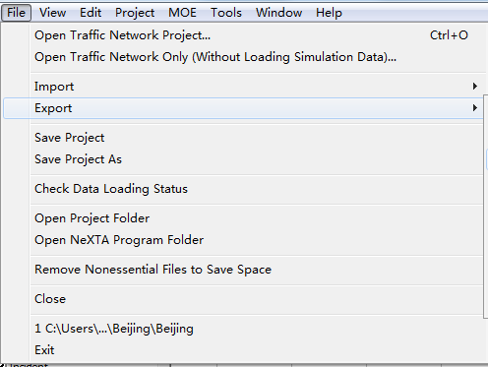
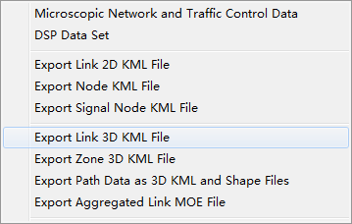
How to exporting 3D links to Google Earth?
1
Notes:
1. Go to File -> Export -> Export Link 3D KML File.

Slide 49
Changing Network Data

Slide 50

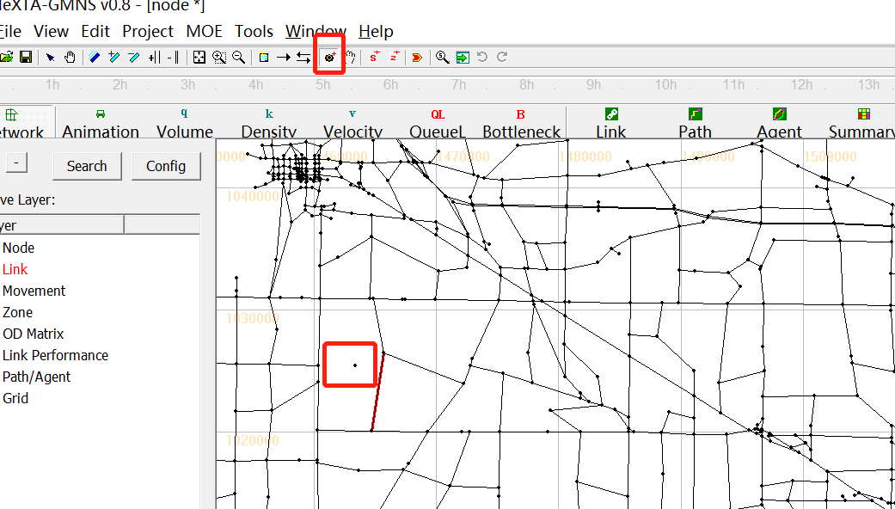
How to add a node?
1
2
New node
Notes:
Click on the “Add New Node” button in the toolbar;
Click on the display view to add a node.

Slide 51
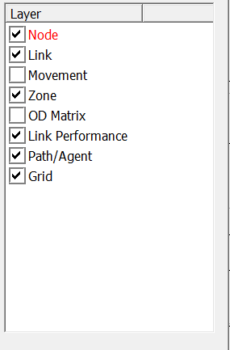

How to delete a node?
1
2
Notes:
Choose Node layer in GIS layer panel;
Choose “Select Object” button in the toolbar;

Slide 52
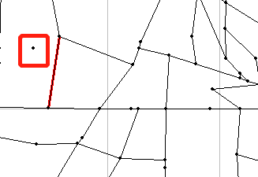

How to delete a node?
3
4
Notes:
3. Select the node you want to delete;
4. Right-click on the display view and click on “Delete Node”.

Slide 53

How to add a link based on a given link type?
1
2
Notes:
Click on “Set Default Link Type” button on the toolbar to show “Default Link Properties for New Links” window;
Set link properties in the “Default Link Properties for New Links” window and click “OK” button;

Slide 54



How to add a link based on a given link type?
3
4
A new link
Notes:
Choose “Add New One-Way Link” or “Add New Two-Way Link” toggle button in the toolbar;
Press and hold the mouse button at the location you want the link to start. Keeping the button pressed, move the mouse to the location you want the link to end.

Slide 55

How to delete a link?
1
2
Notes:
Choose Link layer in GIS layer panel;
Choose “Select Object” button in the toolbar;

Slide 56


How to delete a link?
3
4
Notes:
3. Select the link you want to delete;
4. Right-click on the display view and click“Delete Link”.

Slide 57


How to add node in CSV file?
1
2
Notes:
Under Software_release directory, go to folder sample_data_sets\1.Introduction_to_Traffic_Modeling_Lession1.1_West_Jordan\Salt_Lake_City_West_Jordan, double-click the input_node.csv file to open the file in Excel.
Add a piece of record at the end of data and save the file.

Slide 58


How to add a zone?
1
2
A new zone
Notes:
Click on the “Create Zone” button in the toolbar;
Click at a corner of the zone in the display view and a feature point will be created at that location. Move the mouse cursor to a new location and click again. Repeat this process until the zone is complete. You can close the zone by double clicking the mouse anytime.

Slide 59

How to delete a zone?
1
2
Notes:
Choose Zone layer in GIS layer panel;
Choose “Select Object” button in the toolbar;

Slide 60


How to delete a zone?
3
4
Notes:
3. Select the zone you want to delete;
4. Right-click on the display view and click on “Delete Zone”.

Slide 61


How to add subarea?
1
2
A New subarea
Notes:
Click on the “Create Subarea for Subarea Analysis” button in the toolbar;
Click at a corner of the subarea in the display view and a feature point will be created at that location. Move the mouse cursor to a new location and click again. Repeat this process until the subarea is complete.

Slide 62


How to define a path?
1
2
Notes:
Choose “Path” layer in GIS layer panel;
Right-click on the origin node on the display view and click “Direction from here” in the pop-up menu;

Slide 63


How to define a path?
3
A New path
Notes:
3. Right-click on the destination node on the display view and click “Direction to here” in the pop-up menu.

Slide 64


How to change link attribute for links along a path?
1
2
Notes:
Click on the “Path List” button in the toolbar to open “Path List Dialog” window;
Click on the path in the “Path List” box in the “Path List Dialog” window, click “Change Attributes for Links Along Path” and choose the attribute you want to change along the path.

Slide 65

How to remove activity locations for a zone?
1
2
Notes:
Choose Zone layer in GIS layer panel;
Choose “Select Object” button in the toolbar;

Slide 66

How to remove activity locations for a zone?
3
Notes:
3. Select a zone, right-click on the display view and click “Remove Activity Locations of Selected Zone”.

