Slide 1



GRID2DEMAND: A tool for generating zone-to-zone travel demand based on grid zones
Notes:
Gird2demand is an open-source trip generation and distribution tool for teaching transportation planning and applications. It generates zone-to-zone travel demand.
Specifically, users can obtain zone-to-zone and node-to-node travel demand with a few lines of python code based on OpenStreetMap and OSM2GMNS which is another open-source package to help users to convert open street map data into node and link network file). Before introducing grid2demand, we would first address its background knowledge.

Slide 2
Introduction and Background Knowledge
Four step transportation forecasting
1. Trip Generation
How many trips enter or leave a zone/traffic-analysis-zone (TAZ)
Grid2demand
2. Trip Distribution
How many trips from each zone/TAZ end in all zones/TAZs
3. Mode Choice
Which travel mode is used (e.g., vehicle, transit, or walk) to complete those trips
4. Traffic Assignments
Vehicles/traffic flow to different paths during travel
Calculation of Performance Measures
Notes:
Generally, to understand the decision-making process, planners have implemented the four-step urban planning process. On the left-hand side in this slide, the flowchart shows the typical four step process in transportation planning. Each step estimates 1., estimates 2., estimates 3., and lastly distribute 4. In this sequential process manner, planners can consider travel demand and the characteristics of transportation network, measuring optimal transportation cost.
To avoid the data inconsistency between travel demand and built network environment, we introduce grid2demand package to match the two dimensions efficiently. Particularly, this package helps users generate the first two stages (trip generation and trip distribution).

Slide 3
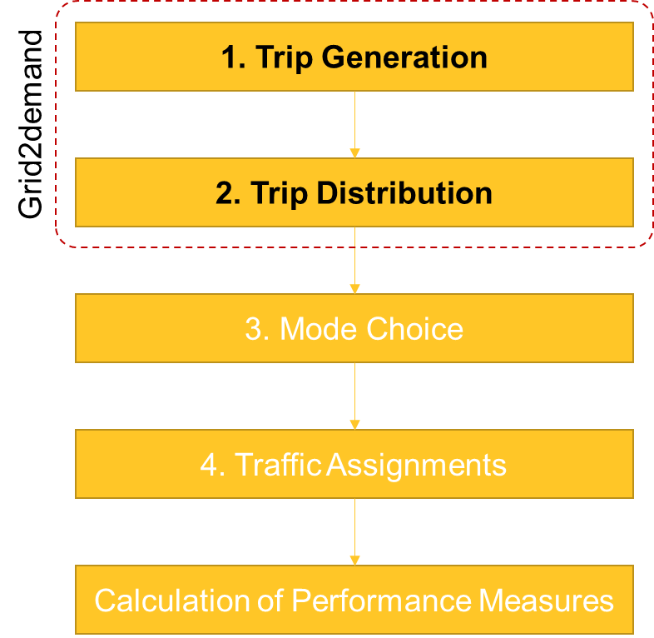
Trip Generation
Four step transportation forecasting
1. Trip Generation
First step in the four-step model
Socio-demographic and economic data
Household size/income
Gender/age
Trips are grouped by different purposes
Home-based work (HBW)
Home-based other (HBO)
Nonhome-based (NHB)
Notes:
First, let’s consider the first stage: trip generation. Using socio-demographic and economic data (household size, income), we estimate the number of person trips originating in or destined for a particular traffic analysis zone.
A person trip involves a single person leaving from an origin and arriving at a single destination, and each trip has a classification/purpose based on typical classification such as home-based-work (HBW), home-based-other (HBO), and non-home-based (NHB). To generate trips in our package, we use trip rates given by point of interest ( the default trip generation rates refer to ITE Trip generation manual).

Slide 4
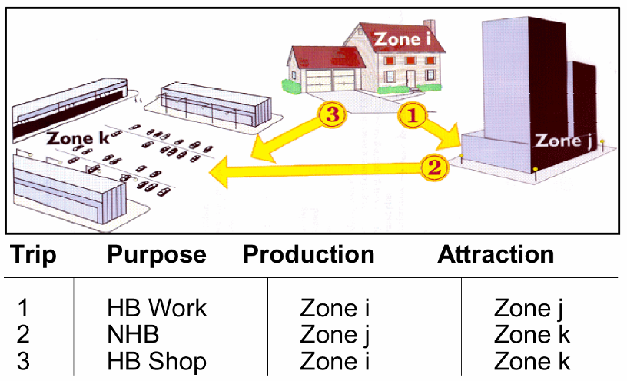
Trips (Production/Attraction)
Trip production:
Home end of a home-based trip
Beginning of a non-home-based trip
Trip attraction:
Non-home end of a home-based trip
Destination of a non-home-based trip
Notes:
In trip-based transportation planning, trip productions/attractions are modeled by a function of population and explanatory variables, which can be obtained from household survey data. For instance, productions in home-based are modeled by the total population and the number of households, and attractions in non-home based (e.g., office) can be generated by the function of the number of households and the number of employees.
Grid2demand uses the trip rates from POI, computing trip production, and trip attraction. Then, with the information, we move on to the second stage.

Slide 5
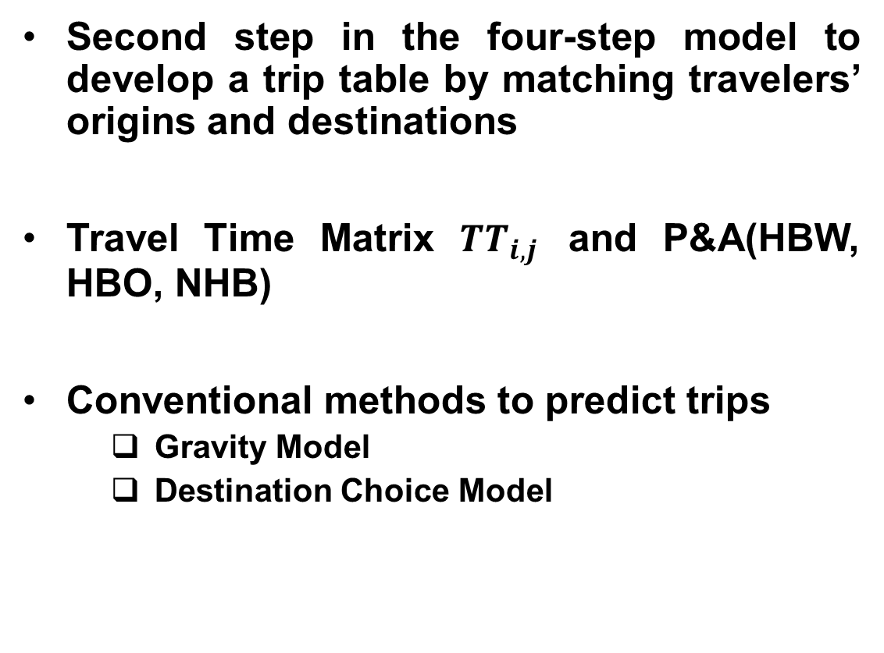
Trip Distribution
Four step transportation forecasting
Second step in the four-step model to develop a trip table by matching travelers’ origins and destinations
Travel Time Matrix $TT_{i,j}$ and P&A(HBW, HBO, NHB)
Conventional methods to predict trips
Gravity Model
Destination Choice Model
2. Trip Distribution
Notes:
This second step generates a trip table to distribute travelers’ origins and destinations in a matrix form. To disaggregate the zone-based production/attraction trips, impedance by travel time will be used. For instance, travelers would select the lower impedance when moving from origin to destination. There are two conventional methods to form the trip distribution matrix; gravity model and destination choice model. In this package, we select the gravity model.

Slide 6
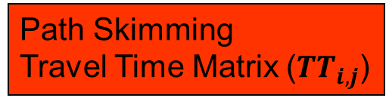
Origin-Destination Matrix
Trip Generation
P & A (HBW)
Path Skimming
Travel Time Matrix ($TT_{i,j}$)
TAZ | Productions | Attractions
1 | 234 | 1080
2 | 76 | 531
3 | 602 | 76
4 | 432 | 47
5 | 472 | 82
TAZ | 1 | 2 | 3 | 4 | 5
1 | 2 | 12 | 8 | 15 | 21
2 | 6 | 3 | 9 | 23 | 14
3 | 20 | 7 | 5 | 10 | 25
4 | 12 | 18 | 8 | 5 | 17
5 | 24 | 19 | 23 | 15 | 6
Trip Distribution
TAZ | 1 | 2 | 3 | 4 | 5 | Productions
1 | 199 | 2 | 15 | 2 | 16 | 234
2 | 35 | 25 | 12 | 3 | 1 | 76
3 | 147 | 324 | 38 | 31 | 62 | 602
4 | 330 | 90 | 4 | 6 | 2 | 432
5 | 369 | 90 | 7 | 5 | 1 | 472
Attractions | 1080 | 531 | 76 | 47 | 82 | 1816
OD matrix
Notes:
By using the trip generation and the travel time matrix, Gravity model distributes production/attraction trips (i.e., Origin-destination matrix). As you can see, when summing up the TAZ column 1 in OD matrix, the total number of trips is matched with the number of the trip attraction in TAZ 1.

Slide 7
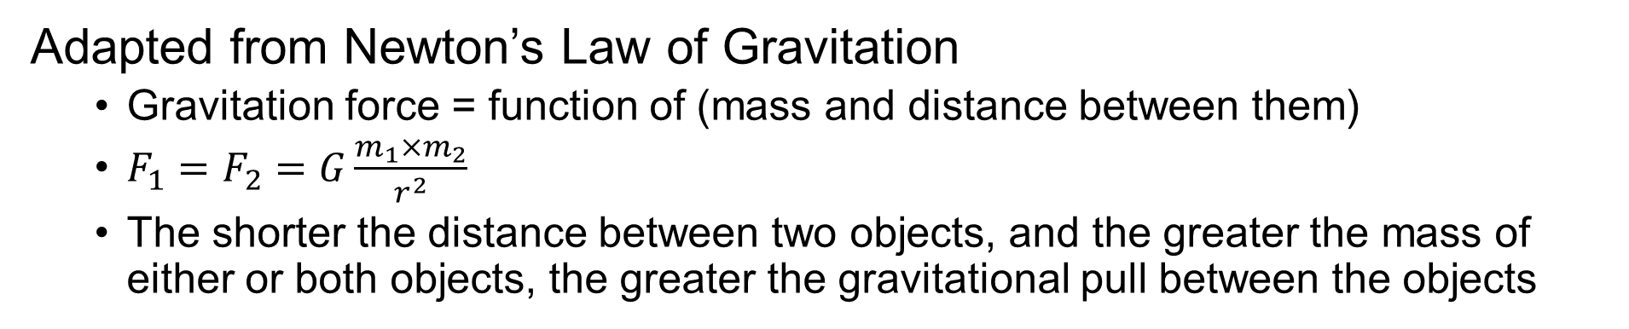



Gravity Model
Adapted from Newton’s Law of Gravitation
Gravitation force = function of (mass and distance between them)
$F_{1}=F_{2}=G\frac{m_{1}×m_{2}}{r^{2}}$
The shorter the distance between two objects, and the greater the mass of either or both objects, the greater the gravitational pull between the objects
$$F_{AB}$$
B
A
$$F_{BC}$$
$$F_{AC}$$
C
Notes:
The principle of gravity model is adapted from newton’s law of gravity. Basically, if the shorter the distance between two objects, the greater the gravitational pull between the objects. or If the greater the mass of either or both objects, the stronger the gravitational pull between them. As illustrated in the figure, we can see the stronger gravitational force between A and B than the force of gravity between A and C.

Slide 8
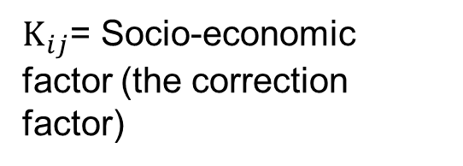
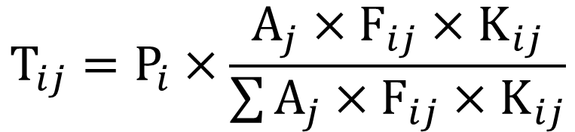



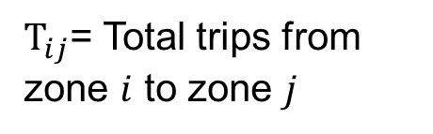
Gravity Model for OD matrix
Determine the number of trips between “from” TAZ_{i} to “To” TAZ
$A_{i}$= Total trip attraction in zone $j$
$$T_{ij}=P_{i}×\frac{A_{j}×F_{ij}×K_{ij}}{\sum{A_{j}×F_{ij}×K_{ij}}}$$
$K_{ij}$= Socio-economic factor (the correction factor)
$T_{ij}$= Total trips from zone $i$ to zone $j$
$F_{ij}$= Friction factor (effect of travel time, distance, and cost between zone $i$ and zone $j$
$P_{i}$= Total trip production in zone $i$
Notes:
For the OD matrix, a typical gravity model to calculate zone-to-zone demand volume is formulated as follows.

Slide 9
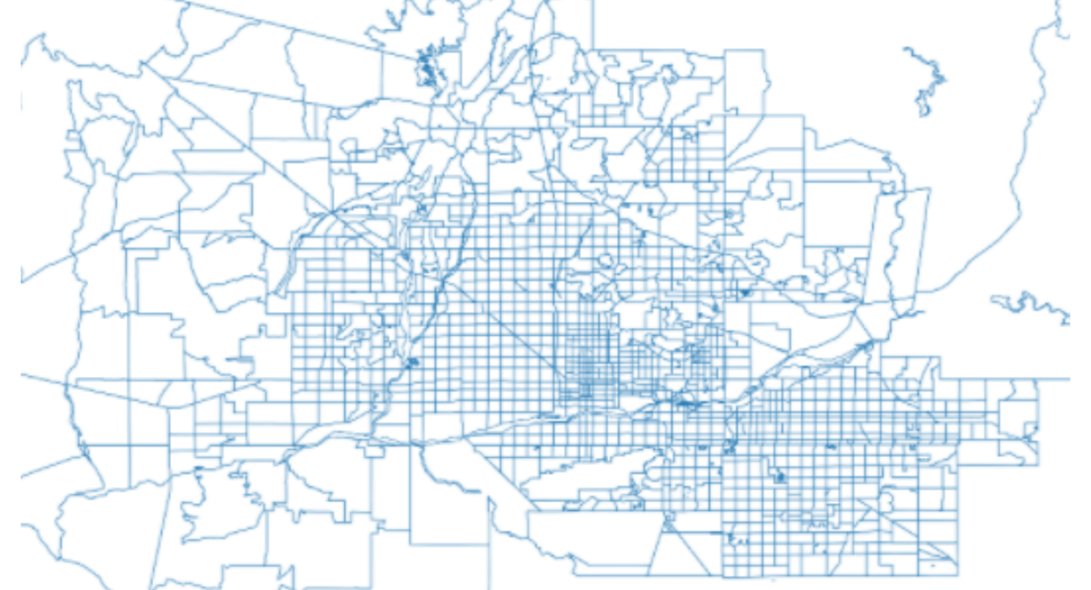
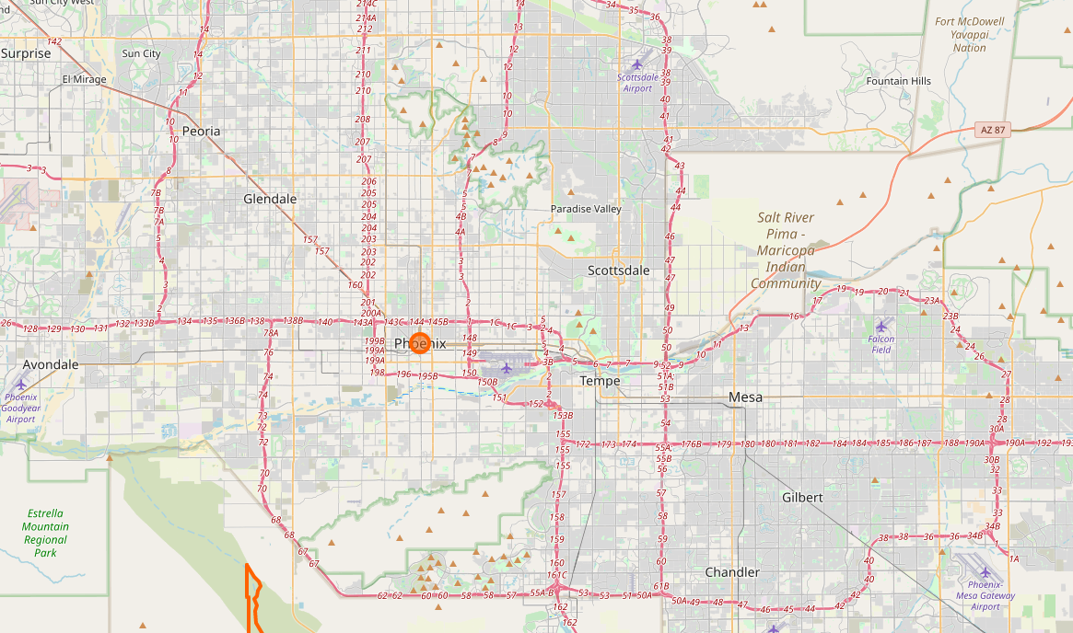
GRID2DEMAND Framework
Traffic Analysis Zone
Mapping
Network
Notes:
This background knowledge is coded in the grid2demand package, and users automatically generate the two sequential steps and take advantage of mapping traffic analysis zone and network efficiently.

