Slide 1
How to Guide: Use NeXTA Visualization Features

Slide 2
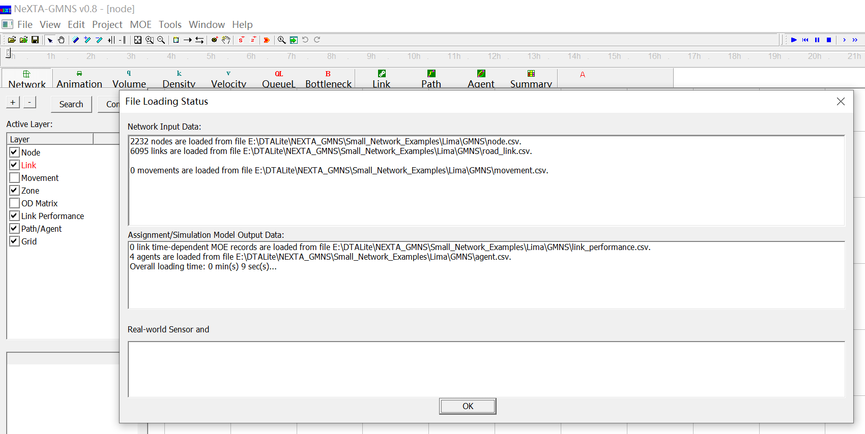
How to open a data set?
1
Notes:
3. NeXTA will open the network, and display the File Loading Status window.

Slide 3
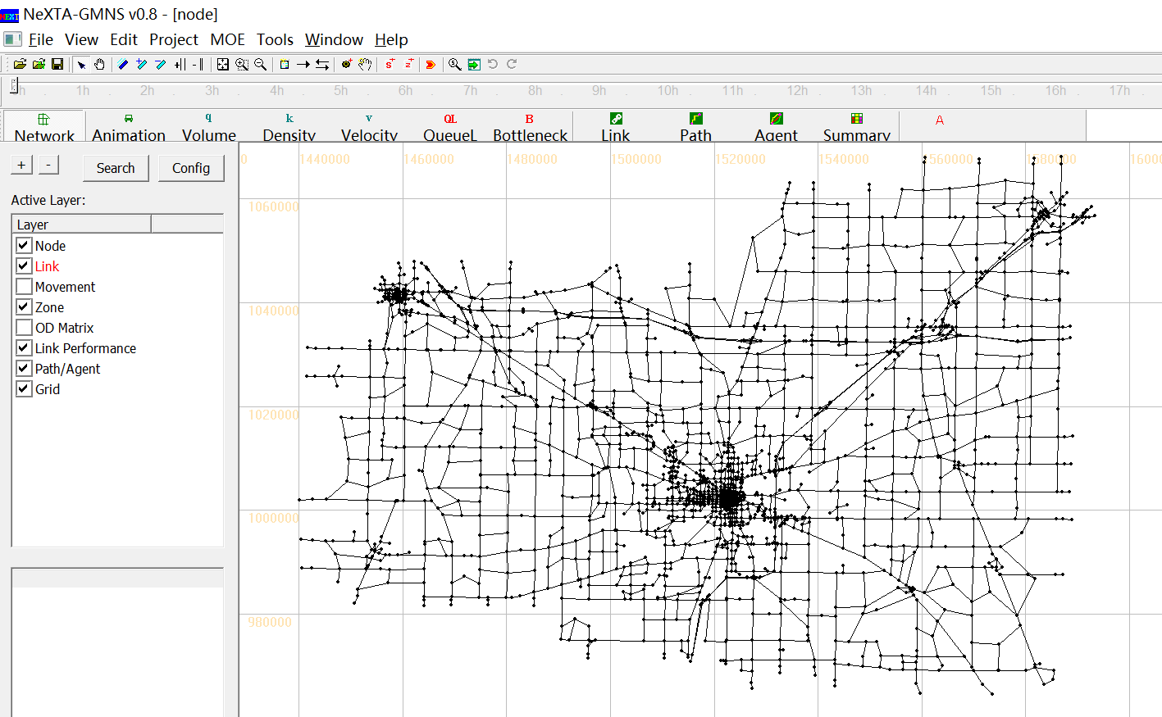
How to open a data set?

Slide 4
Outline
1. Network-related Display
2. Time-dependent Simulation Result Display
3. Advanced Analysis Features
4. Changing Network Data

Slide 5
Network-related Display

Slide 6
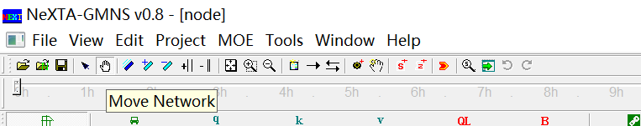
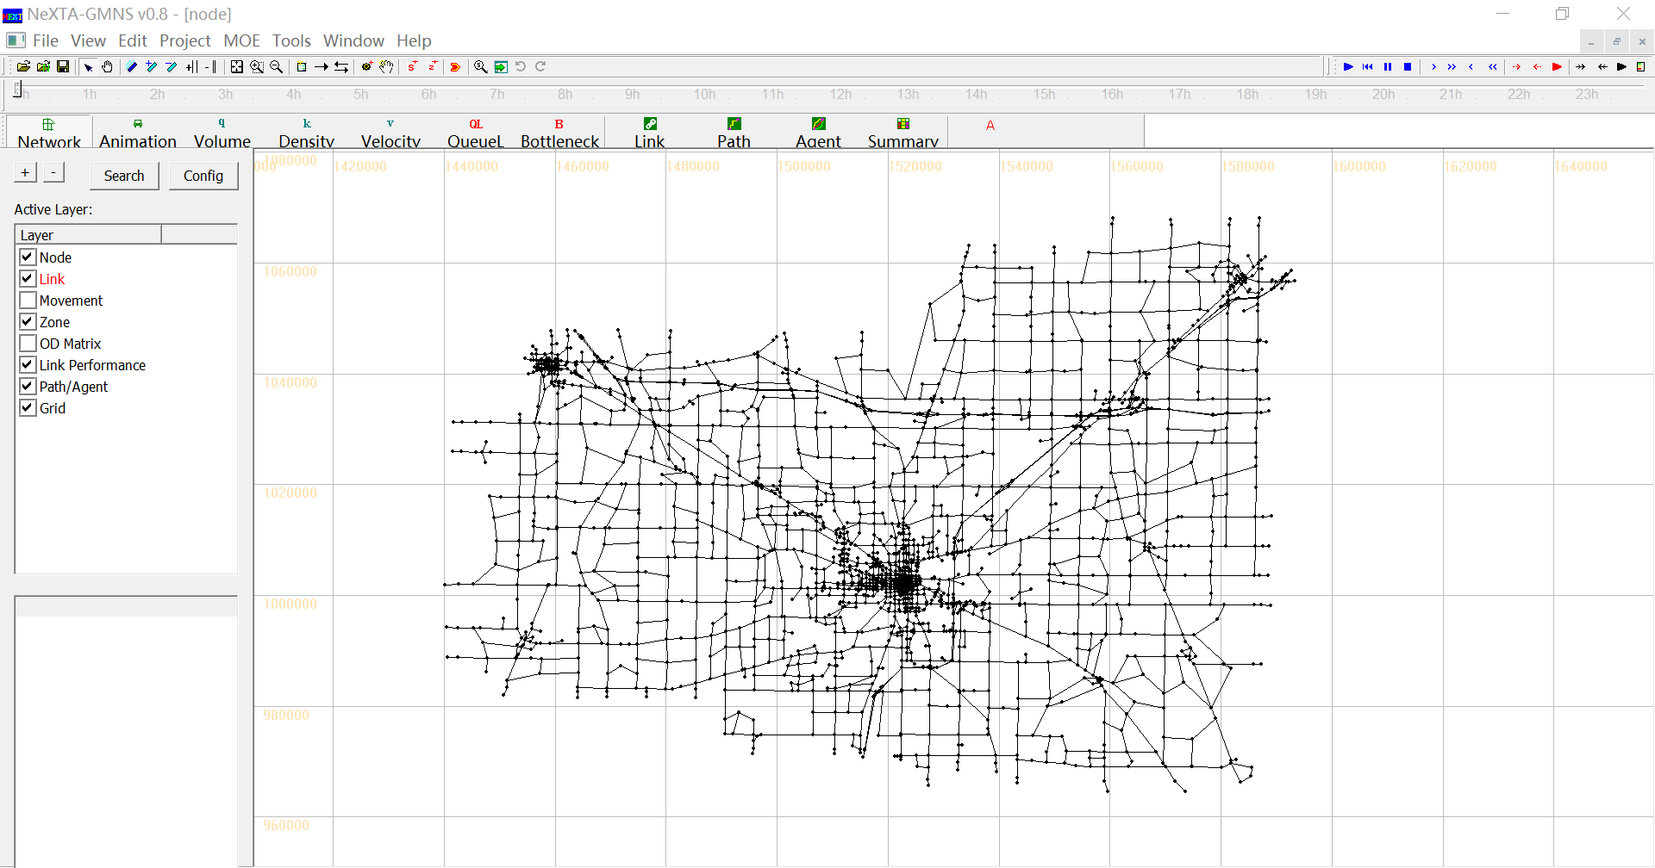
How to move a network?
Notes:
Click on the “Move Network” toolbar button.

Slide 7
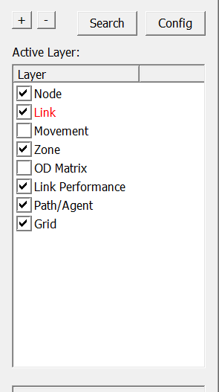
How to use GIS layer panel?
Link layer is selected.
Notes:
GIS layer panel, on the left of the display view, enable users to switch between different layers and show/ hide each layer.
Click one layer on the GIS layer panel , the corresponding layer becomes red when this layer is selected.
Check or uncheck this layer to show the corresponding data items on the display view.

Slide 8
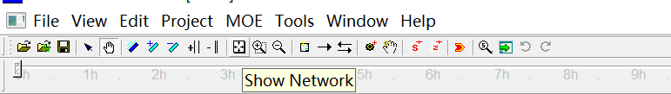
How to reset the network display?
Notes:
Click on the “Show Network” toolbar button.

Slide 9
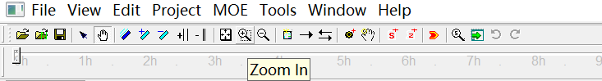
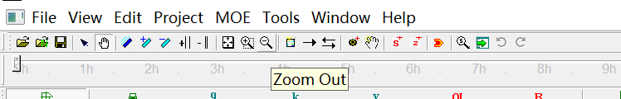
How to zoom in and zoom out?
Notes:
Click on the “Zoom in”/“Zoom Out” toolbar button.
You can also roll the mouse wheel to zoom in and out on the display view.

Slide 10
How to increase/decrease the size of node?
Notes:
Click on the “+”/“-” button in GIS layer panel.

Slide 11
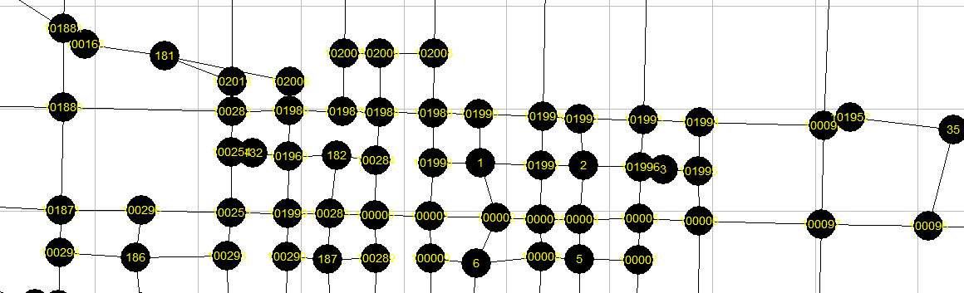
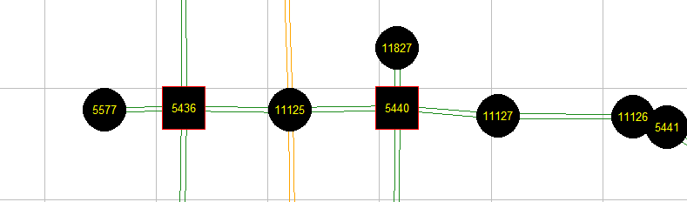
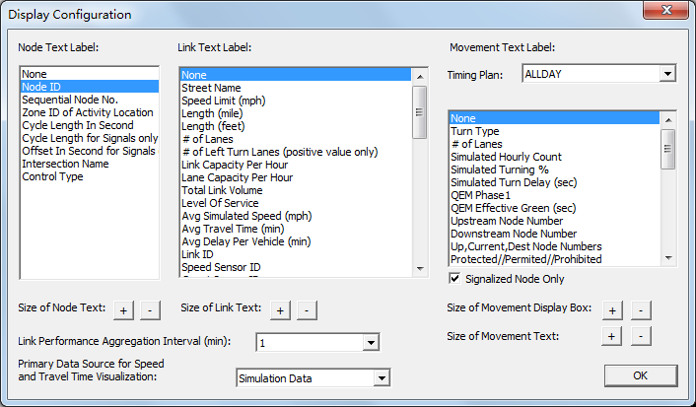
How to show node label?
1
2
Notes:
Click on the "Config" button in GIS layer panel to display the “Display Configuration” dialog;
Choose the text you want to show on the nodes and click “OK”.

Slide 12
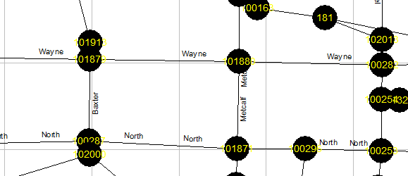
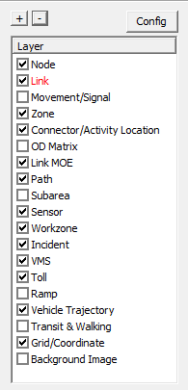
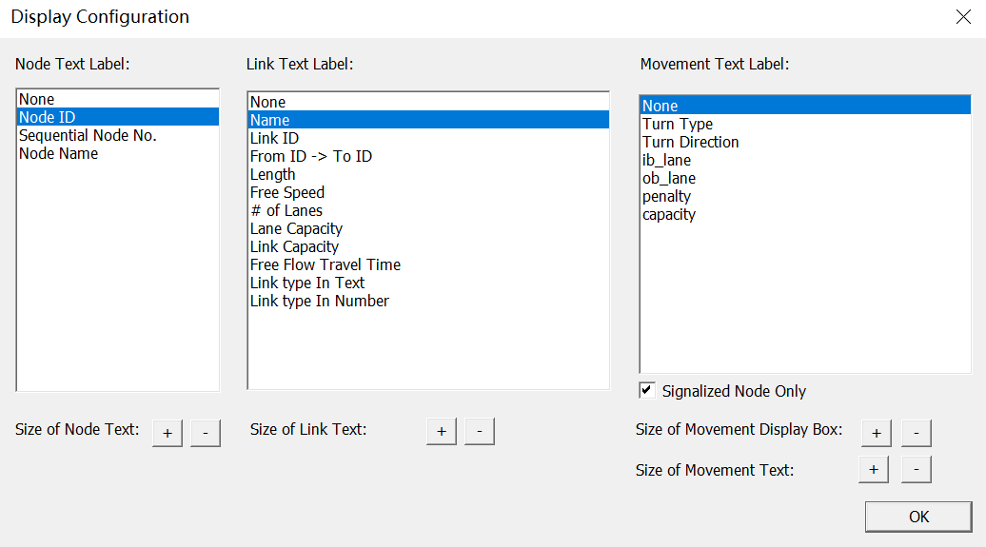
How to show link label?
1
2
Notes:
Click on the "Config" button in GIS layer panel to display the “Display Configuration” dialog;
Choose the text you want to show on the links and click “OK”.

Slide 13


How to increase/decrease offset between links?

Slide 14

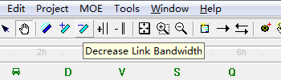
How to increase the bandwidth of a link?

Slide 15
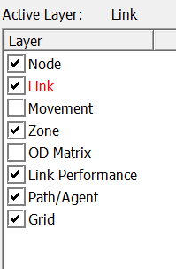
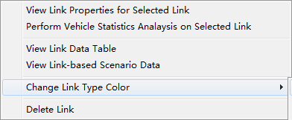
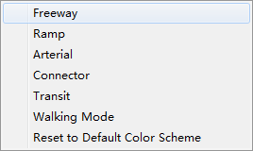
How to change link color?
1
2
3
Notes:
Choose Link layer in GIS layer panel;
Right-click on the display view and choose “Change Link Type Color” in the pop-up menu;
Select the type of link you want to change color of.

Slide 16
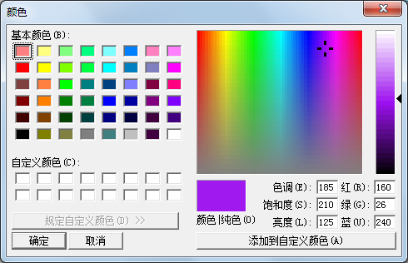
How to change link color?
4
Notes:
4. Choose the color you want to set to the link type.

Slide 17
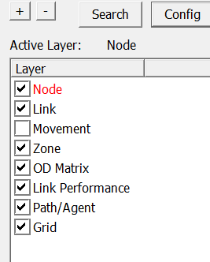
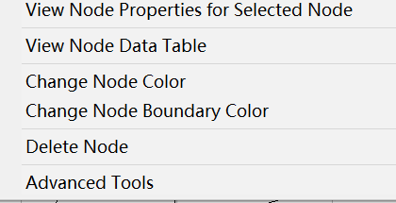
How to change node color?
1
2
3
Notes:
Choose Node layer in GIS layer panel;
Right-click on the display view and choose “Change Node Color” in the pop-up menu;
Choose the color you want to set to the nodes.

Slide 18
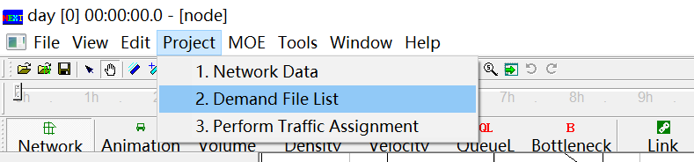
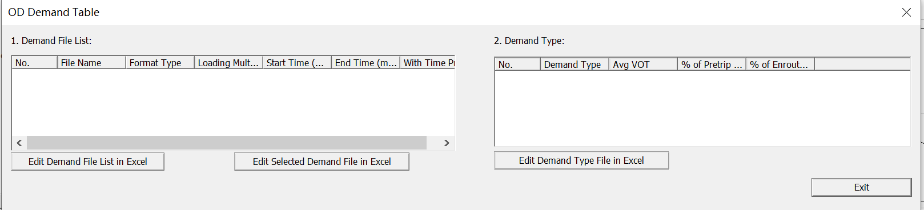
How to show OD matrix?
1
2
Notes:
Go to Project -> 2. Demand Meta Database;
In OD Demand Table, choose the demand find in Demand File List.

Slide 19
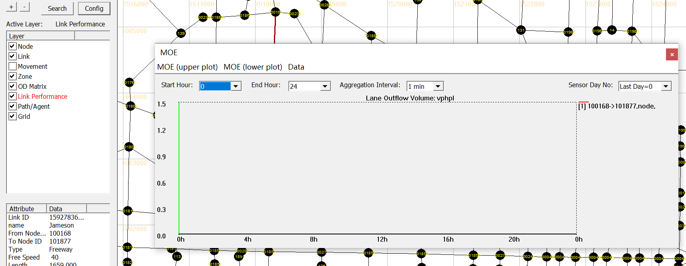
How to show link MOE?
1
2
Notes:
Choose Link MOE layer in GIS layer panel;
Choose a link on the display view.

Slide 20
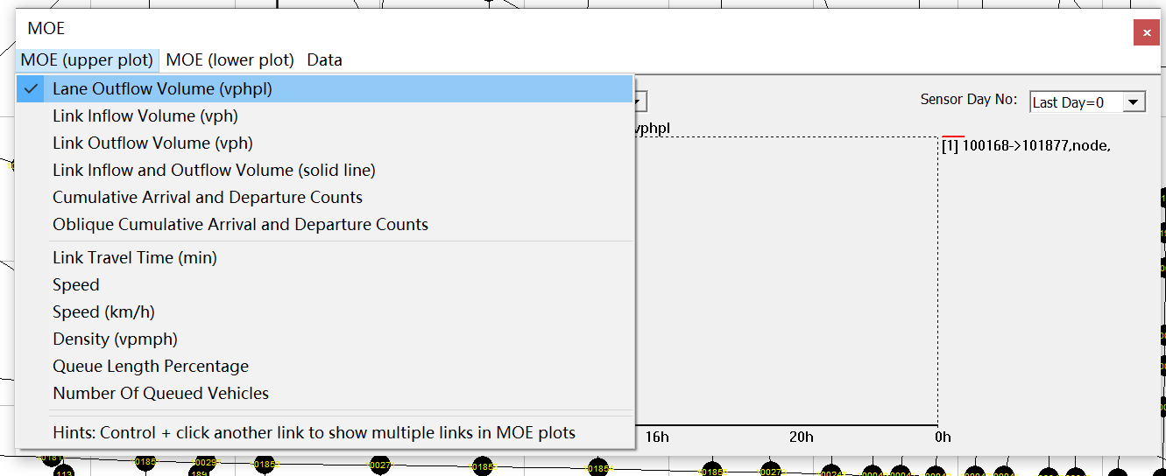
How to show link MOE?
Notes:
You can choose different MOEs from drop-down menu.

Slide 21
How to show two MOEs simultaneously?
1
2
Notes:
Choose Link MOE layer in GIS layer panel;
Choose a link on the display view;

Slide 22
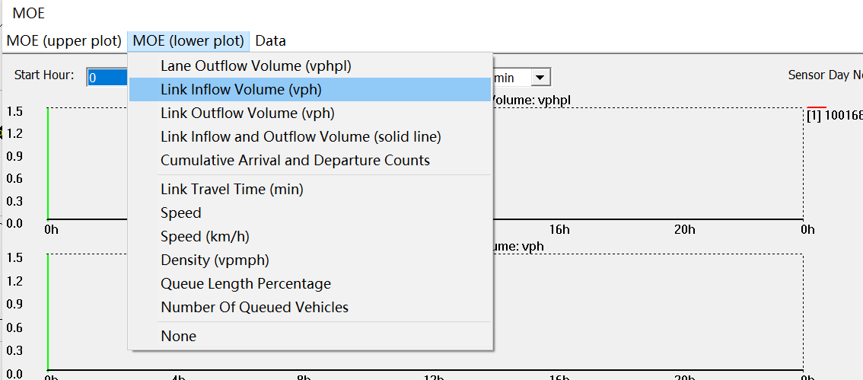
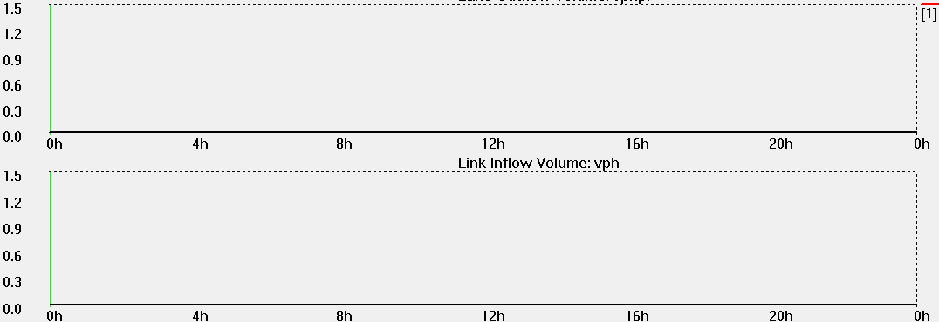
How to show two MOEs simultaneously?
3
Notes:
3. Click “MOE (lower plot)”menu in MOE window and choose an MOE to output.

Slide 23
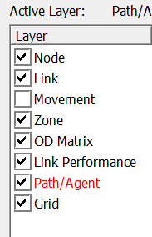
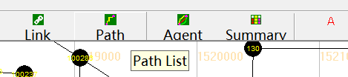
How to select a path?
1
2
Notes:
Check the check box of “Path” in GIS layer panel;
Click on the “Path List” button in the toolbar to open “Path List Dialog” window;

Slide 24
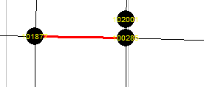
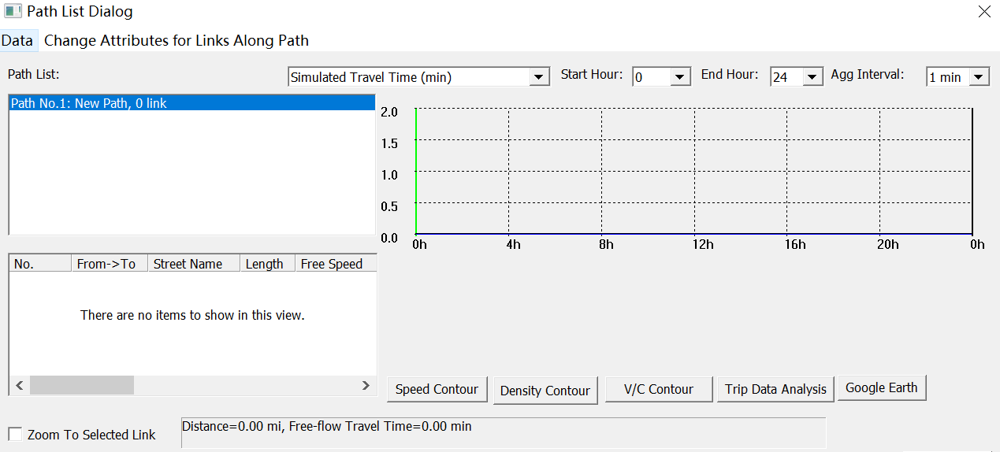
How to select a path?
3
Notes:
3. Click on the path in the “Path List” box in the “Path List Dialog” window, and the corresponding path is selected in the display view.

Slide 25
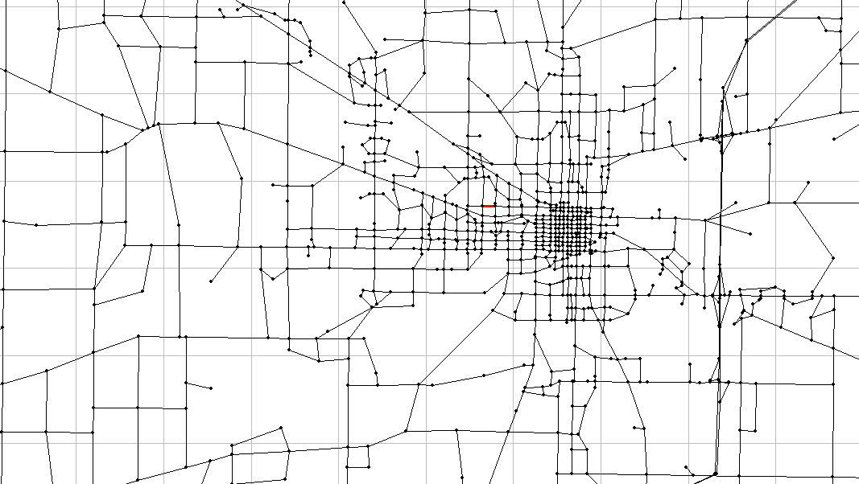
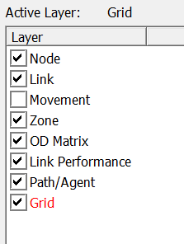
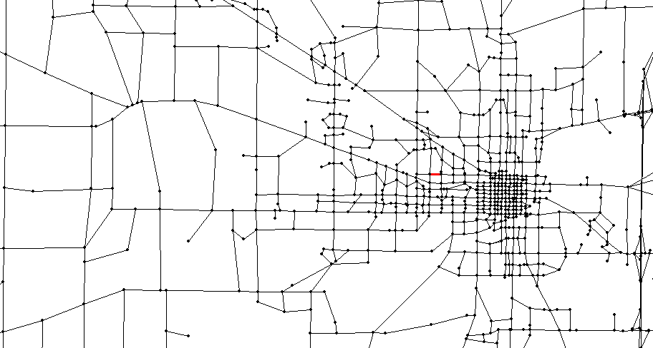
How to show/hide grid?
Notes:
Check/uncheck the check box of “Grid/Coordinate” in GIS layer panel.

Slide 26
Advanced Analysis Features

Slide 27
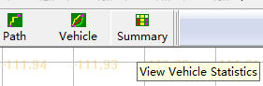
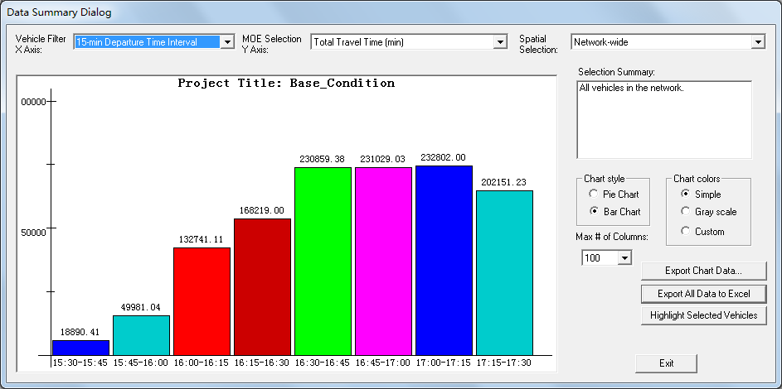
How to do overall network statistics?
1
2
Notes:
Click on the “Summary” button in the toolbar to open “Data Summary Dialog”;
Choose x and y axis to plot various summary chart.

Slide 28
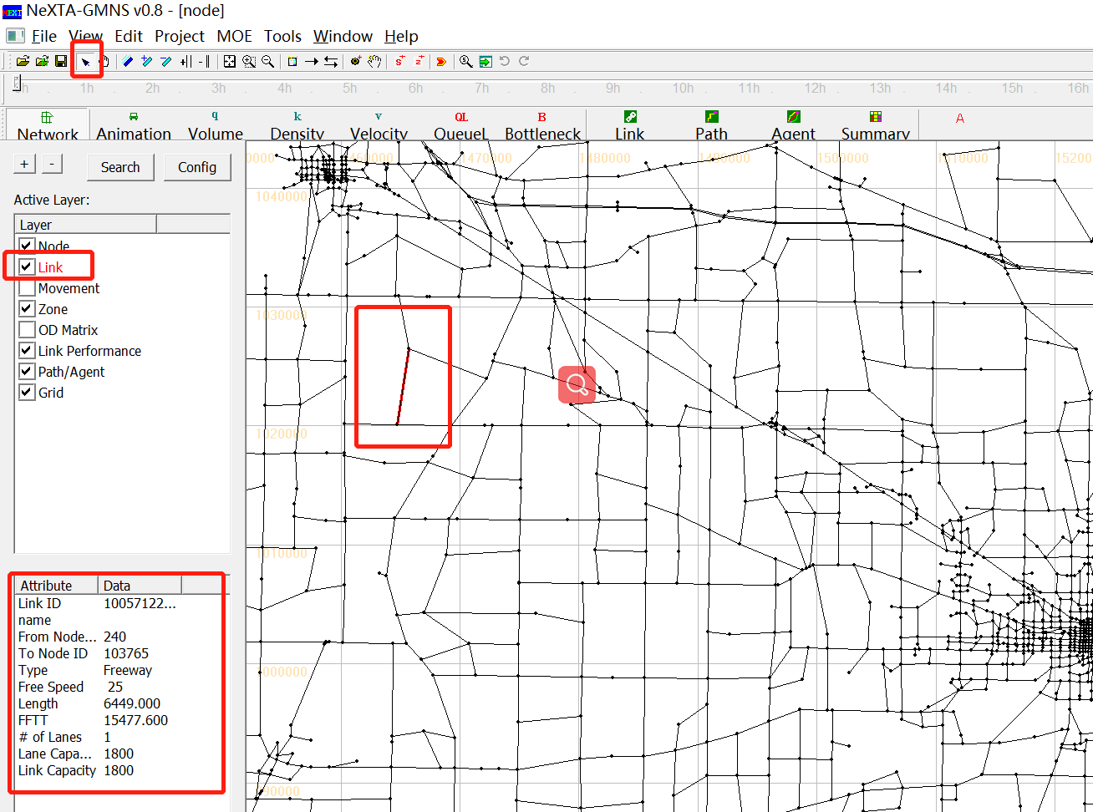
How to select link analysis?
1
2
Notes:
Choose Link layer in GIS layer panel;
Choose “Select Object” button in the toolbar;

Slide 29
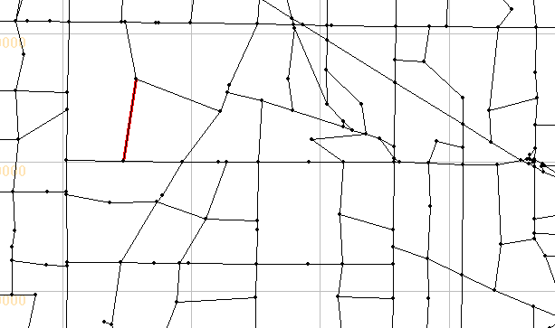
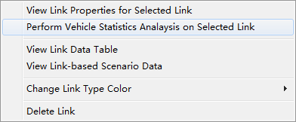
How to select link analysis?
3
4
Notes:
3. Select the link you want to analyze;
4. Right-click on the display view and click “Perform Vehicle Statistic Analysis on Selected Link”;

Slide 30
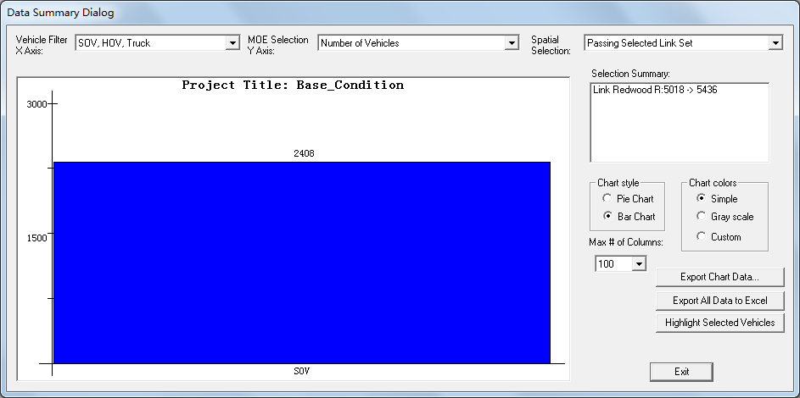
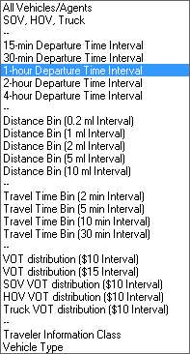
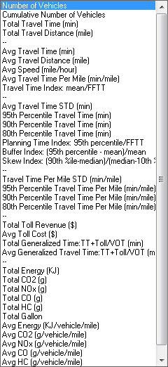
How to select link analysis?
5
Notes:
5. Choose the data for x axis and y axis from the drop-down list.

Slide 31
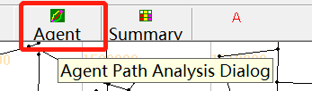
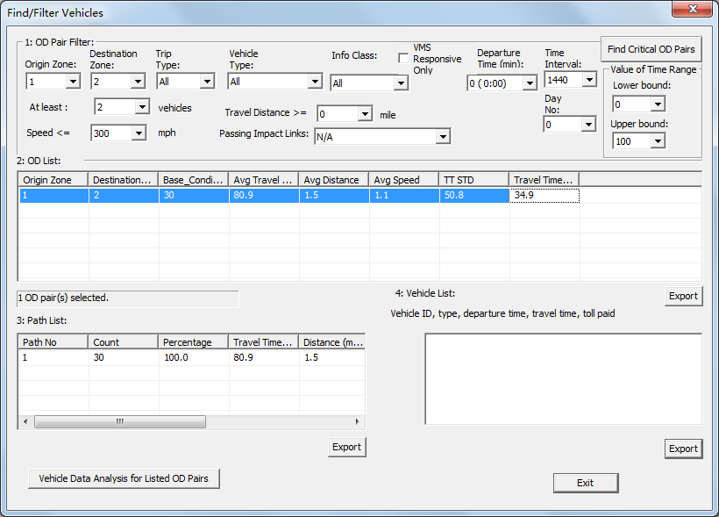
How to select OD analysis?
1
2
Notes:
Click on the “Vehicle” button in the toolbar;
In the “Find/Filter” window, choose the OD information in “1: OD Pair Filter”, click the OD record in the “2: OD List” and click on “Vehicle Data Analysis for Listed OD Pairs”;

