Slide 1
WEEKLY UPDATE
Argonne National Laboratory
August 11, 2026

Slide 2
2012 RAS Competition Problem
Movement planning and train dispatching on multi-track territories
GIVEN
DETERMINE
OUTPUT
Network + trains + operating rules
Routing + timing + precedence
Feasible movement plan
• Multi-track territory: main tracks, sidings, switches, crossovers
• Train origin, destination, direction, and ENTRY TIME
• Running times, speed/length, and operating attributes
• Usable siding length and special-train restrictions
• MOW windows and conflict relationships
• Scheduled Arrival (SA), Terminal Want Time (TWT), track preferences
• Route / physical track used by each train
• Entry and exit time on each selected segment/resource
• Main-track (link type 0/1/2) vs. siding/switch/crossover selection
• Meet/pass and overtaking decisions
• Conflict precedence: which train moves first
• Holding and departure decisions when needed
• Physically connected origin-to-destination route
• One valid track/resource selected per segment
• Conflict-free resource occupancy
• Safe temporal separation
• Executable timetable / dispatching plan
→
→
OPTIMIZATION AFTER FEASIBILITY
FEASIBILITY FIRST → PERFORMANCE SECOND
Among feasible movement plans, minimize weighted operating penalties:
Train delay • Schedule Arrival deviation • Terminal Wanted Time deviation • Non-preferred track usage
FIRST construct a safe, operationally feasible timetable. THEN reduce delay and service penalties.
Reference: INFORMS RAS 2012 competition — “Movement Planner Algorithm Design for Dispatching on Multi-Track Territories”; corrections; Yan & Yang.
Notes:
[Sources]
INFORMS RAS, 2012 Problem Solving Competition announcement, “Movement Planner Algorithm Design For Dispatching On Multi-Track Territories”: https://higherlogicdownload.s3.amazonaws.com/INFORMS/e52cec4c-eedb-4c3b-a379-8408d89f8fc9/UploadedImages/RAS%202012%20Problem%20Solving%20Competition%20Announcement.pdf
2012 RAS Problem Solving Competition Corrections: https://higherlogicdownload.s3.amazonaws.com/INFORMS/e52cec4c-eedb-4c3b-a379-8408d89f8fc9/UploadedImages/2012%20RAS%20Problem%20Competition%20Corrections.pdf
Yan & Yang, Mixed-integer Programming Based Approaches for the Movement Planner Problem: https://optimization-online.org/wp-content/uploads/2016/06/5473.pdf
[/Sources]

Slide 3
Feasibility First: Rules, Validation, and Solution Methods
Safety and physical validity are pass/fail; service deviations affect cost.
1 SAFETY / RESOURCE CONFLICTS
HARD
HARD vs. SOFT
SOLUTION / EVALUATION FRAMEWORK
No incompatible occupancy; switches/crossovers respected; 300 s minimum separation for relevant conflicting movements.
HARD CONSTRAINT
Violation → INFEASIBLE
SOFT / PERFORMANCE TERM
Deviation → higher objective cost
Candidate schedule
↓
Independent validator
↓
Feasible?
NO → Reject YES → Compute objective
2 PHYSICAL CONNECTIVITY
HARD
Continuous O-D movement; one valid resource per segment; train length ≤ usable siding.
3 OPERATIONAL RESTRICTIONS
A late train can still be FEASIBLE.
A safety or physical conflict cannot.
HARD
PROPOSED COMPETITION FRAMEWORK
Inhalation Hazard/Hazmat siding restrictions; applicable meet/pass, overtaking and priority rules.
4 TIME / INFRASTRUCTURE AVAILABILITY
Proposed modern evaluation: 1 feasibility validator — Pass/Fail 2 objective among feasible schedules 3 runtime/scalability 4 method explanation/reproducibility
No entry before ENTRY TIME; running/dwell minima; MOW windows block resources.
HARD
ANY VALID SOLUTION METHOD
Priority-based
event simulation
Space-time shortest path
/ dynamic programming
MILP / CPLEX
CP-SAT
Lagrangian relaxation • Branch-and-price
Large-neighborhood / hybrid search
Solver choice is secondary. Producing a valid movement plan is primary.
FEASIBILITY FIRST → PERFORMANCE SECOND
Reference: INFORMS RAS 2012 competition and corrections; Yan & Yang historical RAS formulation. Validator pipeline is a proposed modern framework.
Notes:
[Sources]
INFORMS RAS, 2012 Problem Solving Competition announcement: https://higherlogicdownload.s3.amazonaws.com/INFORMS/e52cec4c-eedb-4c3b-a379-8408d89f8fc9/UploadedImages/RAS%202012%20Problem%20Solving%20Competition%20Announcement.pdf
2012 RAS Problem Solving Competition Corrections (five-minute / 300-second separation): https://higherlogicdownload.s3.amazonaws.com/INFORMS/e52cec4c-eedb-4c3b-a379-8408d89f8fc9/UploadedImages/2012%20RAS%20Problem%20Competition%20Corrections.pdf
Yan & Yang, Mixed-integer Programming Based Approaches for the Movement Planner Problem: https://optimization-online.org/wp-content/uploads/2016/06/5473.pdf
Independent validator and Pass/Fail → objective → runtime framework: proposed modern competition mechanism, not asserted as the historical 2012 scoring format.
[/Sources]

Slide 4
Refine 1
An 18-waypoint polyline with a match radius reaching 89.9 km tagged 17,637 miles of track for a 2,200-mile railroad
BEFORE – Every BNSF line within the radius
AFTER – routed path through named BNSF facilities
Newton
Chicago
Belen
Barstow
Amarillo
Winslow
LA
every BNSF line within the radius — branches, yard leads, parallel routes — all labelled Transcon
13 of 13 anchor-to-anchor legs routed;
edges weighted by the official network's main-track count
2,213.97
718
14.6
−15,423
route-miles extracted
(BNSF states ~2,200)
route segments,
ordered with mileposts
miles of foreign track
needed to connect legs
miles removed from the
corridor label
Notes:
The old corridor label was assigned by proximity to 18 waypoints with a match radius up to 89.9 km. The rebuild routes through BNSF's own named facilities and weights edges by NARN main-track count.

Slide 5
Refine 2
The network stores the same railroad more than once. Counting records would invent track; the fix is to cluster by lateral offset.
CASE A
CASE B
CASE C
Duplicate records
Genuine parallel mains
A siding inside the envelope
lateral offset from centerline
lateral offset from centerline
lateral offset from centerline
< 10 m apart
> 10 m apart
> 10 m apart
1 alignment
3 alignments
1 alignment
Same track digitised twice with different node ids. Offsets differ by < 10 m.
Separate alignments > 10 m apart that persist for more than ±1.5 mi.
Second alignment lasts only 1–3 mi, so the persistence filter rejects it.
counting records would read 2–6 tracks
this is a real triple track
handed to the siding layer, not counted as main
track_count = max( persistent_alignments , declared_track_count )
Real example — Cajon Pass
Max, never sum. A double track appears either as two alignments of tracks=1 or one alignment of tracks=2 — sometimes both. Summing multiplies the encodings together.
S085708 and S091393: two separate records, both tracks=3, both ~0 m from the centerline. One three-track railroad, not six tracks.
1,643 parallel records (1,209 mi) folded into the route — 30 of them share a node pair with a route segment outright, i.e. verbatim duplicates.
Notes:
This is the correction to our original hypothesis. We expected parallel records to be undercounted tracks. Inspection showed most are duplicate records of the same track, so clustering by lateral offset is required, and the estimator takes a max rather than a sum. Shared-node connected components cannot be used because parallel mains are joined at every crossover.

Slide 6


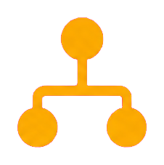


0.25-Mile Bin - (swicth + siding)
Refine track count by split the corridor by milepost into 0.25-mile bins
0.00
0.25
0.50
0.75
1.00
Bin = spatial aggregation unit
Not a signaling block
Milepost
Bin 1
Bin 2
Bin 3
Bin 4
Reconcile multiple sources in each bin to determine main-track count
Bin 1
Bin 2
Bin 3
Bin 4
NTAD
FRA crossing
Reconcile
select the maximum value
Topology
2 main tracks
2 main tracks
1 main track
+ 1 siding (range from 0.3–4 miles)
(excluded from main-track count)
2 main tracks
OSM
track count n_b = [2, 2, 1, 2]
Bin
main track count
(n_b)
track-miles
(n_b × 0.25 mile)
Bin 1
2
0.50
Bin 2
2
0.50
Bin 3
1
0.25
Bin 4
2
0.50
Total = 1.75 track-miles

Slide 7
0.25-Mile Bin (crossover)
Refine track count by split the corridor by milepost into 0.25-mile bins
0.00
0.25
0.50
0.75
1.00
Bin = spatial aggregation unit
Not a signaling block
Milepost
Bin 1
Bin 2
Bin 3
Bin 4
Reconcile multiple sources in each bin to determine main-track count
Bin 1
Bin 2
Bin 3
Bin 4
NTAD
FRA crossing
Reconcile
select the maximum value
Topology
2 main tracks
2 main tracks
2 main track
+ 1 crossover
2 main tracks
OSM
track count n_b = [2, 2, 2, 2]
Bin
main track count
(n_b)
track-miles
(n_b × 0.25 mile)
Bin 1
2
0.50
Bin 2
2
0.50
Bin 3
2
0.25
Bin 4
2
0.50
Total = 2 track-miles

Slide 8
How the track count is now established
Four independent sources reconciled per 0.25-mile bin, with continuity bridging between observations
NTAD North American Rail Network
TRACKS + NET + SUBDIV per arc
1,493 arcs on corridor
sets 8,020 bins
FRA Grade Crossing Inventory
94.2%
Form 6180.71 main / siding / yard
2,027 BNSF crossings on corridor
sets 322 bins
RECONCILE
max of the
four sources
of mileposts carry a direct
official observation
Topology
each under-reports;
none over-reports
parallel-alignment lower bound
from the physical network
sets 234 bins
was 4.5% of segments
OpenStreetMap tracks=*
Continuity bridging: a bin with no observation, lying between two observed bins no more than 25 miles apart, inherits min(left, right) — 302 bins. Bridging never overwrites a bin that has its own observation, which is why Sibley MO and Alva OK stay single track.
2 usable tags of 2,063 segments
— effectively silent
sets 0 bins
Where NARN and FRA both speak
Two independent official datasets agreeing on single track is a far stronger statement than one. Crossing revision dates are 2024–2026.
3,321 bins
1,519 bins
560 bins (~140 mi)
agree
differ
agree it is SINGLE TRACK
Notes:
The reconciliation takes a max across sources because every source under-reports and none systematically over-reports. Modal values are taken within each source so one mis-keyed crossing cannot lift a bin.

Slide 9
How the four sources are merged
One rule per 0.25-mile bin, and a separate, deliberately weaker rule for the bins no source observed
RECONCILE — take the maximum
CONTINUITY BRIDGING — take the minimum
N(bin) = max ( N_NARN , N_FRA , N_topology , N_OSM )
N(gap) = min ( N_left , N_right ) gap ≤ 25 miles
Every one of these sources under-reports and none systematically over-reports. An FRA record written before a double-tracking project still says 1; an unmatched OSM way yields nothing; a railroad digitised as a single alignment yields 1. A source claiming MORE track is therefore evidence; a source claiming less is only silence.
A main track does not stop and restart. A bin with no observation of its own, lying between two observed bins, inherits from them - but only across a gap of 25 miles or less, and never over a bin that carries its own evidence.
Worked example, one bin
mile 100 mile 103 mile 106
tracks = 2 unknown tracks = 3
NARN
2
FRA
3
max = 3
FRA has already
observed 3 tracks here
Why the minimum, when the reconcile rule takes the maximum: three tracks on one side is no evidence that all three run through the gap. The only thing the two observations jointly support is that at least two run continuously - so the gap inherits min(2, 3) = 2.
Topology
2
OSM
no match
Which rule actually set each of the 8,856 bins on the corridor
8,020
322
280
234
NARN track count
FRA main tracks
bridged across a gap
Stage 2 topology only
90.6% of bins
3.6% of bins
3.2% of bins
2.6% of bins

Slide 10

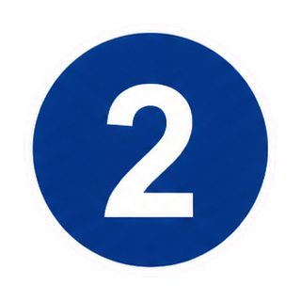

Input_rail_arc.csv
1. Segment layer
2. First copy by track count
track type 0
A
B
Segment S100
A
B
track type 1
A
B
length = L
track_count = 3
track type 2
A
B
3 parallel main tracks

Slide 11
Results and the open findings on Southern Transcon
Track Type | Number of Arcs | Track Mileage (Sum of Arc Lengths) | Mileage Coverage (Union)
Main Track 1 | 1,918 | 2,213.97 | 2,213.97
Main Track 2 | 1,766 | 1,999.31 | 1,999.31
Main Track 3 | 187 | 119.52 | 119.52
Main Track 4 | 40 | 14.54 | 14.54
Crossover | 547 | 54.70 | 0.00
Siding | 56 | 53.85 | 71.70
Switch | 112 | 33.60 | 31.52
Notes:
The three failures are findings, not defects. G05/G06 are the substantive result to discuss with ANL: two independent official datasets disagree with the carrier's public statement, and we have the exact mileposts.

Slide 12
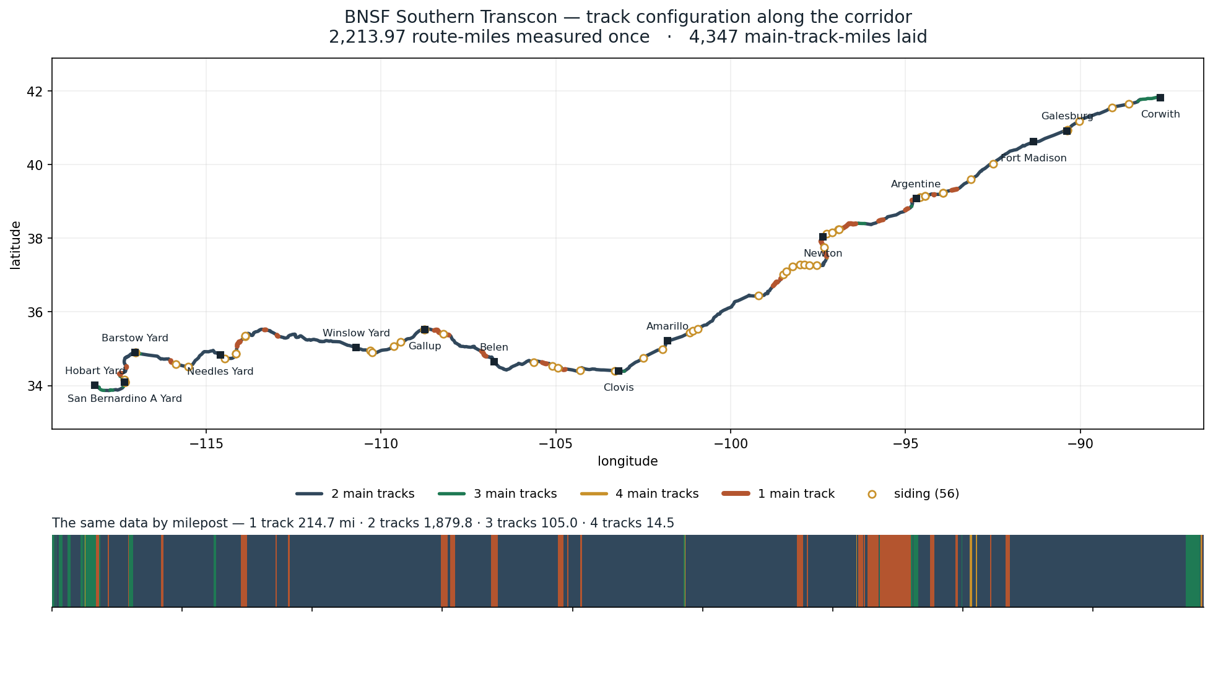

Slide 13

Element | Value | Evidence / Basis
Main Track Speed | 70 mph | FRA timetable: typical/medium speed of 70 mph
Siding Speed | 25 mph | FRA Class 2 track freight speed limit, 49 CFR §213.9
Switch Speed | 30 mph | No. 15 turnout, diverging movement; common U.S. rule of thumb: rated speed ≈ 2 × frog number
Crossover Speed | 45 mph | No. 20 turnout design based on AREMA practice; FRA Report RR06-10
Switch Length | 0.034 mi | Approximate distance from switch point to end of frog for a No. 20 turnout: about 150–180 ft
Crossover Length | 0.114 mi | Connecting track ≈ track spacing × frog number = 15 ft × 20 = 300 ft; including two turnouts gives approximately 600 ft total
Type | Multiplier | 70 × Multiplier
intermodal | 1.00 | 70
autorack | 0.85 | 60
manifest | 0.65 | 46
bulk | 0.50 | 35
Main Track Speed for different Train

Slide 14
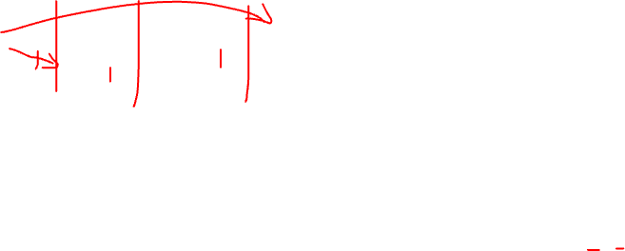
Preprocessing before entering solver
1
3
0
5
6
0
5
6
2
4
2
4
Group 0
Group 1
Group 2
Group 3
Group 0
Group 1
Group 2
Group 3
Frontier nodes: {0}
Frontier nodes: {1, 2}
Frontier nodes: {3, 4}
Frontier nodes: {5}
Frontier nodes: {0}
Frontier nodes: {1, 2}
Frontier nodes: {3, 4}
Frontier nodes: {5}
1
Frontier = {0}
Take all terminal nodes of arcs on the frontier
(0,2), (0,5)
Group 0
Frontier = {0}
Take all terminal nodes of arcs on the frontier
(0,1), (0,2)
Group 0
2
New frontier = {2,5}
(0,2), (5,6)
Group 1
New frontier = {1,2}
(1,3), (2,4)
Group 1
3
New frontier = {4}
(2,4)
Group 2
New frontier = {3,4}
(3,5), (4,5)
Group 2
4
New frontier = {5}
(5,6)
Group 3
New frontier = {5}
(5,6)
Group 3

Slide 15
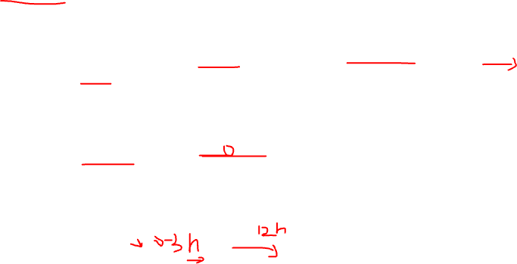
MILP/CPLEX as One Solution Approach: Mixed-Integer Linear Programming (MILP/MIP) + CPLEX Solver, combined with a Rolling-Horizon Approach and Heuristic Variable Fixing.
INPUTS
MILP/MIP MODEL
SOLVER
MILP/MIP + CPLEX Solver with Rolling Horizon and Heuristic Variable Fixing
DECISION VARIABLES
KEY CONSTRAINTS
CPLEX Solver
Train Data
IDs, type, entry time, length, hazardous, Scheduled Arrival (SA), Terminal Want Time (TWT),etc.
x_begin[i][j] :
No entry before ENTRY TIME
time train i enters
Time continuity between consecutive segments
segment j
Minimum running time = length / speed
x_end[i][j] :
Select exactly one track/arc per segment
time train i exits
segment j
Minimum 300-second headway on same segment
q[i][j][k] :
MOW time-window restrictions
binary, train i selects
Length limits for sidings
SOLUTION OUTPUTS
Network Data
tracks/arcs, (main, siding, crossover),
length, speed, MOW Windows
track/arc k at segment j
✓
Train departure times
λ/γ :
Hazmat trains cannot use sidings
✓
sequencing (who goes first)
No overtaking for certain train pairs
Entry and exit times on each segment
for two trains on same segment
Penalties for SA and TWT deviations
✓
Selected track (main / siding /
Ddelay, DSAdev ,
Maximum delay limit (for some datasets)
crossover)
Dtwant_plus/minus :
✓
Train sequencing on conflicts
delay and deviation variables
✓
Total objective value
(delay and deviation penalties)
ROLLING HORIZON APPROACH
HEURISTIC VARIABLE FIXING
Full Planning Horizon
Window t
Heuristic Variable Fixing
Window t+1
Window T
Use heuristics to identify
(Optimize)
(Commit)
(Optimize)
(Optimize)
high-confidence decisions
Benefits
•
Fix variables to reduce
Smaller MILP size
•
problem size and improve
Faster solve time
Fix decisions in the solved
•
Solve MILP with CPLEX
Re-optimize next window
Continue until the end
solve efficiency
Better scalability
window
with updated conditions
of the horizon
•
Focus CPLEX on the most
More stable solutions
Time
critical decisions
Current optimization window
Committed (fixed) decisions
Fixed by heuristic
···
Move forward

Slide 16
Our data match the RAS data schema
TERRITORY: RAS DATA SET 1
DEFAULT SPEED on MAIN TRACKS, WEST -> EAST: 80 mph
DEFAULT SPEED on MAIN TRACKS, EAST -> WEST: 70 mph
MAXIMUM SPEED on SIDINGS, both directions, all trains: 20 mph
MAXIMUM SPEED on CROSSOVERS and SWITCHES, both directions, all trains: 15 mph
MOW: 48 54 120 360
ARC ID ...: (0,1) (0,2) (1,3) ...
TRACKTYPE ...: 0 SW 0 ...
LENGTH (miles): 0.3 0.3 2 ...
TRAINS: 12
Train length …
HEADER: A1
ENTRY TIME ...: 0
ORIGIN NODE: 0
DESTINATION NODE: 39
DIRECTION: EASTBOUND
SPEED MULTIPLIER: 1.00
TRAIN LENGTH (miles): 1
TOB: 75
HAZMAT ...: NO
SA STATUS AT ORIGIN: 0
SCHEDULED ARRIVAL ...: 37: 60 , 39: 130
TERMINAL WANT TIME ...: EAST: 90
TERRITORY: SOUTHERN TRANSCON SET 1
DEFAULT SPEED on MAIN TRACKS, WEST -> EAST (u->v): 70 mph
DEFAULT SPEED on MAIN TRACKS, EAST -> WEST (v->u): 70 mph
MAXIMUM SPEED on SIDINGS, both directions, all trains: 25mph
MAXIMUM SPEED on SWITCHES, both directions, all trains: 30mph
MAXIMUM SPEED on CROSSOVERS, both directions, all trains: 45mph
MOW:
ARC ID (WEST -> EAST, all bidirectional):(0,3) (1,4) (2,5) (0,4) …
TRACKTYPE: 0 1 2 C …
LENGTH (miles): 0.510277 .. 0.081955 .. 0.286935 …
TRAINS: 12
HEADER: B4846_T0095
ENTRY TIME (from current time in minutes): 0
ORIGIN NODE: 0
DESTINATION NODE: 70
DIRECTION: EASTBOUND ((u->v)
SPEED MULTIPLIER: 1.00
TRAIN LENGTH (miles): 0
TOB: 75
HAZMAT (IH: YES or NO): NO
SA STATUS AT ORIGIN: 0
SCHEDULED ARRIVAL (NODE: minutes from current time): 70: 52.146
TERMINAL WANT TIME…: EAST: 52.146
…

Slide 17
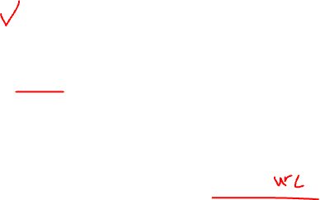
The solver working logic:
In [formal_instances.h (line 18)](17 Bamboo Tsinghua/src/formal_instances.h:18)
The main decision variables include:
x_begin[i][j]: Time when train i enters segment j
x_end[i][j]: Time when train i exits segment j
q[i][j][k]: Binary variable indicating which track/arc train i selects at segment j
lambda/gamma: Binary sequencing variables indicating which of two trains goes first when they use the same segment
D_delay: Train delay
D_SAdeviation: Deviation from the Scheduled Arrival time
D_twant_plus/minus: Positive/negative deviation from the Terminal Want Time
Therefore, the model jointly determines:
When each train departs;
When each train enters and exits each segment;
Which main track, siding, or crossover each train uses;
The precedence/order of conflicting trains.

Slide 18
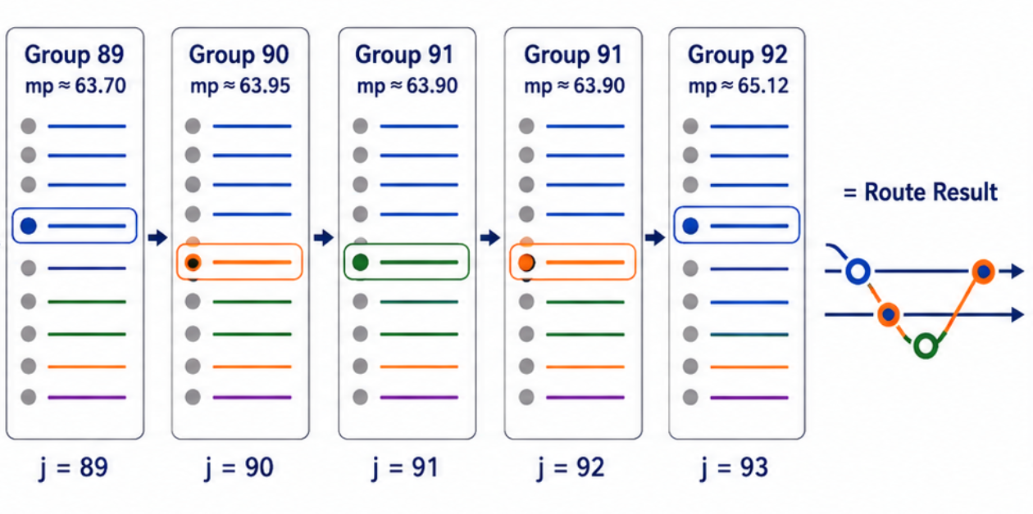
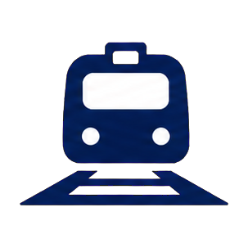
Interpret q[i][j][k] in solver
Group 91: 8 Options
1
Main Track 2
2
Main Track 3
Legend
q[i][j][k] =
Train i
Blue =
Main Track
3
Main Track 1
Train i selects
the k-th arc
at cross-section j.
4
Main Track 0
Green =
Siding
5
Siding S ①
6
Siding S ②
Orange =
Switch
7
Siding S ③
Purple =
Crossover
8
Crossover C
Select 1 arc
at each
cross-section
j = 89
j = 90
j = 91
j = 92
…
j = 93
Connect all j’s in sequence
Train Route

Slide 19
Objective Function:
1
2
2. S-Term Penalty
3
3. TWT Deviation Penalty
4
4. U-Term Penalty
(
∑
)
∑
∑
(
)
∑
∑
c^{U}z^{U}_{i,j}
c^{D}_{i}
x^{entry}_{i,oᵢ}
− b
+
z^{D}_{i,j}
c^{S}z^{S}_{i,j}
c^{TWT}
z^{TWT+}_{i} + z^{TWT−}_{i}
i
j∈Bᵢ
i∈T
j∈Nᵢ
i∈T
j∈Bᵢ
Includes origin waiting / entry-time deviations and delay-related penalties
Represents the penalty term associated
deviations and delay-related penalties
Penalizes early / late deviations from Terminal Want Time (TWT)
Represents the penalty term associated with U-type (e.g., non-preferred routing/use) deviations
T
Bᵢ
i
Nᵢ
i
= set of trains;
= sections / boundaries associated with train
;
= nodes associated with train
;
c*
z*
i
oᵢ
bᵢ
= weights;
= deviation / penalty variables;
= entry time of train
at origin
;
= baseline entry time.
x^{entry}_{i,oᵢ}

Slide 20
Constraints
The solver includes the following constraints:
Trains cannot enter the network before their specified ENTRY TIME;
Temporal continuity must be maintained between consecutive segments;
Minimum running time is calculated based on segment length and operating speed;
Each train must select exactly one track/arc for each segment;
Trains using the same segment must maintain a minimum 300-second headway;
Maintenance-of-Way (MOW) time-window restrictions;
Trains that are too long cannot enter sidings with insufficient usable length;
Hazmat trains are prohibited from using sidings;
Overtaking is prohibited for certain trains or train pairs;
Penalties are applied for deviations from Scheduled Arrival (SA) and Terminal Want Time (TWT);
Some datasets impose a maximum allowable delay.
For example, when two trains use the same segment, the model requires one train to enter at least 300 seconds after the other train exits:
x_begin[k][i] - x_end[j][i] >= 300
This constraint enforces the minimum separation between conflicting train movements on the same segment.

Slide 21
Rolling Horizon Timetabling (Example)
Total planning horizon = 43,200 s = 12 hours
Settings
• plan_horizon = 43200 s (12 h)
4:00
8:00
• Dataset 1: 3 phases × 4 hours
Total Horizon
Phase 0
Phase 1
Phase 2
• Dataset 2: 12 phases × 1 hour
(12 hours)
0:00 – 4:00
4:00 – 8:00
8:00 – 12:00
• Dataset 3: 12 phases × 1 hour
0:00
12:00
Phase 0
Phase 1
Phase 2
Time window: 0:00 – 4:00
Time window: 4:00 – 8:00
Time window: 8:00 – 12:00
0:00
2:00
4:00
4:00
6:00
8:00
8:00
10:00
12:00
Train A
0:30
2:30
Train A
5:30
Train A
Train B
Train B
Train B
2:00
4:00
7:00
Train C
Train C
Train C
3:00
4:00
11:00
Train D
1:00
3:30
Train D
Train D
Train E
4:30
Train E
4:30
Train E
9:30
CPLEX Solve
CPLEX Solve
CPLEX Solve
(MILP)
(MILP)
(MILP)
Confirmed
Reserved
Confirmed
Reserved
Confirmed
(finished in this window)
(crosses the window)
(finished in this window)
(crosses the window)
(finished in this window)
• Train A
(0:30 – 2:30)
• Train B
(2:00 – 5:30)
• Train B
(2:00 – 5:30)
• Train C
(3:00 – 7:00)
• Train C
(3:00 – 7:00)
• Train D
(1:00 – 3:30)
• Train C
(3:00 – 7:00)
• Train E
(4:30 – 9:30)
• Train E
(4:30 – 9:30)
Rolling Horizon Process
Final Timetable (0–12 h)
0:00
4:00
8:00
12:00
Phase 0
• Confirmed: A, D
Phase 1
• Confirmed: B
Phase 2
• Confirmed: C, E
Train A
0:30 – 2:30
(0–4 h)
• Reserved: B, C
(4–8 h)
• Reserved: C, E
(8–12 h)
• Reserved: none
Train B
2:00 – 5:30
CPLEX Solve
CPLEX Solve
CPLEX Solve
Train C
3:00 – 11:00
Train D
1:00 – 3:30
Information (confirmed + reserved) is passed forward
Train E
4:30 – 9:30
Time (hours)

Slide 22
Small case result (12 trains)
Territory | MP 1590–1651 (Newton–Emporia), 88 arcs / 73 nodes
Solution | Phase 0 = 2617.63; Phase 1 = 2632.03; both solved to Optimal
Output | 497 movements, 12 trains, with no temporal discontinuities and no disconnected arcs
Direction | 7 eastbound / 5 westbound; 11 trains traverse all 44 cross-sections, while B169_T0006 terminates mid-territory at node 25 as scheduled
Total waiting time | 163.7 minutes (vs transit vs free flow time) remember we have siding only
Train meets occur exactly where they should. MP 1618.64–1620.32 contains a 1.68-mile single-track mainline section (arc 43→45), with a parallel siding of the same length (44→46). The solver routes eastbound trains into the siding to wait while westbound trains pass:
B4807_T0247 waits 79 minutes in the siding
→ during this period, westbound trains B1291_T0166, B4796_T0220, and B4459_T0419 pass in sequence.
B6117_T0009 waits 12 minutes → B4461_T0044 passes during the wait.
B4847_T0068 waits 26 minutes → B4461_T0044 and B4804_T0083 pass during the wait.

