Slide 1
WEEKLY UPDATE
Argonne National Laboratory
August 18, 2026

Slide 2
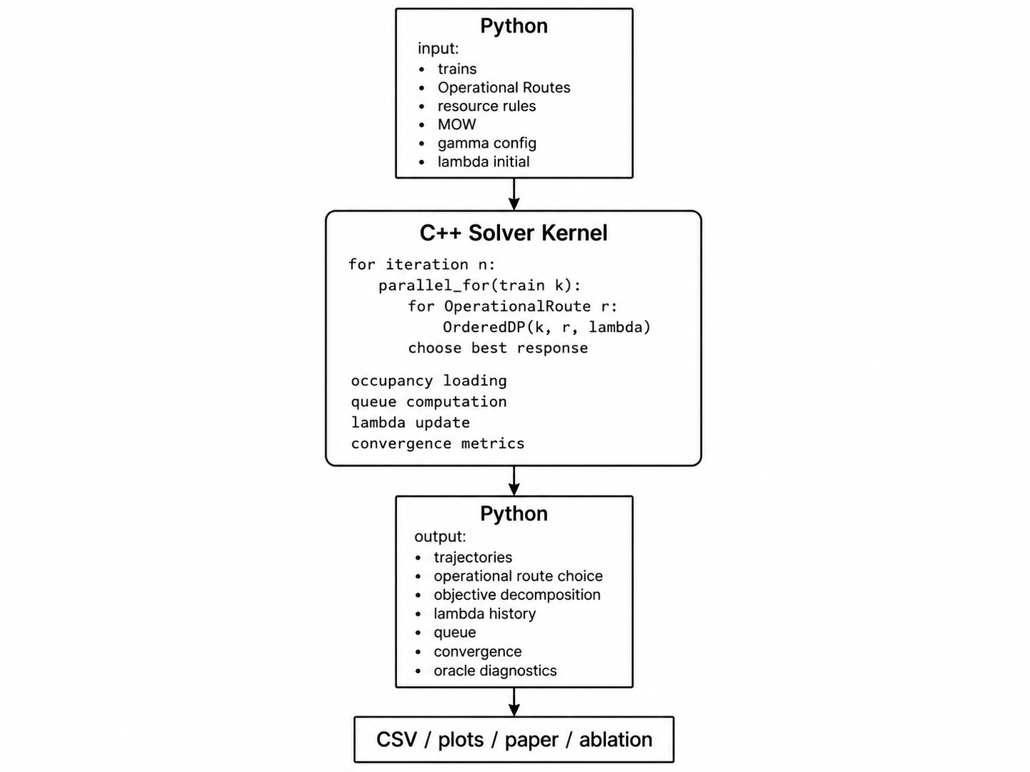
Solver architecture: Python ↔ C++ kernel
Input data: RAS dataset 3
2

Slide 3
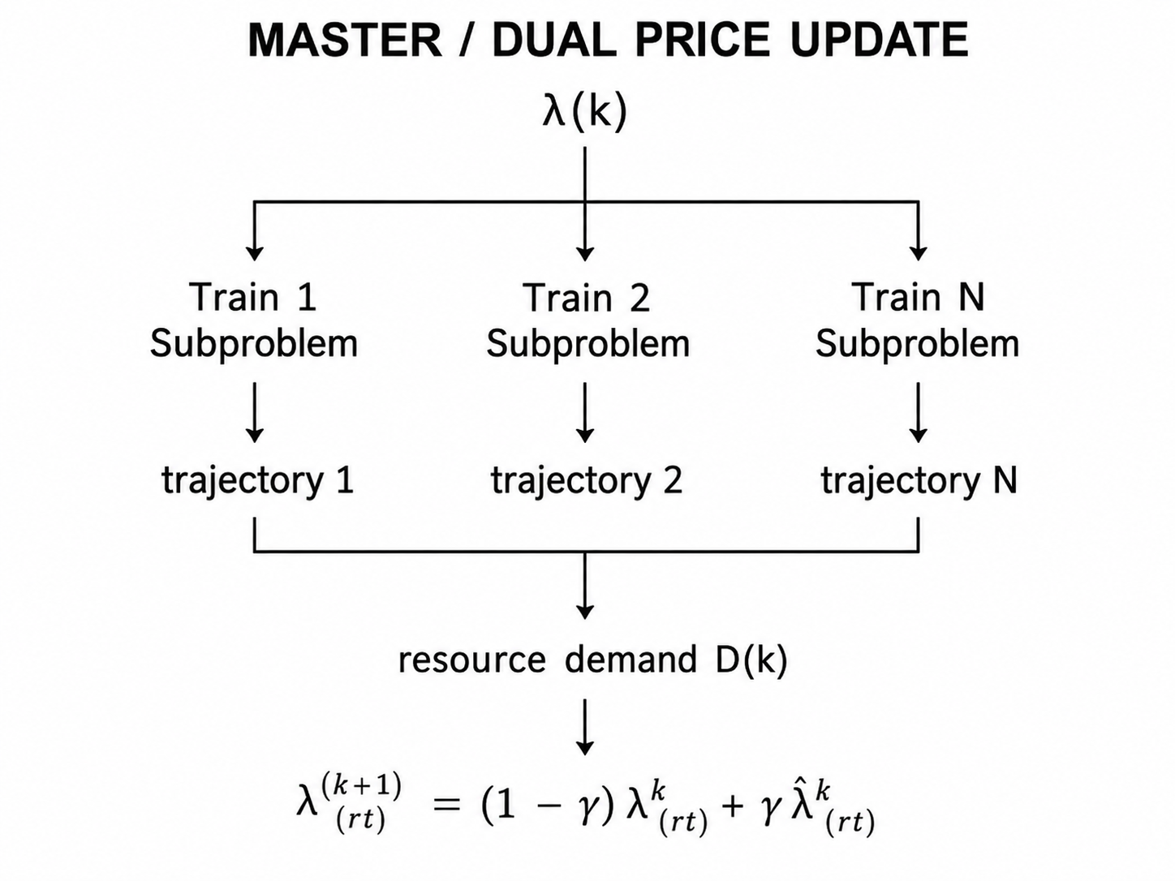
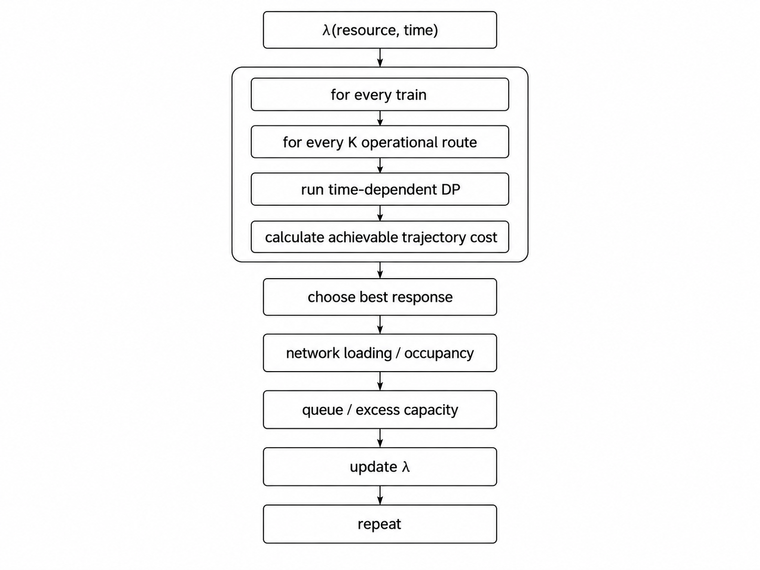
Lagrangian decomposition & dual price update
3

Slide 4
Computational complexity
Assume:
• N = number of trains;
• K = number of operational routes per train;
• I = number of Lagrangian / DTA iterations;
• S = state size of a single space-time DP.
Then the rough computational effort is:
O(I × N × K × S)
4

Slide 5
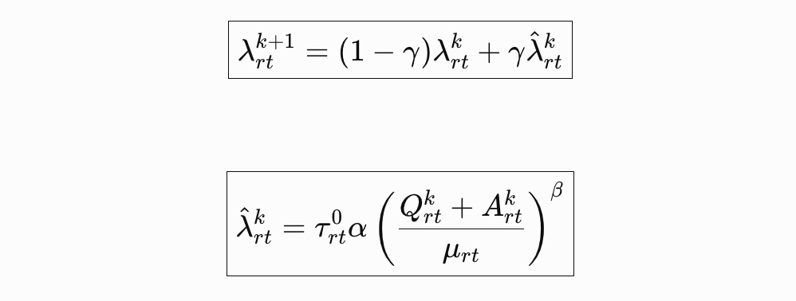
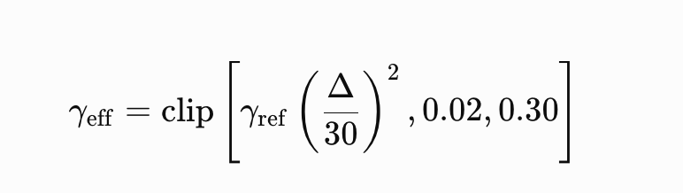
Congestion parameters: α, β, γ
α: penalty scale
Controls how large the congestion cost is overall:
λ̂ = τ⁰ α ρ^{β}.
β: congestion curvature
Controls how steeply the price grows once capacity is approached/exceeded:
ρ^{β}.
For example, with a large β:
D/C 0.5 small 0.8 moderate 1.0 α 1.2 rises rapidly 1.5 very large
So β determines the nonlinear sensitivity of the bottleneck.
γ: smoothing / learning rate
It is not the congestion function itself.
It controls:
how much of this round's new congestion signal enters λ.
That is:
λ^{k+1} = (1 − γ)λ^{k} + γ λ̂^{k}
If:
γ = 1
the new target is used directly:
λ^{k+1} = λ̂^{k}.
If:
γ = 0.15
then:
λ^{k+1} = 0.85 λ^{k} + 0.15 λ̂^{k}.
(Q + A) / μ
where:
• A: train demand / occupancy newly assigned in the current interval/bin;
• Q: residual queue left over from the previous interval;
• μ: capacity that can be served in this time interval;
• ρ = (Q + A)/μ: volume/capacity or demand/capacity ratio.
5

Slide 6


Time-dependent DP formulation
Waiting transition
If the train is allowed to wait one time step at n:
(n, t) → (n, t + Δt)
then:
Therefore:
time itself is a DP state
This is what a true time-dependent DP is.
If we expand it, the DP state can be written as something like:
V_{i}(n, t)
which denotes:
the minimum generalized cost for train i to reach physical node/state n at time t.
A running transition from n to m:
(n, t) → (m, t + τ_{inm})
cost:
so:
9

Slide 7
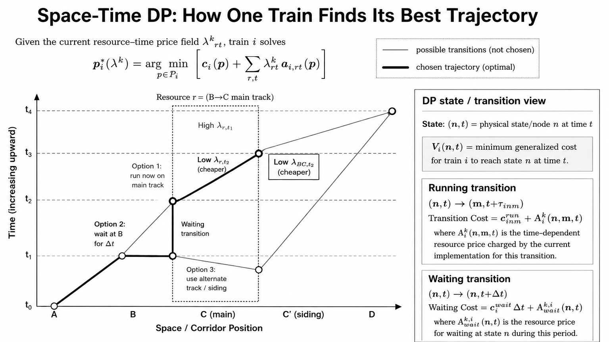

Slide 8
Timing as a decision: a worked example
Total cost:
10_{wait} + 10_{run} + 2_{λ} = 22.
So the DP discovers by itself:
waiting a while is actually better
This is a timetable decision.
If there is also a siding:
Option C
Take the siding at 8:00:
λ_{siding,8:00} = 1
but the siding run time is 8 minutes longer.
Then:
10 + 8 + 1 = 19.
The DP may even choose:
change physical route + change timing
So what CORRIDOR-SIM actually solves is:
Route(main track + siding/crossover)+ departure/waiting time
jointly.
A particularly intuitive example
The same train has two options.
Option A: take Main 1 immediately
Enters the bottleneck at 8:00:
λ_{Main1,8:00} = 15.
Raw run time:
10 min.
Total generalized cost:
10 + 15 = 25.
Option B: wait 10 min first
10 minutes of waiting:
10
then enter Main 1 at 8:10:
λ_{Main1,8:10} = 2.
Run:
10.
6

Slide 9
Fluid queue & congestion propagation
The typical fluid queue relation is:
Q^{k}_{r,t+1} = [Q^{k}_{rt} + A^{k}_{rt} − μ_{rt}]⁺
In other words:
previous-period queue + this-period arrivals − this-period capacity = next-period queue.
For example:
8:00
Q = 0, A = 8, μ = 5
so:
Q_{8:30} = [0 + 8 − 5]⁺ = 3.
8:30
Again:
A = 4, μ = 5
then:
Q_{9:00} = [3 + 4 − 5]⁺ = 2.
9:00
If:
A = 1, μ = 5,
then:
Q_{9:30} = [2 + 1 − 5]⁺ = 0.
So congestion propagates along time:
8:00 → 8:30 → 9:00.
This is what real dynamic congestion feedback is.
7

Slide 10

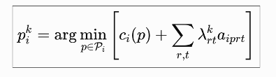
One soft Lagrangian iteration — Steps 1–2
Step 1 — Given the current time-dependent prices
At round k we have:
Note that this is an entire resource × time price surface.
Step 2 — Each train runs a time-space DP
For every train i:
Here p already contains:
p = {route, track, timing, waiting}.
Here c_{i}(p) is the base/physical objective cost of train i choosing trajectory p itself. Objective cost c_{i} could be running time; waiting time; schedule deviation; delay; track penalty. And p is route + timetable trajectory.
8

Slide 11

What one soft-LR iteration actually looks like
First, given the prices of all resource-time bins over the whole 12 hours:
λ^{k}_{rt}.
Then run one full time-space DP for every train:
This DP may plan all the way from 8:10 to 11:40.
For one train, for example:
8:10-8:30 resource A 8:30-9:00 resource B 9:00-9:30 wait at siding 9:30-10:00 resource C
Then it reads, respectively:
λ_{A,8:00−8:30}, λ_{B,8:30−9:00}, λ_{C,9:30−10:00}.
So:
one DP spans many 30-min bins
rather than one DP per bin.
λ^{k}_{rt} over the whole horizon
↓
all trains run the full time-space DP
↓
A^{k}_{rt} aggregated by 30-min bin
↓
Q^{k}_{r,t+1} propagates along time
↓
λ̂^{k}_{rt} updated for all bins
↓
λ^{k+1}_{rt}
↓
next round: all trains run the DP again
10

Slide 12
Full soft-LR loop — Steps 1–6
Step 1: Initialization
λ⁰ = 0
Step 2: All trains do best response
For every train:
p^{k}_{i} = Oracle_{i}(λ^{k})
that is:
min_{p} c_{i}(p) + λ^{kT} a_{i}(p).
this step is done by the C++ time-space DP.
Step 3: Aggregate the demand of each resource/bin
A^{k}_{rt} = Σ_{i} a^{rt}(i, p^{k}_{i}).
Then account for the inherited queue:
D^{k}_{rt} = Q^{k}_{rt} + A^{k}_{rt}.
Step 4: Compute the volume/capacity ratio
ρ^{k}_{rt} = (Q^{k}_{rt} + A^{k}_{rt}) / μ_{rt}
Step 5: Compute the soft Lagrangian target penalty
λ̂^{k}_{rt} = τ⁰_{rt} α (ρ^{k}_{rt})^{β}
pseudocode:
lambda_rt = tau0 * alpha * ((Q + A) / mu) ** beta
Step 6: Soft smoothing
λ^{k+1}_{rt} = (1 − γ_{k})λ^{k}_{rt} + γ_{k} λ̂^{k}_{rt}
Then redo routing + timing.
So the complete closed loop is:
λ^{k} → Train DP → A^{k} → Q^{k} + A^{k} → D/C → α(D/C)^{β} → λ̂^{k} → smoothing → λ^{k+1}
11

Slide 13

The C++ kernel should not be responsible for updating α, β, γ, λ.
The C++ kernel only be responsible for:
p*_{i}(λ) = arg min_{p} [ c_{i}(p) + λ⊤ a_{i}(p) ]
that is:
Given λ, and have the optimal route + timetable trajectory p* for this trainThe Python outer loop remains responsible for:
A, Q, μ
↓
ρ = (Q + A)/μ
↓
λ̂ = τ⁰ α ρ^{β}
↓
λ^{new} = (1 − γ)λ + γ λ̂.
12

Slide 14


Where does the Lower Bound come from?
Each round:
LB^{k} = g(λ^{k}).
That is:
i.e.:
Then:
LB^{best} = max_{k} LB^{k}
This corresponds exactly to what is in Fast-Train:
TotalTripPrice − TotalResourcePrice.
13

Slide 15
The Upper Bound is another feasibility recovery problem
the trajectories generated by LR into:
p̂_{i}
satisfying:
Σ_{i} a^{rt}(i, p̂_{i}) ≤ C_{rt}.
giving:
UB = Σ_{i} c(i, p̂_{i})
So the complete structure is:
LB ← Lagrangian dual
and
UB ← feasible timetable recovery
Finally:
LB ≤ OPT ≤ UB
and:
Gap = (UB − LB) / UB.
14

Slide 16
From Lagrangian Relaxation to a Feasible Timetable
Same corridor • same three trains • two different certificates
Lagrangian Relaxation — Lower Bound
Feasibility Recovery — Upper Bound
Independent priced DPs → shared capacity may conflict
Delay / wait / reroute → globally validated timetable
time ↓
time ↓
λ(C,t)
Capacity conflict
D_C,t > C_C,t
hold at
siding B
+20 min
Train 3
Feasibility
Recovery
Train 3
Train 1
Train 1
Train 2
Train 2
A
B
C
D
delay / wait / reroute
reserve resources
A
B
C
D
corridor space
— recovered ··· original relaxed path
corridor space
TrainBestResponseOracle / time-dependent DP
p̂ᵢ = recovered feasible trajectory for train i
pᵢᵏ = arg minₚ [ cᵢ(p) + (λᵏ)ᵀ aᵢ(p) ]
LBᵏ = Σᵢ SPᵢ(λᵏ) − (λᵏ)ᵀ C | LBᵇᵉˢᵗ = maxₖ LBᵏ
Σᵢ aᵢ,ᵣₜ(p̂ᵢ) ≤ Cᵣₜ ∀ r,t
+ all original hard operational constraints
Quality certificate
LB ≤ OPT ≤ UB
Gap = (UB − LB) / UB
UB = Σᵢ cᵢ(p̂ᵢ)
The lower bound certifies how low the optimum could be; the feasible upper bound certifies an implementable timetable.
LB evaluator is separate from the price-update policy; SOFT_VDF is not treated as dual ascent.

Slide 17
Connect Back to Integrated Service Network Design
4.
Timetabling
(DP + LR +
Feasibility Recovery)
1. Demand /
OD Flows
2. Blocking /
Service Network
Design
3. Train Services /
Frequency /
Routing
5. Feasible
Timetable
6. Simulation /
Operational
Validation
resource-time congestion price λ(r,t)
capacity pressure
route/timing implications
operational feasibility
service reliability
delay
congestion
robustness
UB / LB / Gap
Timetabling is not a standalone end product: it provides operational feasibility,
congestion, and performance feedback to upstream service network design and routing.
Integrated view: service network design ↔ timetabling ↔ simulation

