Slide 1
WEEKLY UPDATE
Argonne National Laboratory
August 25, 2026
1

Slide 2
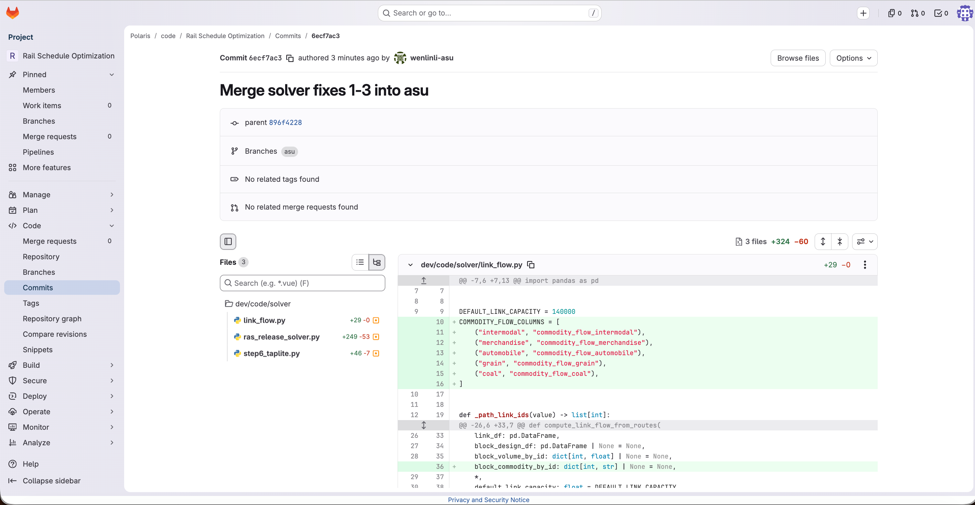
Question from ANL: Update the fixes 1-3 from 7/14/2026 changes in asu branch?
Action: Merged to asu branch
2

Slide 3
Question from ANL: Computing running time increases pretty high in solver step 6 DEFAULT_STEP6_TRANSFER_LAMBDA = 0 for railroad transfer
Answer: Because we have a high volume of links (880k~), any transfer will involve a lot links all related network links and railroad transfer states
A full Step 6 is usually not run only once — it is repeated for several rounds:
one routing pass ↓ MSA iteration 1 ↓ MSA iteration 2 ↓ ... perturbation runs
OpenMP thread count or compile options may differ.
Dry run on my end:
Parameter | Single run | Total of 16 runs | Approx.
lambda=100 | 231.8 s | 3,708.8 s | about 61.8 min
lambda=1000 | 192.9 s | 3,086.4 s | about 51.4 min
3

Slide 4
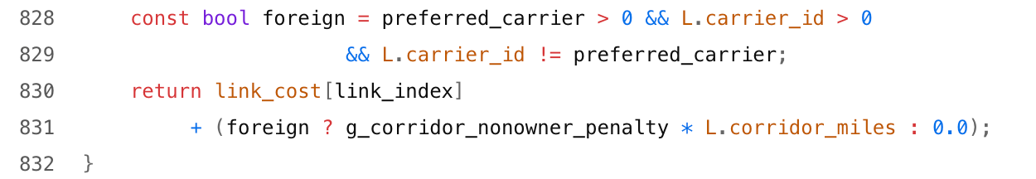
Question from ANL: Found some route choice of Non BNSF company in Southern Transcon
Answer: The issue is confirmed. Under the current solver settings, railroad transfer penalties can reduce carrier switching but cannot make BNSF preferred. For the representative LA–Kansas Intermodal trip, the New Mexico–Kansas portion is indeed UP-dominant. A BNSF-specific preference, whitelist, or non-BNSF mileage penalty is required to force the trip to use BNSF fully or as much as possible.
Yes. transfer_lambda alone cannot guarantee routing over BNSF — the key is the newly added corridor preference penalty.
A parameter combination worth showing is:
Step 4b sequence_transfer_lambda_miles = 100 Step 4b sequence_max_transfer_count = 3 Step 6 transfer_lambda = 0 Step 6 max_transfer_count = 3 corridor_nonowner_penalty = 5.0
LA → Chicago ODs result:
Metric | Baseline | New parameters
BNSF total mileage | 1,177.5 mi (67.9%) | 1,815.8 mi (99.6%)
tap_lite_cg.cpp:
4

Slide 5
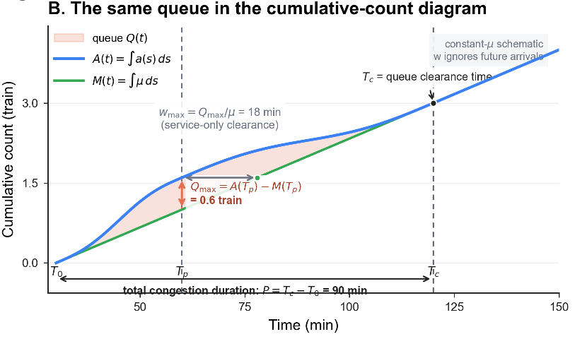

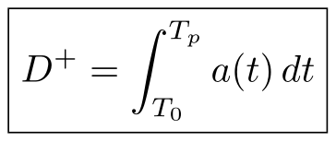
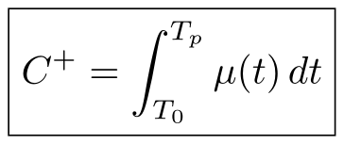



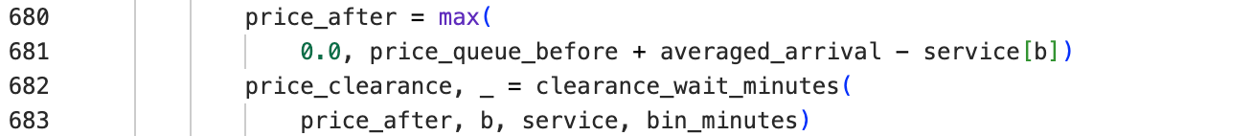
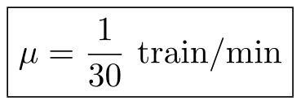
Update for this week: Fluid Queue Interpretation
The superscript + denotes the accumulation phase of queue buildup / oversaturation, i.e. from the onset of congestion T₀ until the queue reaches its maximum T_{p}:
Define:
the cumulative number of trains arriving in this period;
What is μ?
the cumulative number of trains that can be served / released in the same period.
So the difference between the two is the backlog:
The unit is usually:
i.e. how many trains this resource can “digest” per minute.
For example, with your current 30-min Fluid Queue baseline:
5

Slide 6
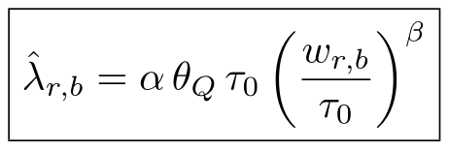

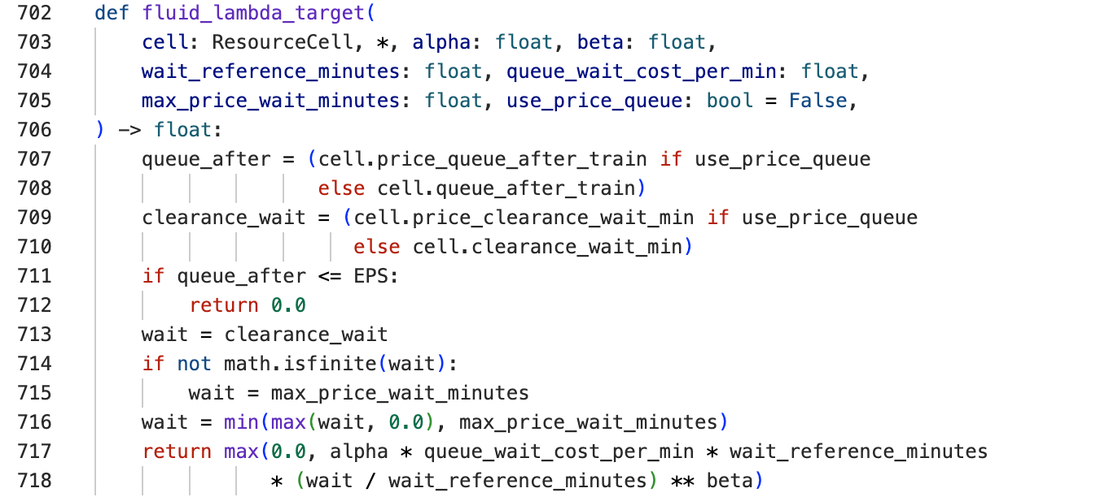
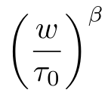

This formula is the core mapping current Fluid-Queue Soft-Lagrangian that turns “queueing severity” into a resource price:
Why Divide By τ₀
Because we cannot simply write:
otherwise, with β = 3, the unit becomes min³, which is hard to interpret physically.
Written as:
this part has no unit.
Therefore:
determines the unit of the price, while
only decides “how severe the congestion is”.
6

Slide 7
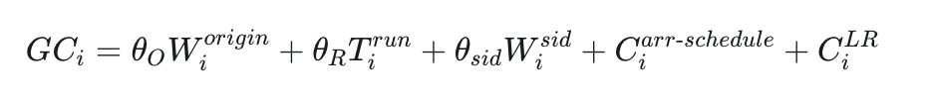

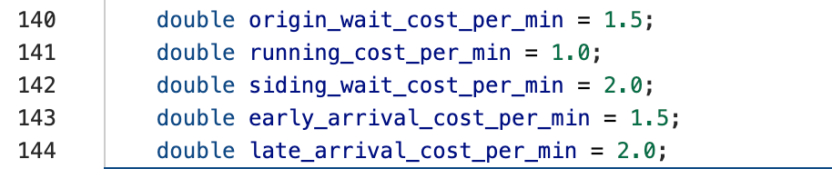



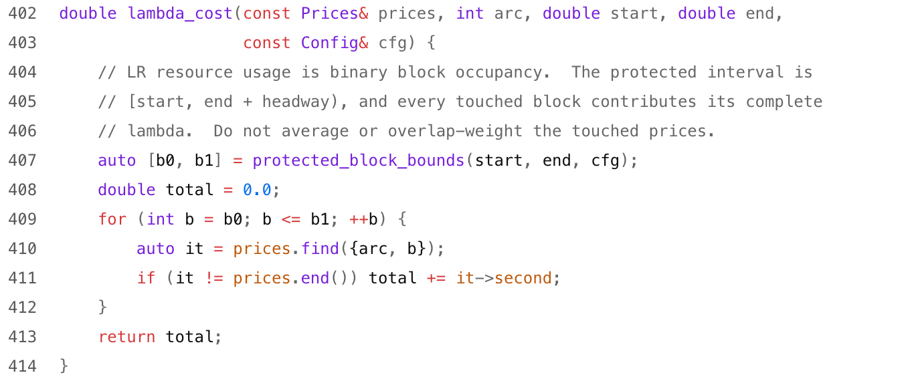
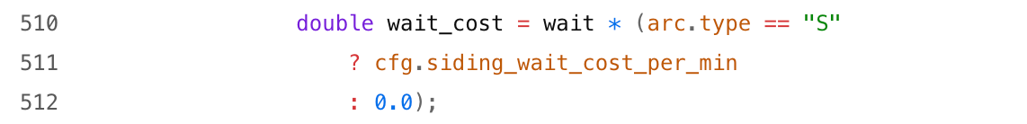

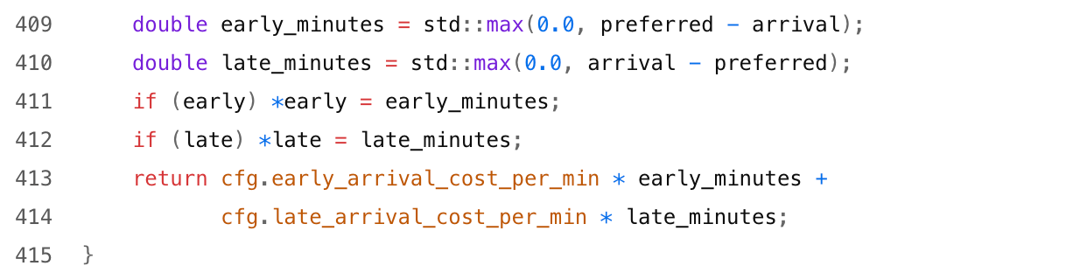
Generalized cost in DP
7

Slide 8


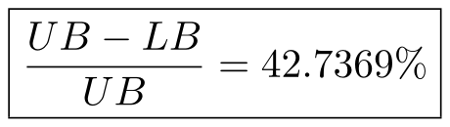
Result (RAS dataset 3):
Absolute gap:
Relative gap (normalized by UB):
8

Slide 9
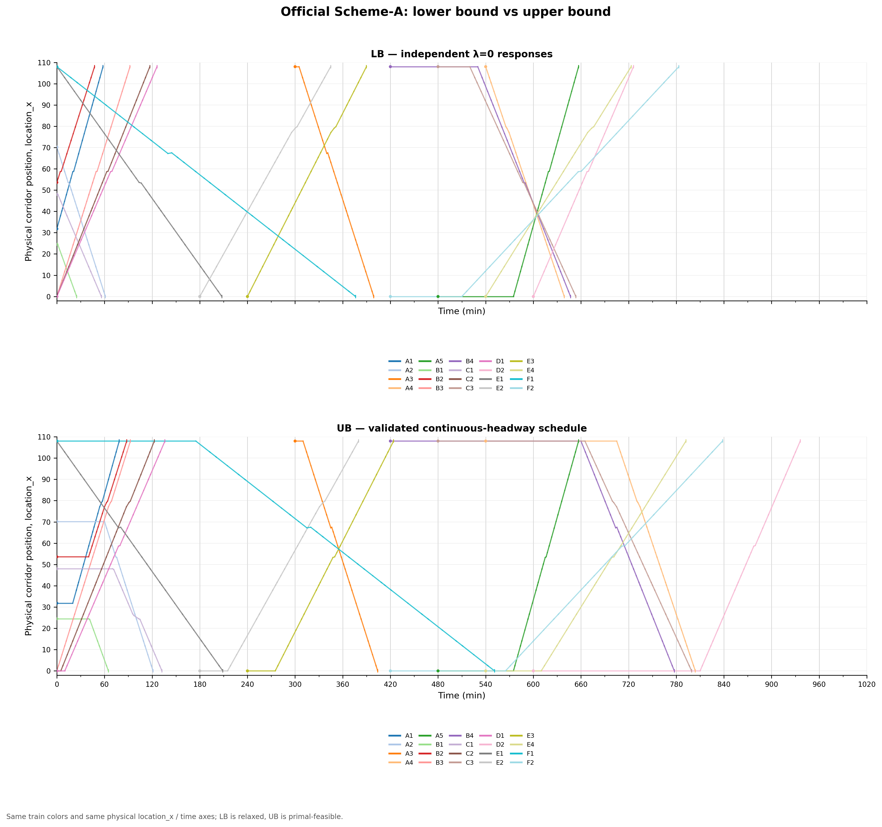
9

Slide 10
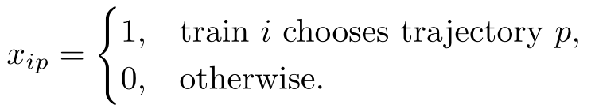
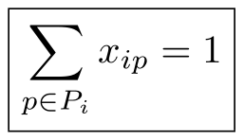


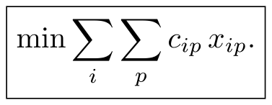


Approaches Produced Feasible UB
Choosing one trajectory per train out of all candidates
Mathematically this can be understood as:
Independent validation
After finding this solution, the optimization solver is not trusted directly.
From the actually selected trajectories, the program check:
• the entry time of each arc;
• exit time;
• direction;
• MOW;
• safety separation;
and checks all pairs.
Finally:
Every train must choose exactly one:
If trajectory p and trajectory q conflict under continuous headway:
Then look for a 20-train selection that satisfies all these constraints.
The corresponding objective:
which is why it qualifies as a legal:
The legal combination found so far is:
10

Slide 11

Fix train 1
Mark the cell/resource blocks it occupies as unavailable.
train 2
Run the single-train DP again.
The DP decides by itself:
• late departure;
• siding waiting;
• operational route;
• timing.
Then fix train 2.
And continue:
This is sequential feasible recovery / upper bound.
32

Slide 12



Next and current step (not fully implemented): Pruning
The idea is:
where:
If a feasible UB is already available:
then any state with:
can be pruned directly.
This is exactly branch-and-bound / A*-style lower-bound pruning.
11

Slide 13

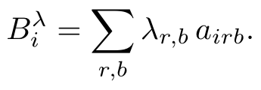

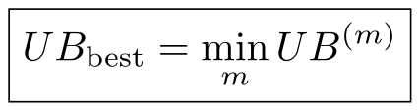
Implemented as “multi-ordering Sequential Recovery”
highest conflict degree first
Handle the train that conflicts with the most other trains first.
Soft-Lagrangian price burden first
For instance, try at least:
earliest departure first
highest cost priority first
Fix the train with the largest schedule deviation cost first.
most constrained first
Schedule the train with the fewest available route/timing options first.
Handle the most congested train first.
Each ordering gives:
and finally:
12

